Slide 1
S26A SD only K* wave2 probe summary
ww5
Lidia

Slide 2
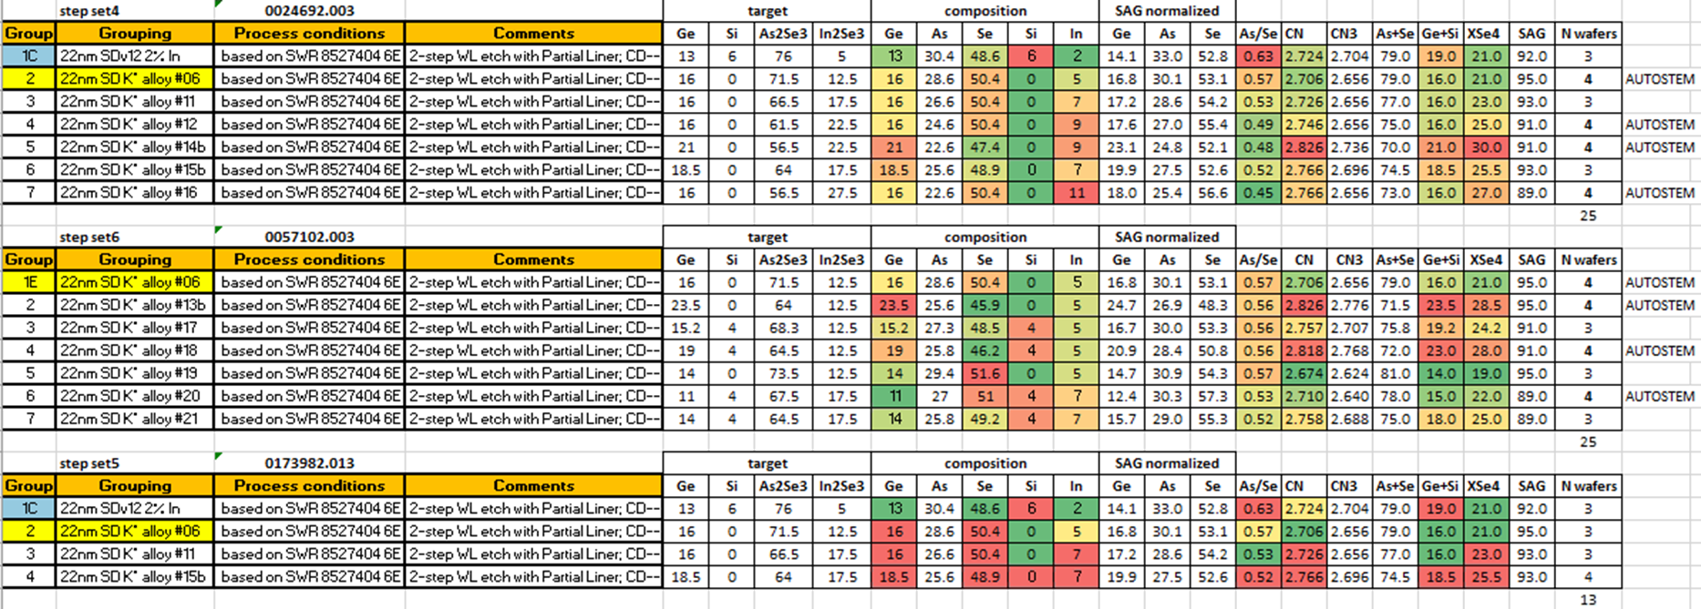
Split Table
PR 28 at 50C
PR 28 at 85C
PR 29 at 85C
No significant change with probe rev; IRST fixed at 120uA and SET pulse fixed at P1=22.5uA, P3 = 25uA, P4 = 22.5uA
One lot has been probed at 50C unintentionally

Slide 3
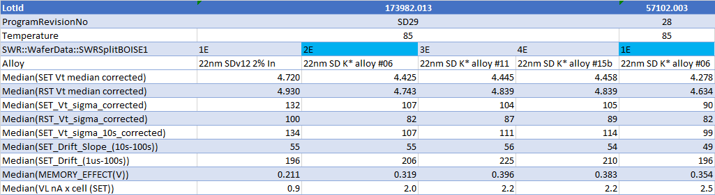
85C probe 0173982.013 + a repetition of Alloy 6 on 0057102.003
Zone A/B median after filtering for structure fail
All the metrics have been corrected for the access transistor and refer to the voltage across the cell
Need to evaluate the impact on the array with proper access transistor contribution that differs between S15C and S26A
The lowest SET Vt can be over- estimated by the sweep range with current DAC. In general 10s SET Vt is properly extracted. Other metrics that uses 1us SET Vt can be also affected (memory effect is eventually under-estimated)

Slide 4
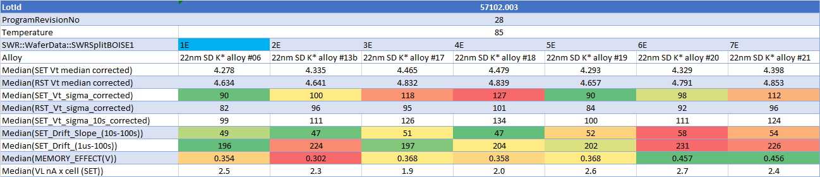
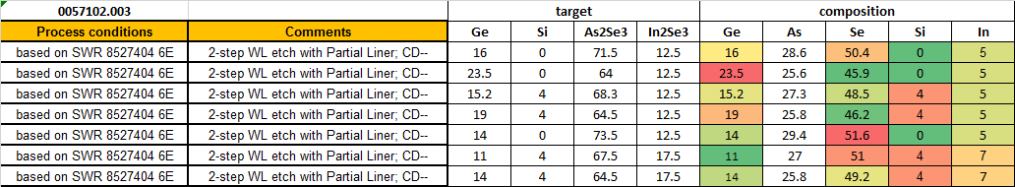
0057102.003 full lot

Slide 5
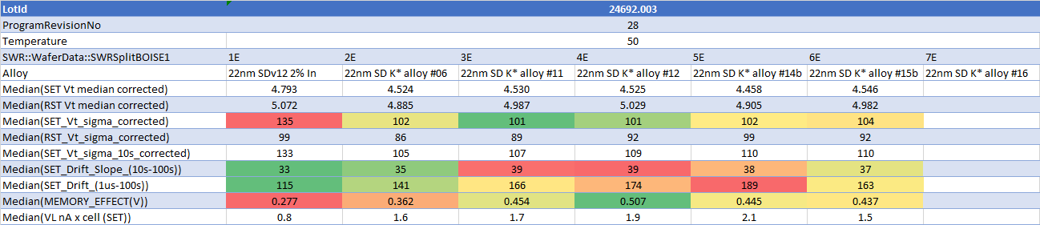
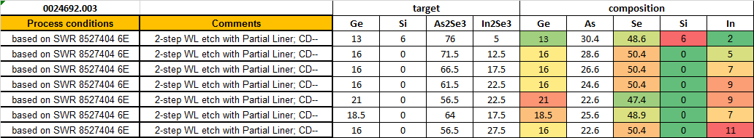
0024692.003 full lot (50C)
Fail at periph

Slide 6
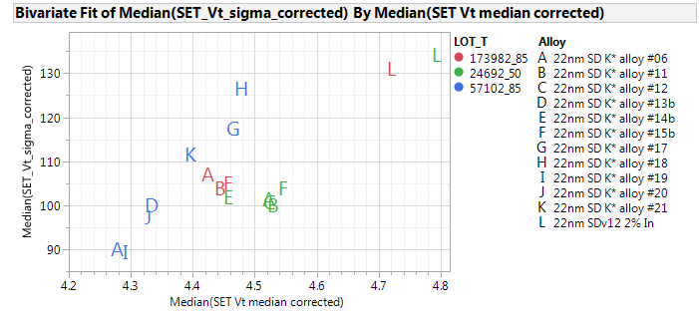
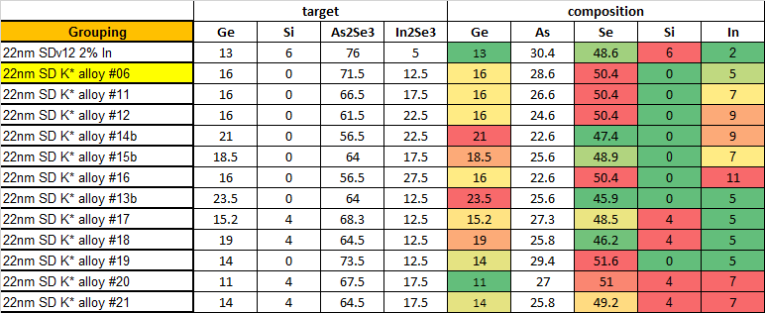
Sigma vs SET Vt

Slide 7
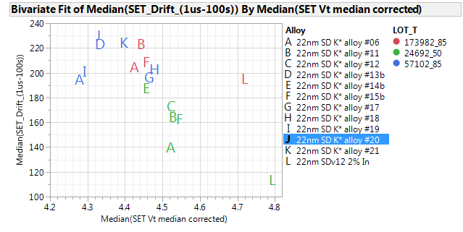
Drift vs SET Vt

Slide 8
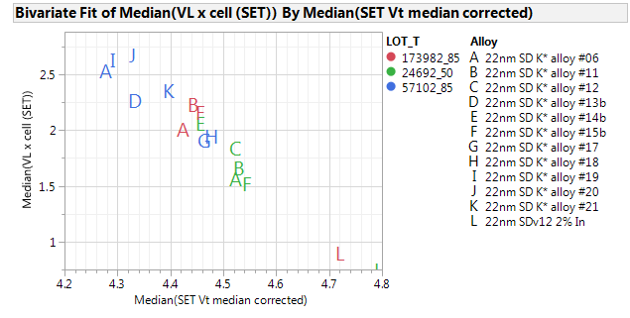
VL vs SET Vt

