Slide 1
S26A SSM Lots Param Trend
Jie Liao
Jan/31/2018

Slide 2
Summary
Raw Jmp plots:
http://edcfab4.micron.com/fab4/RCP001/_layouts/15/DocIdRedir.aspx?ID=6H4ASHP5DEEU-2066537420-741
SSM vs. F4 single deck baseline lots 1C:
Lot-to-lot & W2W variations for both baseline & SSM
Overall SSM lots 1C has lower AV0, higher BL Res, more C2C shorts at wafer mid/edge; other critical array params are comparable
Recent SSM lots show increased WL Res with fliers, more R2R shorts (wafer edge), higher AV1 & BL Res with larger variation, lower BL Cap
0170032.003 whole lot shows higher BL Cap with some fliers and significant C2C shorts
SSM SWR Toggles:
20nm WL W splits: higher AV0, higher WL Res, lower WL Cap, no R2R shorts
Lots/Splits with different K* alloy processes: small toggles on WL Res & WL Cap, increased WL Cap & R2R, higher C2R Cap & Lkg; alloy #16 & #20 have further increased R2R & C2R Lkg; alloy #20 has higher C2C lkg as well
SDv16 has higher C2R cap compared with SDv12
0176312.013 2E (alloy #6+no lamina etch op1): lower AV0, lower WL Res fliers at wafer edge, bad WL Cap & R2R, higher C2R Cap & Lkg
0176312.013 3E (alloy #6+no lamina etch op2): more C2C shorts & higher C2R Lkg
0176312.003 3E&4E (BL no WSiN): bad AV1, higher BL res, lower BL Cap with larger variation, more C2C shorts
0170032.003 3E&4E (without 5A AlOx): higher C2R Lkg

Slide 3
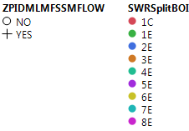
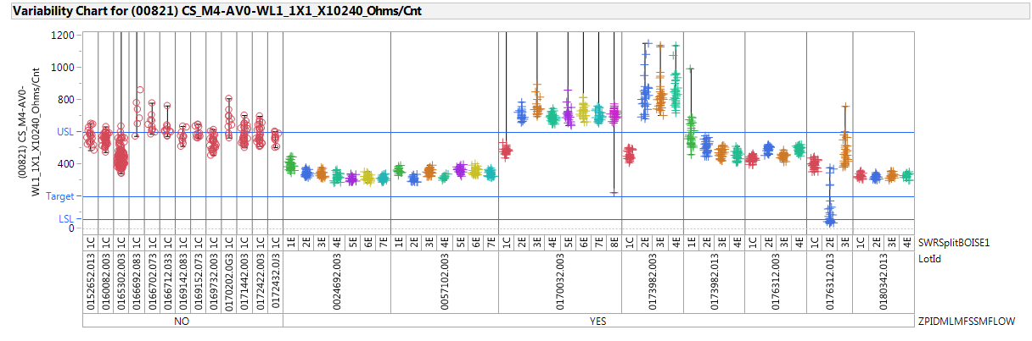
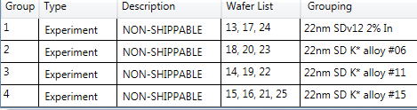
WL CS AV0
F4 single deck baseline lots 1C wafers
Lot-to-lot variations; overall SSM 1C has lower AV0 than baseline’s
0170032.003 2E~8E (20nm WL W groups) & 0173982.003 2E~4E (20nm WL W groups) have higher AV0
0176312.013 2E (alloy #6) has lower AV0

Slide 4
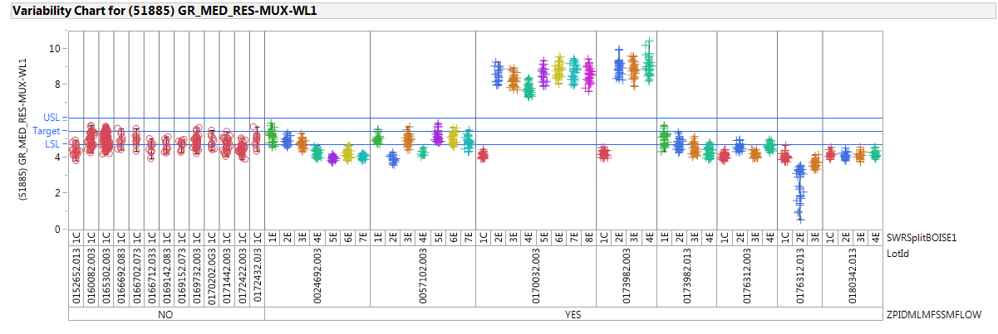
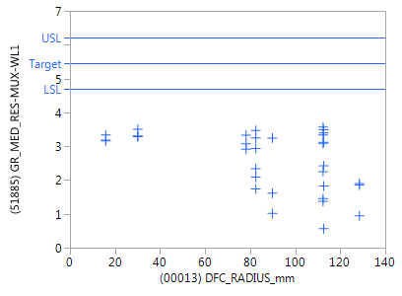
WL Res
SSM 1C shows good alignment with baseline
0024692.003 E groups & 0057102.003, 0173982.013 with different K*alloy show small toggles
0170032.003 & 0173982.003 E groups (20nm WL W) show higher WL Res as expected
0176312.013 2E (K* alloy#6, no lamina etch op1) has low fliers at wafer edge

Slide 5
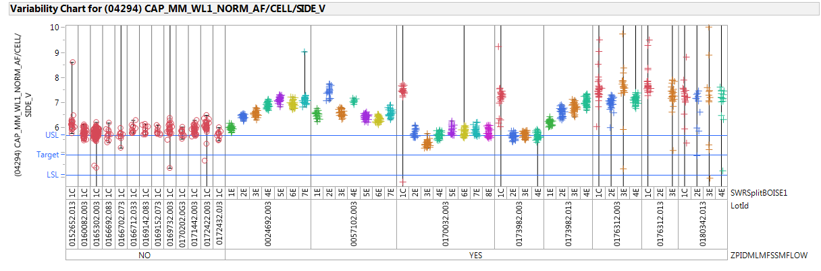
WL MM Cap
Lot-to-lot variations in SSM lots; Recent SSM lots have higher WL Res with fliers
0024692.003 E groups & 0057102.003, 0173982.013 with different K*alloy show some increase with small toggles
0170032.003 & 0173982.003 E groups (20nm WL W) show lower Cap as expected, but more aligned with baseline and cleaner data?
0176312.013 2E (K* alloy#6, no lamina etch op1) shows bad data

Slide 6
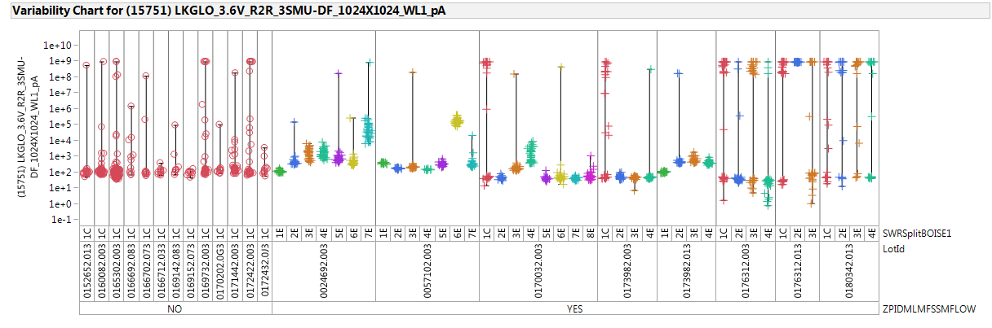
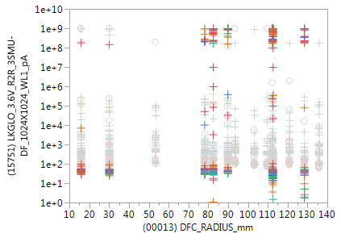
MM R2R@3.6V
Alloy #16
Alloy #20
Lot-to-lot variations; Recent SSM lots show more shorts mainly at wafer edge
Different K*alloy show some increase with alloy toggles
0170032.003 & 0173982.003 E groups (20nm WL W) hve no shorts compared with 1C
0176312.013 2E (K* alloy#6, no lamina etch op1) shows bad data

Slide 7
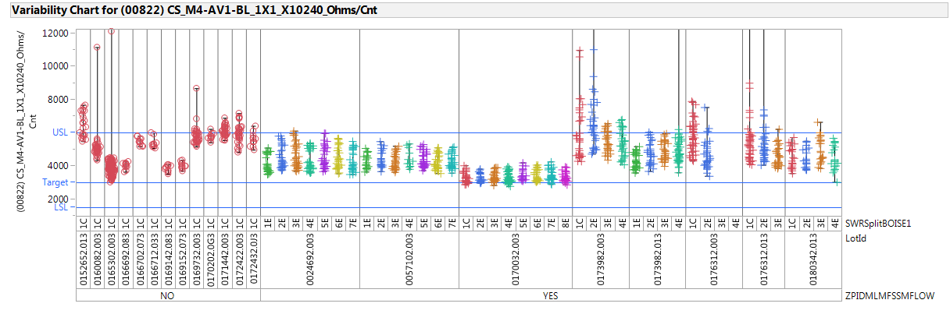
BL CS AV1
Lot-to-lot variations; recent SSM lots have higher AV1 with larger variation
0176312.003 3E&4E (BL no WSiN groups) have bad AV1 data

Slide 8
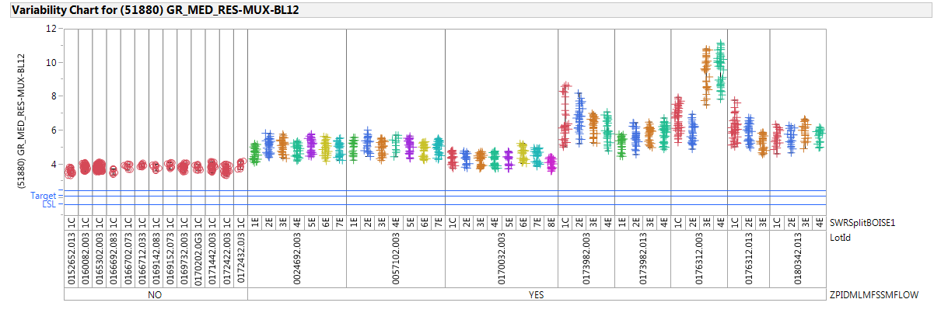
BL Res
Overall SSM 1C shows higher BL Res than baseline (smaller CD or thinner?); Recent SSM lots show higher BL Res with larger variation
0176312.003 3E&4E (BL no WSiN) show higher BL Res

Slide 9
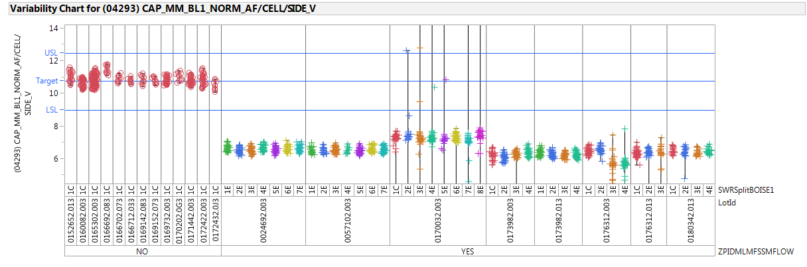
BL MM Cap
SSM lots have lower BL Cap. Combined contributions from lack of PM + potential smaller CD or thinner? (as the toggle seen on BL Res)
0170032.003 the whole lot has slight higher BL Cap with some fliers
0176312.003 3E&4E (BL no WSiN groups) have lower BL Cap with lager variation

Slide 10
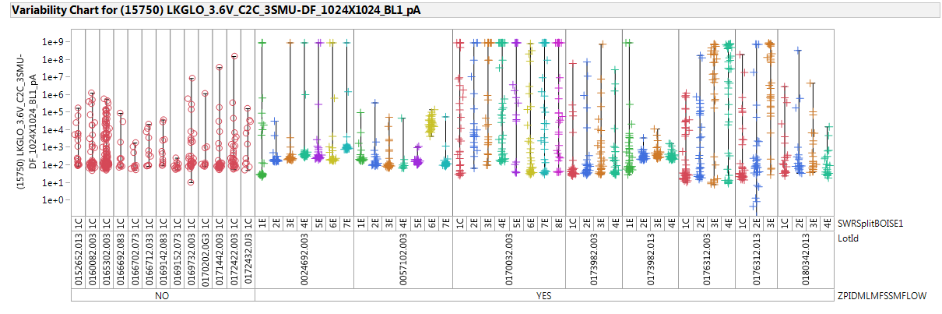
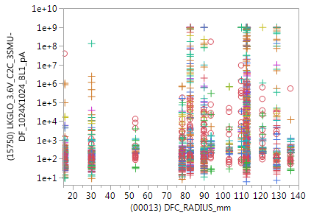
MM C2C @3.6V
Lot-to-lot & W2W variation; overall SSM lots have more shorts at wafer mid/edge, 0170032.003 shows significant shorts
0057102.003 6E (Alloy #20) shows higher
0173982.013 E groups (K* alloy) has less shorts & tighter distribution compared with 1C
0176312.003 3E&4E (BL no WSiN groups) & .013 3E (no lamina etch op2) have more shorts

Slide 11
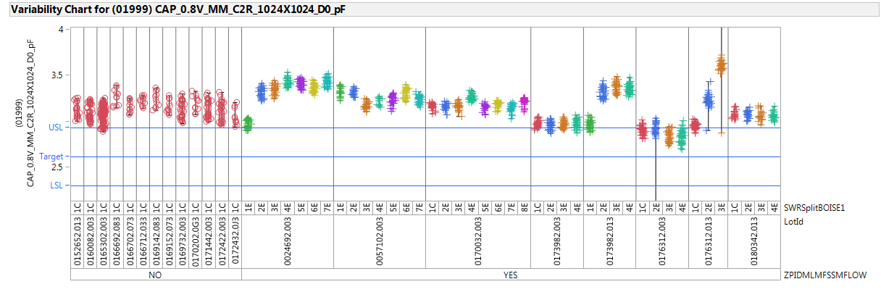
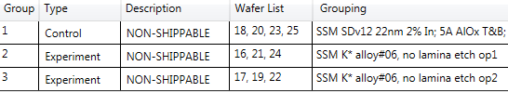
MM C2R Cap@0.8V
All the lots/splits with K* alloy or SDv16 have higher C2R Cap
0176312.013 2E & 3E with K* alloy#6 have higher C2R Cap; 3E with no lamina etch op2 shows further higher

Slide 12
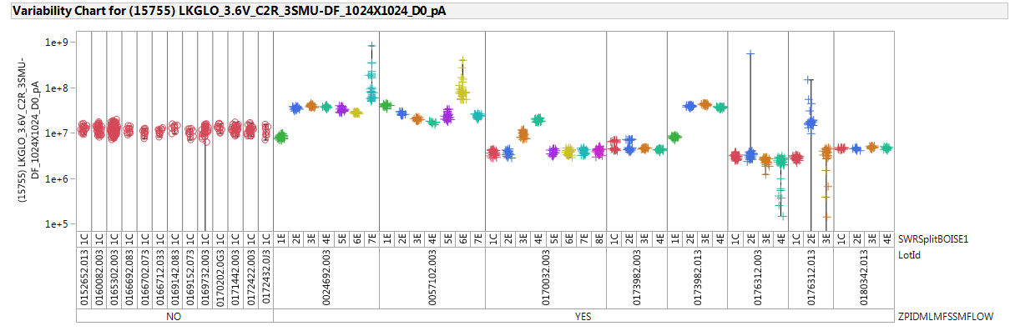
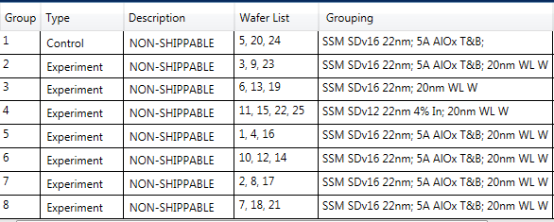
Vertical MM Lkg@3.6V
Alloy #16
Alloy #20
All the lots/splits with K* alloy process have higher C2R Lkg; alloy #16& #20 show even higher with larger variation
0170032.003 3E & 4E (without 5A AlOx) show higher
0176312.013 2E alloy #6 with no lamina etch op1 shows higher

Slide 13
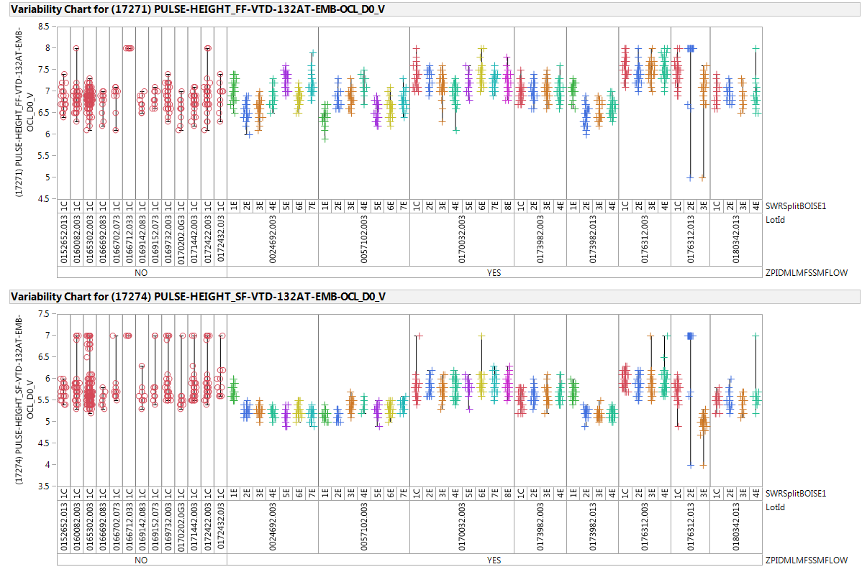
OCL EMB FF & SF
Lot-to-lot, W2W variations
0176312.013 2E alloy #6 with no lamina etch op1 shows bad data
Pls note OCL Vt is just for reference, not that accurate

Slide 14
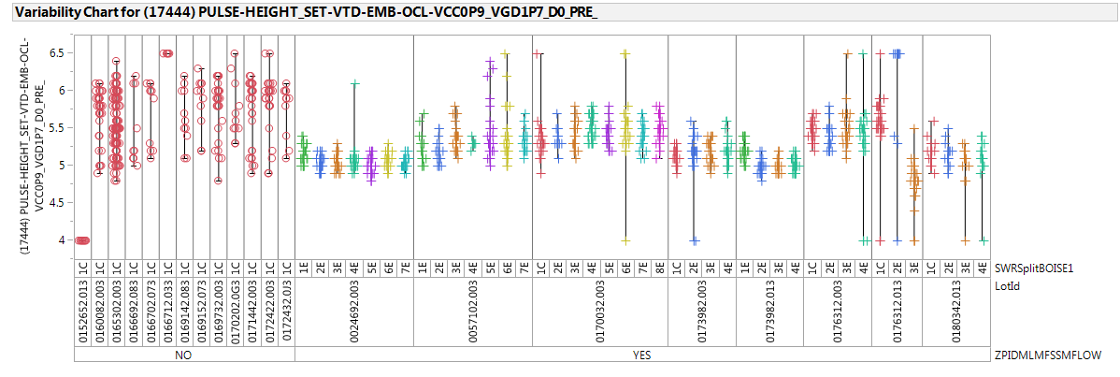
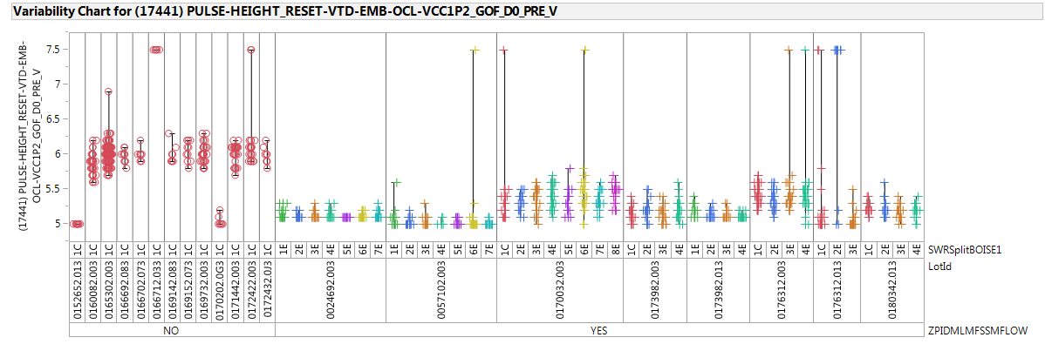
OCL EMB SET & RESET
Lot-to-lot, W2W variations
SSM Lots have lower Vt with tighter distribution
0176312.013 2E alloy #6 with no lamina etch op1 shows bad data
Pls note OCL Vt is just for reference, not that accurate

