Slide 1
0173982 SR71B

Slide 2
Summary
A1 lot
CD-- straight profile @WL
Lot tested with negative reading, then retested with positive reading
Trial | SD thk. | Ge% | As% | Se% | In% | Si% | 51 WL etch | Wf
1C | 22 ver12 | 13 | 30.4 | 48.6 | 2 | 6 | CD - - | 13,17,24
2E | 22 | 16 | 28.6 | 50.4 | 5 | 0 | CD - - | 18,20,23
3E | 22 | 16 | 26.6 | 50.4 | 7 | 0 | CD - - | 14,19,22
4E | 22 | 18.5 | 25.6 | 48.9 | 7 | 0 | CD - - | 15,16,21,25

Slide 3
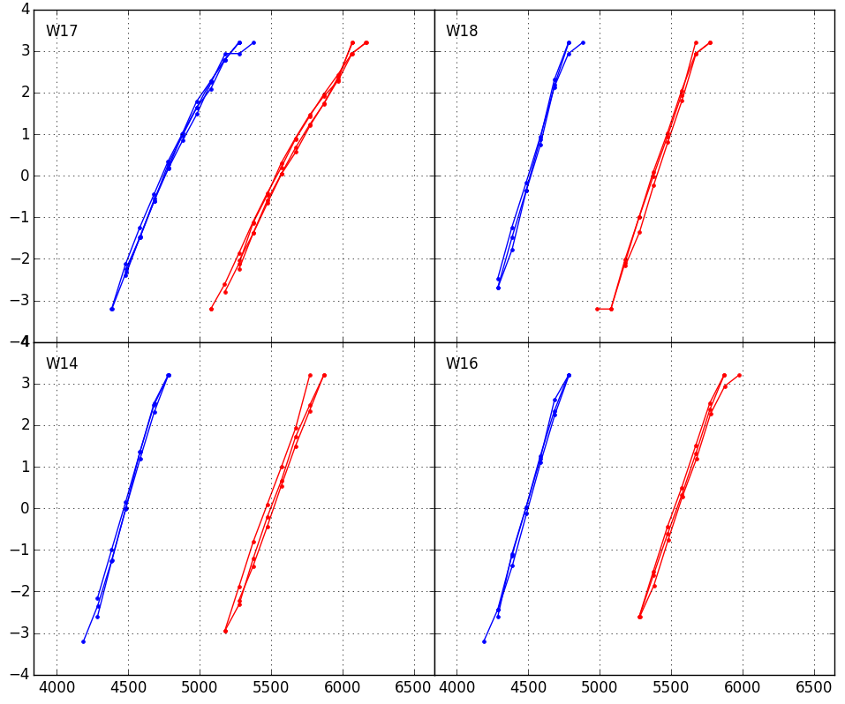
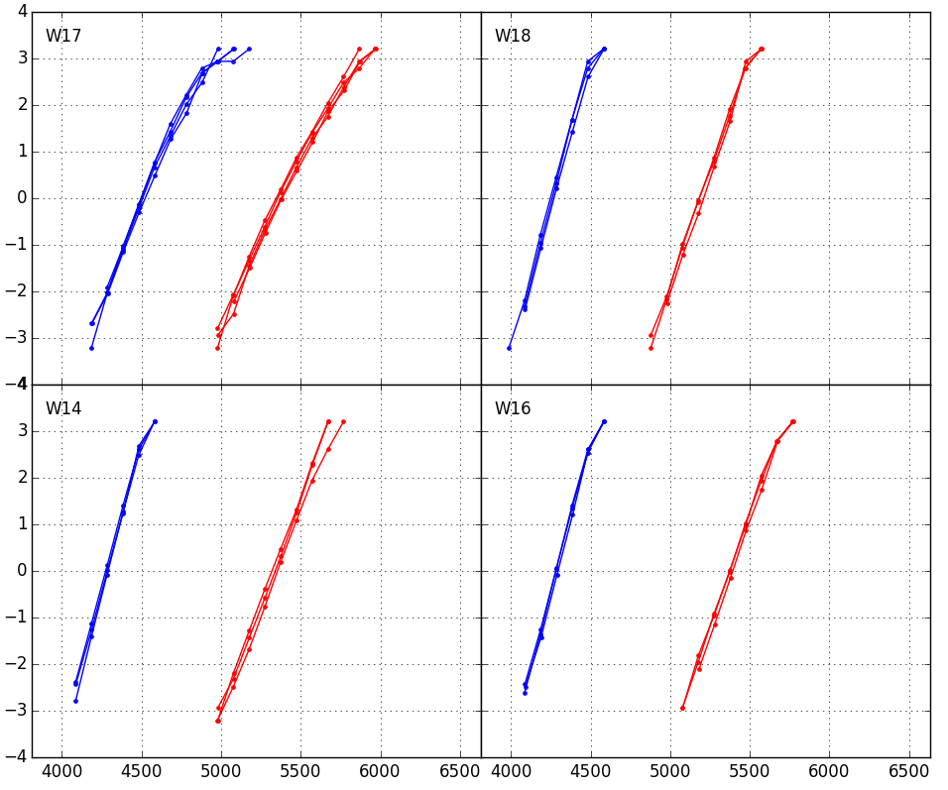
Distributions 1us
1k cycles
128k cycles
1C v12
Ge 13%
In 2%
Si 6%
2E
Ge 16%
In 5%
1C
Ge 13%
In 2%
Si 6%
2E
Ge 16%
In 5%
3E
Ge 16%
In 7%
4E
Ge 18.5%
In 7%
3E
Ge 16%
In 7%
4E
Ge 18.5%
In 7%

Slide 4
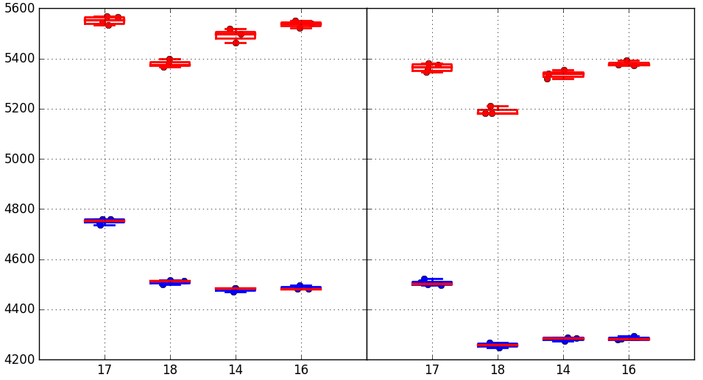
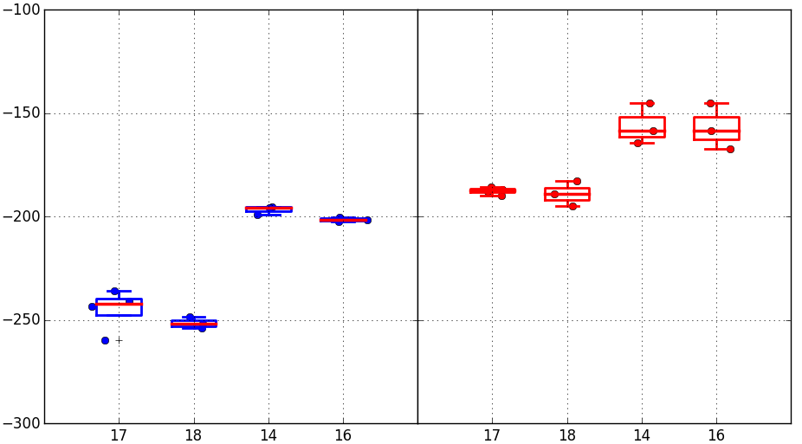
Vt Medians + Vt shift
In doping >2% shows lower set Vt
Reset Vt is increasing from group 2E to 4E. If we align Set Vt, Reset Vt form group 1C to 4E trends with lower As % and higher Ge+In %.
Vt shift in cycling (1k→128k) is smaller for In 7% groups
1k cycles
128k cycles
Median Vt
1C
2E
3E
4E
1C
2E
3E
4E
Vt shift 1k→128k cycles
SET
RESET
Trial | SD thk. | Ge% | As% | Se% | In% | Si%
1C | 22 ver12 | 13 | 30.4 | 48.6 | 2 | 6
2E | 22 | 16 | 28.6 | 50.4 | 5 | 0
3E | 22 | 16 | 26.6 | 50.4 | 7 | 0
4E | 22 | 18.5 | 25.6 | 48.9 | 7 | 0

Slide 5
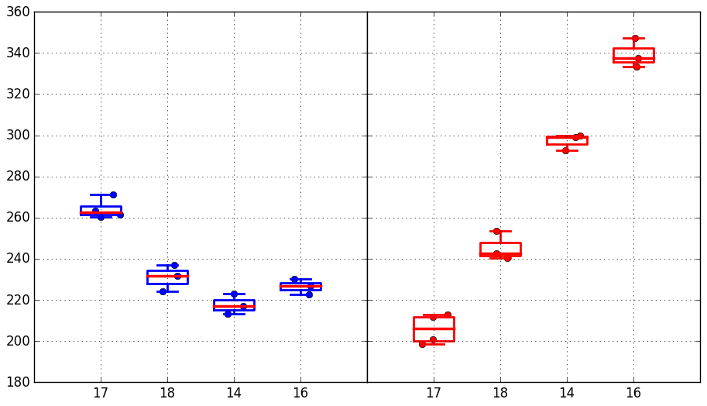
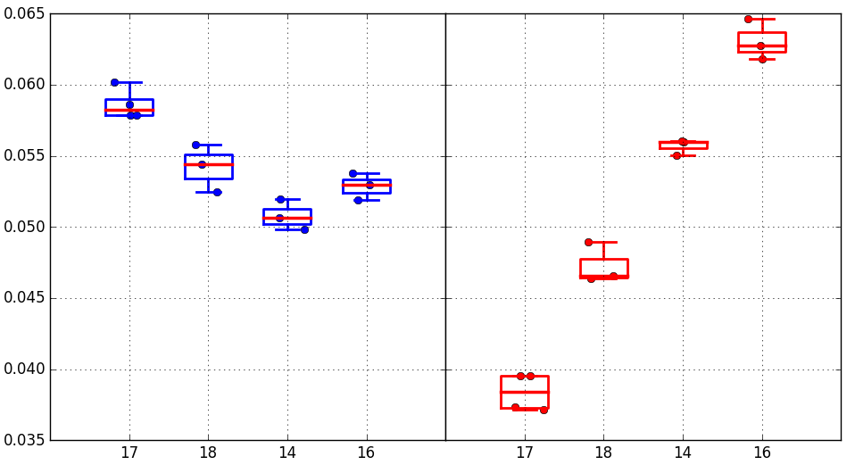
Median drift 1us-10s @85C (128k cycles)
Absolute drift mV
SET/RESET
Trial | SD thk. | Ge% | As% | Se% | In% | Si%
1C | 22 ver12 | 13 | 30.4 | 48.6 | 2 | 6
2E | 22 | 16 | 28.6 | 50.4 | 5 | 0
3E | 22 | 16 | 26.6 | 50.4 | 7 | 0
4E | 22 | 18.5 | 25.6 | 48.9 | 7 | 0
1C
2E
3E
4E
1C
2E
3E
4E
Set drift: some improvements with higher In % / Slight worsening with higher Ge %
Reset drift: strong trend of reset drift with lower As %. Groups 3E and 4E have much larger drift on reset than on set → window opening
Relative drift
SET/RESET
1C
2E
3E
4E
1C
2E
3E
4E

Slide 6
Long time drift
16k cycles preconditioning
Negative reading
Reference: 10s @85C
Drifted: 3d @90C

Slide 7
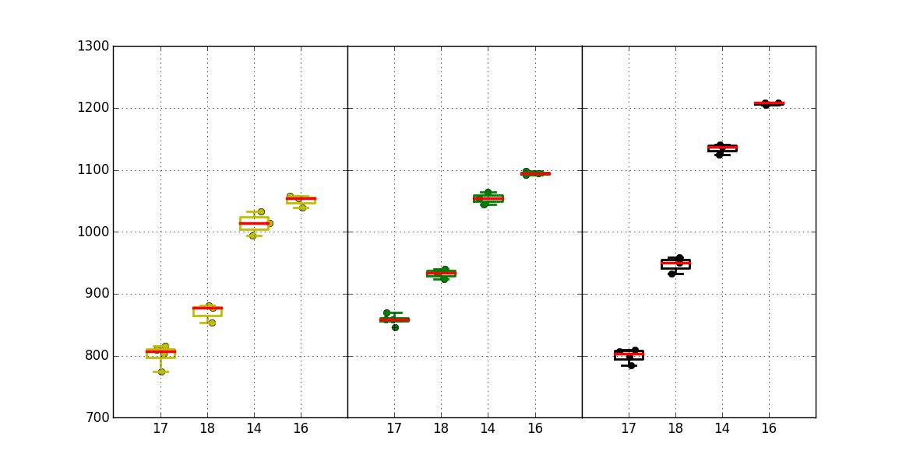
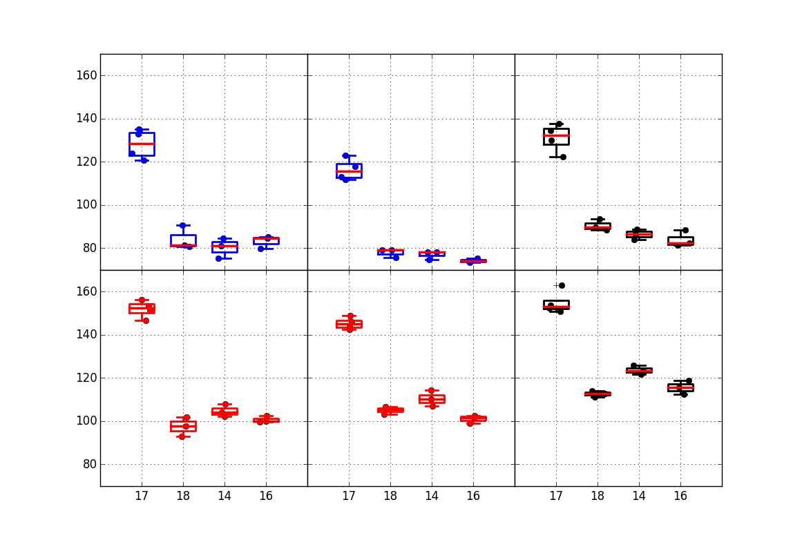
Window & sigma
Groups 2E to 4E benefit from the increasing reset Vt in terms of median window. Groups 3E and 4E see window enlargement after drift
Median
Window
Very good sigmas when alloy has no Si doping: set sigma ~80mV or even less after some cycling. Reset sigma is higher but in the range of 100~110mV. Best sigmas so far!
Small worsening of sigma after 10s drift (~10mV)
1C
2E
3E
4E
1C
2E
3E
4E
1C
2E
3E
4E
1k cycles
128k cycles
128k cycles +10s drift
Robust
sigma
SET
Trial | SD thk. | Ge% | As% | Se% | In% | Si%
1C | 22 ver12 | 13 | 30.4 | 48.6 | 2 | 6
2E | 22 | 16 | 28.6 | 50.4 | 5 | 0
3E | 22 | 16 | 26.6 | 50.4 | 7 | 0
4E | 22 | 18.5 | 25.6 | 48.9 | 7 | 0
RESET
1C
2E
3E
4E
1C
2E
3E
4E
1C
2E
3E
4E

Slide 8
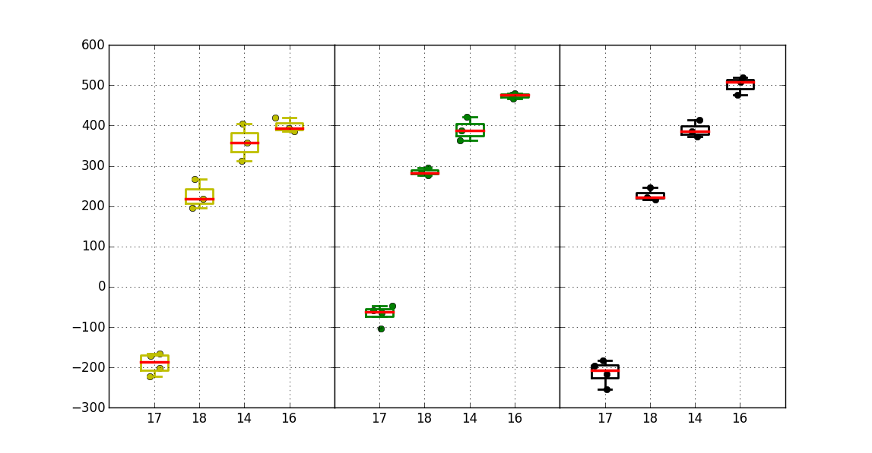
Projected window @3.54 sigma
Trial | SD thk. | Ge% | As% | Se% | In% | Si%
1C | 22 ver12 | 13 | 30.4 | 48.6 | 2 | 6
2E | 22 | 16 | 28.6 | 50.4 | 5 | 0
3E | 22 | 16 | 26.6 | 50.4 | 7 | 0
4E | 22 | 18.5 | 25.6 | 48.9 | 7 | 0
Higher window and very small sigmas → no Si groups have positive window already after 1k cycles. Best group is able to achieve +400mV/+500mV window
1k cycles 1us
128k cycles 1us
128k cycles +10s drift
1C
2E
3E
4E
1C
2E
3E
4E
1C
2E
3E
4E

Slide 9
Positive / Negative reading comparison

Slide 10
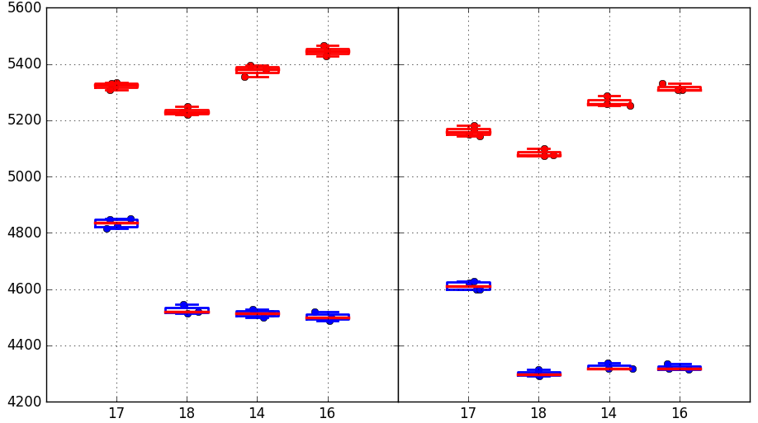
Median Vt comparison
Negative reading
Positive reading
1k cycles
128k cycles
1k cycles
128k cycles
1C
2E
3E
4E
1C
2E
3E
4E
1C
2E
3E
4E
1C
2E
3E
4E
Trial | SD thk. | Ge% | As% | Se% | In% | Si%
1C | 22 ver12 | 13 | 30.4 | 48.6 | 2 | 6
2E | 22 | 16 | 28.6 | 50.4 | 5 | 0
3E | 22 | 16 | 26.6 | 50.4 | 7 | 0
4E | 22 | 18.5 | 25.6 | 48.9 | 7 | 0
Trends are the same for both polarities.
Toggle on Set Vt is very small, while there is a significant decrease of Reset Vt for positive reading → lower window

Slide 11
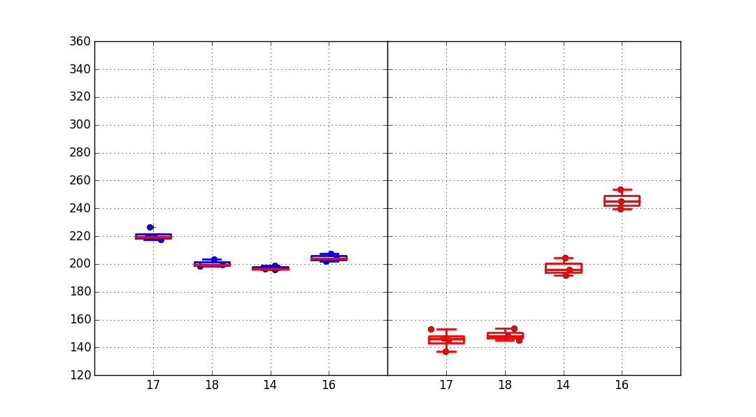
1us→10s Drift comparison
Trial | SD thk. | Ge% | As% | Se% | In% | Si%
1C | 22 ver12 | 13 | 30.4 | 48.6 | 2 | 6
2E | 22 | 16 | 28.6 | 50.4 | 5 | 0
3E | 22 | 16 | 26.6 | 50.4 | 7 | 0
4E | 22 | 18.5 | 25.6 | 48.9 | 7 | 0
Absolute drift mV
SET/RESET
Negative reading
Positive reading
1C
2E
3E
4E
1C
2E
3E
4E
Very similar trends for both polarities.
Set drift for positive is ~30mV lower, while Reset drift is much lower, though maintaining the same trend.
→ Opening of positive window happens only for group 4E
1C
2E
3E
4E
1C
2E
3E
4E

Slide 12
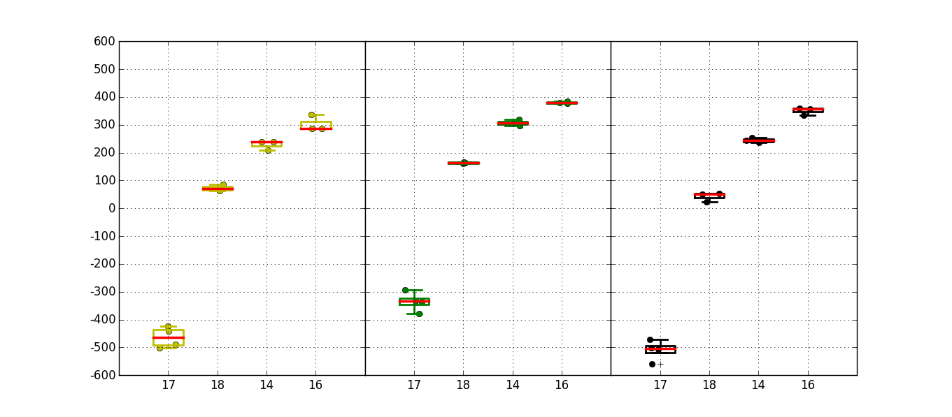
Projected window @3.54 sigma comparison
Negative reading
Positive reading
1k cycles 1us
128k cycles 1us
128k cycles +10s drift
1k cycles 1us
128k cycles 1us
128k cycles +10s drift
1C
2E
3E
4E
1C
2E
3E
4E
1C
2E
3E
4E
Trial | SD thk. | Ge% | As% | Se% | In% | Si%
1C | 22 ver12 | 13 | 30.4 | 48.6 | 2 | 6
2E | 22 | 16 | 28.6 | 50.4 | 5 | 0
3E | 22 | 16 | 26.6 | 50.4 | 7 | 0
4E | 22 | 18.5 | 25.6 | 48.9 | 7 | 0
1C
2E
3E
4E
1C
2E
3E
4E
1C
2E
3E
4E

Slide 13
Conclusions
Reset Vt increases with decreasing As% (or increasing Ge+In%), accounting for a higher median window, not exploiting cell tapering
Reset drift is strongly modulated (probably by decreasing As doping): for the first time we have a window that is opening after drift (10s). Long time drift experiments already planned
Sigmas are the best so far, with lowest achieved being <80mV for set after cycling. Reset around 100mV. Main toggle here is no Si alloy, minor contributors to be assessed (CD--?)
Projected window for new alloys is +400/+500mV until 10s drift. 3E and 4E groups very promising
Positive reading confirms the trends above, with some upside on the set drift but a downside on reset Vt and drift (both lower), resulting in 100~150mV worse projected window. Overall, performance in the two polarities are not too different

