Slide 1
SSM process development update
ww1803

Slide 2
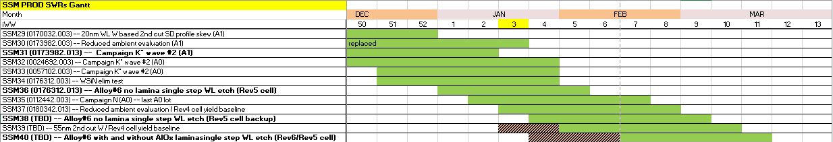
WIP status update
  Comments to the Gantt chart:
    Lots in bold will run with rotating Screamer priority; Next week Rev5 backup lot is pending PVD readiness
    G* -- L1D and PROD SWRs -- Q2 activity
    Dual deck setup and demo -- Q2 activity
  Short term line conversions:
    Rev4.x – WSiN elimination; 55nm 2nd cut W
    Rev5.x/6.x L1D and potential conversion in Q1’18
    65 NCMP FSL slurry and 350A 52 Nitride Cap

Slide 3
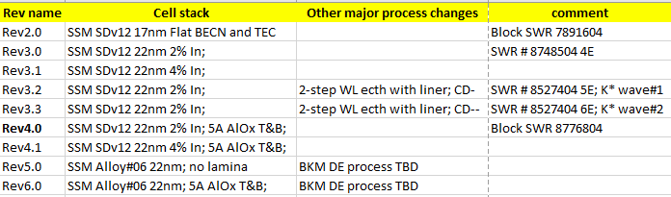
PI objectives Q1’18
    Q1’18 priorities
      Enable K* runner up alloy single step WL etch (Vt window demo)
        NO Lamina (Cell rev5) – Mid February to probe
        WITH lamina (Cell rev6) – Mid March to probe
      Establish SSM Rev4.0 yield baseline (4-5 lots control groups on A1 material) as a basis for yield gap pareto to S26A full stack;
        Initial yield summary can be based on control groups of lots SSM 30,34,36,37 lots by ww10

Slide 4
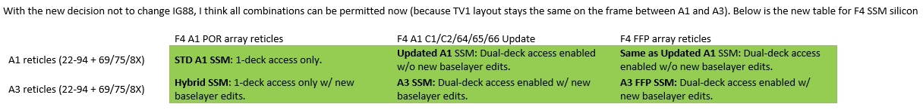
SSM dual deck assessment on SR71B and 2D structural yield
Tape-out in late February
    Based on the reviewed tape-out plan, initial assessment on dual deck can be enabled by mid-Q2 (Si to probe)
    Pull in and streamlining (reducing dependency on A3 and FPP) can potentially allow 2 full info-turns to probe on 2D before the end of Q2’18
    Cell revision for 2D info-turns has to be defined before March (Rev6 D0 data still will not be available)

Slide 5
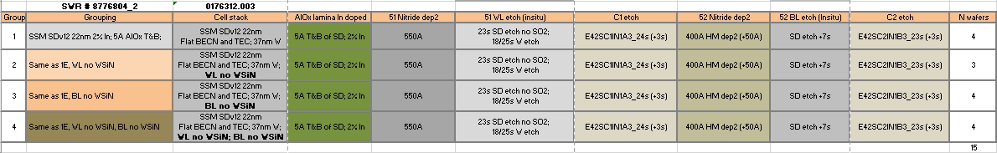
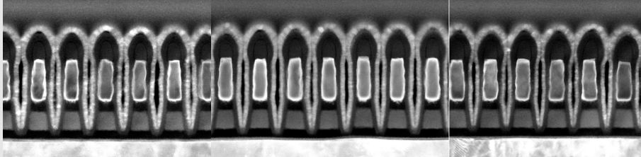
WSiN elimination (2nd cut x-section);
Wafer Center
Cell rev4.0
WL with WSiN
BL no WSiN; BL W 45nm
Wafer Mid
Cell rev4.0
WL with WSiN
BL no WSiN; BL W 45nm
Wafer Edge
Cell rev4.0
WL with WSiN
BL no WSiN; BL W 45nm

Slide 6
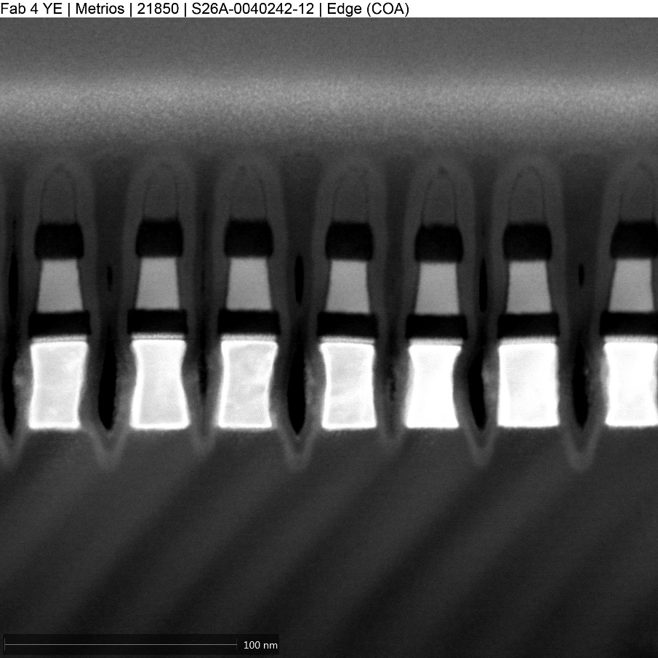
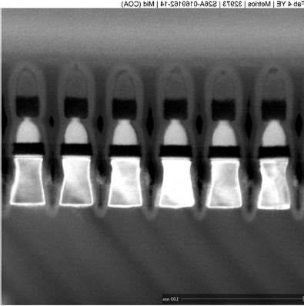
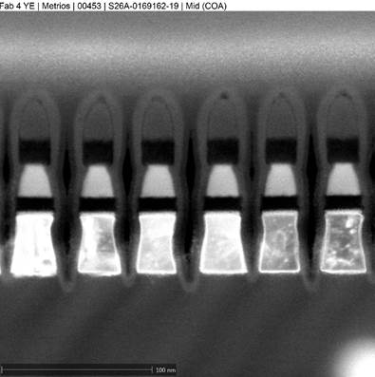
Rev5 cell (K* Alloy#6, no AlOx lamina) 1st PROD lot
1E for PROD SWR
Rev4 control
2E for PROD SWR
Rev5 candidate
3E for PROD SWR
Rev5 candidate

Slide 7
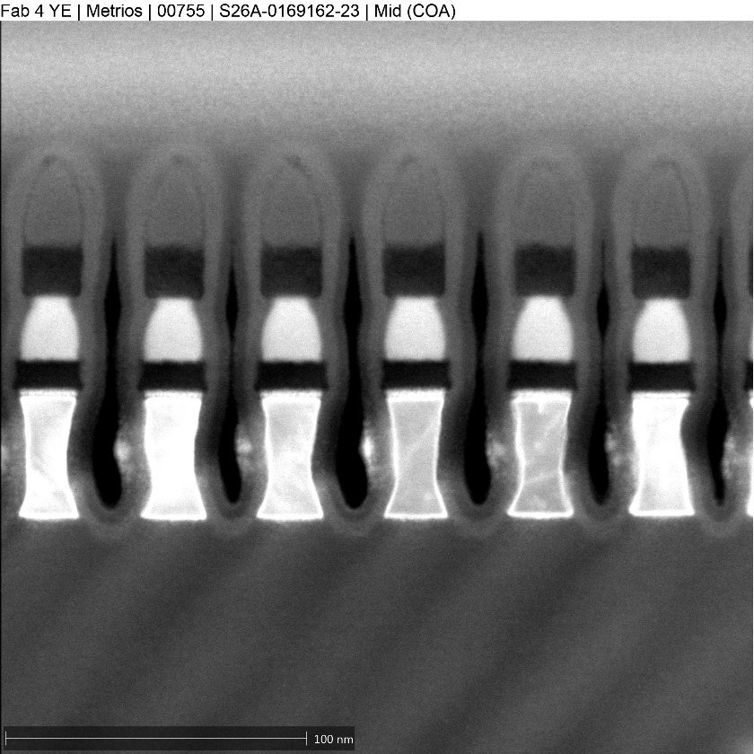
Rev5 cell (K* Alloy#6, no AlOx lamina) backup PROD lot
1E for PROD SWR
Rev4 control
2E (replacing 2E on the first lot)
Rev5 candidate
3E for PROD SWR
Rev5 candidate
K* alloy#06; 22nm;
No AlOx lamina
200A HM dep2
10s High pressure SD etch
New SXP BKM W etch
K* alloy#06; 22nm;
No AlOx lamina
350A HM dep2
10s High pressure SD etch
20s/17s W etch 2-step hi N2 W1, lo N2 W2;

Slide 8
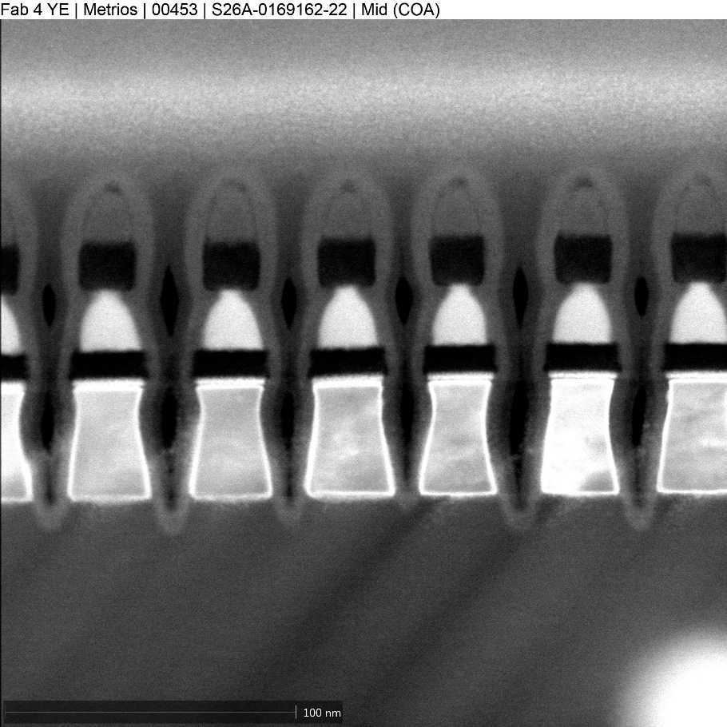
Rev5 cell (K* Alloy#6, no AlOx lamina) L1D work (1st cut)
Similar to SDv12 5% In with no AlOx lamina profie
High pressure SD etch – less top notching of SD
Moderately modified W etch – little effect
K* alloy#06; 22nm;
No AlOx lamina
400A HM dep2
21s SD etch no SO2;
15s/22s W etch 2-step POR conditions;
K* alloy#06; 22nm;
No AlOx lamina
350A HM dep2
10s High pressure SD etch
20s/17s W etch 2-step hi N2 W1, lo N2 W2;
K* alloy#06; 22nm;
No AlOx lamina
350A HM dep2
21s SD etch no SO2;
20s/17s W etch 2-step hi N2 W1, lo N2 W2;

Slide 9
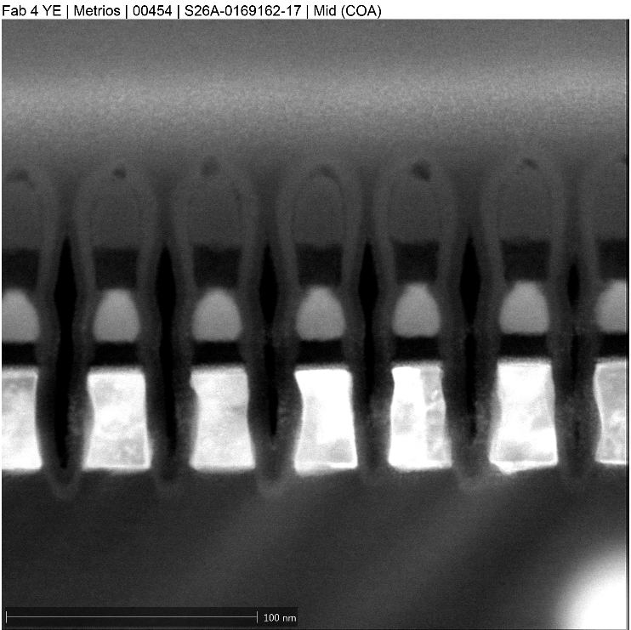
Rev5 cell (K* Alloy#6, no AlOx lamina) L1D work (1st cut)
Alt. BEC etch: BEC CD reduction,
W space improved; SD eroded
New W etch BKM; Wider W space, less HM consumption, low Oxide recess
K* alloy#06; 22nm;
No AlOx lamina
350A HM dep2
10s High pressure SD etch
20s/17s W etch 2-step hi N2 W1, lo N2 W2;
K* alloy#06; 22nm;
No AlOx lamina
400A HM dep2
10s High pressure SD etch ; Alt BEC etch 45s
15s/22s W etch 2-step POR conditions;
K* alloy#06; 22nm;
No AlOx lamina
200A HM dep2
10s High pressure SD etch
New SXP BKM W etch

Slide 10
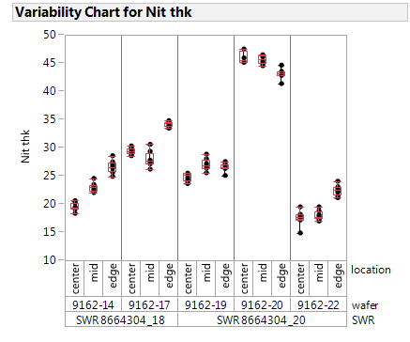
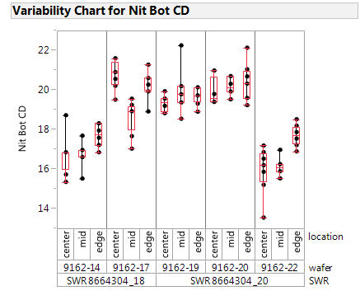
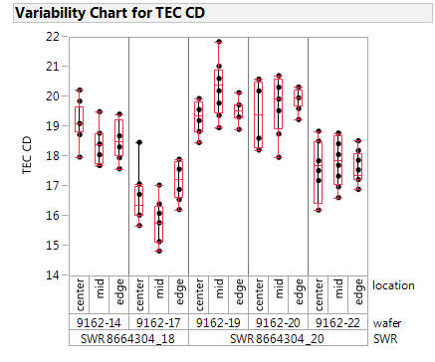
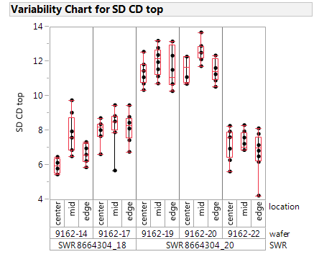
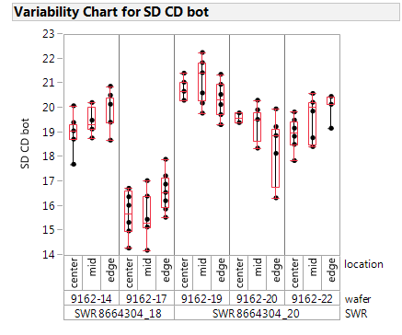
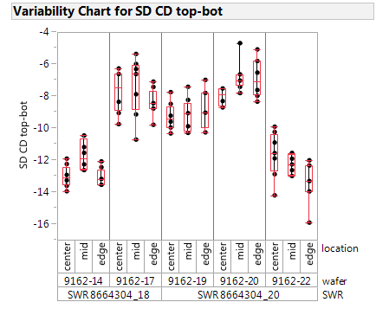
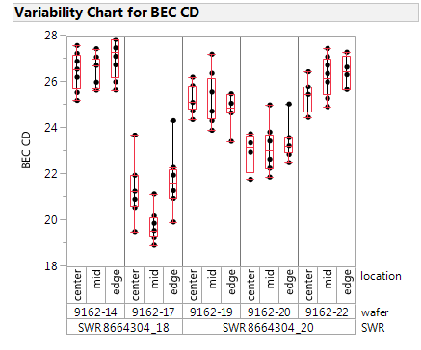
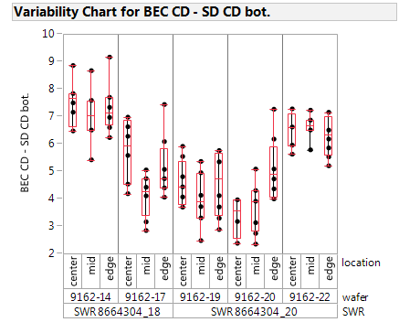
Rev5 cell (K* Alloy#6, no AlOx lamina) L1D work (1st cut)
CCASELLA
| Micron Confidential

Slide 11
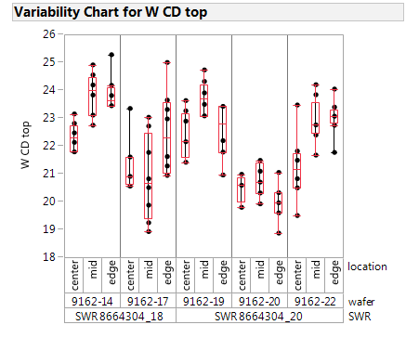
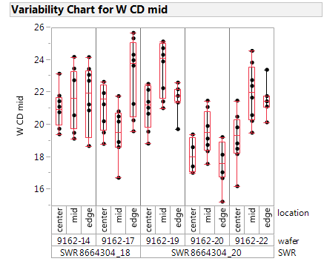
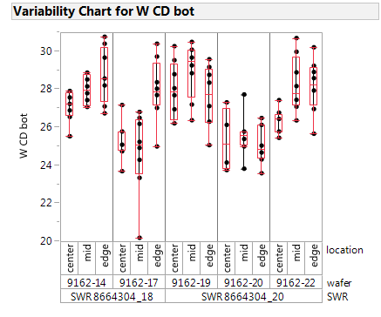
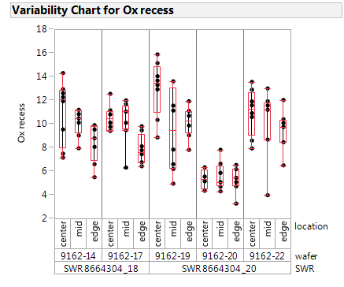
Rev5 cell (K* Alloy#6, no AlOx lamina) L1D work (1st cut)
Yield goal
Wf #19 seems to be a good compromise, SD CD top is large enough with a considerable tapering, on the other hand CD top could large enough to guarantee a quite enough stable WL.
Also wf #20 has a comparable SD CD top with wf#19 but the nitride HM as to be retuned and the oxide recess is very poor to guarantee a good WL – WL separation.
CCASELLA
| Micron Confidential

Slide 12
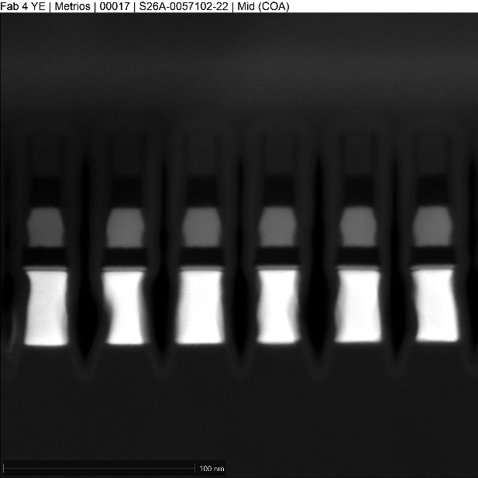
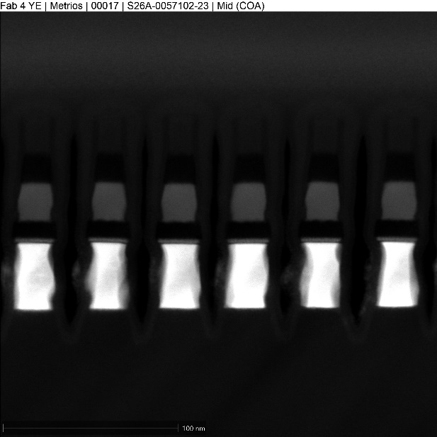
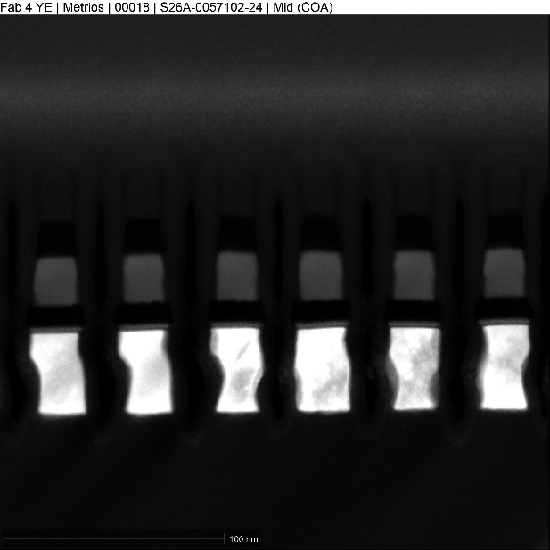
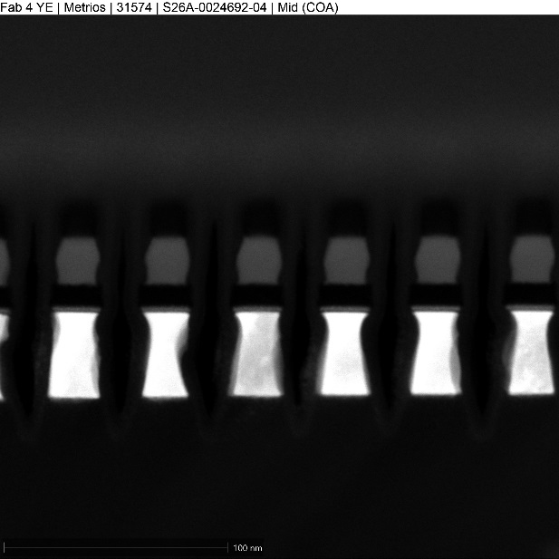
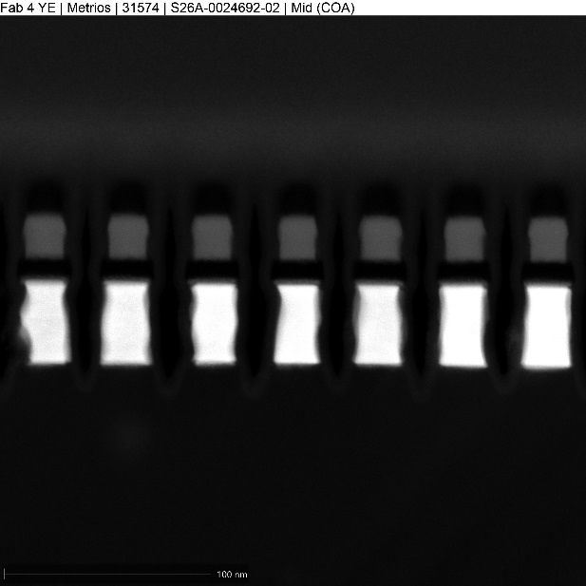
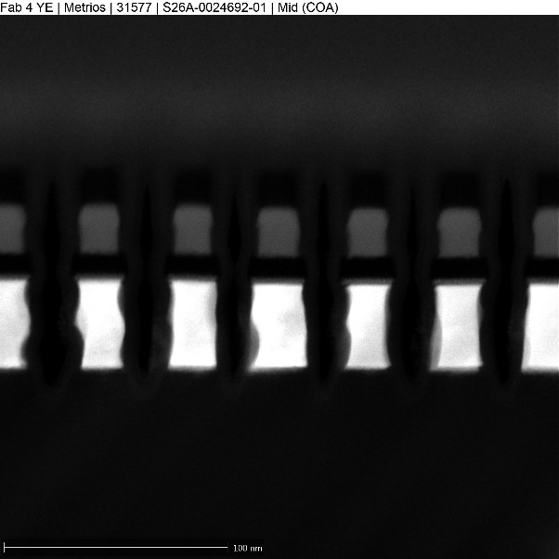
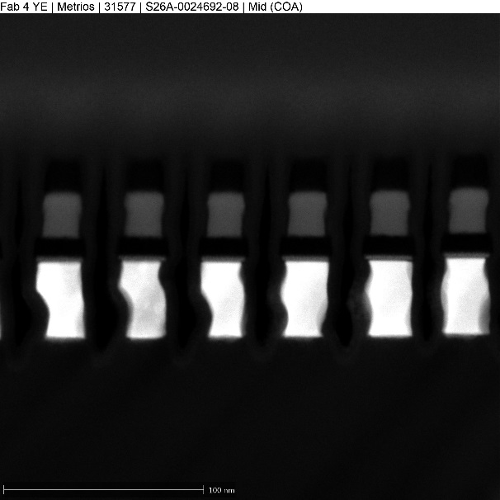
K* wave2 WL etch profiles (2-step etch CD--)
alloy20
alloy18
alloy13
alloy6
alloy12
alloy16
alloy14b

Slide 13
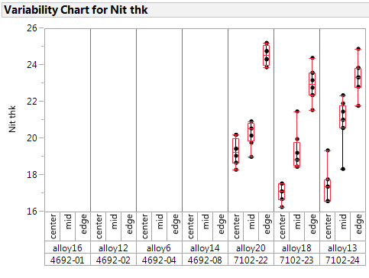
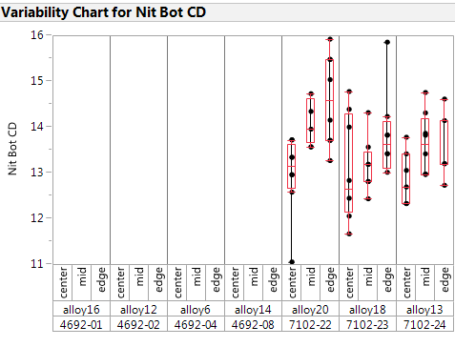
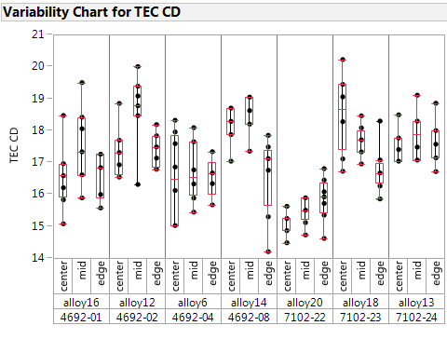
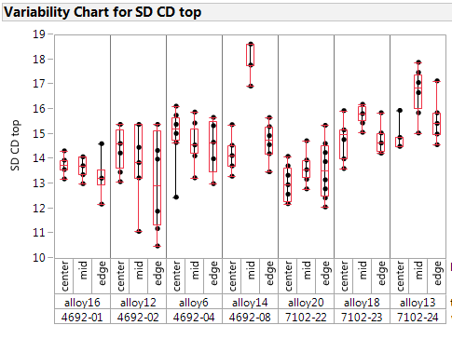
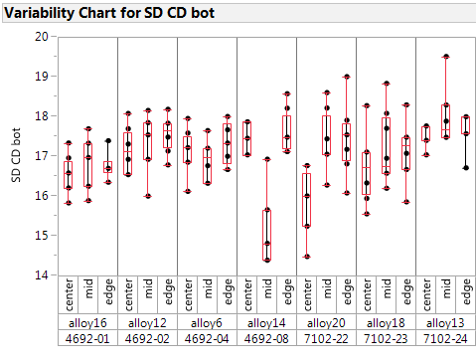
K* WL CDs
CCASELLA

Slide 14
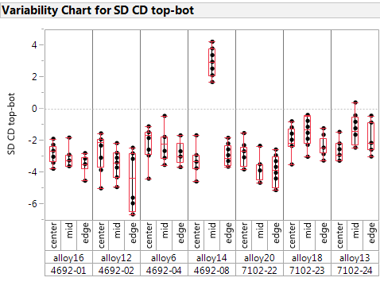
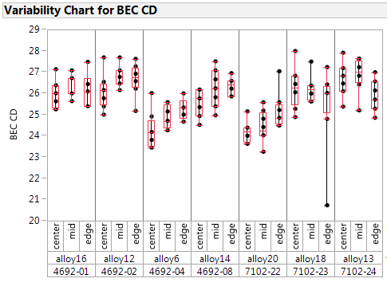
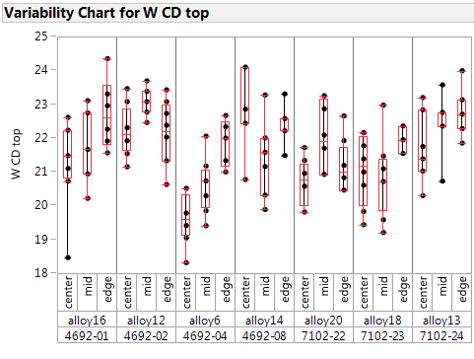
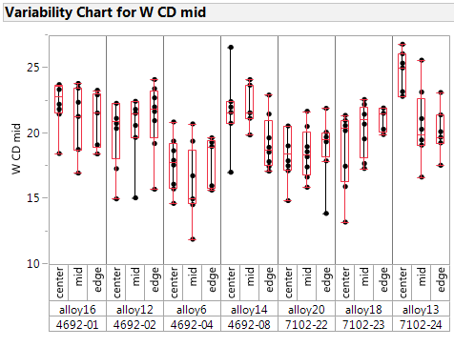
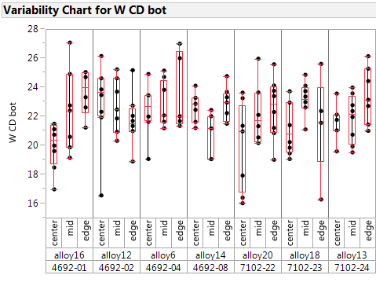
K* WL CDs
CCASELLA

Slide 15
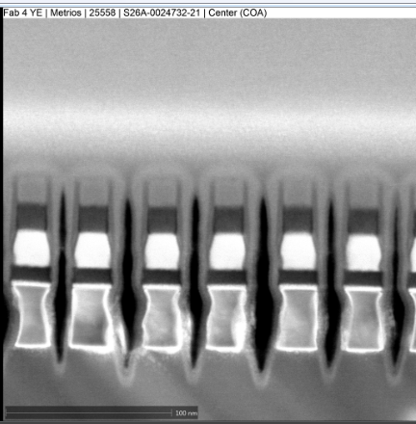
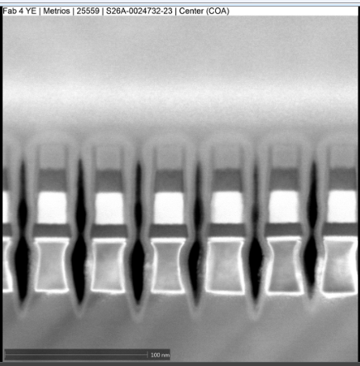






K* wave1 WL etch profiles (2-step etch CD-)
CCASELLA
alloy2
alloy4
alloy5
alloy6
alloy7
alloy8
alloy9
POR

Slide 16
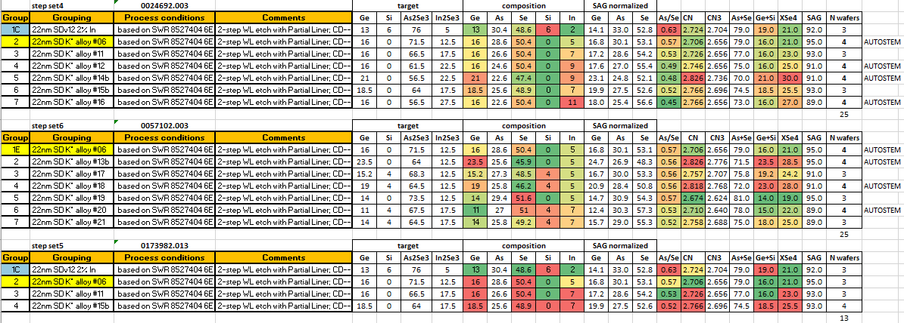
K* wave # 2

Slide 17
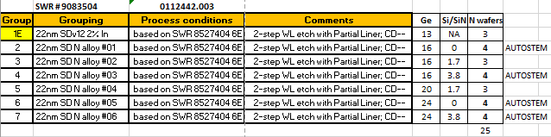
Campaign N

Slide 18
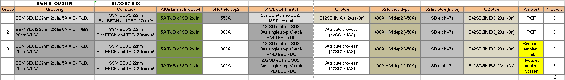
SWRs in-line

