Slide 1
0170032 SR71B

Slide 2
Summary
Testing has moved to 85C
Low confidence of actual BL profile due to misprocess (wrong BL W thickness)
Trial | SD thk. | In-doping | AlOx lamina | WL W thk. | 52 BL etch | Wf
1C | 22 ver16 | 2% | 5A T&B | 37nm | SD etch +7s | 5,20,24
2E | 22 ver16 | 2% | 5A T&B | 20nm | SD etch +7s | 3,9,23
3E | 22 ver16 | 2% | - | 20nm | SD etch +5s | 6,13,19
4E | 22 ver12 | 4% | - | 20nm | SD etch +5s | 11,15,22,25
5E | 22 ver16 | 2% | 5A T&B | 20nm | Straight | 1,4,16
6E | 22 ver16 | 2% | 5A T&B | 20nm | Tapered | 10,12,14
7E | 22 ver16 | 2% | 5A T&B | 20nm | Straight CD- | 2,8,17
8E | 22 ver16 | 2% | 5A T&B | 20nm | Tapered CD- | 7,18,21

Slide 3
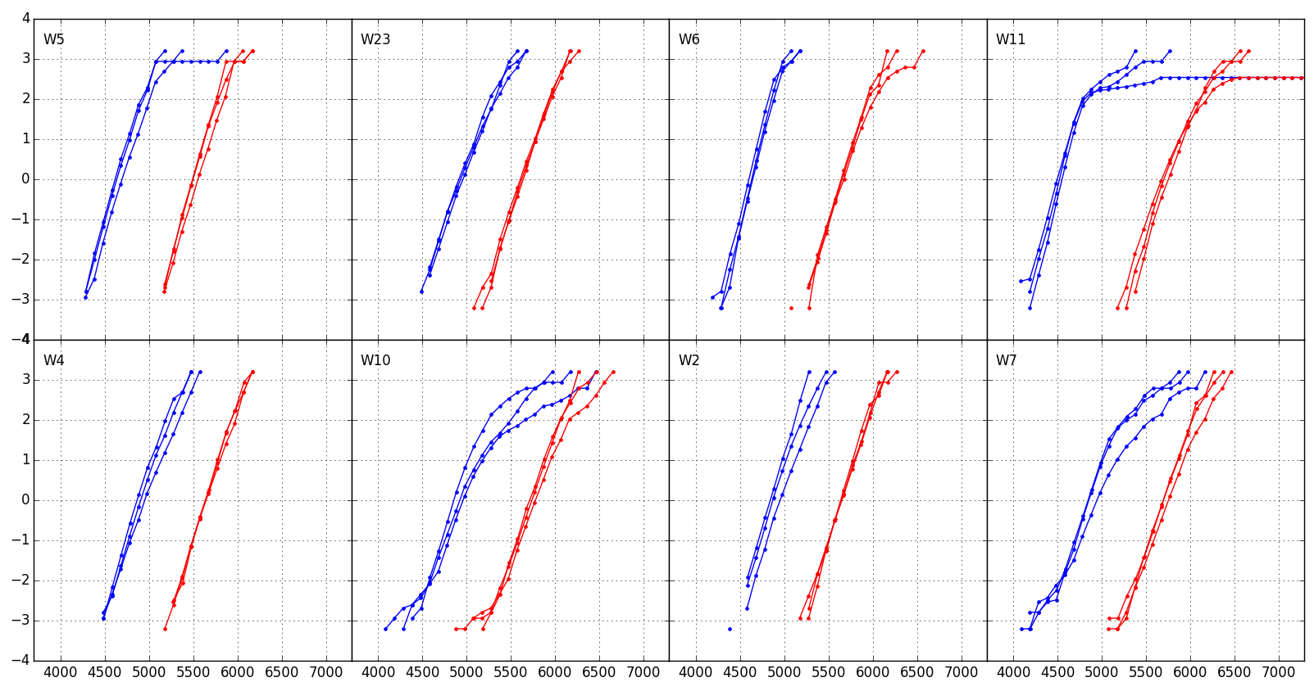
Distributions 1us 1k cycles
1C v16
In 2%
AlOx T&B
37nm WL W
BL etch std
2E v16
In 2%
AlOx T&B
20nm WL W
BL etch std
3E v16
In 2%
No AlOx
20nm WL W
BL etch std
4E v12
In 4%
No AlOx
20nm WL W
BL etch std
5E v16
In 2%
AlOx T&B
20nm WL W
BL etch STRAIGHT
6E v16
In 2%
AlOx T&B
20nm WL W
BL etch TAPERED
7E v16
In 2%
AlOx T&B
20nm WL W
BL etch STRAIGHT CD-
8E v16
In 2%
AlOx T&B
20nm WL W
BL etch TAPERED CD-

Slide 4
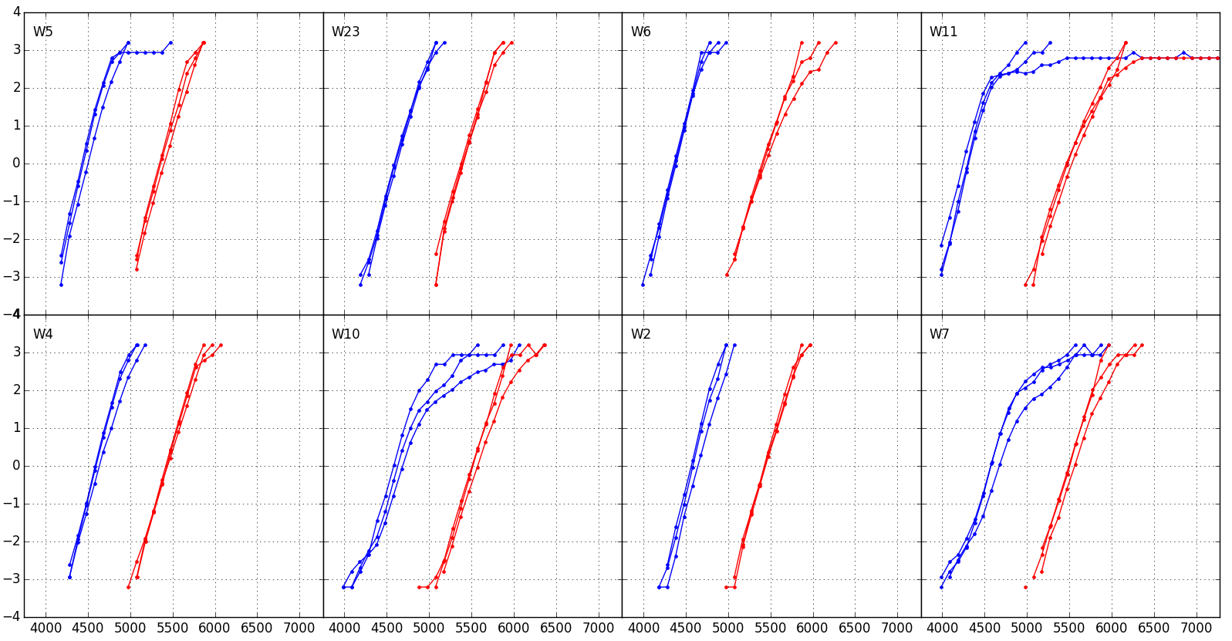
Distributions 1us 128k cycles
Groups with BL etch for tapered profile show high Vt tails
To a minor extent, no lamina groups show tails/opens
1C v16
In 2%
AlOx T&B
37nm WL W
BL etch std
2E v16
In 2%
AlOx T&B
20nm WL W
BL etch std
3E v16
In 2%
No AlOx
20nm WL W
BL etch std
4E v12
In 4%
No AlOx
20nm WL W
BL etch std
5E v16
In 2%
AlOx T&B
20nm WL W
BL etch STRAIGHT
6E v16
In 2%
AlOx T&B
20nm WL W
BL etch TAPERED
7E v16
In 2%
AlOx T&B
20nm WL W
BL etch STRAIGHT CD-
8E v16
In 2%
AlOx T&B
20nm WL W
BL etch TAPERED CD-

Slide 5
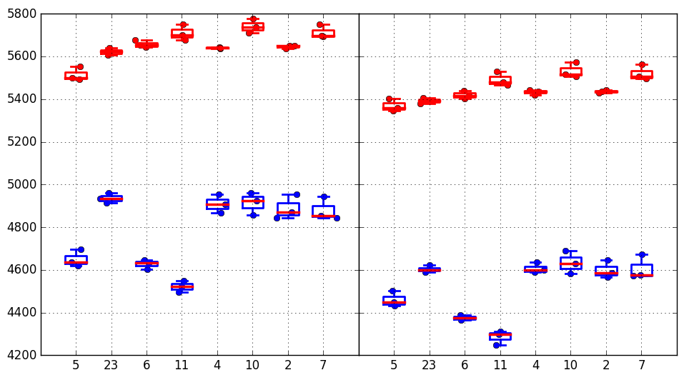
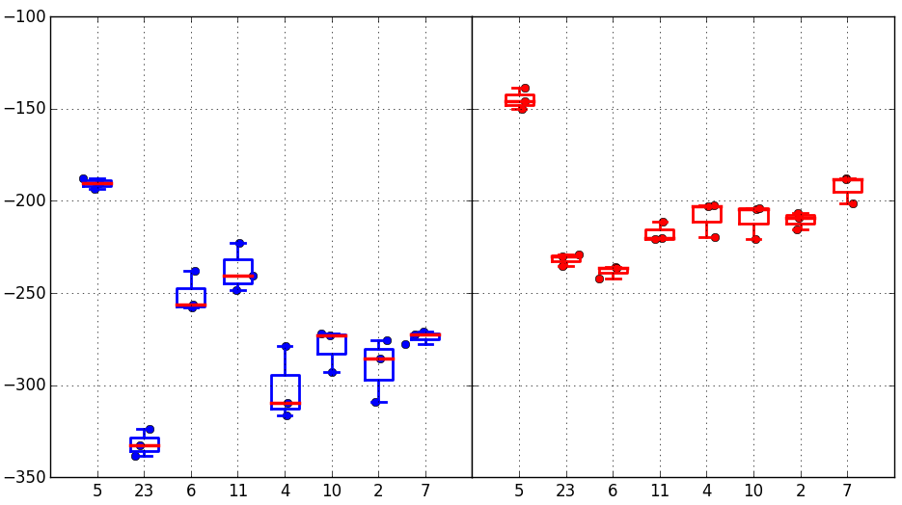
Vt Medians + Vt shift
As previously observed, 20nm WL W thickness has the downside of less effective seasoning (especially on low state). So the Vt evolution from 1k to 128k cycles is larger
Set seasoning seems partially better on no lamina groups
Tapered vs straight profile has ~100mV higher reset Vt with same set Vt
1k cycles
128k cycles
Median Vt
1C
2E
3E
4E
5E
6E
7E
8E
1C
2E
3E
4E
5E
6E
7E
8E
Vt shift 1k→128k cycles
Trial | SD thk. | In - % | AlOx lamina | WL W thk. | 52 BL etch
1C | 22 v16 | 2% | 5A T&B | 37nm | SD etch +7s
2E | 22 v16 | 2% | 5A T&B | 20nm | SD etch +7s
3E | 22 v16 | 2% | - | 20nm | SD etch +5s
4E | 22 v12 | 4% | - | 20nm | SD etch +5s
5E | 22 v16 | 2% | 5A T&B | 20nm | Straight
6E | 22 v16 | 2% | 5A T&B | 20nm | Tapered
7E | 22 v16 | 2% | 5A T&B | 20nm | Straight CD-
8E | 22 v16 | 2% | 5A T&B | 20nm | Tapered CD-
SET
RESET
1C
2E
3E
4E
5E
6E
7E
8E
1C
2E
3E
4E
5E
6E
7E
8E

Slide 6
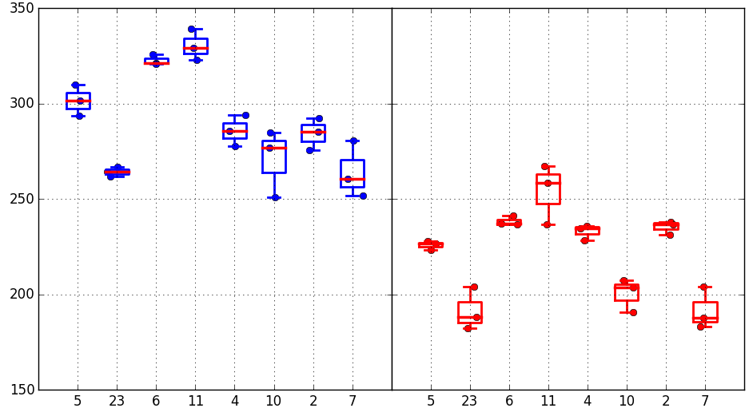
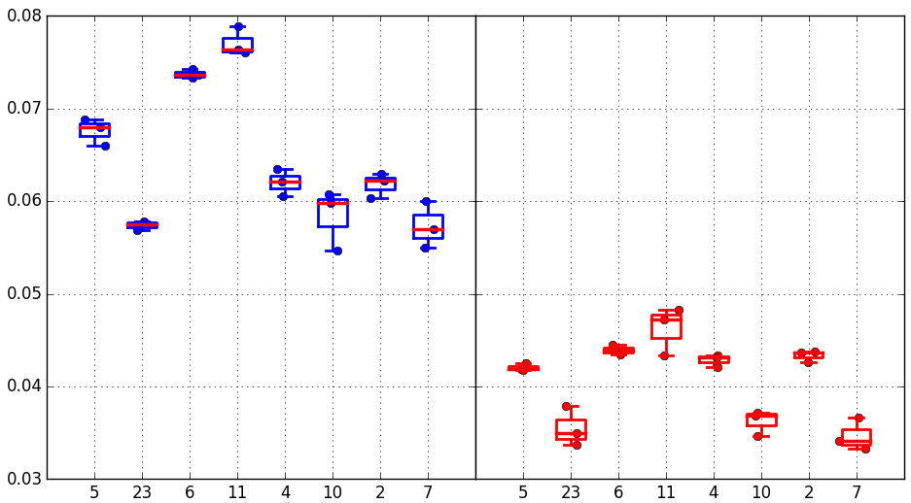
Median drift 1us-10s @85C
(128k cycles)
Trial | SD thk. | In - % | AlOx lamina | WL W thk. | 52 BL etch
1C | 22 v16 | 2% | 5A T&B | 37nm | SD etch +7s
2E | 22 v16 | 2% | 5A T&B | 20nm | SD etch +7s
3E | 22 v16 | 2% | - | 20nm | SD etch +5s
4E | 22 v12 | 4% | - | 20nm | SD etch +5s
5E | 22 v16 | 2% | 5A T&B | 20nm | Straight
6E | 22 v16 | 2% | 5A T&B | 20nm | Tapered
7E | 22 v16 | 2% | 5A T&B | 20nm | Straight CD-
8E | 22 v16 | 2% | 5A T&B | 20nm | Tapered CD-
Absolute drift mV
SET/RESET
1C
2E
3E
4E
5E
6E
7E
8E
1C
2E
3E
4E
5E
6E
7E
8E
For no lamina groups drift is slightly higher
For the other 20nm W WL groups, drift is slighty lower then POR
Straight vs tapered profile @BL has higher drift
Relative drift
SET/RESET
1C
2E
3E
4E
5E
6E
7E
8E
1C
2E
3E
4E
5E
6E
7E
8E

Slide 7
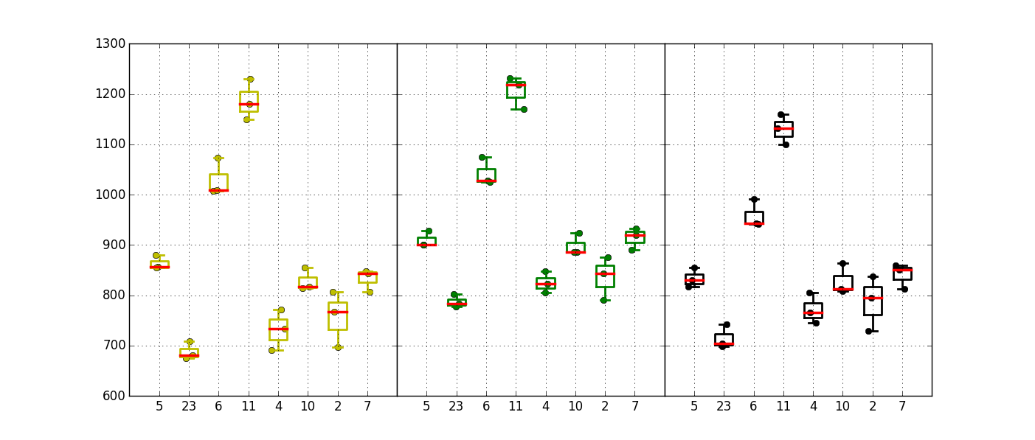
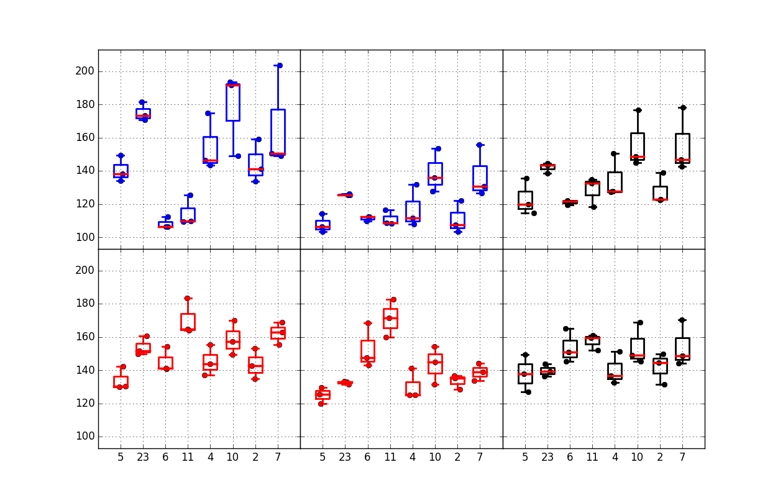
Window & sigma
No lamina groups (aggressive tapering @WL) show the usual boost in median window. Higher In% results in more boost (tapering)
Tapered profile @BL has similar window with POR. Straight profile has lower window
Median
Window
1k cycles sigma data is affected by poor seasoning
Reset sigma is higher than set, as usual when we have tapering with negative reading
Tapered BL profile has worse sigma
1C
2E
3E
4E
5E
6E
7E
8E
1C
2E
3E
4E
5E
6E
7E
8E
1C
2E
3E
4E
5E
6E
7E
8E
1k cycles
128k cycles
128k cycles +10s drift
Robust
sigma
SET
Trial | SD thk. | In - % | AlOx lamina | WL W thk. | 52 BL etch
1C | 22 v16 | 2% | 5A T&B | 37nm | SD etch +7s
2E | 22 v16 | 2% | 5A T&B | 20nm | SD etch +7s
3E | 22 v16 | 2% | - | 20nm | SD etch +5s
4E | 22 v12 | 4% | - | 20nm | SD etch +5s
5E | 22 v16 | 2% | 5A T&B | 20nm | Straight
6E | 22 v16 | 2% | 5A T&B | 20nm | Tapered
7E | 22 v16 | 2% | 5A T&B | 20nm | Straight CD-
8E | 22 v16 | 2% | 5A T&B | 20nm | Tapered CD-
RESET
1C
2E
3E
4E
5E
6E
7E
8E
1C
2E
3E
4E
5E
6E
7E
8E
1C
2E
3E
4E
5E
6E
7E
8E

Slide 8
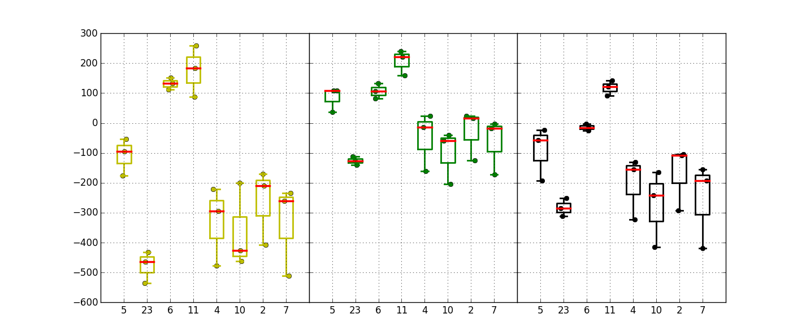
Projected window @3.54 sigma
Trial | SD thk. | In - % | AlOx lamina | WL W thk. | 52 BL etch
1C | 22 v16 | 2% | 5A T&B | 37nm | SD etch +7s
2E | 22 v16 | 2% | 5A T&B | 20nm | SD etch +7s
3E | 22 v16 | 2% | - | 20nm | SD etch +5s
4E | 22 v12 | 4% | - | 20nm | SD etch +5s
5E | 22 v16 | 2% | 5A T&B | 20nm | Straight
6E | 22 v16 | 2% | 5A T&B | 20nm | Tapered
7E | 22 v16 | 2% | 5A T&B | 20nm | Straight CD-
8E | 22 v16 | 2% | 5A T&B | 20nm | Tapered CD-
In general, lower WL W thickness needs more cycling to get a decent window. Exceptions are the no lamina groups, that perform well even after 1k cycles
1k cycles 1us
128k cycles 1us
128k cycles +10s drift
1C
2E
3E
4E
5E
6E
7E
8E
1C
2E
3E
4E
5E
6E
7E
8E
1C
2E
3E
4E
5E
6E
7E
8E

Slide 9
Conclusions
Lower WL W thickness is confirmed to have an ineffective seasoning, especially for set distributions, and this is mitigated in no lamina stacks. Upside is a small reduction for drift
Tapered profile @BL groups have distributions with worse sigma and presence of high Vt tails. Small toggle of tapered vs straight BL profile, with an increase of window ~100mV. The increase is due to higher reset Vt
No lamina groups (aggressive tapering @WL) confirm window boost (neg read), with In 4% having a larger window
PFA needed to check actual morphology of trials

