Slide 1
SSM process development update
ww1802

Slide 2
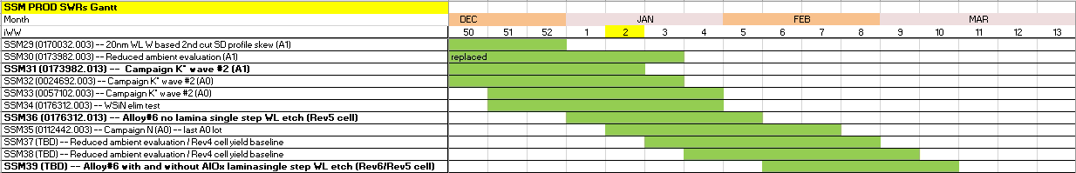
WIP status update
  Comments to the Gantt chart:
    Lots in bold will run with rotating Screamer priority
    G* is more distant, Q2 activity
    Dual deck setup is also Q2 activity, depending on the tape out schedule and first conversion layer.
  Quality issues:
    SSM29 lot had thick (55nm instead of 45nm) W deposited at 52 level. Can have issues related to BL-BL and periphery due to under-chop
    SSM31 also had misprocess at C2 OXIDE CMP, which has risk of BL-BL shorting.
    Both issues are related to 20s SXP line conversions affecting SSM setup, both fixed, but impacted PROD material.

Slide 3
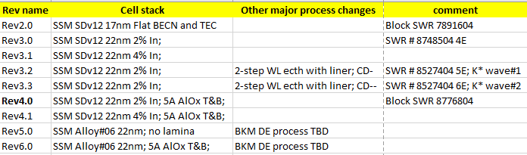
PI objectives Q1’18
    Q1’18 priorities
      Enable K* runner up alloy single step WL etch (Vt window demo)
        NO Lamina (Cell rev5) – Mid February to probe
        WITH lamina (Cell rev6) – Mid March to probe
      Establish SSM Rev4.0 yield baseline (4-5 lots control groups on A1 material) as a basis for yield gap pareto to S26A full stack;

Slide 4
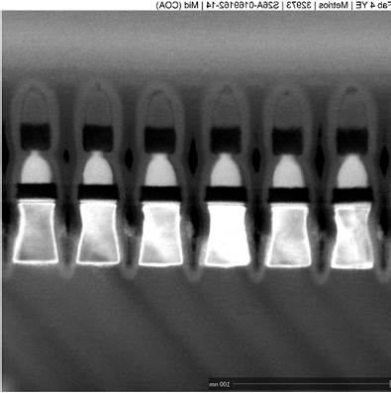
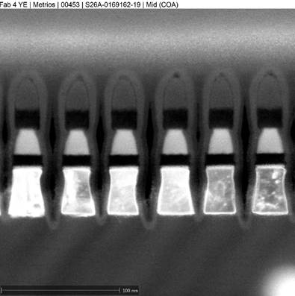
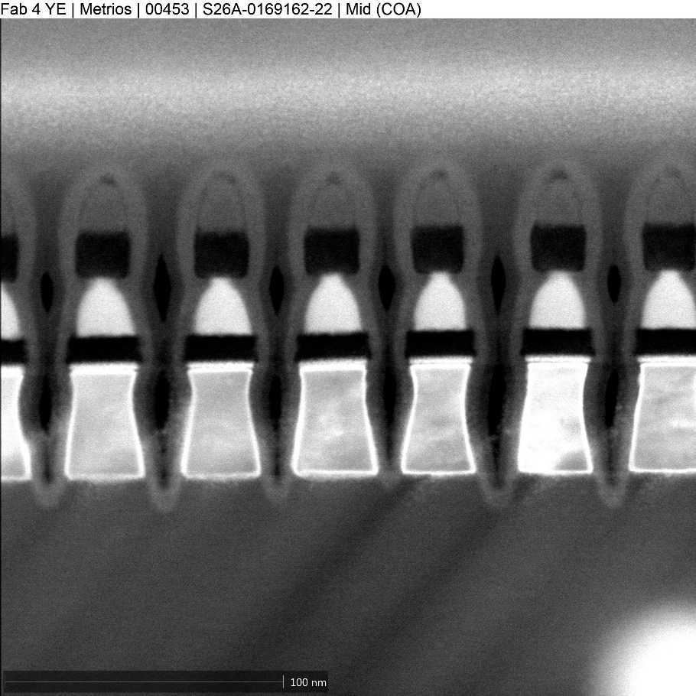
Rev5 cell (K* Alloy#6, no AlOx lamina) L1D work (1st cut)
Similar to SDv12 5% In with no AlOx lamina profie
High pressure SD etch – less top notching of SD
Moderately modified W etch – little effect
K* alloy#06; 22nm;
No AlOx lamina
400A HM dep2
21s SD etch no SO2;
15s/22s W etch 2-step POR conditions;
K* alloy#06; 22nm;
No AlOx lamina
350A HM dep2
10s High pressure SD etch
20s/17s W etch 2-step hi N2 W1, lo N2 W2;
K* alloy#06; 22nm;
No AlOx lamina
350A HM dep2
21s SD etch no SO2;
20s/17s W etch 2-step hi N2 W1, lo N2 W2;

Slide 5
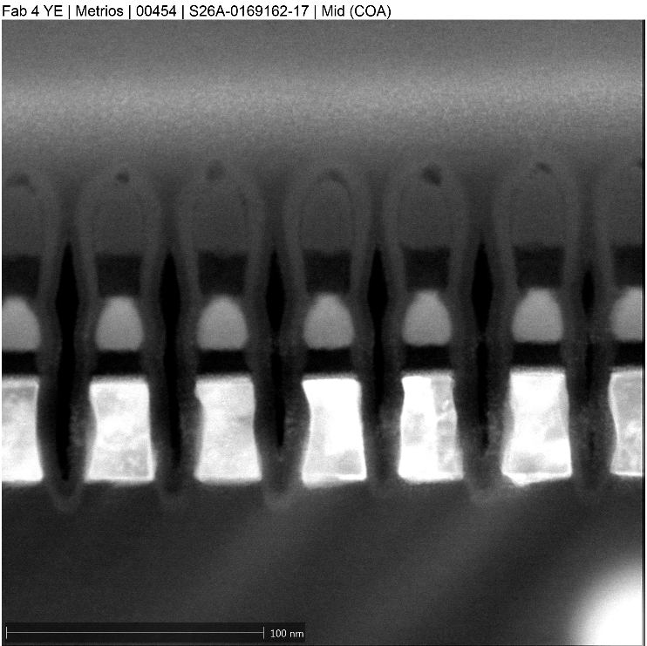
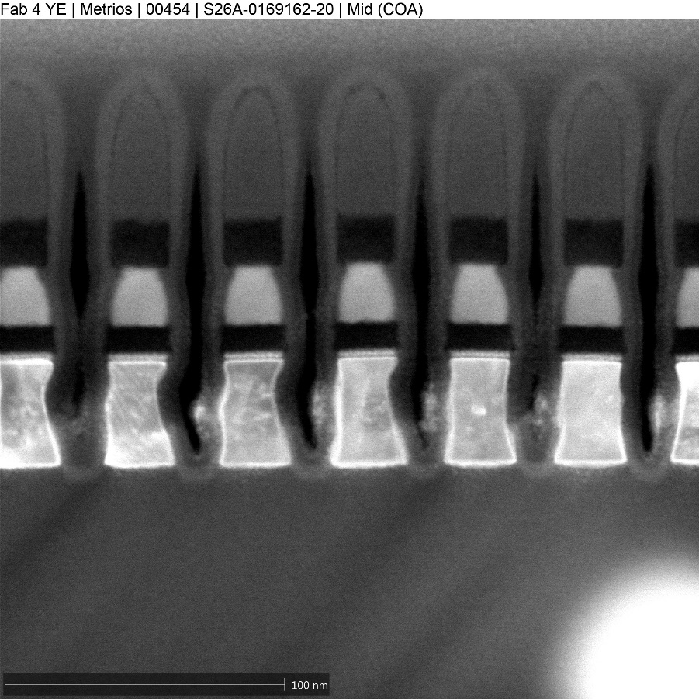
Rev5 cell (K* Alloy#6, no AlOx lamina) L1D work (1st cut)
Alt. BEC etch: BEC CD reduction,
W space improved; SD eroded
New W etch BKM; Wider W space, less HM consumption, low Oxide recess
K* alloy#06; 22nm;
No AlOx lamina
350A HM dep2
10s High pressure SD etch
20s/17s W etch 2-step hi N2 W1, lo N2 W2;
K* alloy#06; 22nm;
No AlOx lamina
400A HM dep2
10s High pressure SD etch ; Alt BEC etch 45s
15s/22s W etch 2-step POR conditions;
K* alloy#06; 22nm;
No AlOx lamina
350A HM dep2
10s High pressure SD etch
New SXP BKM W etch

Slide 6
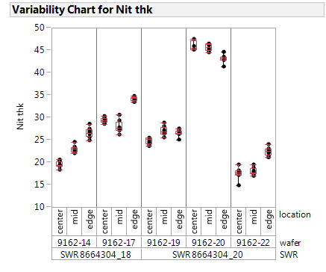
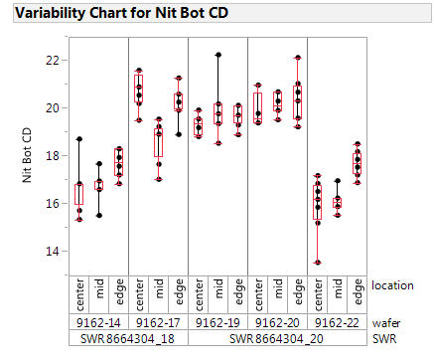
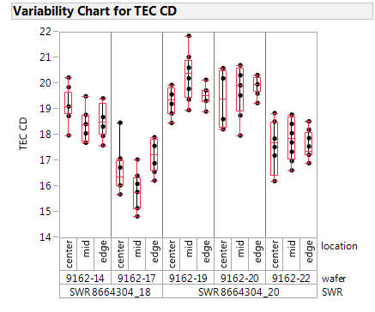
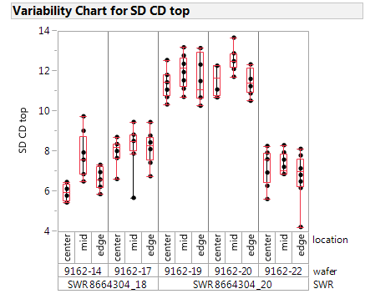
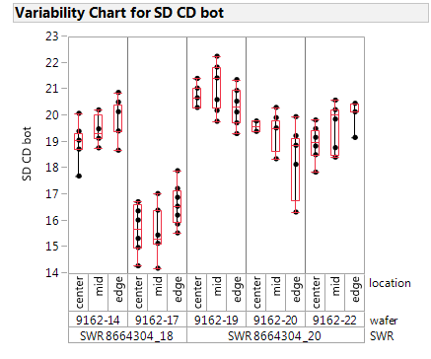
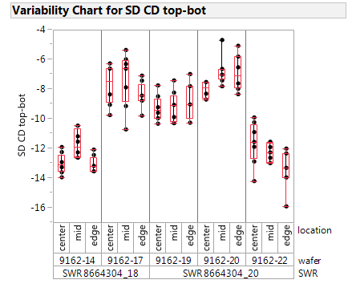
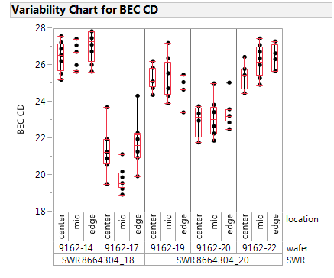
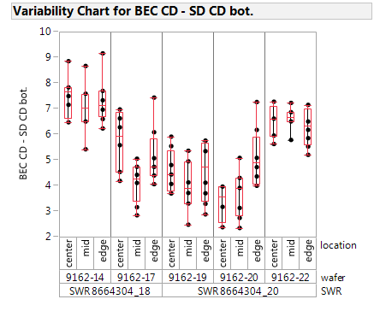
Rev5 cell (K* Alloy#6, no AlOx lamina) L1D work (1st cut)
CCASELLA
| Micron Confidential

Slide 7
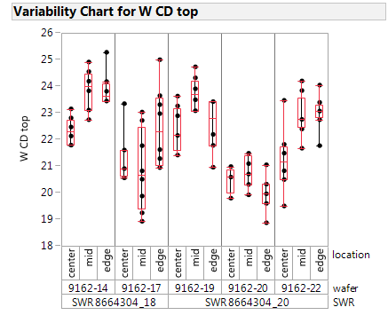
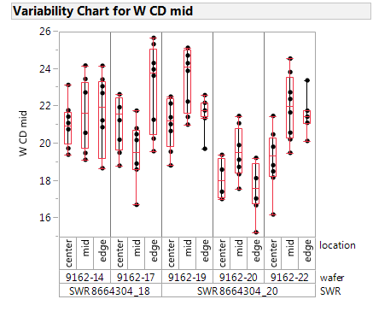
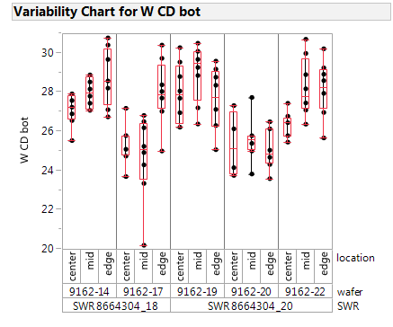
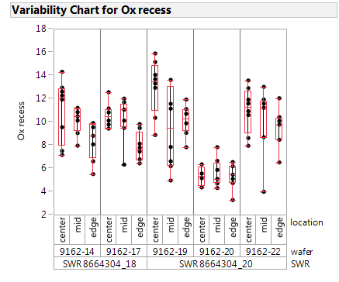
Rev5 cell (K* Alloy#6, no AlOx lamina) L1D work (1st cut)
Yield goal
Wf #19 seems to be a good compromise, SD CD top is large enough with a considerable tapering, on the other hand CD top could large enough to guarantee a quite enough stable WL.
Also wf #20 has a comparable SD CD top with wf#19 but the nitride HM as to be retuned and the oxide recess is very poor to guarantee a good WL – WL separation.
CCASELLA
| Micron Confidential

Slide 8
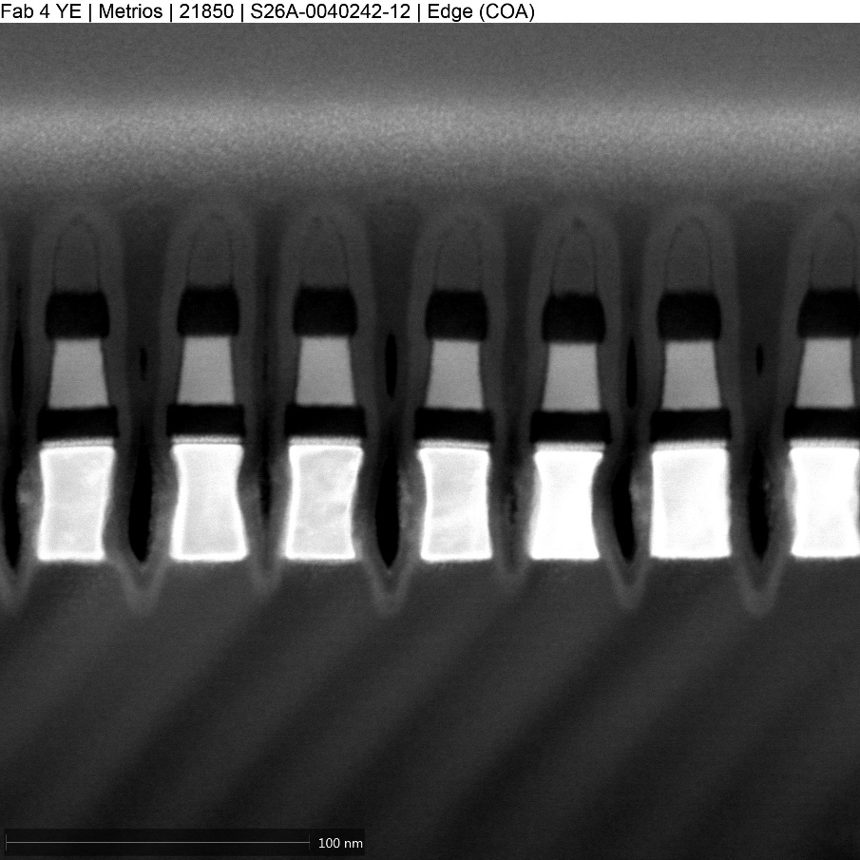
Rev5 cell (K* Alloy#6, no AlOx lamina) L1D work (1st cut)
1E for PROD SWR
Rev4 control
2E for PROD SWR
Rev5 candidate
3E for PROD SWR
Rev5 candidate

Slide 9
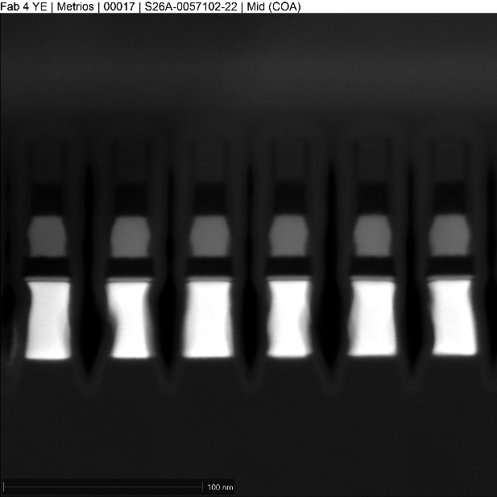
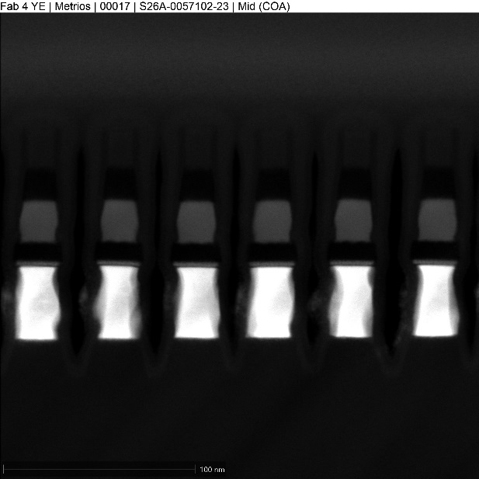
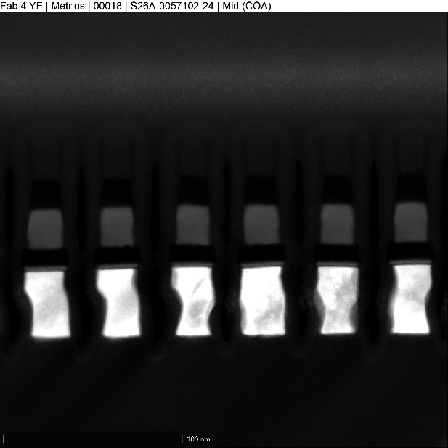
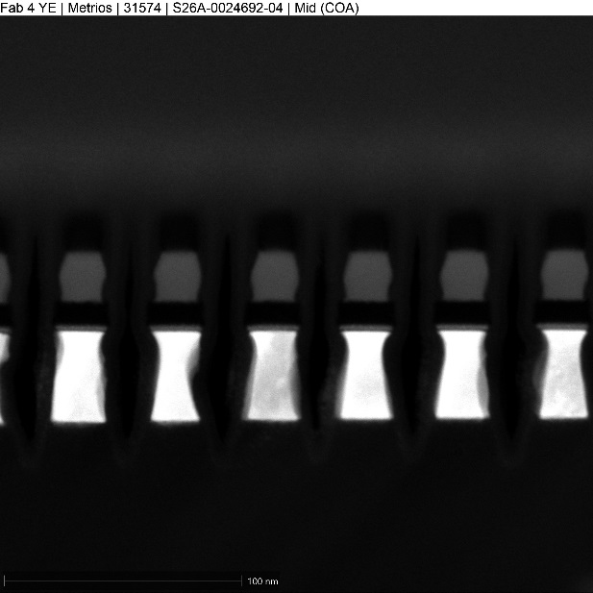
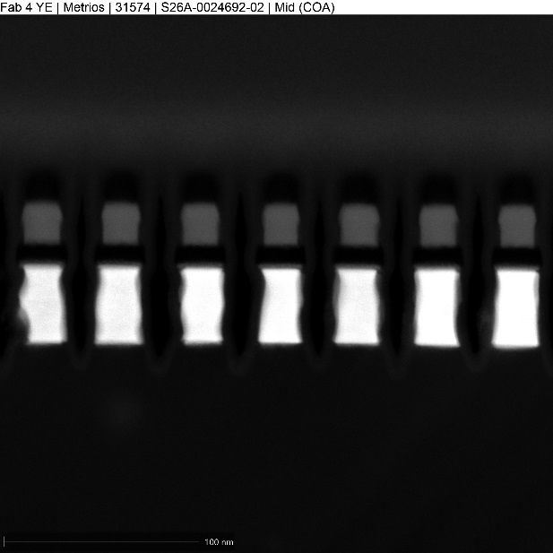
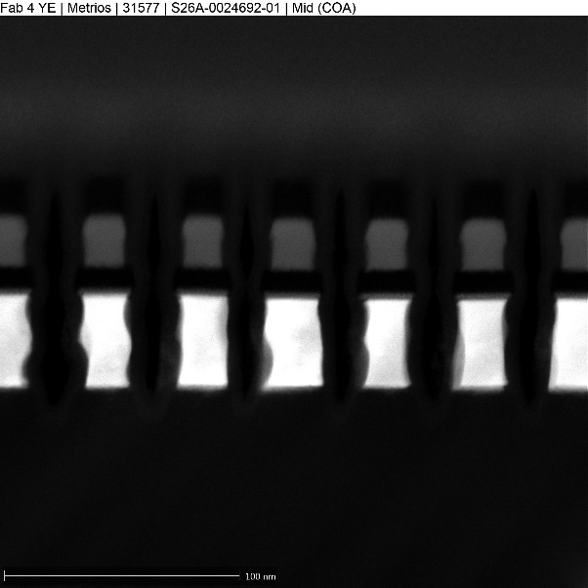
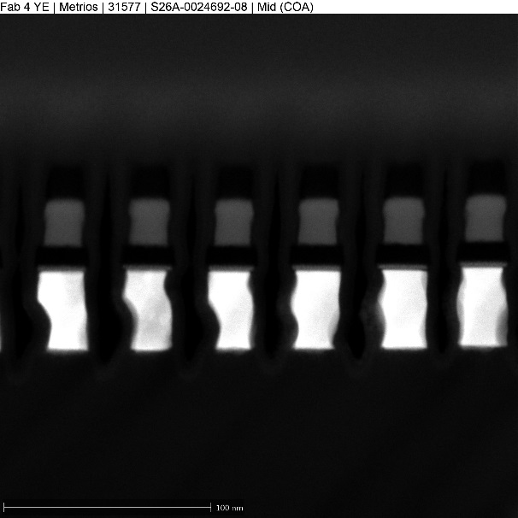
K* wave2 WL etch profiles (2-step etch CD--)
alloy20
alloy18
alloy13
alloy6
alloy12
alloy16
alloy14b

Slide 10
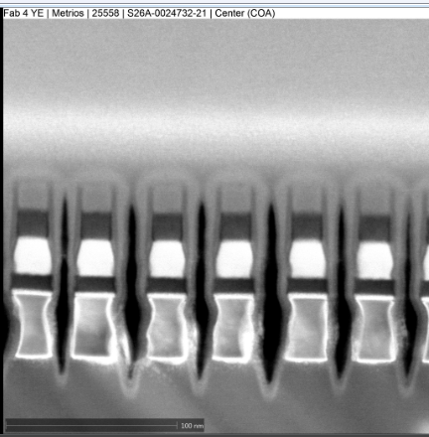
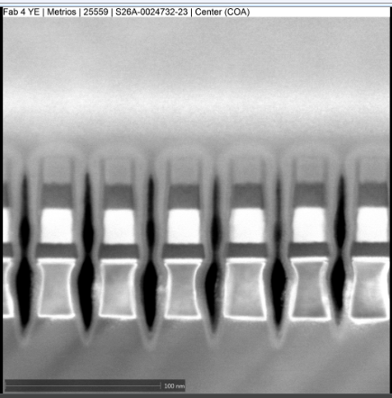






K* wave1 WL etch profiles (2-step etch CD-)
CCASELLA
alloy2
alloy4
alloy5
alloy6
alloy7
alloy8
alloy9
POR

Slide 11
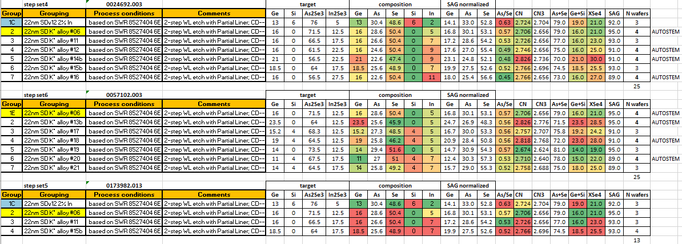
K* wave # 2

Slide 12
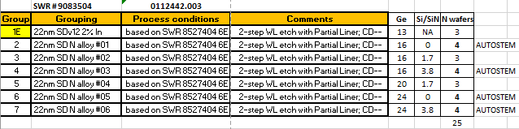
Campaign N

Slide 13
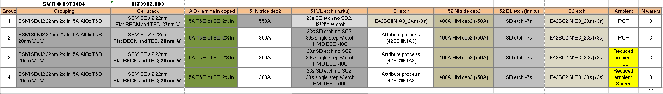
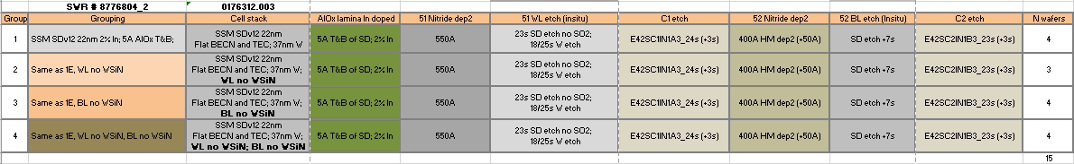
SWRs in-line

