Slide 1
SR71B
Reliability char
Lot 0104052, A1
Enzo / Mattia R.

Slide 2
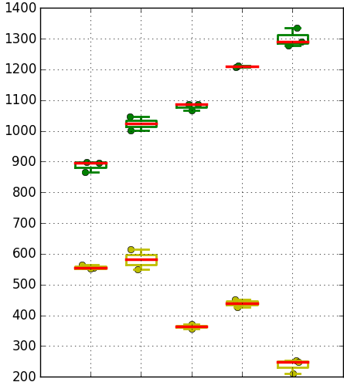
Summary
Trial | SD thk. | In-doping | AlOx lamina | WL etch
1C | 22 v12 | 2% | 5A T&B | No SO2
2E | 25 v12 | 2% | 5A T&B | No SO2
3E | 22 v12 | 2% | - | SO2
4E | 22 v12 | 2% | - | No SO2
5E | 25 v12 | 2% | - | SO2
6E | 25 v12 | 2% | - | No SO2
Two setups available:
  50C setup: first measures done here, on group 1C and 6E
  85C setup: new POR setup both for probe and WLR
Most of characterizations done with negative reading, to exploit max window
(SET: Neg pgm; RESET: Pos pgm)
All seasoning/cycling done with alternating program polarities and symmetric currents
This first round all done on mid-ED cells (20kΩ access resistance)
Some PA, PW skew characterization done to identify best settings for following reliability chars
Med. Window (100ms delay, 50C, 1k cycles)
Neg read
6E
5E
1C
Pos read

Slide 3
SSM reliability assessment on neg window : priority list
Write current functionality skew ( 20uA --> 80uA) and time ( 45ns--> 150ns)
Skew of read sense (40ns -->150ns)
85C window evolution (short time and long time drift)
Extended cycling / read endurance and IPD (Inter Pulse Delay) effect
Reset read disturb ( fast IPD, cross T check)
  Bias drift during program
Thermal disturb check
Full tile testing/cross tile (256kb)
------------------------------------------------- (end of scorecard for DTS) -------------------------------------
Write cycling vs ED
First Fire recovery @ high T (4 cases for each bake)
Next priority

Slide 4
PA / PW Program & Read char
POR (1C) pre cycled 32k @80uA, 50C setup

Slide 5
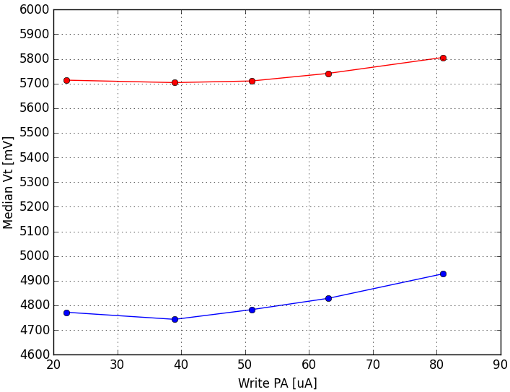
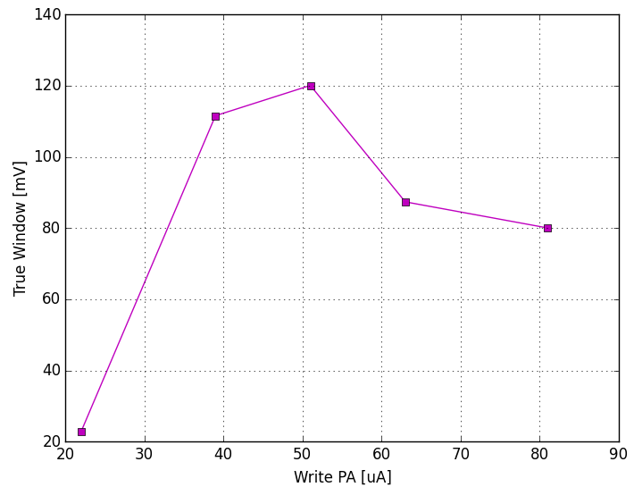
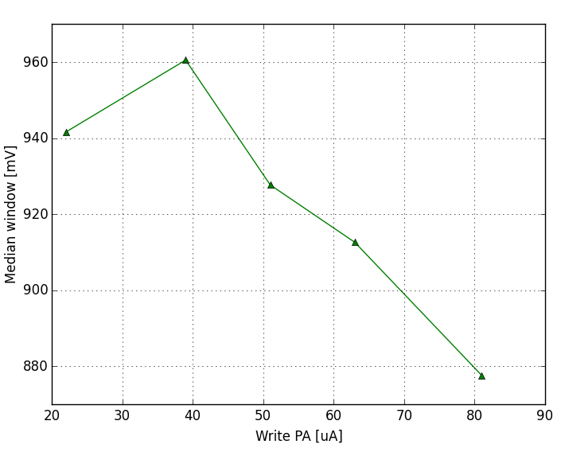
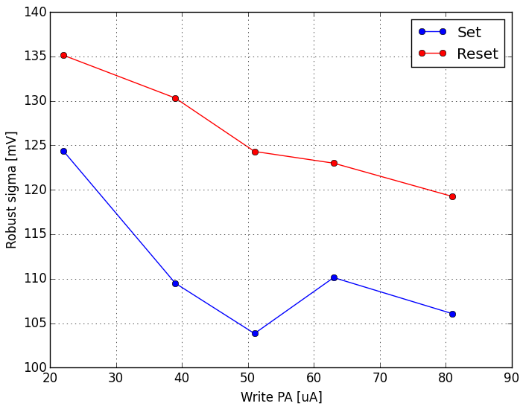
Write PA skew
Fixed Write PW (43ns)
Fixed Read PW (43ns)
Write-to-read delay 100ms
Set & Reset median Vt
Increasing PA sigmas get better, but intrinsic window gets smaller → there is optimum range for true window (40~50uA).
With unbalanced currents, best case would be set at low current (40uA) and reset at higher current (80uA) → 130mV projected true window gain
Effective window @ 3.54sigma
Intrinsic window
Robust sigma

Slide 6
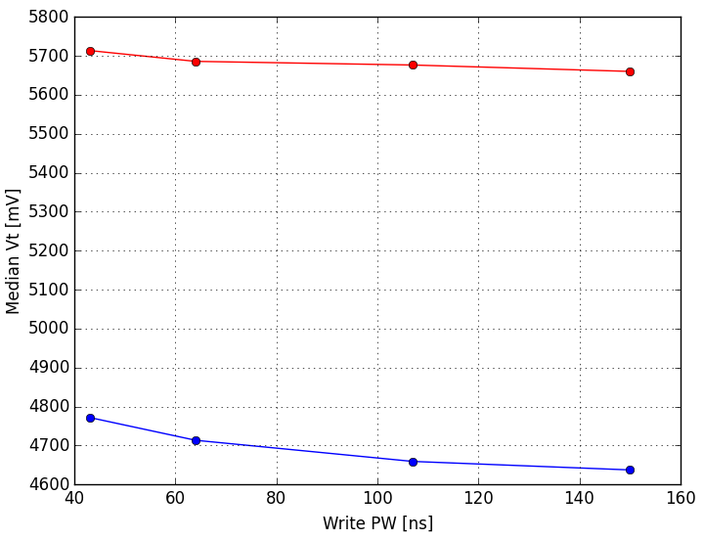
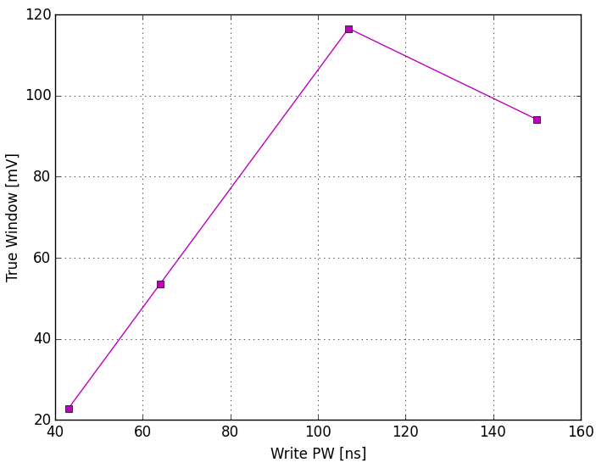
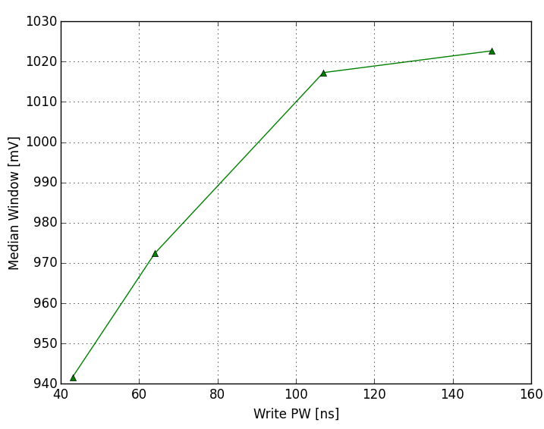
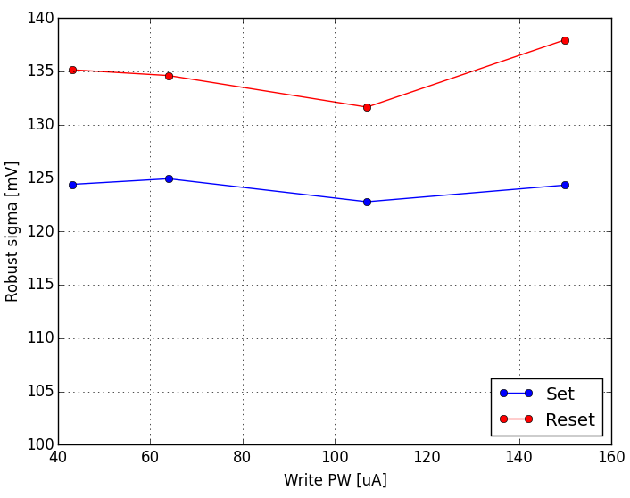
Write PW skew
Fixed Write PA (22uA)
Fixed Read PW (43ns)
Write-to-read delay 100ms
Set & Reset median Vt
Increasing PW has some beneficial effect in terms of intrinsic window, no significant toggles for sigma.
With unbalanced PW, best case would be set at long PW (150ns) and reset at short PW (40ns) → 140mV projected true window gain
True window
Intrinsic window
Robust sigma

Slide 7
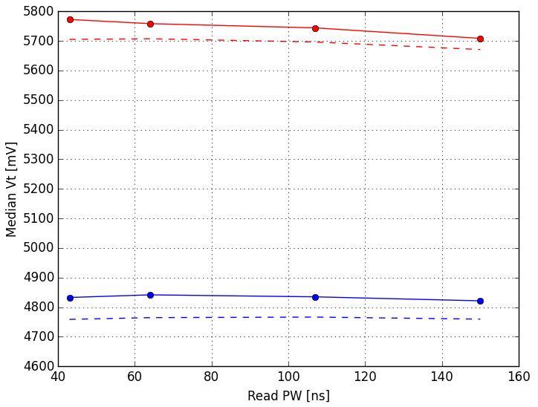
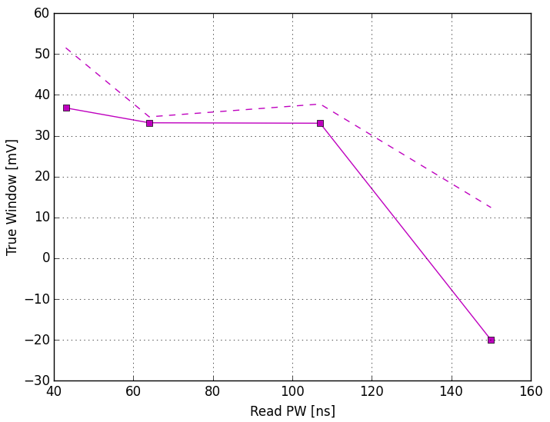
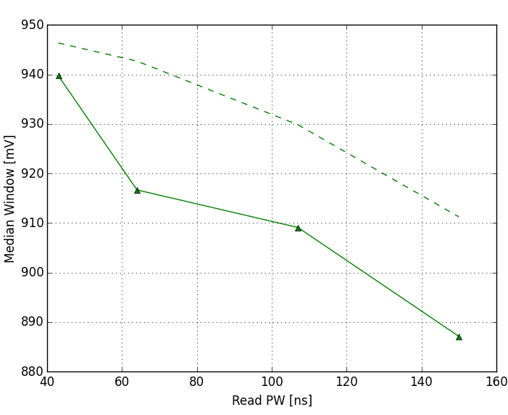
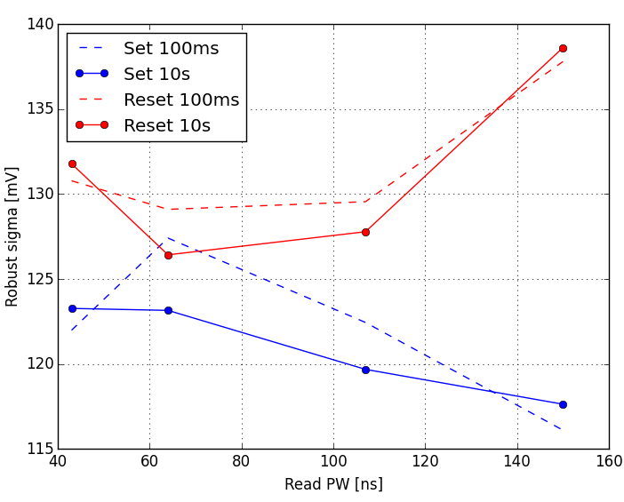
Read PW skew
Dashed → 100ms delay
Solid → 10s delay
Fixed Write PA (22uA)
Fixed Write PW (43ns)
Set & Reset median Vt
For short time drift (up to 10s @50C) there is no benefit in increasing sense time. Best results for shorter sense time, with some gain in intrinsic window.
Need to check sense time impact on long time drift.
True window
Intrinsic window
Robust sigma

Slide 8
Conclusions on PA, PW skew
Some possible room for window optimization, considering asymmetric set and reset pulses (both PA and PW)
Symmetric approach was chosen for all following characterizations, under best conditions:
Program PA → 40uA
Program & Read PW → ~44ns

Slide 9
Window functionality check
- @ 85C
- short and long time drift evolution (1us →3days)

Slide 10
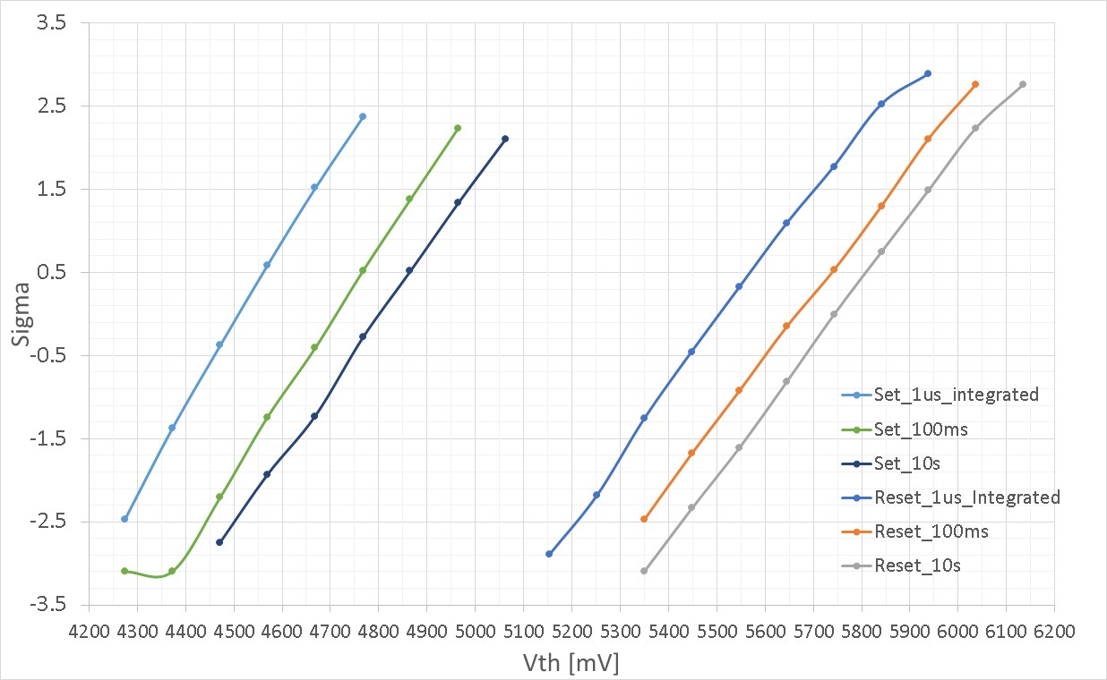
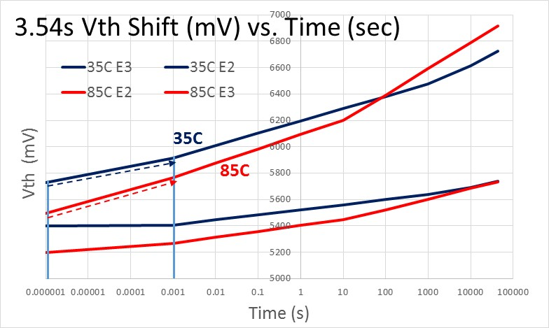
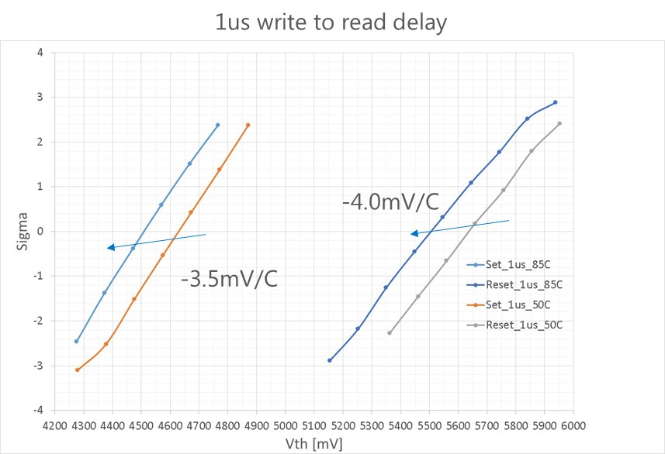
Short time Drift, 1us→ 10s after 128k Cycles
SXP ref from Bob
1C
85C
300mV shift
250mV shift
250mV
Temperature activation pre drift
Set drift is consistent with SXP data @ 85C
Intrinsic window loss for SSM in the range of 50mV from 1us to 10s
Sigma worsening with drift

Slide 11
Long time drift set & reset (16k precycled samples)
Different subtiles measured for each Vdm
Reference: 10s @50C
Drifted: 3days @90C
High window split (tapering)
῀ 44 ns sense time, Negative sense (A1)
῀ 44 ns sense time, Negative sense (A1)
Set shift =
350mV
Set shift =
500mV
1C: 22nm SD / 2%In / Double lamina
6E: 25nm SD / 2%In / No lamina
Process window amplification (tapering?) correlate with drift ☹

Slide 12
Polarity impact on long time drift : symmetrical window
῀ 44 ns sense time, Negative sense
῀ 66 ns sense time, Positive sense
Lot 0104052, A1, split 1C
22nm SD / 2%In / Double lamina
Lot 0024682, A0, split 7E
Set shift =
360mV
Set shift =
210mV
Window spuriously increased (+150mV) due to memory effect
[V]
Sense time impact but also read polarity is a big player on same nominal process stack

Slide 13
Polarity impact on long time drift: asymmetrical window
῀ 44 ns sense time, Negative sense
῀ 66 ns sense time, Positive sense
Lot 0104052, A1
Lot 0024682, A0
Set shift =
500mV
Set shift =
250mV
6E: 25nm SD / 2%In / No lamina
[V]
3E: 22nm SD / 2%In / No lamina
Read polarity impact even more visible on asymmetric window split

Slide 14
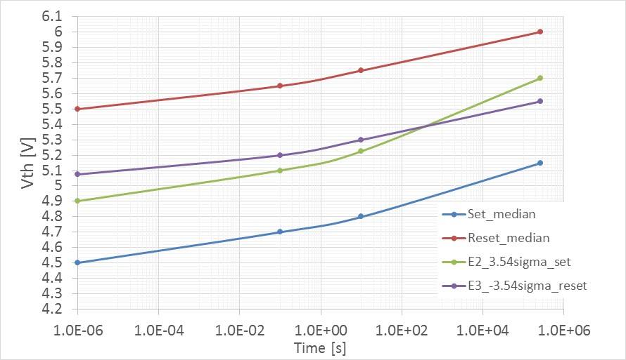
Drift summary: window evolution @ 85C
(ref split 1C: 22nm SD / 2%In / Double lamina)
SXP (Bob)
250mV
Drift toggles (priority order):
Material composition (In doping)
Sense polarity (and time)
Asymmetry of the window (tapering?)
SSM Window loss:
150mV intrinsic window loss from 1us up to 3days @ 85C
300mV window loss expected @ 3.54 sigma. Need to better quantify sigma degradation on new In-SAG alloys

Slide 15
Conclusions on window evoltution (T, drift)
Main RWB detractor is accelerated drift, no big window closure with temperature before drift (< 1mV/C)
Material composition is the first knob for set drift modulation (In-doping breakthrough)
Read polarity and process split (tapering?) are the main drift modulators after composition

Slide 16
Endurance check
- write endurance (bipolar operation)
- read endurance (unipolar swicth)
- Vth cycling evolution vs IPD

Slide 17
Write Endurance
Effects of extended cycling on array:
Degradation of distribution sigma
Appearance of open bits and low Vt tails
More current density (CD) / larger spike (Vth)
+/- 40uA write current
Normal quantile
1C
6E
Vt
Vt

Slide 18
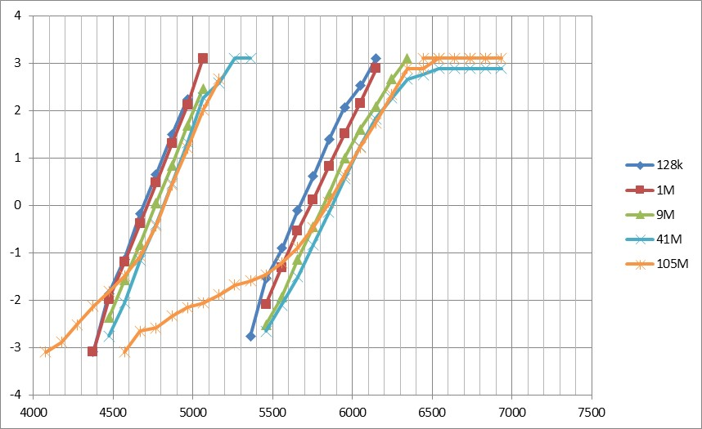
Read Endurance (after 32k write bipolar cycling)
Effects of read cycling (unipolar) on array:
Intrinsic shift of distribution toward larger Vth
Appearance of low Vt tails and low delta Vth bits (imprinting like?)
Readout performed always with interlaced algo with bipolar program (set/reset/detection vs reset/set/detection)
Program is done with +/-40uA pulses
No clear open tail appears: less spike during unipolar cycling test
Low window tails appear after 100M read cycles: Imprinting?
25uA clamp current
Normal quantile
1C
Vt
Vt

Slide 19
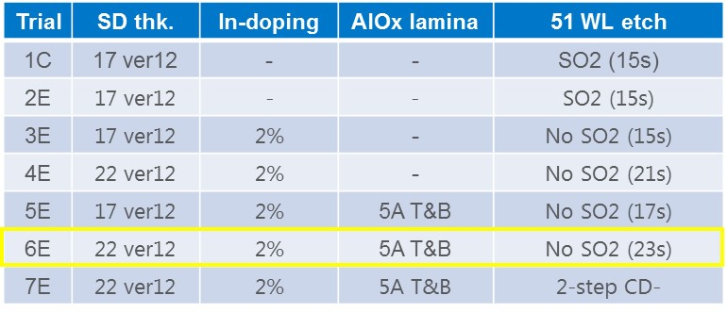
Read disturb on low Vth state: Clamp current effect (A0 material)
0028832, split 6E
Low clamp current (30uA)
High clamp current (50uA)
Read cycles
Read cycles
Static current stress should be minimized in order to improve distribution stability after cumulative read pulses
New read algos to be tried

Slide 20
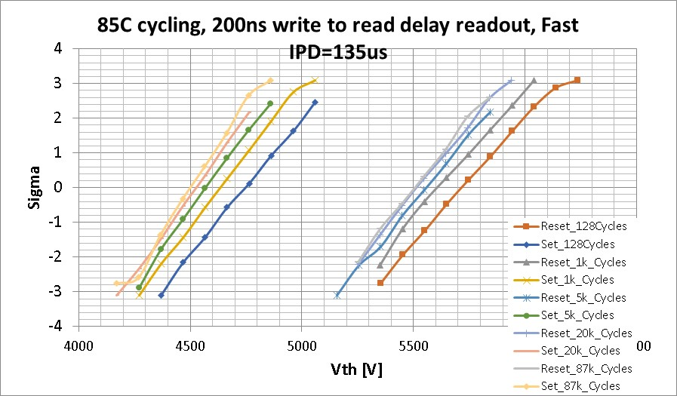
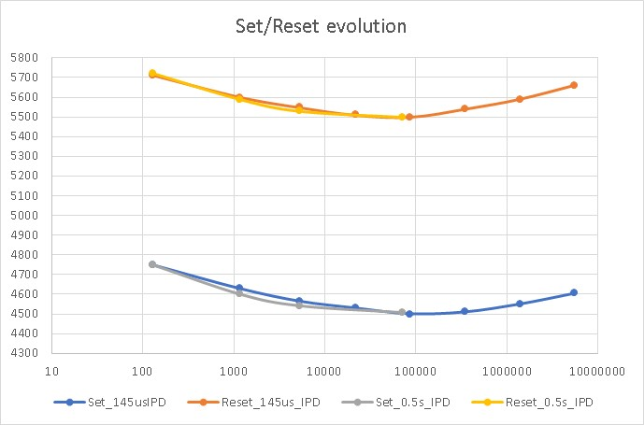
Set/ reset Vth evolution vs IPD
1C
Vth [mV]
200ns Write to read delay (pre drift evolution):
Typical bathtub shape
Reset (+40uA)
IPD
IPD
40ns
40ns
Cycles [#]
Set (-40uA)

Slide 21
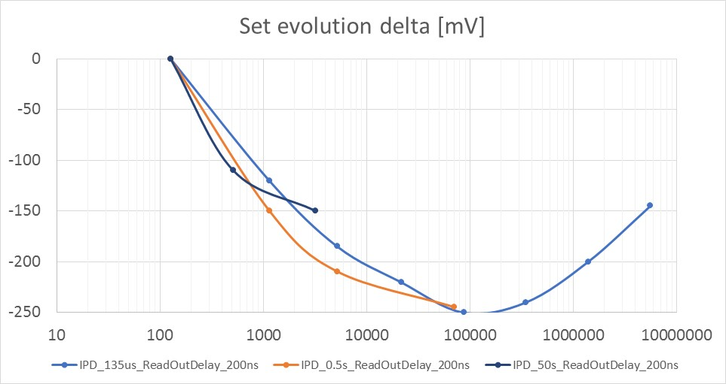
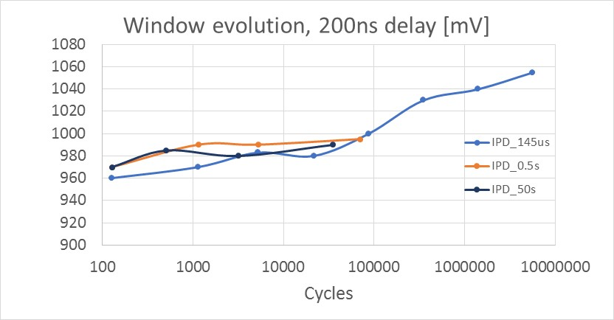
Bathtub / window evolution vs IPD (200ns write to read delay)
Set/ reset Vth evolution depend on IPD but window is not affected
Delta Vth [mV]
Cycles [#]

Slide 22
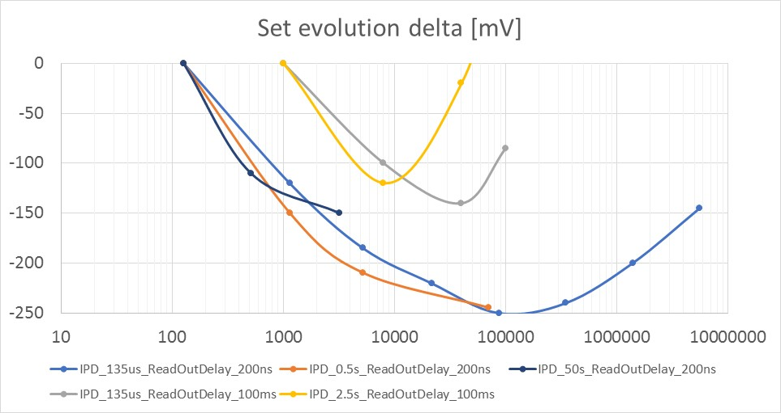
Bathtub evolution vs drift time
1C
Turnaround anticipated only for long drift time?

Slide 23
Conclusions on endurance
Cycling endurance (open limited) is spike driven when prog current is below 40uA (cell internal resistance / tile capacitance/ spike mitigation are possible knobs )
Read endurance is not open limited (less spike) but show Vth shift (clamp current / process modulated ) , low Vth tails (process related?) and low window tails (imprinting ?). Need to check alternative read algos, with larger spike inhibition and lowering static current, no setback needed
Vth shift during cycling does not correlate with opens (probably process dependent) but is modulated by cycling IPD and drift before readout. In any case no window closure but need to track optimal Vdm. Need to check same signal without lamina

Slide 24
Reset read disturb
- BER collection and RWB impact
- Distribution shape extraction

Slide 25
RD on reset RBER (32k precycled samples)
1C
6E
Measure details:
for each Vdm:
  Reset placement
  RBER of reference @Vdm (reset @1s drift)
  Reset placement
  Read Disturb cycles @Vdm
  RBER of disturbed array @Vdm

Slide 26
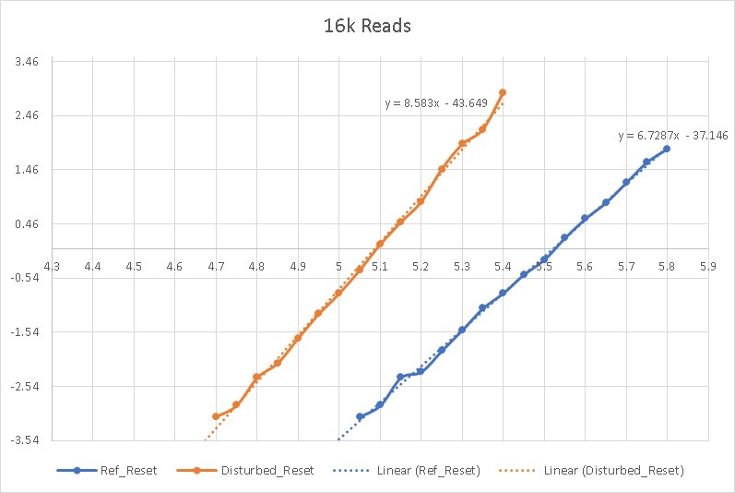
Vdm Margin extraction method
Margin of Vdm vs E3 @-3.54 sigma, that we have to take to accommodate a given number of consecutive read cycles
85C

Slide 27
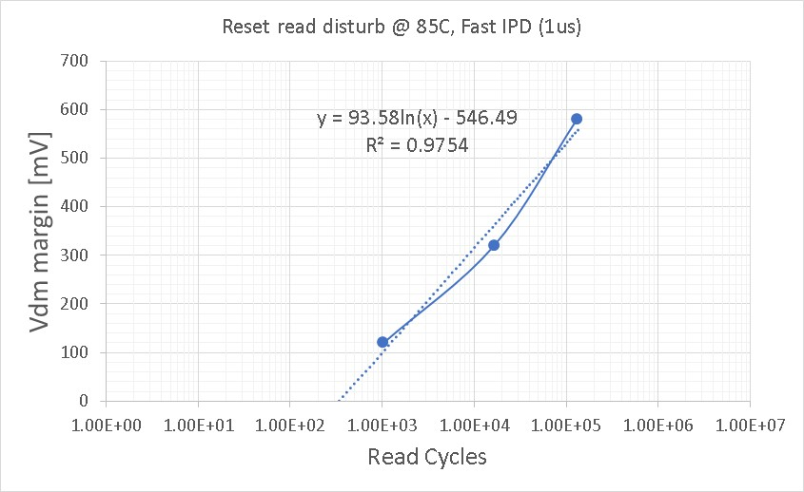
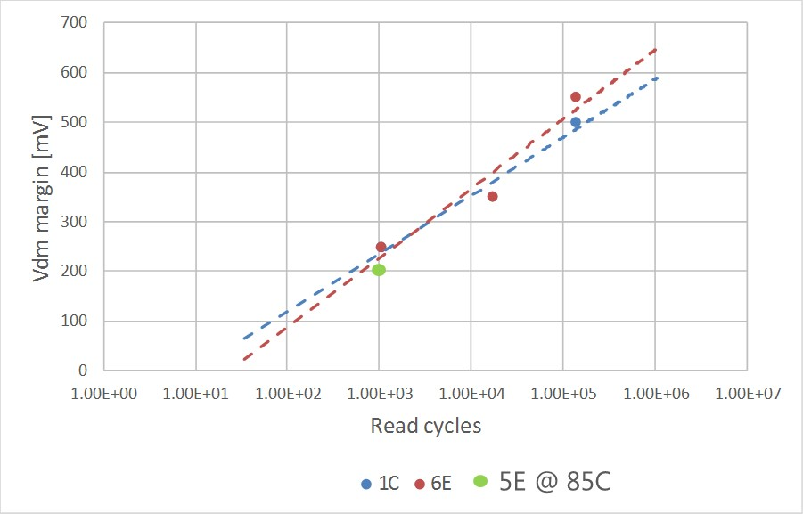
Read disturb: slow vs fast IPD on POR (margin for 3.54sigma)
R
Read disturb slow, 135us IPD
R
Read disturb fast, 1us IPD
2.5s
135us
1us
1us
1us
ReadOut
single Vdm
2.5s
ReadOut
single Vdm
Drift impact reduces at high cycle counts
Slow IPD (135us), Split 1 and 6 tested @ 50C
Split 1C (POR), fast IPD
Tested @ 85C
Steepness increased
Drift @ 85C can help in reducing margin required at low cycle counts

Slide 28
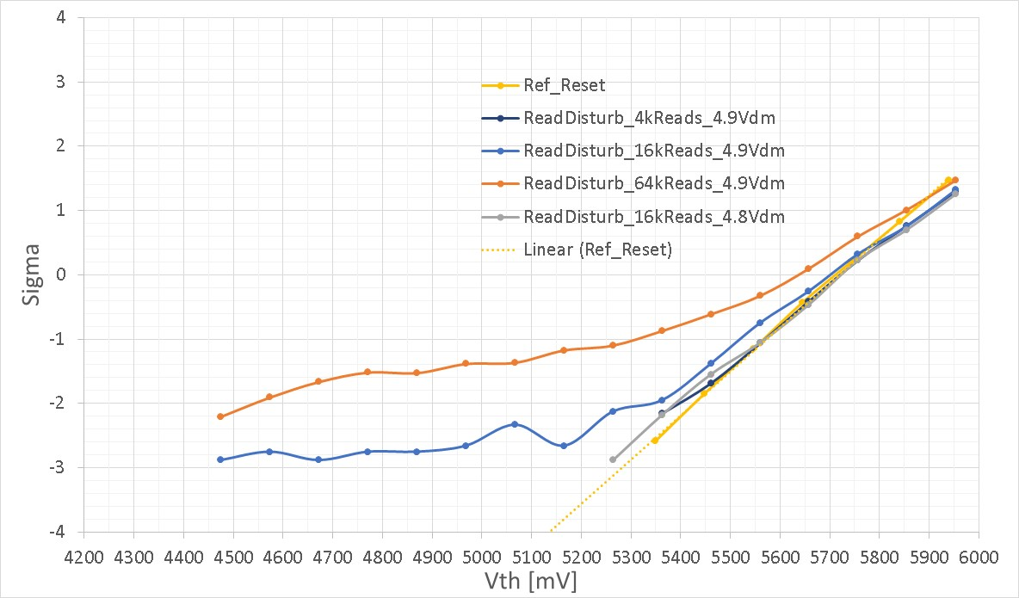
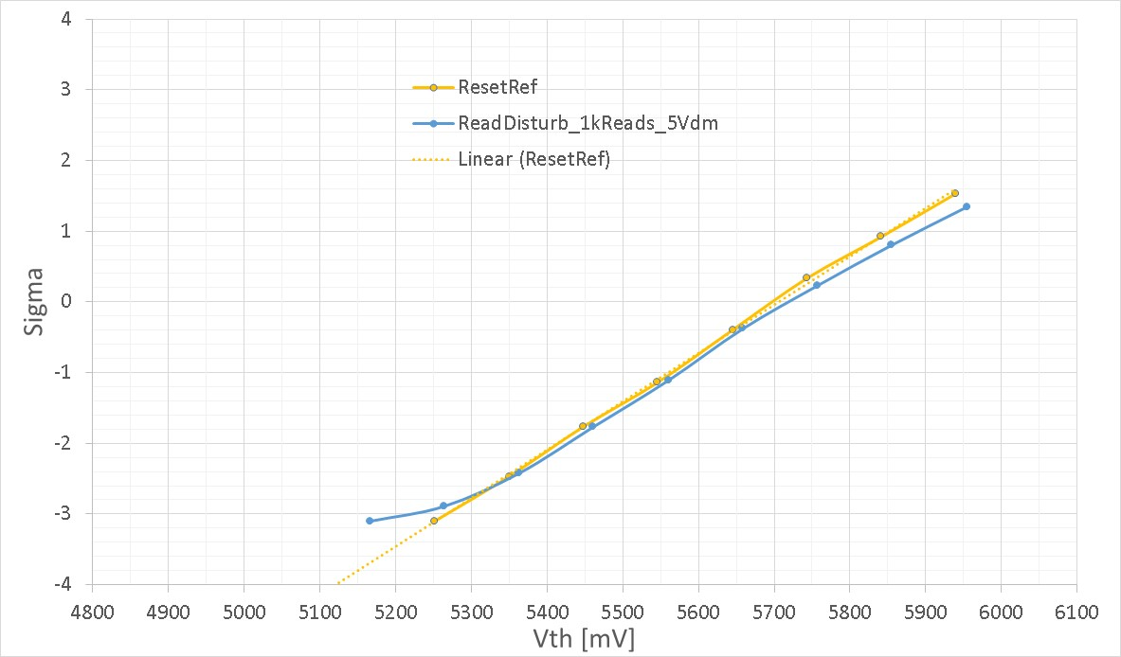
Margin check @ 85C: distribution shape (slow read disturb)
400mV is the required margin after drift for 16k reads
200mV is the required margin after drift for 1k reads
Vdm
Bias rotation
400mV
200mV

Slide 29
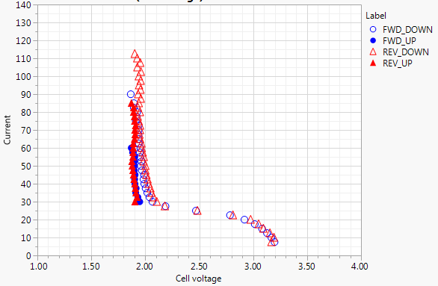
Energy model program
ON-IV on SD only
(Luca C.)
Energy spent during single program :
44ns x 40uA x 2V = 1.76 pJ
No big current dependence (see first slides)→ No strong T acceleration
Energy spent during sub-threshold soft program (read disturb):
44ns x 0.5uA (Ith) x 5V (E3 VDM) = 0.11 pJ
No big T dependence of read disturb
15 read cycles close to Vth (Vdm margin zero) deliver the same energy of program
Taking margin decrease sub-Vth leakage exponentially (200mV/dec?)
Is atom movement compatible with sub-Vth programming?

Slide 30
Conclusions on reset read disturb
Read disturb on reset is an intrinsic mechanism (continuous increasing tail with number of cycles) that is able to soft program the cell toward opposite state
Program mechanism seems energy driven (No T acceleration)
Vdm margin is the key toggle to be inserted into RWB (sub Vth stress accelerate exponentially the disturb)
Sub-Vth measurements are not easy to be interpreted with atom movement (No temperature increase)

Slide 31
Bias drift
- Cycles impact
- Deselection voltage impact

Slide 32
Single Vdm test: sampling block on diagonal tile (20k access resistance)
1st core
BL number
Blocks circled in green are cycled with same selection voltage
Blocks circled in red are experiencing bias drift due to selection voltage along the column of cycled blocks (Cells have been previously seasoned with 32k cycles and placed in set state)
Each red block is read with different Vdm to extract the final distribution
Second core is used as reference to track unbias drift during cycling
Same technique is used for read disturb, stressing red block with same Vdm read cycles
Reset (+40uA)
WL number
135us
135us
40ns
40ns
Set (-40uA)

Slide 33
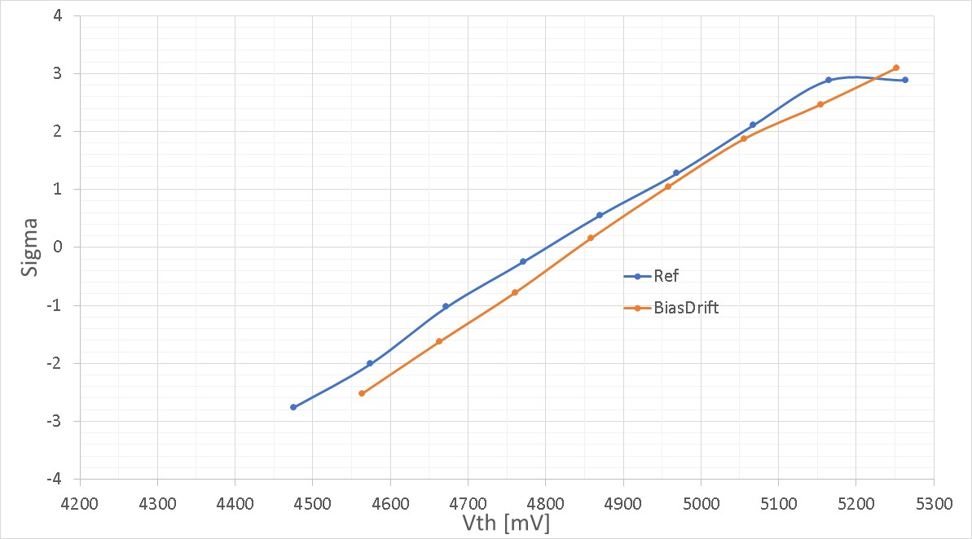
Bias drift: SSM operating conditions
17M writes (50%set/50%reset, 40ns pulses), 7.2V selection voltage, 7kHz pulse frequency
0.7s total bias time (50% positive, 50% negative)
32k prior cycles (64k writes) on the cells before bias stress
135us
135us
< 50mV median shift

Slide 34
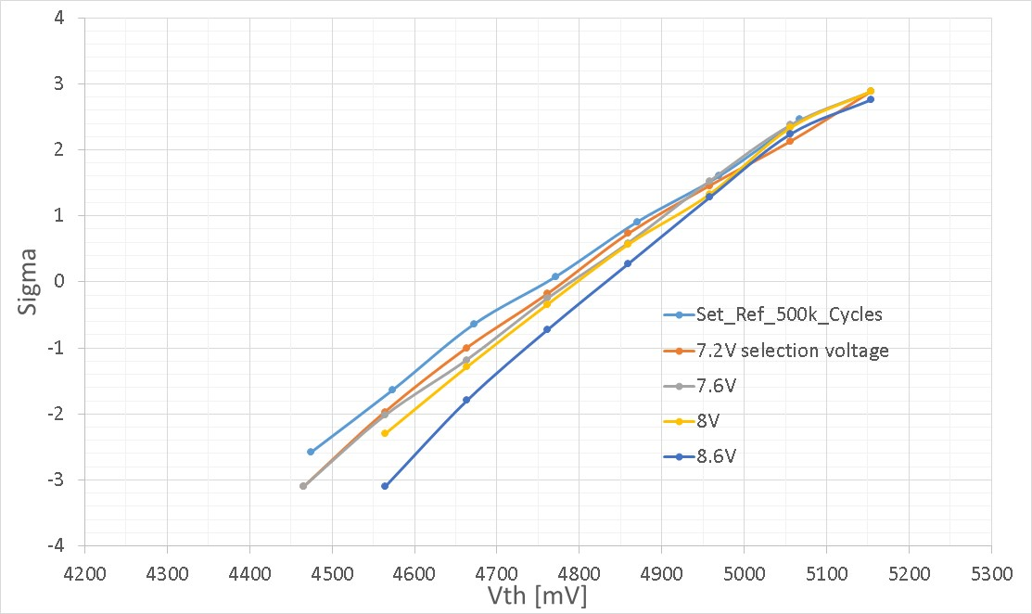
Bias drift on SSM: selection voltage skew
1M total writes bias stress (50% set / 50% reset, 40ns pulses)
Ref distribution taken after same total drift time of bias stress
Bias drift tend to rotate the distributions (adding a contribution to unbiased drift at low sigma, improving E1 margin)
Acceleration with deselection voltage is expected, no clear change in RWB on top of unbiased drift
For typical selection voltages (<8V ) median biased drift is less than 50mV
Deselection bias acceleration, E1 margin improves

Slide 35
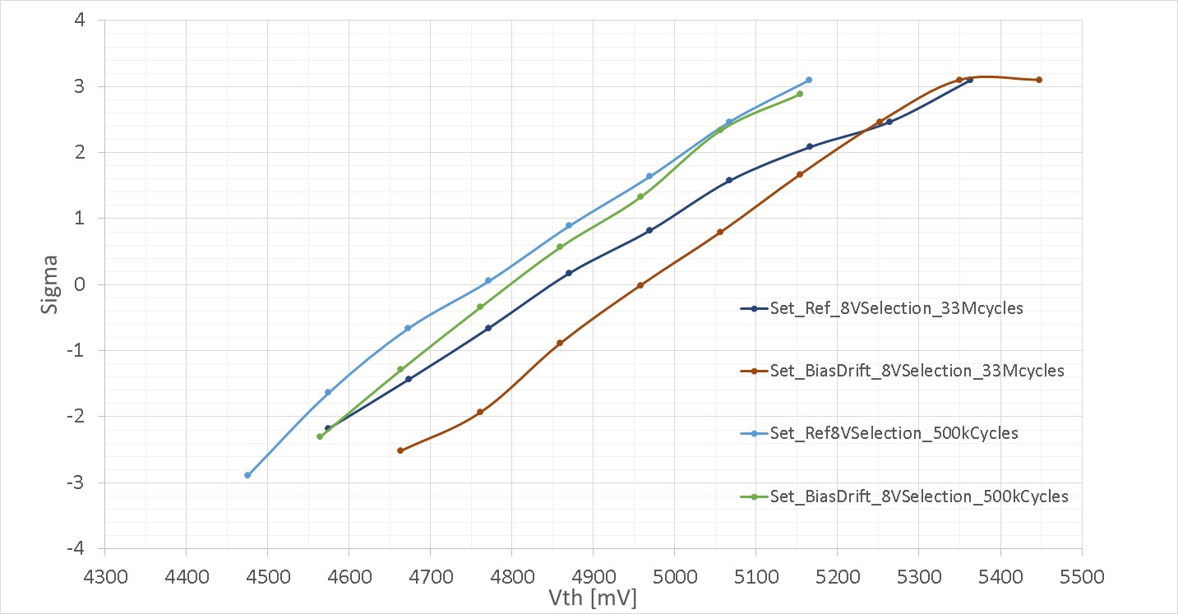
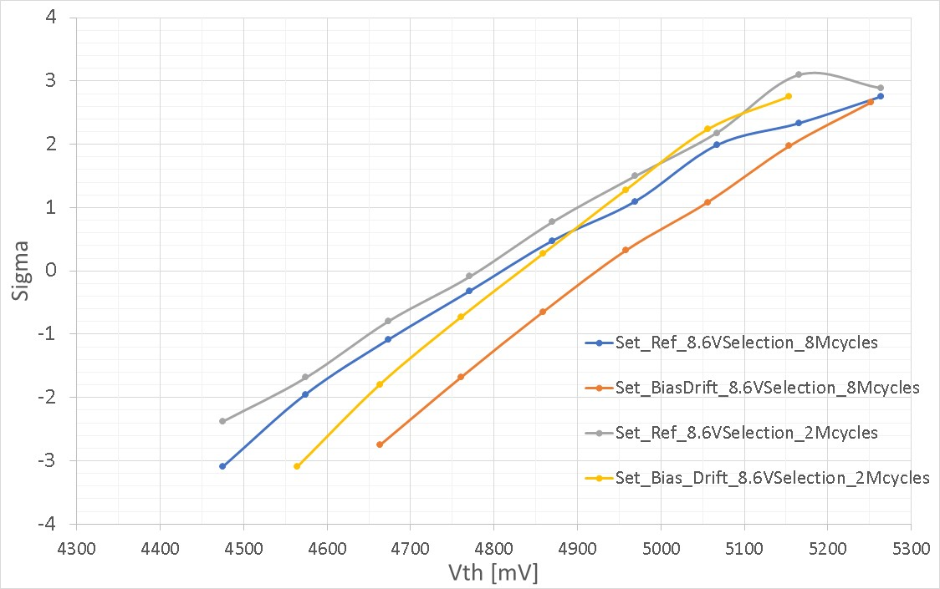
Bias drift on SSM : cycles skew
Selection voltage = 8V
Deselection voltage = 4V
Selection voltage = 8.6V
Deselection voltage = 4.3V
8Mcycles take 100s drift time @ 85C: reference distribution placement depends on total unbias drift time needed for cycling
Distributions tend to rotate also with cycles, so no clear erosion of window budget added on top of unbiased drift

Slide 36
Conclusions on cross point bias drift
Bias drift is exponentially accelerated by deselection voltage and logarithmically accelerated by number of cycles.
Low drift of E4 allow to keep max selection voltage below SXP requirements, no need of C-cells turn on, pure V/2 scheme to minimize program energy consumption should be fine.
In any case both selection voltage and cycles rotate the set distributions without changing E2 margin. No need to take into account additional RWB margin on top of unbias drift

Slide 37
Full tile map
- Defectivity up to 4.5 sigma
- Accelerated seasoning impact
- Trend by access resistance

Slide 38
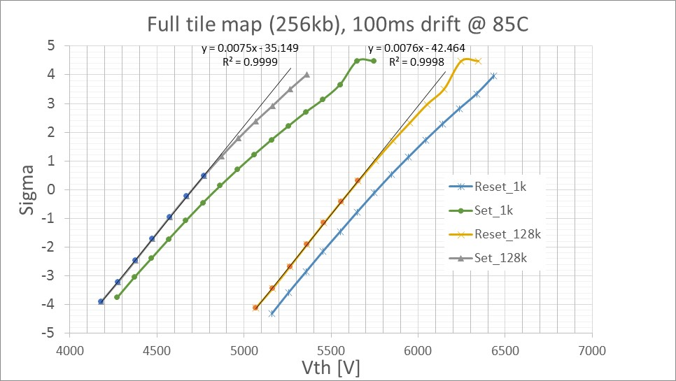
Full tile map readout @ 85C : 256 kb
100mV
Residual cross tile
After seasoning
seasoning
seasoning
No particular defectivity visible up to 4.5 sigma
Need to accelerate seasoning to reduce cross tile below 100mV @ 3.5sigma (130mV intrinsic sigma)
Two different dice tested at 1k vs 128k

Slide 39
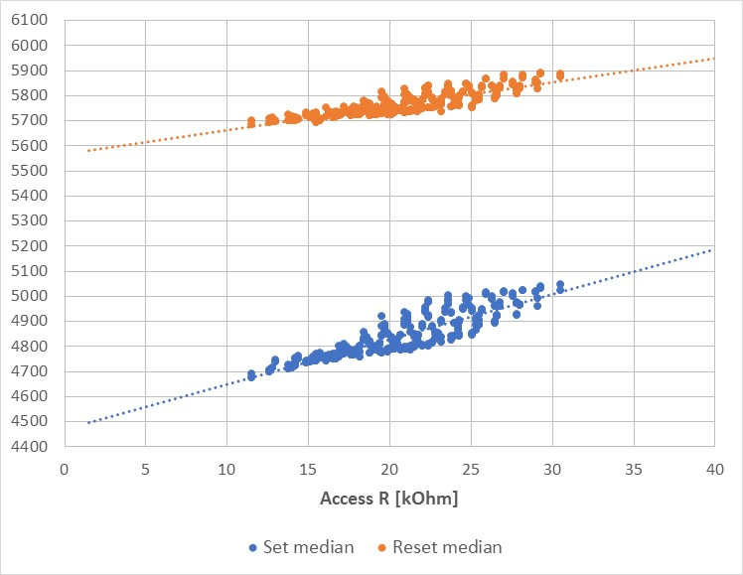
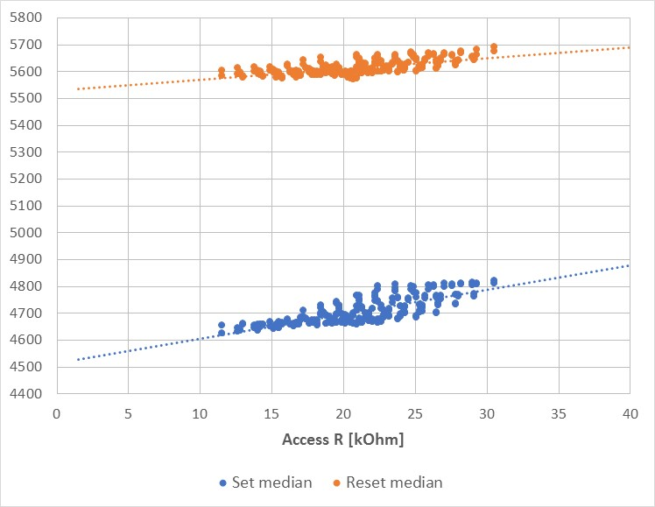
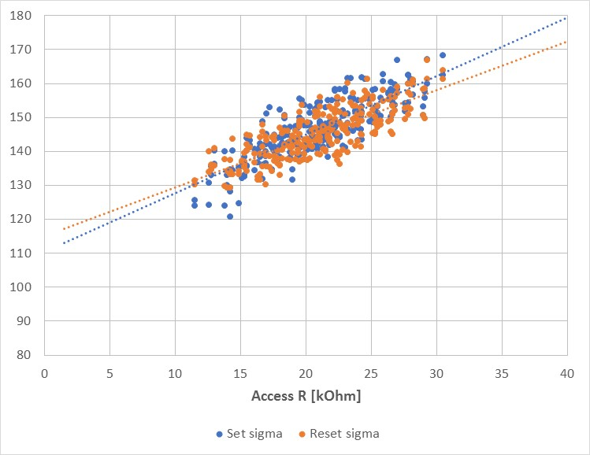
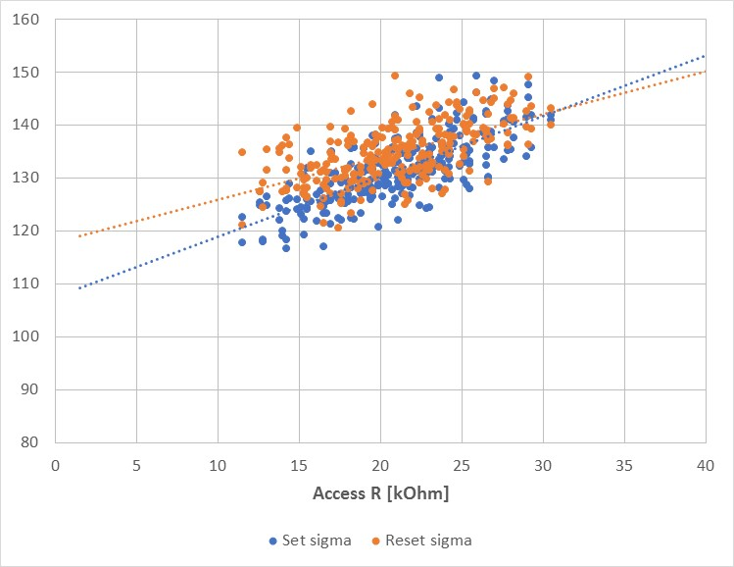
Full tile map after seasoning: cross tile components vs ED @ 85C
1k cycles
128k cycles
Vth trend by access resistance[mV]
Robust sigma trend by access resistance [mV]

Slide 40
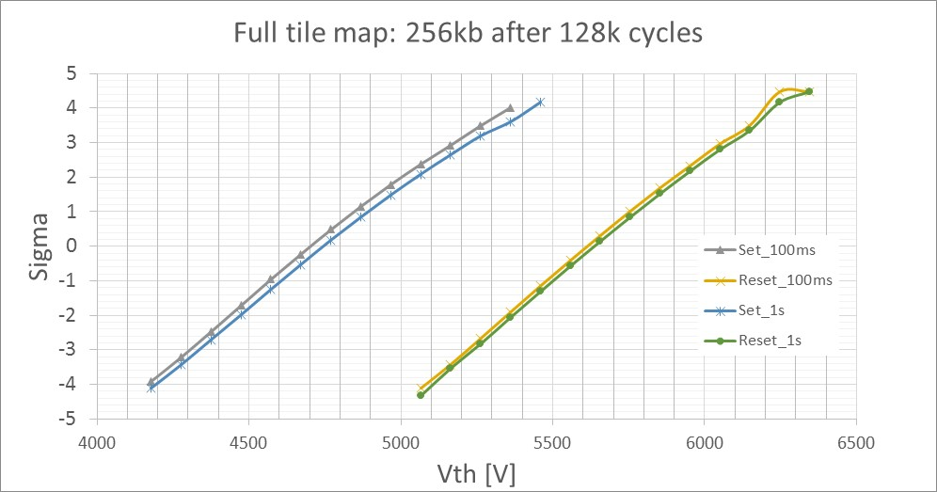
Drift vs cross tile (85C measures)
No big drift distortion vs ED
Need to expand the range down to 1us to have more signal

Slide 41
Conclusions on cross tile
Need to find a way to accelerate seasoning for far Eds (W thickness increase? Electrical pulses change?)
Spike inhibition introduction can help in reducing seasoning on small Eds but cycling stability can be compromised (bathtub curve)

Slide 43
Group 1C (POR): 1us to 100ms drift @50C
Normal quantile
1k pre cycles
128k pre cycles
Vt
Vt
Short time drift quite independent from pre cycling (up to 128k)

Slide 44
Group 6E: 1us to 100ms drift @50C
Normal quantile
1k pre cycles
128k pre cycles
Vt
Vt
Group 6E has steeper drift

Slide 45
Split table lot 0028832
Trial | SD thk. | In-doping | AlOx lamina | 51 WL etch
1C | 17 ver12 | - | - | SO2 (15s)
2E | 17 ver12 | - | - | SO2 (15s)
3E | 17 ver12 | 2% | - | No SO2 (15s)
4E | 22 ver12 | 2% | - | No SO2 (21s)
5E | 17 ver12 | 2% | 5A T&B | No SO2 (17s)
6E | 22 ver12 | 2% | 5A T&B | No SO2 (23s)
7E | 22 ver12 | 2% | 5A T&B | 2-step CD-
Wf 10 of split 6E has been used to check read endurance and read disturb on low Vth state
Read endurance:
Read cycles + final program (interlaced)
Read disturb:
Read cycles + final Vdm sweep for readout (BER check)

Slide 46
Read endurance (read cycles on low Vth + interlaced write check, ED4)
Vdm stress=6V
Vth shift after read cycles, no opens up to 150M
Partial cycling program recovery
Read endurance is different from write endurance: no open appears, intrinsic shift is less
Small tail in reset distribution after 150M reads: possible “imprinting”?
Delta Vth after read endurance is partially recoverable after write cycles: need to check a possible usage model (mix of read and write) to have a more reliable assessment for VDM tracking
Write endurance,
Many opens appears after 2M switches
(Mattia)

Slide 47
Read disturb (read cycles on low Vth state + Vdm final sweep) vs drift
No tails appearing up to 3 sigma
100ms set drift
Read cycles
10 s set drift
100mV shift @ 3 sigma between 1k and 1M read cycles. In any case shift up to 3 sigma is contained inside std drift between 100ms and 10s @ 50C (100mV) that is the time range of the measure assuming drift erasing after read

Slide 48
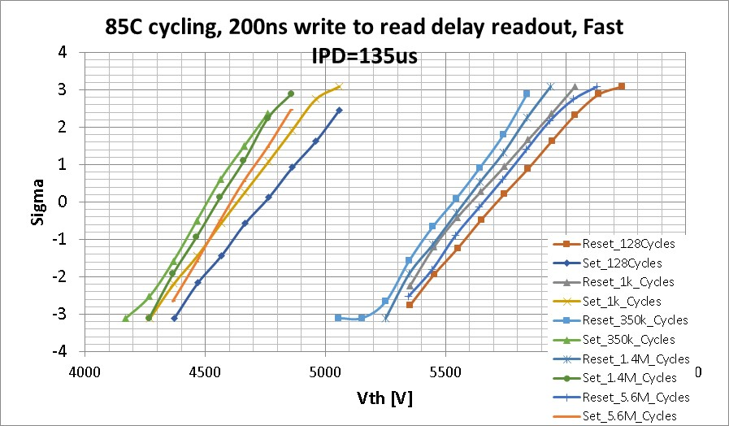
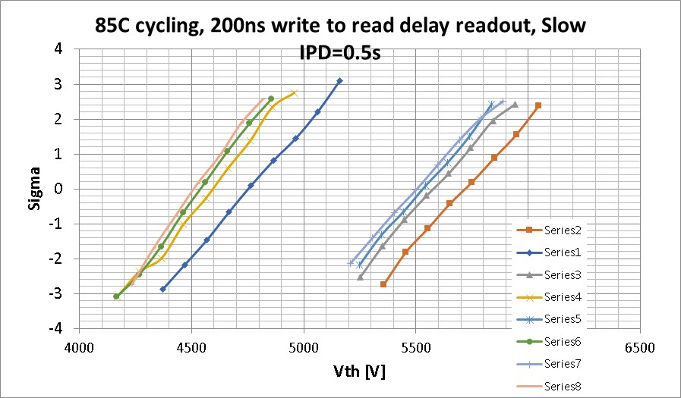
Distributions
No clear sigma worsening with cycling IPD
cycling

Slide 49
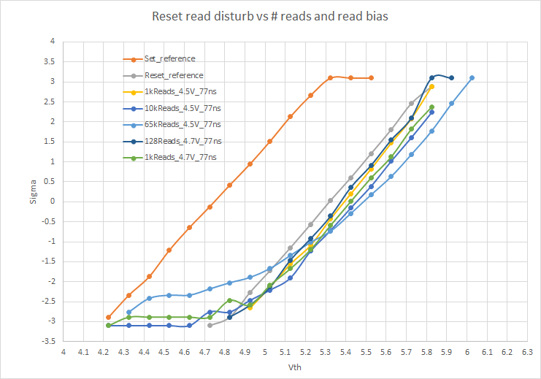
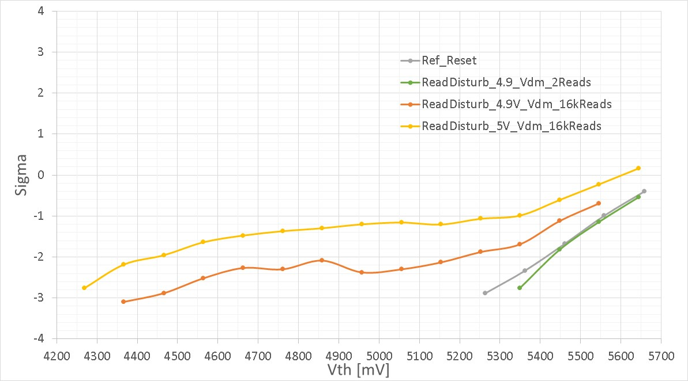
Read disturb distributions: single Vdm detection
Single Vdm, negative reading
Cumulative Histo, positive reading (old data)
Accelerated drift
Tail appearing confirmed
Tail growth

Slide 50
BL direction
WL direction

Slide 51
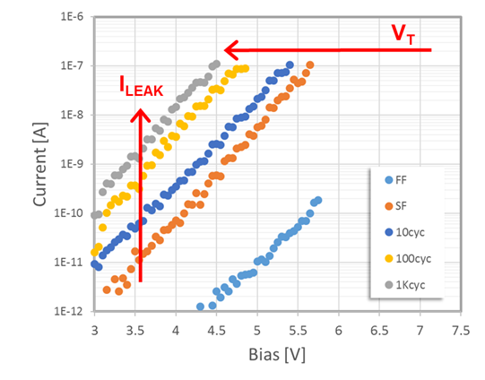
Sub Vth IV on set (SXP reference)

