Slide 1
Y Doping of GeSbTe Campaign W Targets: GST447 (PDC)/SbY (RF)/GeTe (PDC)

Slide 2
Summary
Composition skewed with GeTe target unable to deliver 1 to 1 composition at powers needed to balance other 2 source materials (would require 5x increase in power on GST target)
ICP-Complete
Rs-vs T samples in metro steps (13 samples submitted 12 more pending)
XRD material on hold (PV1 project for PG1T1 has >160hrs of data collection still pending)
Samples from Rs vs T will be sent for Pulse Laser Crystallization.
DSC 13 samples collected

Slide 3
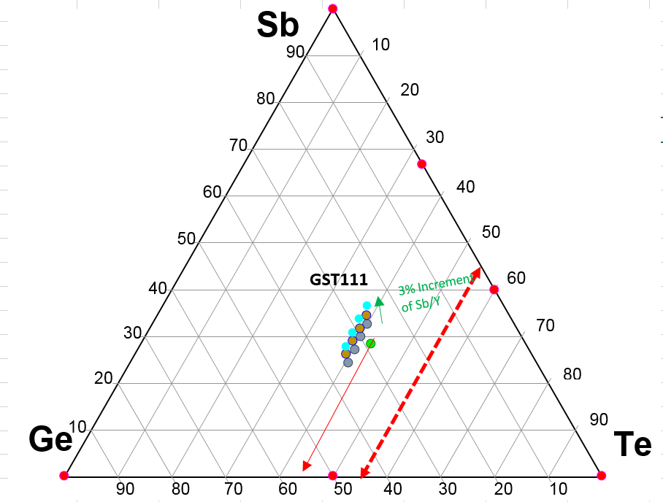
Current Configuration
3 and 6% Sb with no additional Ge have been run for L1. Results pending.
L0 Data for all target values has started. ICP data should be reported 6/27-6/28
Once ICP confirms recipes are correct, remaining L0 data will be collected.
Rs vs T lab submission ~6/30
XRD ~7/10
Target Change to higher Te content can be done 6/30 if L1 is completed

Slide 4
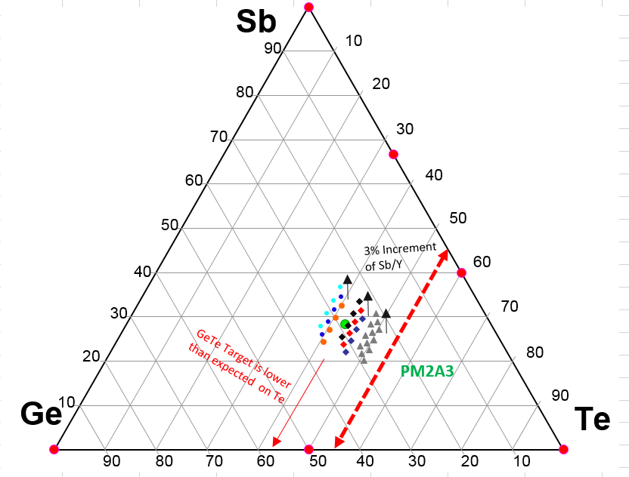
Te Rich Region
GST225 Target estimates are shown in grey triangles
Another target could conceivably give near the PM2A3 range
As predicted, movement can only be a single line unless an increase in the dopant Y. This will move the material in the Sb direction.
5th element would be addition of N2 if needed for voiding.

Slide 5
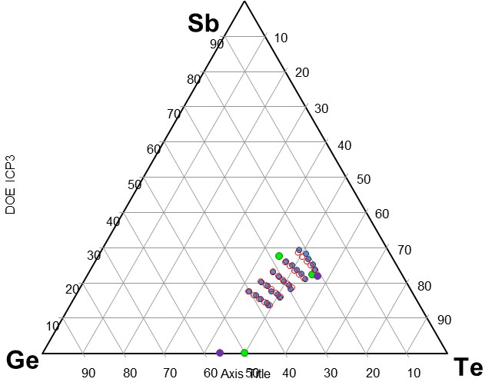
ICP

Slide 6
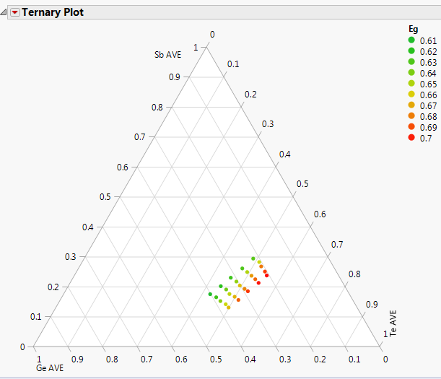
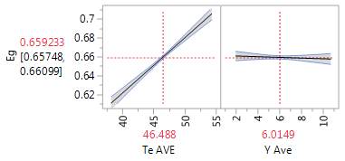
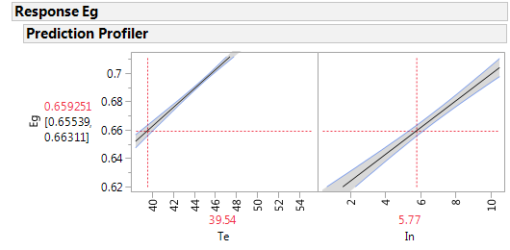
Eg
Almost strictly related to the Te content of the film.
Comparison to Campaign M8.InTe

Slide 7
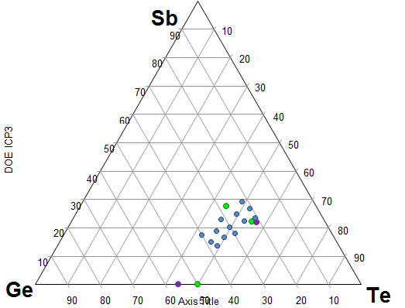
Background and Results Obtained
Thirteen ~80Å carbon/300Å PM/5.5kÅ3 thermal oxide/Si substrate wafers were submitted for 4 point probe analysis of the resistivity versus temperature measurements. Temperature sweeps were performed from room temperature to ~500ºC and then back to room temperature.
Table 1: Description of wafers submitted for analysis
Wafer ID | Description
1 | Ge20.3Sb23.3Te54.4Y2.1
3 | Ge28.2Sb18.1Te51.6Y2.1
5 | Ge36.3Sb12.8Te48.8Y2.0
7 | Ge23.7Sb21.6Te50.7 Y4.0
9 | Ge32.3Sb16.0Te47.9 Y3.8
12 | Ge23.6Sb22.2Te48.0Y6.2
14 | Ge32.6Sb16.5Te45.1Y5.8
16 | Ge18.9Sb25.8Te46.7Y8.6
18 | Ge28.1Sb20.0Te44.0Y8.0
20 | Ge36.0Sb15.2Te41.2Y7.6
21 | Ge19.5Sb26.2Te43.6Y10.7
23 | Ge28.3Sb20.7Te40.9Y10.0
25 | Ge36.3Sb15.8Te38.2Y9.6
13 Sample Initial Group of wafers

Slide 8
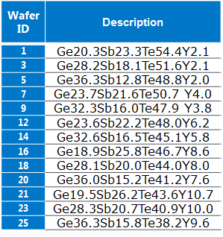
Figures and Comments
Figures 1-3 are the representative Rs versus temperature 4PP measurements for the wafers.
Figure 1: Resistivity versus temperature: wafers 1-9

Slide 9
Figures and Comments
Figure 2: Resistivity versus temperature: Wafers 12-20
.

Slide 10
Figures and Comments
Figure 1: Resistivity versus temperature: Wafers 21-25
.

Slide 11
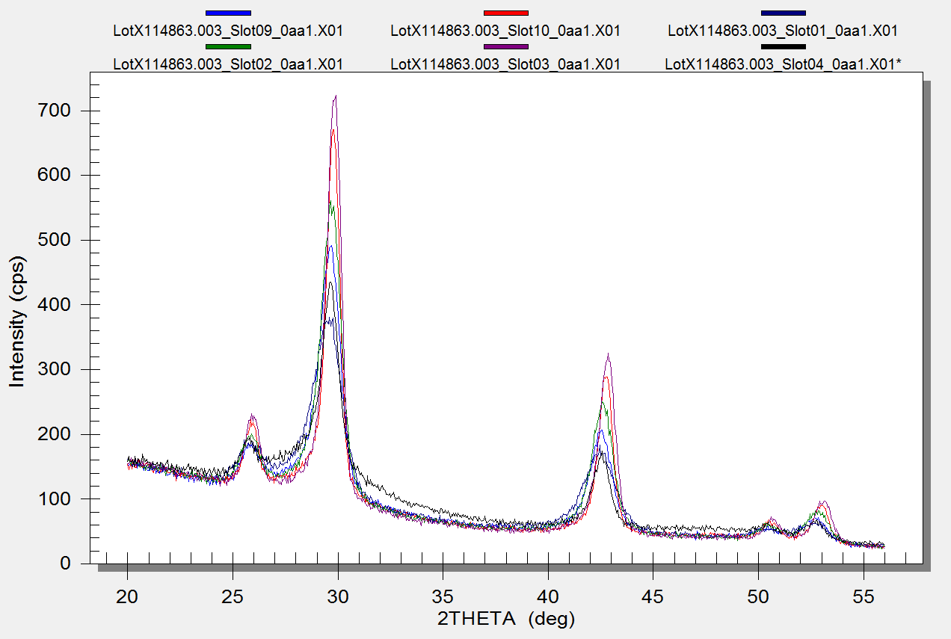
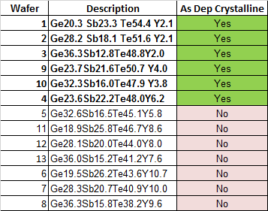
XRD Post Deposition- 240C
Crystallization as expected for the higher Te and Lower Y content films

Slide 12
Y-doped for L3
Enrico

Slide 13
target | Ge | Sb | Te | Ge | Sb | Te
447 | 4.0 | 3.9 | 6.9 | 27.01 | 26.41 | 46.58
446 | 4.0 | 4.0 | 6.0 | 28.57 | 28.57 | 42.86
GeTe* |  |  |  | 55 | 0 | 45
Asdep | target |  |  | film |  |  |  | GST only
alloy | GeTe* | 446 | YSb | Ge | Sb | Te | Y | Ge | Sb | Te
1 | 0 | 92 | 8 | 26.3 | 30.3 | 39.4 | 4 | 27.4 | 31.5 | 41.1
2 | 8 | 84 | 8 | 28.4 | 28.0 | 39.6 | 4 | 29.6 | 29.2 | 41.3
3 | 16 | 76 | 8 | 30.5 | 25.7 | 39.8 | 4 | 31.8 | 26.8 | 41.4
4 | 24 | 68 | 8 | 32.6 | 23.4 | 39.9 | 4 | 34.0 | 24.4 | 41.6
Asdep | target |  |  | film |  |  |  | GST only
alloy | GeTe* | 447 | YSb | Ge | Sb | Te | Y | Ge | Sb | Te
5 | 0 | 92 | 8 | 24.8 | 28.3 | 42.9 | 4 | 25.9 | 29.5 | 44.6
6 | 8 | 84 | 8 | 27.1 | 26.2 | 42.7 | 4 | 28.2 | 27.3 | 44.5
7 | 16 | 76 | 8 | 29.3 | 24.1 | 42.6 | 4 | 30.5 | 25.1 | 44.4
8 | 24 | 68 | 8 | 31.6 | 22.0 | 42.5 | 4 | 32.9 | 22.9 | 44.2
: process transformation function
asdep alloy 2 would enable Y-alloy3 at EOL, based on PM2A3 transformation

