Slide 1
SD Characterization Update
Dan Gealy, Enrico Varesi, Folsom TEMlab, Boise TEM lab, Mattia Robustelli, Umberto Meotto
Feb 14, 2018

Slide 2
PFA on SD1
Goal: to verify element segregation on a SD material more thermally stable than POR SD, to confirm previous PFA results addressing Se/As segregation similarly to Te/Sb for PM.
SD1 (only) samples
S26 (pos program) – post probe 0024732/wf2
S26 (virgin) 0024732/wf2
SR71 (pos/neg/virgin program) 0024732/wf16
Prog sequence: pos,/neg prog seasoning + CHKBD positive prog (4 pulses)
line pattern: adjacent pos and neg prog between 6 not programmable cells

Slide 3
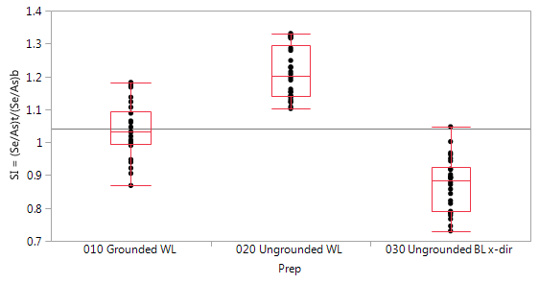
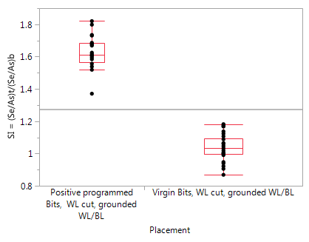
Summary – TEM PFA Work SD1
TL180206001 – S26 virgin die - SD1 split
WL cut (Y-dir)
Grounded WL/BL
Little segregation observed. SI ≈ 1
Ungrounded
Se/As segregation observed – top is Se rich, bottom is As rich. SI > 1
BL cut (X-dir)
Ungrounded
Se/As segregation observed – top is As rich, bottom is Se rich. SI < 1
TL180108002 – S26 probed die - SD1 split
WL cut (Y-dir) - Grounded WL/BL. “Positive” programming
Se/As segregation observed – top is Se rich, bottom is As rich. SI > 1
S26a
Virgin bits
S26a
Pos/Virgin bits
Consistent with selenium tendency to enrich (by migration) toward positive electrode, either if poled by program or by ungrounding charging

Slide 4
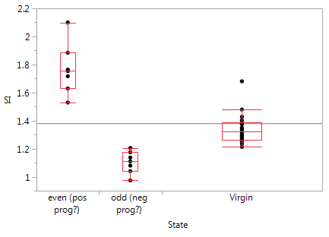
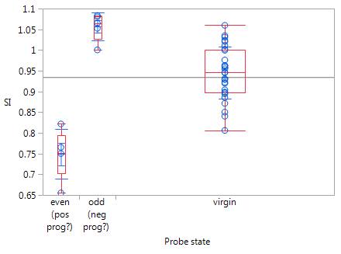
Summary – TEM PFA Work SD1 (2)
TL1721222001 SR71b with bit placement - SD1 split
WL cut (WL14). No grounding
Strong Se/As segregation trending
Even/odd bit placement is opposite
SI: “even bits” > virgin bits > “odd bits” observed – top is Se rich, bottom is As rich. SI > 1
Thickness changes not prominent
PFA 1357– SR71b SD1 split
BL cut (X-dir)
Ungrounded
Se/As segregation observed – top is As rich, bottom is Se rich
Se/As segregation trending
“odd bits”> virgin bits >”odd bits” – top is Se rich, bottom is As rich
Thickness changes not prominent
PFA 1357/TL180206001 ungrounded BL cut are consistent
Prog assignment to be confirmed
TL172122001
PFA1357

Slide 5
PFA on SD1 – Summary Table
Job | device | Lot/wf | status | GND | Cut_dir | type | Se rich | Se/As (top/bottom)
Pfa-1357 | SR71 | 0024732/wf16 | Done | No | X | Prog2 | Bottom | 0.75
 |  |  |  |  |  | Virgin | Bottom | 0.95
 |  |  |  |  |  | Prog1 | no | 1.06
 | SR71 | 0024732/wf16 |  | Yes | Y | Neg
 |  |  |  |  |  | Virgin
 |  |  |  |  |  | Pos
TL171222001 | SR71 | 0024732/wf16 | Done | No | Y | Neg (odd) | Top | 1.11
 |  |  |  |  |  | Virgin | Top | 1.31
 |  |  |  |  |  | Pos (even) | Top | 1.75
TL180108002 | S26 | 0024732/wf2 | Done | Yes | Y | Pos | Top | 1.62
TL180206001 | S26 | 0024732/wf2 | Done | Yes | Y | Virgin | no | 1.02
 | S26 | 0024732/wf2 | Done | No | X | Virgin | bottom | 0.86
 | S26 | 0024732/wf2 | Done | No | Y | Virgin | Top | 1.2
Pfa-1385 | S26 | 0024732/wf2 |  | Yes | Y | Pos

Slide 6
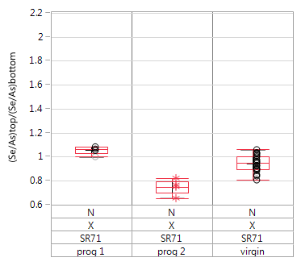
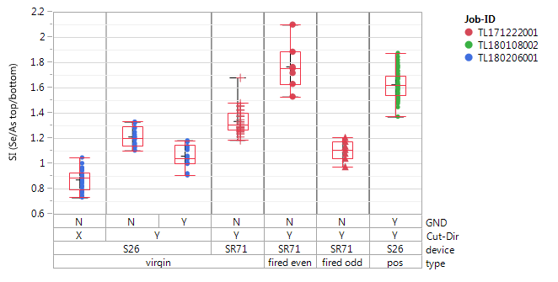
PFA on SD1 – Summary; Segregation Index Boxplots
SI = (Se/As)top/ (Se/As)bottom
pfa-1357
negative
positive
Selenium tends to enrich (by migration) toward positive electrode, either if poled by program or by ungrounding charging

Slide 7
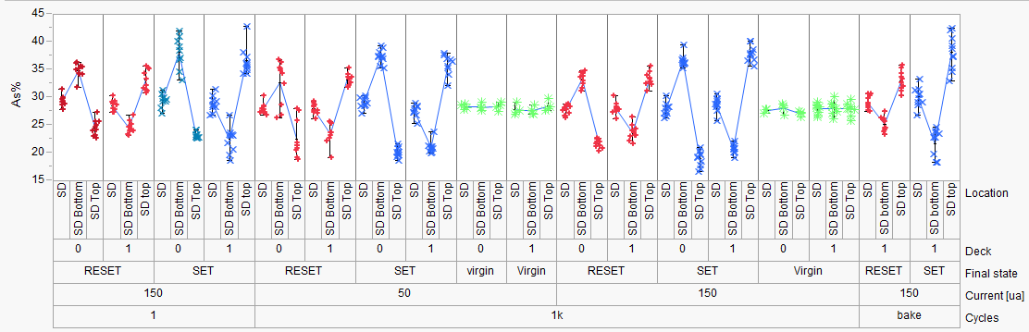
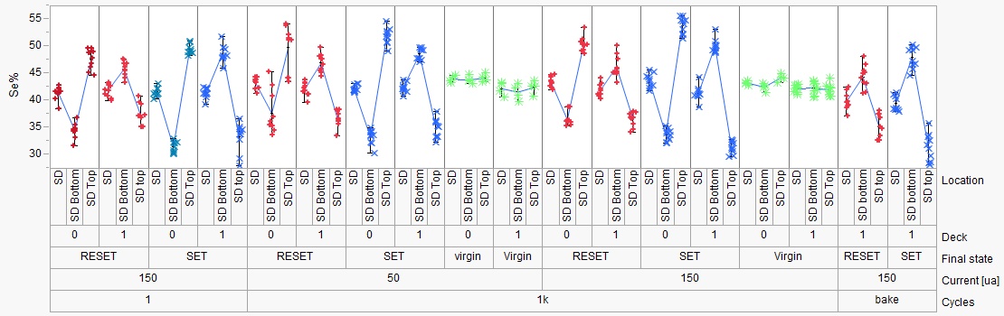
Previous SD1 Elemental Migration Work
PFA-396 (SD1)
Hefei, Enrico
SD1:
Stronger As/Se segregation
for SET vs RESET (time dominating)
1us
50ns
1k cycles
50 ns | 1000 ns | 50 ns | 1000 ns
50 uA |  | 150 uA
1us
50ns
Elemental segregation with SD1
Consistent with current direction (as with PM)
Opposite electromigration behavior on D0 & D1
Back

Slide 8
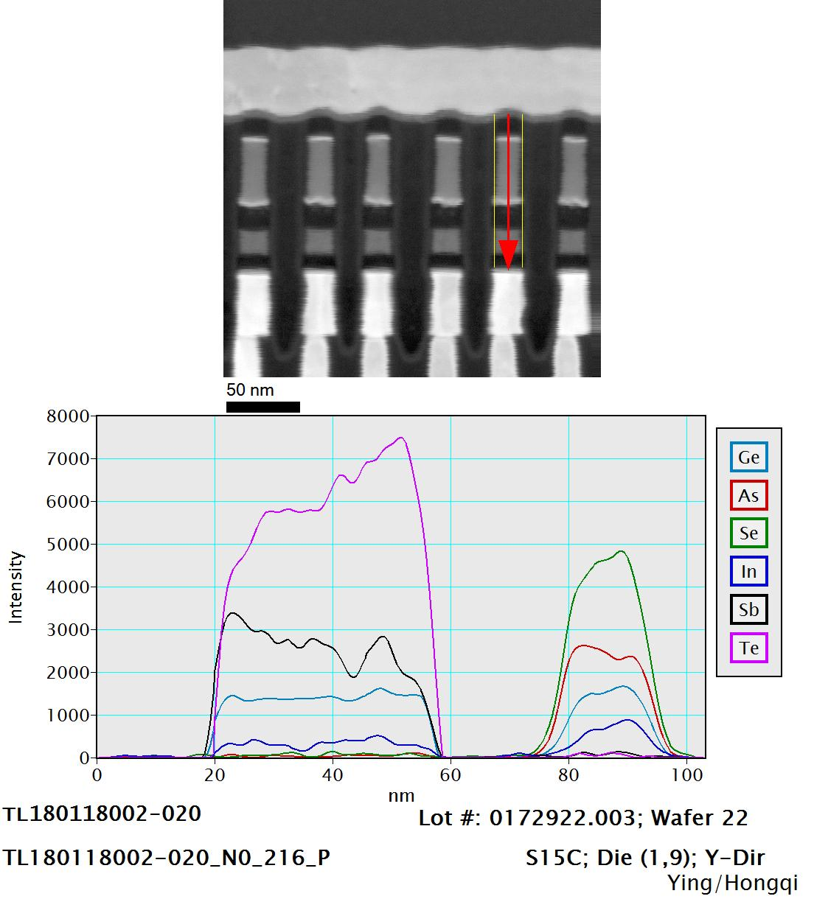
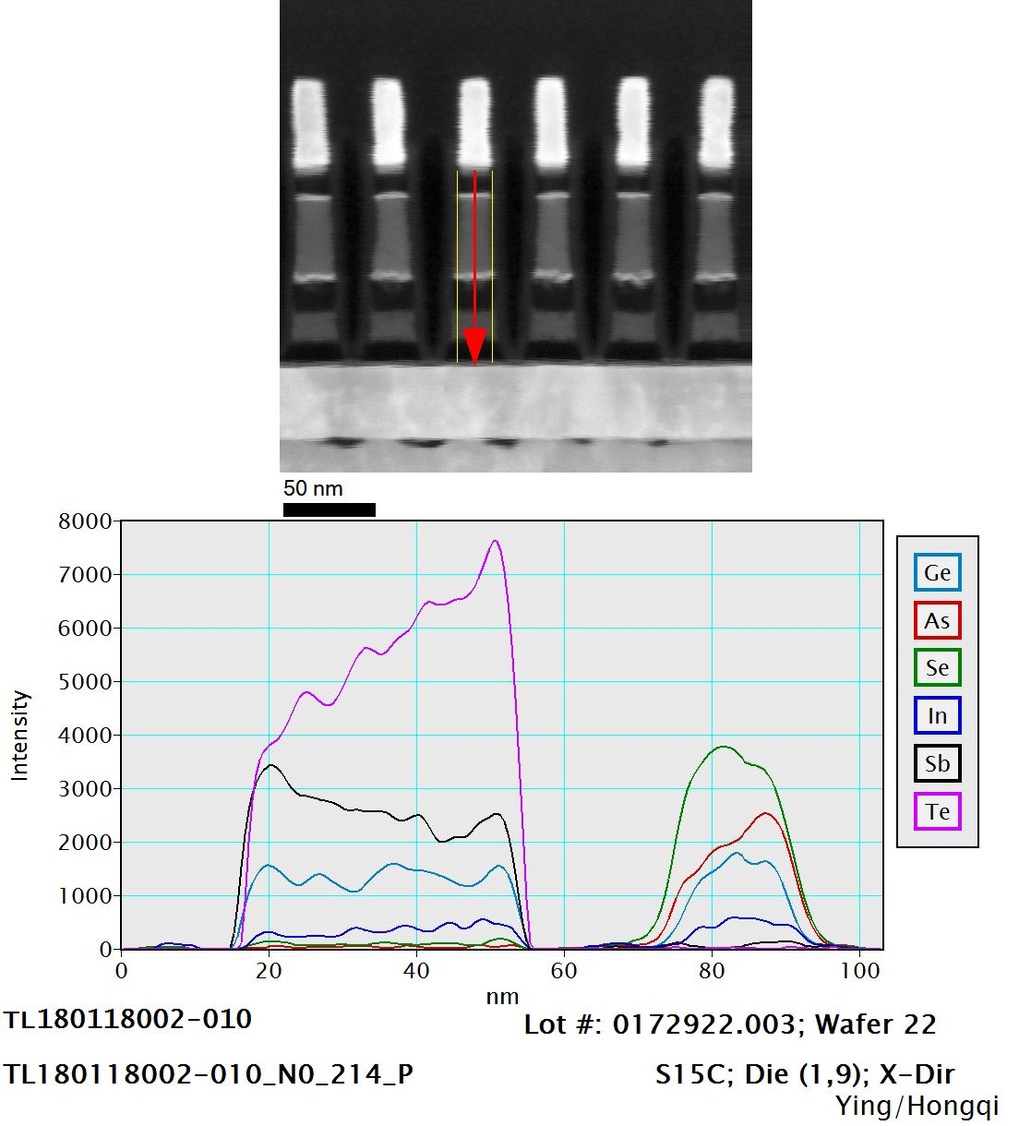
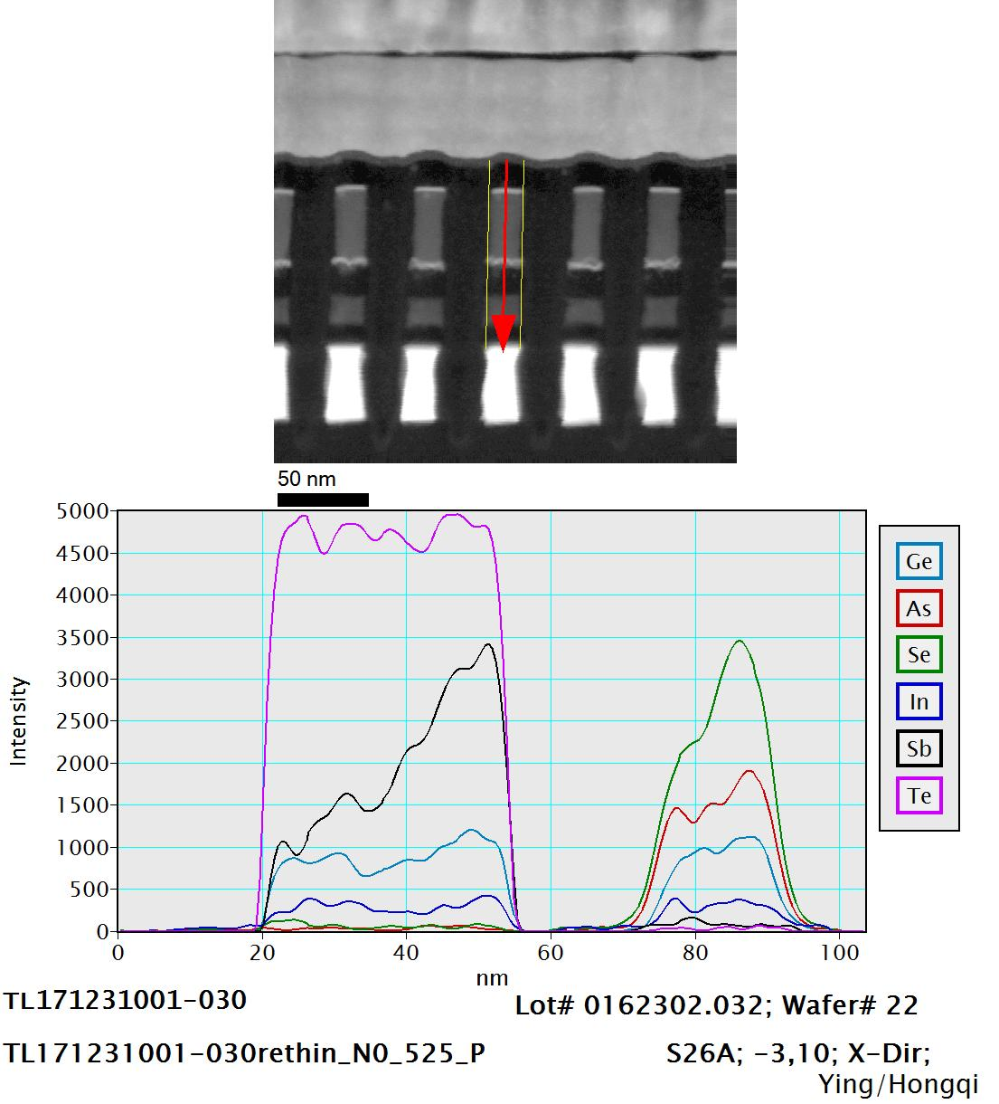
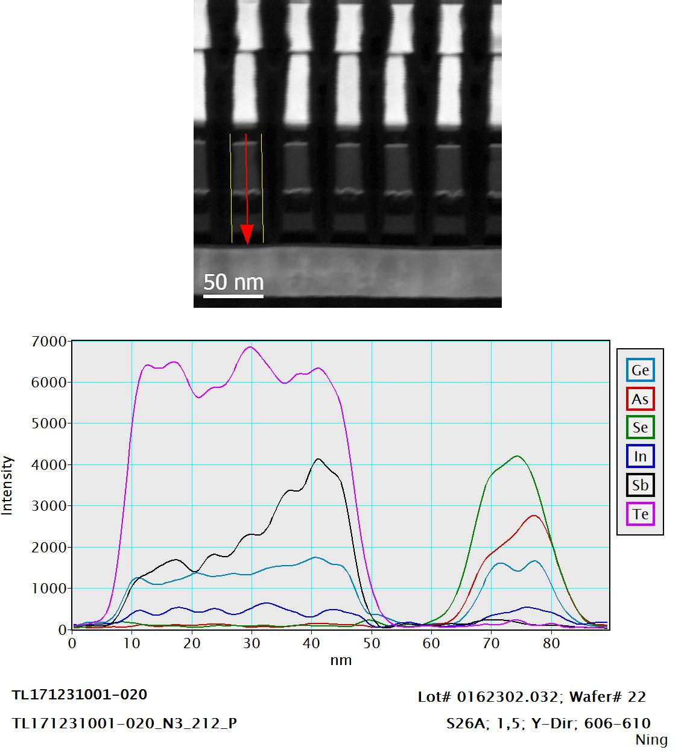
+
Previous typical ungrounded result:
- grounded= WL-BL grounding
- ungrounded = just the line inside lamella is grounded, the other metals can charge positively during FIB cut.
D1
+
D1, X-cut=Se bottom
D1, Y-cut=Se top
+
X-cut=Se bottom
Y-cut=Se top
+
D0
D0, X-cut=Se bottom
D1, Y-cut=Se top
Consistent with Se moving toward positive electrode

Slide 9
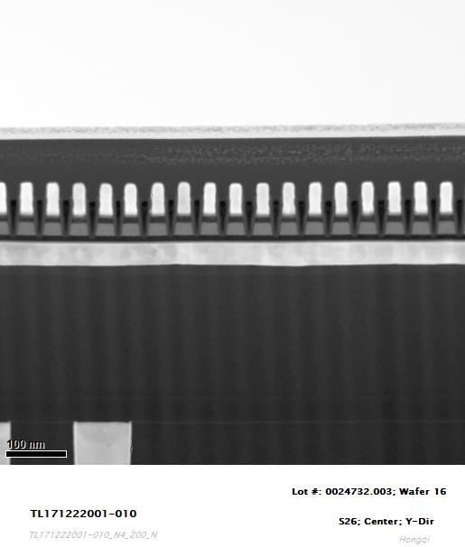
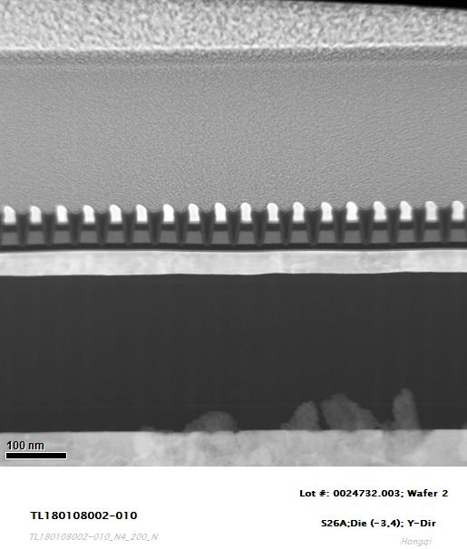
WL-BL grounding
SR71 WL cut
(Y-dir)
S26 WL cut
(Y-dir)
metal
W BLs were not grounded.
W BLs were grounded.

Slide 10
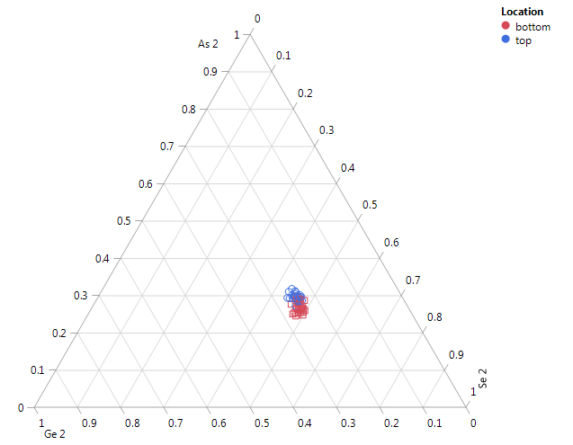
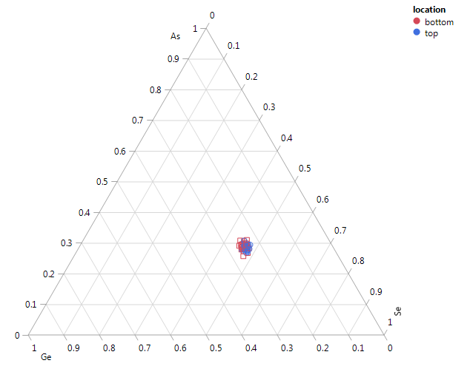
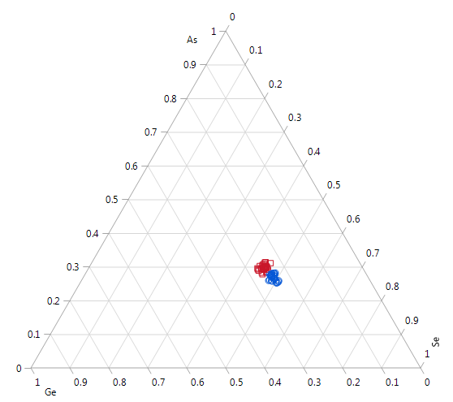
Virgin Bits – S26a TL180206001
Virgin array -ungrounded BL cut
SD1 split4E, w02 Ungrounded WL/BL cuts
Grounded WL cut shows little segregation
Ungrounded show segregation
Opposite segregation between WL & BL cuts
Virgin array -grounded WL cut
Virgin array - ungrounded WL cut
Hongqi

Slide 11
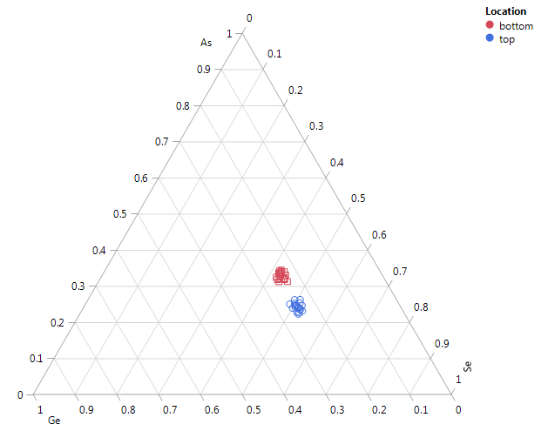
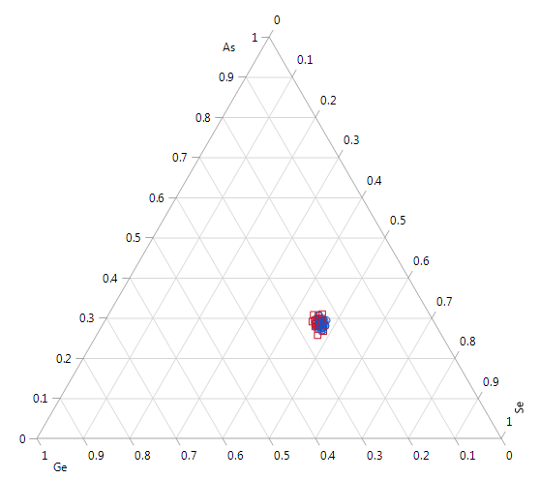
Fired/Virgin Bits – S26A TL180108002, TL180206001
Grounded WL Cuts
SD1 split4E, Grounded WL cuts
w02 S26A
Programed
Virgin array
Segregation on programming observed
Se rich top, As rich bottom
Little preparation bias
Pos prog TL180108002
Virgin Array TL180206001
Hongqi

Slide 12
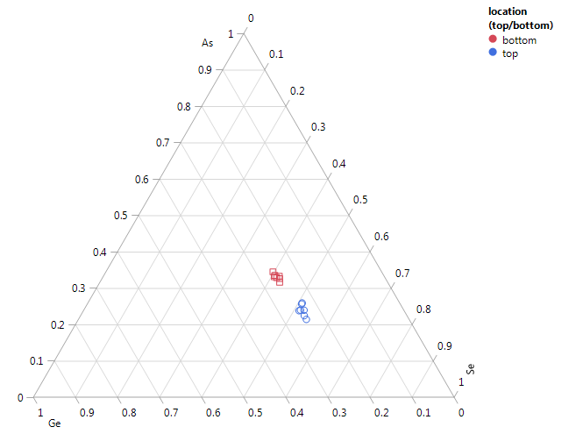
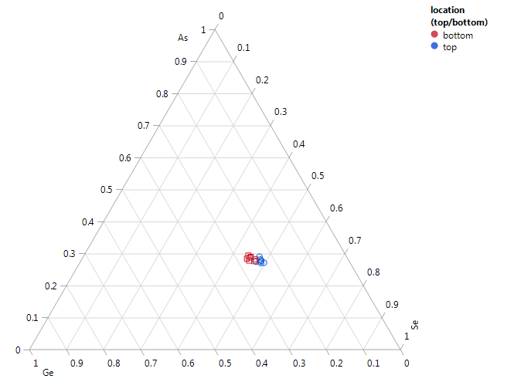
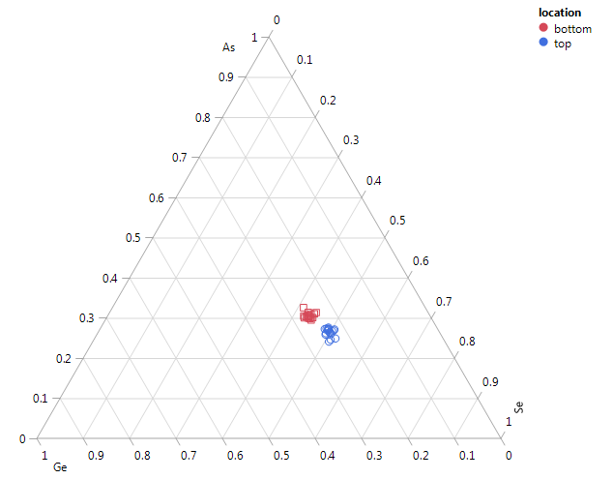
Fired/Virgin Bits – SR71b TL1712222001
TL172122001
SD1 split4E w16
WL Cut. No grounding
WL 14/multiple BL’s
Se/As segregation trending
SI “even bits”> virgin bits >”odd bits” – top is Se rich, bottom is As rich
Even (Pos prog?)
Odd (Neg prog?)
Virgin
Hongqi
Ungrounded WL cut overlays a preparation segregation bias that adds to D0 positive programming but subtracts from D0 negative programming

Slide 13
Fired Bits – SR71b TL1712222001, S26a TL180108002
SD1 split4E
w16 SR71b
WL Cut. No grounding
WL 14/multiple BL’s
w02 S26a
WL cut. Grounded
Data is consistent if we assume pos. programing on even bits
Logical interpretation is that even lines are probed negatively
Even (Pos prog?) SR71b
Pos prog
S26a
Hongqi

Slide 14
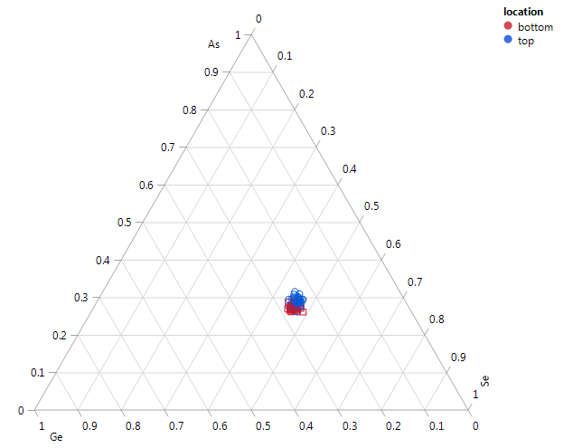
Virgin Bit Comparison – SR71b/S26a
SD1 split4E w16
BL Cut. No grounding
SI < 1
Virgin Bits S26a -ungrounded BL cut
Virgin Bits – SR71b ungrounded BL cut PFA 1357

Slide 15
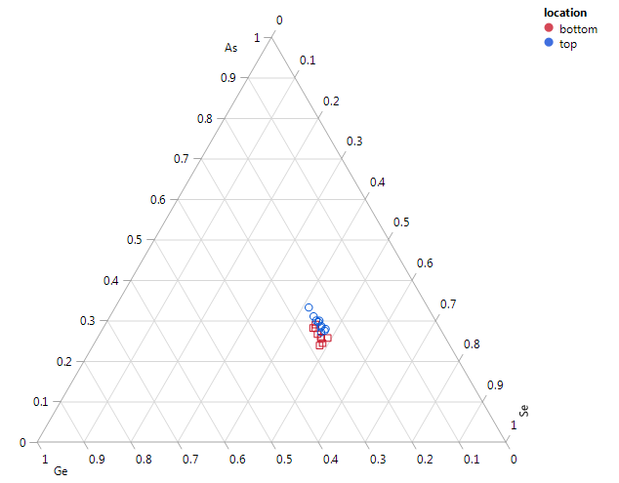
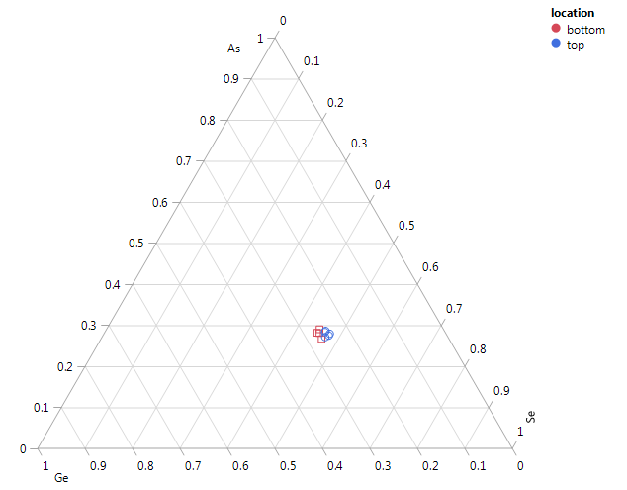
Fired/Unfired Bits – PFA 1357
SD1 split4E w16
BL Cut. No grounding
Even (Pos prog?)
Odd (Neg prog?)
Virgin
Hefei

Slide 16
PFA 1357 / TL122122001 Comparison
TL172122001
TL172122001
WL Cut. WL14 (1st active) - verifiied
PFA1357
BL Cut. BL 9
Trends are opposite between PFA 1357 & TL122122001
Actual placement needs to be better understood
Assuming even bits are positively programed (not intended) WL cuts on SR71b & S26a not grounded v. grounded are consistent
PFA1357

Slide 17
EDS Element Line Scan TL171222001 Oppositely Fired Bits (SR71)
38
37
36
35
34
33
Linescans not normalized
38
37
36
35
34
33

Slide 18
EDS Element Line Scan TL171222001 Not Fired Bits (SR71)
38
37
36
35
34
33
38
37
36
35
34
33
Linescans not normalized

Slide 19
EDS Element Line Scan TL80108002 (S26)
Linescans not normalized
Grounded WL/BL
Consistent with SR71B
As/Se motion

Slide 20
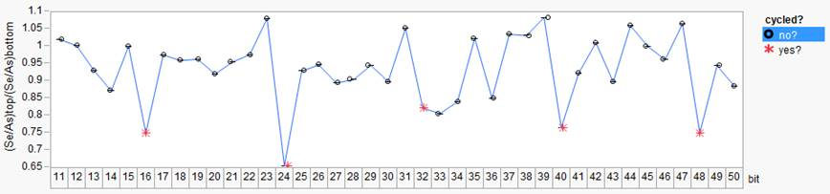
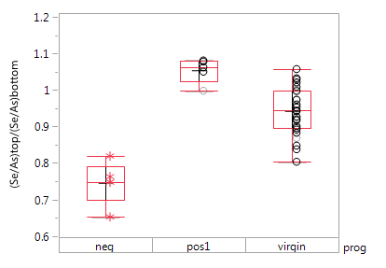
Stem Images: 0024732.003, split 4E SD1 SAG, wafer16 SR71B
Folsom
X-cut SR71 ungrounded
Prog sequence:
pos,/neg prog seasoning
chkb positive prog (4 pulses)
line pattern:
adjacent pos and neg prog between 6 not programmable cells
Significant Se enrichment at bottom for one of the two programmed cell
Opposite smooth segregation for opposite prog, compared to virgin
Prog assignment to be confirmed

Slide 21
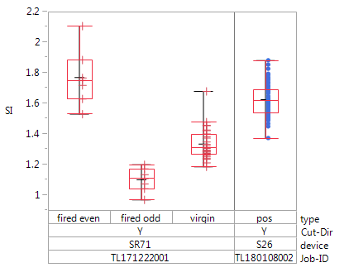
SD1
summary
Boise, Y-cuts
Folsom
X-cut, ungrounded
(usually Se-bottom)
ungrounded
(usually Se-top)
grounded
S26
SR71 even
top
bottom
SR71 odd
ungrounded
grounded
SR71 virgin

