Slide 1
PM crystal-amorphous transformation by laser pulse
evaresi

Slide 2
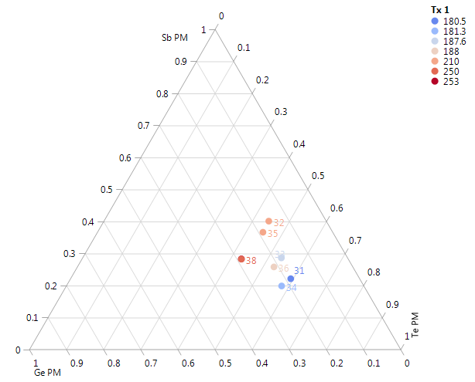
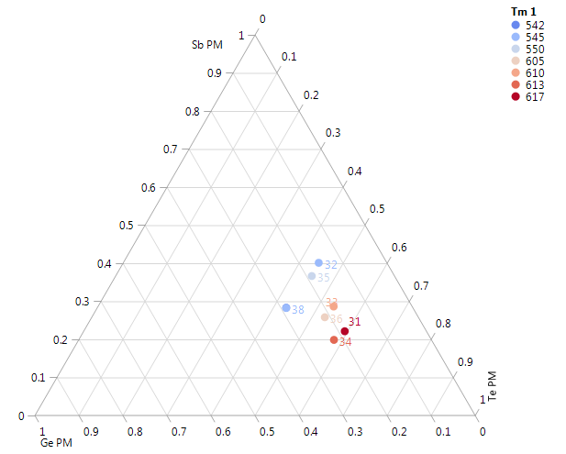
DSC samples (Dale)
Job | Lot | Wafer |  | Ge | In | Sb | Te | N2 | Scribe | Chamber
CL170706032 | Te-rich 2 | 4 | 34 | 21.7 | 2.1 | 19.5 | 56.8 | yes | W902B024ESC4 | 4C
CL170706032 | Sb-rich 2 | 5 | 35 | 18.4 | 2.2 | 35.9 | 43.6 | yes | W7YKW114ESB4 | 4C
CL170706032 | Bulk 2 | 6 | 36 | 20.8 | 2.2 | 25.3 | 51.8 | yes | BR3LE097SEF0 | 4C
CL170706032 | PM2.A3 | 7 | 37 | 27.9 | 3.1 | 27.5 | 41.6 | yes | BQ9YH211SEA2 | 4C
CL170706032 | PM2.A3 | 8 | 38 | 27.9 | 3.1 | 27.4 | 41.6 | yes | W7NKH034ESH2 | 390mm
GISTN transformation temperature extracted: same trend as for pure GST
Tx
T melt
Sb-rich
Sb-rich
Te-rich
Te-rich

Slide 3
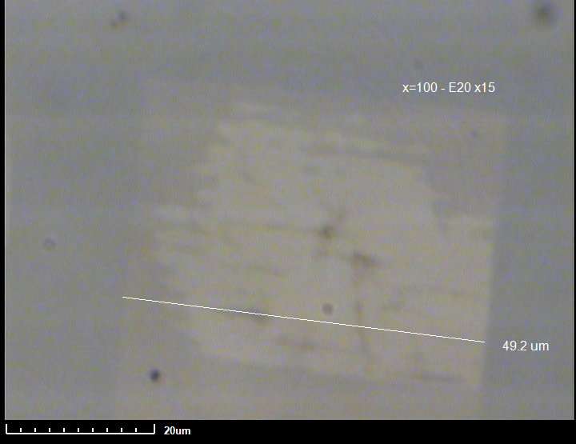
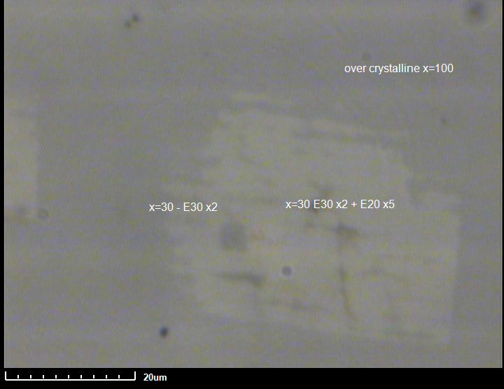
DSC – PM- 4 (Te-rich) 200nm/C(10)
Ge | In | Sb | Te
21.7 | 2.1 | 19.5 | 56.7
Laser spot
Reamorphized (E30 x2)
amorph
asdep
crystallized
reamorph + Recrystallized (E30 x2 + E20x5)
Crystallization, reamorphization and recrystallization

Slide 4
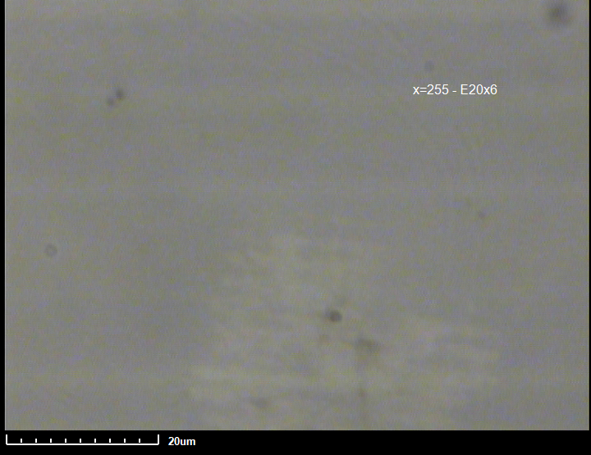
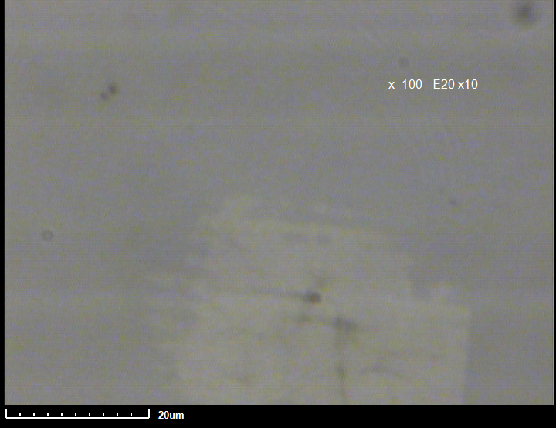
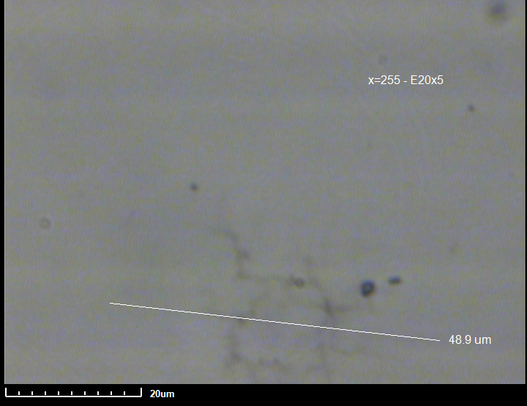
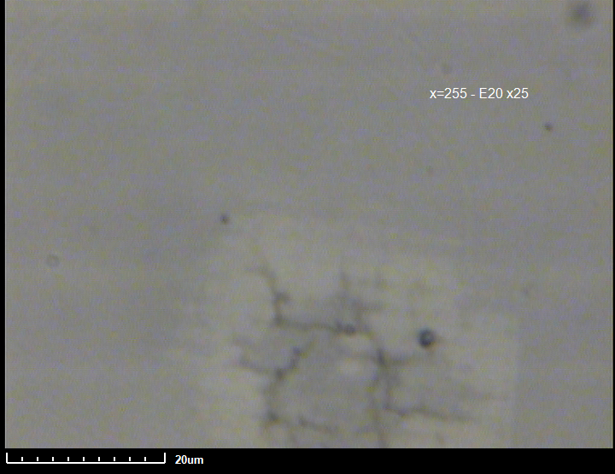
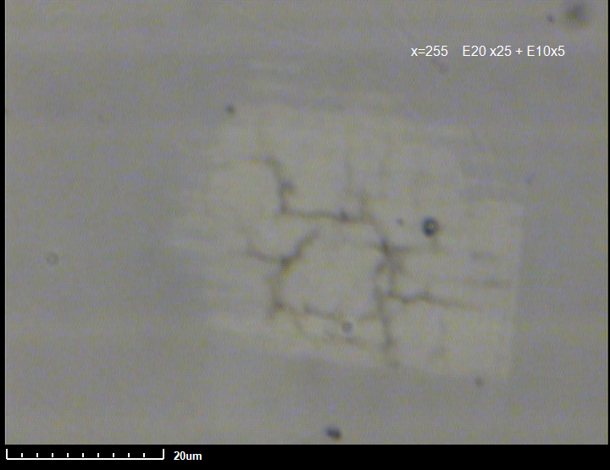
#4 (Te-rich)
THOX(550nm)/PM(200)/C(10)
50um
E20 x 6pulses
50um
E20 x 10pulses
50um
E20 x 15pulses
Ge | In | Sb | Te
21.7 | 2.1 | 19.5 | 56.7
#6 (EOL)
50um
E20 x 5pulses
50um
E20 x 25pulses
50um
E20 x 25pulses+E10 x5
amorph
asdep
Ge | In | Sb | Te
20.8 | 2.2 | 25.3 | 51.7
reamorph
crystallized

Slide 5
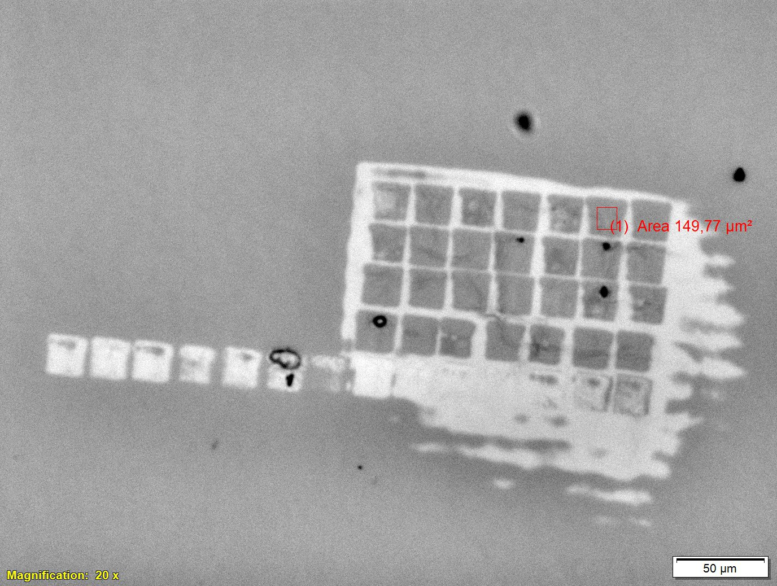
DSC – PM- 4 (Te-rich) 200nm/C(10)
Ge | In | Sb | Te
21.7 | 2.1 | 19.5 | 56.7
Recrystallized:
crystal (E20x15)
reamorph (E30 x2)
recrystall (E20 x n)
Recrystallized:
reamorph (E30 x2)
recrystall (E20 x n)
1
2
3
4
5
6
7
1
2
3
4
5
6
7
Reamorphized array (5um size)
4 pulses enough to fully rescrystallize Te-rich alloy

Slide 6
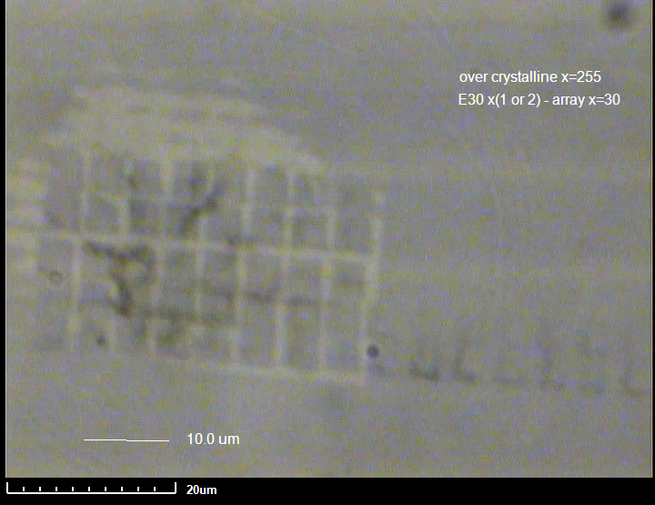
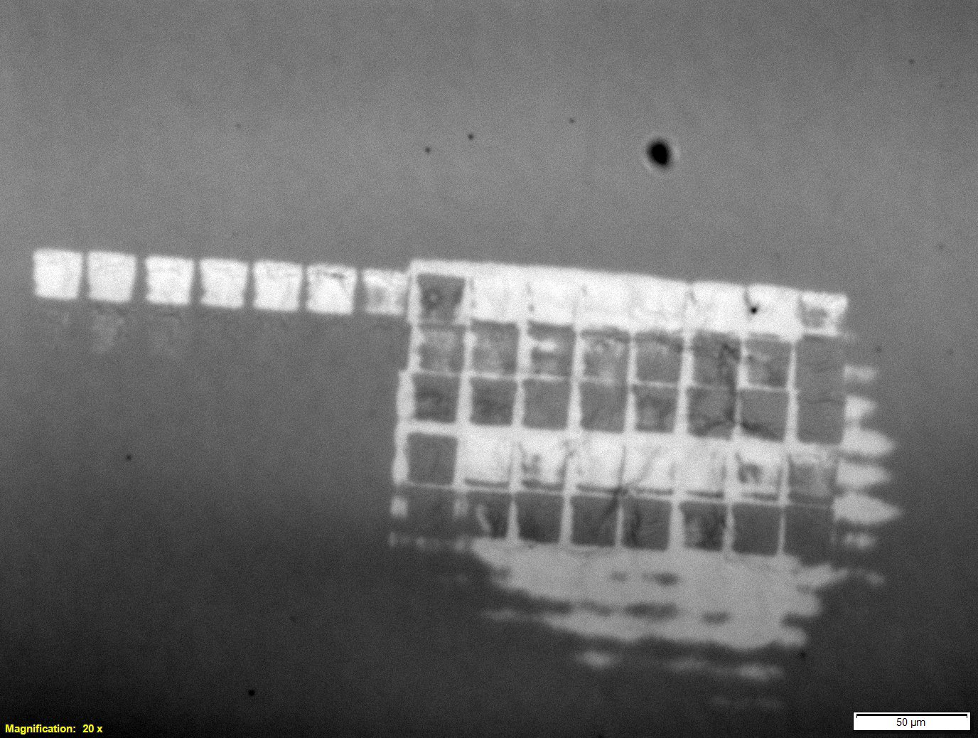
DSC – PM- 6 (EOL) 200nm/C(10)
Ge | In | Sb | Te
20.8 | 2.2 | 25.3 | 51.7
reamorphized array
Reamorphized + recrystallized
range/step
A: 1-7/1 pulses
B: 8-20/2 pulses
C: 10-40/5 pulses
B
A
C
>12 pulses need to rescrystallize EOL alloy => EOL alloy is slower than Te-rich alloy

Slide 8
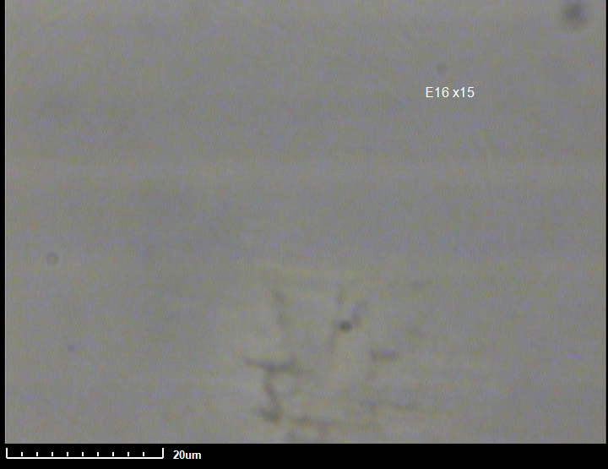
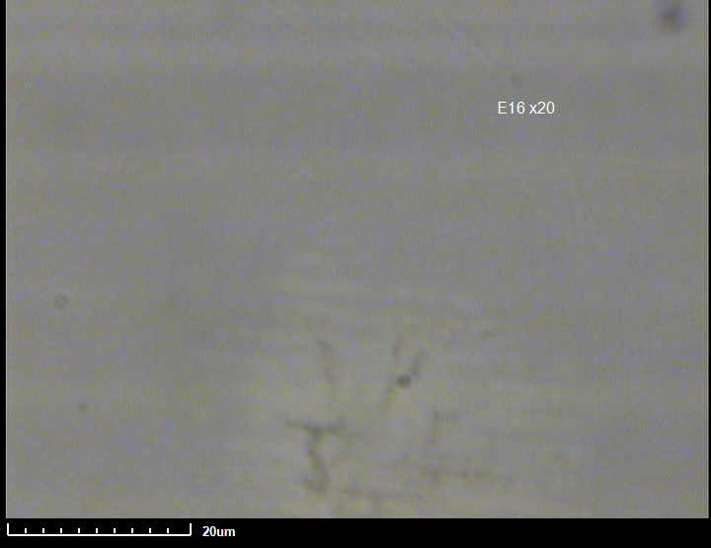
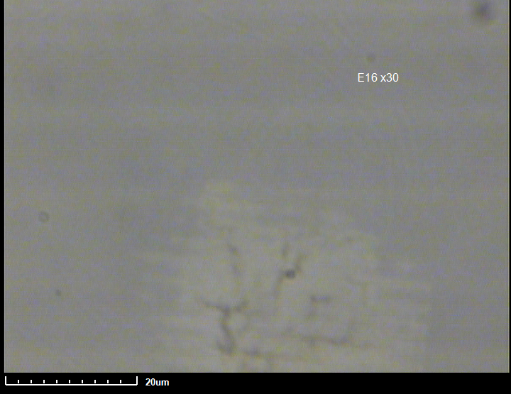
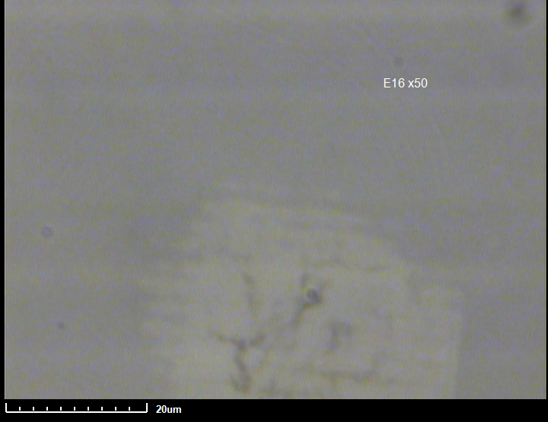
DSC – PM- 6 (EOL) 200nm/C(10)
Ge | In | Sb | Te
20.8 | 2.2 | 25.3 | 51.7
50um
E16 x 15pulses
50um
E16 x 20pulses
50um
E16 x 30pulses
50um
E16 x 50pulses

