Slide 1
Campaign N – SiN doped SAG
Swapnil Lengade
Fab 4 PVD

Slide 2
Camp N – Introduction
The motivation of Camp N comes from SiN doping of SDv13 (~8% Si already in the alloy) where we saw an improvement in the thermal stability of the alloy. Unfortunately, those alloys showed a worsening of Vt drift with SiN doping.
  In this campaign we test low levels of SiN doping into SAG type alloys (no Si pre-exists in the alloys)
The following targets were installed on MMUM4C0300 F1
  Gun1: As2Se3
  Gun2: Ge
  Gun3: SiN
The scope of this work is to test known thermally stable (@290C-300C) alloys with the lowest Ge (currently 16% at.) and going up on the Ge content up to the SD1 levels (~24% at.). The SiN content will vary from ~1.5 to 3.5% (based on ICP Si content).
The overall goal is to achieve both, thermal and electrical (Vt drift) stability

Slide 3
Camp N – SiN/Ge Matrix
Si / Ge | 16 | 20 | 24
0 | x |  | X (SD1)
1.7 | x | x
3.7 | x |  | x
The lowest amount of Si(N) (~1.7%) is dictated by the deposition rates of the individual As2Se3, Ge, SiN targets
  The at. % quoted is for Si from ICP-OES since we cannot determine N from this technique

Slide 4
Camp N – ICP data 1/8/2018
Sample Description | Job No. | Analysis Date | As | Ge | Se | Si
DOE1 | CL180103020 | 01/03/2018 | 31.8 | 16.3 | 51.9 | 0.0
DOE2 | CL180103020 | 01/03/2018 | 31.8 | 16.5 | 50.1 | 1.7
DOE3 | CL180103020 | 01/03/2018 | 31.3 | 16.0 | 48.9 | 3.7
DOE4 | CL180103020 | 01/03/2018 | 30.4 | 20.3 | 47.8 | 1.5
DOE5 | CL180103020 | 01/03/2018 | 29.6 | 23.9 | 46.5 | 0.0
DOE6 | CL180103020 | 01/03/2018 | 28.4 | 24.1 | 44.0 | 3.4

Slide 5
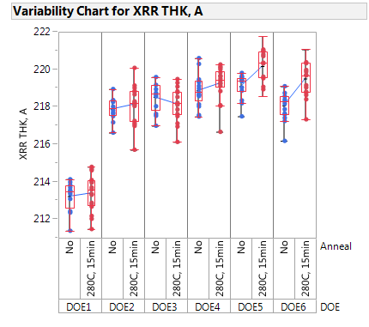
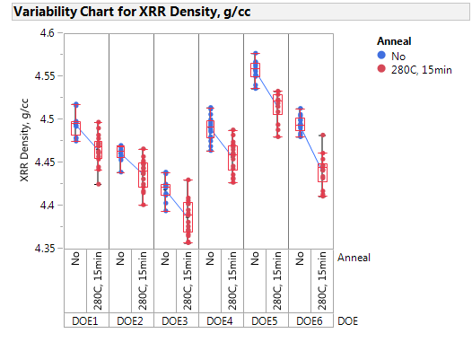
XRR Data
Post anneal thickness does not show much of a change
XRR density does show a decrease post anneal on all the splits but the change ~0.05 g/cc is not likely significant
No split dependance

Slide 6
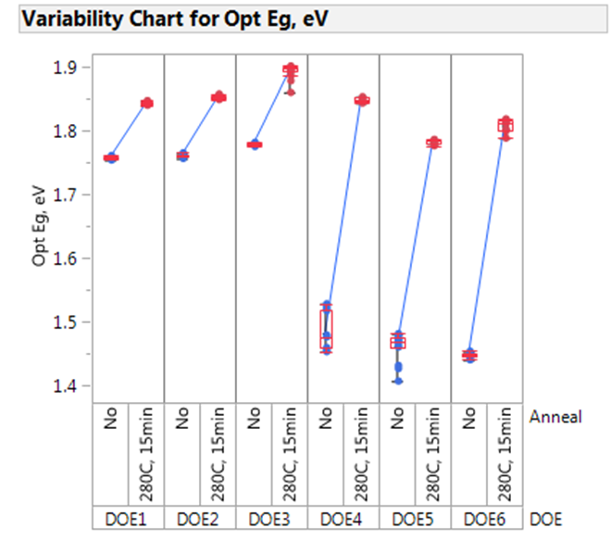
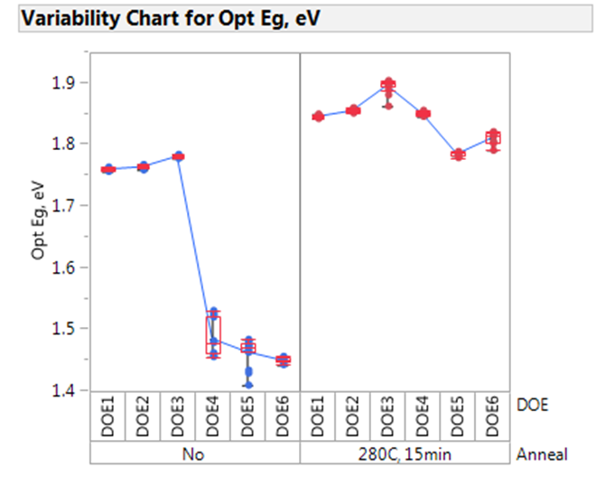
Optical Band Gap Eg
16%
16%
Significant difference in the as-deposited optical Eg between the low Ge (16%) and the high Ge (20, 24%) splits.
  Post anneal, Eg recovery is much higher for the high Ge splits. The Eg recovers close to the low Ge splits!
Addition of Si(N) increases the Eg of the film

Slide 7
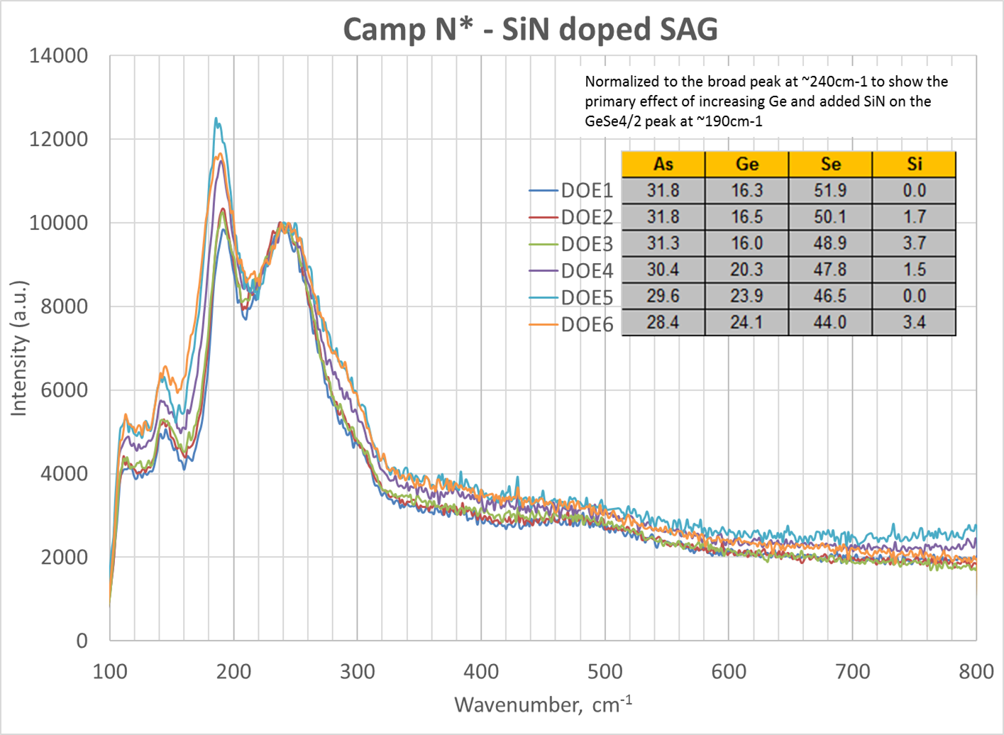
Raman Spectra
Raman shows the predictable increase in the GeSe_{4/2} peak (~190 cm⁻¹) with increasing Ge content
  Addition of Si supplements the same tetrahedral GeSe_{4/2} peak with the addition of SiSe_{4/2} structures
  Shoulder around 300 cm⁻¹ emerges with higher Ge content indicating Ge-Ge homopolar bonds

Slide 8
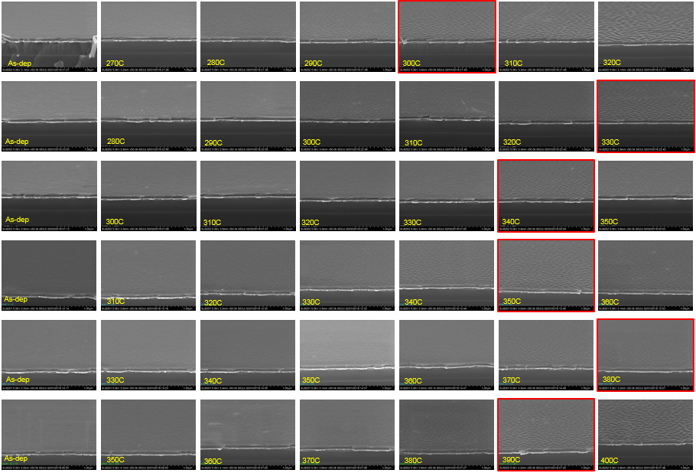
SEM Wrinkle Data –
Angled Top Downs
DOE1
DOE2
DOE3
DOE4
DOE5
DOE6

Slide 9
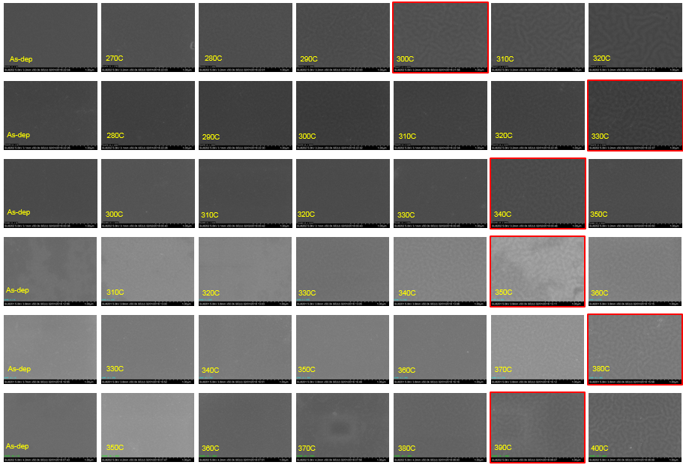
SEM Wrinkle Data –
Top Downs
DOE1
DOE2
DOE3
DOE4
DOE5
DOE6

Slide 10
L0 data summary
Alloy | As | Ge | Se | Si | CN | As/Se | XRR Density, g/cc [As-dep] | XRR Density, g/cc [Post 280C, 15min anneal] | XRR Thk, A [As-dep] | XRR Thk, A [Post 280C, 15min anneal] | Optical Eg, eV [As-dep] | Optical Eg, eV [Post 280C, 15min anneal] | T0 | T1 | T2 | T3 | T4 | T5 | T6 | SW Temp
DOE1 | 31.8 | 16.3 | 51.9 | 0.0 | 2.643 | 0.612 | 4.495 | 4.464 | 213.2 | 213.4 | 1.693 | 1.829 | 0 | 270 | 280 | 290 | 300 | 310 | 320 | 300
DOE2 | 31.8 | 16.5 | 50.1 | 1.7 | 2.681 | 0.634 | 4.463 | 4.437 | 218.2 | 218.1 | 1.678 | 1.856 | 0 | 280 | 290 | 300 | 310 | 320 | 330 | 330
DOE3 | 31.3 | 16.0 | 48.9 | 3.7 | 2.708 | 0.640 | 4.417 | 4.387 | 218.6 | 218.2 | 1.708 | 1.897 | 0 | 300 | 310 | 320 | 330 | 340 | 350 | 340
DOE4 | 30.4 | 20.3 | 47.8 | 1.5 | 2.740 | 0.636 | 4.492 | 4.457 | 218.9 | 219.3 | 1.498 | 1.851 | 0 | 310 | 320 | 330 | 340 | 350 | 360 | 350
DOE5 | 29.6 | 23.9 | 46.5 | 0.0 | 2.774 | 0.636 | 4.559 | 4.516 | 219.1 | 220.2 | 1.493 | 1.757 | 0 | 330 | 340 | 350 | 360 | 370 | 380 | 380
DOE6 | 28.4 | 24.1 | 44.0 | 3.4 | 2.836 | 0.646 | 4.494 | 4.441 | 218.0 | 219.5 | 1.463 | 1.786 | 0 | 350 | 360 | 370 | 380 | 390 | 400 | 390
Thermal stability improves with SiN addition
  CN increases with Si addition
Band gap increases with SiN
Band gap trends lower with higher Ge content of the film
Band gap recovery post anneal is much higher for the higher Ge films
  Post anneal band gap for the high Ge films is almost close to the low Ge films
No real film shrinkage/expansion post anneal

