Slide 1
Summary
Composition skewed with GeTe target unable to deliver 1 to 1 composition at powers needed to balance other 2 source materials (would require 5x increase in power on GST target)
ICP-Complete
Rs-vs T samples in metro steps
XRD material on hold (PV1 project for PG1T1 has >160hrs of data collection still pending)
Samples from Rs vs T will be sent for Pulse Laser Crystallization.

Slide 2
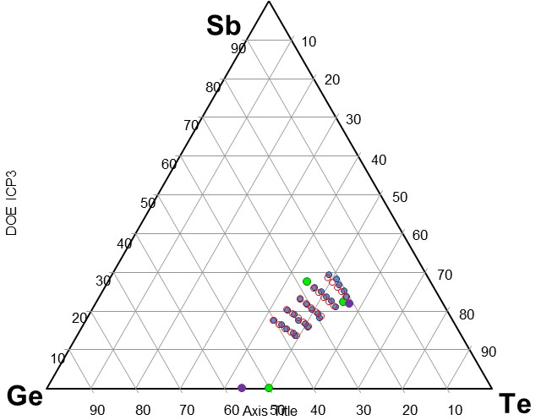
ICP

Slide 3
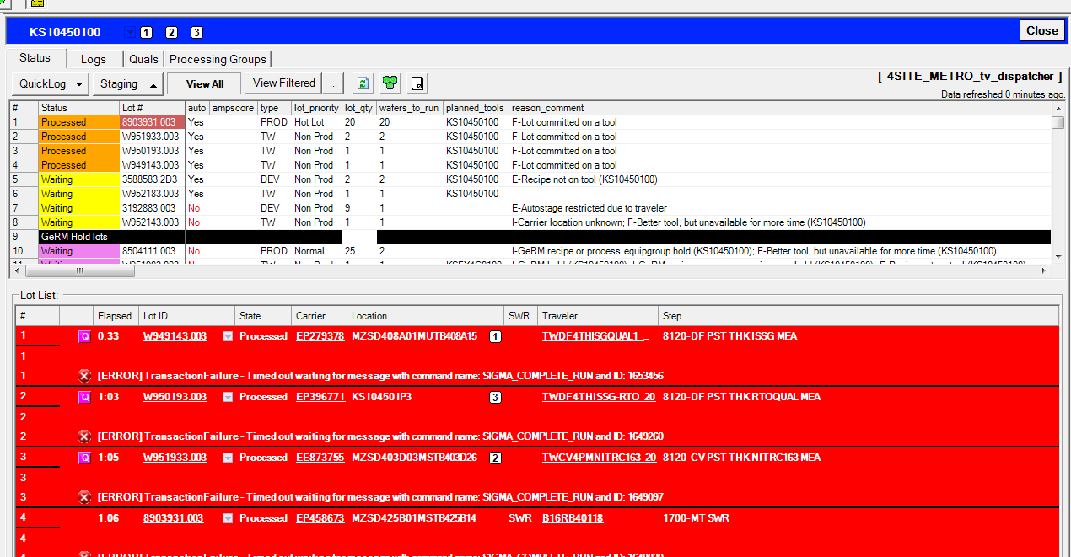
Eg
Data missing.
Re-running of data is still not posting. Metro is aware of issues but solution is not complete.

