Slide 1
SD Characterization Update
Dan Gealy, Enrico Varesi
1 24 2018

Slide 2
Summary – work in progress
PFA 1357 in progress – SD1 split
Some segregation observed
Primarily As motion
No grounding
Thickness changes not prominent
Not all data is in
Not consistent with initial work on SD1
PFM work at the PFM/AFM
No data yet
Raman from probed arrays

Slide 3
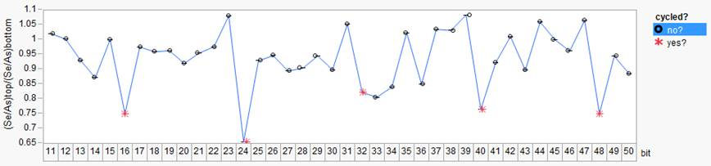
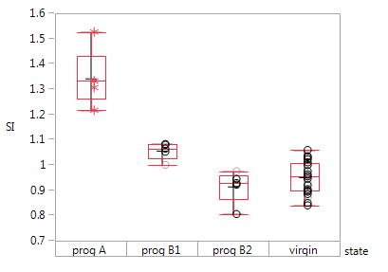
Stem Images: 0024732.003, split 4E SD1 SAG, wafer16 SR71B
15
32
31
16
15
24
23
22

Slide 4
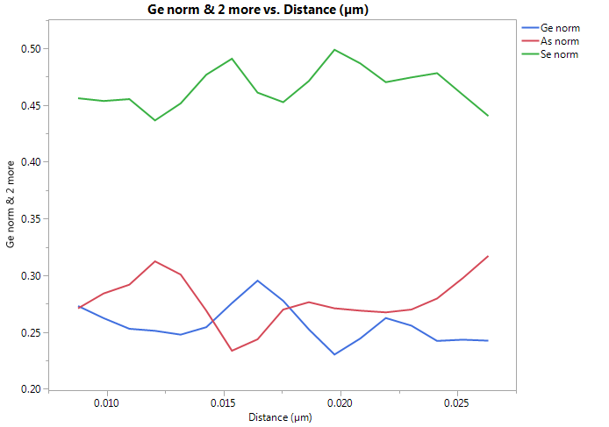
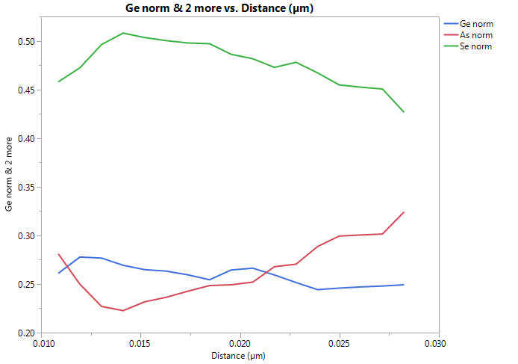
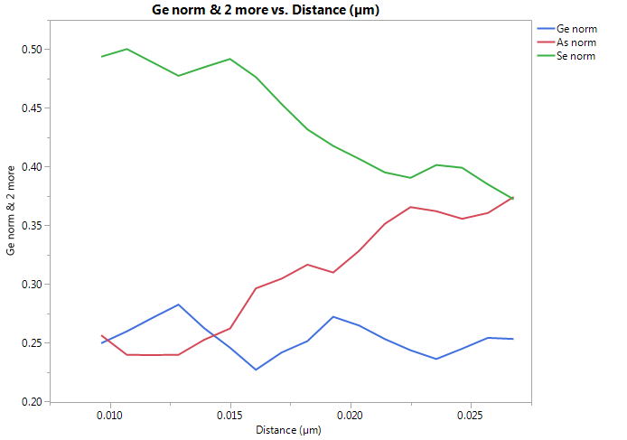
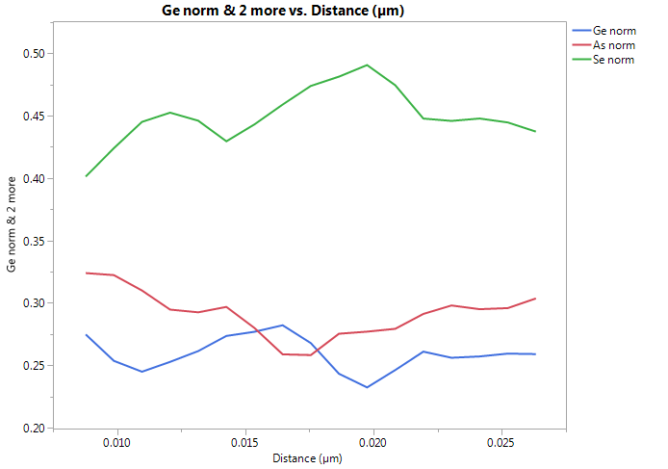
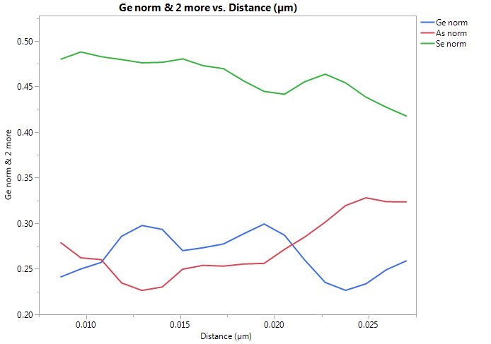
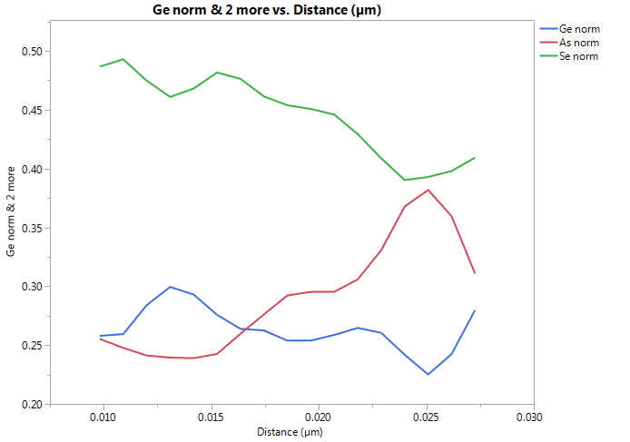
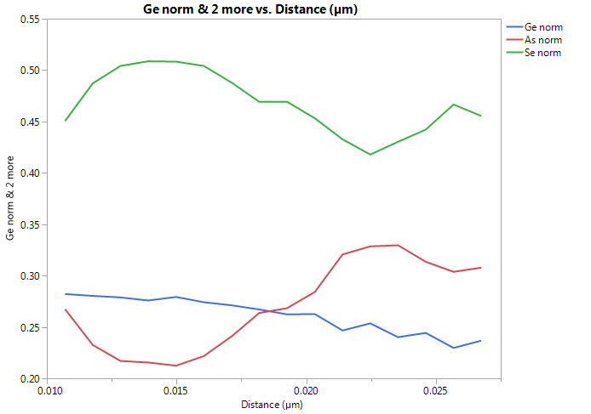
Filtered normalized composition profiles
Virgin #12
#16
#24
Virgin #11
#32
#40
#48

Slide 5
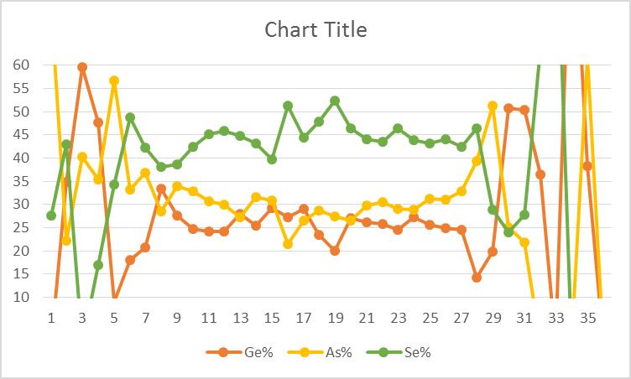
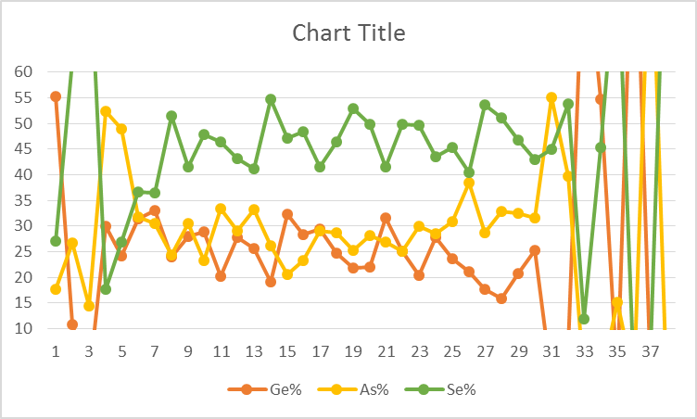
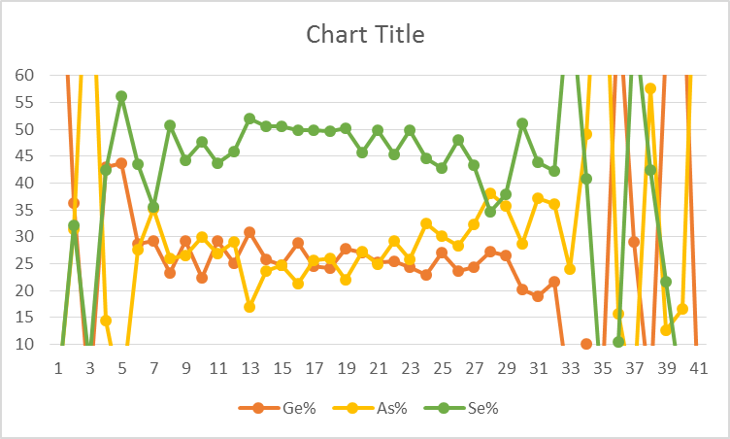
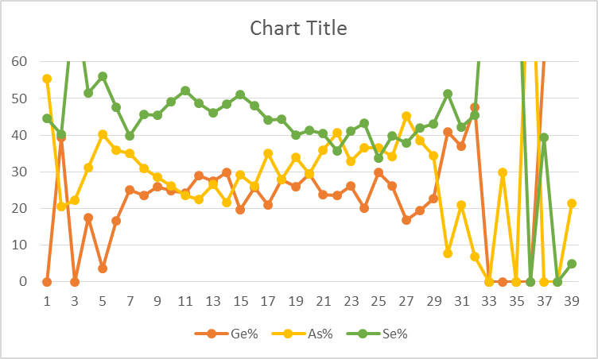
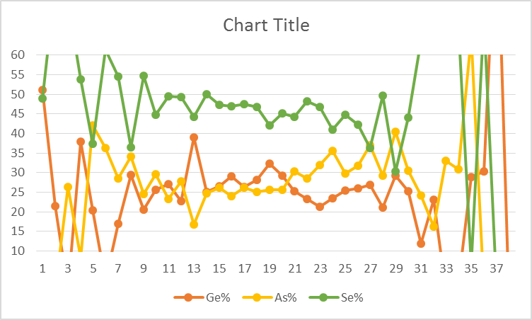
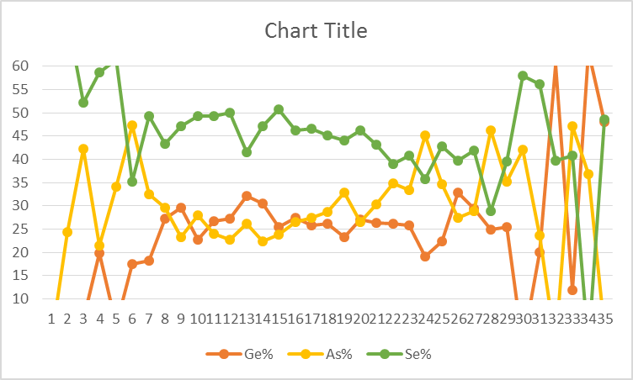
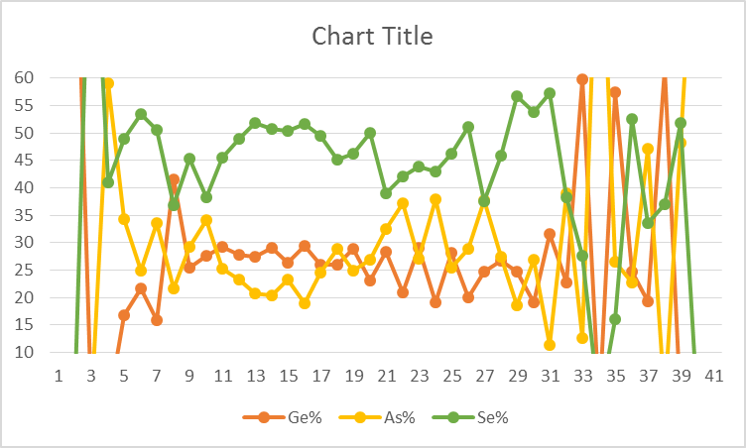
Linescan: 0024732.003, split 4E SD1 SAG, wafer16 SR71B
Bit 11 virgin
Bit 12 virgin
Bit 16
Bit 12 virgin
Bit 24
Bit 32
Bit 40
Bit 48

Slide 6
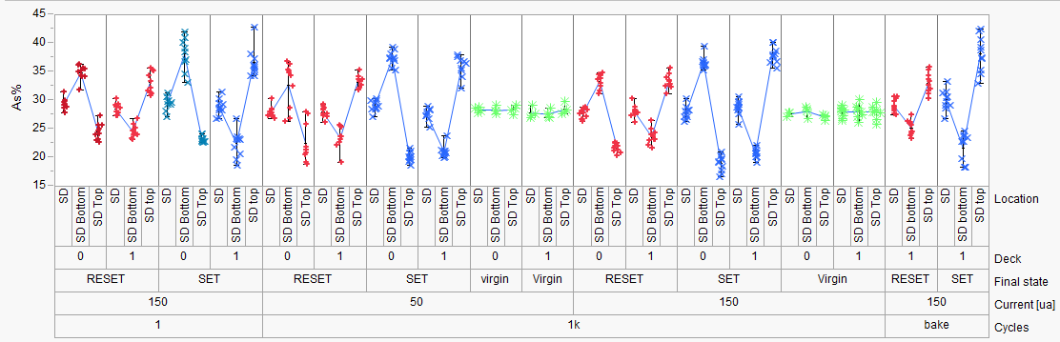
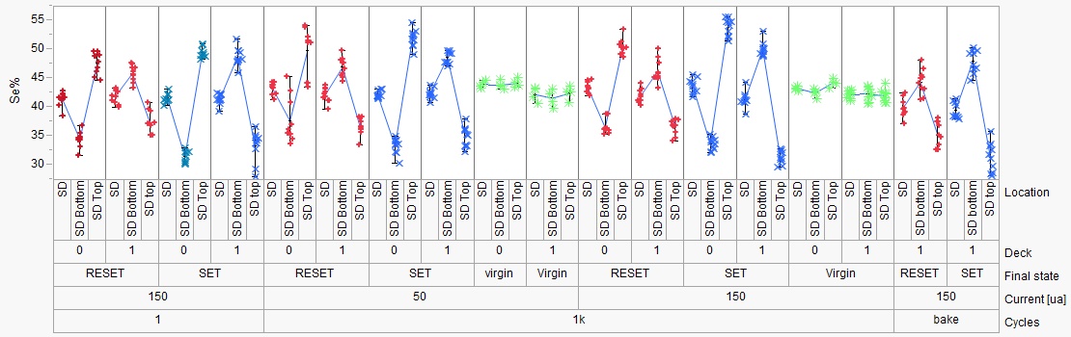
SD1 Elemental Migration
PFA-396 (SD1)
Hefei, Enrico
SD1:
Stronger As/Se segregation
for SET vs RESET (time dominating)
1us
50ns
1k cycles
50 ns | 1000 ns | 50 ns | 1000 ns
50 uA |  | 150 uA
1us
50ns
Elemental segregation with SD1
Consistent with current direction (as with PM)
Opposite electromigration behavior on D0 & D1
Back

Slide 7
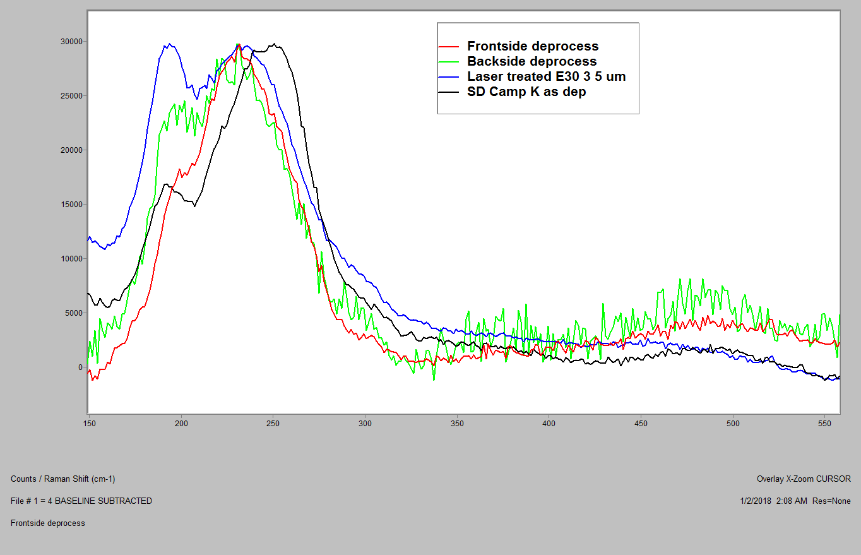
Raman on Probed arrays
Laser treated was not bake recoverable
Differences observed between front-side deprocessed virgin & probed
Backside deprocessed not completed

