Slide 1
Forming on CLV
See the notes on the left margin of many of these slides for instructions on their use.
Subtitle
Speaker name
and title

Slide 2
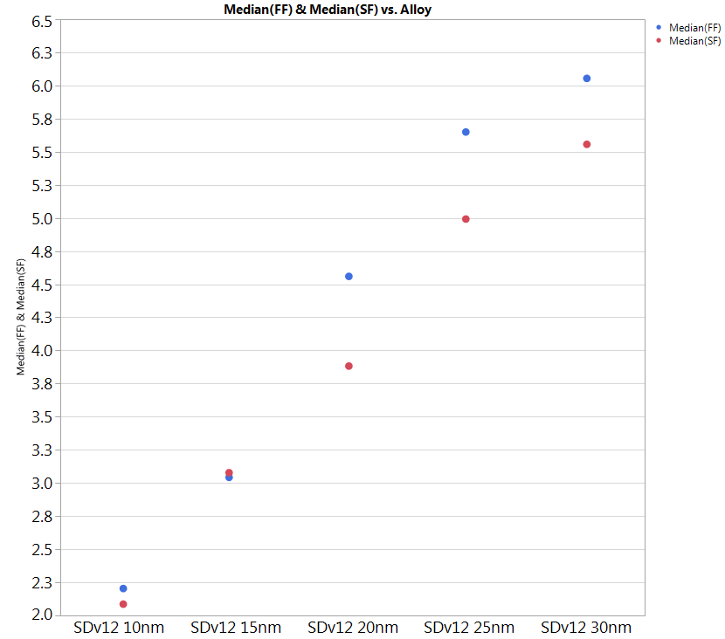
Forming on CLV
Data are taken on CLV lot with SDv12 thickness skew.
SDv12 as appears in the graph does not show forming.
This lot confirms data we obtained in the past with CLV with SDv12→ cantilever is formingless and the difference between FF and SF could be ascribed to drift process.

