Slide 1
Follow up on Hf-GST CLV lot
See the notes on the left margin of many of these slides for instructions on their use.
Subtitle
Cristina

Slide 2
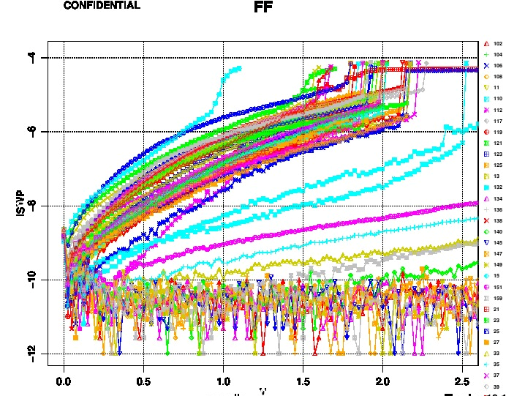
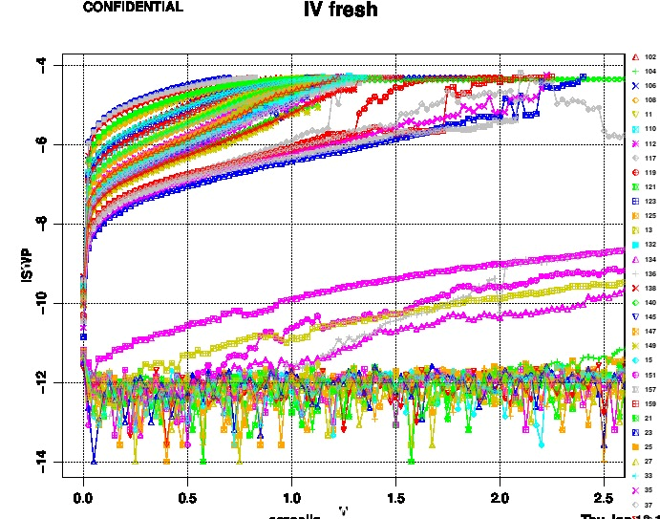
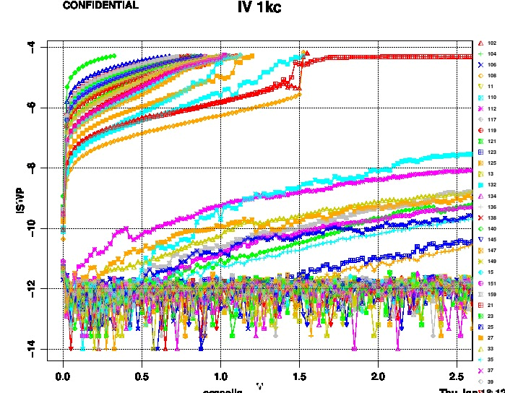
Checkerboard map test
Checkerboard map run on PM2.A.3 wf
Results confirm the behavior seen with std test done on 5 sites at wafer center
After FF (which is reasonable compared to other PM2.A.3 wafers) there is a degradation, no dependence with wafer position, no map highlighted
Each curve reported below is one site

Slide 3
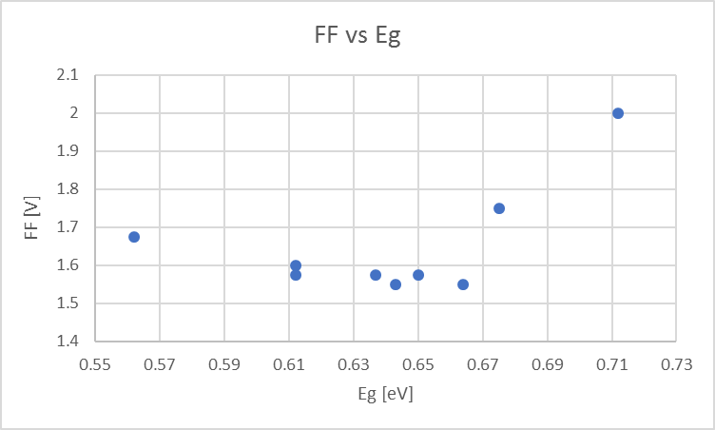
FF vs Eg
As FF values are reasonable we did the correlation between FF VT and Eg
It has been confirmed that PM2.A.3 is the one with higher Eg and Vth, while all Hf-GST alloys having lower Eg have a lower Vth.
PM2.A.3
Hf-GST alloys

