Slide 1
PM speed
Samples for RWTH POT

Slide 2
purpose
Measurement of PM transformation speed @RWTH by POT (pulsed optical tested)
Availability to measure a few alloys
Interest for Te-rich, Sb-rich and contaminated

Slide 3
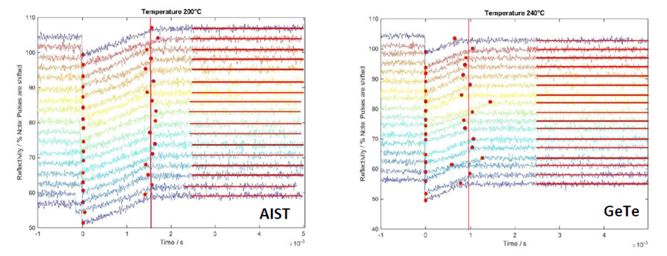
Reflectivity measurements
Wuttig group built a Phase Change Optical Tester (POT), with also time resolved capability
Within this collaboration there is also the request to characterize some alloys from Micron.
Planned measurement on top/bottom segregated alloys (Te-rich, Sb-rich), w/w-o contaminant – target available from next Jan.

Slide 4
Standard RWTH stack for POT measurement

Slide 5
Status: simulation on Si (wafer)/SiO2 (550nm)/GST-like (120nm)/carbon (20nm)
λ=658 nm
Suggested best stack:
GST= 70-90 nm
Carbon= 10-20 nm

Slide 6
Proposed samples (final stack to be defined)
PM(Sb-rich) + buffers
THOX
THOX preann
TEOS (or CSOD) asdep
TEOS (or CSOD) preann
PM(Te-rich)
THOX
THOX preann
TEOS (or CSOD) asdep
TEOS (or CSOD) preann

