Slide 1
K* campaign: S26 data
Deeper insights, potential warnings and expectations
Lidia, Ago and Paolo

Slide 2
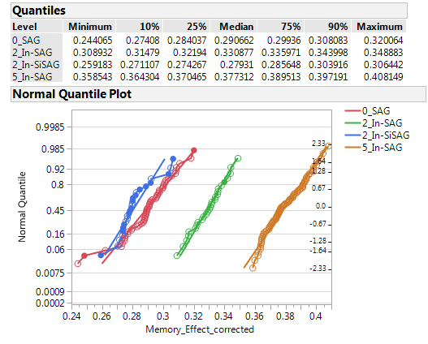
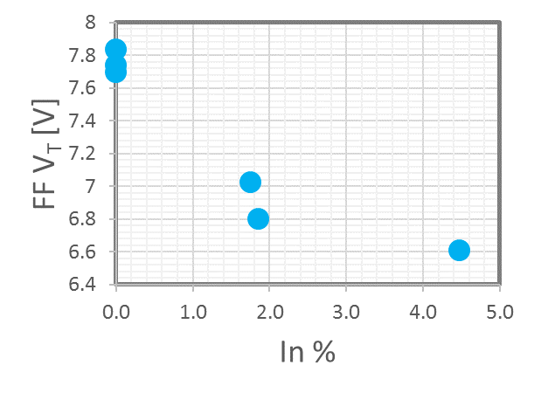
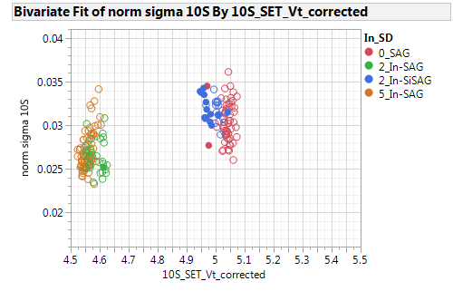
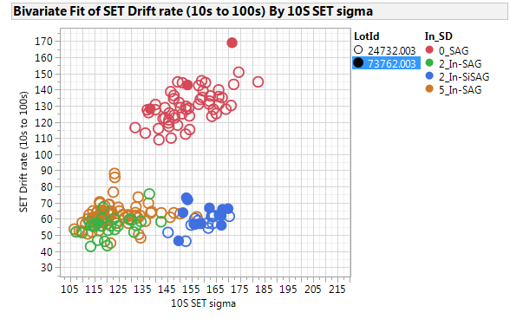
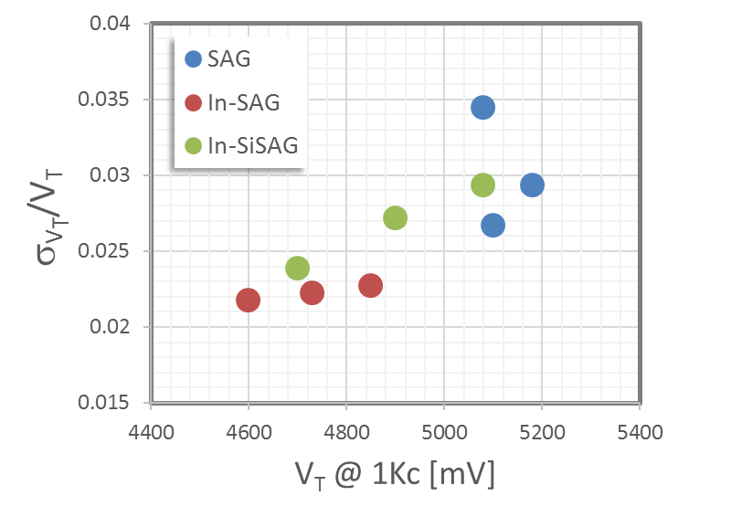
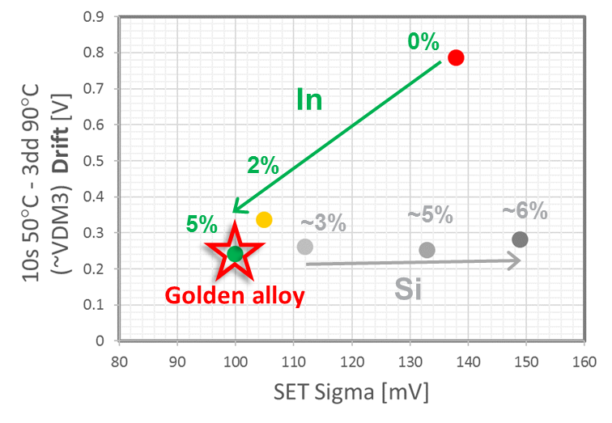
Upsides from S26
Memory effect vs Composition
2 Lots out of the K* camp (In-SAG and In-SiSAG)
S26 main array probe confirms SR71 trends with In
Main upsides of the In-SAG matrix:
FF reduction
Lower sigma
Good drift performances
Higher Memory Effect
Higher SSM window (just from SR71 and 2xCMOS)
Split | Ge | Si | In
1C | 13 | 6 | 2
2E | 16 | 0 | 0
3E | 21 | 0 | 0
4E | 25 | 0 | 0
5E | 16 | 0 | 2
6E | 16 | 0 | 5
7E | 19 | 0 | 2
Golden alloy
FF reduction
Normalized Sigma vs. V_{T}
Drift Rate vs 10s SET sigma @ 85C
Drift vs. Sigma
In-SAG alloys
>1 Volt!
Probe no visib at higher Vt
10s

Slide 3
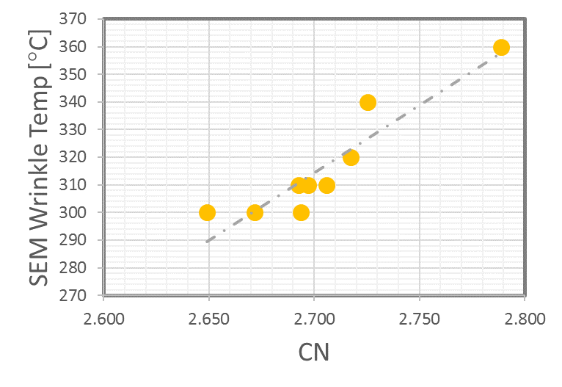
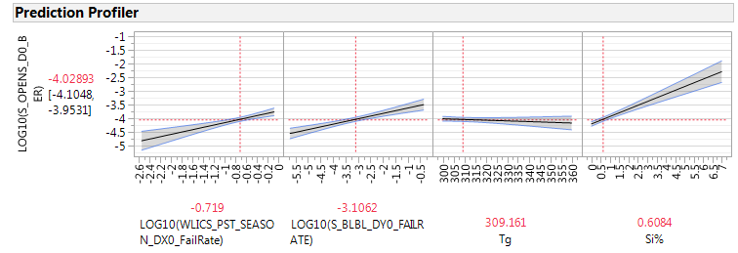
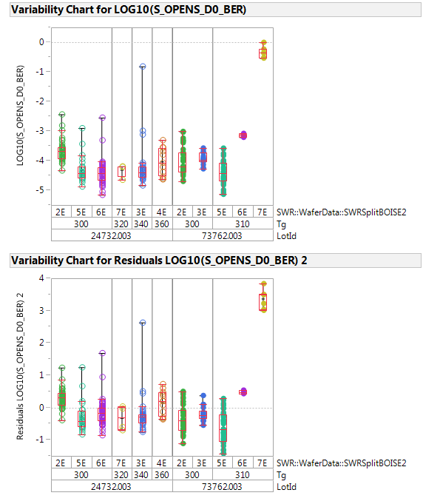
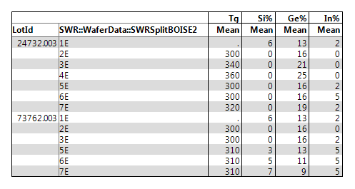
Potential warning of In-SAG: Lower Tg
Thermal stability
Lower Tg/lower thermal stability have not impact on opens on these alloys
SDv12
Opens (log) model
by Swap
Si major driver
Filtered from zone E and railed WLICS
Residual after fitting by BLBL

Slide 4
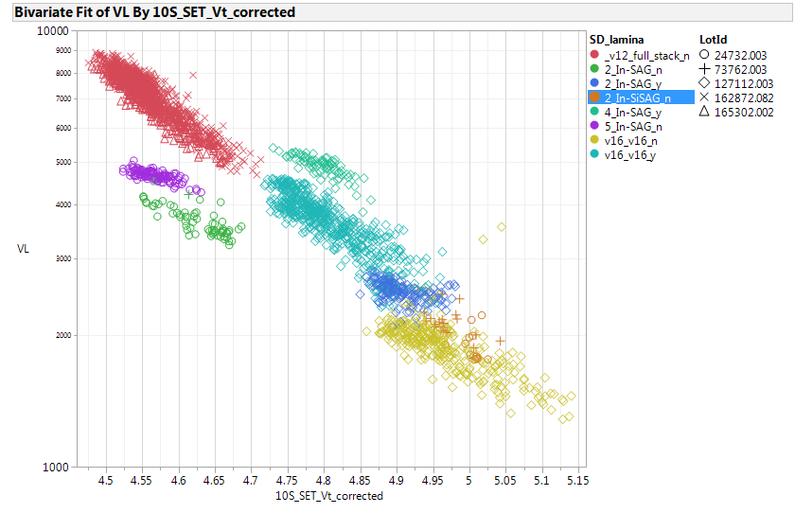
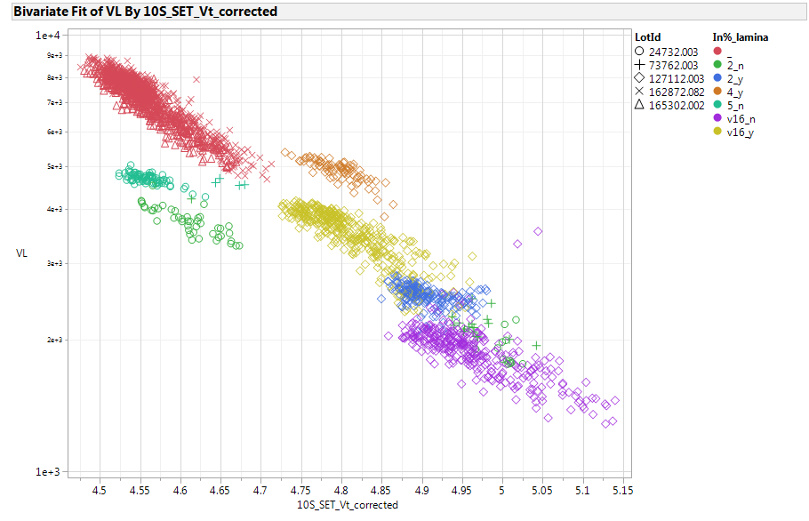
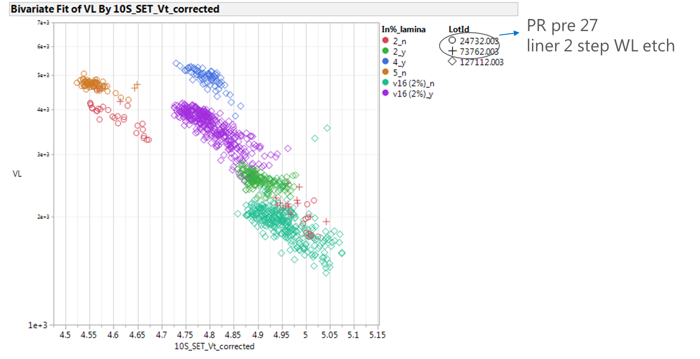
Potential warning of In-SAG: Leakage – S26 data
Full Stack
85°C
4% SD only w/ T&B lamina
5% SDonly
Inc In%
2% SDonly
VL at 3.6V nominal;
4K cells
50-50% SET/RST back pattern
SD at 22nm for SD only
+15-20% VL from 2% to 5% In
Adding lamina

Slide 5
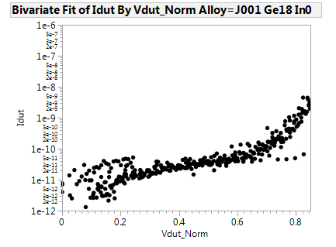
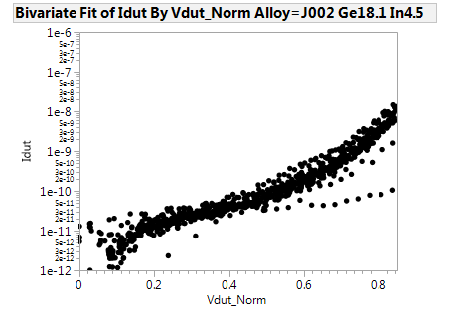
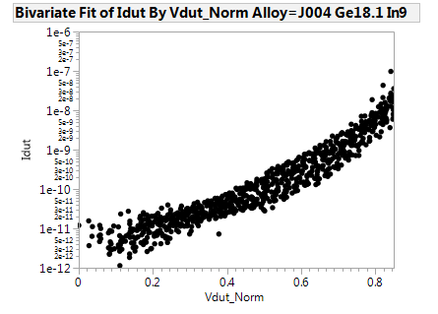
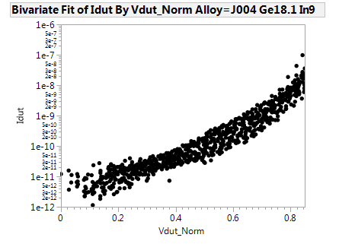

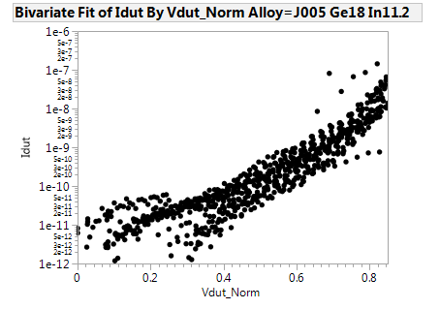
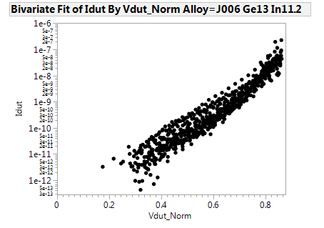
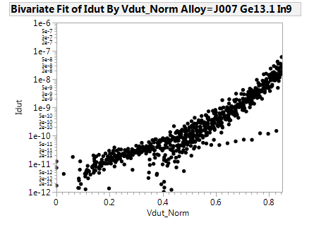
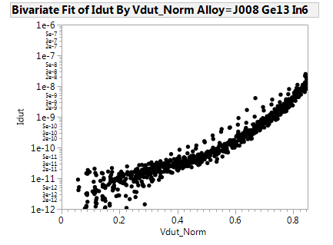
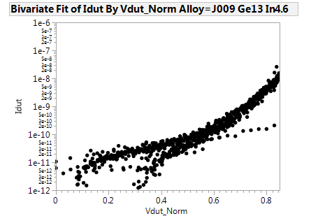
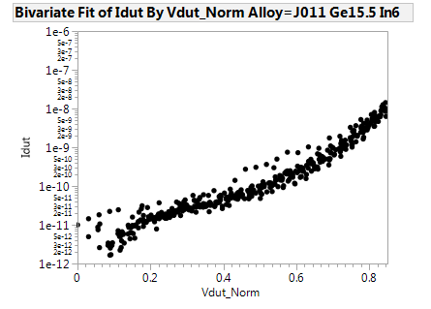
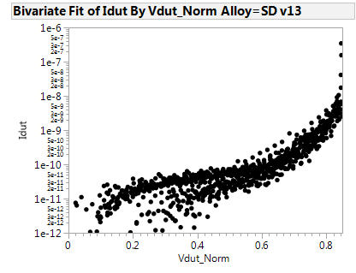

Camp J*: “Normalized” I-V curves (x-axis bias is from 0 to 85%V_{T})
The progressive In addition tends to increase the sub-V_{T} P-F conduction. See here the comparison with SDv13.
Leakage increase consistent with what observed on array
Ge 13%
Ge 13%
Ge 13%
In 11%
In 9%
In 6%
From the K camp
Ge 15%
$$\}$$
~4E alloy!
SDv13
In 5%
In addition

Slide 6
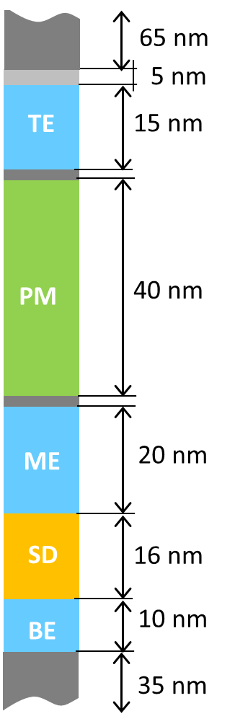
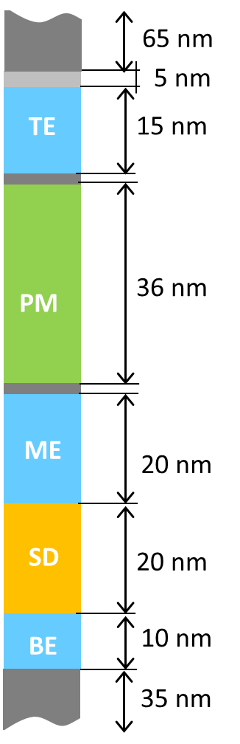
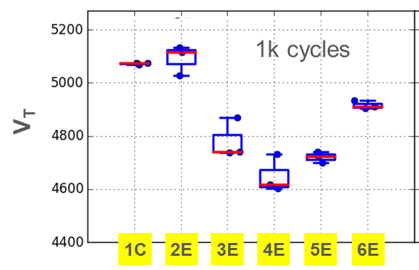
SiSAG vs In-SAG/In-SiSAG benchmarking for SxP
Better Drift, Sigma higher Memory effect can be capitalized for PM scalability
In-SAG will require higher SD thickness (~4 nm) than Si-SAG to get the same V_{T}
Thus, In-SAG can be of interest for SxP also
Actual 30S
30S w/ In-SAG
To get the same POR V_{T} with In-SAG (4E), we need to increase t_{SD} by ~ 4 nm
Better Sigma (<100mV for In-SAG) wrt ~120 mV for POR, better Drift (240 mV wrt 280 mV in the ~ VDM3 from SR71), higher Memory Effect (280 mV) represent a RWB improvement that could be capitalized as PM scaling
@ 22 nm thickness
POR
Si-SAG
$$\}$$
In-SAG
$$\}$$
In
ΔV_{T}~0.5V
Si
Recommendation:
SxP trial with In-SAG centered on 16%Ge and 5%In

Slide 7
Back-up

Slide 8
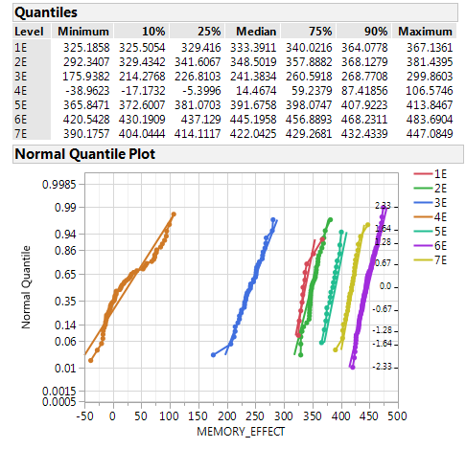
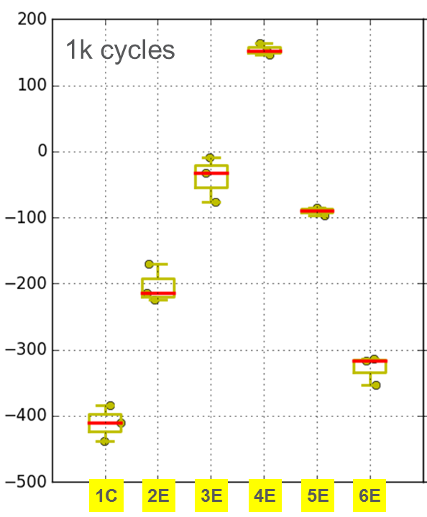
Upsides from S26
Memory effect vs Composition
Split | Ge | Si | In
1C | 13 | 6 | 2
2E | 16 | 0 | 0
3E | 21 | 0 | 0
4E | 25 | 0 | 0
5E | 16 | 0 | 2
6E | 16 | 0 | 5
7E | 19 | 0 | 2
2 Lots out of the K* camp (In-SAG and In-SiSAG)
Main upsides of the In-SAG matrix:
FF reduction
Lower sigma
Good drift performances
Higher Memory Effect
Higher SSM window (just from SR71 and 2xCMOS)
Note: Memory Effect reliability to be verified
Golden alloy
SSM window
Normalized Sigma vs. V_{T}
Drift vs. Sigma
FF reduction
In-SAG alloys
In
Si
>1 Volt!
SSM window - 3.54s projected

Slide 9
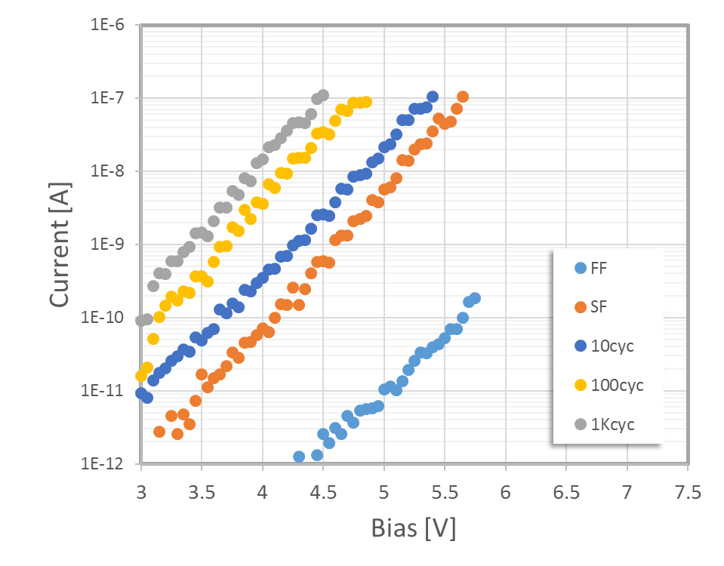
V_{T}
I_{LEAK}

Slide 10
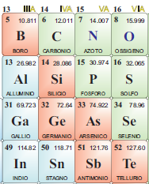
Recommendations:
2nd Lot confirmed the recommendation to purchase of In-SAG alloy with Ge16% and In 5% mono-tg as SSM pre-POR → ETA for tg arrival end-Jan
Preliminary analysis of K* pushes to consider In-SAG for 30S too → opportunity to run it on 3DXP when the 30S perspectives will be clarified
In-SAG results reinforce the roadmap for Ga-SAG
In line with the III-group exploration we can check if the the Electronegativity contrast wrt Se the important parameter for the SSM window?
GaSe tg in house, more suitable for this campaign is the Ga₂Se₃ tg → just ordered (ETA ~ wk 8)
1.8
1.6
2.4
1.7

Slide 11
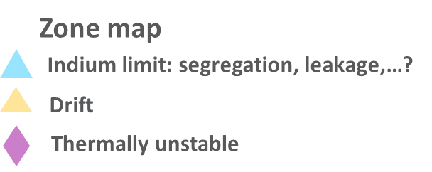
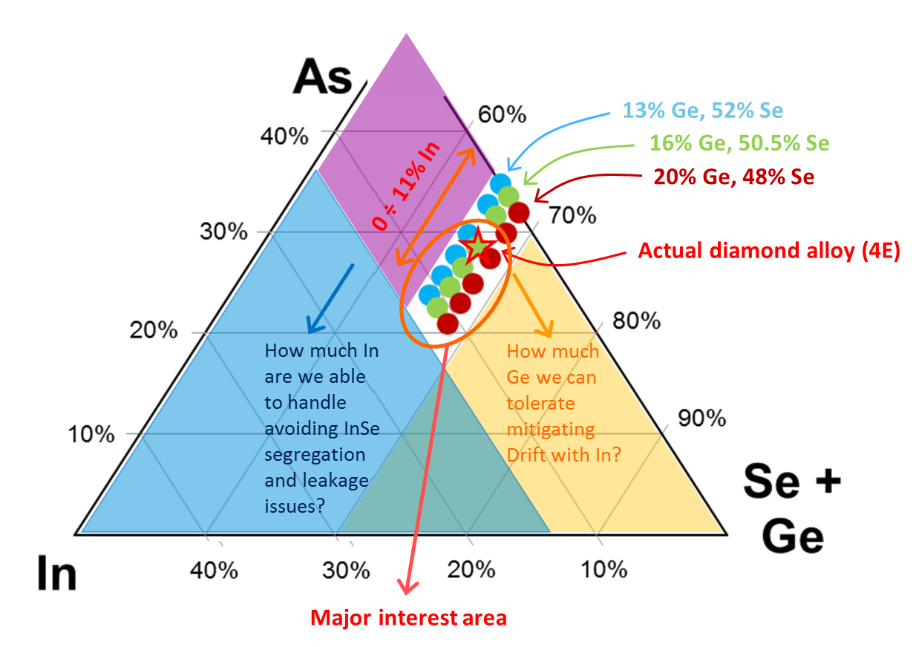
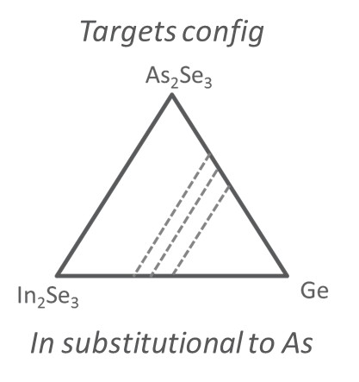
Towards a Treasure Map of the In-SAG based SD3 (including also In-SiSAG)
2 further A0 Lots planned to complete the treasure map exploration of the In-SAG (and In-SiSAG) system (split tables) + some selected alloys on A1 → Next read: wk 04
Main open question we need to answer: what is the maximum In% we can tolerate w/o segregation and leakage issues?

Slide 12
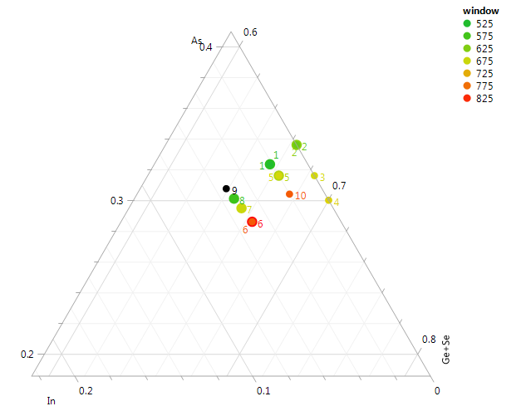
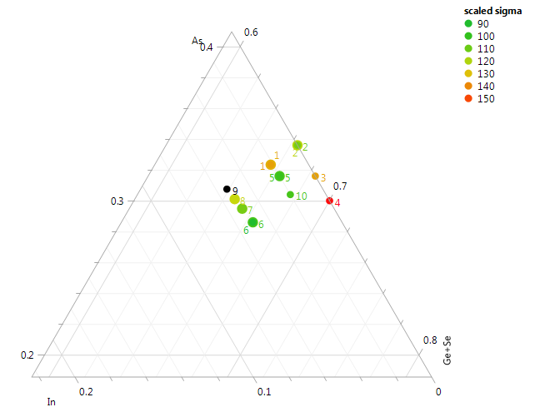
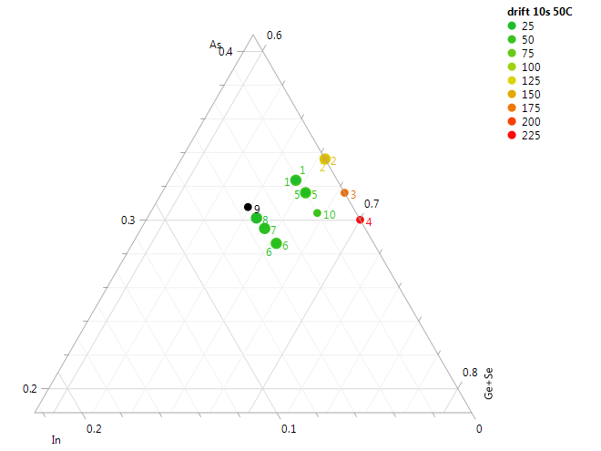
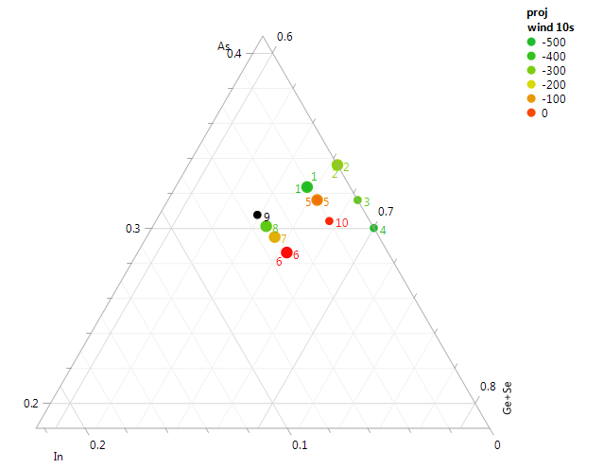
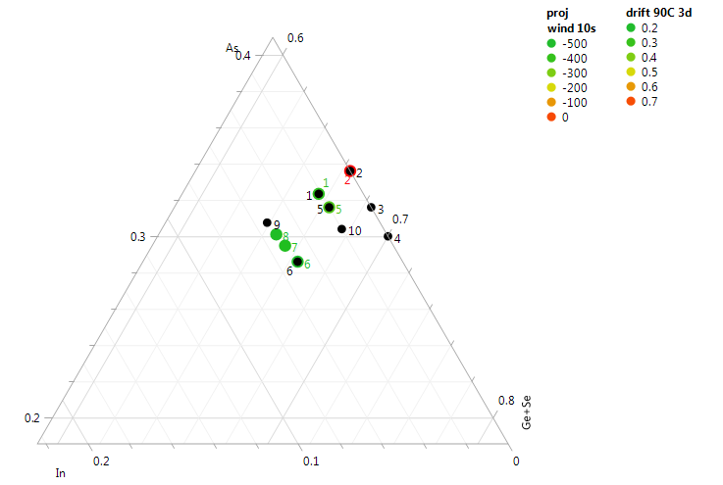
Area of further interest:
+In, +Ge
verify Si role

