Slide 1
Hf campaign II
See the notes on the left margin of many of these slides for instructions on their use.
Subtitle
Speaker name and title

Slide 2
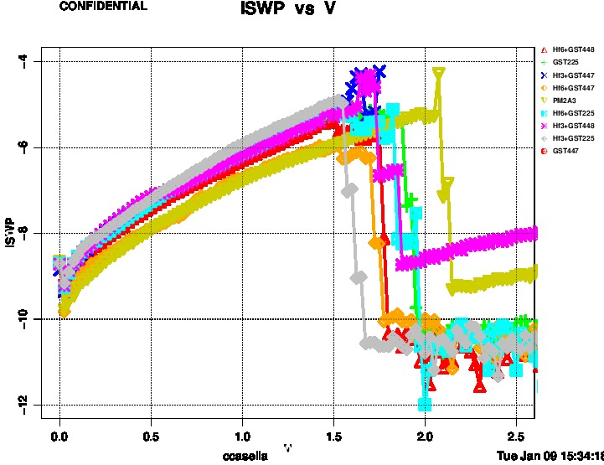
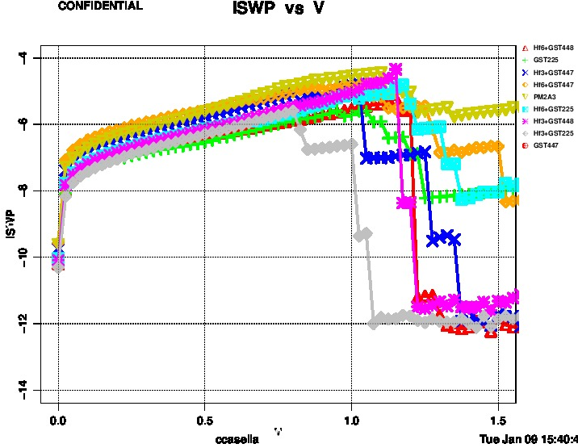
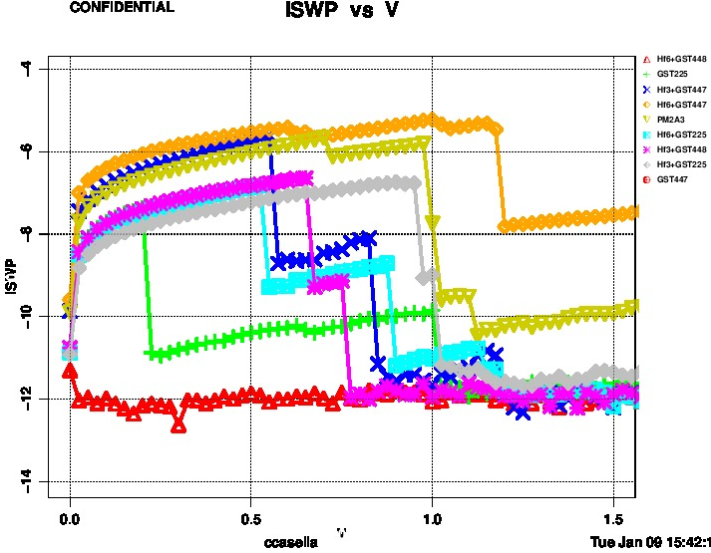
FF/IV curves
FF
POR
IV
POR
IV 1kc
POR
FF values are reliable while after 1kc seems that cells degraded.

Slide 3
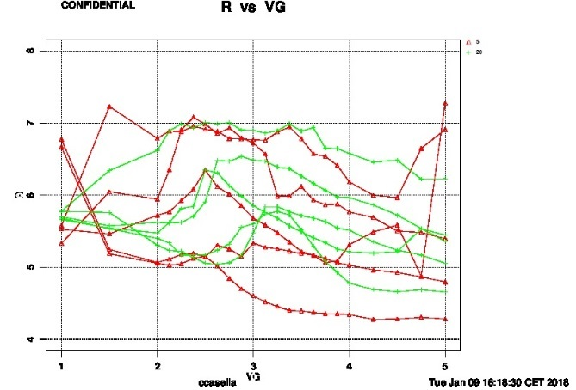
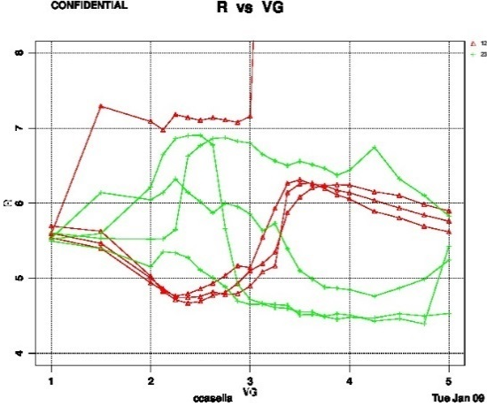
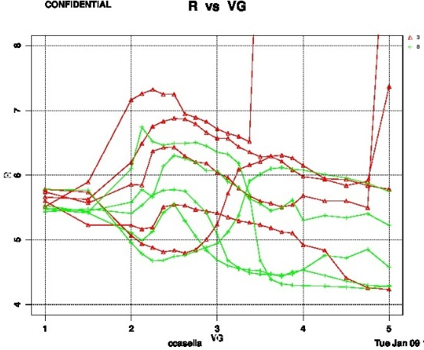
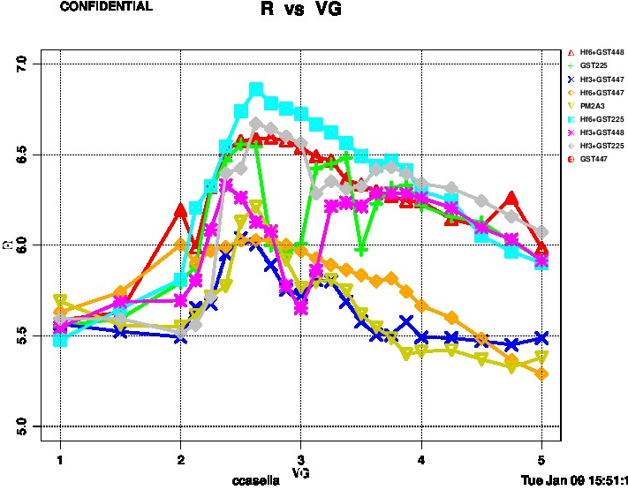
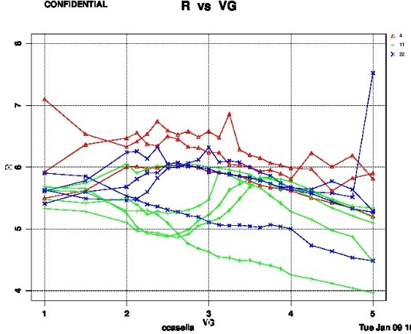
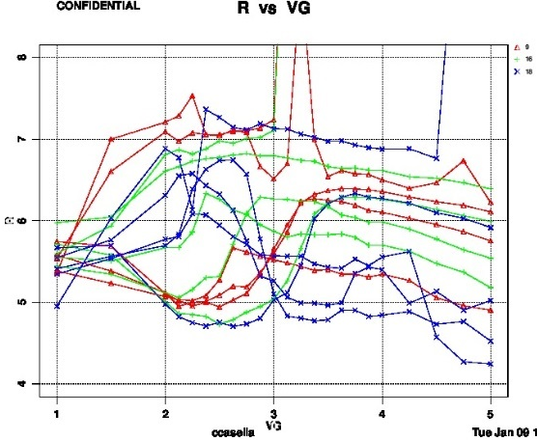
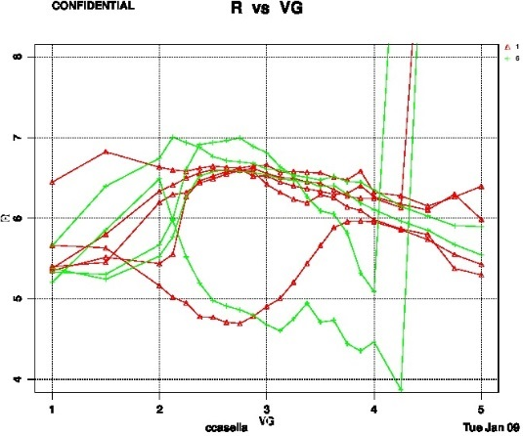
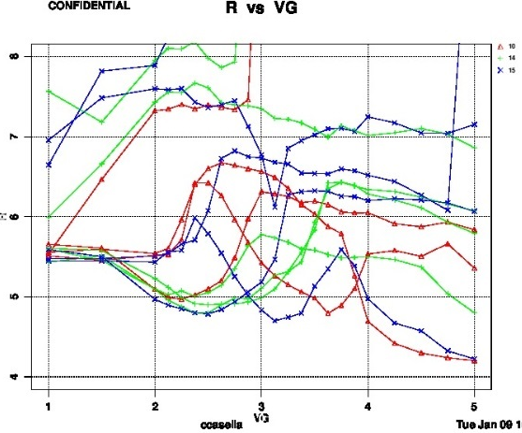
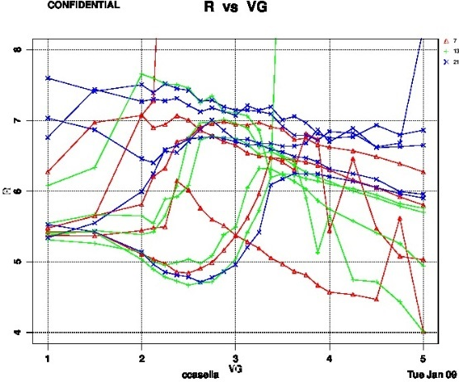
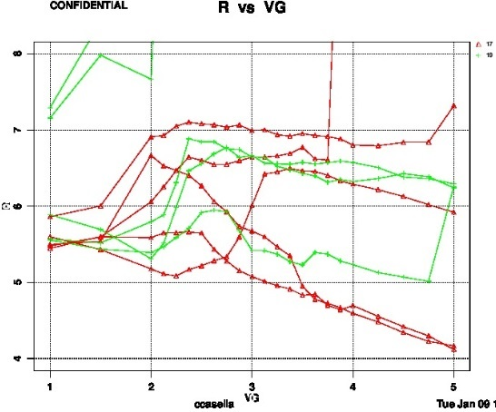
Set to reset
POR
GST447
Hf3% GST447
Hf6% GST447
Hf3% GST448
Hf6% GST448
Notes:
Very high wf 2 wf and intra wf variation.
Variability is not alloy dependent, also POR is not aligned with the past.
No conclusions on the trial can be done.
Hf3% GST225
Hf6% GST225
GST225

Slide 4
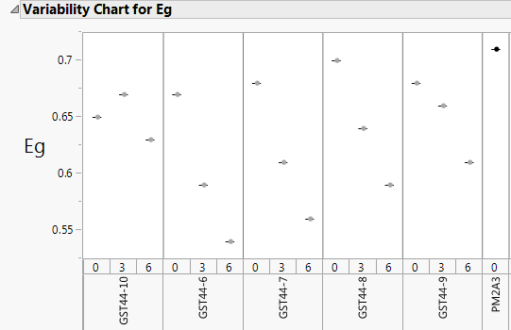
Conclusions and summary on Hf campaign
Courtesy of dwcollins
No data from this lot can be done collected form this lot;
Eg data of alloy deposited on this round did not indicate an increasing in Vth value;
From the previous lot no Hf doped alloy was more promising than the PM2.A.3;
Hf target has been dismounted from the tool
No reasons to go further in the investigation of Hf doped alloys or promote to L1D step.

