Slide 1
K* campaign synopsis from both SR71 (SSM) and S26 data
Deeper insights, expectations and further directions
Contributes from Materials Team, SSM Team and Array Team

Slide 2
K* campaign: In-SAG and In-SiSAG systems exploration
5 Lots processed for this exploration
  Note: first 2 lots were of poor quality as a consequence of the integration with larger CD (CD- instead of CD--) which lead to periphery yield loss → thus neglected from this S26 summary
All lots run following the SD-only flow with 22 nm thickness and SD liner-protected
Metrics used for the SD alloy assessment:
  L0 metrics (Thermal stability and band gap, mainly)
  Structural yield
  Forming
  V_{T} Sigma
  Drift
  SSM window
  Leakage
  Memory Effect
  Endurance (V_{T} stability thru cycling)
Cross-check between the two vehicles (S26 and SR71) always done, when possible

Slide 3
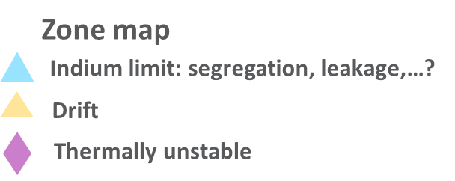
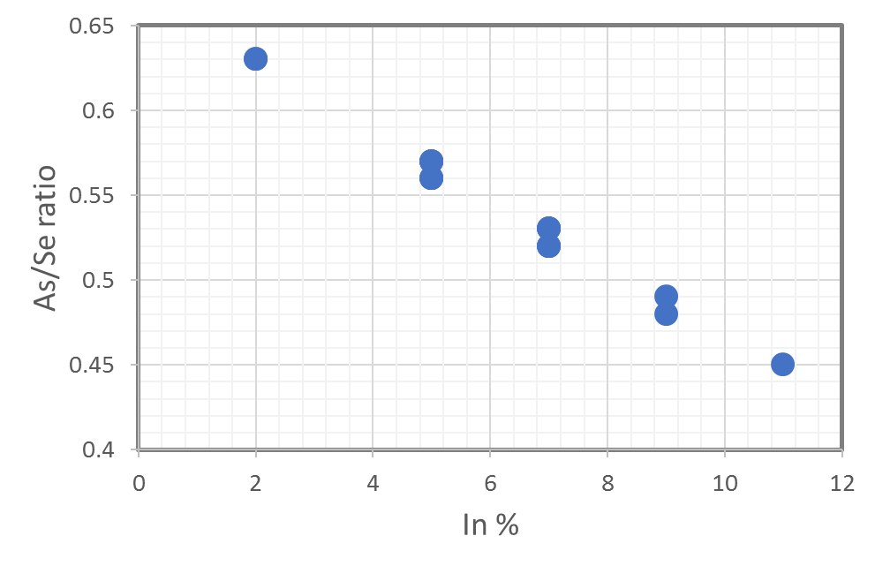
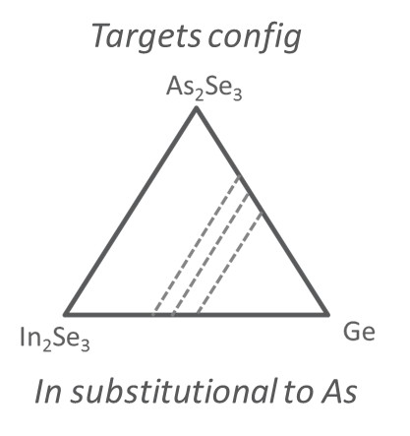
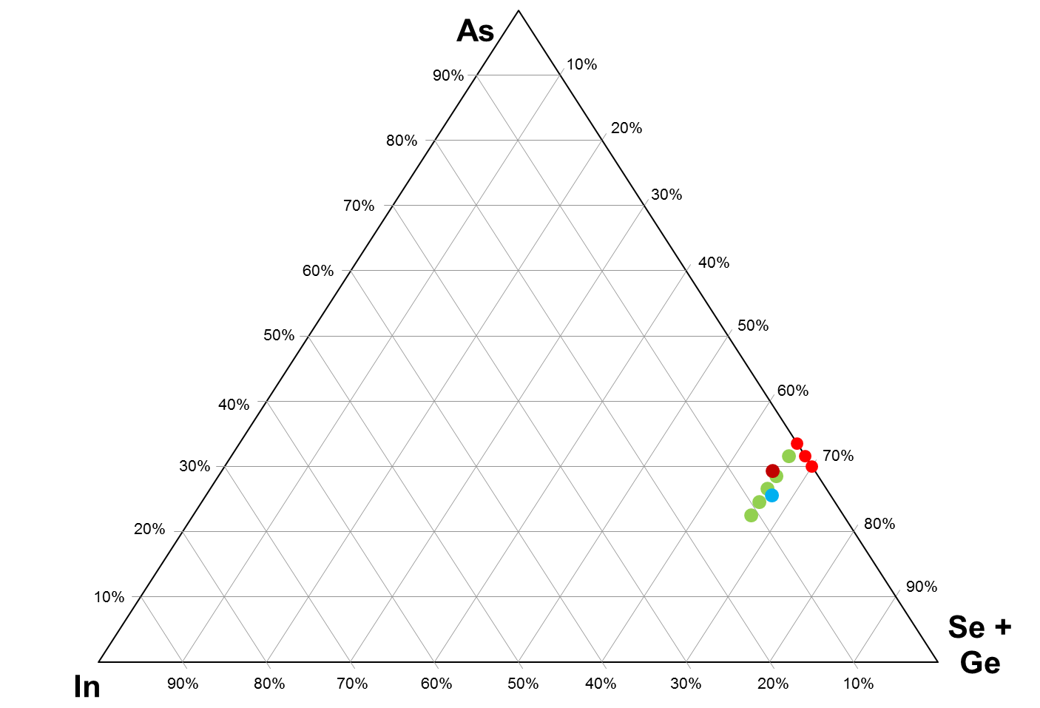
Fundamentals of K* campaign:
Towards a Treasure Map of the In-SAG based SD3
(including also In-SiSAG)
As/Se vs Indium correlation
4C chamber configured with: As₂Se₃, In₂Se₃, Ge and Si
  Main campaign: In-SAG exploration; Si thought just to mild possible Indium drawbacks (like leakage)
  Note: when In increases As/Se decreases
Main open question: what is the maximum In% we can tolerate w/o segregation and leakage issues?
As
Si
0-11% In skew
SD1
SDK1 – SSM Pre-POR
w/ 5% In and 16% Ge
Max Ge% to control Drift?
Max In% to manage integration and leakage?
In

Slide 4
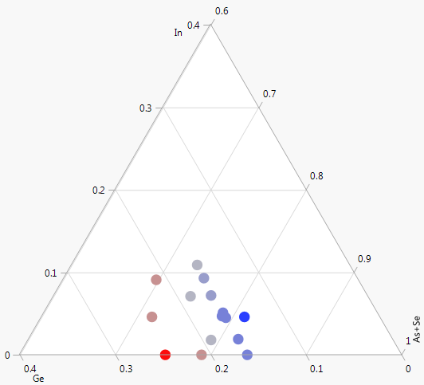
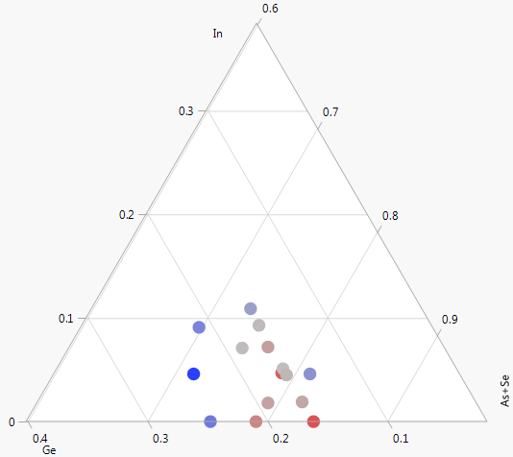
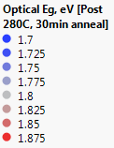

L0 metrics: Thermal stability and Band gap
by Swap
SEM Wrinkle
Eg
Ge
Ge
In
Thermal stability largely governed by Ge content
Optical Eg lowers with higher Indium and Ge (more so with Ge than In)

Slide 5
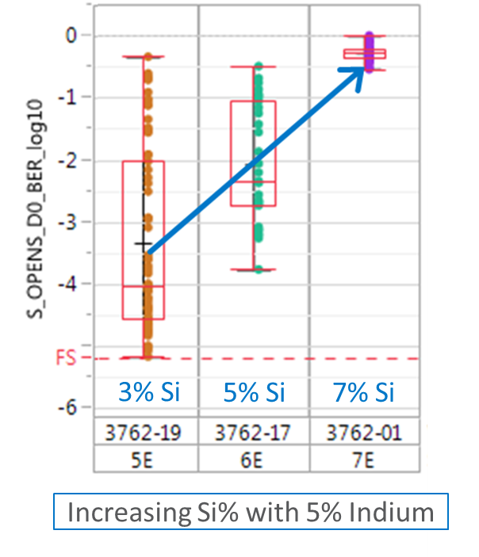
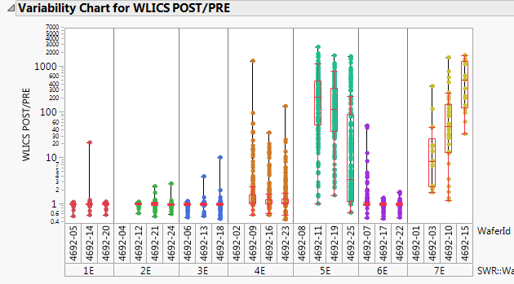
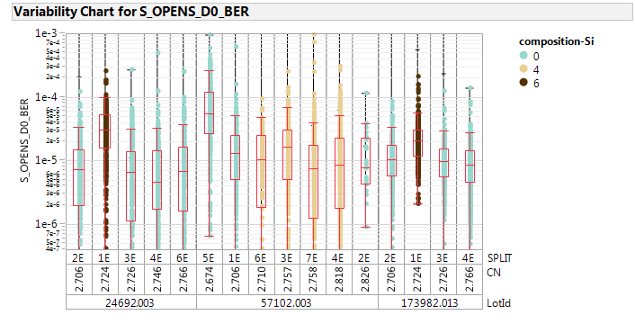
Structural yield (intrinsic and extrinsic)
Structure Opens
by Lidia
Take-away:
Si increase on In-SAG matrix degrades Opens
In increase degrades vertical leakage after cycling
5% In appears safe; 7% needs deeper assessment
  PFA running on to segment the nature of vertical shorts/SWL
Warnings about alloys with CN < 2.674
by Lidia
2%
7%
9%
9%
7%
11%
In%
Lowest CN – Lowest Tg
5%
Plot vs CN?
No Si
Opens BER after filtering from laterals

Slide 6
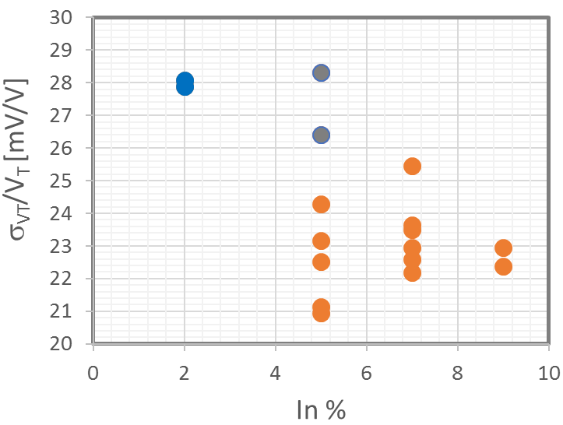
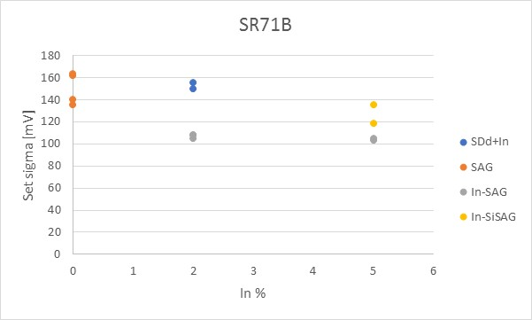
Sigma V_{T} trends
Normalized 10s Sigma vs In
In-SiSAG
S26
In-SAG: ~20% Normalized SET sigma improvement w/ 5%
Worsening w/ Si
No clear worsening from 5% to 7-9%
  Carefully evaluate L2L
w/ 4% Si
~ 20% improvement w/ 5% In
σ_{VT} sigma for SDK1 can be as low as 90 mV
In-SAG shows the best sigma on both vehicles: S26 and SR71

Slide 7
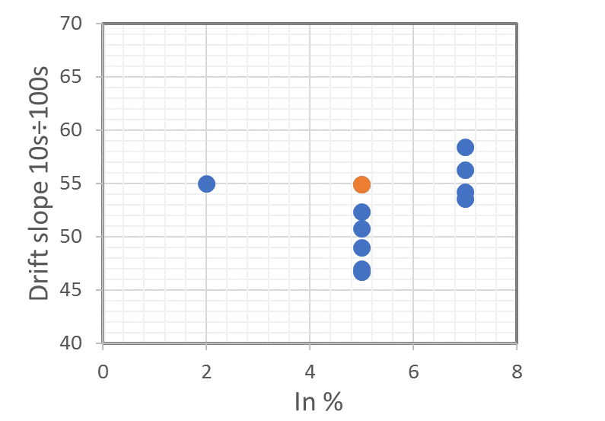
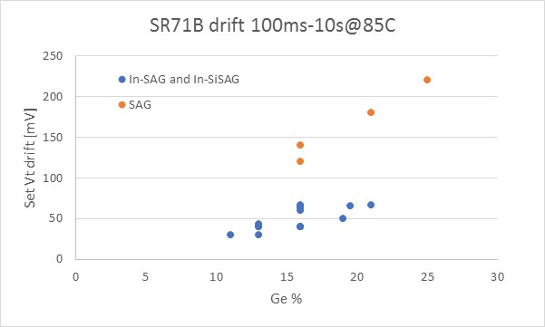
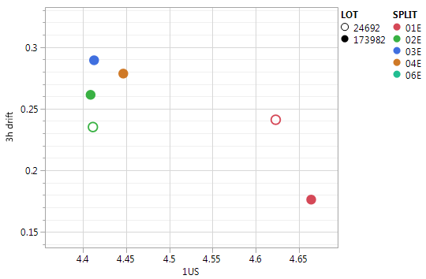
Drift trends
S26
PG4 test
Same alloy SDK1 on 2 different lots
Not clear trends from S26
Notes:
  Indium (as Si) mitigates Drift
  InSAG comparable or worsen than SiSAG
  Possible worsening could be associated to the usual Drift-V_{T} correlation
3hrs Drift vs V_{T}
S26
PG4 test
5% InSAG
Typical trend w/ Ge
POR

Slide 8
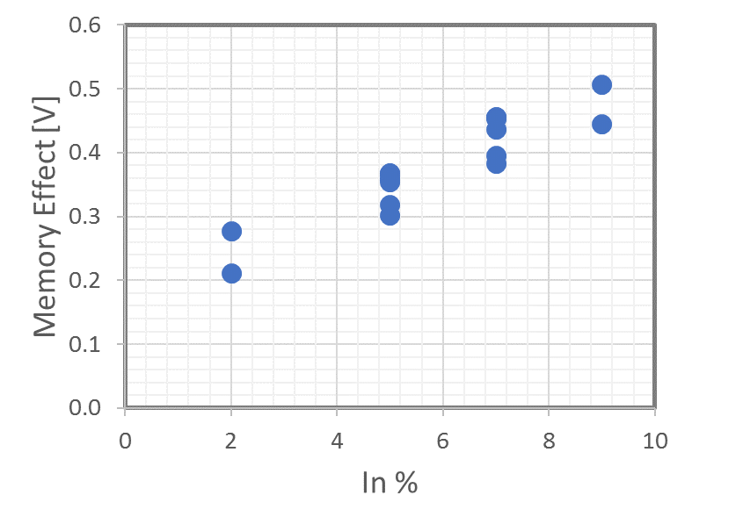
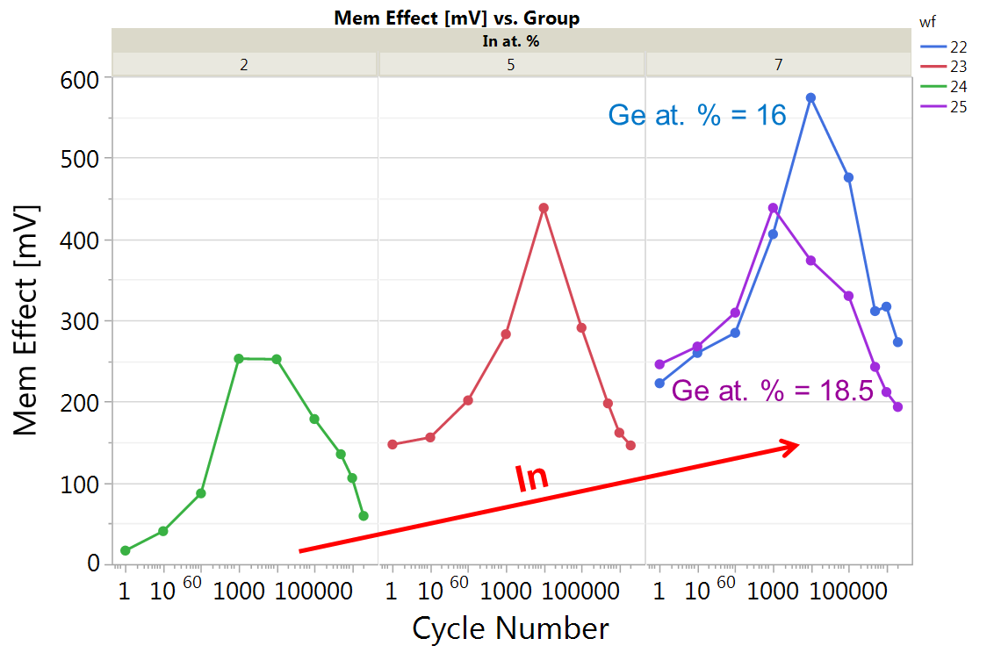
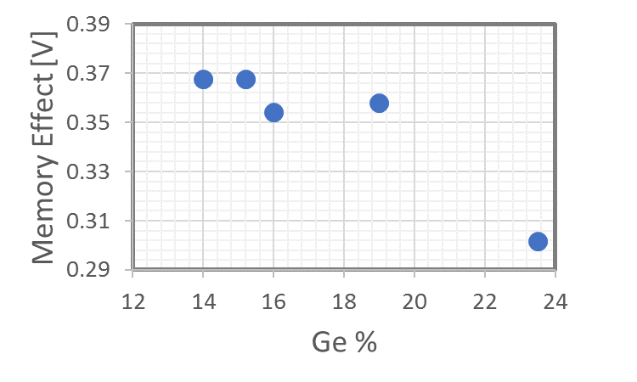
Memory Effect
Memory Effect clearly trends with In content
SDK1 alloy reaches 350 mV
A trend in the decrease direction captured with Ge increase
A bell shape w/ maximum and a loss of the effect thru cycling
Memory Eff. Vs cycling
by MattB
All ED mixed

Slide 9
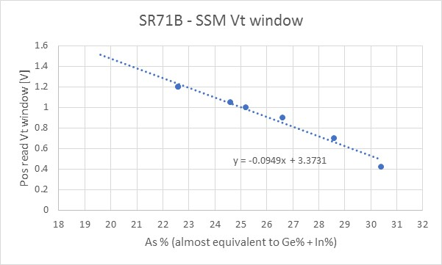
SSM window trends
SSM V_{T} window is increased with the addition of Ge% or In%
Best correlation found with total As%
Target window can be reached in the region around 20 As%
Goal
SDK1 – SSM Pre-POR
w/ 5% In and 16% Ge
As/Se vs Indium correlation

Slide 10
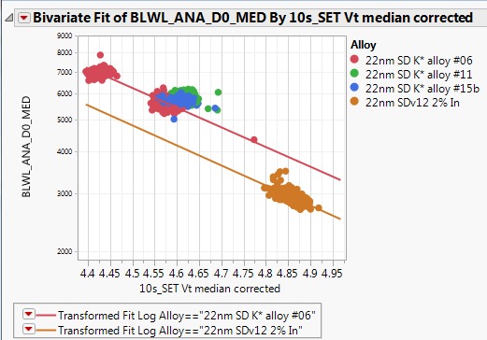
Leakage trends
S26
+25%
  Leakage increase with Indium not so critical (within 25%)

Slide 11
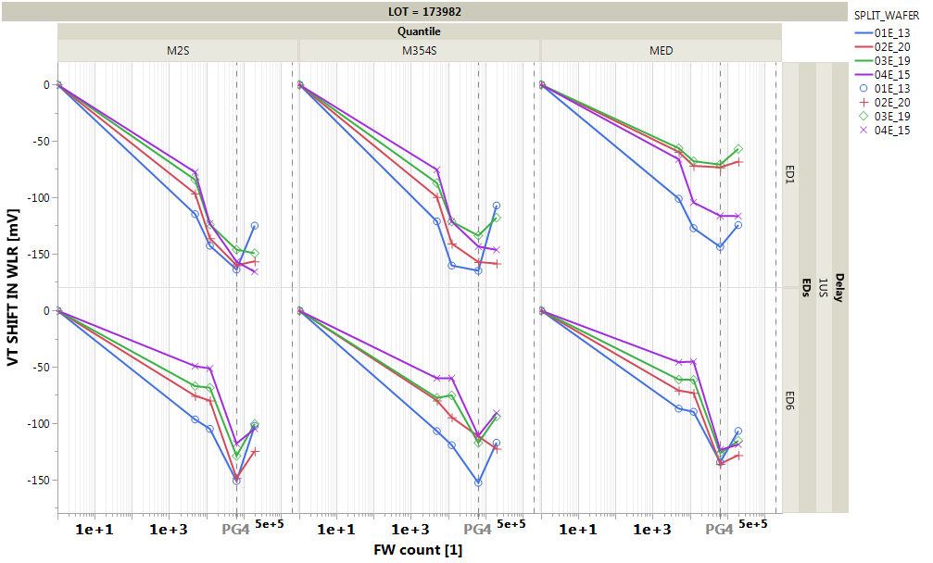
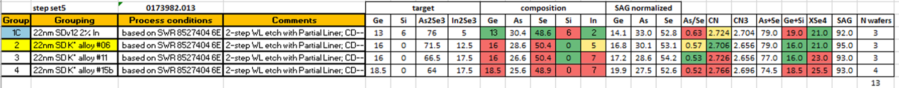
Endurance: some signals
S26 - WLR
  Preliminary from WLR
  More exhaustive result from bench will be available
  SDK#6 presents some advantages wrt SDv12+In:
  Smaller degradation of V_{T} median with cycling
  Less pronounced turnaround
  Signal to be checked on the other lots

Slide 12
K* camp: Key messages
Main upsides of the In-SAG matrix:
  FF reduction → ~1V lower
  Lower sigma → down up to 90-100mV
  Higher SSM window → up to 0.5 V gain
  Higher Memory Effect → upsides ~100mV
  Reduced V_{T} shift w/ cycling → reduced degradation and turnaround
Also some warnings arise from the K* lots analysis:
  Drift performances not clear → it could be stable or degrade
  The intrinsic/extrinsic weakness of In-SAG alloys with In>7% → PFA running on
  The leakage increase with Indium (not critical, within 25%)
In-SAG alloy likes for SSM applications and, potentially, for 30S SxP scaling:
  K* campaign allowed finding the new pre-POR (SDK1) pure In-SAG alloy for SSM
  At first order approximation it is as SDv12 where Indium substitutes Si and lower As/Se ratio

Slide 13
SSM perspectives and Plan
SDK1 monotg installed in the 3C to foster:
  learning about montg fabrication and stoichiometry mapped on Si
  assessment the role of AlO₂ lamina on integration and performances w/ In-SAG
Possible SDK2 monotg from SD K* 2nd run → decision wk#9-10
E* target (close to GeSe₄ w/ 5%In) installed in the 4C chamber to:
  segment the role of As reduction on In-SAG (that will be further explored w/ G* camp w/ fixed 5%In 3C)
  run the 3rd K* trial in order to maximize the SSM window by higher In and Ge
Campaigns Gantt
Recommendations:
EDX on In-SAG for both transformation function learning and to understand how segregation modulates SSM window
Deeper reliability characterization on In-SAG alloys to assess the alloys robustness

Slide 14
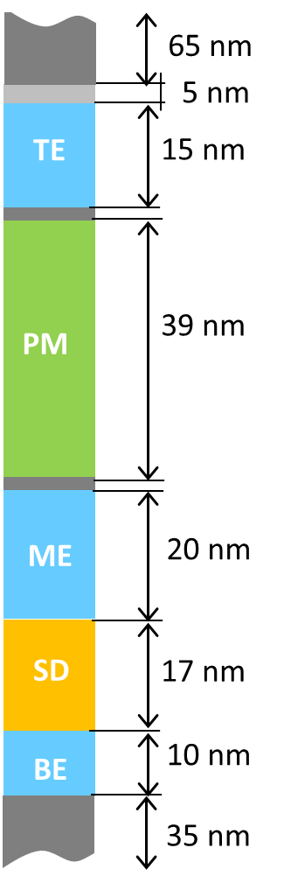
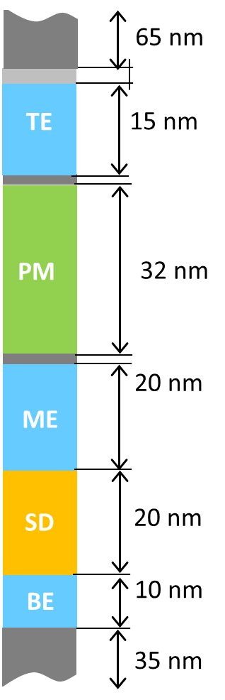
SiSAG vs In-SAG/In-SiSAG benchmarking for SxP
Under the below assumptions (supported by the experimental picture reported in the previous slides):
  Sigma VT gain ~ 100 mV
  Memory effect gain ~ 100 mV
  Same Drift
200mV RWB gain thru the substitution of SiSAG with In-SAG can be computed
This gain can be transferred in -7nm PM thickness maintaining the same ΔV_{T} (considering 28mV/nm sensitivity), w/ +3 nm SD thickness to match the same V_{T}
Actual 30S
30S w/ In-SAG
In-SAG
$$\}$$
Si-SAG
$$\}$$
Recommendation:
SxP trial on FS with In-SAG centered on SDK1 pro 30S planned on March
To get the same POR V_{T} with In-SAG, we need to increase t_{SD} by ~ 3 nm, but 7 nm reduction on PM

Slide 15
Back-up

Slide 16
In-SAG opportunity for 30S
SDK#6 (In-SAG) upsides wrt SDv12+In:
  Sigma: more than 10mV sigma gain
  Memory effect: more than 100 mV larger
  Drift: equivalent up to VDM2, to be better segmented the VDM3
  Endurance: reduced E2 turnaround
  Note: all these parameters have been evaluated from SD only silicon probed with:
  The same seasoning as the one of the FS (that could not be optimum for SD-only)
  A 3E Set pulse with lower maximum current (~26 uA)
  PG4 t_{sense}
  Process with Liner-protected SD
  About points 1, 2 segmentation in progress (MattiaB.)

Slide 17
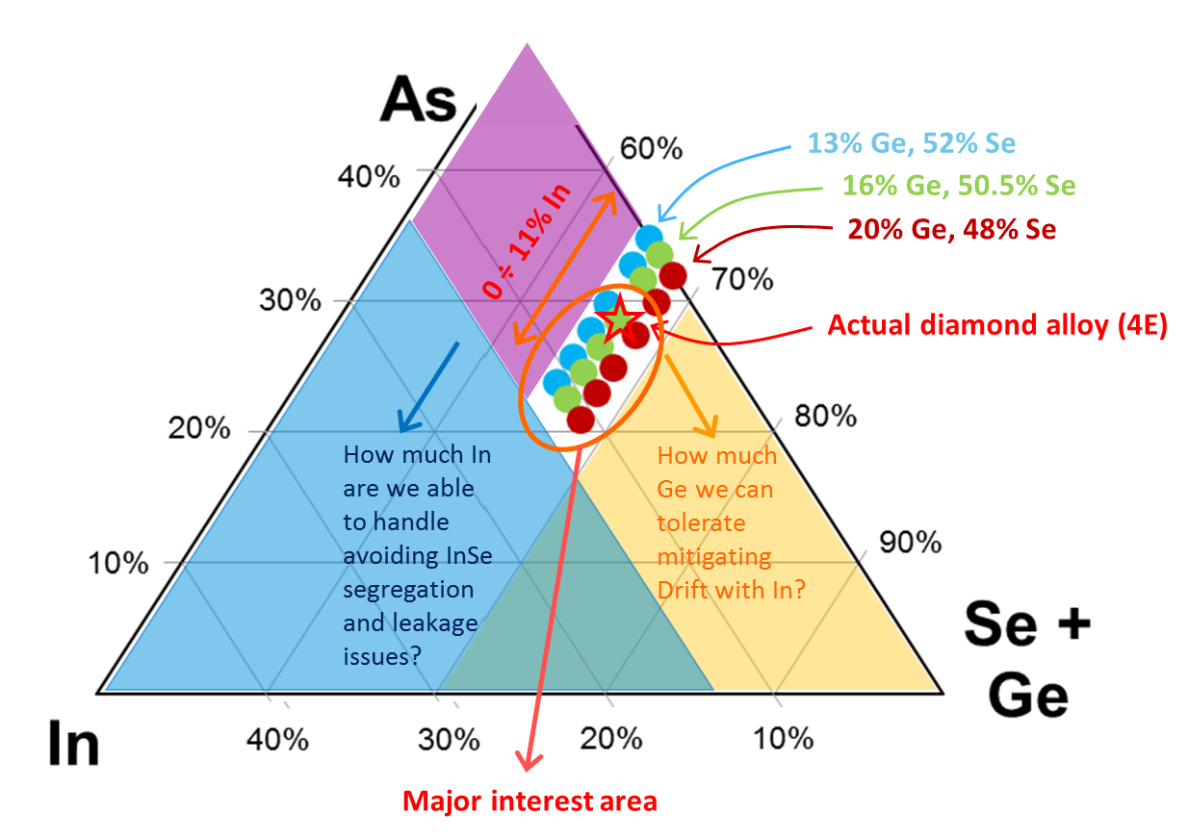
As
Actual pre-POR for SSM
In

