Slide 1
30S 3DXP / SSM Material Strategy Review
Jan 31, 2018
Material core team: Dale, Swapnil, Andrea, Kolya, Enrico, Paolo, Dan, Cristina, Lorenzo

Slide 2
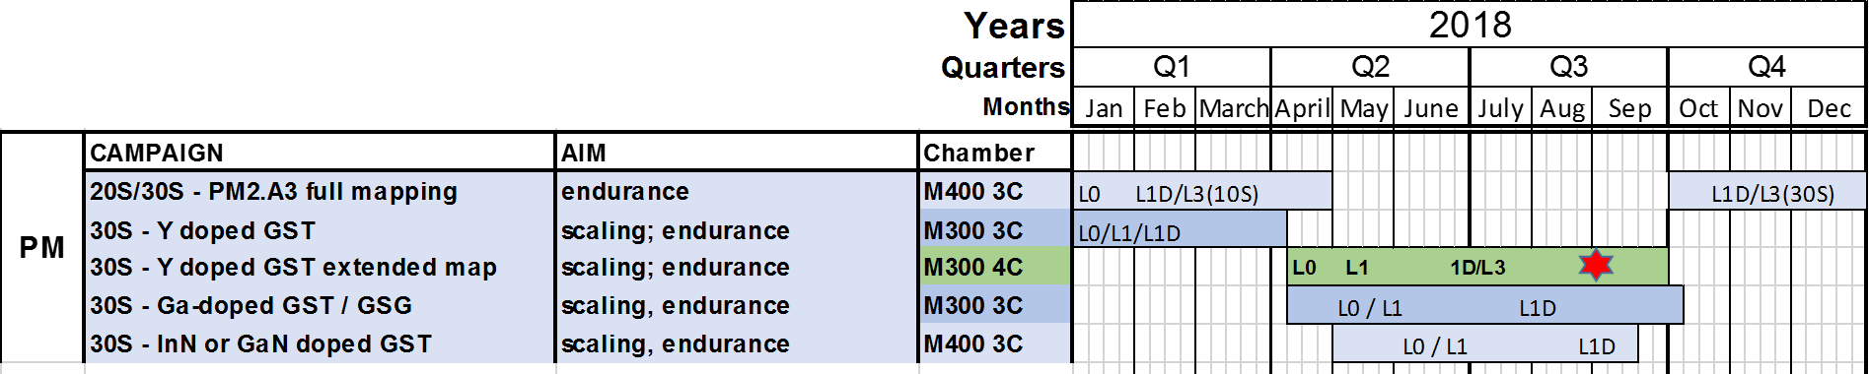
3DXP 30S: PM development for scalability and endurance
Hf / Y Transition metal doping of GST running -- targetting 30S
Aim: search a breakthrough for thickness scaling (same VT, more speed, less degradation)
Hf campaign: completed L0/L1; Eg/VT data so far not supporting L3
Status: Y running at L0/L1 level, L1D starting. Goal: intercept S36X array integration
PM2.A3 In-GST corners in the Sb-poor region running – more learning
Aim1: complete L0 characterization and learning on ‘segregated’ compositions
Aim2: optimize the GST matrix limiting the Sb enrichment post-segregation (endurance)
L1D/L3 execution starting on S15
Next: III group element PM doping, alternative to Indium H2 2018
Planned options: Ga-based PM (Ga-GST, GaSbGe,); AlN or BN or GaN molecular doping
Back-up to Y

Slide 3
SSM & 3DXP 30S - SD development
K* campaign – In(Si)SAG SD, In/Si/Ge trimming running – targeting SSM & 30S
Aim 1: increase SSM VT window with controlled sigma & drift
Aim 2: improve VT sigma and drift for 30S SD
Goal: assessed SD3 material & integration to intercept S26S release
G* campaign – InSAG SD, As/Se trimming planned – targeting SSM
Aim1: increase SSM VT window; eventual upside to be combined with K*
Aim2: validate segregation model for VT window thru bilayer deposition
N* Campaign – SiN-SAG running
Aim: first exploration of molecular doping; L2 lot out in Feb.18
Next: III group element SD doping, alternative to Indium H2 2018
Planned options: Ga-based SD (Ga-SAG or GaN-SAG molecular doping)

Slide 4
2018 Tentative Plan for PM & SD
Note: two 3C co-sputter chamber available for SD, and two for PM. 4C chamber can be used for both, and its allocation based on priority is relevant for completion date

Slide 5
Bonus

Slide 6
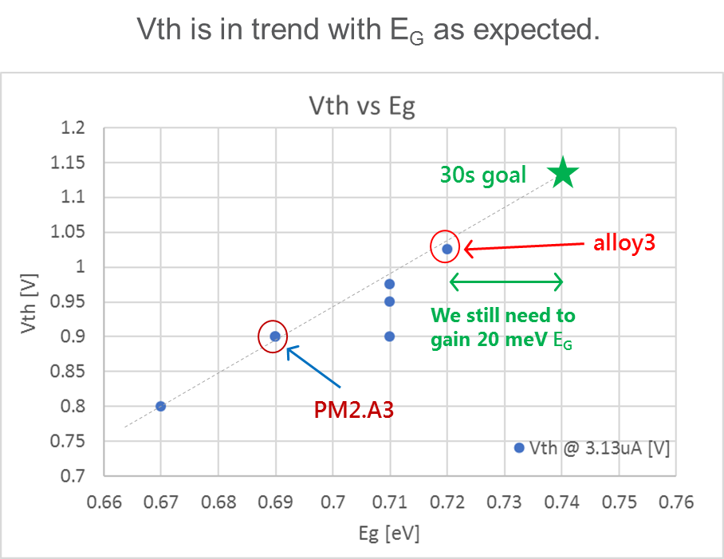
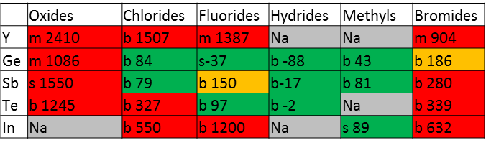
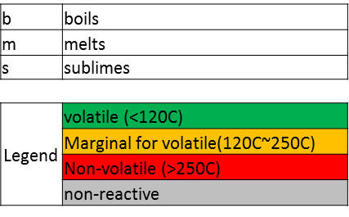

3DXP 30S: Y-doped PM development status
Background
Value proposition in Dec.2016 (Paolo, 30S material pathf.) based on ab-initio simulation. Initial goal: 30nm thickness (25% scaling)
Y atoms substituting Sb enlarge the band gap (tgt: Eg from 0.69 to 0.74)
Y doesn’t depress the sub-critical nuclei for crystallization, high SET-speed is expected
Recent read-out in Nov.2017:
Eg 0.72eV obtained with a Sb-rich alloy, anyway faster than PM2 at L1 (CLV)
Running campaign to get higher 0.74eV Eg or more
L1 1st half lot at depo with more balanced Ge/Sb content, partial read wk.08.18; L1 wafers shortage (W CMP issues) will delay L1 campaign completion to wk.13.18
Success criteria are Eg / VT window and nucleation speed
L1D planned on S26 (39nm thickness, Y 4%) → go/no go check point wk.10/18
Success criteria: to demonstrate etch capability, in spite of poor Y volatility; avoid ‘YTe clustering formation
L3: confirmation to run it on S26 at check-point → 2 Silicon loops by end Q2.18
Success criteria: to assess Y-PM speed/dVT performance after integration; low segregation
Note 1: execution time impacted by PVD resources engagement on PM endurance TF
Note 2: Y campaign running on 3C chamber (GeTe, 225, Ysb), only ‘lines’ feasible in the composition space, good to assess value but not enough to screen the best alloy
Cristina

Slide 7
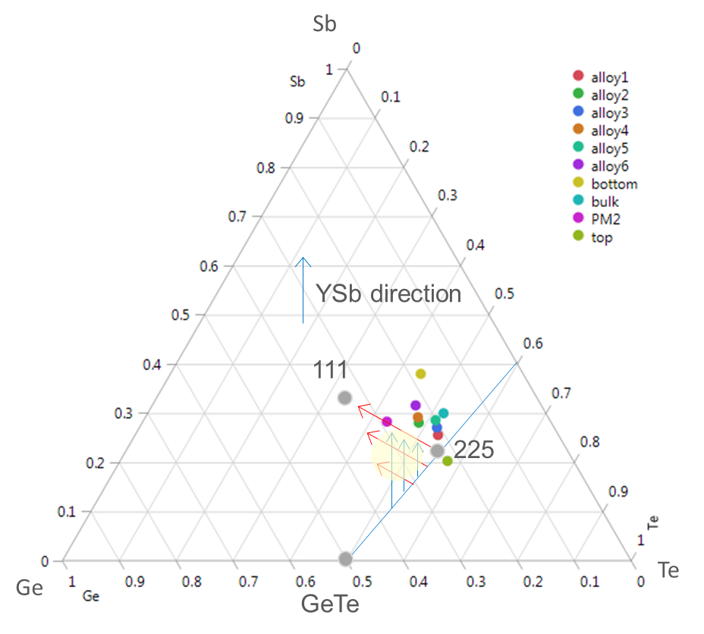

3DXP 30S: Y-doped PM development path
Next steps / methodology
Based on PM2 and Al-doped PM learning, the new PM optimization strategy is to extend L0/L1 characterization and reduce composition change steps at L3, where integration effort is huge
Extended L0/L1 characterization means:
to map basic parameters (Rs, Tx, Tg,…) values and gradients on composition space, including ‘segregated like alloys’
Trimming all Y-GST 4 elements independently in the composition space
If value confirmed on running campaign on 3C, plan is to move the Y-PM development to the 4C chamber , starting from Apr.18
Extended L0/L1 mapping in May-June.18
L3 corner integration on S26/S36X tentatively in July-Sep.18;
Recommendations / Action needed:
4C chamber is used for SD K* campaign, till Apr.18, aimed to SSM VT window. Possible conflict with SSM if SD K* will need to accelerate the SD3 assessment on 4C. – Decision to be taken by end March
Ensure PVD resources are enough to support all 10S/20S/30S/SSM programs in parallel
Next 3C exploration
Mapping by 4C
(including ‘segregation’)

Slide 8
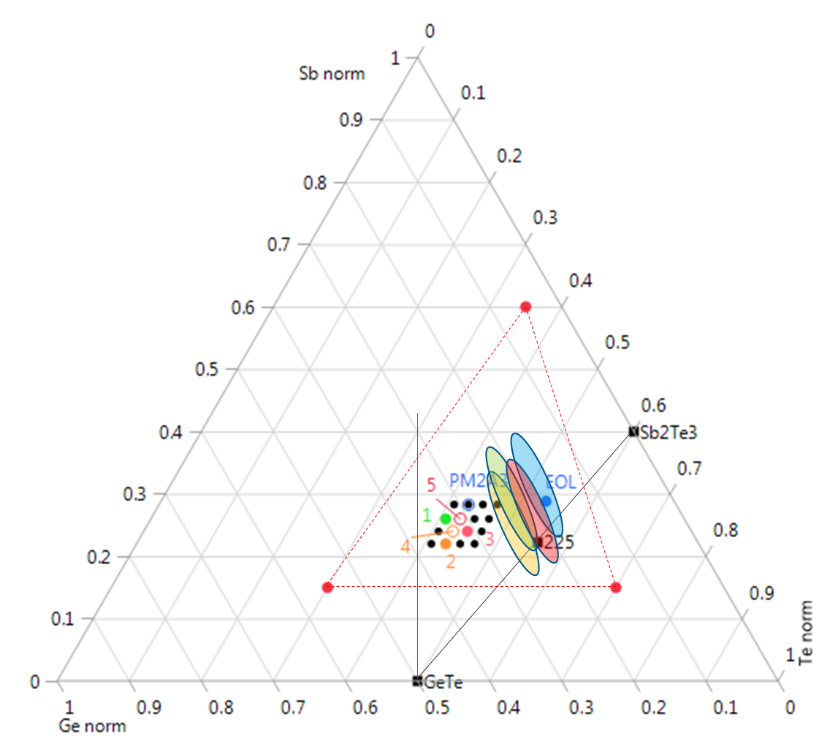
3DXP 20S/30S: PM2 corners characterization
Aim and plan
As a follow-up of recent learning on enhanced segregation, and to complete the PM2 corner evaluation on consolidated process in view of PM scaling, this last PM2 campaign is aimed to:
1. basic L0 characterization of extreme compositions after segregation, combined with forced H/OH contamination
Output: assessment of set degradation mechanisms and model
2. exploration of GST region less Sb-rich, trying to mitigate the set-ability degradation in cycling, with no penalty in speed
Output: learning on optimal GST matrix for In/Y/Ga doping PM
Output: back-up option to optimize 30S PM in case of Y/Ga failure
Plan:
L0 completion and S15 corner lot out by end March.2018
Targets and composition corners to be considered also for S36X later on
PM2.A3 composition area, In ~3%
PM2.A3 post segregation
Ge-rich new alloys
Targets composition

Slide 9
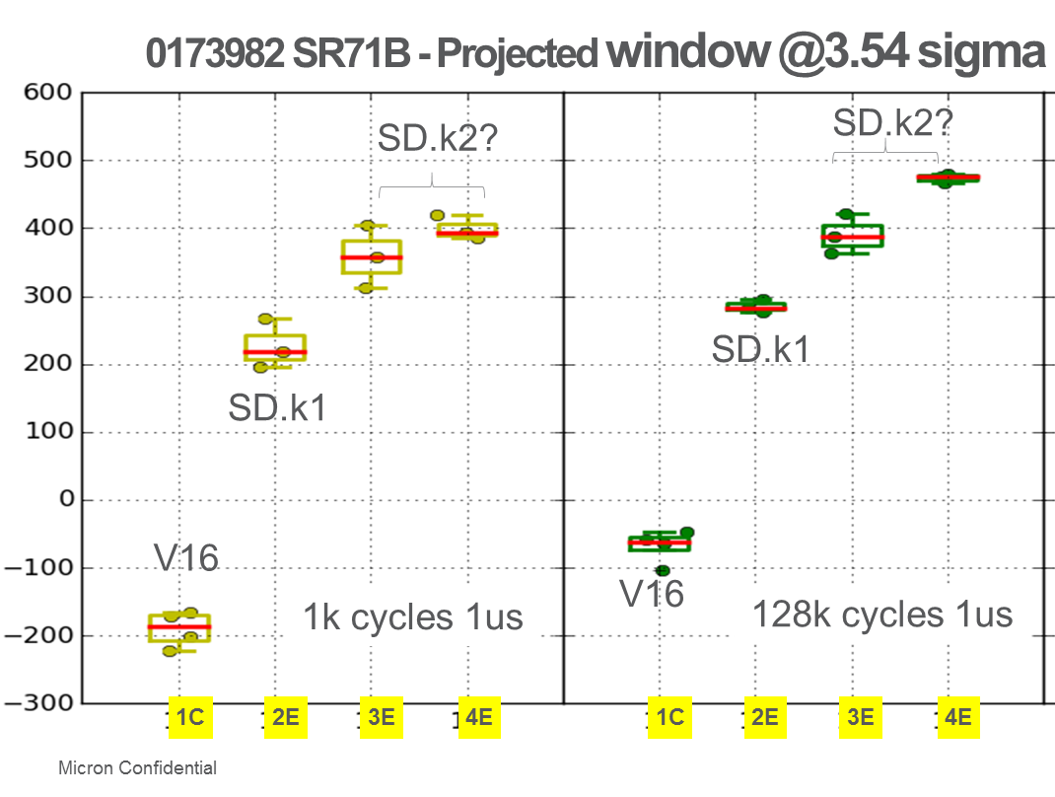
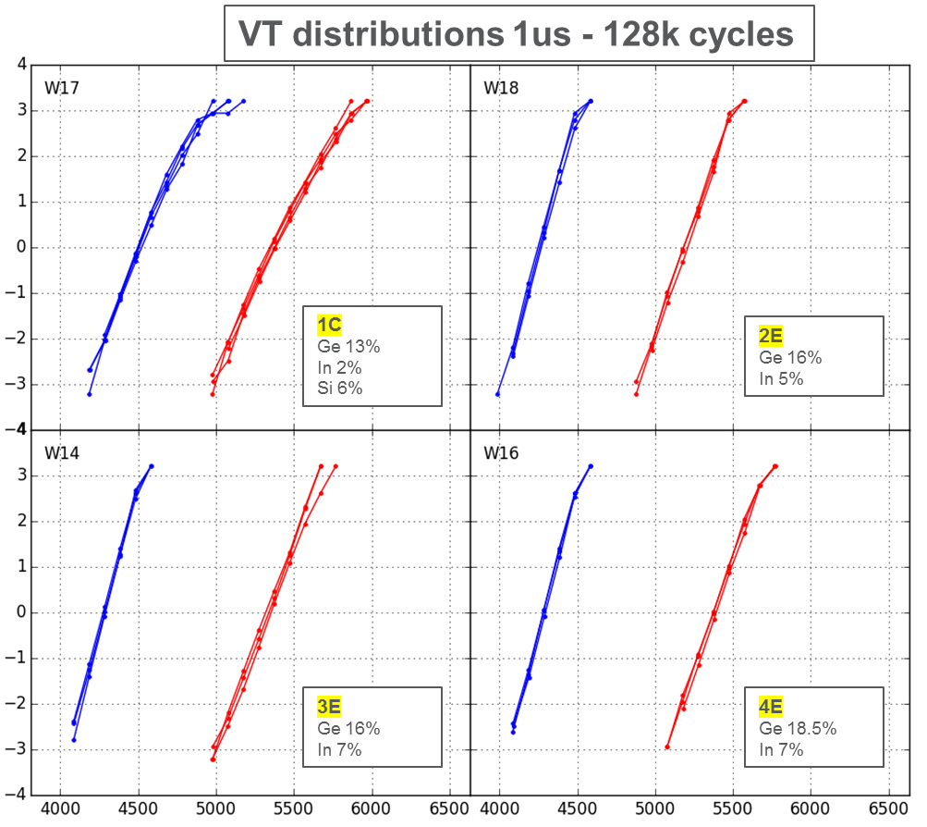
SSM: SD3 path execution status
0173982 SR71B
K* In-SAG progress and status
First K* run provided a 1st SD3 candidate, the #6E alloy, aka SD.k1
Composition: In 5%, Ge 16%, As3Se3 at depo; EOL pending PFA
Small monolithic for Prod lots will be installed in wk.7-8, ICP validation about [co-sputter to mono] transformation by beginning of Mar.18
Second K* run (3 lots, 1 completed, 2 at probe) is addressing an even better candidate, aka SD.k2 (SSM meeting wk.04)
better RWB increasing In doping to 7%, Ge to 19%
Complete evaluation to promote SD.k2 by wk.07-08
Opportunity of a 3rd K* run, to be combined with AlOx lamina & shape
Note1: PVD co-sputter chambers are supporting material exploration but also PROD wip with POR target changing (MUMM500-3C)
Today configuration: [AlOx, V12, V16]; from wk.7-8: [AlOx, V16, SD.k1];
Note2: Need of AlOx lamina is relevant for tools capability & campaign execution to assess SD3 (air break to be avoided)
Note3: K* exploration is running on 4C; next campaign will go on 3C

Slide 10
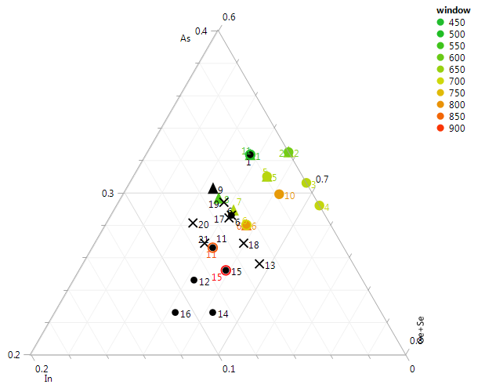
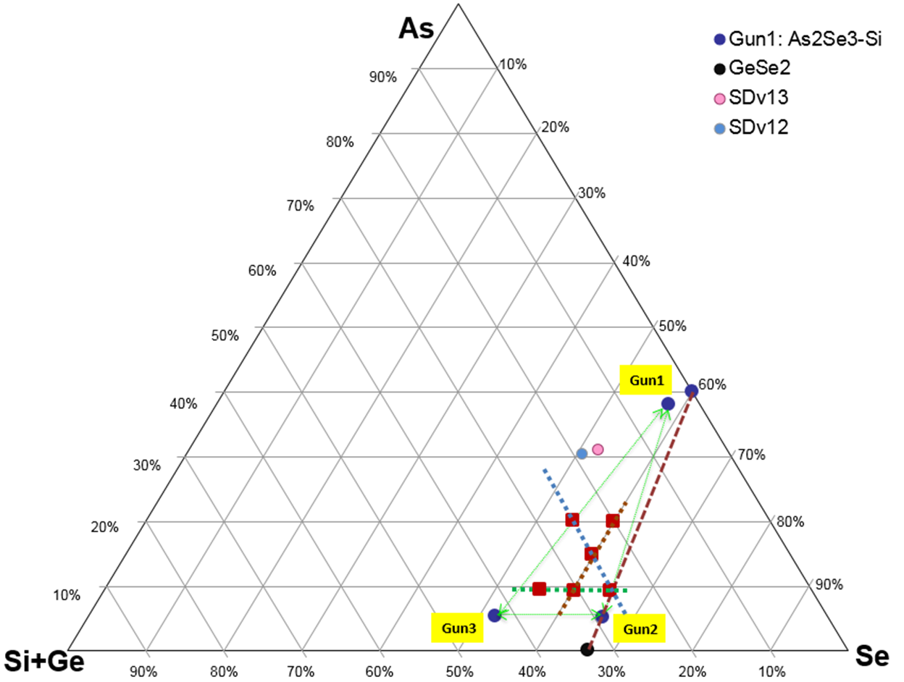
SSM: SD3 path execution status
As
K* exploration area, In >5%
VT window trend
SD3 completion path
K* activity planned on 4C in Feb-Mar.18 period:
AlOx installed with In-SAG K* targets. Aim: to integrate SD.k1/SD.k2 with/wo AlOx lamina – decision about AlOx lamina needed by end Apr.18
Eventual 3rd K* run to explore higher In/Ge content; possible outputs by apr.18:
a SD.k3 pre-POR candidate,
Hints to order 3 targets at risk to run the combined [K*+G*] campaign
G* campaign to segment role of As/Se (In-SAG, In 5%) on window
planned on M300-3C: tgt in by wk.10, lots out by end May.18
Including Bi-layer combination key experiment for SD VT transformation model
Output: opportunity to combine [K*+G*] results;
The eventual combination of K* and G* to assess the SD3 composition
final campaign on M300-3C in Jun-Aug.18, if needed
Availability of 4C would anticipate the [K*+G*] execution in Apr-June.18
Actions / Recommendation
To ensure fast purchase of selected SD.k alloys targets
To segment K* SD performance on S26 to assess possible advantages also for 30S 3DXP
Only 2 kits available for target change on 4C; recommended to order one more
Ge+Se
In
G* exploration area, In 5%

Slide 11
SSM In-SAG material trimming scenario
A 3-4 steps path for SD3 assessment is possible, based on today understanding
With a consequent need of targets purchase

Slide 12
Next Quarter Tactical Plan for PM & SD

