Slide 1
SD Characterization Update
Dan Gealy, Enrico Varesi, Folsom TEMlab, Boise TEM lab, Mattia Robustelli, Umberto Meotto, Brady Jenkins, Brian Gerhard
1 31 2018

Slide 2
Summary – work in progress
PFA on SD1 (only)
  SR71 X-cut (no grounded) Folsom (pos/neg/virgin program) – 0024732/wf16
  SR71 Y-cut (no grounded) Boise (pos/neg/virgin program) - 0024732/wf16
  S26 Y-cut (grounded) Boise (pos program) - 0024732/wf2
    Thickness changes not prominent
    SR71: some segregation detected on opposite programmed cells moving opposite compared to virgin (not all data are in to have full correspondence), in addition to a main modulation by cut direction (as usual for ungrounded samples).
    Grounded positive only prog S26 indicates Se enrichment at top.
  Not much consistent with initial work on SD1 (it was much higher)
PFM work at the PFM/AFM
  No data yet
Raman from probed arrays

Slide 3
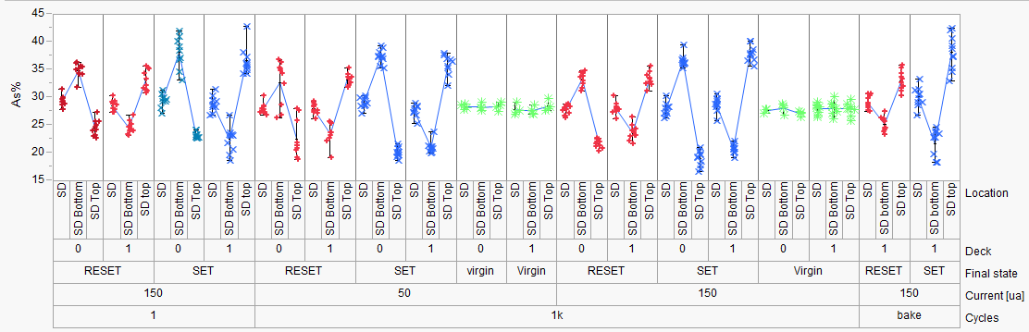
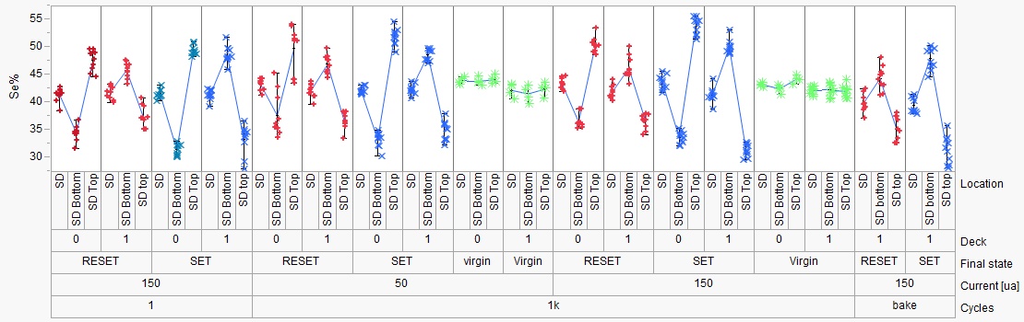
SD1 Elemental Migration
PFA-396 (SD1)
Hefei, Enrico
SD1:
Stronger As/Se segregation
for SET vs RESET (time dominating)
1us
50ns
1k cycles
50 ns | 1000 ns | 50 ns | 1000 ns
50 uA |  | 150 uA
1us
50ns
  Elemental segregation with SD1
    Consistent with current direction (as with PM)
      Opposite electromigration behavior on D0 & D1
Back

Slide 4
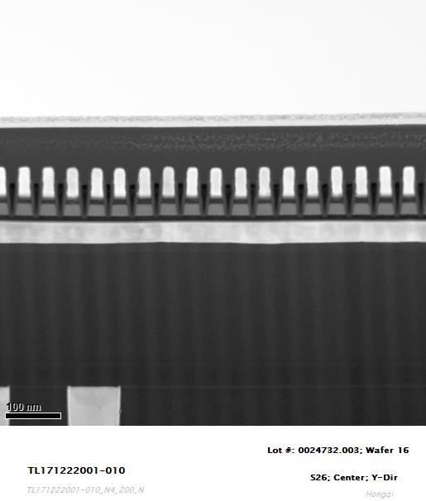
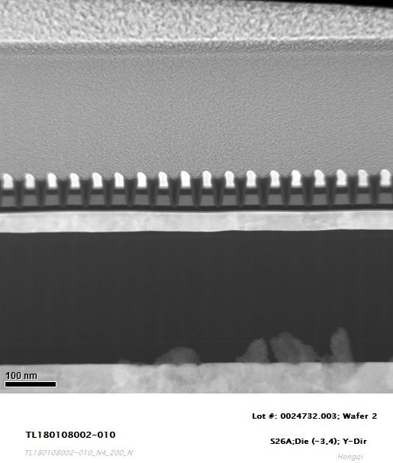
WL-BL grounding
SR71 Boise
Y-cut
S26 Boise
Y-cut
W BLs were not grounded.
W BLs were grounded.

Slide 5
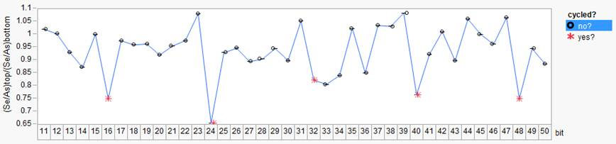
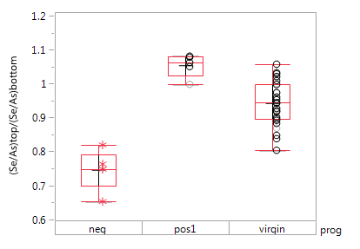
Stem Images: 0024732.003, split 4E SD1 SAG, wafer16 SR71B
Folsom
X-cut SR71 ungrounded
Prog sequence:
pos,/neg prog seasoning
chkb positive prog (4 pulses)
line pattern:
adjacent pos and neg prog between 6 not programmable cells
Significant Se enrichment at bottom for one of the two programmed cell
Opposite smooth segregation for opposite prog, compared to virgin
Prog assignment to be confirmed

Slide 6
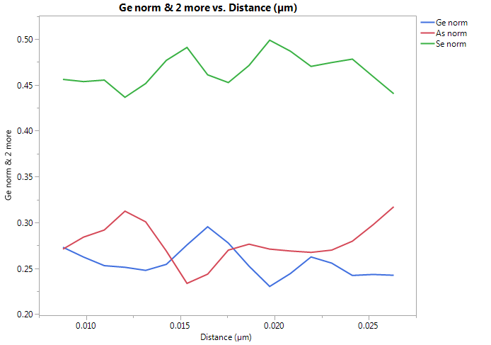
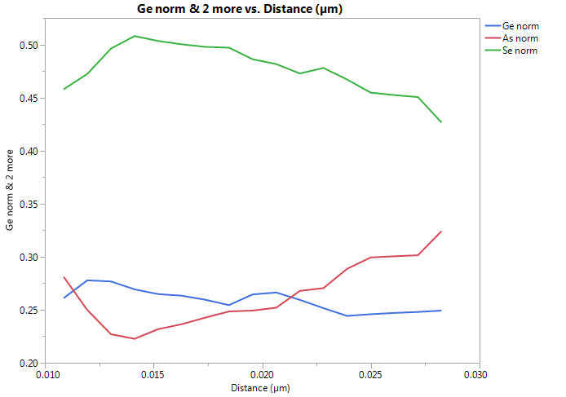
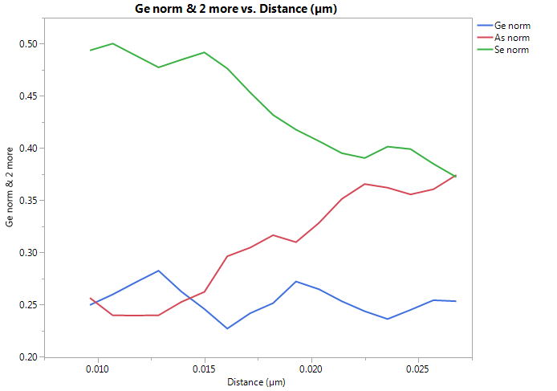
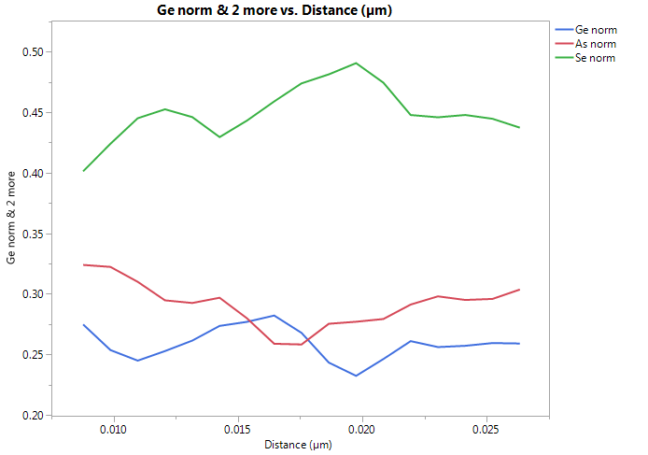
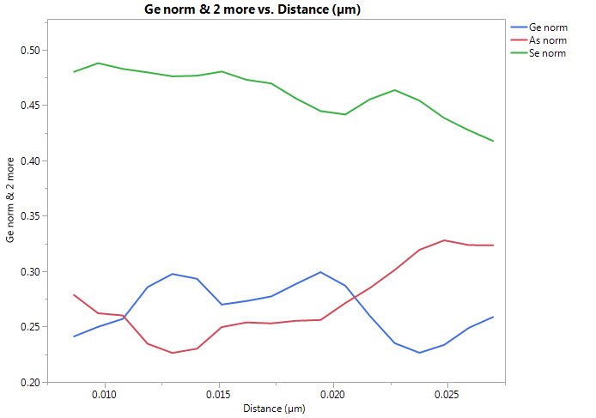
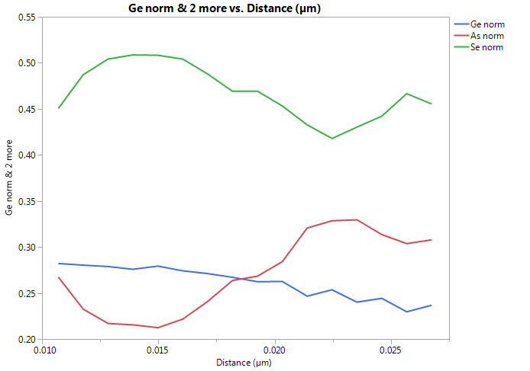
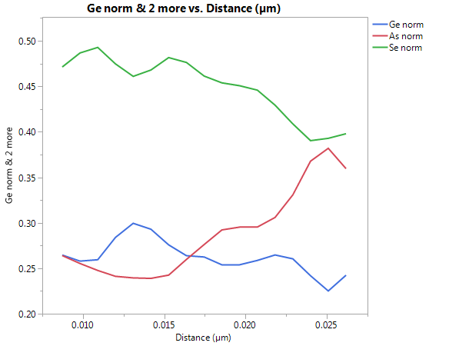
Filtered normalized composition profiles
Folsom
X-cut SR71 ungrounded
Virgin #12
#16
#24
Virgin #11
bottom
top
#32
#40
#48

Slide 7
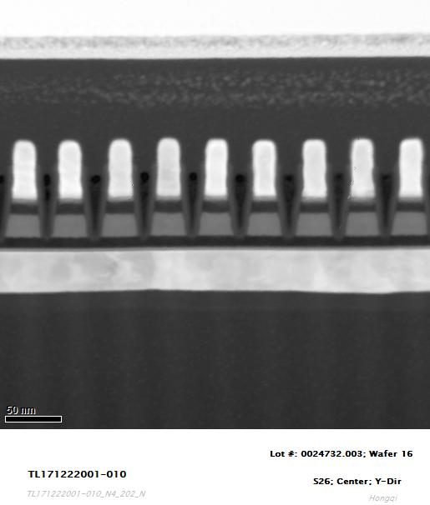
RS71 SD1
TL171222001 – Boise
WL cut (Y) not grounded
http://edcfab4.micron.com/fab4/RTL010/_layouts/15/osssearchresults.aspx?k=TL171222001
EDS Element Mapping
Se map
As map
Ge map
Even
neg
Odd
pos

Slide 8
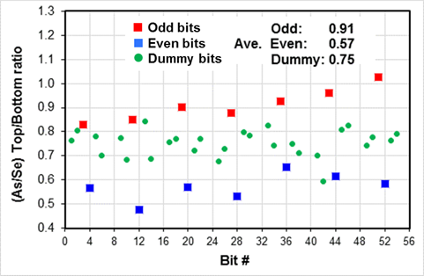
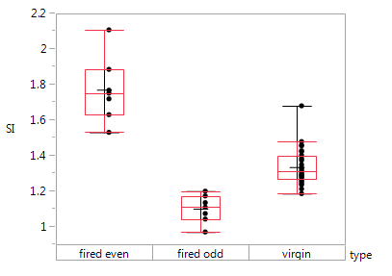
RS71 SD1
TL171222001 – Boise
WL cut (Y) not grounded
http://edcfab4.micron.com/fab4/RTL010/_layouts/15/osssearchresults.aspx?k=TL171222001
SI= (Se/As)_{top} / (Se/As)_{bottom}
neg
pos
Due to the difficulty of de-processing for specific location samples, in this sample, W BLs were not connected together. Therefore, sample prep would cause element segregation. Here it is assumed that the effect of sample prep on element segregation is at the same extent for all the bits.
Odd and even bits were fired oppositely.
For oppositely fired bits, the As/Se segregation behavior is also opposite.

Slide 9
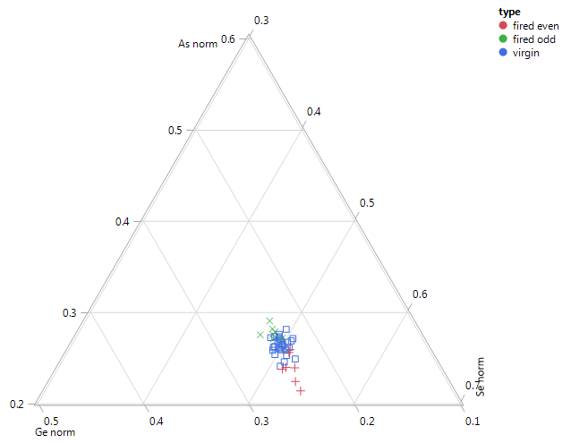
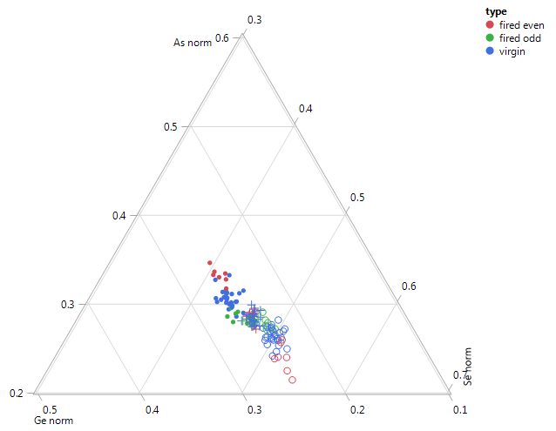
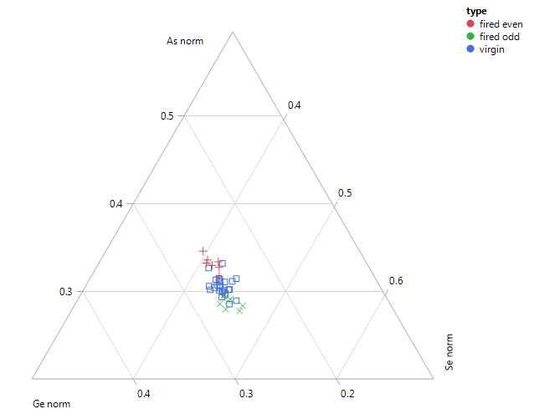
RS71 SD1
TL171222001 – Boise
WL cut (Y) not grounded
Top
Se-rich
Bottom
As-rich

Slide 10
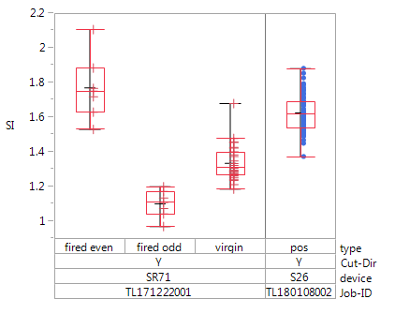
SD1
summary
Boise, Y-cuts
Folsom
X-cut, ungrounded
(usually Se-bottom)
ungrounded
(usually Se-top)
grounded
S26
SR71 even
top
bottom
SR71 odd
ungrounded
grounded
SR71 virgin
SR71-even = neg prog ?
SR71-odd => pos prog ?
S26 => pos prog

Slide 11
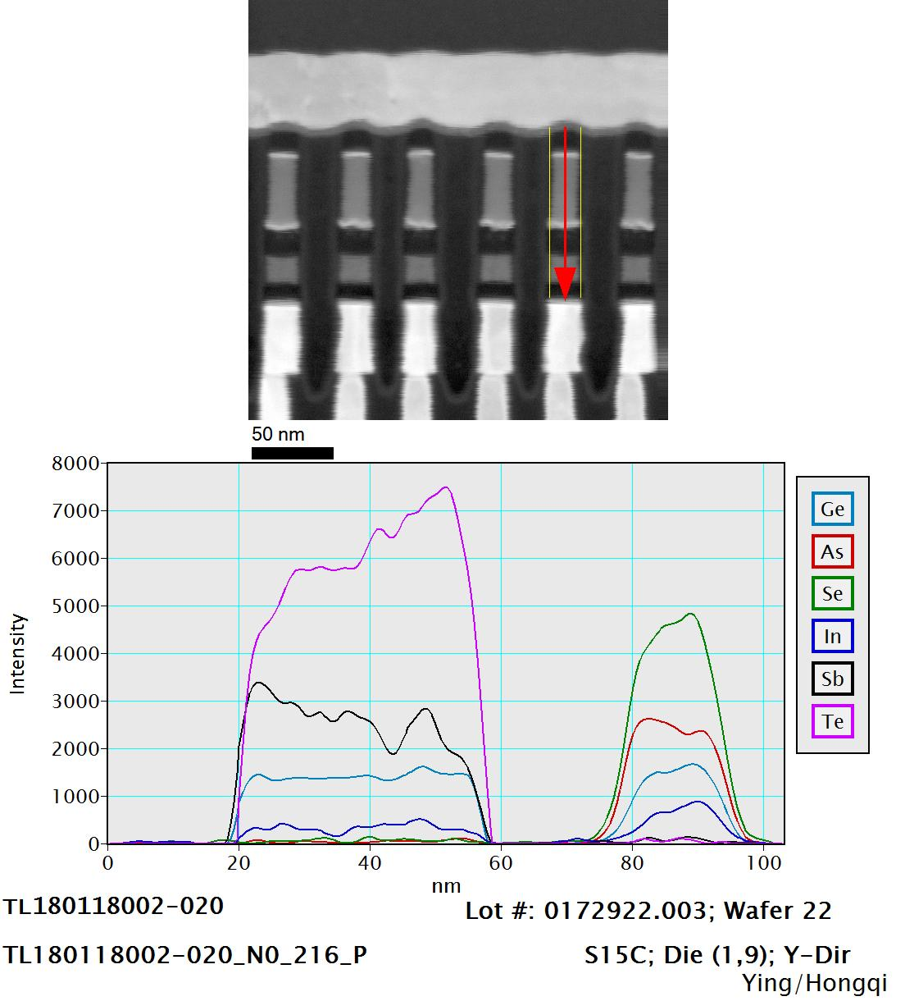
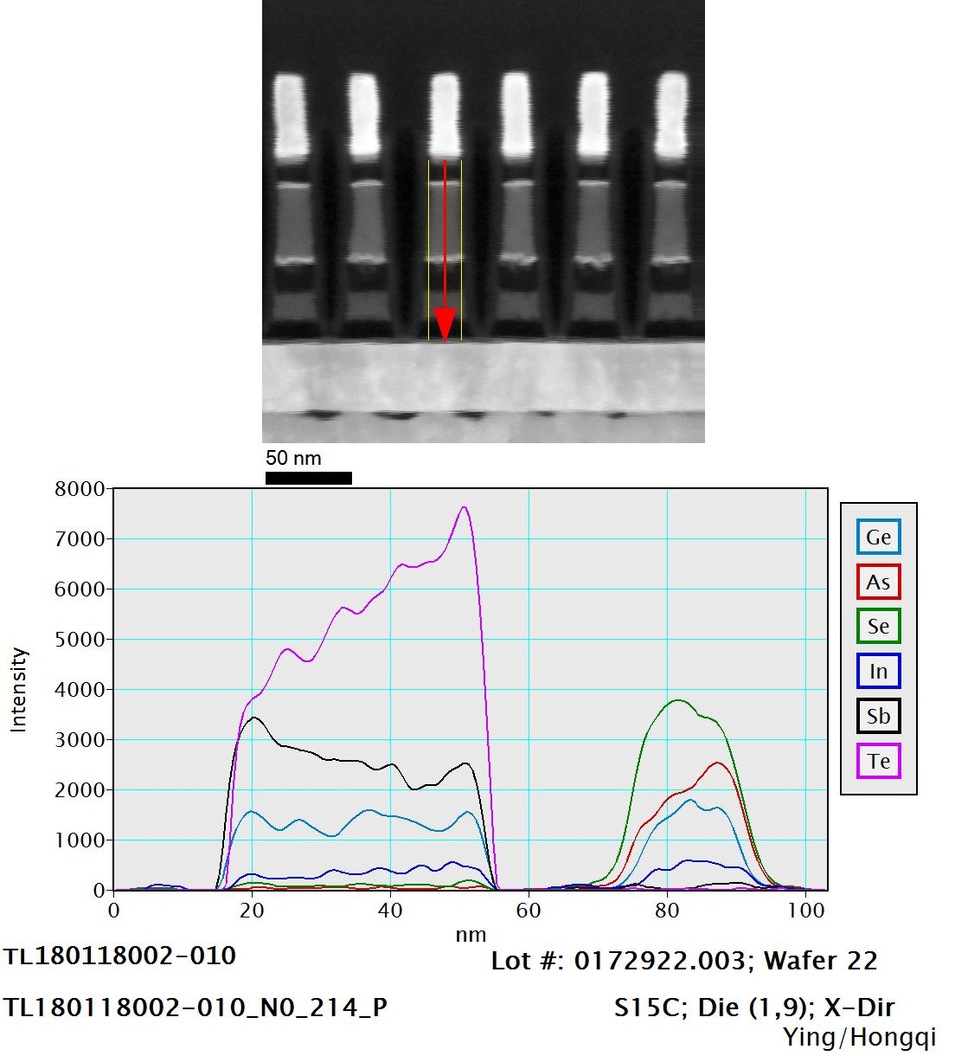
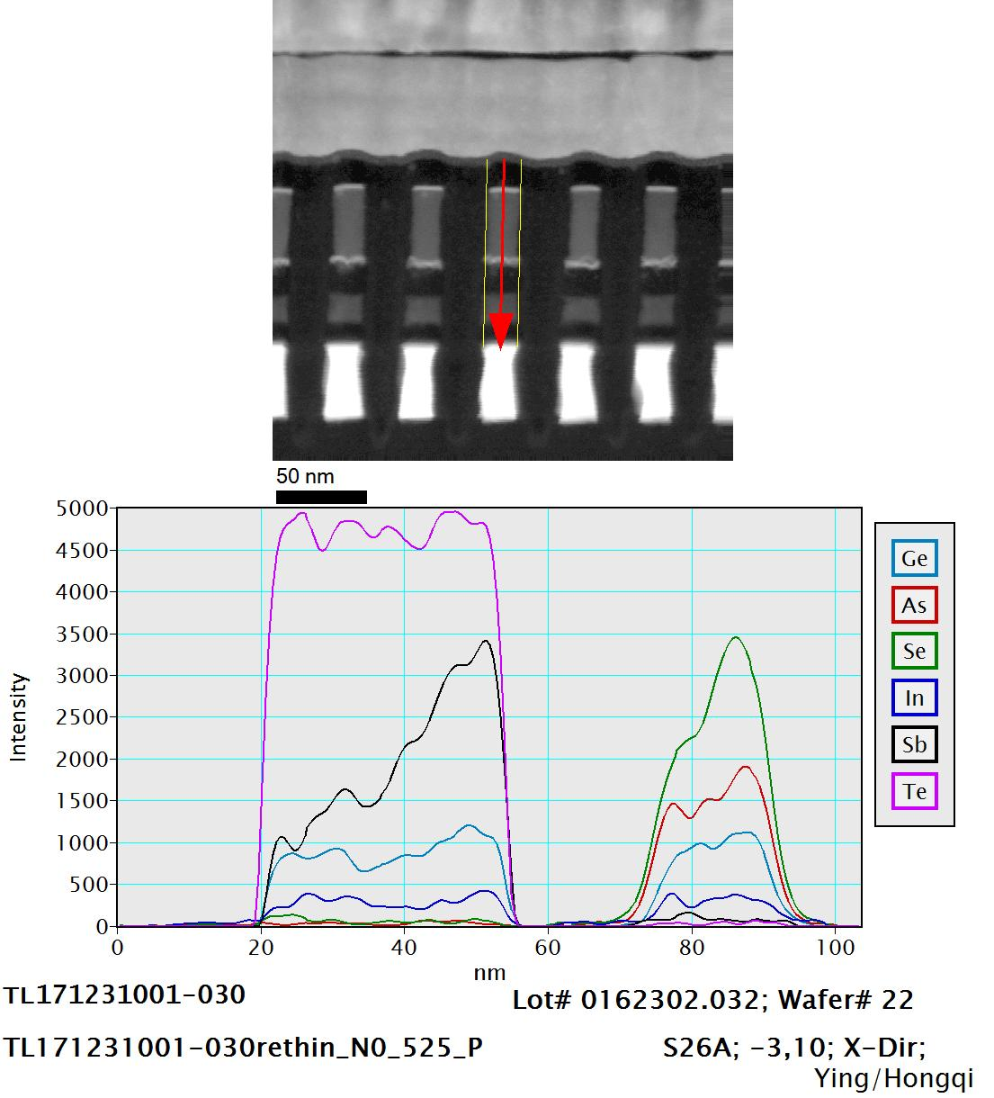
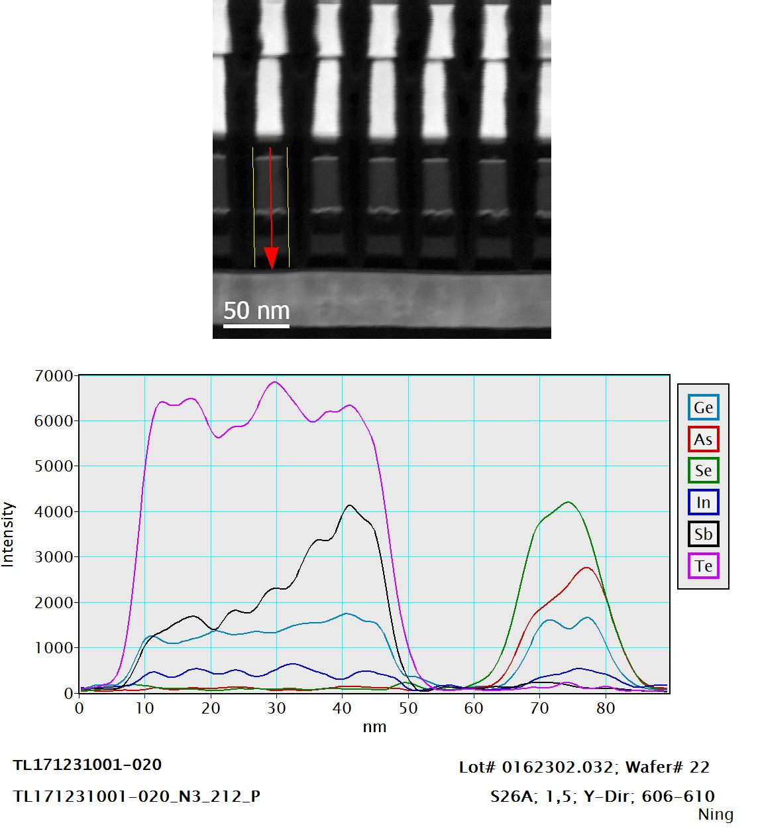
Typical
Ungrounded result
D1
D1, X-cut=Se bottom
D1, Y-cut=Se top
X-cut=Se bottom
Y-cut=Se top
D0
D0, X-cut=Se bottom
D1, Y-cut=Se top

Slide 12
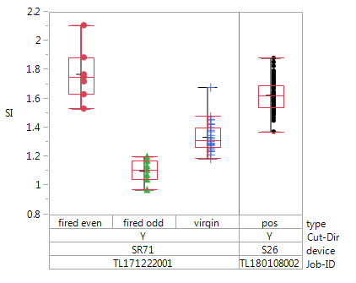
SD1 PFA summary
Typically ungrounded:
X-cut=Se-rich at bottom
Y-cut=Se-rich at top
device | TEM lab | cut | line | Grounding WL-BL | prog | Se/As top/bottom | Se-rich
SR71 | Folsom | X | BL 9 | no | Pos | 1.06
 |  |  |  |  | Neg | 0.75
 |  |  |  |  | virgin | 0.95 | bottom
SR71 | Boise | Y | WL 14 | no | Pos | 1.10
 |  |  |  |  | Neg | 1.77
 |  |  |  |  | virgin | 1.33 | top
S26 | Boise | Y |  | yes | Pos | 1.63
SR71 (ungrounded):
  Overall (virgin) main segregation modulated by cut direction (as usual)
  Opposite segregation for opposite programming compared to virgin
  Programming assignment to be confirmed
S26 (grounded pos prog): Se enrichment at top

Slide 13
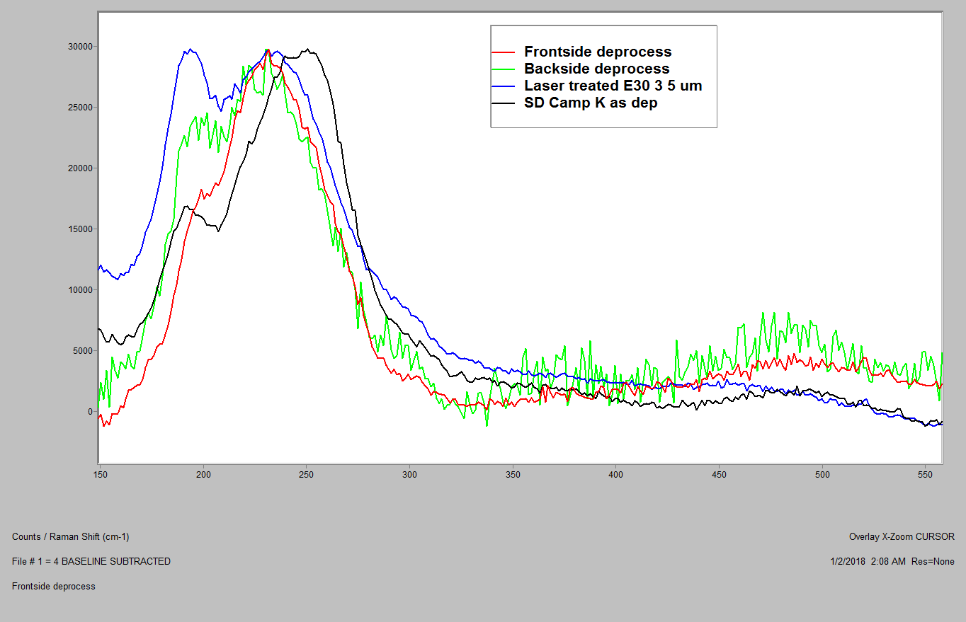
Raman on Probed arrays (SDv12 SD-only, S26)
Frontside deprocessed
Red: virgin
Black: programmed
Laser treated was not bake recoverable
Differences observed between front-side deprocessed virgin & probed
Backside deprocessed not completed

