Slide 1
SSM Update to JDP COMM
Feb/23/2018
Status and Plan:
Successful K* SWR yields prePOR candidate (Alloy6/CR5.3) and roadmap to meet PG1 RWB requirement.
S24S, 20nm 64Gb SSM vehicle, design started.
Dual Deck SR71 is being taped out at Fab 4, ECD WW09. Lead silicon probe ECD WW17
Strategy development to build SSM Alpha Product
Define the deliverable to assess “step up” for decision

Slide 2
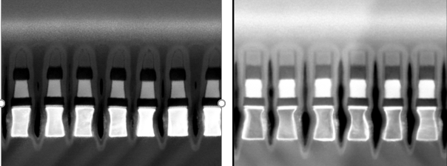
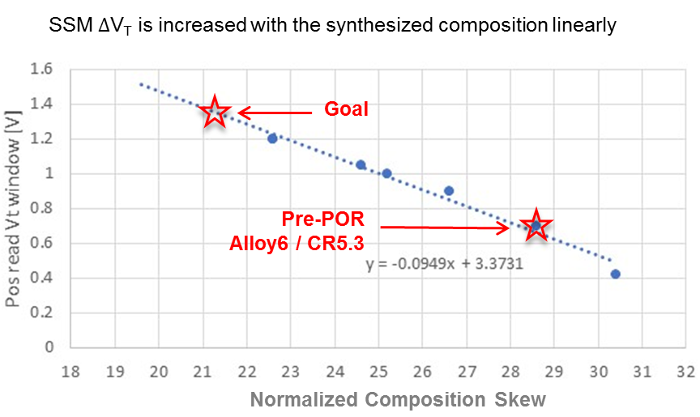
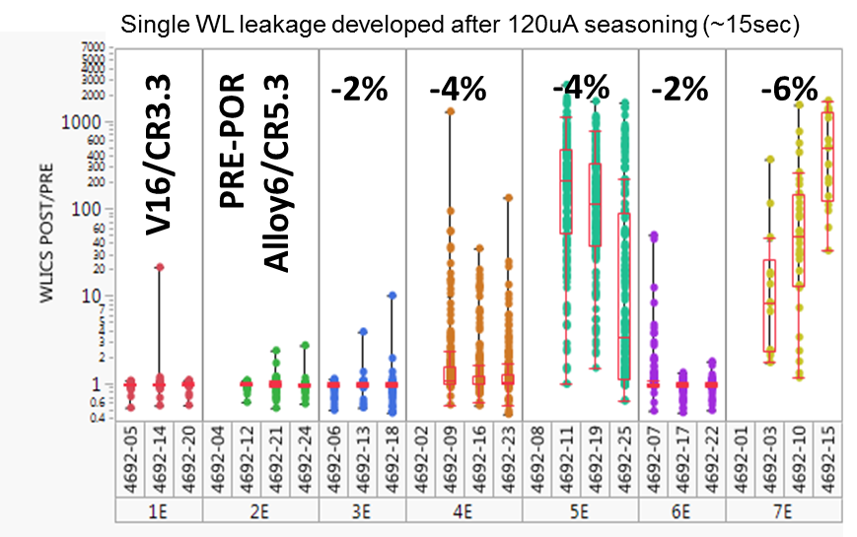
K* SD Alloy / CR5.3 Learning
PrePOR Alloy6/CR5.3 RWB gap to goal reduced to 650mV (from 1V)
CR5.3 yields 50mV or less ∆V_{T} difference on read polarity, positive read higher, without a visible tapering.
Strong modulation on ∆V_{T} and Post seasoning WL leakage with composition skew. Complete segmentation ECD is WW10. Risk Mitigation plan to be followed.
CR4 Single Etch
V16 / 5Å AlOx T&B
CR5.3 Partial Etch
Alloy6 / no lamina
(1st cut)
(1st cut)
SR71 D0 PG4 RWB (Piecewise Built) S26A1 silicon (Neg Read) | Alloy6 CR5.3 85C 1us-10s | Alloy6 CR5.3 85C 3s-2d
Set Vt [V] | 4.41 | 4.645
Delta Vt [V] | 0.9 | 0.91
Set Vt sigma [V] | 0.08 | 0.09
Reset Vt sigma [V] | 0.1 | 0.11
Set drift [V] | 0.235 | 0.288
Reset drift [V] | 0.245 | 0.275
Reset RD margin [V] | 0.22 | 0.3
Set Vt-evolution [V] | 0.15 | 0.15
Reset Vt-evolution [V] | 0.12 | 0.12
Gap to goal [V] | -0.46 | -0.65

Slide 3
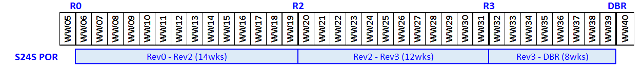
S24S Design Strategy, Milestone and Gates
Enable path to fast fail or success (S24S) by minimizing non-cell related design risks
  Inhibit 50% of the array drivers to provide area for new bipolar pre-drivers
  Add tile level polarity control and update partition control logic to enable bipolar operation with SSM read/write algorithms
Features | S26A | S24S (Design POR)
Density | 256Gb | 64Gb
Die Size | 197mm² | 197mm²
I/O Performance (Interface) | 1600MT/s/pin (DDR4) | 1600MT/s/pin (DDR4)
Read Latency | 95ns | 95ns
Write Completion Time | 475ns | 240ns
Read/Write Throughput | 1600 / 800 MB/s | Estimated 731 / 425 MB/s
Read / Write Energy | 52 / 118 pJ/b | 89 / 179 pJ/b
Power Supplies | Vdd=Vddq=1.2V Vhh=3.3, Vpp=5.3, Vnn=-4.7V | Vdd=Vddq=1.2V Vhh=3.3, Vpp=5.3, Vnn=-4.7V
Milestone | Criteria
Rev 2 | Sheet level performance validation complete / circuits ready for layout
Rev 3 | Full chip functional and performance validation of features, specifications and test modes
DBR | Database Ready for Manufacturing

Slide 4
SSM Alpha Product Pathfinding and Deliverables
The strategy for ‘fast fail or succeed’ is built on ‘stepping-up’
SR71 – SSM basics, including scaling, symmetry with solid empiricals to support switching mechanism
S24S – Array feature development with high volume statistical validation with Probe, WLR, Burn and ULR metric.
Build alpha product – Design exercise in order to pick a node so that Array, CMOS, Design Rule, and BEOL all work coherently for die size and performance matching or better than SXP counterpart.
Deliverables for “step up” or not

Slide 5
Backup Material

Slide 6
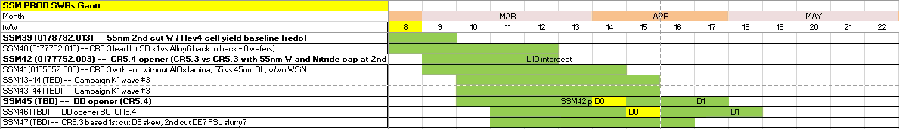
Silicon Horizon in March
CR6?

Slide 7
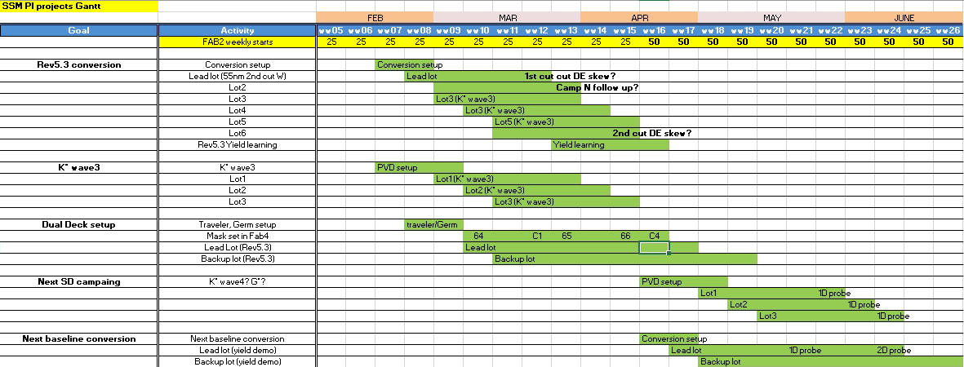
Gantt Chart

