Slide 1
SSM Update to JDP COMM
Feb/23/2018
Status and Plan:
Successful K* SWR yields prePOR candidate (Alloy6/CR5.3) and roadmap to meet PG1 RWB requirement. DTS R0.4 is proposed based on K* silicon and Dual V_{DM}; 350mV E4 reduction is deemed feasible.
Complete RA/RM is expected at WW10 for Alloy6/CR5.3 and DTS R0.4 change ratification.
S24S, 20nm 64Gb SSM vehicle, design started. Design milestones is planned; gates to execution is identified; DBR tracks to WW39
Dual Deck SR71 is being taped out at Fab 4, ECD WW09. Lead silicon probe ECD WW17
SOW planning and strategy analysis:
Strategy is built to step up from cell fundamental on DD SR71 to high density bipolar decoder vehicle validation before full product validation
Two plans are analyzed for ratification –
Plan A to build SSM alpha product of 20nm 256Gb S26A BW @ Q2/2020 Qual vs.
Plan B to build SSM alpha product of 14nm 512Gb 2X BW @ Q1/2021 Qual

Slide 2
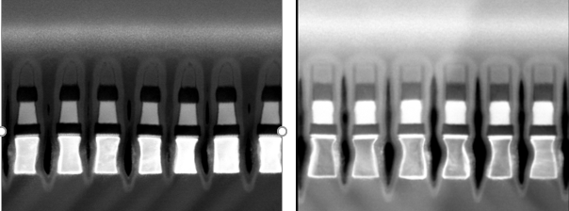
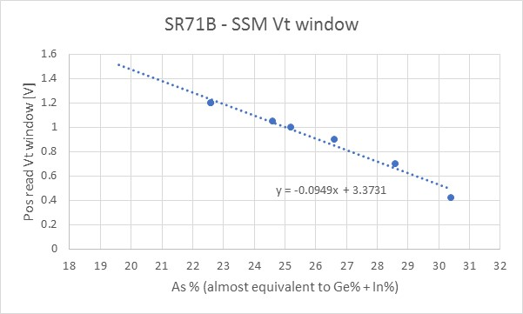
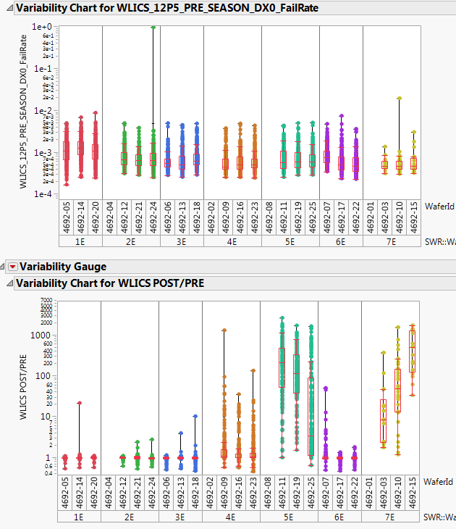
K* / CR5.3 Learning
CR4 Single Etch
V16 / 5Å AlOx T&B
CR5.3 Partial Etch
Alloy6 / no lamina
CR5.3 yields 50mV or less ∆V_{T} difference on read polarity, positive read higher, without a visible tapering.
Strong modulation on ∆V_{T} and Post seasoning WL leakage with composition skew
Complete segmentation ECD WW10
(1st cut)
(1st cut)
SSM ∆V_{T} is increased with the synthesized composition linearly
Single WL leakage developed after 120uA seasoning (~15sec)
-2%
-4%
-4%
-2%
-6%
Goal
PRE-POR
Alloy6/CR5.3
V16/CR3.3
Pre-POR
Alloy6 / CR5.3
Normalized Composition Skew

Slide 3
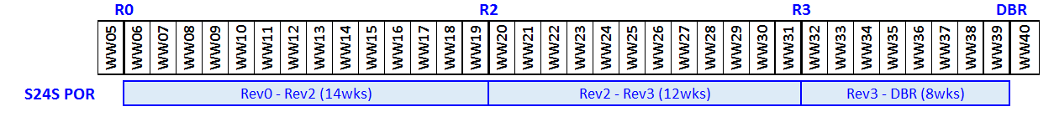
S24S Design Strategy, Milestone and Gates
Enable path to fast fail or success (S24S) by minimizing non-cell related design risks
Inhibit 50% of the array drivers to provide area for new bipolar pre-drivers
Add tile level polarity control and update partition control logic to enable bipolar operation with SSM read/write algorithms
Features | S26A | S24S (Design POR)
Density | 256Gb | 64Gb
Die Size | 197mm² | 197mm²
I/O Performance (Interface) | 1600MT/s/pin (DDR4) | 1600MT/s/pin (DDR4)
Read Latency | 95ns | 95ns
Write Completion Time | 475ns | 240ns
Read/Write Throughput | 1600 / 800 MB/s | Estimated 800 / 400 MB/s
Read / Write Energy | 52 / 118 pJ/b | 89 / 179 pJ/b
Power Supplies | Vdd=Vddq=1.2V Vhh=3.3, Vpp=5.3, Vnn=-4.7V | Vdd=Vddq=1.2V Vhh=3.3, Vpp=5.3, Vnn=-4.7V
Milestone | Criteria
Rev 2 | Sheet level performance validation complete / circuits ready for layout
Rev 3 | Full chip functional and performance validation of features, specifications and test modes
DBR | Database Ready for Manufacturing

Slide 4
SSM 20nm Alpha Product
Alternative Alpha Product – 14nm
Risk in schedule

Slide 5
Backup Material

Slide 6
Assumption and Critical Path for 14nm Alpha Product
SR71 Development: Demonstrate piecewise RWB for 14nm technology roadmap
Dual-Deck @ 20.5nm; material class and stack defined; RWB gap manageable.
SR71 on PQ is working (need to be validated) ➔ S36X SD only flow and SR71 testable; 14nm scaling on single deck; RWB consistent with 20.5nm learning
PQ SR71’s critical path are resources in silicon allocation and module development, minimum leverage from 20’s and 30’s projects; additional funding / scope need to be assessed.
14nm scaling expectation – 40% program current scaling no Vt changes by Q3/2018
S34X DBR: 14nm dual-deck spider based on option-1 decoder
Based layout is S36X + Option-1 CMOS decoder (no new DR);
Reduced addressable space (near ½ of S36X)
Similar Read/Write energy of S34S (higher read/write delays) in probe
14nm array design collateral feedback/correction 2 quarters prior to S37S DBR (2 quarters of learning)
14nm Bipolar Architecture
14nm die size and energy assessment being consistent with 20nm assessment
14nm SSM collateral release
Preliminary release including 14nm cell DTS, TGnMOST model and Design Rules
Revision are based on additional learning on TGnMOST, S37A periphery yield and S34X learning
Schedule risk: upto 1 quarter push to the best case.

Slide 7
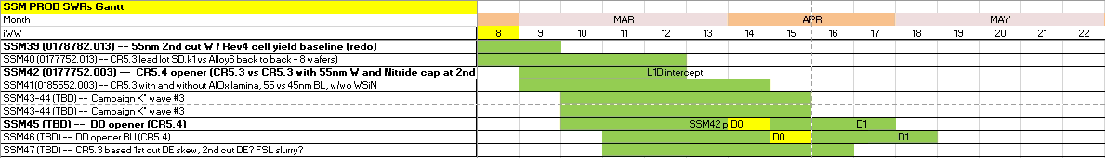
Silicon Horizon in March
CR6?

Slide 8
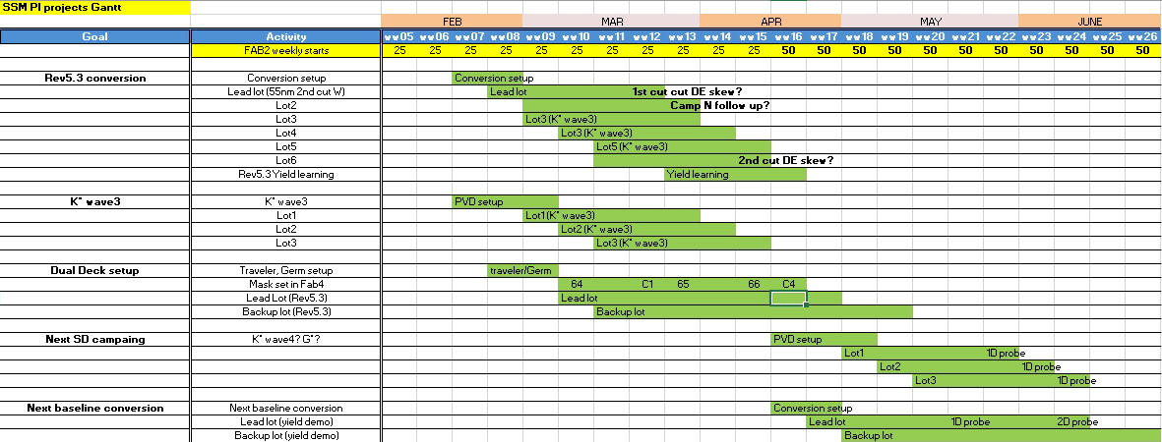
Gantt Chart

