Slide 1
SSM physics work in progress
1/22/2018, DerChang Kau

Slide 2
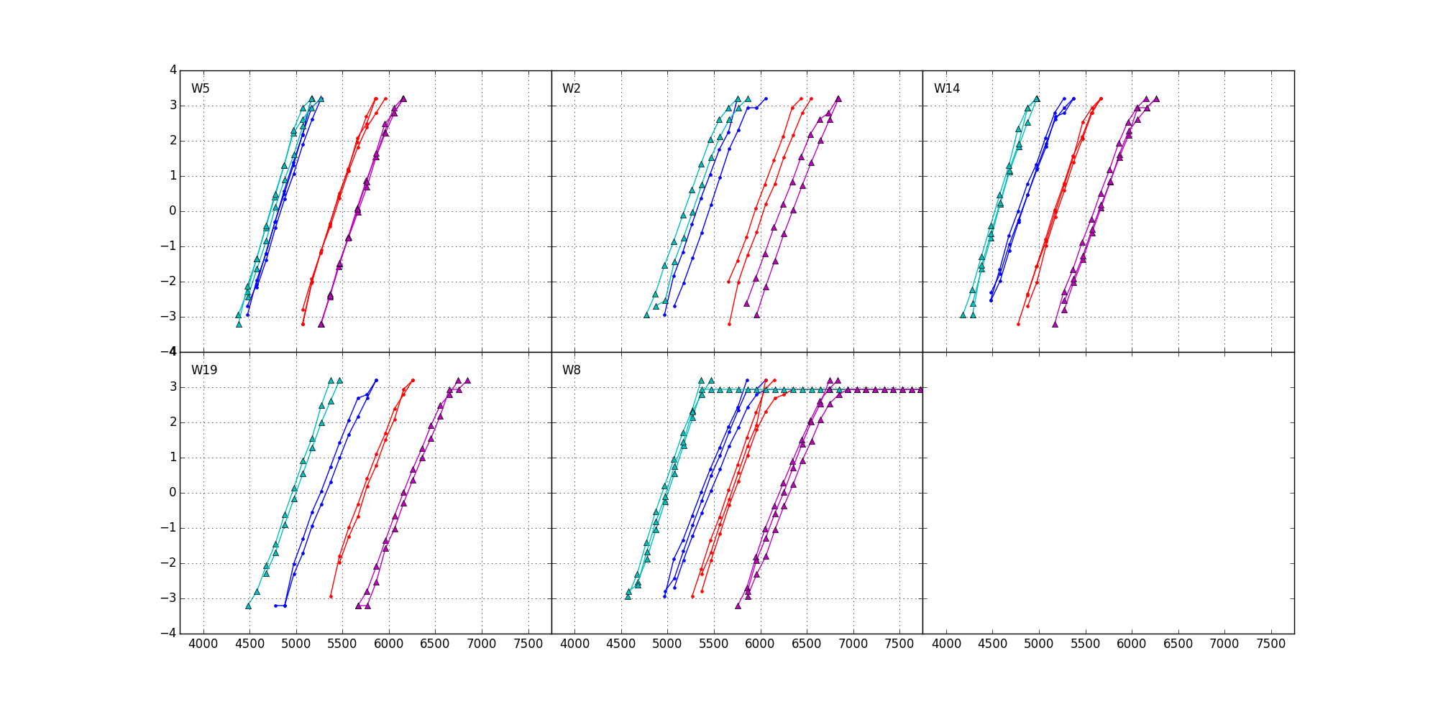
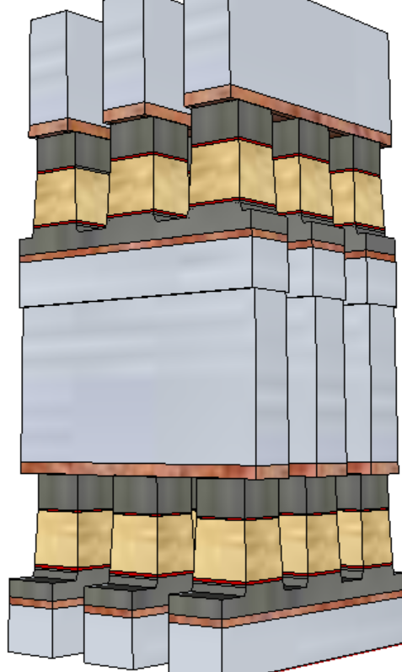
Introduction to Self-Select Memory (SSM)
+/+
−/+
S15B SD-only, lot 8792062, 18nm SDδ ver 4
Write/Read
Polarity
−/−
+/−
V_{T,High}
Positive
Write
σ of bit distribution
Pulse Polarity
Negative
read
TE
900mV
SD
V_{T,Low}
Negative
Write
Negative
read
BE
V_{TH} [mV]
Fundametally, it is a 3DXP technology.
Physical construction of SSM array is BEOL 3D stackable X-Y cross point comptatible with mainstream CMOS.
Read/write is to threshold a cell in a tile while the rest of cells are inhibited in subthreshold bias.
A V_{T} window (∆V_{T}) has been observed by applying programming pulses with opposite polarity. The best known ∆V_{T} physics is an electrochemical potential modulation effect subject to mass transport by polarity.
Leakage characteristics of SD is unlikely to sustain a charge-trap nonvolatile memory model.
Bipolar Read signature refutes filamentation (conductive channel formation/dissolution).
Bipolar Write supports mass transport between electrodes.

Slide 3
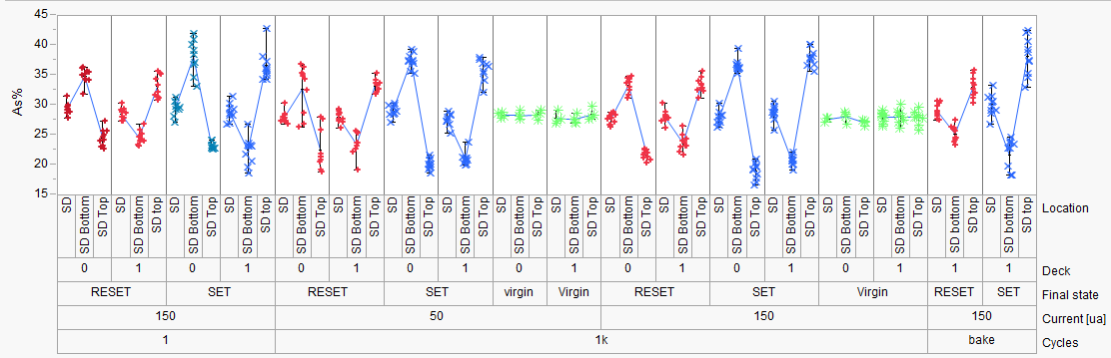
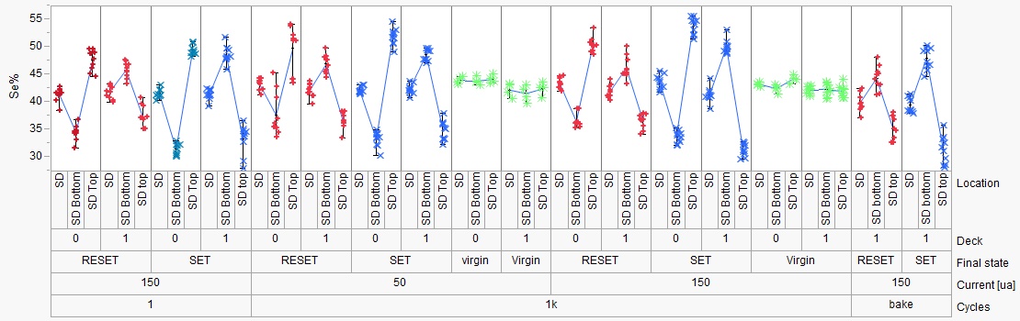
SAG20 Elements Movement (Positive Pulse), similar to GST
PFA-396 (SD1)
Hefei
1k cycles
50 ns | 1000 ns | 50 ns | 1000 ns
50 uA |  | 150 uA
1us
50ns
1us
50ns

Slide 4
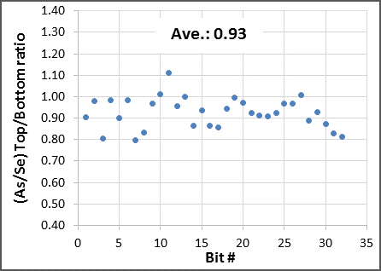
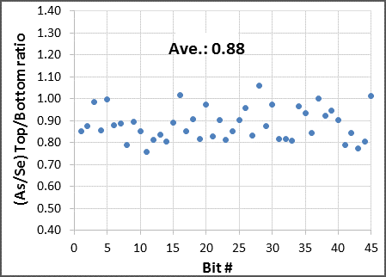
(As/Se)_{top}/(As/Se)_{bottom} Ratio
Virgin bits
Fired bits (one positive pulse)

Slide 5
Physics development of SSM Window

Slide 6
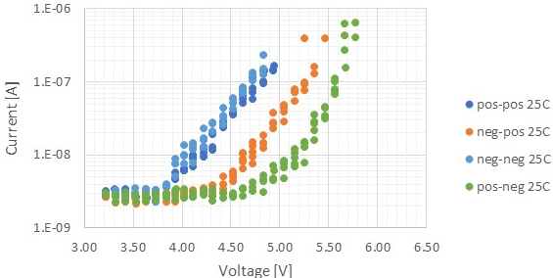
Electrical Equivalent Circuit and Possible Underline Physics
A V_{T} window (∆V_{T}) has been observed by applying programming pulses with opposite polarity. The best known ∆V_{T} physics is an electrochemical potential modulation effect subject to mass transport by polarity.
Leakage characteristics of SD is unlikely to sustain a charge-trap nonvolatile memory model.
Bipolar Read signature refutes filamentation.
Bipolar Write supports mass transport between electrodes.
Near parallel shift on SubVt I-V subject to polarity
For ‘neg read’ – 1V of ∆V_{T} in SubVt
The equivalent circuit – a programmable battery connected to a Chal Glass Resistor serially
Where and what is the battery modulation (near 1V)
Fermi Level (homogeneous junction)
Band structure (heterogeneous junction) in Electronegativity or Work Function (Bandgap is 2^{ndary} augmentation)
Assuming Electrode to Chal Glass junction is subject to defect tunneling therefore voltage contribution is insignificant (On-State I-V and other evidence?)
Chal Glass Res

Slide 7
Basic Band Diagram of SAG and Model assumptions Electronic Structure of Amorphous Semiconductors, D. Adler and E. J. Yoffa, Phys. Rev. Lett. 36, 1197-1200 (1976)
Assumptions:
EG:2eV
Effective intrasite electronic correlation energy is negative therefore P-type is exhibited (pinned)
3 Electronic models on with SAG mass transport by polarity
Ge/As moves toward cathode
Homojunction – Correlation energy changed to positive therefore n-type (similar to tetrahedrally coordinated amorphous semiconductor)
Heterojunction-I – Band offset due to coordination changes (Michaelson’s Electronegativity Scales & The work Function, IBM JRD 1978), higher Work Function
Heterojunction-II – Band offset, but lower Work Function
0.8eV Change is used to illustrate all 3 models
C
SAG/Se+
C
Vacuum
E_{c}
E_{f}
ϕ_{e}
E_{v}
As+/Ge+
Vacuum
(I)
(II)
(III)
∆E_{f}=+0.8eV
∆χ=−0.8eV
∆χ=+0.8eV

Slide 8
1D Space Charge and Built-in Field
Trap Density [cc⁻¹]
ϵ_{SD} = 10
ε_{max} [MV/cm]
V_{bi}=1V
V_{bi}=.1V
Space Charge Width [nm]
ε[MV/cm]
Space Charge Width
ε_{max}
Trap Density [cc⁻¹]
E_{BD} : Si ~0.3MV/cm SiO₂ 10~15MV/cm, GST ~0.3MV/cm, TAG ~1MV/cm, SAG ~3MV/cm

Slide 9
Physical model – working principles & assumptions
SSM device is a string of domains serially concatenated. Node is an abstract point junction between domains.
Simplified with 1D model
Per Kirchhoff law
The nodal current is zero
Assumption – Qausi-static SubVt I-V represents device I-V at nano-second regime
The “domain” voltage drop for a current level will determine the shape of the I-V curve;
Shift right is higher threshold voltage and Voltage contribution of shifting is the memory effects
4 carrier transport mechanisms –
Conduction in delocalized state such as Diffusion and Drift
Conduction between localized and delocalized states such Poole-Frankel
Direct tunneling such as band to band and defect to defect between metallurgical junctions
Drift is linear function of electrical field – contribution is very low due to low free carrier and low mean-free path
Likewise, Diffusion contribution is also low (Einstein relation)
Electronic trap density is in the order of 1% of atomic density (inactive or pinned) ~10²¹/cc
10% structural vacancies in typical crystalline GST225, If electronically active, Debye length is < lattice constant; CV measurement exhibits Debye length in the order of μm or longer
Space charge region @ junction established by direct tunneling with build-in potential

Slide 10
1D Space Charge and Built-in Field in SAG
ε[MV/cm]
V_{bi} [volt]
Trap Density [cc⁻¹]
ε_{BD}
E_{BD} : SAG ~3MV/cm
Space Charge Width

Slide 11


Model Comparison
Model (I) – Homojunction
Model (II) – Heterojunction, higher 𝛘
Model (III) – Heterojunction, lower 𝛘
Bias
C
As+/Ge+
SAG
C
Bias
C
As+/Ge+
SAG
C
Bias
C
As+/Ge+
SAG
C
Vacuum
Vacuum
Vacuum
$$\vec{ℰ}$$
ϕ
⊕
$$\vec{ℰ}$$
ϕ
⊖
⊖
⊕
$$\vec{ℰ}$$
ϕ
⊕
(−)
(−)
⊖
$$\vec{ℰ}$$
ϕ
(−)
$$\vec{ℰ}$$
ϕ
(−)
⊕
⊕
$$\vec{ℰ}$$
ϕ
⊕
⊖
⊖
⊖
0V
0V
0V
0V
$$\vec{ℰ}$$
ϕ
⊕
$$\vec{ℰ}$$
ϕ
$$\vec{ℰ}$$
ϕ
(+)
⊖
(+)
⊖
⊕
(+)
⊕
⊖

Slide 12
Model (I) – Homojunction
(–) Bias Read, same polarity of write
Bias initially contributed to barrier reduction, very low current, shift I-V to right.
(+) Bias Read, opposite polarity of Write
Space charge region maintained or no change. Potential drop evenly cross Chal glass.
Homogeneous junction model does not support the observed polarity effect
Bias
C
As+/Ge+
SAG
C
Vacuum
$$\vec{ℰ}$$
ϕ
⊕
⊖
(−)
$$\vec{ℰ}$$
ϕ
⊕
⊖
0V
$$\vec{ℰ}$$
ϕ
⊕
(+)
⊖

Slide 13
Model (II) – Heterojunction, higher 𝛘
(–) Bias Read, same polarity of write
Space charge region maintained or little change. Potential drop evenly cross Chal glass.
(+) Bias Read, opposite polarity of Write
Bias initially contributed in compensating built-in potential, shift I-V to right.
Higher 𝛘 heterogeneous junction model supports the observed polarity effect
Bias
C
As+/Ge+
SAG
C
Vacuum
⊕
$$\vec{ℰ}$$
ϕ
⊖
(−)
(−)
⊕
$$\vec{ℰ}$$
ϕ
⊖
0V
0V
$$\vec{ℰ}$$
ϕ
(+)
⊕
⊖

Slide 14
Model (III) – Heterojunction, lower 𝛘
(–) Bias Read, same polarity of write
Bias initially contributed in compensating built-in potential, shift I-V to right.
(+) Bias Read, opposite polarity of Write
Space charge region maintained or very low. Potential drop evenly cross Chal glass.
Lower 𝛘 heterogeneous junction model does not support the observed polarity effect
Bias
C
As+/Ge+
SAG
C
Vacuum
$$\vec{ℰ}$$
ϕ
⊕
⊖
$$\vec{ℰ}$$
ϕ
(−)
⊕
⊖
0V
$$\vec{ℰ}$$
ϕ
(+)
⊕
⊖

Slide 15
Electrical Equivalent Circuit and Possible Underline Physics
A V_{T} window (∆V_{T}) has been observed by applying programming pulses with opposite polarity. The best known ∆V_{T} physics is an electrochemical potential modulation effect subject to mass transport by polarity.
Near parallel shift on SubVt I-V on polarity effects
The equivalent circuit – a programmable battery connected to a Chal Glass Resistor serially
From empirical to physical
Pursuing the validation of heterogeneous junction model
Programmable battery is formed by the band offset
Write –Band offset switching subject to mass transport.
Read – Space Charge modulation results in voltage shift
Post
Neg
Write
C
As+/Ge+
SAG
C
SD Resistor
⊖
⊕
$$\vec{ℰ}$$
ϕ
(−)
(−)
⊖
⊕
$$\vec{ℰ}$$
ϕ
Read Polarity
0V
0V
$$\vec{ℰ}$$
ϕ
(+)
⊖
⊕

Slide 16
Vt Shifts
Unbias Drift, Negative and Positive Biased in Subthreshold and On-State

Slide 17
Drift
3 basic attributes associated with Drift
Program:
Primary: Polarity
2^{ndary}: Amplitude, Width
Other factor: Cycle counts (after 10K cycles of ‘seasoing’), Pulse termination
Interrogation (Vt detect)
Primary: Polarity
2^{ndary}: τ_{sense} or threshold delay
Drift
Primary: Temperature, Bias Polarity
Initial full factorial DOE: Program / Interrogate / Drift
Program: two levels – “+” vs. “−”, keeping Amplitude and Width at SR71 POR (40uA/40nsec)
Interrogation: two levels – “+” vs. “−”, τ_{sense} or threshold delay at SR71 POR (40ns)
Drift: 5X3 levels bias conditions from 1usec to 3Hrs (11 decades in 6 steps) all at 85℃
5 levels in polarity: No-bias vs. “+” vs. “−” vs. “±” vs. “∓”
3 levels in pulse frequency: 10Hz, vs. 100Hz vs. 1000Hz.
Drift characterization and characteristics
How to establish bias-time on S26, SR71, QTT and 2XCMOS
SubVt characteristics: decouple slope and intercept to segment bulk relaxation vs. interfacial barrier modulation.

Slide 18
Scratch pad

Slide 19
Model Comparison
Model (I) – Homojunction
Model (II) – Heterojunction, higher 𝛘
Model (III) – Heterojunction, lower 𝛘
Bias
C
As+/Ge+
SAG
C
Bias
C
As+/Ge+
SAG
C
Bias
C
As+/Ge+
SAG
C
Vacuum
Vacuum
Vacuum
$$\vec{ℰ}$$
ϕ
Space Charge Width Widening
⊕
$$\vec{ℰ}$$
ϕ
⊖
⊖
⊕
$$\vec{ℰ}$$
ϕ
⊕
(−)
(−)
(−)
⊖
$$\vec{ℰ}$$
ϕ
$$\vec{ℰ}$$
ϕ
⊕
⊕
⊖
⊖
⊕
$$\vec{ℰ}$$
ϕ
⊖
0V
0V
0V
$$\vec{ℰ}$$
ϕ
⊕
$$\vec{ℰ}$$
ϕ
$$\vec{ℰ}$$
ϕ
(+)
⊖
(+)
⊖
⊕
(+)
⊕
⊖

Slide 20
Model (I) – Homojunction
(–) Bias Read, same polarity of write
Bias initially contributed to barrier reduction, very low current, shift I-V to right.
(+) Bias Read, opposite polarity of Write
Space charge region maintained or no change. Potential drop evenly cross Chal glass.
Homogeneous junction model does not support the observed polarity effect
Bias
C
As+/Ge+
SAG
C
Vacuum
$$\vec{ℰ}$$
ϕ
⊕
⊖
(−)
$$\vec{ℰ}$$
ϕ
⊕
⊖
0V
$$\vec{ℰ}$$
ϕ
⊕
(+)
⊖

Slide 21
Model (II) – Heterojunction, higher 𝛘
(–) Bias Read, same polarity of write
Bias initially contributed to widen spacer charge region.
(+) Bias Read, opposite polarity of Write
Space charge region maintained or no change. Potential drop evenly cross Chal glass.
Higher 𝛘 heterogeneous junction model does not support the observed polarity effect
Bias
C
As+/Ge+
SAG
C
Vacuum
Space Charge Width Widening
⊕
$$\vec{ℰ}$$
ϕ
⊖
(−)
⊕
$$\vec{ℰ}$$
ϕ
⊖
0V
$$\vec{ℰ}$$
ϕ
(+)
⊕
⊖

Slide 22
Model (III) – Heterojunction, lower 𝛘
(–) Bias Read, same polarity of write
Space charge region maintained or no change. Potential drop evenly cross Chal glass.
(+) Bias Read, opposite polarity of Write
Bias initially contributed to widen spacer charge region.
Lower 𝛘 heterogeneous junction model supports the observed polarity effect
Bias
C
As+/Ge+
SAG
C
Vacuum
Space Charge Width Widening
$$\vec{ℰ}$$
ϕ
⊕
⊖
$$\vec{ℰ}$$
ϕ
(−)
⊕
⊖
0V
$$\vec{ℰ}$$
ϕ
(+)
⊕
⊖

Slide 25
SSM reliability assessment on neg read window : Enzo’s czn priority list
1us interlaced set/reset algo (Hernan to release the routine, need to ask also the fast read disturb pointed out by Al)
Current functionality skew ( 20uA --> 80uA) and time ( 45ns--> 150ns)
Skew of read sense (40ns -->150ns)
25C vs 85C Vth / window sensitivity extraction with Temperature (best prog/read conditions)
Extended cycling on best split
Reset read disturb (@ 85C)
Long Time drift for best split (2d @ 85C)
Cycling vs IPD
Bias drift
Read endurance
Thermal disturb check
Full tile testing/cross tile (256kb)
------------------------------------------------- (end of scorecard)-------------------------------------
Write cycling vs ED
First Fire recovery @ high T (4 cases for each bake)
Done
Next priority

