Slide 1
S24S Quad Deck to Dual Deck Change Proposal
Balaji, Eddie & DerChang, WW14/2018
To socialize change proposal and collect feedback to final ratification
Minimize impact to DBR and no impact to S/U plan
Would like change POR by WW15

Slide 2
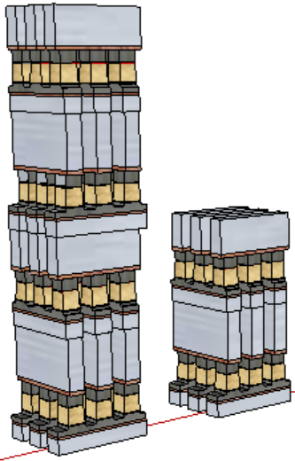
Qual Deck (S26A) vs. Dual Deck (S15C)
WL
WL
WL
PM
PM
PM
SD
SD
SD
BL
BL
PM
PM
PM
SD
SD
SD
WL
WL
WL
WL
WL
WL
WL
WL
WL
PM
PM
PM
PM
PM
PM
SD
SD
SD
SD
SD
SD
BL
BL
BL
BL
PM
PM
PM
PM
PM
PM
SD
SD
SD
SD
SD
SD
WL
WL
WL
WL
WL
WL
Isolation
Isolation
2 BL Sockets
2 WL Sockets
1 BL Socket
2 WL Sockets

Slide 3
Change Proposal
Repurpose B1 driver patch to other CMOS function
Maintain existing M4 layer
B1 patches becomes float Dummy
no impact to functionality
Process integration neutrality
Keep Quad Deck Array Layout
To keep additional WL layer
Top WL 0 S26A and Top WL1 layer to emulate Quad deck electrical parasitics

Slide 4
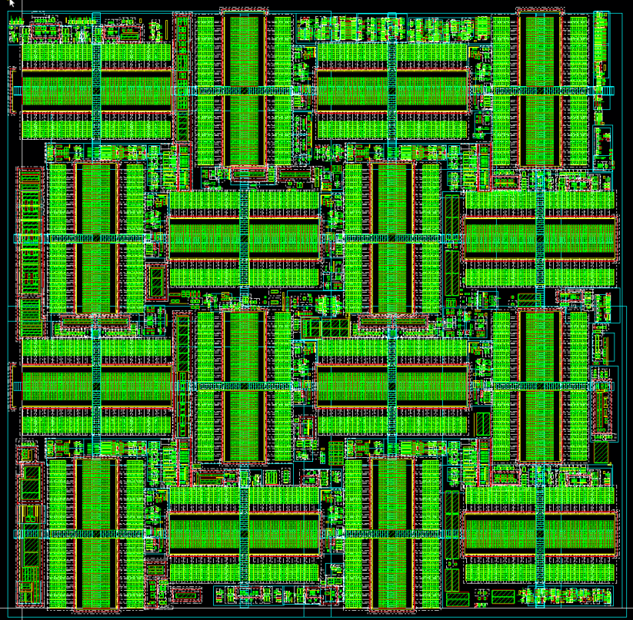
The Change
W0
W1
W0
W1
B0
B1
B0
B1
W0
W1
W0
W1
B0
B1
B0
B1
W0
W1
W0
W1
B0
B1
B0
B1
W0
W1
W0
W1
B0
B1
B0
B1

Slide 5
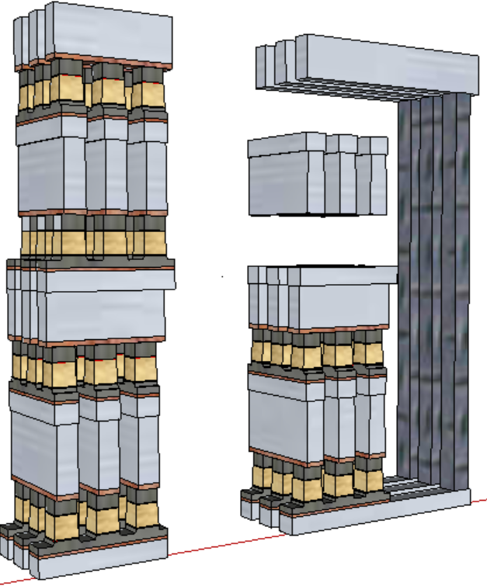
4-Deck to 2-Deck
WL
WL
WL
WL
WL
WL
PM
PM
PM
SD
SD
SD
BL
BL
BL
BL
PM
PM
PM
SD
SD
SD
WL
WL
WL
WL
WL
WL
WL
WL
WL
WL
WL
WL
PM
PM
PM
PM
PM
PM
SD
SD
SD
SD
SD
SD
BL
BL
BL
BL
PM
PM
PM
PM
PM
PM
SD
SD
SD
SD
SD
SD
WL
WL
WL
WL
WL
WL
Isolation
Isolation
2 BL Sockets
2 WL Sockets
1 BL Sockets
2 WL Sockets

Slide 6
Reference Material

Slide 7
S26S Socket
Key Differences from 10s
2 more decks
4 more WL/BL levels + 2 more array via levels
For stacked WL/BL levels, array vias connect to the upper instead of the lower level
A must-have feature for 65L (AV1) because some of the 65 vias (AV7 landing pads) need to land on 51L WL’s
A nice-to-have feature for 66L & 67L to help control the near-near cell SET current spike
69L (TV1) will likely need to stack on top of the array via levels
Quilt Architecture driving different integration needs in the socket area
69L
68L
67L
66L
65L
64L

