Slide 1
2.0 Strategy
Overview, Development Vehicles, Scaling Roadmap, Alpha Product and Gen+1

Slide 2
2.1 Strategy Overview
“Fast fail or succeed” by building a 3DXP product for SSM
Test complete array in high volume and validate product worthiness by building prototypes
To minimize additional cell development beyond SSM pathfinding, the SSM process flow developed on S26A mask set will be exploited for alpha product demonstration.
Leverage 20’s infrastructure and synergy for high velocity development.
Bipolar Decoder Design
Fast implementation: based on S26A floor plan, inc. Pad
Low risk execution: S26A based CMOS technology & collateral @ minimum augmentation required
Algo development leverage by reusing S26 test infrastructure
Enable probe synergy with S26 PG1 specs at shorter write completion time
S26S Tapeout
Product vehicle: 256Gb in 197mm² @S26A Spec, plus
Power delivery for @ 240ns write completion testable
Fail or Succeed
20nm Startup Flow Defined
Structure and RWB demonstrated yield
DTS/MTS/RWB are consistent
Scaling Roadmap
Process architecture Stack (S26A like) vs. Tier (3DNAND-like)
SSM Switching Physics w/ 20nm Cell
Cell development (DTS/MTS) based on S26A scribe mini array and single cell structures (SR71, QTT, 2XCMOS)
Develop fundamental understanding of switching mechanism for tuning window and reducing distribution
20nm SSM Structure Yield
Establish S26A SSM-flow baseline and change control
Leverage with S26A yield improvement

Slide 3
2.2 Development Vehicle Expectations
S26A – Live die and the scribe structures of S26A (20nm node) Plate-set
Dual deck process: product die structure yield learning for SSM baseline process flow
Single Cell: Basic bipolar characterization capability is established with the 2xCMOS test structure.
QTT (quarter-tile size mini array): A electrically bi-directional operable mini array test structure.
SR71 (one full tile array) – A bi-directional decoded, operable 512K addressable array:
S26S – A 20nm node bipolar 3DXP product in compliance with S26A spec
Features | S26A | S26S
Density | 256Gb | 256Gb
Die Size | 197mm² | 197mm²
Array Architecture | Quilt | Quilt
Number of Partitions | 32 | 32
I/O Performance (Interface) | 1600MT/s/pin (DDR4) | 1600MT/s/pin (DDR4)
Read Latency | 95ns | 95ns
Write Completion Time | 475ns | 240ns
Read/Write Throughput | 1600 / 800 MB/s | 1600 / 800 MB/s
Read / Write Energy | 52 / 118 pJ/b | 52 / 118 pJ/b
Power Supplies | Vdd=Vddq=1.2V Vhh=3.3, Vpp=5.3, Vnn=-4.7V | Vdd=Vddq=1.2V Vhh=3.3, Vpp=5.3, Vnn=-4.7V

Slide 4
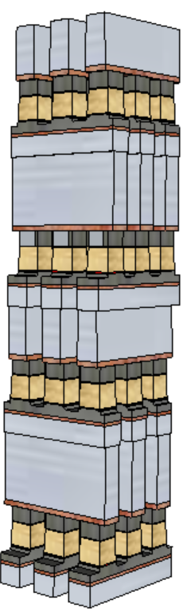
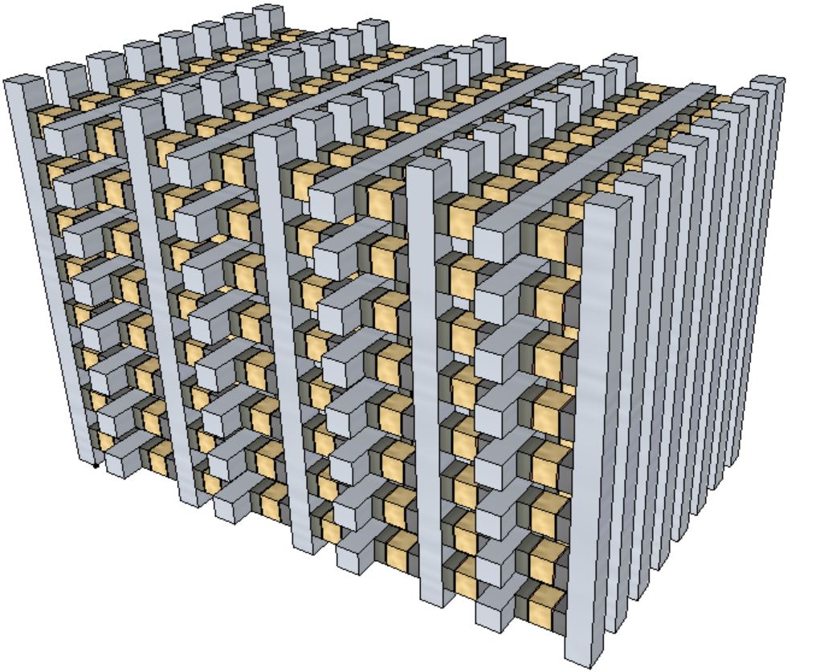
2.3 Scaling Roadmap Development
Architecture
SSM memory switching physics is the foundation
Scalable cell architecture will be established based on RWB tuning enablers.
Low cost process architecture will be developed in accordance to cell architecture.
Scalable memory core architecture will be developed based on cell architecture and scaling requirement for density and performance.
Scaling rule of thumb
Density: doubling every generation
Latency: equal or reduce
Bandwidth/GB: Equal or improve
Reference architecture: SXP stack vs. 3D-NAND tier
Scalable architecture development starts when 1. Switching mechanism is manageable and 2. 20nm Product Vehicle is DBR’d
3D-stack
3D-tier

Slide 5
2.4 Lead Product for “Fast Fail or Succeed” and Risk Mitigation Strategy
To build with S26S in compliance with S26A spec @ ½ set time.
Test complete array in high volume and validate product worthiness by building prototypes
High level of synergy and reuse with 20series in design, tests and collateral
Additional Thick Gate nMOS Transistor (TGnMOST) is required in order to meet S26A energy spec
S24S Design Start
100% S26A collateral
CMOS Bipolar Decoder (no HV Stress) 50% high switching energy
S26A3 footprint/50% Dummy WL/BL
Wafer level testable for SSM functionality @ ½ of set time
Power/thermal envelope prohibitive for full throttle component test (system level validation)
TGnMOST & DR Assessment
Decoder fitted, TGnMOST meet I-V requirement for 20nm
High Risk
EoQ1 RA for Q3 TO
Risk in DR
S24S DBR @Q3/18
w/o TGnMOST
Validation at lower BW
Low Risk
High Risk
S26S’ DBR @Q3/18
w/o TGnMOST
Validation at lower BW
Risk in TGnMOST
Low Risk
Change CMOS decoder scheme to TGnMOST decoder scheme [+2Q]
Design to S26A full spec, compatible to S26A full spec
Spec-compliant S26S DBR @Q1/19
w/ TGnMOST

Slide 6
2.5 Gen+1 Product outlook
High-level strategy definition to be reexamined and better defined (e.g. with execution plan) under scaling roadmap analysis in Q4’18.
Development Vehicle Strategy
14nm SSM Spider Chip:
Base silicon uses S26S, Array spider similar or identical to S36X layout High level of synergy and reuse with S26S for jump start 14nm cell scaling and structure yield
14nm SSM Alpha Product: Fast time of transition to 14nm half-pitch product in compliance with S37A spec High level of synergy and reuse with 30series in design, tests and collateral
 | S26A | S36X | S26S | S37A | 14nm SSM Spider | 14nm SSM Alpha
Density/Die Size | 256Gb / 197mm² | 128 Gb / 197mm² | 256Gb / 197mm² | 512Gb / 195mm² | 128Gb / 197mm² | 512Gb / 195mm²
half pitch | 20.5nm | 14nm | 20.5nm | 14nm | 14nm | 14nm
Cell Architecture | SXP | SXP | SSM | SXP | SSM | SSM
Decoder | Unipolar | Unipolar | Bipolar | Unipolar | Bipolar | Bipolar
Read/Write Latency | 95/475 ns | 95/475 ns | 95/240 ns | 80/475 ns | 95/240 ns | 80/240 ns
Read/Write Energy | 52/118 pJ/b | 52/118 pJ/b | 52/118 pJ/b | 26/59 pJ/b | 52/118 pJ/b | 26/59 pJ/b
Read/Write Thruput | 1600/800 MB/s | 1600/800 MB/s | 1600/800 MB/s | 3200/1100 MB/s | 1600/800 MB/s | 3200/1100 MB/s
I/O and Transfer Rate | DDR4 1600MT/s | DDR4 1600MT/s | DDR4 1600MT/s | DDR5 3200MT/s | DDR4 1600MT/s | DDR5 3200MT/s
Color coding:
S26A based
S37A based
S26S unique
G+1 SSM unique

Slide 7
3.0 Milestone
Fail Check and Critical Path

Slide 8
3.1 Fail Check
# | Objectives as measured by | On or before (Calendar year)
1 | SSM switch mechanism validated with Dual Deck silicon (SR71) 20nm Product D0 vs. D1 Read/Write polarity defined; No RWB showstopper on paper | Q2/2018
2 | 20nm Vehicle DBR S26A3 die size @ ½ set speed 20nm SSM Process Startup flow defined | Q3/2018
3 | 20nm Vehicle yielding @ PG1 spec Silicon demonstrated, no show stopper on bipolar ops. | Q2/2019
4 | 20nm Vehicle Memory Qual As measured by qual success criteria @ ½ set speed | Q4/2019
S24S is POR for 20nm Vehicle.
Energy Spec compliant S26S is prePOR pending on TGnMOST and DR readiness.
Should fast-fail decision be favorable to S26S, POR change decision will be ratified by JDP Committee by the end of Q1/2018.

Slide 9
3.2 Product POR and Decision Process for POR Change
In order to meet die size and energy of SXP counter part, SSM has high design collateral scope & risk
More aggressive DR is needed to fit more transistors for bipolar decoder
TGnMOST development is required in complaint to energy spec
TGnMOST & Collateral Assessment
Decoder fitted, TGnMOST meet I-V requirement for 20nm
S24S Design Start
100% S26A collateral
CMOS Bipolar Decoder (no HV Stress)
20~50% high switching energy
S26A3 footprint @ ¼ of density
Wafer level testable for SSM cross tile functionality @ ½ of set time, 64Gb
EoQ1 RA for Q3 TO
Risk in DR & TGnMOST
S26S
TGnMOST
low risk 20nm DR
S26A spec
Low Risk
High
Risk
S24S
No TGnMOST
100% 20nm DR
S26A spec @ Lower BW
Continue S24S Design
Collateral Development
TGnMOST
14nm SSM Design Collateral
To fit in S37A density/die size
S37S
TGnMOST
S37S DR
S37A spec
POR
PrePOR
Evaluation/Decision

Slide 10
3.3 POR Critical Path: Fast Fail and Fast Succeed and Beyond POR as of Q1/2018, S24S is 20nm Product Vehicle
Based on high confidence
collateral for fast fail
 |  | 2018 |  |  |  | 2019 |  |  |  | 2020 |  |  |  | 2021
 |  | Q1 | Q2 | Q3 | Q4 | Q1 | Q2 | Q3 | Q4 | Q1 | Q2 | Q3 | Q4 | Q1 | Q2 | Q3 | Q4
20nm SSM | SSM RWB demonstrated on Dual Deck SR71
 | S24S DBR
 | S24S Probe Yield @ PG4 RWB
 | S24S Probe Yield @ PG1 RWB
 | S24S Qual
14nm SSM | S36X Spider Chip DBR
 | SSM Collateral Release (TGnMOST, DR)
 | RWB demonstrated, S/U Flow Defined
 | S37S DBR
 | S37S Qual
Scaling Roadmap Pathfinding Starts
Passing PG4 criteria triggers 14nm SSM Alpha Product Design Start for fast succeed
S26A PG1 PRQ
S37A PG1 PRQ

Slide 11
3.4 PrePOR Critical Path for 20nm then 14nm Products with high confidence of energy spec compliant S26S DBR by Q1/19
Based on TGnMOST / DR for energy spec compliant S26S
 |  | 2018 |  |  |  | 2019 |  |  |  | 2020 |  |  |  | 2021
 |  | Q1 | Q2 | Q3 | Q4 | Q1 | Q2 | Q3 | Q4 | Q1 | Q2 | Q3 | Q4 | Q1 | Q2 | Q3 | Q4
20nm SSM | SSM RWB demonstrated on Dual Deck SR71
 | S26S DBR
 | S26S Probe Yield @ PG4 Spec
 | S26S Probe Yield @ PG1 Spec
 | S26S Qual
14nm SSM | S36X Spider Chip DBR
 | SSM Collateral Release (TGnMOST, DR)
 | RWB demonstrated, S/U Flow Defined
 | S37S DBR
 | S37S Qual
Scaling Roadmap Pathfinding Starts
Passing PG4 criteria triggers 14nm SSM Alpha Product Design Start for fast succeed
S26A PG1 PRQ
S37A PG1 PRQ

Slide 12
6.0 Design SOW

Slide 13
6.1 Integrated Alpha Products Strategy (20nm and 14nm)
In order to meet die size and energy of SXP counter part, SSM has high design collateral scope & risk
More aggressive DR is needed to fit 2X more transistors for bipolar decoder
TGnMOST development is required in complaint to energy spec.
TGnMOST & Collateral Assessment
Decoder fitted, TGnMOST meet I-V requirement for 20nm
S24S Design Start
100% S26A collateral
CMOS Bipolar Decoder (no HV Stress)
20~50% high switching energy
S26A3 footprint @ ¼ of density
Wafer level testable for SSM cross tile functionality @ ½ of set time, 64Gb
EoQ1 RA for Q3 TO
Risk in DR & TGnMOST
S26S
TGnMOST
low risk 20nm DR
S26A spec
Low Risk
High
Risk
S24S
No TGnMOST
100% 20nm DR
S26A spec @ Lower BW
Continue S24S Design
Collateral Development
TGnMOST
14nm SSM Design Collateral
To fit in S37A density/die size
S37S
TGnMOST
S37S DR
S37A spec
POR
PrePOR
Evaluation/Decision

Slide 14
6.2 20nm Alpha Product Spec
S26S – A 20nm node bipolar 3DXP product in compliance with S26A spec
S24S – A contingency to eliminate the design collateral risk
Favorable to “Fast-Fail” with 100% S26A collateral (low risk, fast execution) ➔ DBR Q3/2018
S26A die size, ≤ ¼density, higher energy, lower bandwidth validation
Features | S26A | S26S | Contingency: S24S
Density | 256Gb | 256Gb | 64Gb
Die Size | 197mm² | 197mm² | 197mm²
# of Deck | 4 | 4 | 4
Array Architecture | Quilt | Quilt | Quilt
Number of Partitions | 32 | 32 | 32
I/O Performance (Interface) | 1600MT/s/pin (DDR4) | 1600MT/s/pin (DDR4) | 1600MT/s/pin (DDR4)
Read Latency | 95ns | 95ns | 95ns
Write Completion Time | 475ns | 240ns | 240ns
Read/Write Throughput | 1600 / 800 MB/s | 1600 / 800 MB/s | 930 / 527 MB/s
Read / Write Energy | 52 / 118 pJ/b | 52 / 118 pJ/b | 89 / 179 pJ/b
Power Supplies | Vdd=Vddq=1.2V Vhh=3.3, Vpp=5.3, Vnn=-4.7V | Vdd=Vddq=1.2V Vhh=3.3, Vpp=5.3, Vnn=-4.7V | Vdd=Vddq=1.2V Vhh=3.3, Vpp=5.3, Vnn=-4.7V

Slide 15
6.3 14nm Alpha Product Spec
“S37S” – A 14nm node bipolar 3DXP product in compliance with S37A spec
TGnMOST and Pitched-Cell Design Rule to fit bipolar decoder in S37A patch
Features | S37A | S37S
Density | 512Gb | 512Gb
Die Size | 195mm² | 195mm²
# of Deck | 4 | 4
Array Architecture | Quilt | Quilt
Number of Partitions | 32 | 32
I/O Performance (Interface) | 3200MT/s/pin (DDR5) | 3200MT/s/pin (DDR5)
Read Latency | 80ns | 80ns
Write Completion Time | 475ns | 240ns
Read/Write Throughput | 3200 / 1100 MB/s | 3200 / 1100 MB/s
Read / Write Energy | 26 / 86pJ/b | 26 / 86 pJ/b
Power Supplies | Vdd=Vddq=1.1V Vhh=tbd, Vpp=tbd, Vnn=tbd | Vdd=Vddq=1.1V Vhh=tbd, Vpp=tbd, Vnn=tbd

