Slide 1
SDv16 440mm target fails
Swapnil Lengade, Dan Ruppel, John Knoop
Fab4/Fab2 PVD

Slide 2
Issue
We are experiencing fails on SDv16 (2% In-doped SDv12) targets due to cracking and/or breaking
Up to date we’ve had 4x 440mm targets of the SDv16 composition fail
Additionally we rejected a bad press (so technically 5 targets)

Slide 3
Target Fail Mechanisms
Failure Mode 1:
Target chipped during a maintenance event. This is unrelated to the target quality. This happened on target #1
Root cause: Handling
Failure Mode 2:
Stress cracking: This could be the main issue with the In-doping of SD. The Indium addition or the un-optimized target press process leading to residual stress build-up in the target blank could lead to cracking during sputtering in the Ar plasma
Target vendor has noted that the In-doped SDv16 targets are more glassy in appearance (compared to SDv12) and also have a tendency to stick to the mold post pressing
This happened on target #2 and target #3 both of which saw different press conditions compared to target #1
Root cause: wrong burn procedure, target press conditions, Indium content
Failure Mode 3:
Bonding fail: The bonding between the target and the backing plate failed. This happened on the target #5. This also happened on a SDv12 target in Fab2 (the target was bonded right before the SDv16 target #5
Root causes: Unknown so far

Slide 4
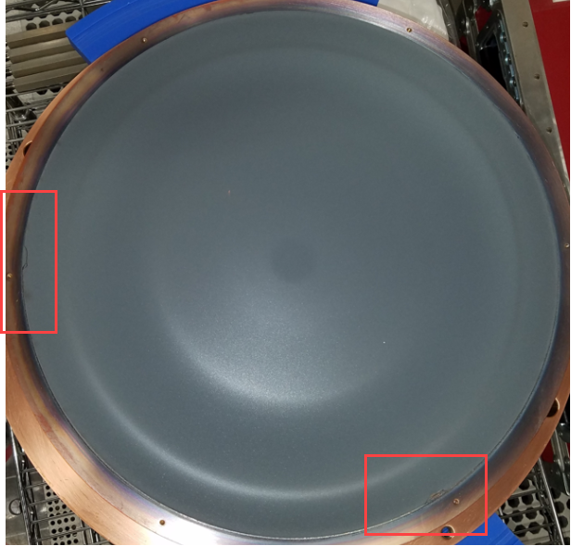
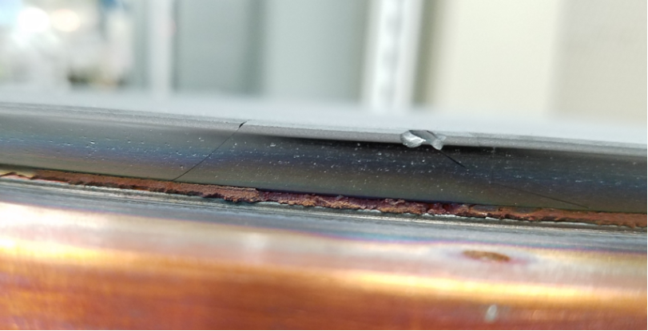
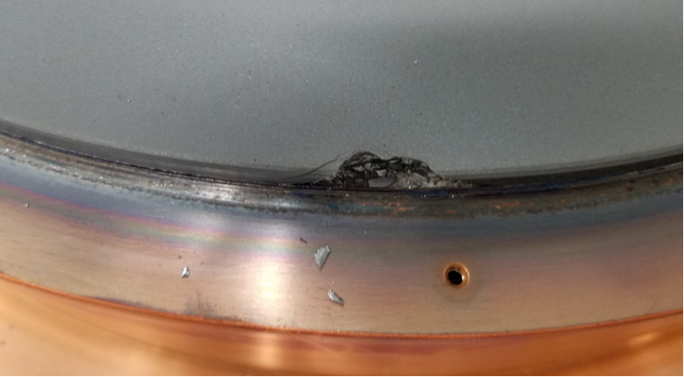
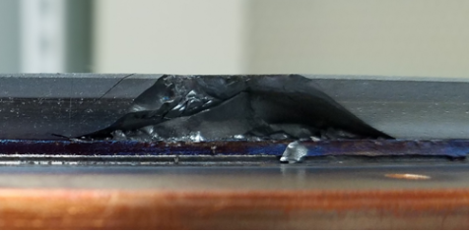
Failure Mode 1: Handling
Target edges were chipped (likely from collision) during a maintenance event
No hair-line cracks noted on the target surface
Targets are hoisted on a crane and moved to a target jig and back during maintenance

Slide 5
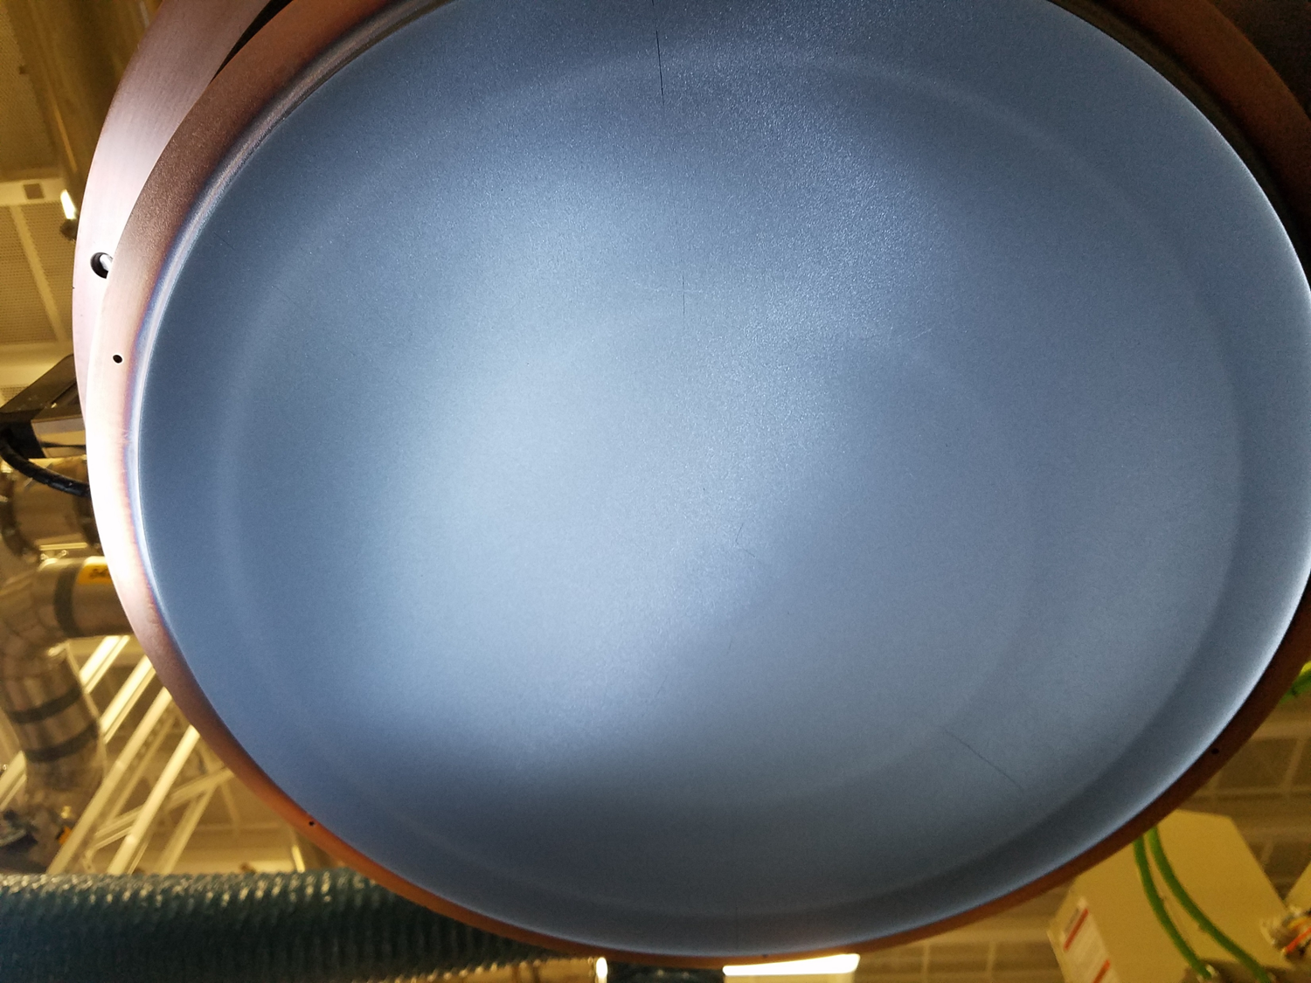
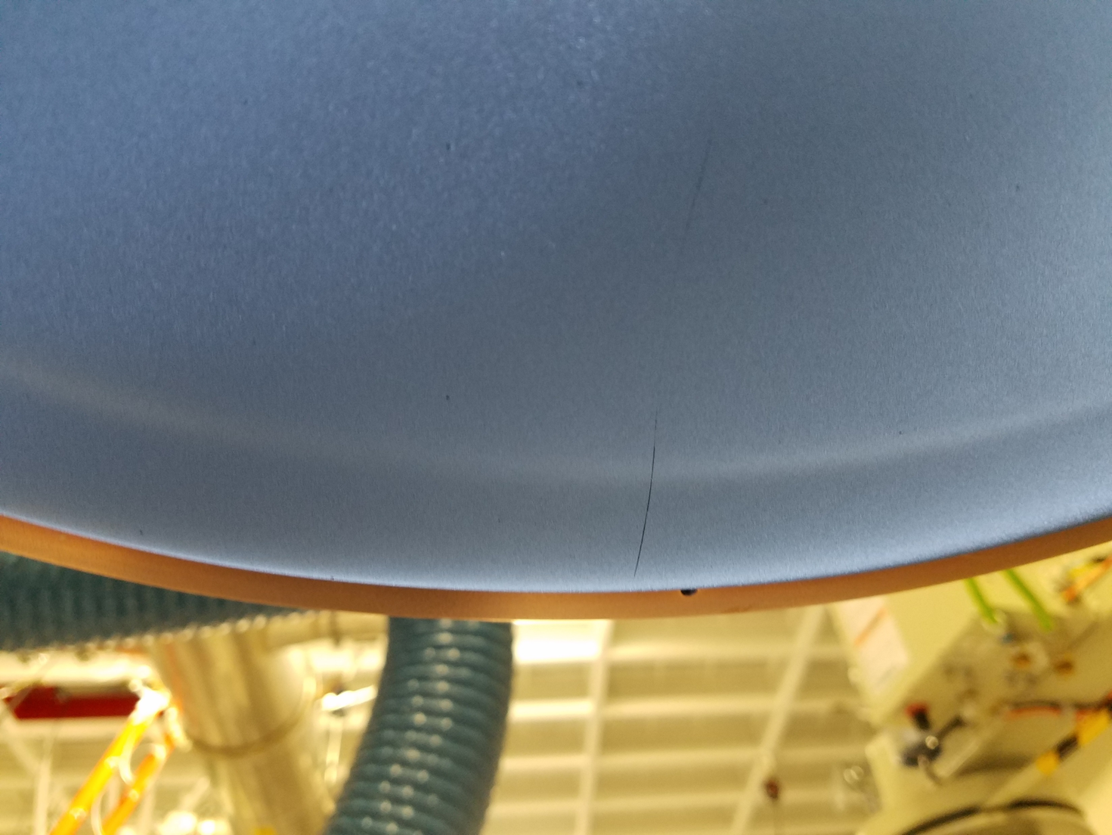

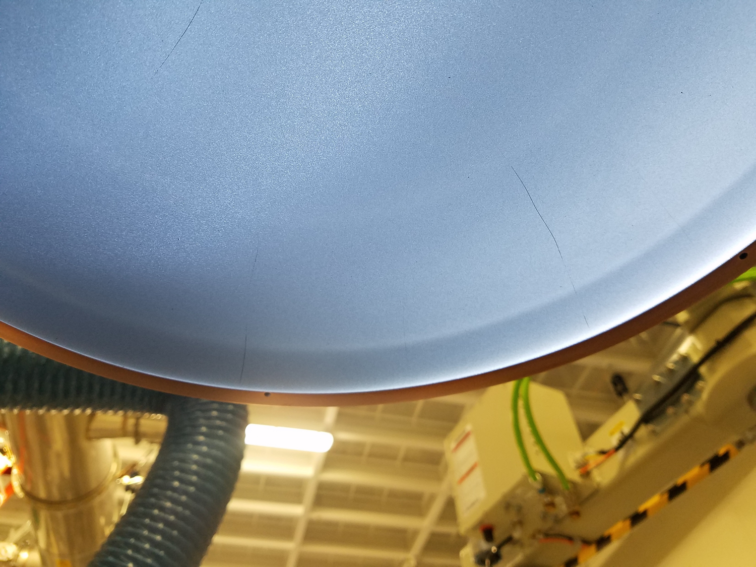
Failure Mode 2: Stress Cracking
Cracks emanating from the fail point on the target and propagating outwards.
Cracks observed to be getting worse with burn-in (on target 2 in Fab4)
Defectivity 10x to 20x higher

Slide 6
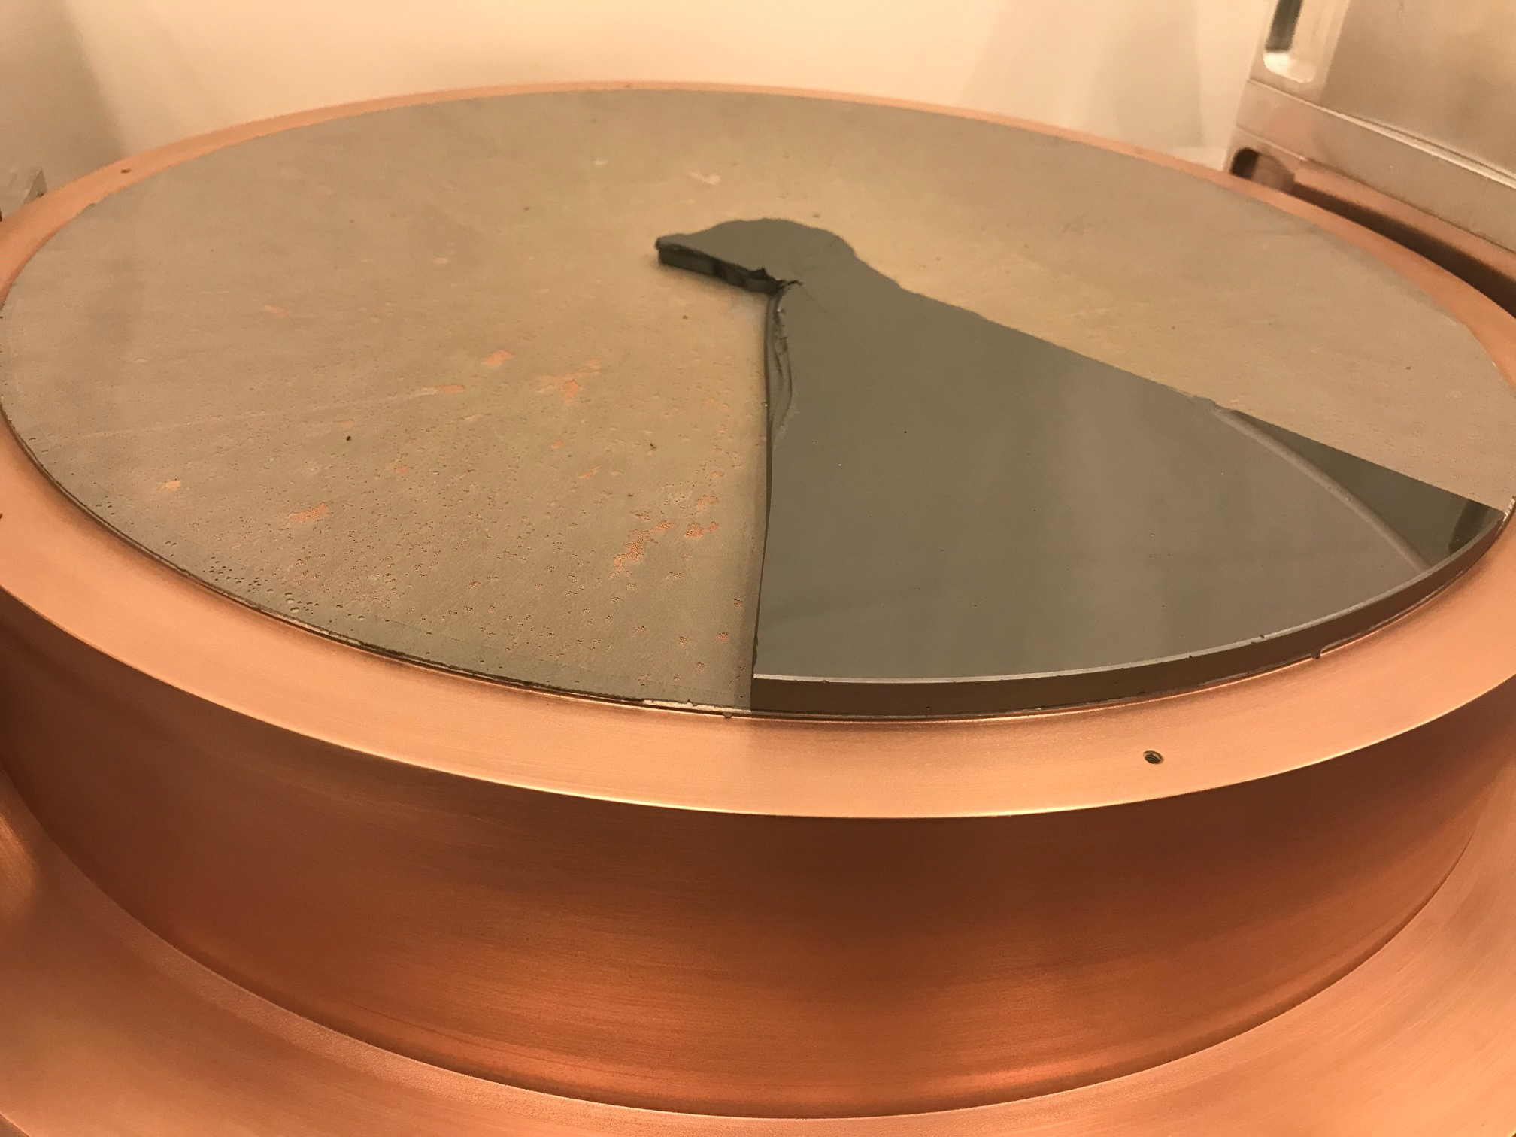
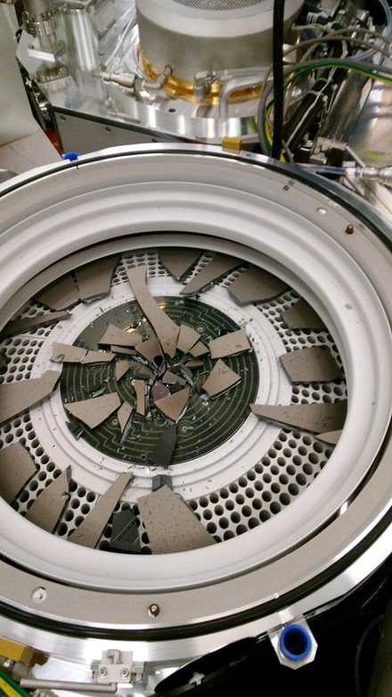
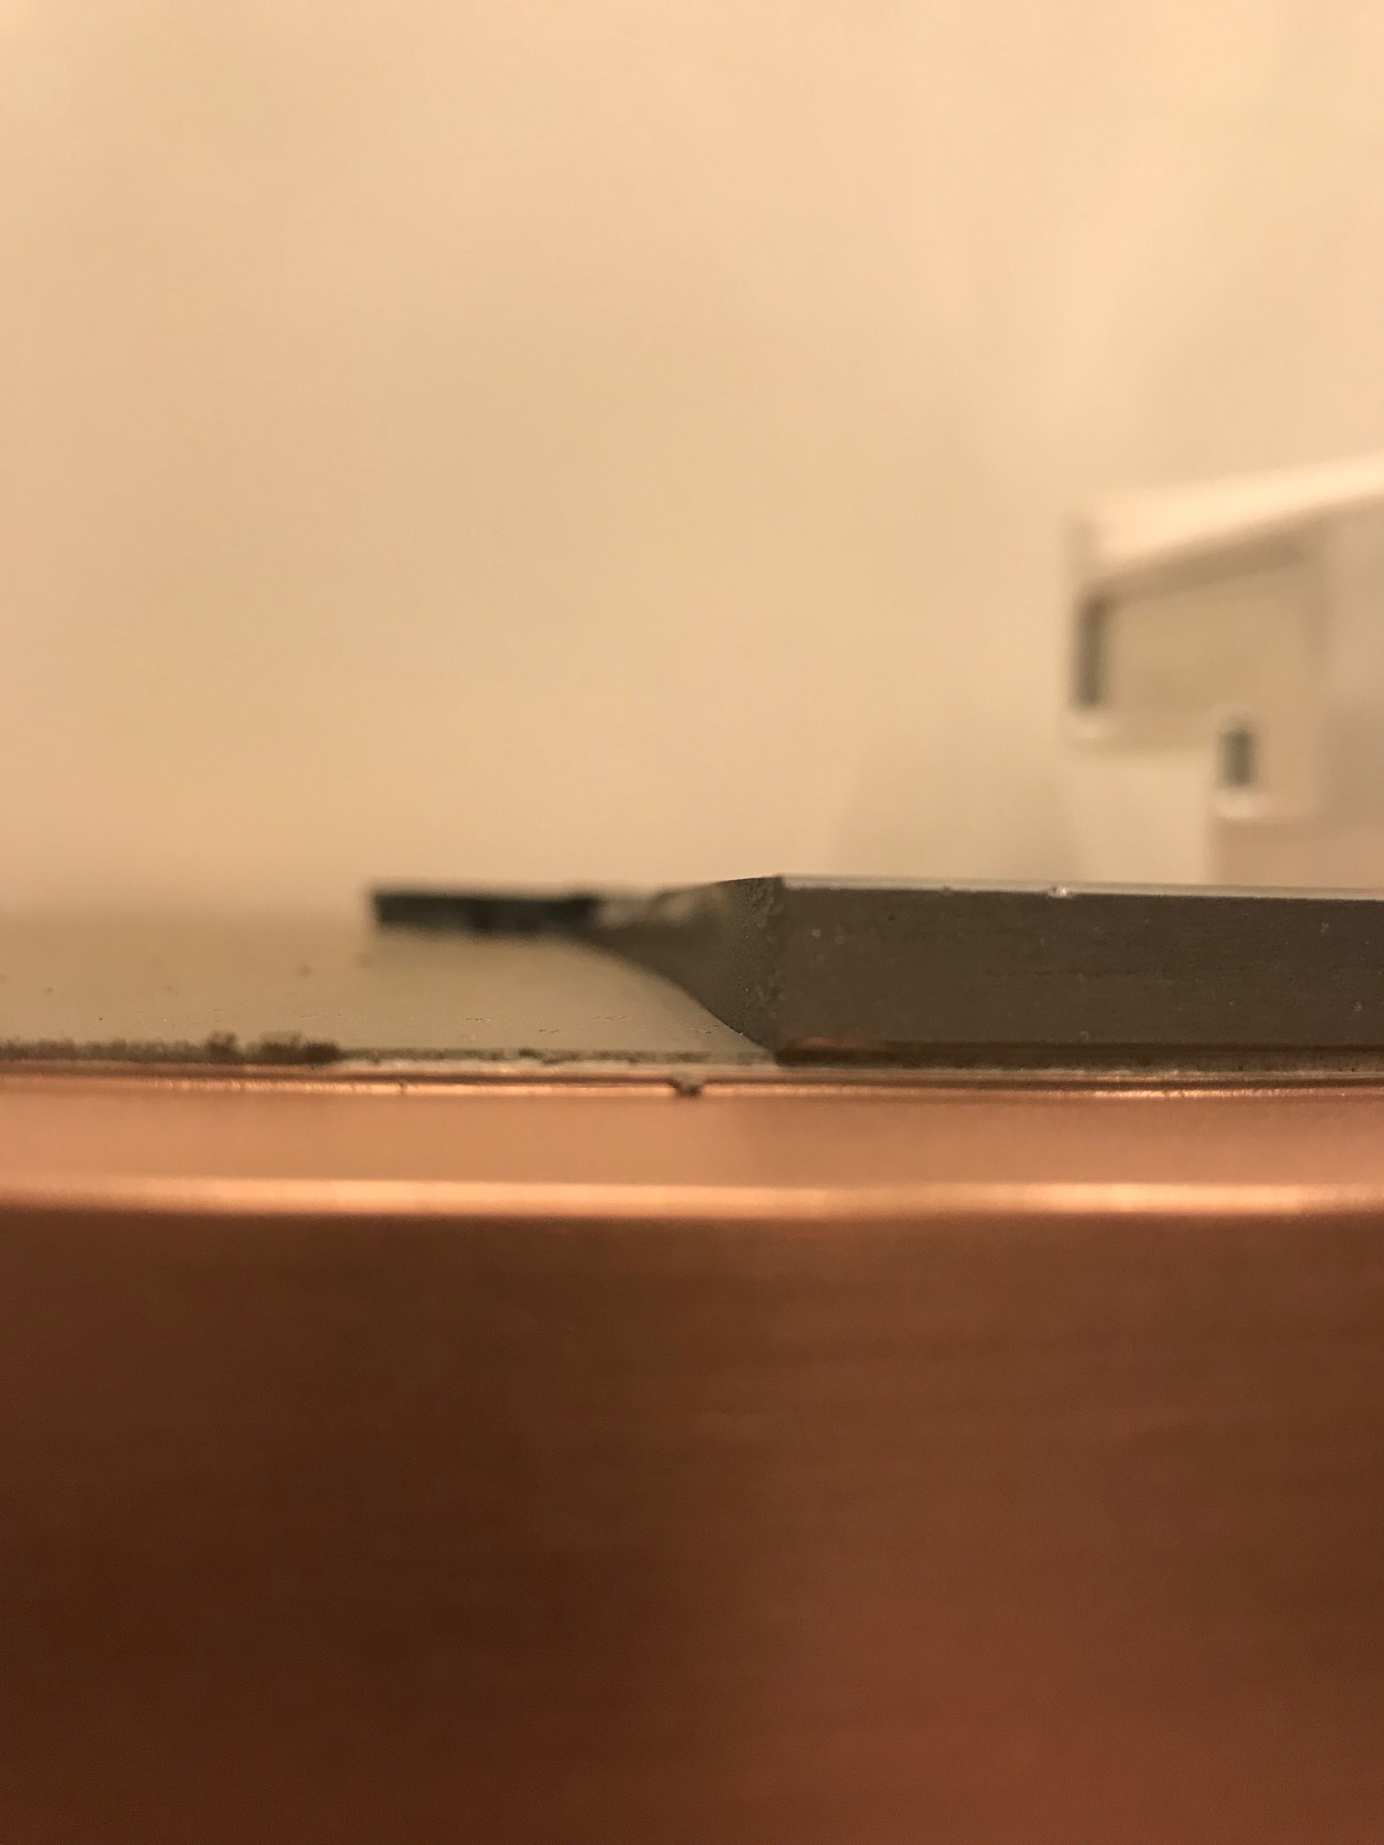
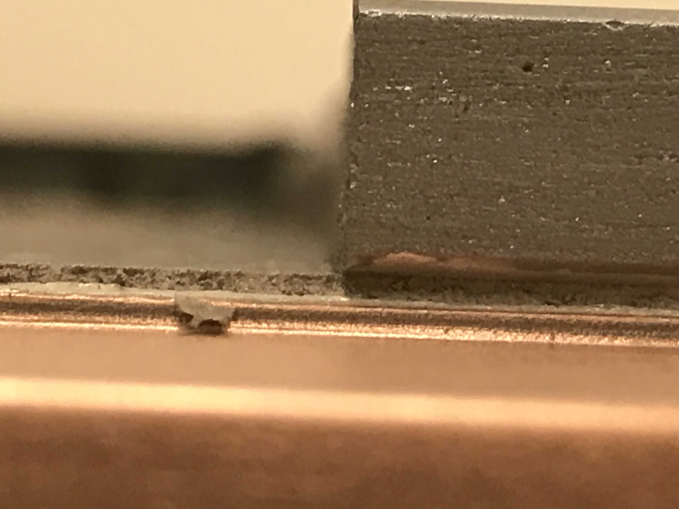
Failure Mode 3: Bad Bonding
Target de-bonding from the backing plate and dropped on the ESC below
This happened during the chamber bake-out post target install
Target did not see any plasma
From the failed interface, it looks like the elastomer bond did not stick to the backside of the target
A SDv12 target de-bonded in a similar fashion in Fab2. That target was bonded right before this SDv16

Slide 7
Pioneer SDv16 Targets status
Target | Target Press Condition | Observations | Performance | Status | Fail Root Cause
1 | BKM | Surface Pitting - Glassy | Benchmark – Chipped during maintenance | Scrapped/ Fab2 | Target mis-handling during maintenance
2 | BKM Minus T | Good surface quality - Glassy | Stress cracked during initial Burn-in | Scrapped/ Fab4 | High power burn / In content / Target press cond.
3 | BKM Minus xT | Poor press quality – Powdery | Stress cracked during burn-in | Scrapped/ Fab2 | In content / Target press cond.
4 | BKM Minus T | Poor press quality - Powdery | NA / Did not test | Scrapped/ Pioneer | Did not test
5 | BKM | Surface Pitting – Glassy | Target dropped in the chamber during bake-out due to Bond fail | Scrapped/ Fab4 | Unknown
6 | BKM | Pending | Pending | Ship ETA (~18th April) | NA
7 | VHP-D, 47%+ ton, Increase soak, Decrease cool rate | Pending | Pending | Ship ETA (~18th April) | NA

Slide 8
What about the bonding issues?
The bonding company is running a FA on the SDv12 target from Fab2
Due 3/30
Fab4 will ship the de-bonded SDv16 to the bonding company for FA on it
Ship ETA 3/28
Based on the failed SDv12, so far they think it is not the elastomer curing but the BSM layer (a sputtered metal layer on the back of the target blank to prevent the SD interaction with the elastomer) adhesion to the elastomer that shows weakening
Testing the BSM with 2 different elastomers at different times b/w BSM sputter and bonding
Results 3/30

Slide 9
What is happening on the target vendor front?
The first thing we want to do is to test the BKM condition (target #1) once the bonding issues are resolved
Target #6 will be based on BKM press conditions
Current ETA for that target is 4/18
The vendor has procured a new press with higher tonnage capability and a larger uniform temperature zone.
Target #7 will be pressed in the new VHP-D at 47% higher tonnage
This target will also see an increased soak time (above Tg) post press + a decreased cool-down ramp so as to let the target equilibrate and the stresses anneal out
Current ETA for that target is 4/18

Slide 10
Is PVD looking at other vendors for the SDv16?
PVD has already initiated talks with 2 other vendors for procuring targets in the SDv16 composition
Honeywell:
They are in the feasibility study mode (of doping Indium into the SD) before they can give me a quote / timeline
Vendor 3:
Quote requested this week. No response yet. (this vendor has come forward to make a SDv12 and even quoted it with a 15 week timeline for target once PO is cut)
A word of caution on the new vendors: These are bigger companies than the current vendor so their capabilities are likely better. This also means that there is red-tape involved and when it comes to As-containing materials, the timelines are usually longer…

Slide 11
Can we support the SDv16 qual on 10s/20s with a clean 3C process in Fab 4?
We need a defect-free (sub 100 adders) process on the 3C chamber if we want to support the SDv16 qual on 10s/20s
2x 125mm SDv16 monolithic composition targets have been quoted by the target vendor and will be ordered in the next day
ETA TBD?
Current 5% In-SDv12 target (part of the co-sputter targets’ set on MMUM450500) has 1500+ adders

Slide 12
What is the projection for higher Indium content SAG targets for 30s 3DxP / SSM ?
We need to understand if the Indium content or the press conditions is the root cause of the target fails
If the Indium content is the root cause, then we have a longer road ahead of us as far as optimization is concerned even on the SDv16 composition
If going to the BKM press conditions solves the issues for SDv16, the vendor can steer his attention to In-SAG
Currently foresee late CY Q2 to Q3 for target development on the In-SAG targets of the SDk1, SDk2 compositions (with the current target vendor)

Slide 13
How does this affect 3C chambers availability for Materials Exploration?
SDv16 co-sputter targets are installed on guns 1 and 2 on MMUM4505F1 3C chamber
The defectivity is high on the co-sputter process (~20x of large target process)
BLICS / bin XG associated with the co-sputter deposition ~2x higher
Given the above issues, PI is not really interested in running a co-sputter SDv16
PO for SDv16 mono 3C targets will be cut within 48hrs
ETA: TBD
Based on the ETA and based on SDv16 large target performance (next ones to arrive on April 18th), we may need access to MMUM4505F1 3C chamber again in late April

