Slide 1
SD Characterization Update
Dan Gealy, Enrico Varesi
Update - March 28, 2018

Slide 2
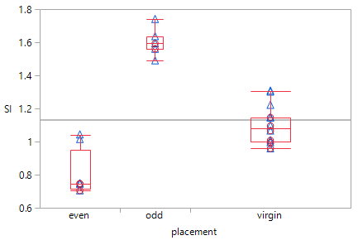
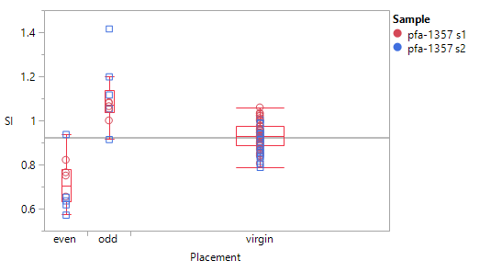
Summary – TEM PFA Work SD1
PFA 1357– SR71b SD1 split, completed
    WL Cut (Y-Dir) – Grounded (new)
    BL Cut (X-Dir) – replicate
  PFA 1357/TL180206001 ungrounded BL cut remain consistent
  Grounded WL-cuts still provides the best data
  BL cut (X-dir)
    Ungrounded
      Se/As segregation observed – top is As rich, bottom is Se rich
    Se/As segregation trending
      “odd bits”> virgin bits >”odd bits” – top is Se rich, bottom is As rich
      Thickness changes not prominent
  Prog assignment to be confirmed
S3 grounded WL
S1, S2 ungrounded BL

Slide 3
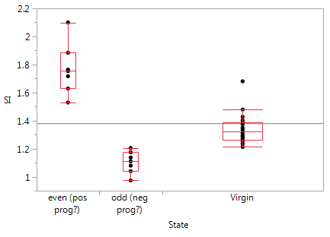
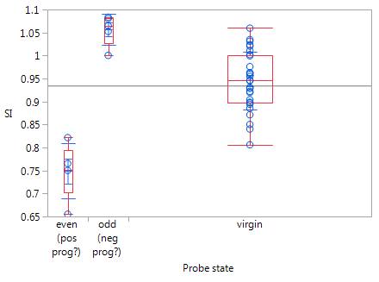
Summary – TEM PFA Work SD1 (2)
TL172122001 SR71b with bit placement - SD1 split
  WL cut (WL14). No grounding
  Strong Se/As segregation trending
    Even/odd bit placement is opposite
    SI: “even bits” > virgin bits > “odd bits” observed – top is Se rich, bottom is As rich. SI > 1
    Thickness changes not prominent
PFA 1357– SR71b SD1 split
  BL cut (X-dir)
    Ungrounded
      Se/As segregation observed – top is As rich, bottom is Se rich
    Se/As segregation trending
      “odd bits”> virgin bits >”odd bits” – top is Se rich, bottom is As rich
      Thickness changes not prominent
  PFA 1357/TL180206001 ungrounded BL cut are consistent
  Prog assignment to be confirmed
TL172122001
PFA1357 S1 ug-BL

Slide 4
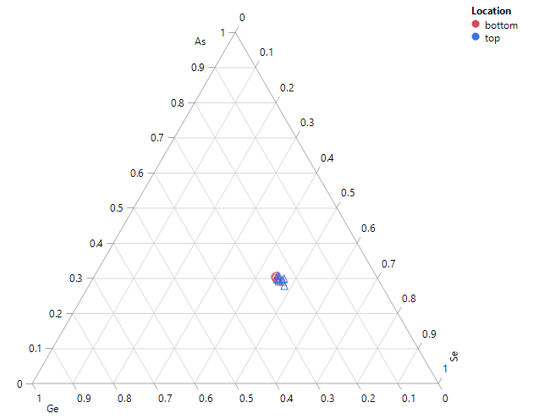
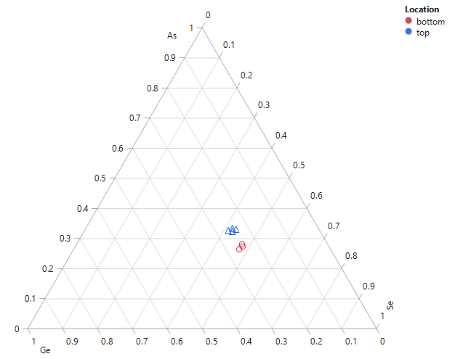
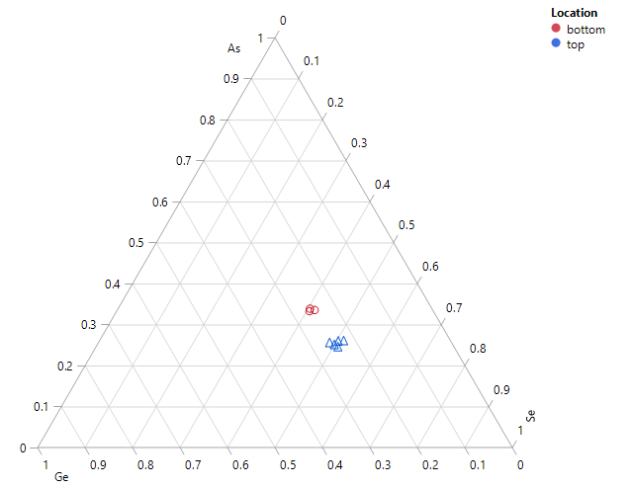
Fired/Virgin Bits – SR71b PFA 1357 s3
SD1 split4E w16
  WL (Y) Cut. – Grounded
  Polarity driven segregation observed
  Little segregation in unfired bits but there is still a small offset which is additive to the polarity driven segregation
Grounded WL cut shows a smaller preparation segregation bias
Odd Bits (Neg prog?)
Virgin
Even Bits (Pos prog?)
Hefei

Slide 5
PFA 1357 on SD1 – SI Box plots/linescans
Polarity driven segregation observed
S2 corroboration
Thickness artifacts
pfa-1357, grounded WL cut, S3
pfa-1357, ungrounded BL cut, S1, S2

Slide 6
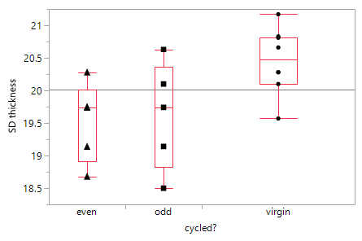
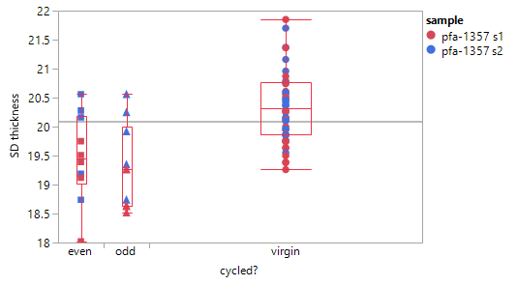
PFA 1357 on SD1 – SD Thickness
Fired bits are marginally thinner
pfa-1357, grounded WL cut, S3
pfa-1357, ungrounded BL cut, S1, S2

Slide 7
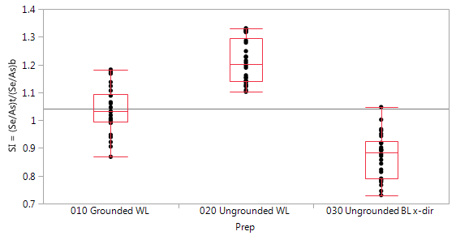
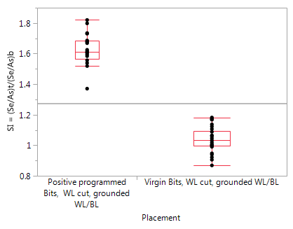
Summary – TEM PFA Work SD1
TL180206001 – S26 virgin die - SD1 split
  WL cut (Y-dir)
    Grounded WL/BL
      Little segregation observed. SI ≈ 1
    Ungrounded
      Se/As segregation observed – top is Se rich, bottom is As rich. SI > 1
  BL cut (X-dir)
    Ungrounded
      Se/As segregation observed – top is As rich, bottom is Se rich. SI < 1
TL180108002 – S26 probed die - SD1 split
  WL cut (Y-dir) - Grounded WL/BL. “Positive” programming
  Se/As segregation observed – top is Se rich, bottom is As rich. SI > 1
S26a
Virgin bits
S26a
Positive programed /Virgin bits

Slide 8
PFA on SD1 (only) – Summary Table
Job | device | Lot/wf | status | GND | Cut_dir | type | Se rich | Se/As (top/bottom)
Pfa-1357 | SR71 | 0024732/wf16 | Done | No | X | Prog2 (neg ?) | Bottom | 0.75
 |  |  |  |  |  | Virgin | Bottom | 0.95
 |  |  |  |  |  | Prog1 (pos ?) | no | 1.06
 | SR71 | 0024732/wf16 |  | Yes | Y | Neg |  | 0.74
 |  |  |  |  |  | Virgin |  | 1.12
 |  |  |  |  |  | Pos |  | 1.59
TL171222001 | SR71 | 0024732/wf16 | Done | No | Y | Neg (odd) | Top | 1.11
 |  |  |  |  |  | Virgin | Top | 1.31
 |  |  |  |  |  | Pos (even) | Top | 1.75
TL180108002 | S26 | 0024732/wf2 | Done | Yes | Y | Pos | Top | 1.62
TL180206001 | S26 | 0024732/wf2 | Done | Yes | Y | Virgin | no | 1.02
 | S26 | 0024732/wf2 | Done | No | X | Virgin | bottom | 0.86
 | S26 | 0024732/wf2 | Done | No | Y | Virgin | Top | 1.2
Pfa-1385 | S26 | 0024732/wf2 |  | Yes | Y | Pos

Slide 10
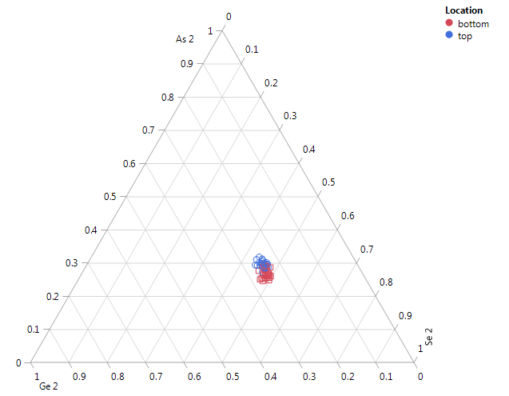
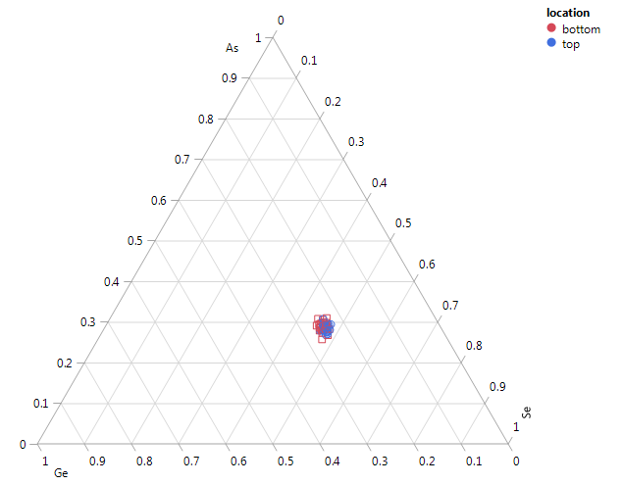
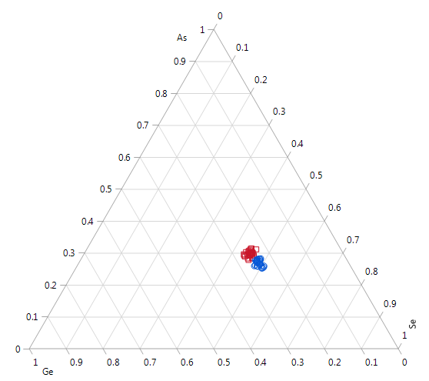
Virgin Bits – S26A TL180206001
Virgin array -ungrounded BL cut
SD1 split4E, w02 Ungrounded WL/BL cuts
  Grounded WL cut shows least segregation
  Ungrounded show segregation
  Opposite segregation between WL & BL cuts
Virgin array -grounded WL cut
Virgin array - ungrounded WL cut
Hongqi

Slide 11
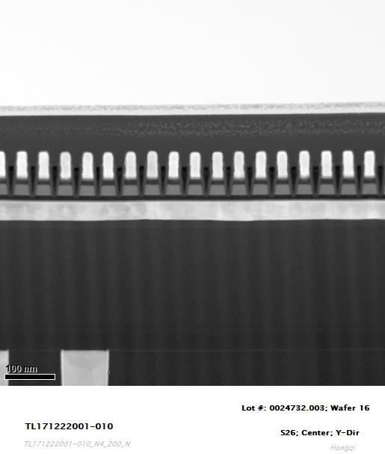
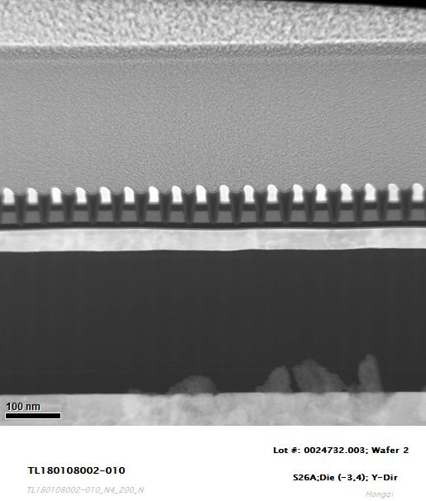
WL-BL grounding
SR71 WL cut
(Y-dir)
S26 WL cut
(Y-dir)
W BLs were not grounded.
W BLs were grounded.

Slide 12
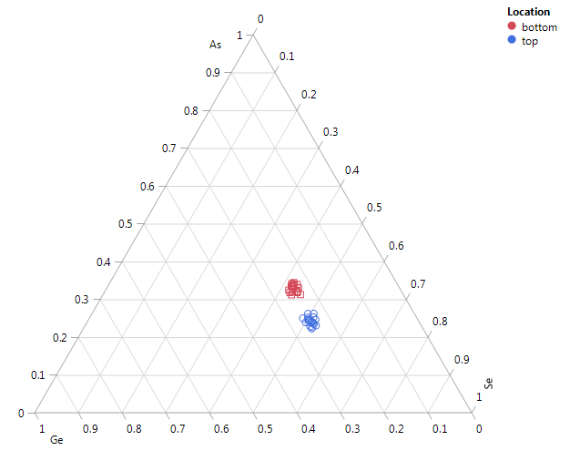
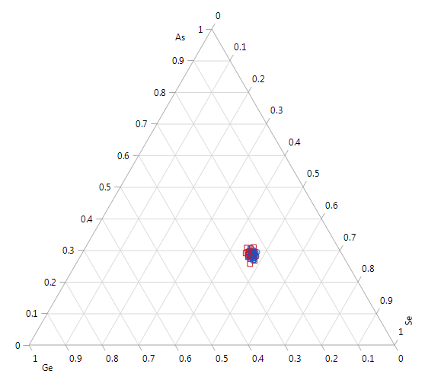
Fired/Virgin Bits – S26A TL180108002, TL180206001
Grounded WL Cuts
SD1 split4E, Grounded WL cuts
  w02 S26A
    Programed
    Virgin array
  Segregation on programming observed
    Se rich top, As rich bottom
  Little preparation bias
Pos prog TL180108002
Virgin Array TL180206001
Hongqi

Slide 13
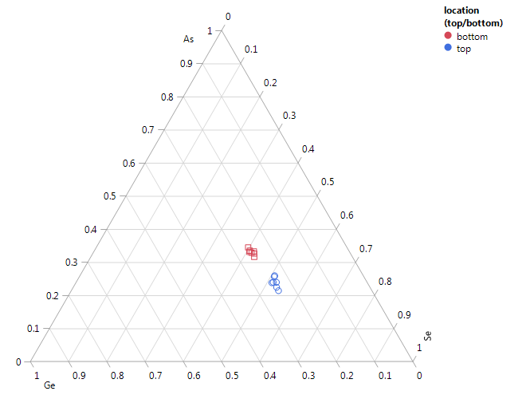
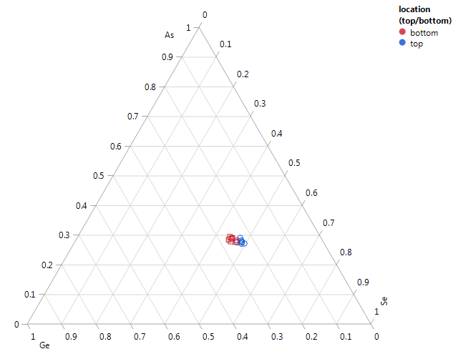
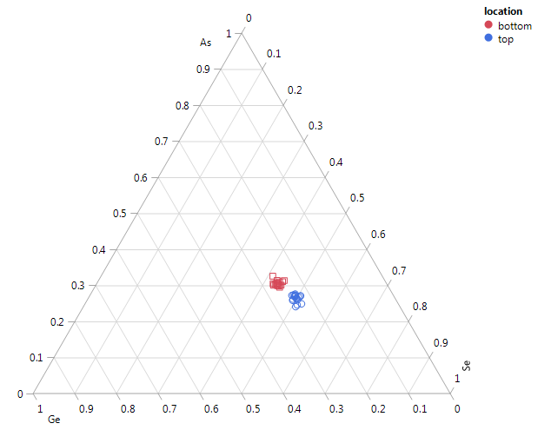
Fired/Virgin Bits – SR71b TL1712222001
TL172122001
SD1 split4E w16
  WL Cut. No grounding
    WL 14/multiple BL’s
    Se/As segregation trending
      SI “even bits”> virgin bits >”odd bits” – top is Se rich, bottom is As rich
Even (Pos prog?)
Odd (Neg prog?)
Virgin
Hongqi
Ungrounded WL cut overlays a preparation segregation bias that adds to D0 positive programming but subtracts from D0 negative programming

Slide 14
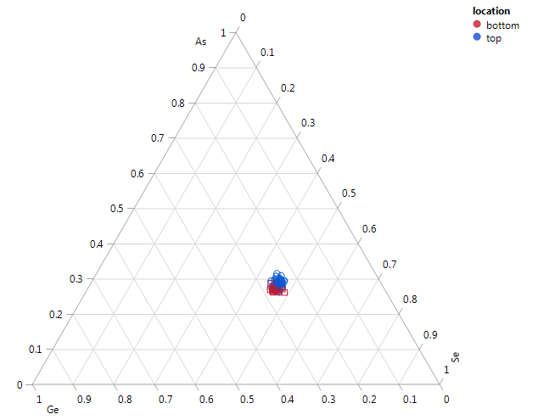
Virgin Bit Comparison – SR71b/S26a
SD1 split4E w16
  BL Cut. No grounding
  SI < 1
Virgin Bits S26a -ungrounded BL cut
Virgin Bits – SR71b ungrounded BL cut PFA 1357

Slide 15
Fired Bits – SR71b TL1712222001, S26a TL180108002
SD1 split4E
  w16 SR71b
    WL Cut. No grounding
    WL 14/multiple BL’s
  w02 S26a
    WL cut. Grounded
  Data is consistent if we assume pos. programing on even bits
    Logical interpretation is that even lines are probed negatively
Even (Pos prog?) SR71b
Pos prog
S26a
Hongqi

Slide 16
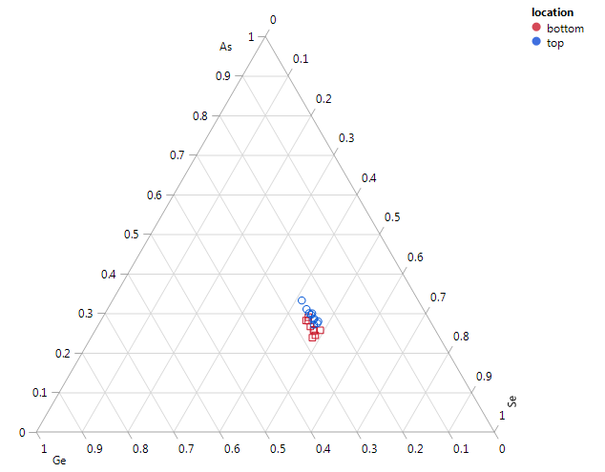
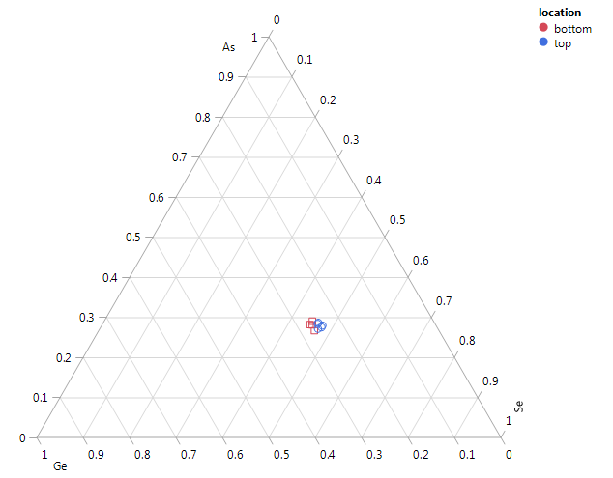
Fired/Unfired Bits – PFA 1357
SD1 split4E w16 - S1, S2
  BL Cut. No grounding
Even (Pos prog?)
Odd (Neg prog?)
Virgin
Hefei

Slide 17
PFA 1357 / TL122122001 Comparison
TL172122001
TL172122001
  WL Cut. WL14 (1st active) - verifiied
PFA1357
  BL Cut. BL 9
Trends are opposite between PFA 1357 & TL122122001
Actual placement needs to be better understood
Assuming even bits are positively programed (not intended) WL cuts on SR71b & S26a not grounded v. grounded are consistent
PFA1357

Slide 18
EDS Element Line Scan TL1712222001 Oppositely Fired Bits
38
37
36
35
34
33
Linescans not normalized
38
37
36
35
34
33

Slide 19
EDS Element Line Scan TL1712222001 Not Fired Bits
38
37
36
35
34
33
38
37
36
35
34
33
Linescans not normalized

Slide 20
EDS Element Line Scan TL80108002
Linescans not normalized
Grounded WL/BL
Consistent with SR71B
As/Se motion

Slide 21
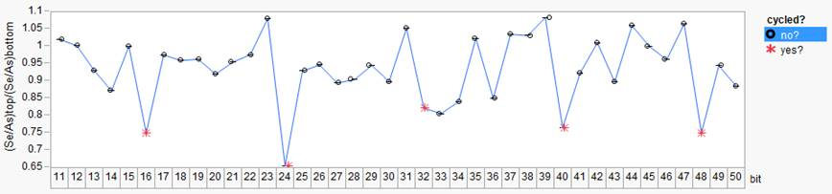
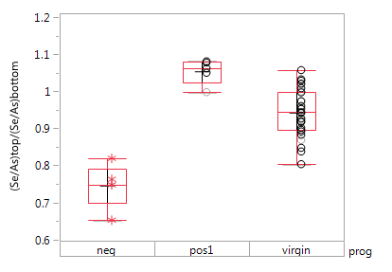
Stem Images: 0024732.003, split 4E SD1 SAG, wafer16 SR71B
Folsom
X-cut SR71 ungrounded
Prog sequence:
pos,/neg prog seasoning
chkb positive prog (4 pulses)
line pattern:
adjacent pos and neg prog between 6 not programmable cells
Significant Se enrichment at bottom for one of the two programmed cell
Opposite smooth segregation for opposite prog, compared to virgin
Prog assignment to be confirmed
Enrico

Slide 22
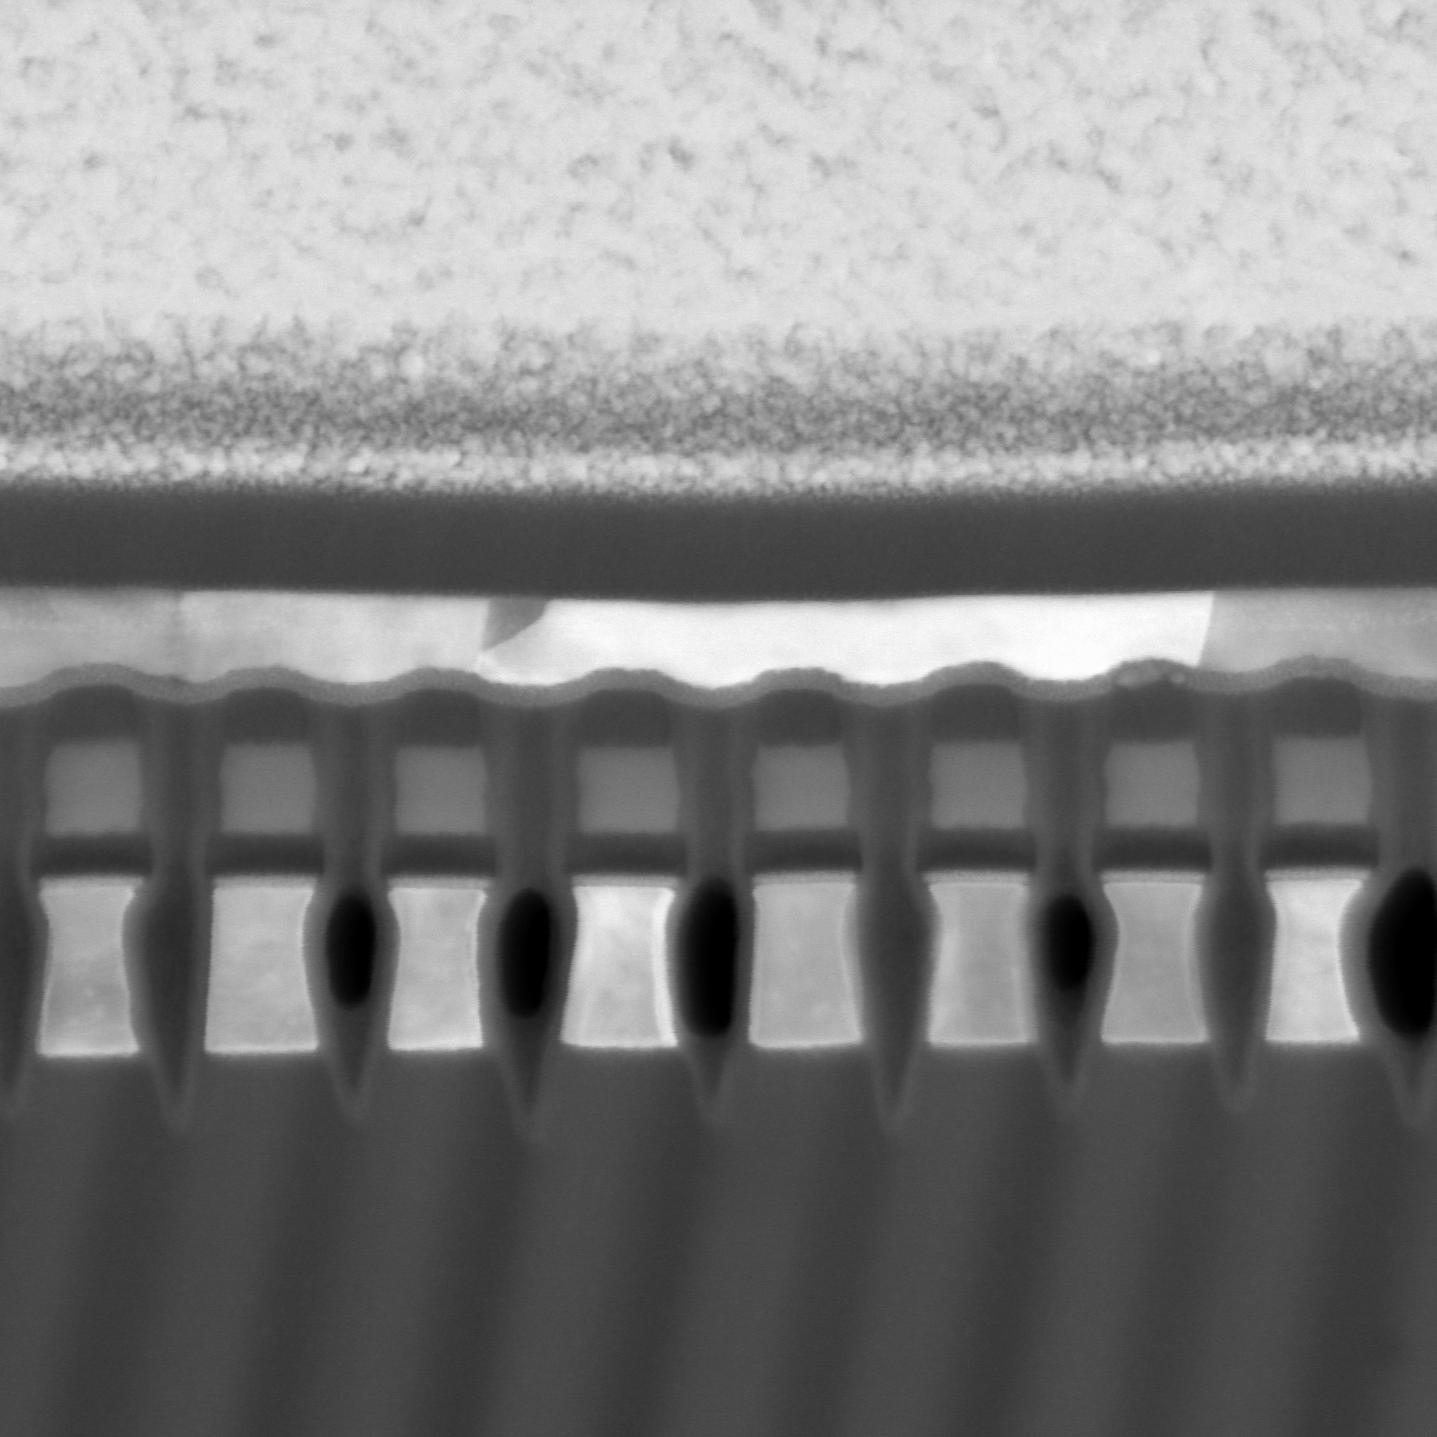
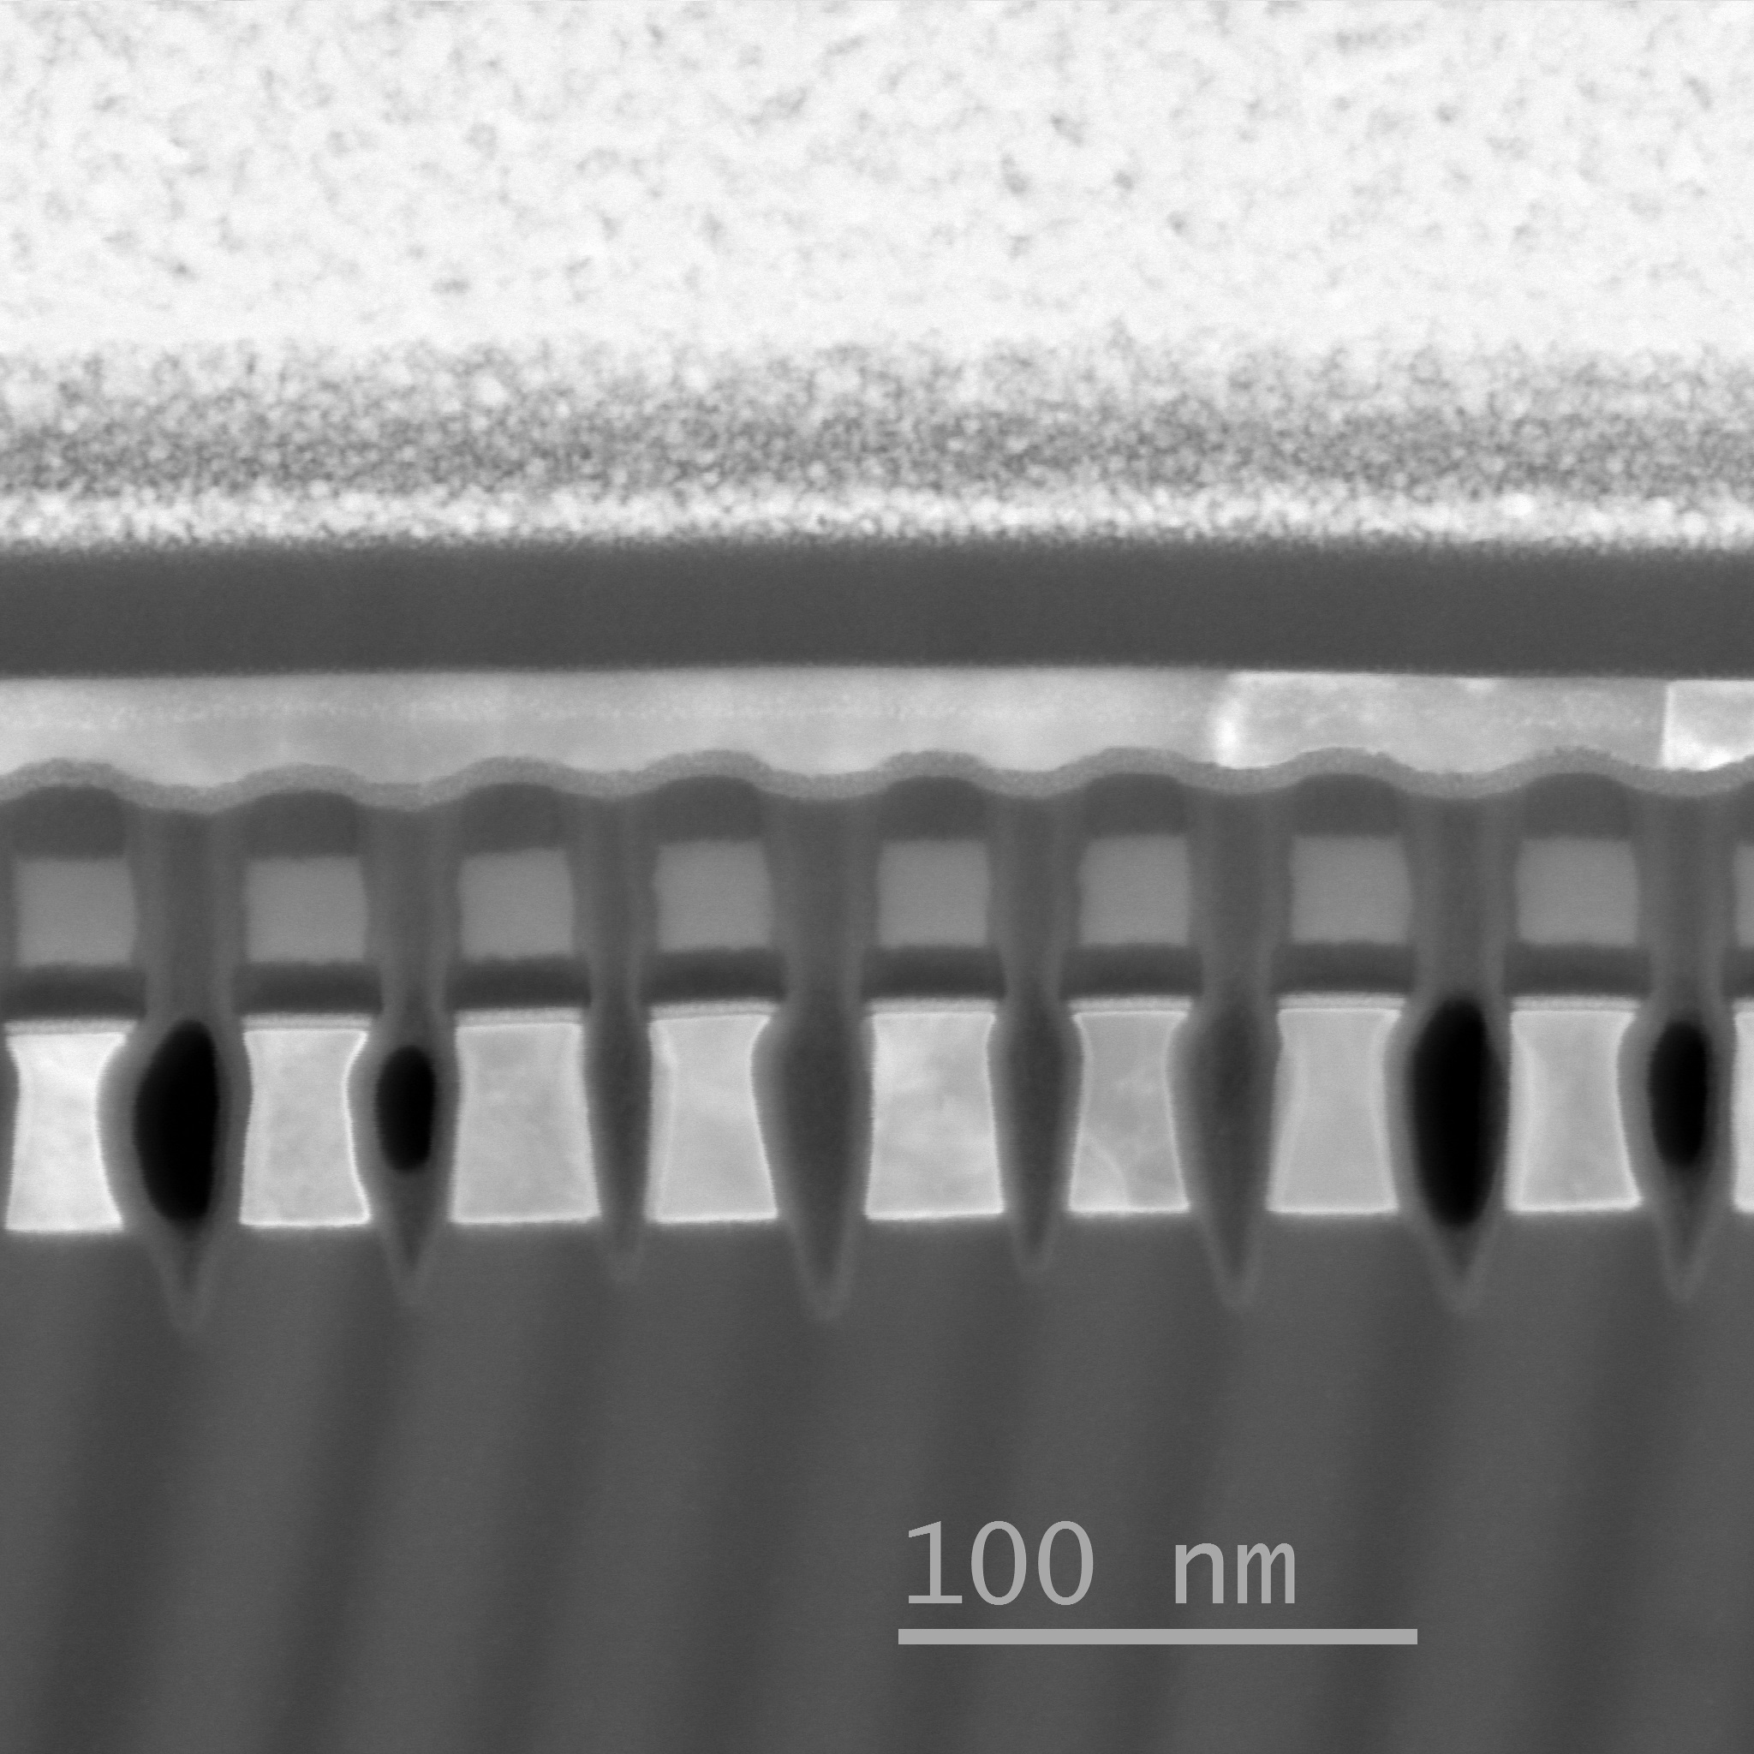
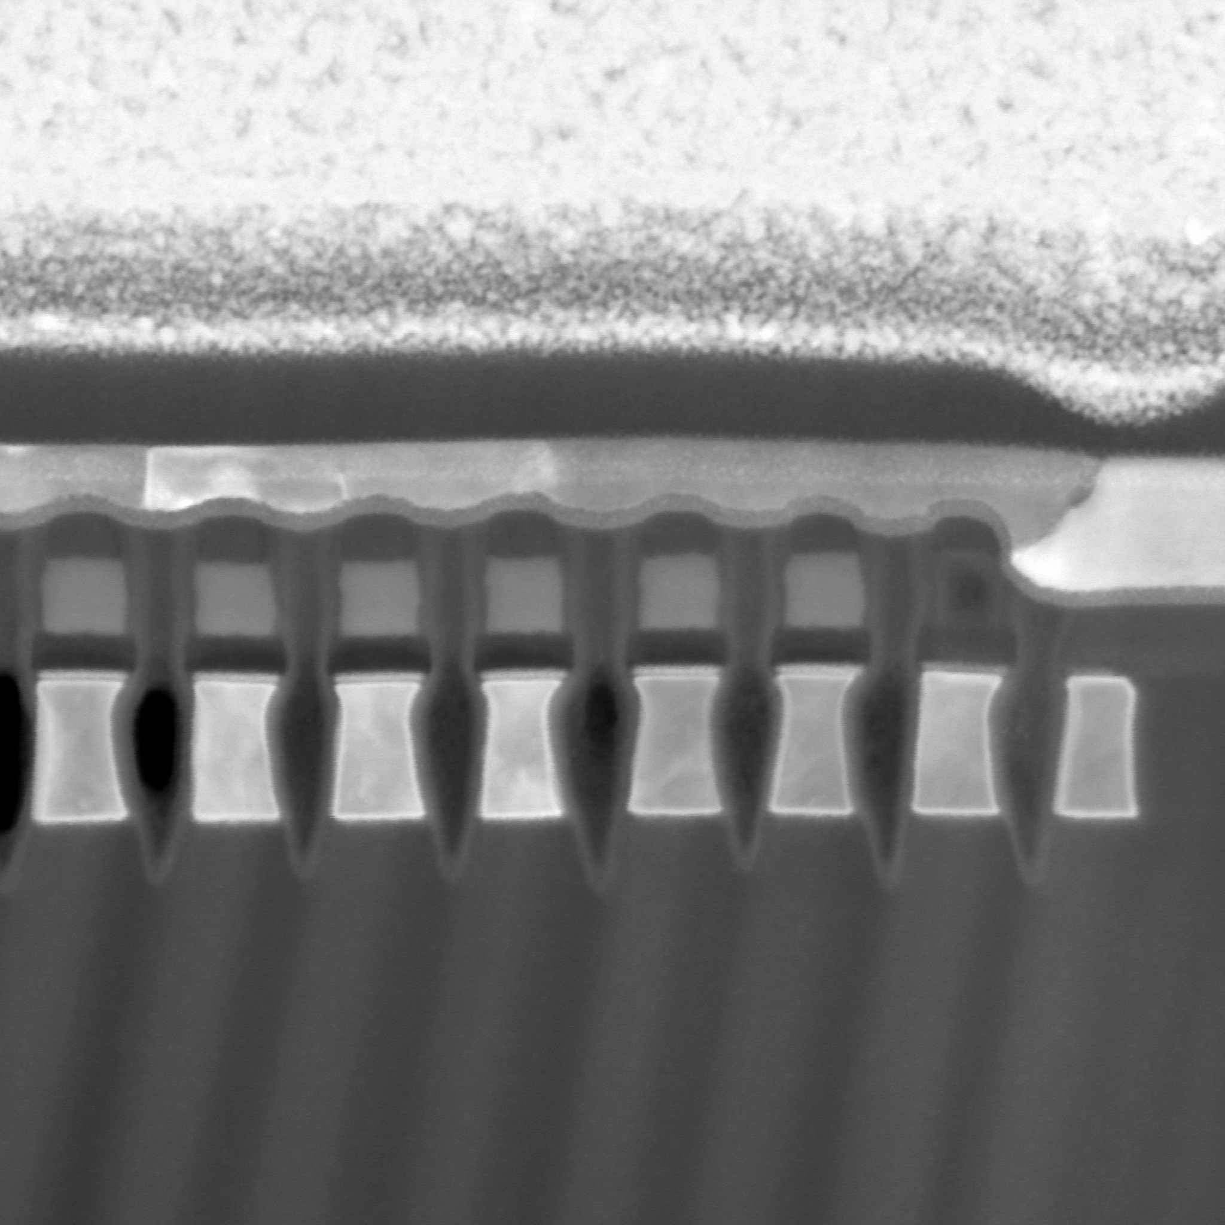
Stem Images: 0024732.003, split 4E SD1 SAG, wafer16 SR71B
31
23
22
15
8
22-15
15-8
8-1
PFA1357

Slide 23
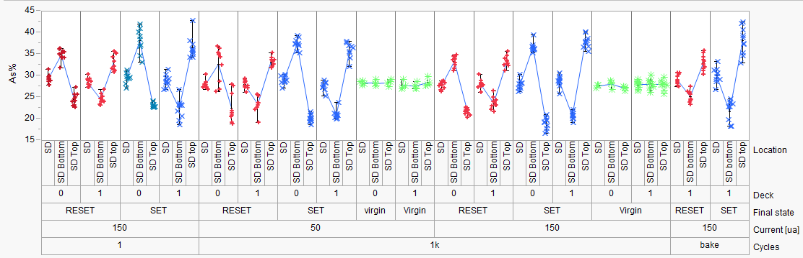
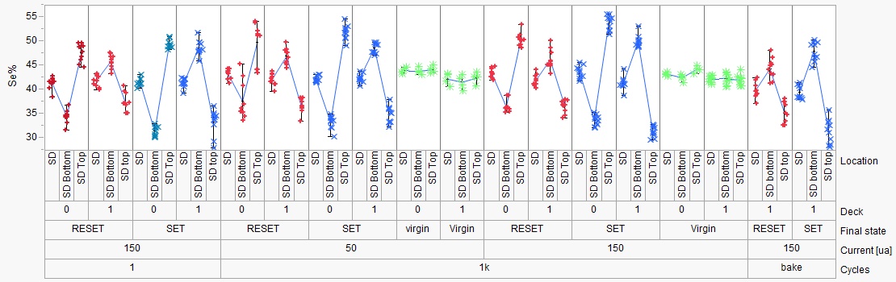
Previous SD1 Elemental Migration Work
PFA-396 (SD1)
Hefei, Enrico
SD1:
Stronger As/Se segregation
for SET vs RESET (time dominating)
1us
50ns
1k cycles
50 ns | 1000 ns | 50 ns | 1000 ns
50 uA |  | 150 uA
1us
50ns
  Elemental segregation with SD1
    Consistent with current direction (as with PM)
      Opposite electromigration behavior on D0 & D1
Back

Slide 24
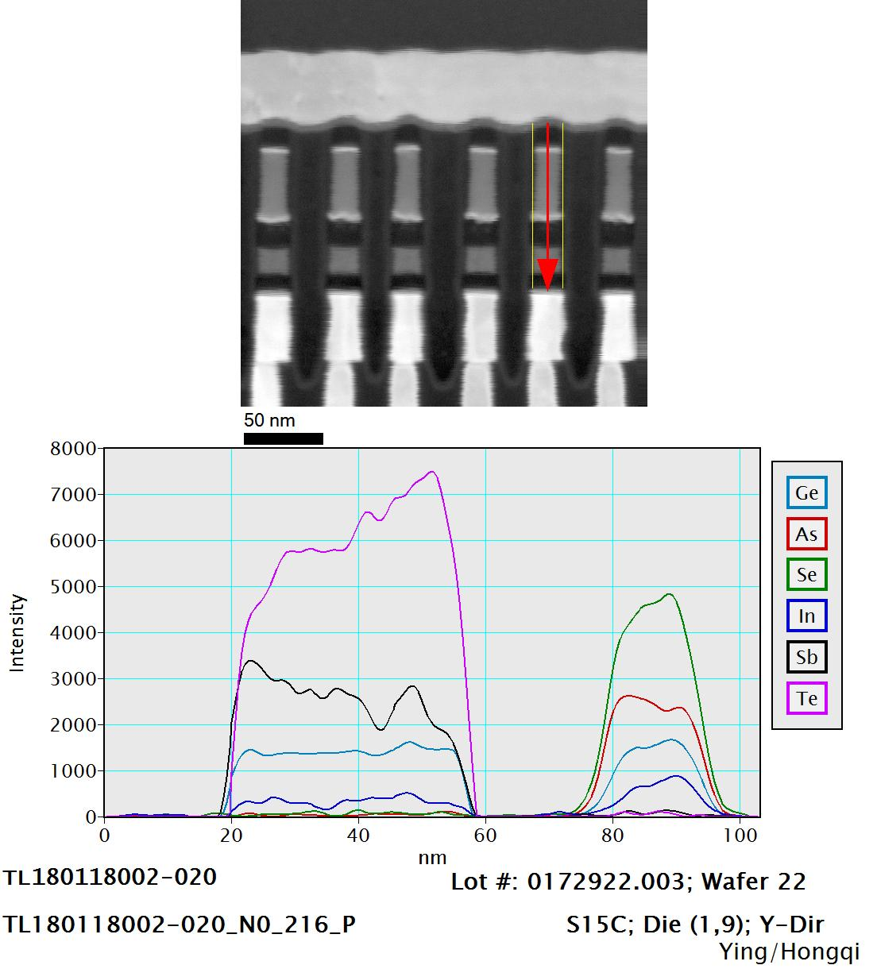
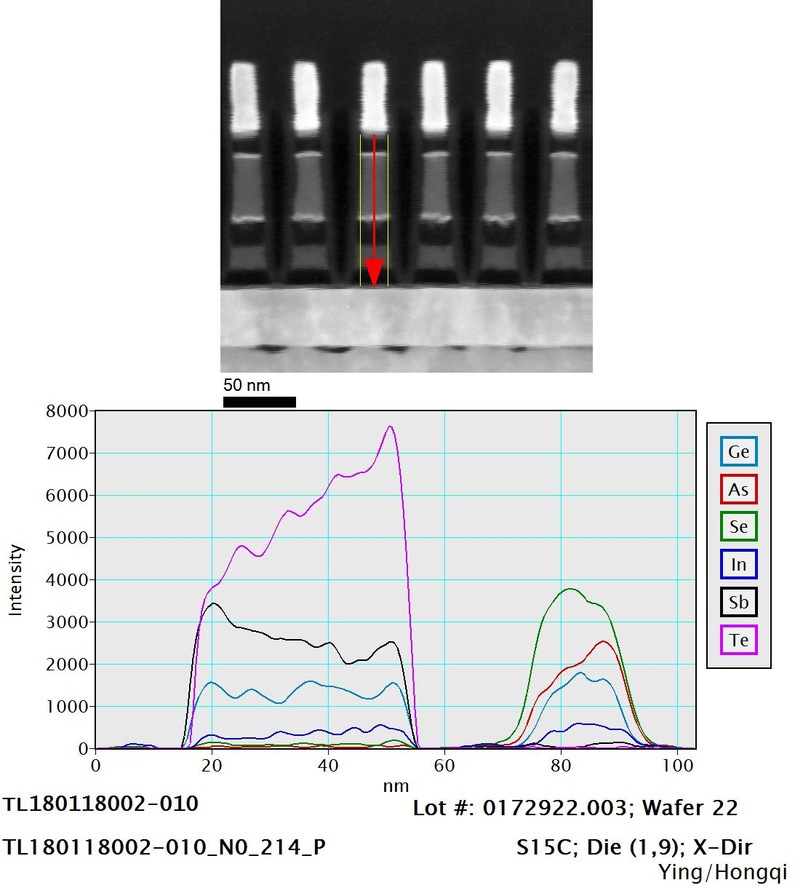
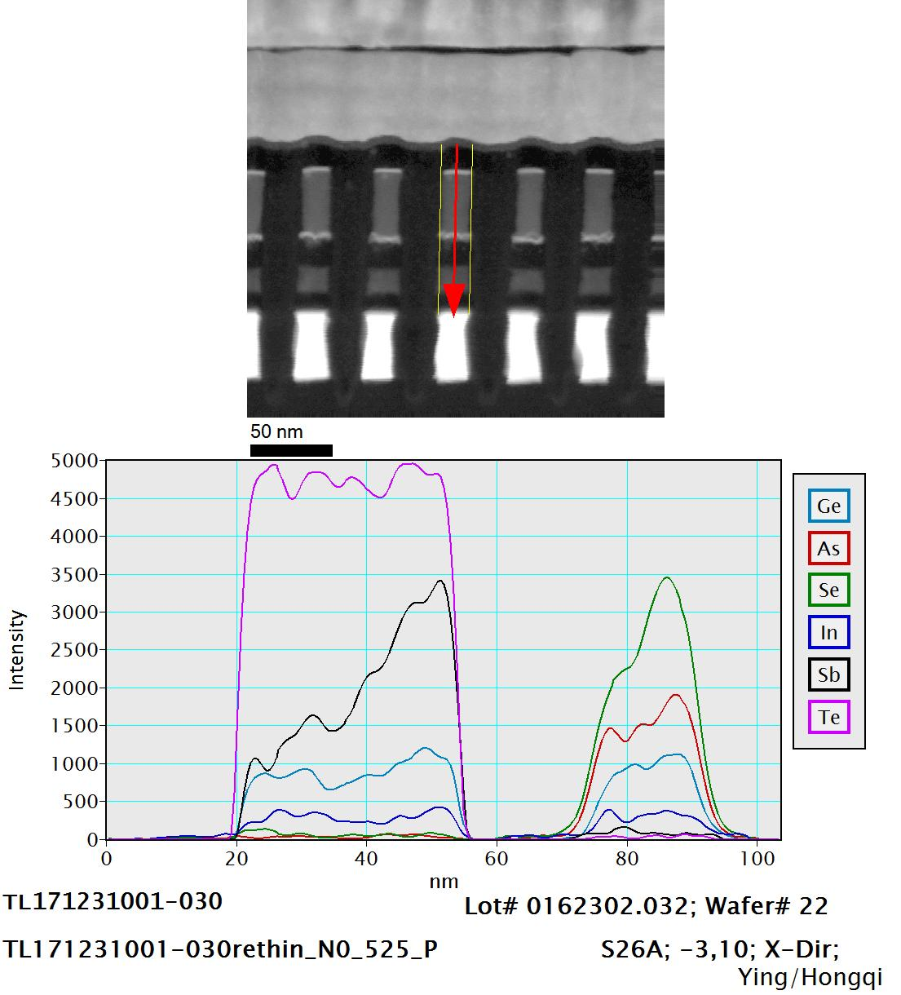
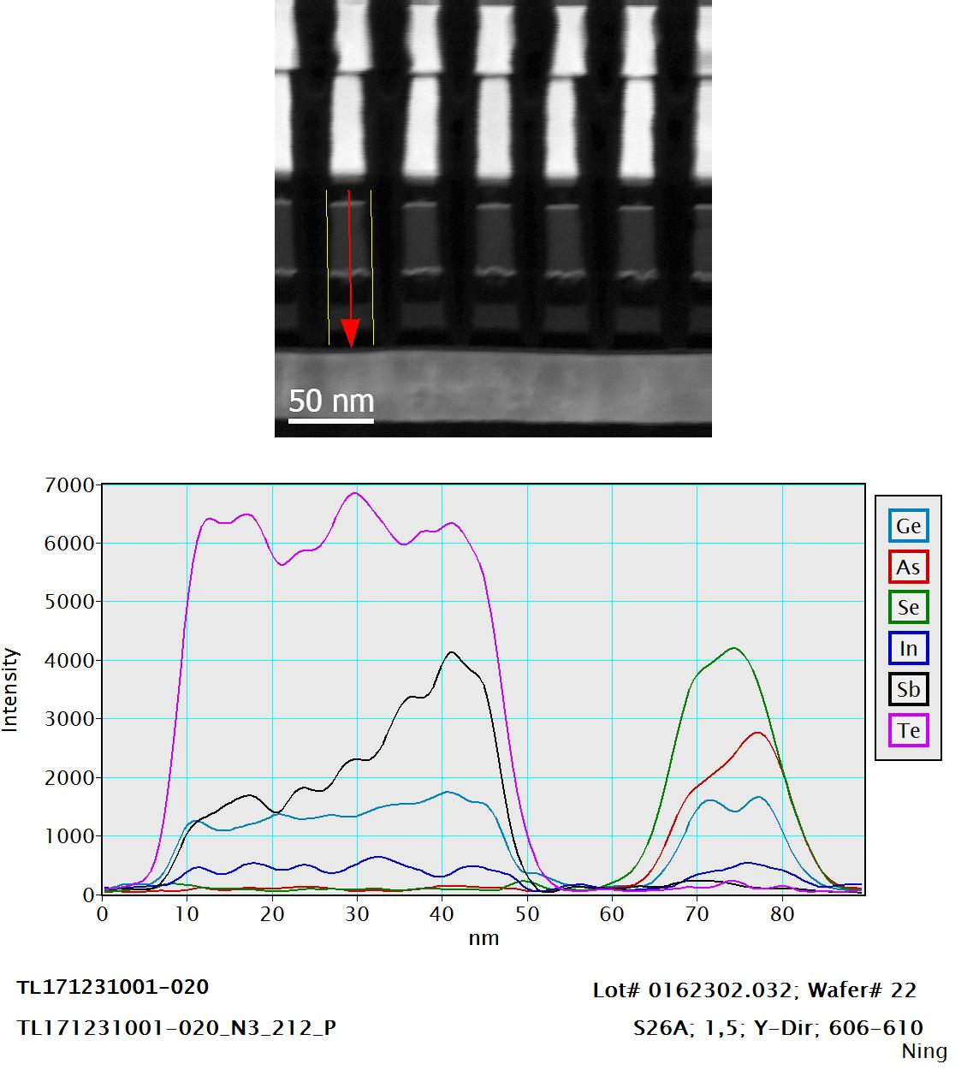
PreviousTypical
Ungrounded result
D1
D1, X-cut=Se bottom
D1, Y-cut=Se top
X-cut=Se bottom
Y-cut=Se top
D0
D0, X-cut=Se bottom
D1, Y-cut=Se top

Slide 25
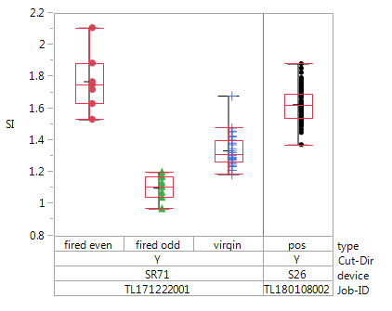
SD1 PFA summary
Typically ungrounded:
X-cut=Se-rich at bottom
Y-cut=Se-rich at top
device | TEM lab | cut | line | Grounding WL-BL | prog | Se/As top/bottom | Se-rich
SR71 | Folsom | X | BL 9 | no | Pos | 1.06
 |  |  |  |  | Neg | 0.75
 |  |  |  |  | virgin | 0.95 | bottom
SR71 | Boise | Y | WL 14 | no | Pos | 1.10
 |  |  |  |  | Neg | 1.77
 |  |  |  |  | virgin | 1.33 | top
S26 | Boise | Y |  | yes | Pos | 1.63
SR71 (ungrounded):
  Overall (virgin) main segregation modulated by cut direction (as usual)
  Opposite segregation for opposite programming compared to virgin
  Programming assignment to be confirmed
S26 (grounded pos prog): Se enrichment at top

Slide 26
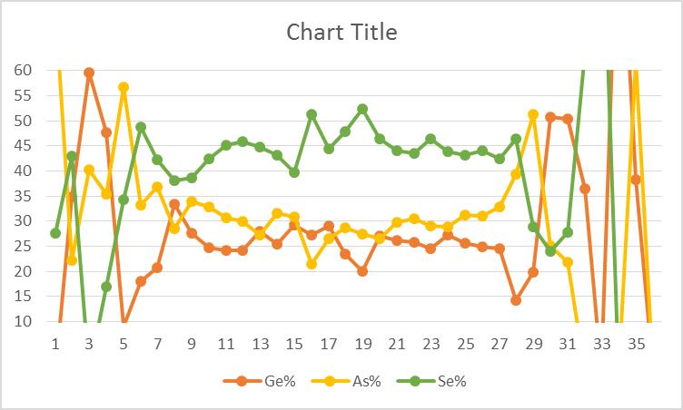
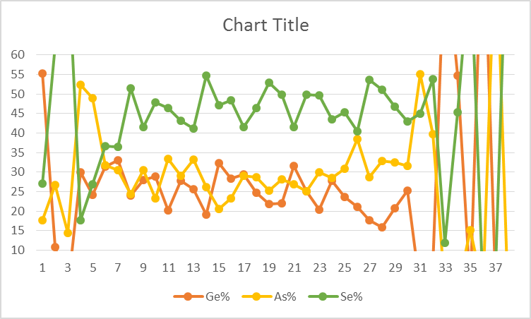
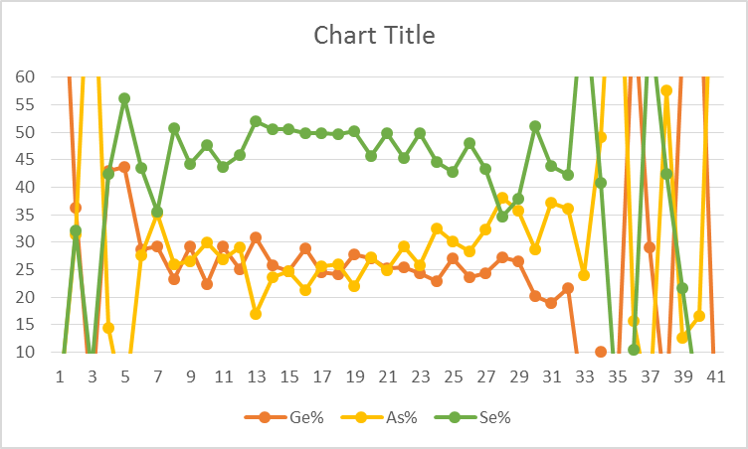
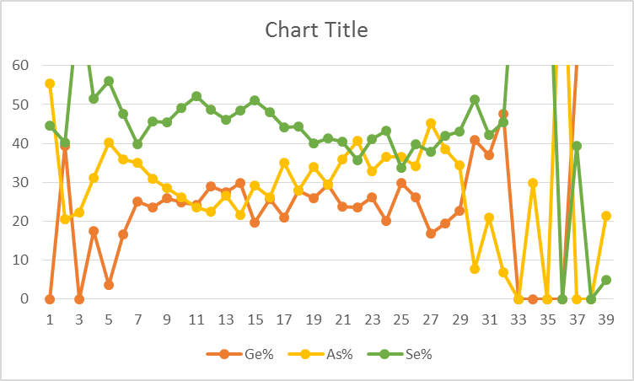
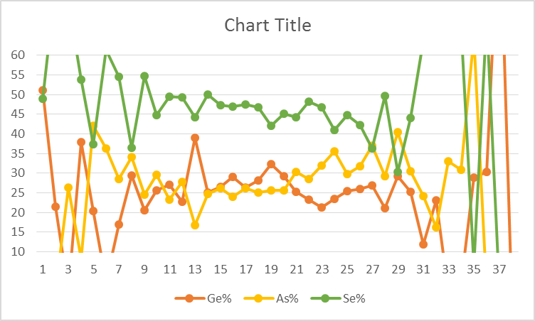
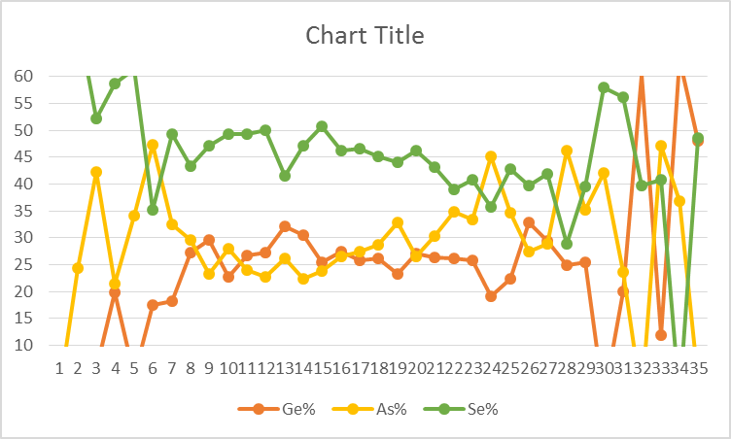
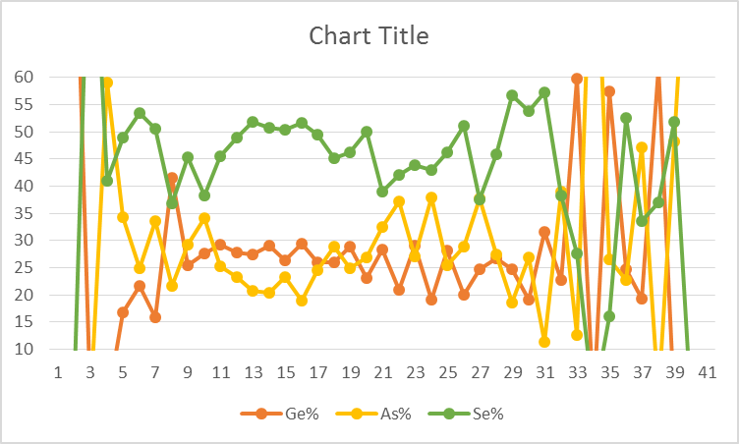
Linescan: 0024732.003, split 4E SD1 SAG, wafer16 SR71B
Bit 11 virgin
Bit 12 virgin
Bit 16
Bit 12 virgin
Bit 24
Bit 32
Bit 40
Bit 48

Slide 27
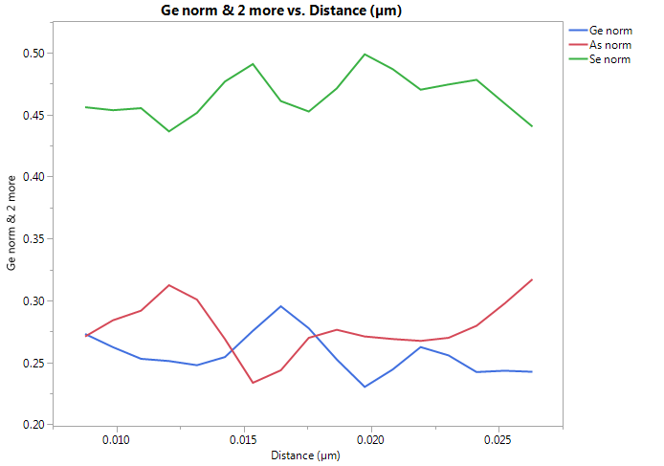
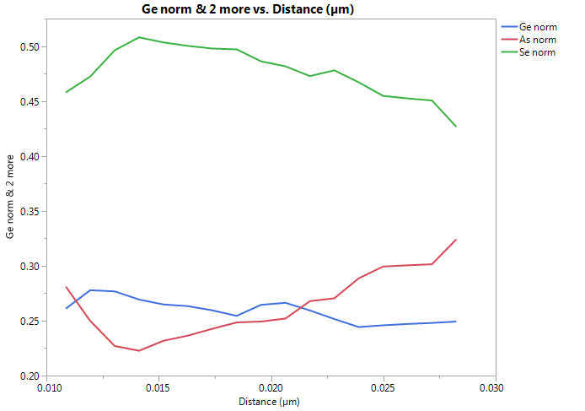
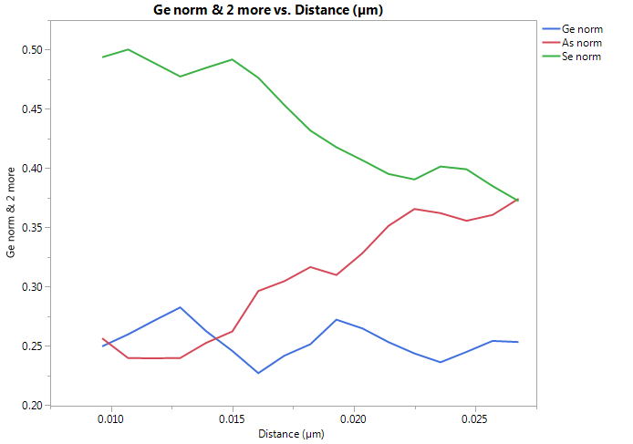
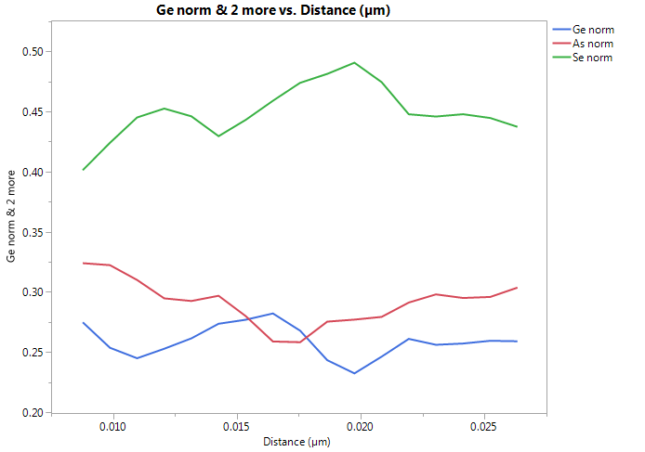
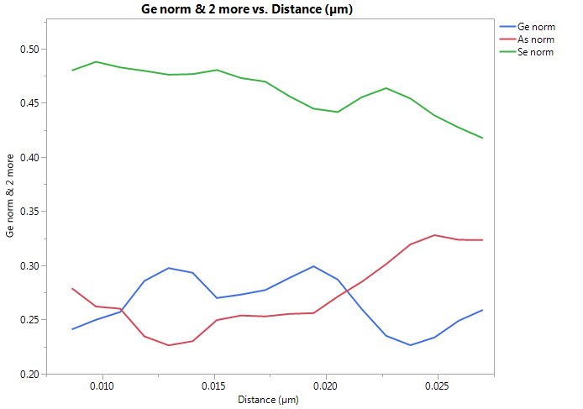
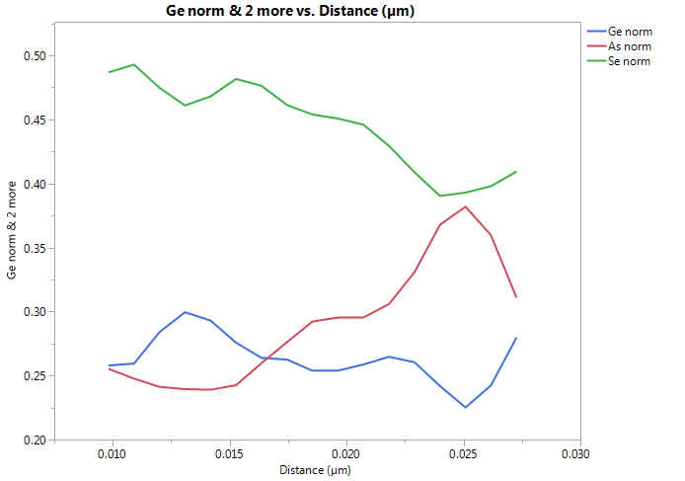
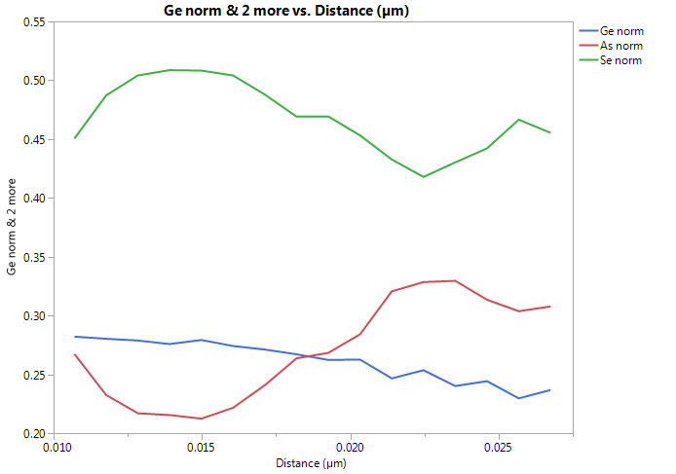
Filtered normalized composition profiles
Virgin #12
#16
#24
Virgin #11
#32
#40
#48

Slide 28


labeled in TL17222001 | As drawn BL
3 | 57
4 | 56
11 | 49
12 | 48
19 | 41
20 | 40
27 | 33
28 | 32
35 | 17
36 | 16
43 | 9
44 | 8
51 | 1
52 | 0
17
1
0
9

