Slide 1
FIB induced SD CD shrink (TEM analysis)

Slide 2
Summary
Observations of SD CD measurement differences (thickness) between different samples prompted additional study
FIB preparation can alter the measured SD thickness
Hypothesis is that the PT cap deposited onto the array compresses the memory stack.
Limitations:
If CD measurements are required, we can do a bulk sample, however specific targeted locations are not possible.
Targeted locations will not have accurate CD measurements for SD thickness.
PM measurements TBD

Slide 3
Preparation image library
Y-cut. D0 grounded sample
X-cut. D1 grounded sample

Slide 4
POR ungrounded preparation
Bulk prepared sample

Slide 5
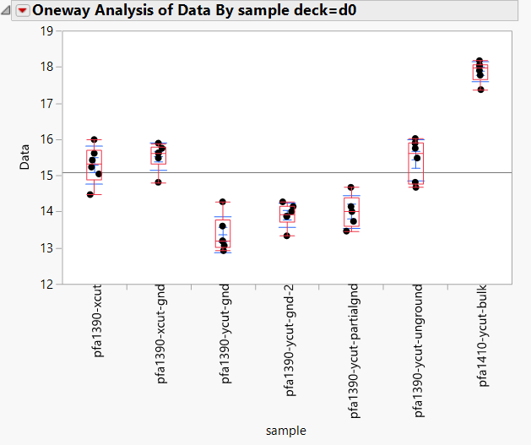
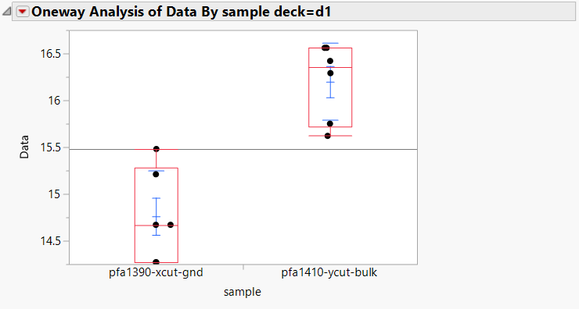
SD CD thickness
Deck 0
Deck 1

