Slide 1
Enhanced segregation
Update 3/14/2018
Enrico, Hongmei

Slide 2
Further evidences of enhanced segregation both for Sb-rich and Te-rich directions
Some indication of high resistance for very Te-rich alloys (further L0 analysis on-going)

Slide 3
RD
All bits fail
D0
D1
enhanced Sb segregation corresponds to residual amorphous region
enhanced Te segregation corresponds to crystalline region

Slide 4
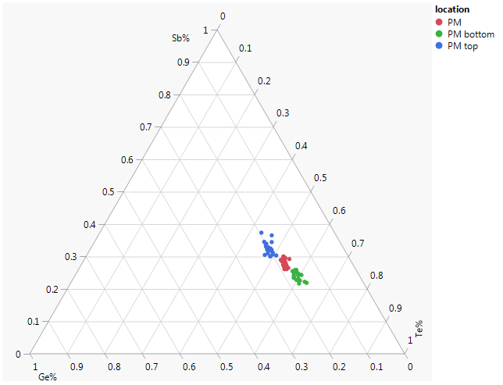
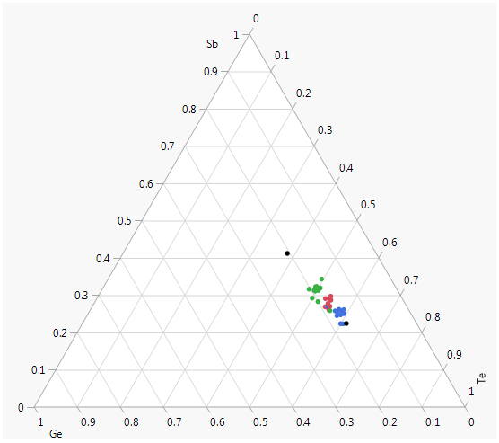
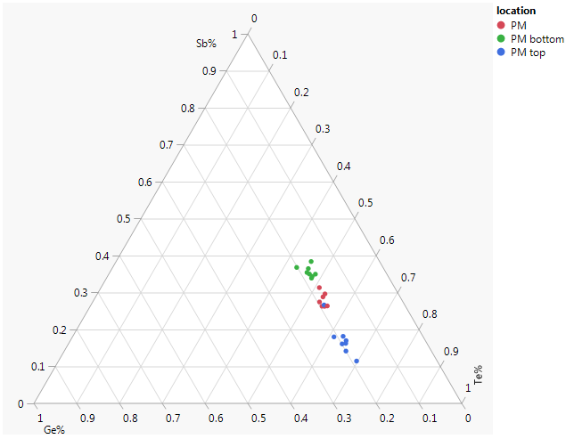
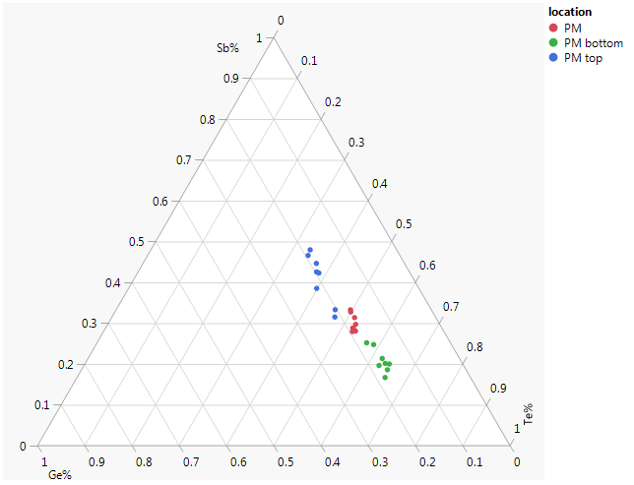
D0 1078
D1 1078
Usual segregation
D0 1092
SET on SET cycling
D1 1092
10M
also
high OPEN
10M
Enhanced segregation
Top: Ge-rich
=> colder
Ge-rich
Ge-rich

Slide 5
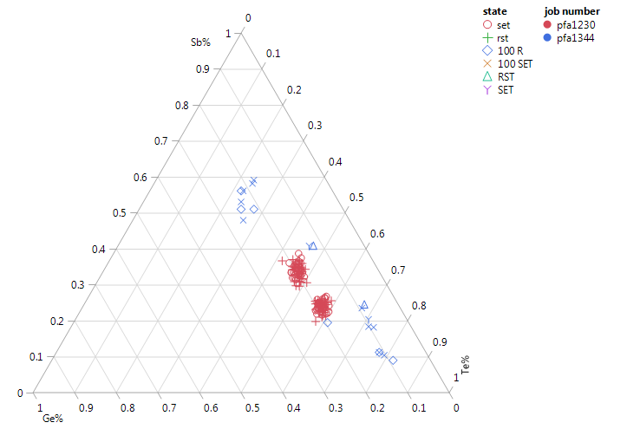
D1
Pfa RD 2017;
Pfa-1344
100R
100SET
RD & SET on SET
Te-rich alloy (as Sb-rich) has lower melting (liquidus) point => progressive thermodynamic enhanced segregation,
since liquid (or hot fragile alloy) tends to enrich towards eutectic compositions (yellow arrows)

Slide 6
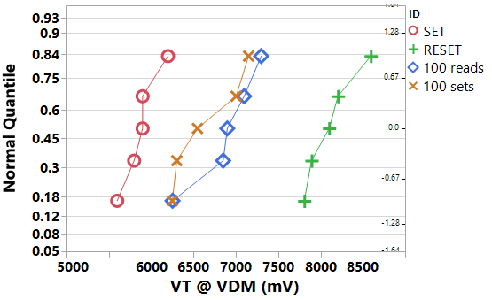
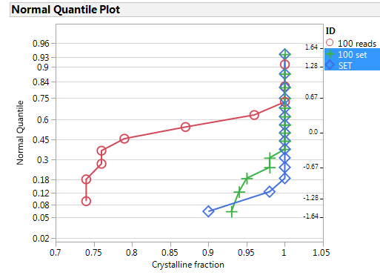
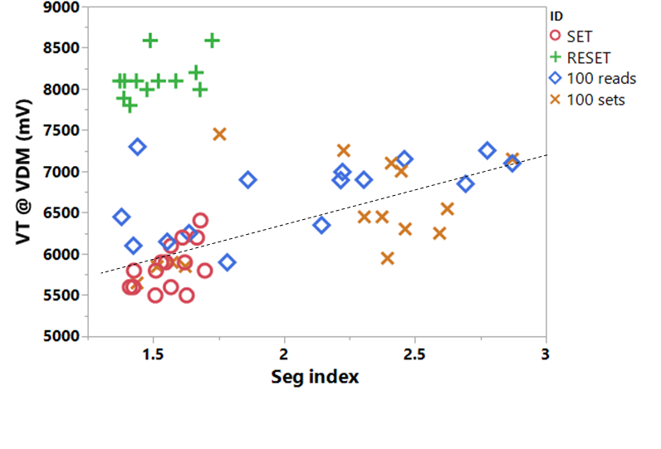
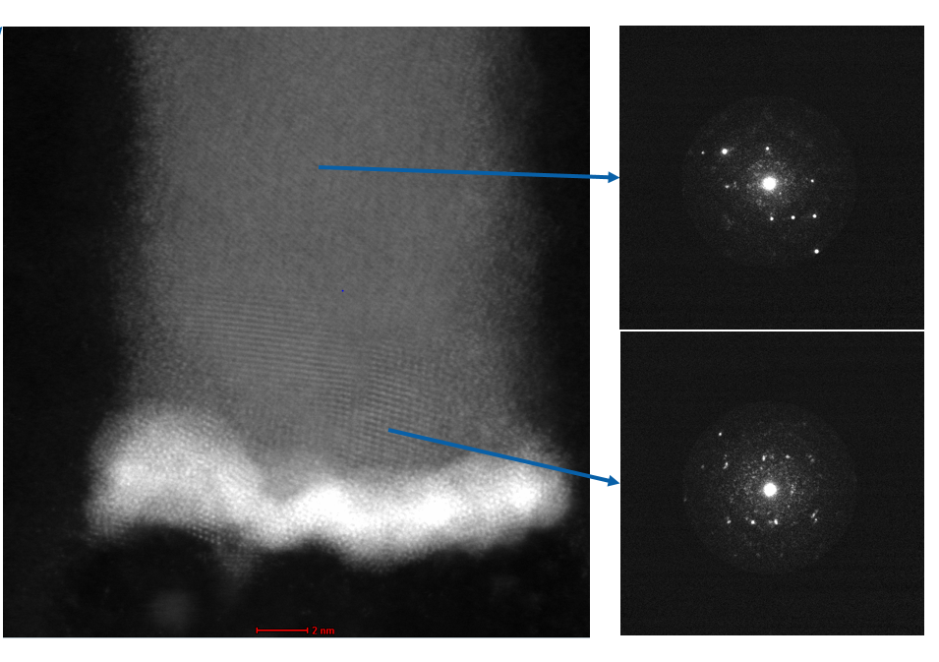
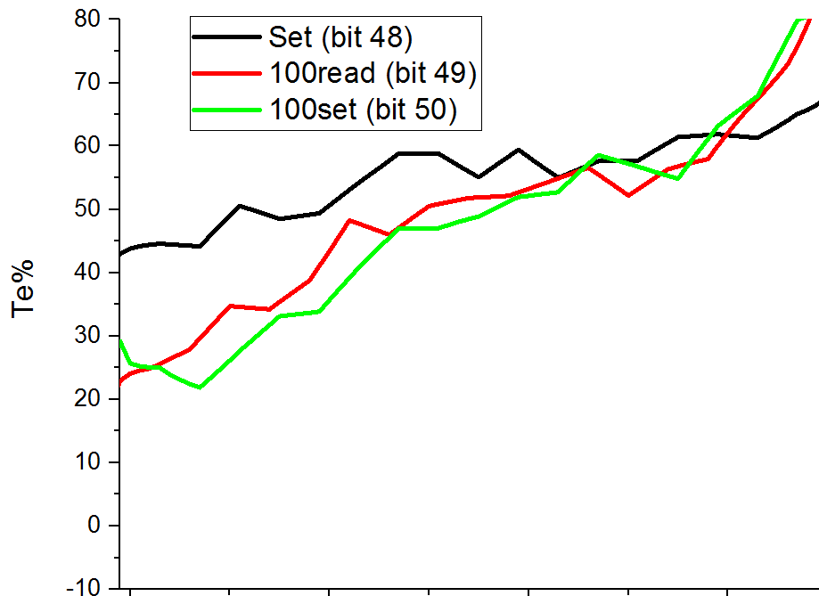
Davide M./Hefei/Rohini
Deck-1
SET-on-SET bits show Vt shift, however, we don’t see residual amorphous layer formed in those SET-on-SET bits.
Those high Vt SET-on-SET bits doesn’t show high segregation index, which show good correlation with Vt.
Both Read-on-read and SET-on-SET bits show extremely higher (>70%) Te accumulation at on side of interface.
Those Te rich range form different crystalline than the main range of PM.
Does this Te rich crystalline layer has high resistance, thus cause Vt shift even it is crystalline?
Te rich area
100R: amorph very Sb-rich + very Te-rich
100SET: very Te-rich

Slide 7
GST phase diagrams
Very Te-rich alloy is toward Ge₁₅Te₈₅ :
Low melting point (<400C) (eutectic)
Reported as OTS-like (i.e. APPLIED PHYSICS LETTERS 100, 143505 (2012))

Slide 8

Crystal refinement principle
Enhanced segregation
=> Sb-rich
k=L/S (slope ratio)
theory
Growth/
solidification
$$C=kCo {(1−x)}^{k−1}$$
x(norm)
Multicomponent system even with small Th. gradient and no field/current component:
depletion of one component during solidification
=> enrichment in liquid => enrichment in the last solidified

Slide 9
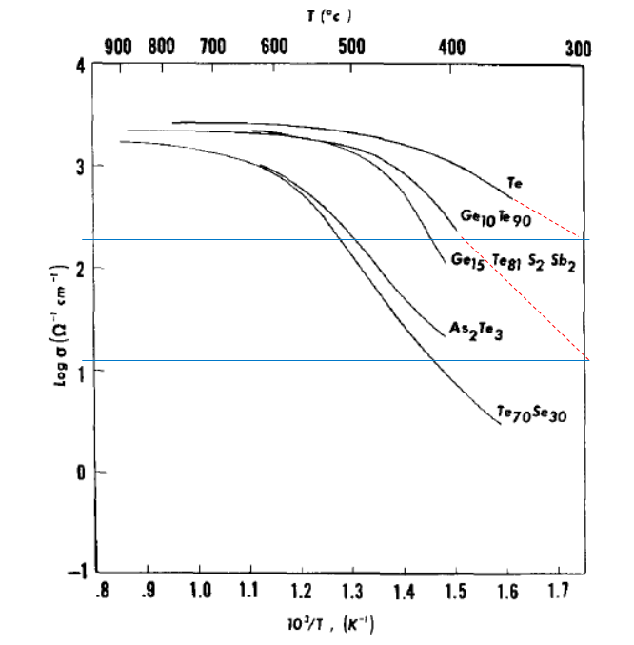
Te-rich alloys conductivity
Te electrical resistivity vs carrier concentration
Element | Resistivity(Ωm) | Electrical Type
Te | 0.0001 | Semiconductor
Ge | 0.0005 | Semiconductor
Sb | 4X10⁻⁷ | Conductor
As | 3X10⁻⁷ | Conductor
Se | 1.2X10⁻⁷ | Semiconductor
alloy | S (300C) (Ohm⁻¹ cm⁻¹) | Rho (300C) (mOhm cm)
Te | 200 | 5
Ge10Te90 | 10 | 100
“Doped”-Te can have high resistivity

Slide 10
Te-rich alloys:
Agrate Old data
ρ= 10 or 100 mOhm cm?
+Te
pseudobinary
?
Damaged film
melting
pseudobinary
+Te
?
+Ge
- Sb
Damaged film

Slide 11
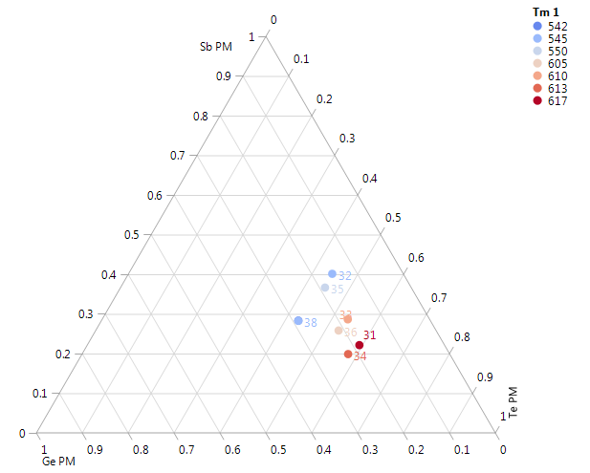
precipitation
“Normal” Te-rich segregated alloy results with good conductivity
Very Te-rich segregation (with the associated low T precipitation)
could introduce high resistance even crystalline
“normal”
Te-rich
GISTN
DSC
Sb-rich
bulk
Te-rich
<400C ?
Very Te-rich alloy now deposited and under characterization

Slide 12
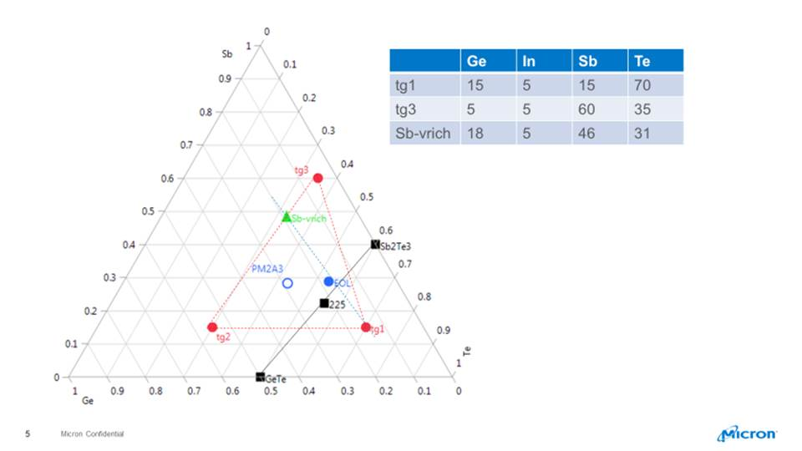
GST only
GISTN
On going mapping of L0 on GISTN diagram (Tx, Tm, Eg, speed)

Slide 13
T crystal (Rs-T)
GST only
T (C )
Need for mapping of L0 crystallization speed (optical)
Literature example: crystallization time is high around GST 111

Slide 14
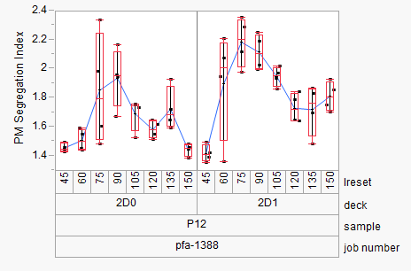
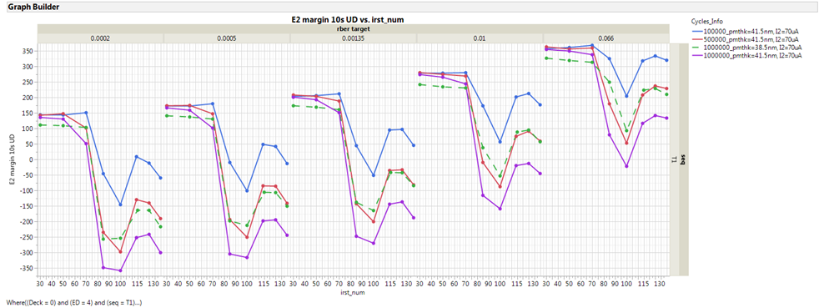
PM Segregation
Lu/Hefei
PFA-22
Vim
Higher segregation index for intermediate programming, the worst for Iprog ~ Imelt
Recovery by IRST
consistent with thermodynamic enhanced segregation mechanism
Correlation with Vth TE

Slide 15
Enhanced segregation (driven by thermodynamic driving force under thermal gradient) is active to increase Sb-enrichment and Te-enrichment, with corresponding consequence on amorphous residual (Sd-rich) and/or possible high resistance crystalline (Te-rich).
Higher the segregation, higher the impact on related failing mechanism (Vth TE, RD, WD, ..)
On cycling the modification of cell response (either by PM material or by cell thermal environment changes) can more easily enable a partial transformation and consequently the corresponding enhanced segregation, especially on not median bits, which accelerates the endurance degradation.
Mapping the impact on modifying the phase diagram (liquidus surface, physical properties) with different PM alloys (i.e. doping) can provide some visibility to mitigate segregation-based issues.
Enhanced segregation is here discussed and supported for PM but similar mechanism could occur also for SD, since is based on the presence of solid/liquid front under certain programming condition. However, contrary to PM, physical SD segregation evidence is still not assessed (but neither is well stabilized how a supposed segregation is affecting threshold switching), but electrical behavior of SD only is historically playing similarly to PM: RE Vth shift increase is enhanced at higher read current, recovered by RST.

Slide 16
Enhanced segregation mechanism
Enhanced segregation easily occurs when programming condition applies a not uniform thermal stress along the cell thickness such that a region is in a high temperature and diffusivity regime (i.e. liquid), while the adjacent region is at lower temperature and low diffusivity, relative to their local properties, in order to have a phase boundary.
Such a situation is draining from the boundary the elemental component which makes the composition more thermodynamically stable. The situation is similar to solidification refinement, when the solidification front depletes or enriches in certain components in order to minimize the energy of the system.
From the GST diagram, during solidification of an alloy with a typical composition for SXP, the last liquid to solidify tends to enrich in Sb (or Te), since the most stable form of liquid is rich in Sb (or Te) (there are eutectic points in the Sb-rich direction and in Te-rich direction)).
Such a thermodynamic driving force (temperature gradient driven) is combining with the other segregation driving forces to produce the final segregation and is considered important whenever an “intermediate” condition is produced.

Slide 17
overview segregation on programming
element segregation on programming
Mass transport can be modeled by the equilibrium of different driving forces:
Concentration
gradient
Thermal
gradient
Electric Field/
current
Mechanical
stress
The thermal gradient component includes also thermodynamic segregation, when equilibrium solubility of one component, in a multicomponent alloy, can depend on temperature or (even more) on the phase (solid/liquid).

Slide 18
GST Phase Segregation
Contribution from thermal gradient
Simple implementation:
Novielli et al. IEDM 2013
TCAD extended description
on-going
During solidification on cooling, chemical potential drives the composition which solidify first;
residual liquid tends to the lowest eutectic point
For GST this is rich in Sb and poor in Ge: Sb accumulates in the liquid phase, Ge in the solid one.
Additional flux across solid/liquid interface
Thermodynamic component

