Slide 1
PM scaling for 3DXP: Y-GST status and plan
Y-GST: fundamentals, preliminary data and plan
30S Material Pathfinding

Slide 2
PM scaling: Y-GST development
Y-GST Fundamentals:
Yttrium doped GST → Proposal based on Atomistic Simulations – thru the collaboration with Prof. Bernasconi
Features/Expectations of Y-GST system from simulations:
Yttrium as effective dopant to increase E_{G} thanks to stronger Y-Te bonds and with higher charge transfer wrt Sb-Te bonds → Enhanced ΔV_{T} if E_{G} is V_{T} proxi
Ability of Y to keep high the fraction of 4-membered rings acting as crystalline precursors in the α-phase → Enhanced SET-speed performances
Stronger bonds Y-Te bonds wrt Sb-Te bonds leading to stronger thermal stability → Enhanced WD immunity
Enhanced Charge Transfer of Y-Te wrt Sb-Te
4-fold Rings Statistics
GIST
High Set speed

Slide 3
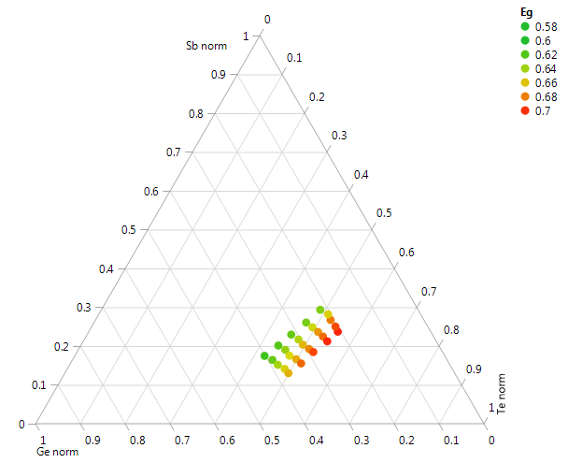
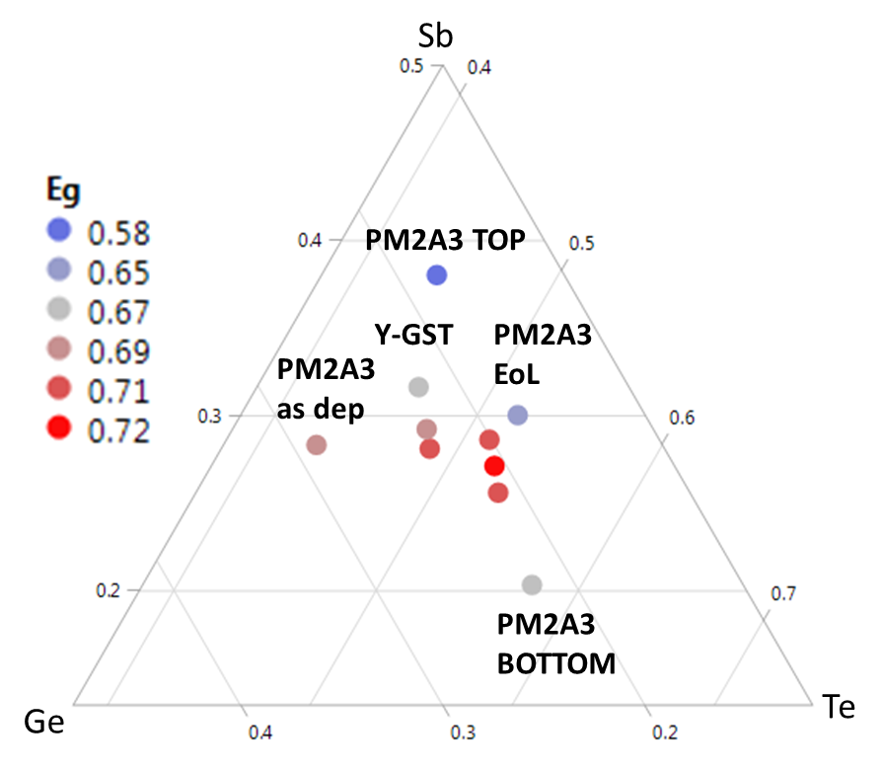
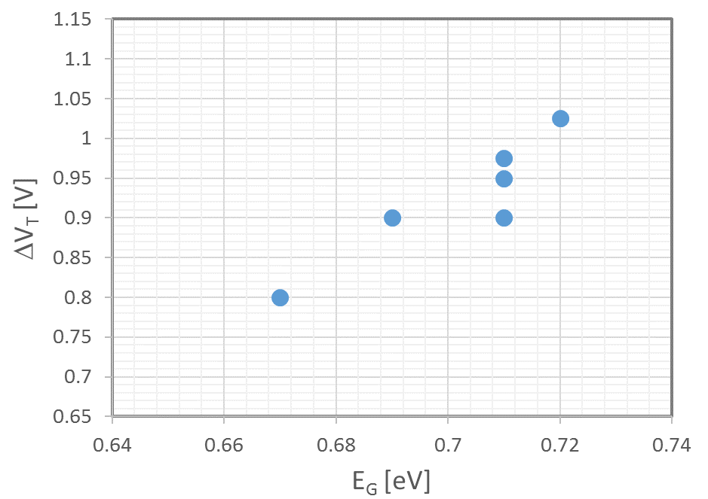
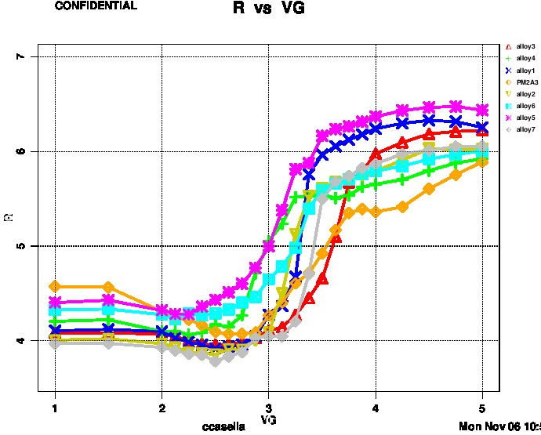
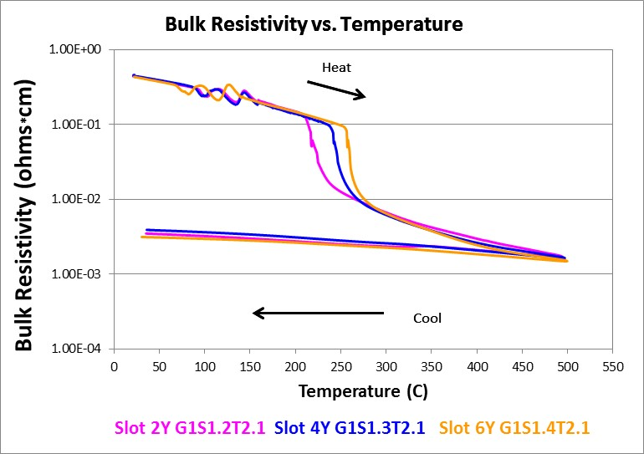
Y-GST: L0 and L1 data
E_{G} trend
L0 Data: Key Results
E_{G} trend: E_{G} increase w/ Te- and Sb-rich and low Y % (~4%)
Higher E_{G} in the expected EoL composition region
Higher crystallization temperature signature of stronger bonds
L1 Data: Key Results
Higher ΔV_{T} as a consequence of higher E_{G}
Good SET-speed at CLV screening level
Crystallization speed char thru optical measurements on going
Y: 2-10%
Ge
Te
E_{G}: Y-GST vs GIST
>50mV E_{G} contrast in EoL alloys
~447GST + 4%Y to intercept the highest E_{G} @ EoL composition
V_{T} trend in line w/ E_{G}
S2R CLV
Cycled (1kc)
Y-GST EoL to be targeted
Y-GST targeted: stable pgr curves
PM2A3 as dep
PM2A3 EoL
PM2A3 as dep
Tx increase w/ YSb
EoL E_{G} contrast

Slide 4
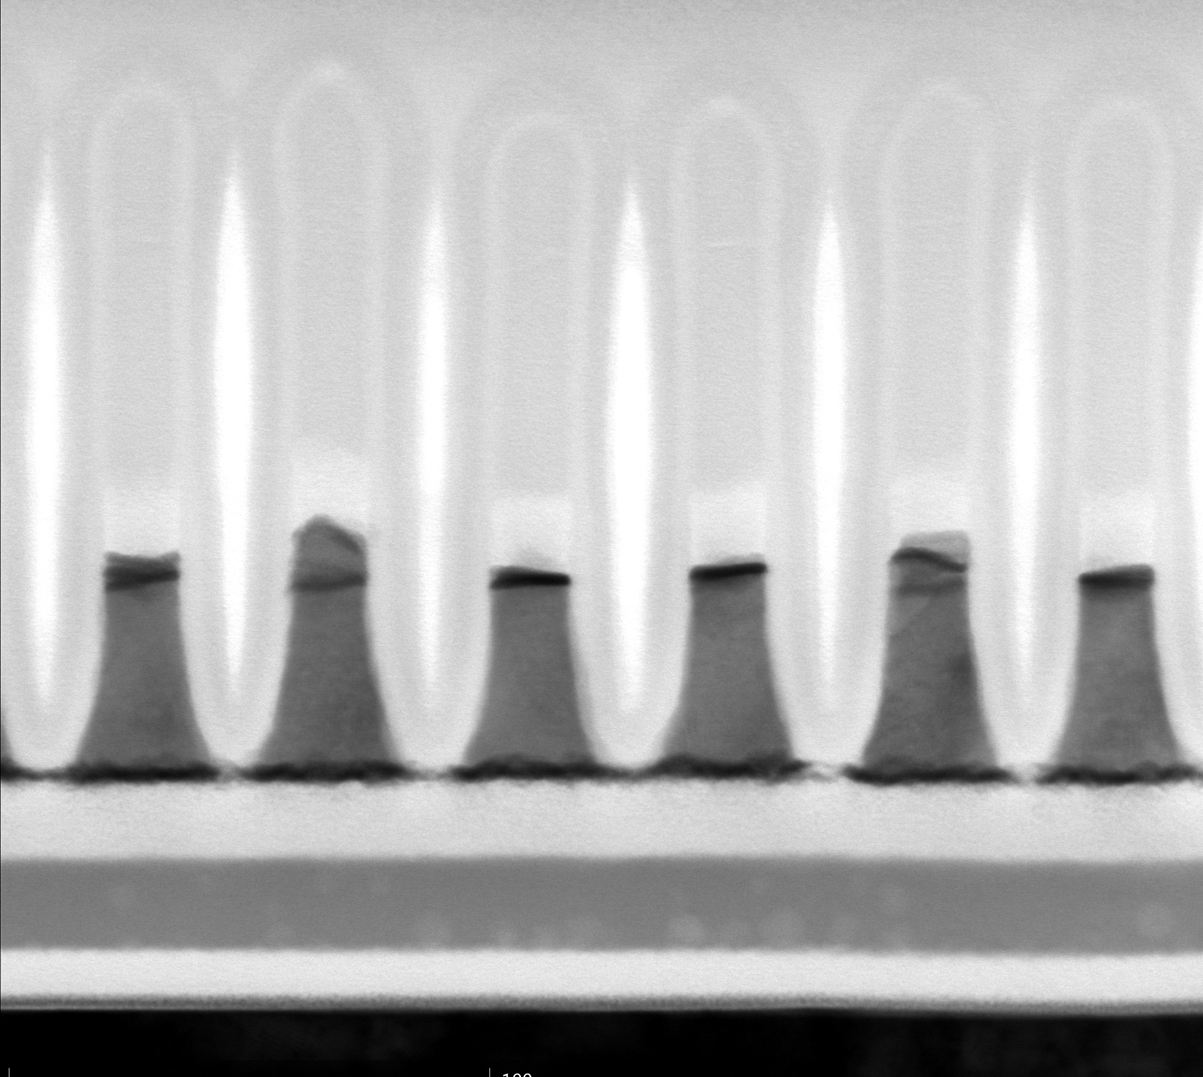
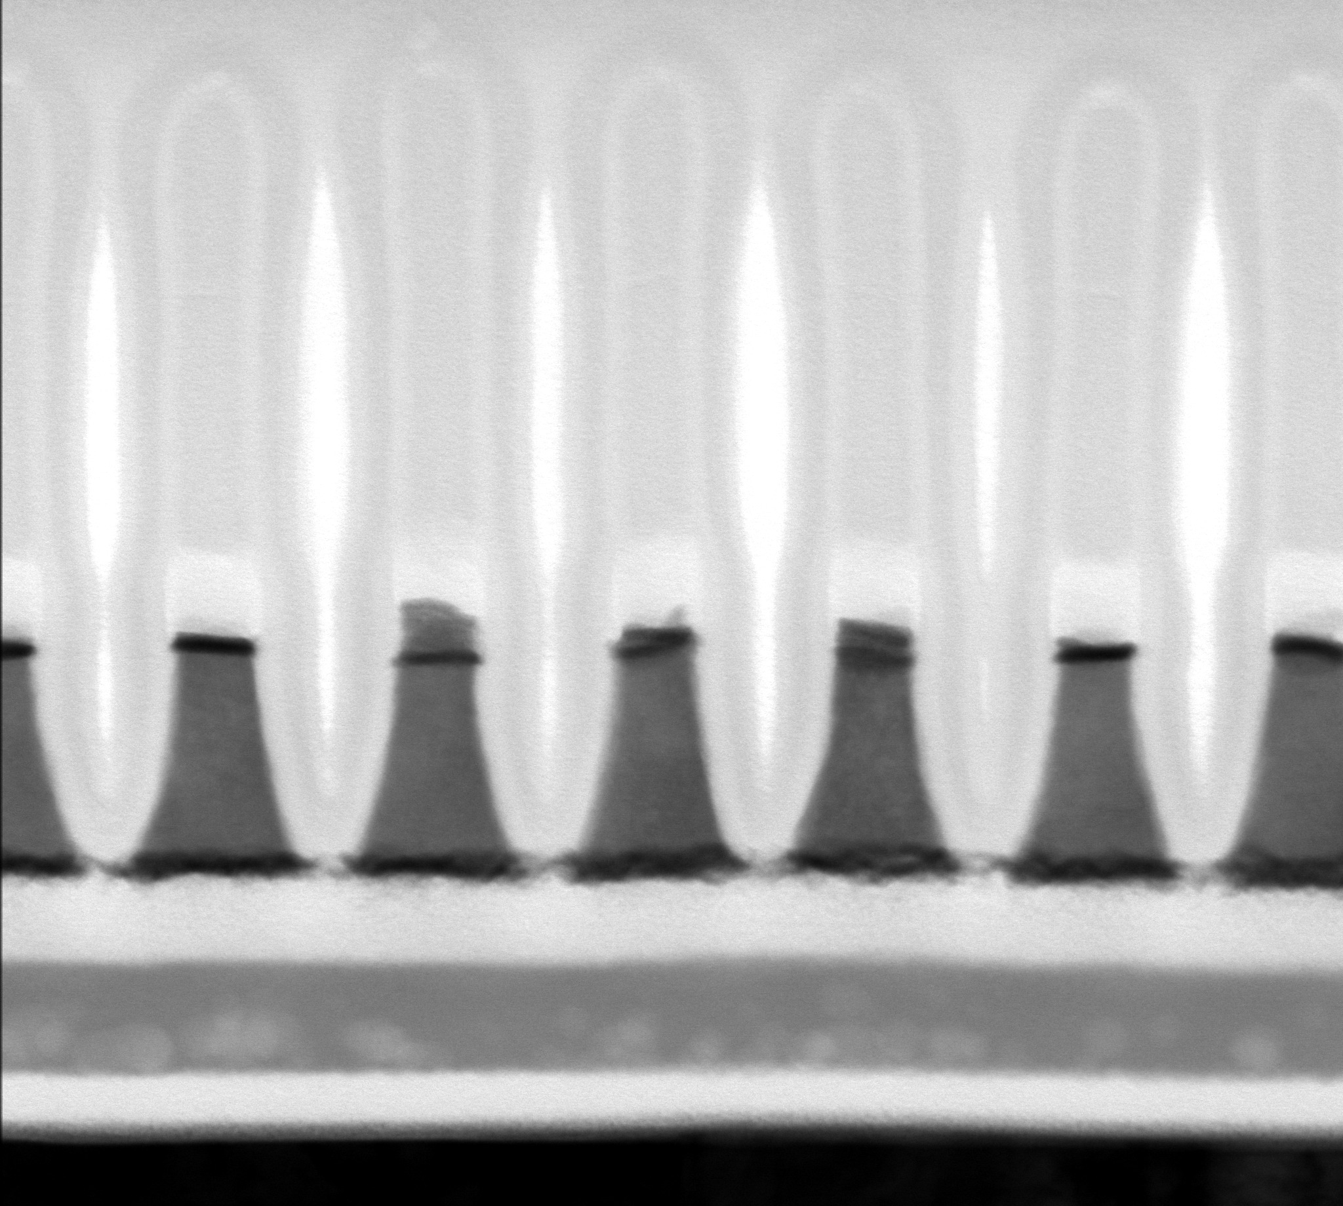
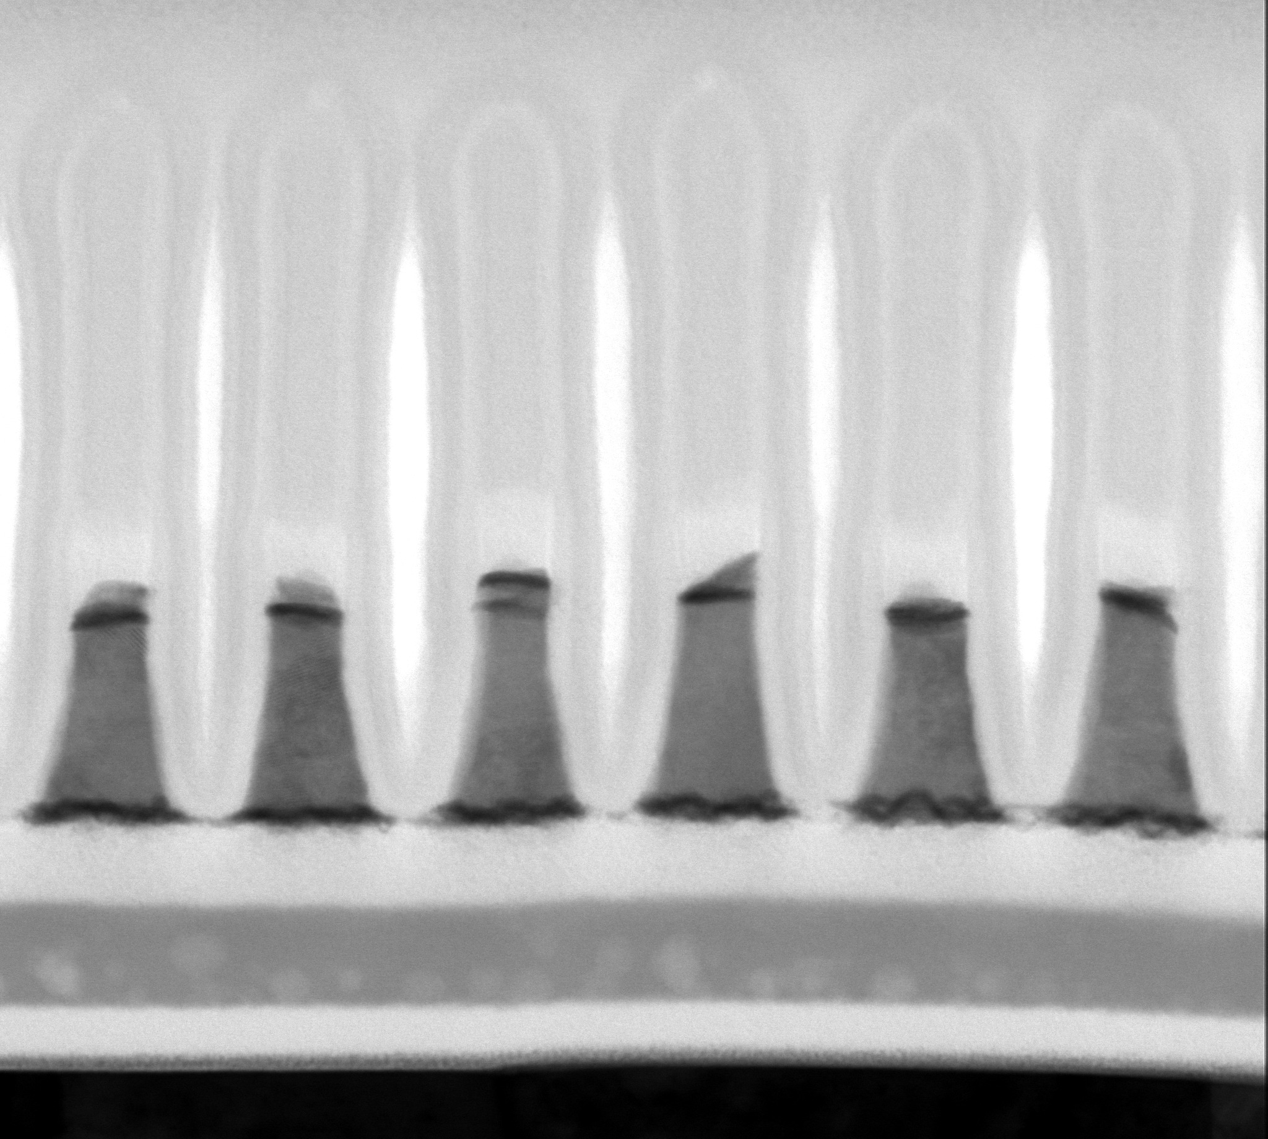
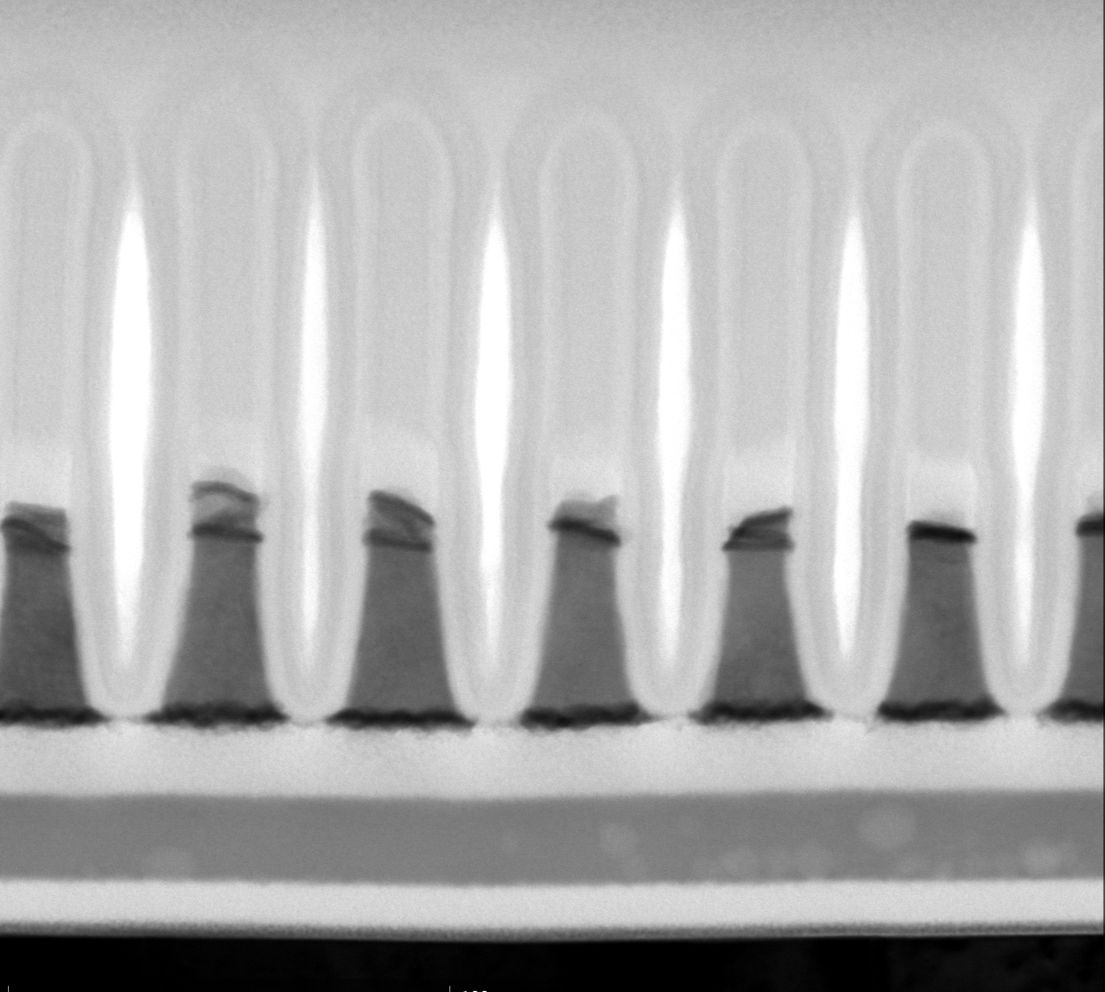
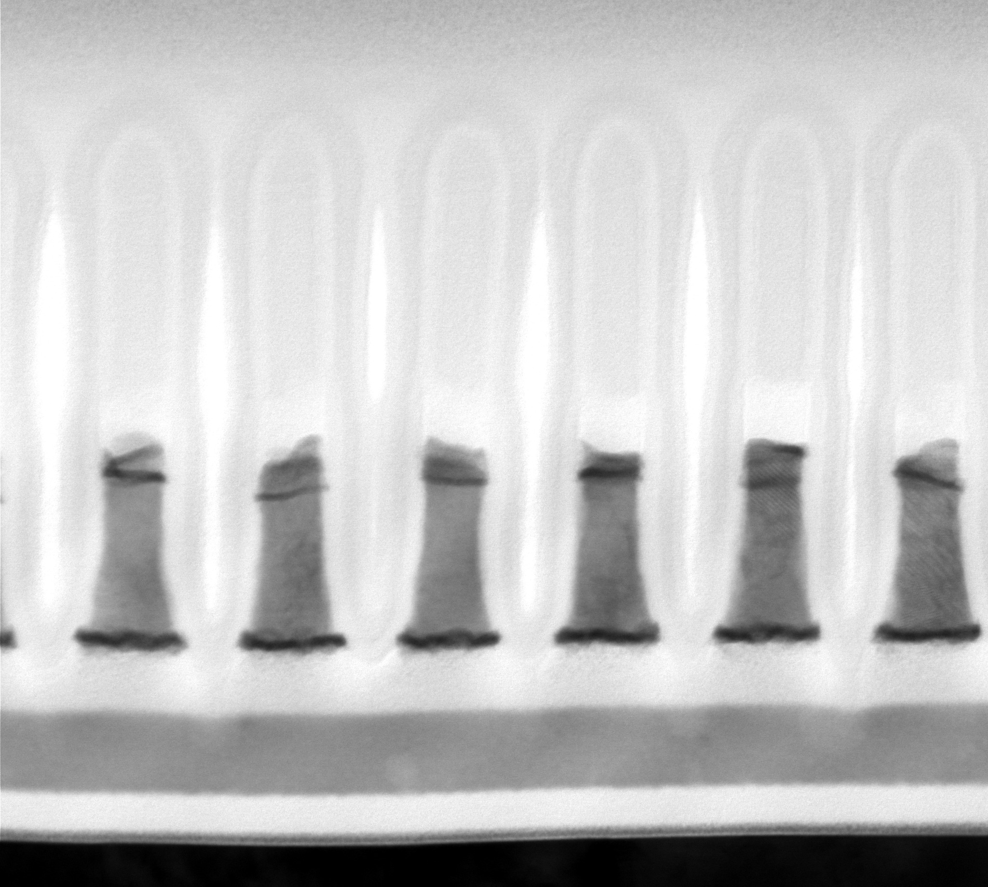
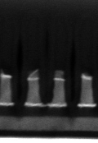
Y-GST: L1D status
POR 70s PM + BGM3 ArO2 SP (Cond-A)
Start with sloped PM, incomplete WL2 etch
No profile change w/ longer PM time except slight CD shrink
Slight bot PM profile improvement with 2 step PM w/ high bias 2nd PM etch
Y precipitation seems to be the cause since no known volatile, etchable compounds
Need sputter etch
High bias (1000Vb) with longer time improved profile but SD punch thru
Need high bias process → Tool max 1150Vb, new HW may require
Follow up test with 1100~1150Vb and reduced time 70~80s
1 step 100s POR PM
2 step PM: 40s POR + 30s 1000Vb
1 step 100s, 1000Vb PM
SD punch thru

Slide 5
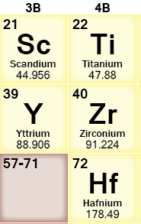
PM scaling: Sc-GST as further opportunity
Scandium (Sc) is tight relative to Yttrium
A recent Science paper [F. Rao et al., Science 358, 1423 (2017)] shared at 30S Mat. Pathf. wk#10 showed the ability of ~4% Sc doped Sb₂Te₃ to improve the SET speed down to ns [link]
Authors applied a very similar methodology to the one we used for Y-GST to select Sc
Authors found:
Strong Sc-Te bonds giving robust 4-fold rings crystalline precursors
Among the class of TM Sc and Y are found to show chemical bonds of high strength with Te and good geometric conformability criterion (better for Sc than Y)
Follow-up:
Prof. Bernasconi is simulating also Sc-GST (wk 12)
Dale is asking for Sc-based target quotations
TM

