Slide 1
SSM process development update
ww1812

Slide 2
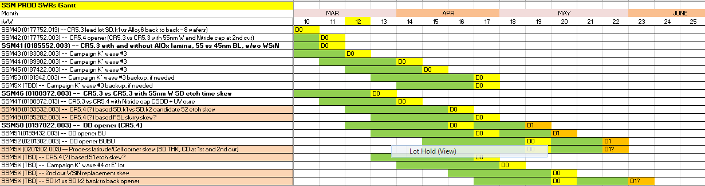
WIP status update
    SSM43 K* wave3 shows periphery failures – unexpected on the groups that ran the same alloys as on wave2 – segmentation in progress; Replacement will be needed, overall delay of 3 weeks on K* wave3; SSM44 (second lot of wave3) also is past C1 chop and might have to be replaced (the x-sections pending)
    Current process with 2nd cut Nitride cap shows high level or periphery shorts (SSM42); Potential recovery with CSOD + UV cure (SSM47)
    52 etch improvement for yield issues mitigation on 55nm E: SWL/E1 knee – SD under-etch; BL-BL – CD targeting (SSM46; SSM48)
    DD setup lot (SSM50) started at Fab4 ww12

Slide 3
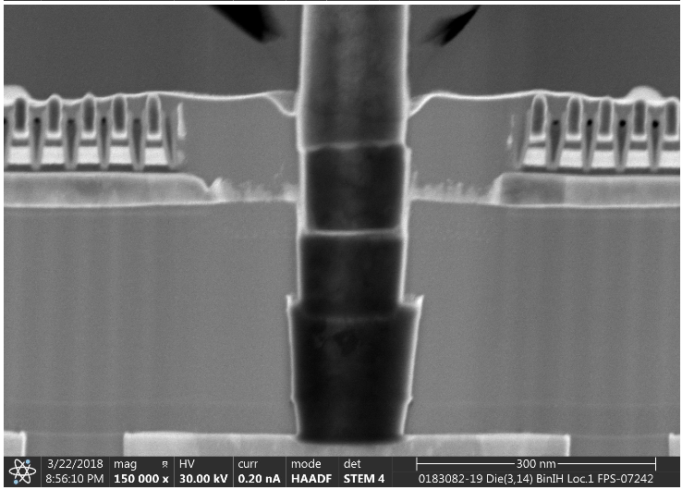
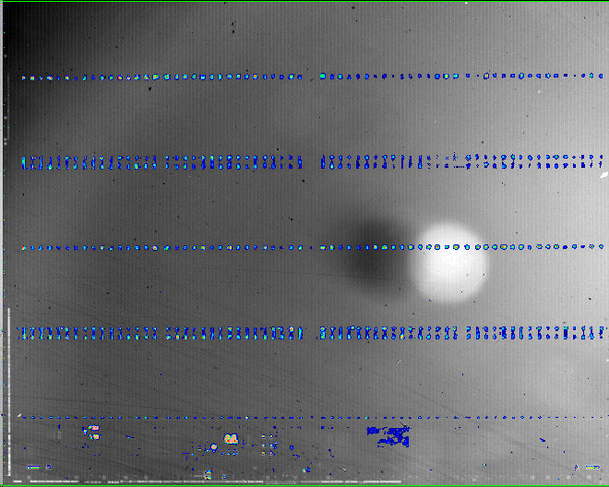
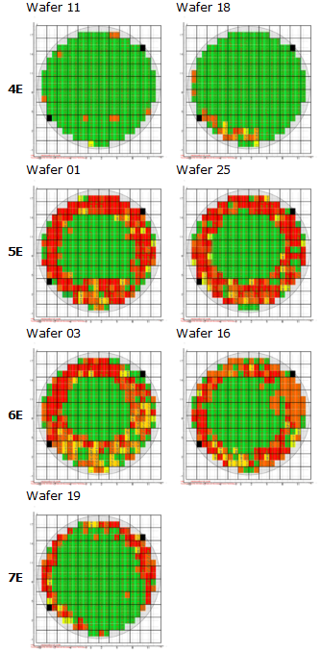
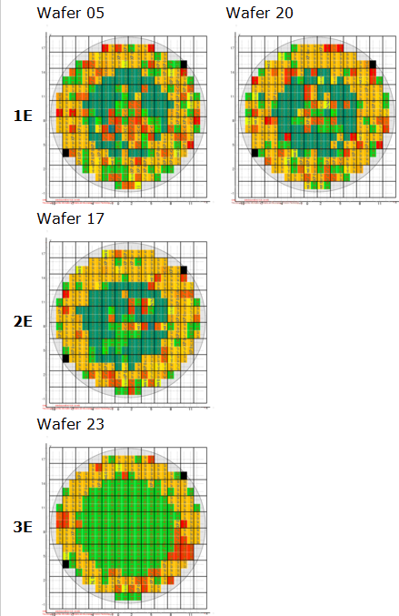
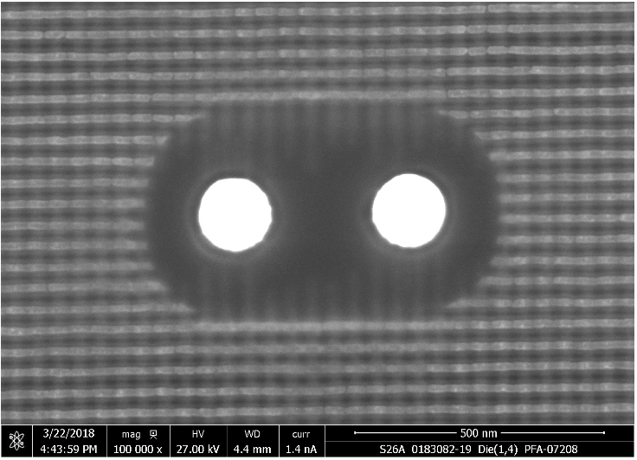
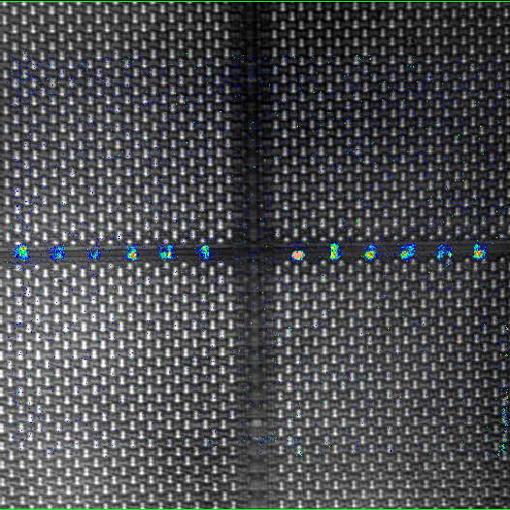
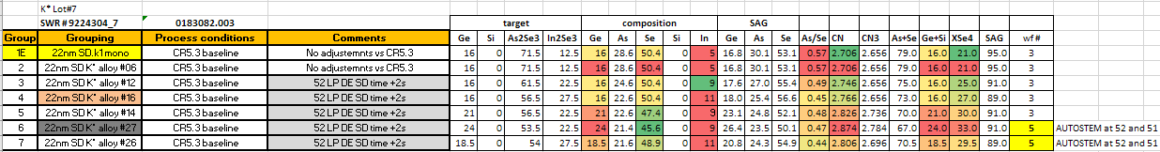
SSM43 (K* wave3 lot1)
Partition18
Partition17
Partition14
Partition13
PFA

Slide 4
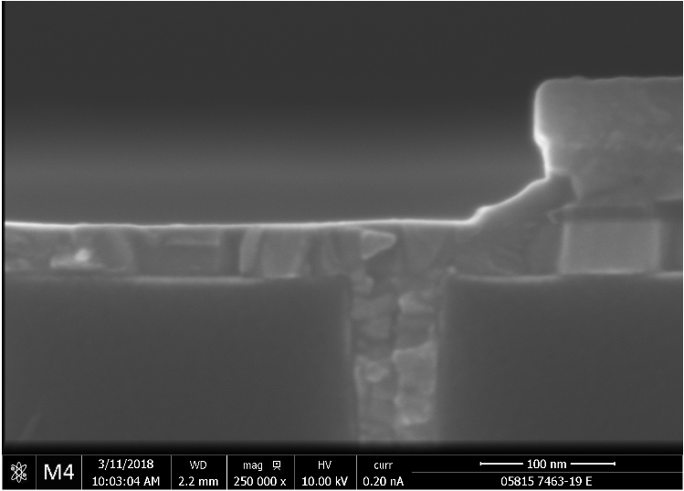
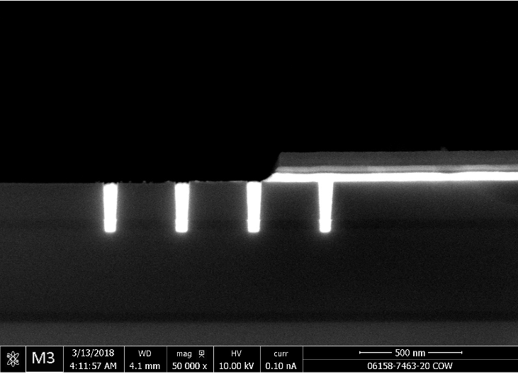
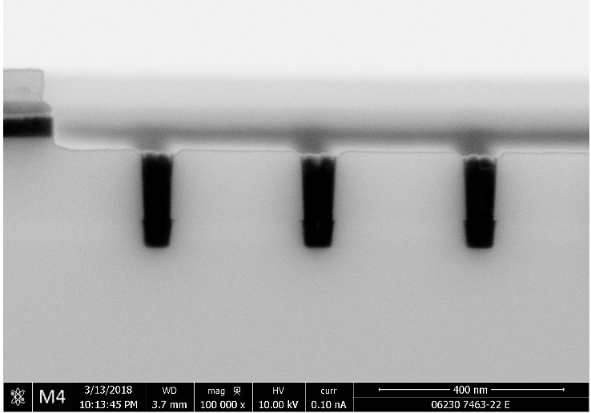
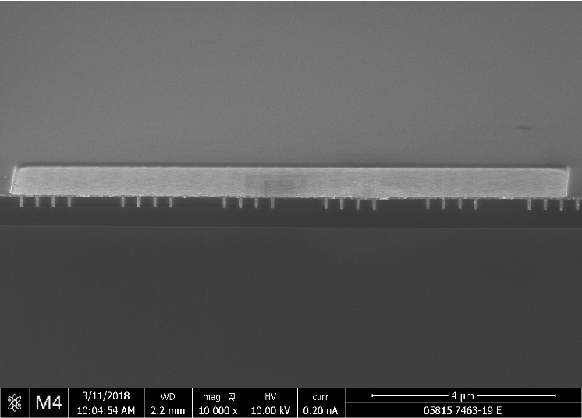
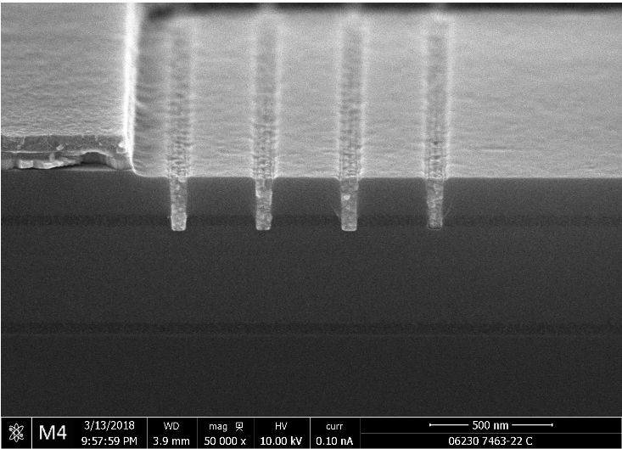
Campaign K* alloy14 (SD.k2 candidate) E1 etch
SSM POR E1 etch
SSM POR E1 etch +40% time
SSM POR E1 etch +60% time;
Higher Ar flow (+sputter)
    In rich alloys had trouble to clear at E1 etch and significant etch time/conditions adjustment was required;
    Need follow up on C1/C2 etch;
    51-52 etch x-sections are expected from PROD K* lots

Slide 5
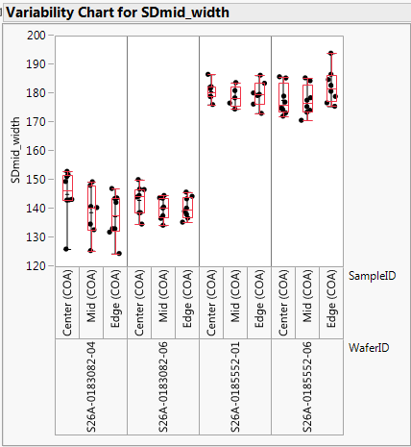
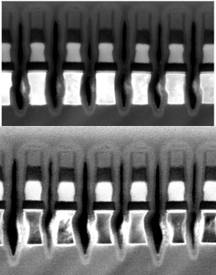
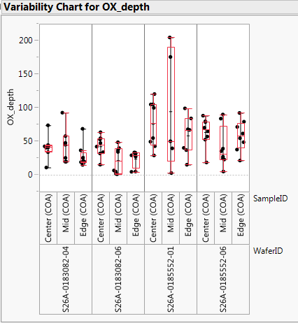
SSM43 (K* wave3 lot1) 51 ecth
K*26,27
K* alloy26
CR5.3 w/wo AlOx
K*26,27
CR5.3 baseline

Slide 6
S26A- 0024692.003
SWR # 8658504
ww1731 -- S26A SSM Campaign K*, SS4
VS
S26A- 0183082.003
SWR # 9224304
ww1809 -- S26A SSM Campaign K* wave3, SS7
F4 RDA
Contacts: baalbertson,kyastreb

Slide 7
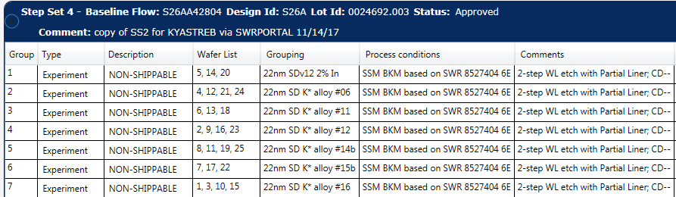
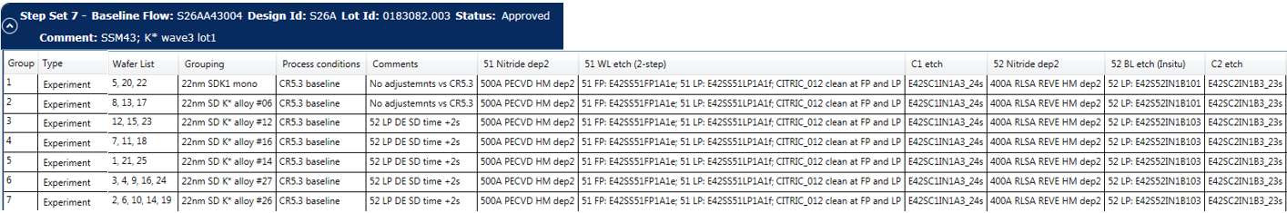

Slide 8
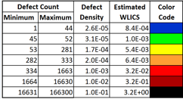
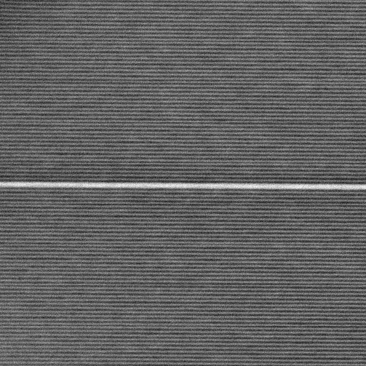
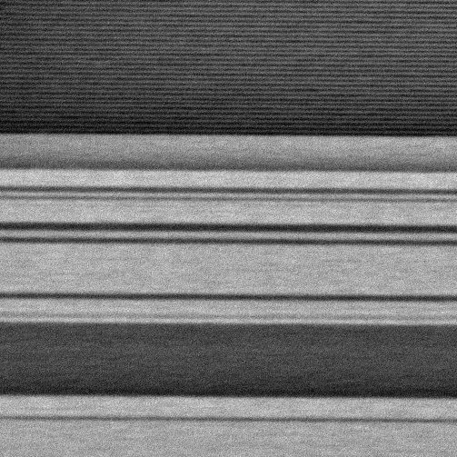
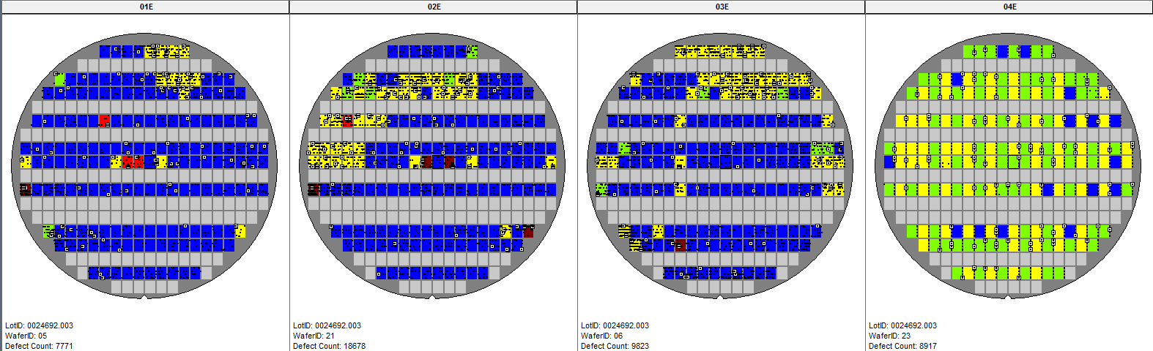
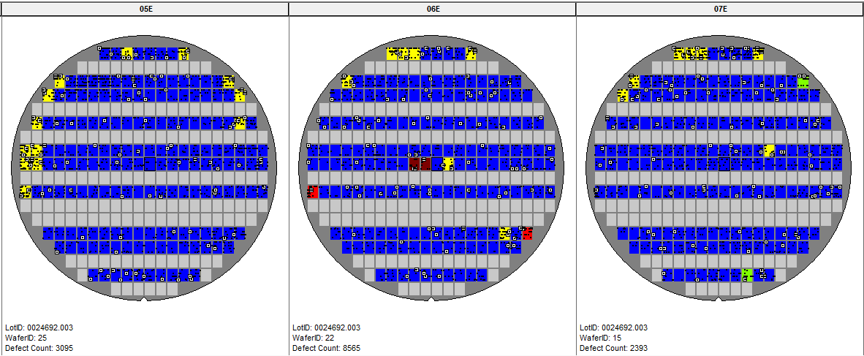
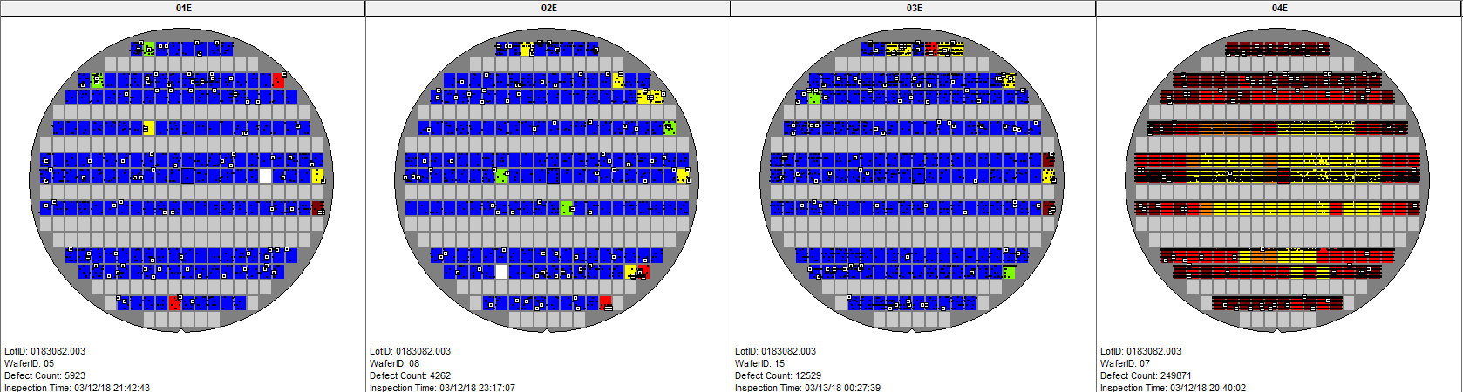
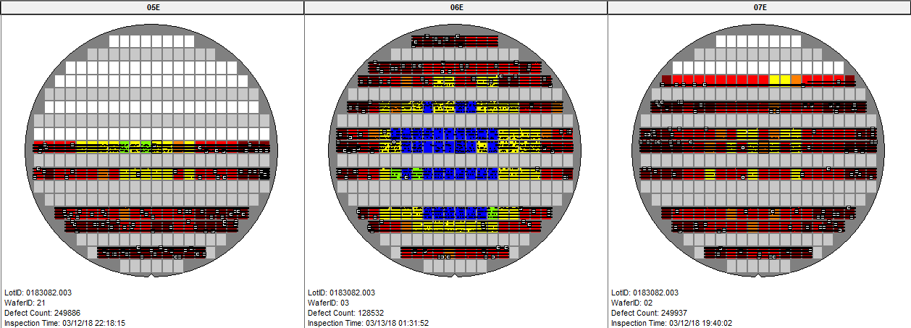
65VIANITCMP
WL-WL SHORTS
Comments: with exception of 3082-03, maps are accurate. Center shading from 3082-03 shows multiple shorts within field of view (example far right) indicating this region is massively shorted and map is not reflective of the true shorting counts. Typically inspection shorting defect look like example near right.

Slide 9
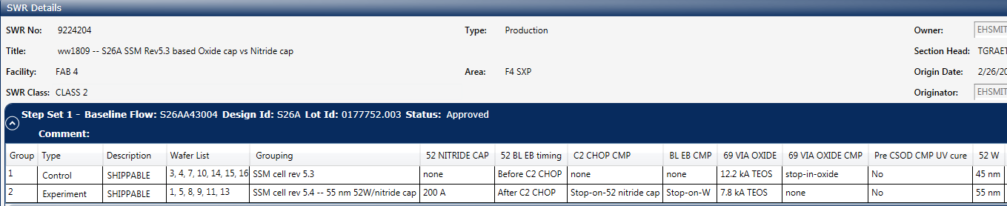
Lot 0177752
SD: K1
Group 1C: wafer 03 W=45nm; SD=25s (AUTOSTEM link)
Group 2E: wafer05 W=55nm; SD=25s (AUTOSTEM link)
YAOJIN

Slide 10
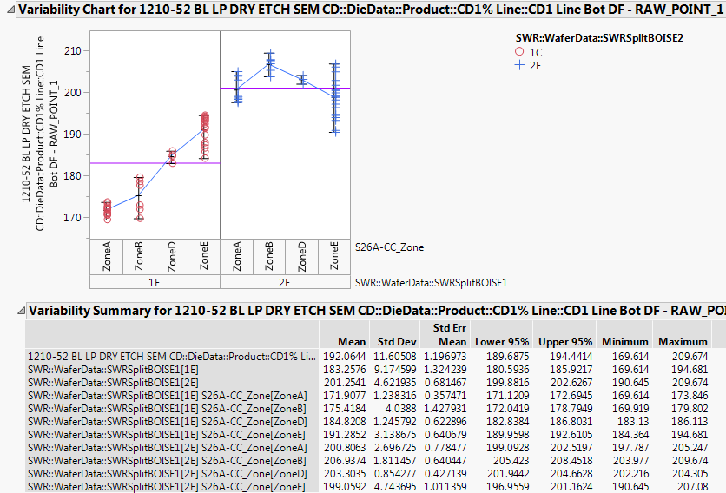
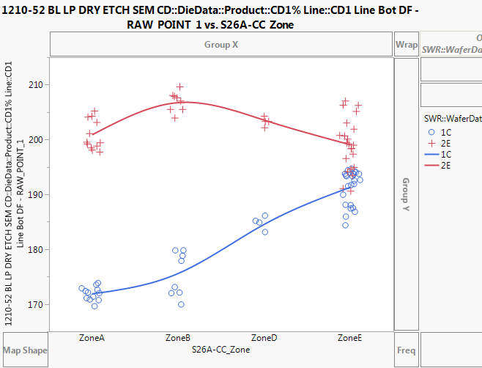
Inline measurement
SEM measured CD:
55nmW CD is ~1.8nm bigger than 45nm W
55nmW CD profile is different than 45nm W

Slide 11
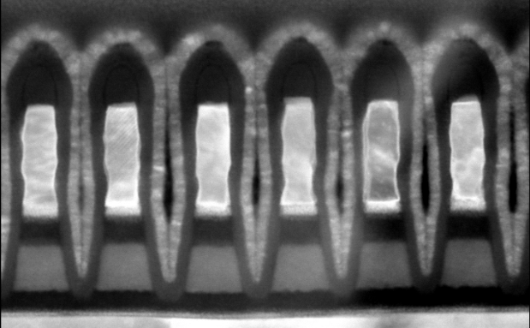
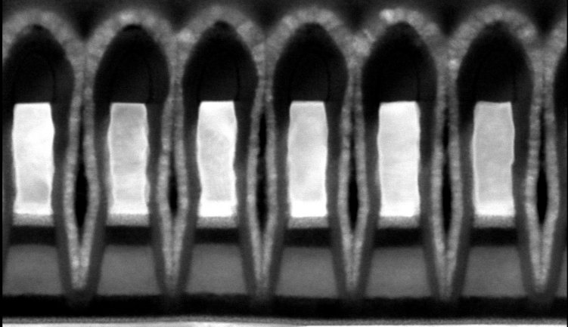
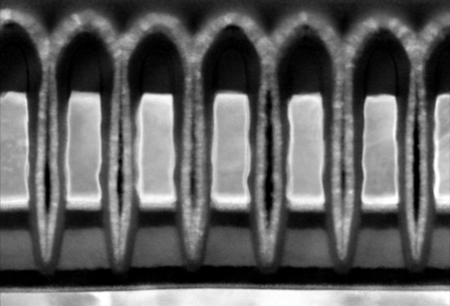
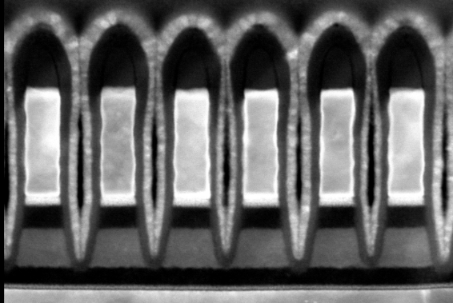
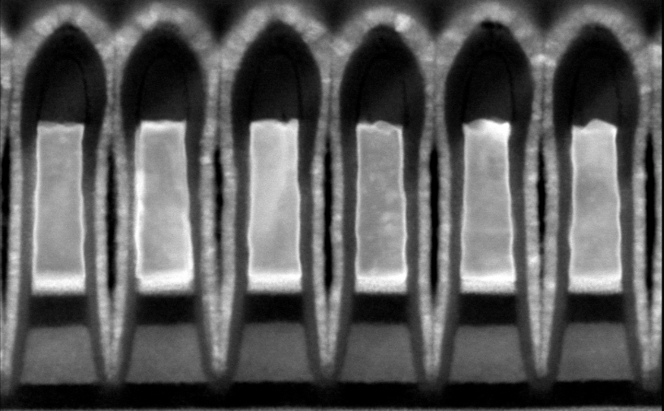
45nm W
CoW
EoW
55nm W
CoW
MoW
EoW
YAOJIN

Slide 12
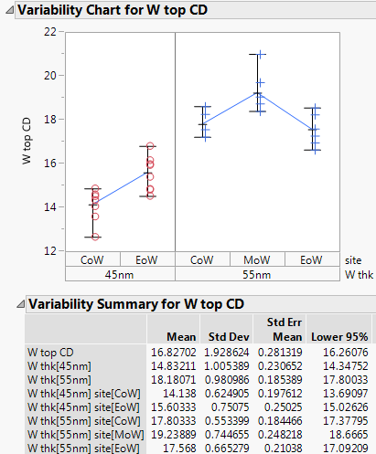
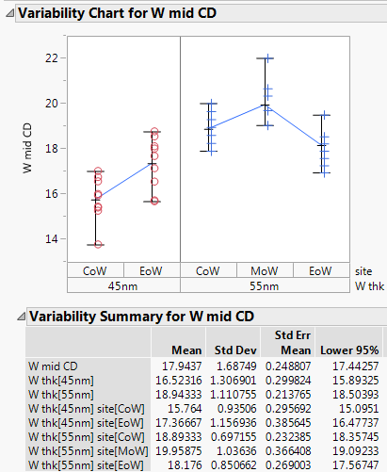
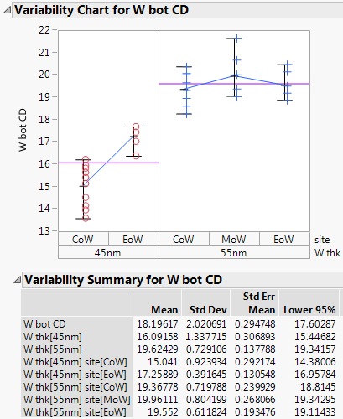
XSEC measurement- W CD
YAOJIN

Slide 13
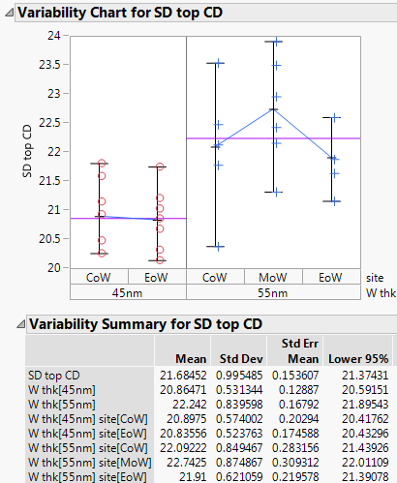
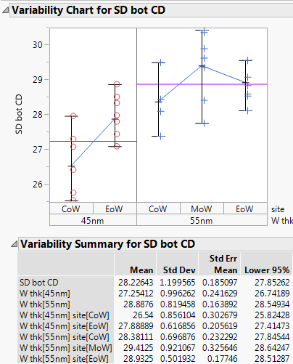
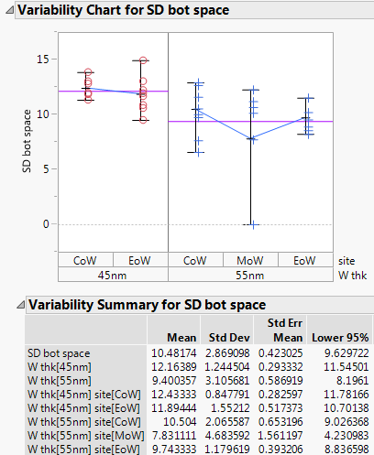
SD CD measurement
YAOJIN

Slide 14
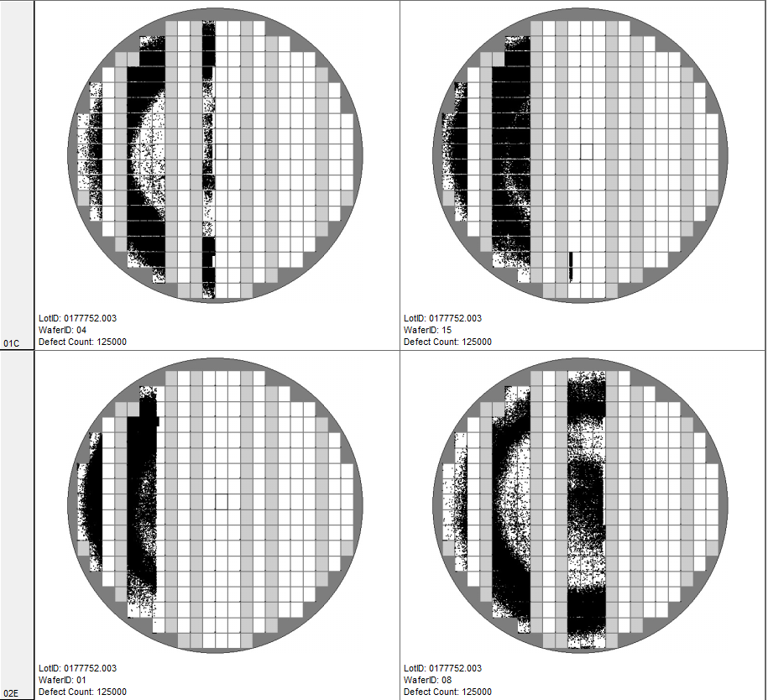
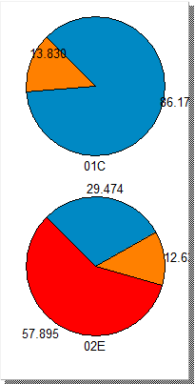

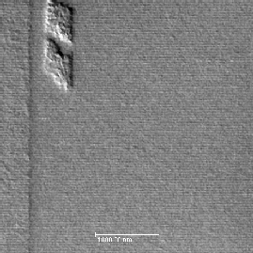
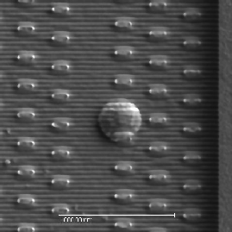
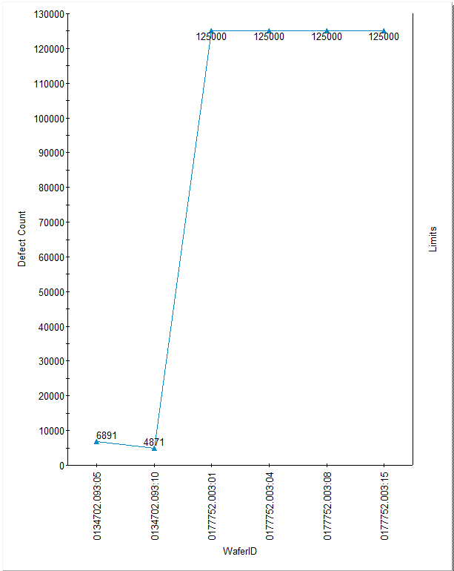
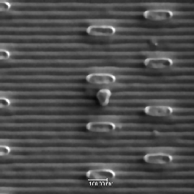
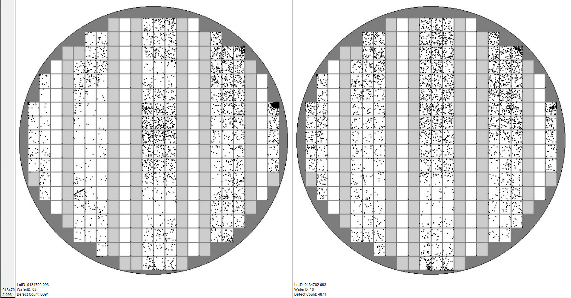
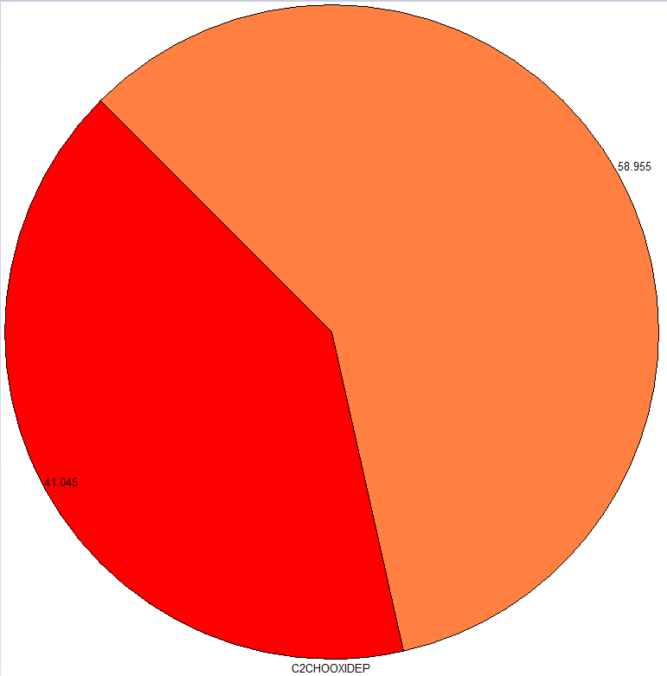
C2CHOOXIDEP
Micro Inspect
EHSMITH
Comments: we are seeing high percentages of blocked etch on the reviewed defects of the nitride cap wafers, 0177752.003-02E and 0134702.093. however defect counts are significantly lower on 0134702.093. these defect counts are ~ 3X of SxP baseline -> much more comparable to SxP baseline than SSM baseline. SxP baseline has also seen comparable blocked etch percentages @ this inspect.
oxide cap
0177752.003
CSOD no UV nitride cap
CSOD+UV +nitride cap
0134702.093
CSOD+UV +nitride cap
SSM47

Slide 16
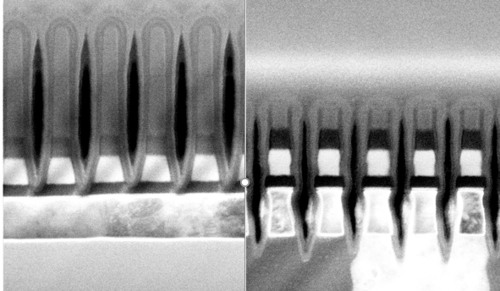
51 DE movie x-sections (CR5.3)
    Tapered SD profile results in liner run out at LP etch
    Liner protection remains on SD top (see the dashed line on the image), while SD bottom is narrowed by W etch
    Pre-liner DEP SD profile optimization will be required
Post 51 LP etch
Post 51 FP etch + Liner dep

Slide 17
PI alignment – housekeeping rules
SWR setup/ownership:
  Use one SWR per experiment lot (all deviations in one SWR); SWR owner is responsible for the whole setup (not just in the module of ownership);
  Only one additional SWR allowed – block SWR for baseline process if not set by GeRM
  Preserve SWR naming convention
GeRM setup:
  All reasonable effort should be invested into GeRM setup to avoid misprocesses as number of lot/SWR owners grows;
  PROD block SWR is the last resort, only one block (no copies to a separate block SWR)
Module ownership:
  In addition to ownership of development in the module, please invest some time to expedite PROD WIP (mitigate holds, long idle times, un-necessary metro)
  Request DEV material (Kyle owns/coordinates DEV starts)

