Slide 1
Vth evolution by ED
A1 reliability data
Enzo

Slide 2
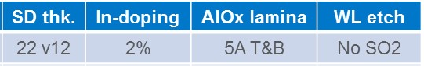
Summary
A1 lot 0173982
CD-- straight profile @WL
Reliability done on neg reading polarity
Trial | SD thk. | Ge% | As% | Se% | In% | Si% | 51 WL etch | Wf
1C | 22 ver12 | 13 | 30.4 | 48.6 | 2 | 6 | CD - - | 13,17,24
2E | 22 | 16 | 28.6 | 50.4 | 5 | 0 | CD - - | 18,20,23
3E | 22 | 16 | 26.6 | 50.4 | 7 | 0 | CD - - | 14,19,22
4E | 22 | 18.5 | 25.6 | 48.9 | 7 | 0 | CD - - | 15,16,21,25
Best
window
Old POR

Slide 3
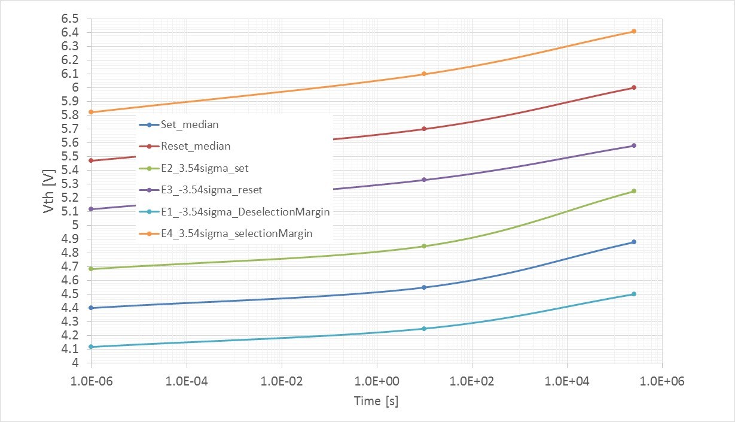
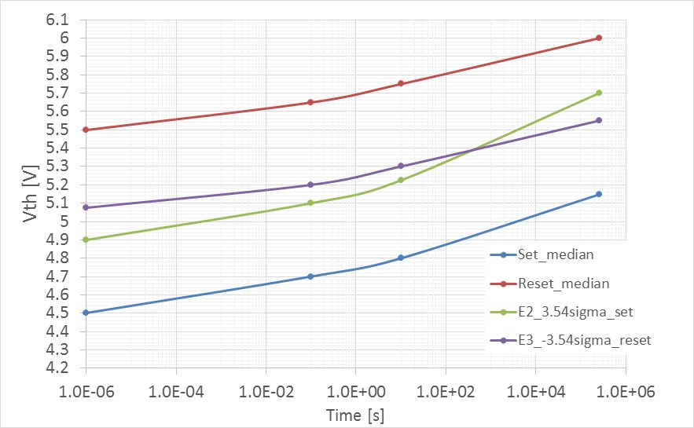
Best Window budget, ED4 only, 16k cycles: split 4E (85C time evolution)
150mV only gap to cover 1us→ 3days @85C with single Vdm with 3.54 sigma defectivity
No issue on E1/E4 but need to extend visibility up to 4 sigma
No reset read disturb budget in this calculation but single VDM will improve also reset read disturb
Split 4E, k*alloy
E4
E3
Vdm2
Vdm1
E2
Old POR with lamina
Window closure @ 100s
E1

Slide 4
Extended full tile cycling : 2M FW
1us W2R delay
1s W2R delay
Very small defectivity tail appear after 2M FW above 4 sigma level!
No additional cross tile modification after 128k cycles

Slide 5
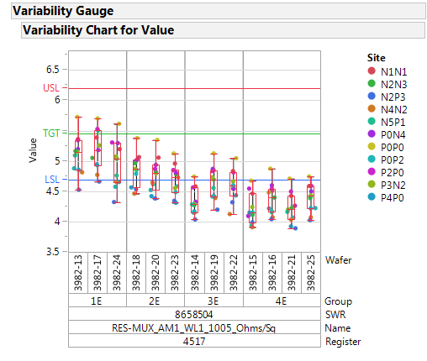
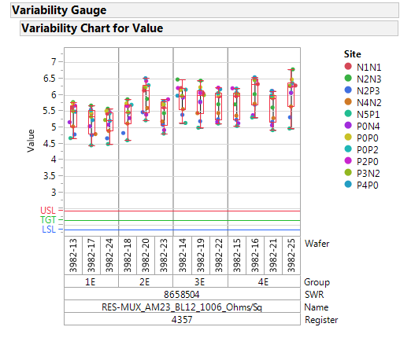
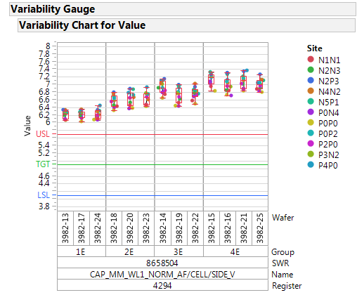
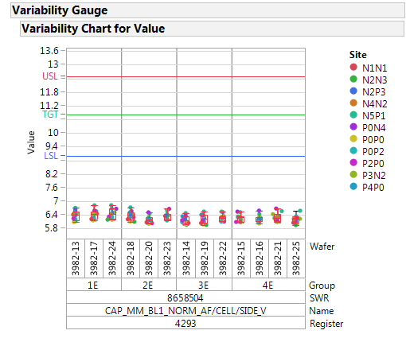
Resistance / Capacitances
WL Res=4.2 Ohm/sq
WL Res=4.2 Ohm/sq
BL Res= 6 Ohm/sq
BL Res= 6 Ohm/sq
WL total cap=30 fF
BL total cap=26 fF
WL Cap=7aF/cell/side
WL Cap=6.2aF/cell/side
Numbers from Hernan and Jeremy:
BL Decoder capacitance ~ 40 fF
WL Decoder capacitance ~ 9 fF

Slide 6
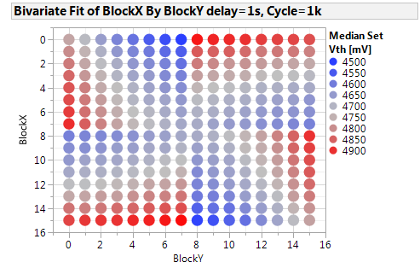
New resistance calibration check: split 4E
Total access resistance for each block [kOhm]
Median set Vth by block position

Slide 7
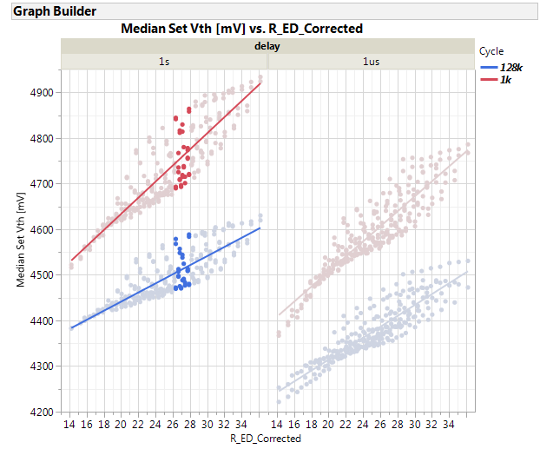
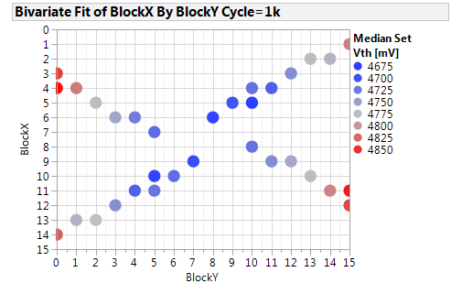
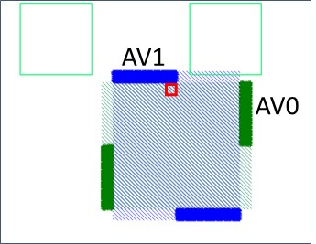
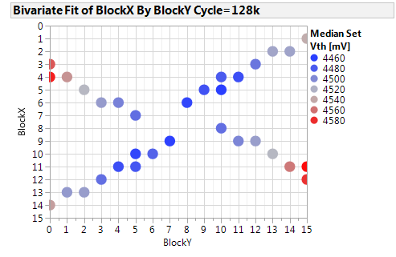
Is ED the only variable for Vth evolution?
Tile effect only, same ED
Lower Vth toward center of tile
[kOhm]

Slide 8
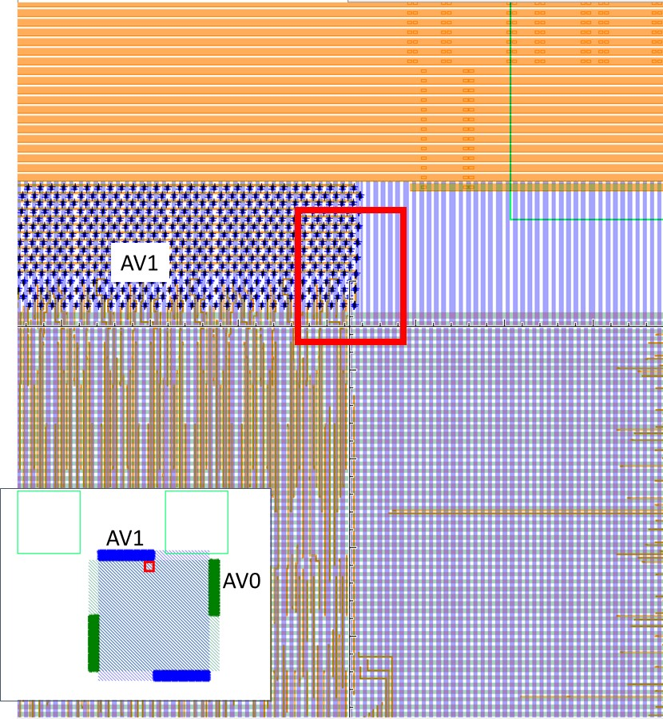
S26 vs SR71B: Line are driven from middle vs edge
S26 (Tony sketch)
SR71B
Worst case is still the same (2k + 1k)
Consider this cell on WL0 and BL0
WL0
WL0
WL0
WL0
WL1
BL1
WL1
BL0
WL0
WL0
WL0
WL0
BL1
WL1
BL0
WL1
WL0
WL0
WL0
WL0
WL0
BL1
WL0
BL0
WL0
WL0
WL0
WL0
BL1
WL0
BL0
WL0
In S15C the worst case was 3k (2k BL + 1k WL)
In S26C the worst case is 3.5k (2k WL + 1.5k BL)

Slide 9
Spike vs tile position model (one decoder very close)
Min ED / max discharge
Med ED / lower discharge
BL (0V)
WL dec (7.2V)
BL (0V)
WL decoder (7.2V)
R
R
Spike increase going toward center of WL
2R
R
Intra tile contribution
Spike increase going toward center of BL
Tile effect + decoder effect are added (ED change)
R= 1k cells

Slide 10
Spike vs tile position model (one decoder far)
WL dec (7.2V)
WL dec (7.2V)
R
2R
Spike decrease going toward center of WL
R
R
Spike decrease going toward center of BL
2R
2R
2R
BL (0V)
BL (0V)
Tile effect + decoder effect are subtracted (ED change)

Slide 11
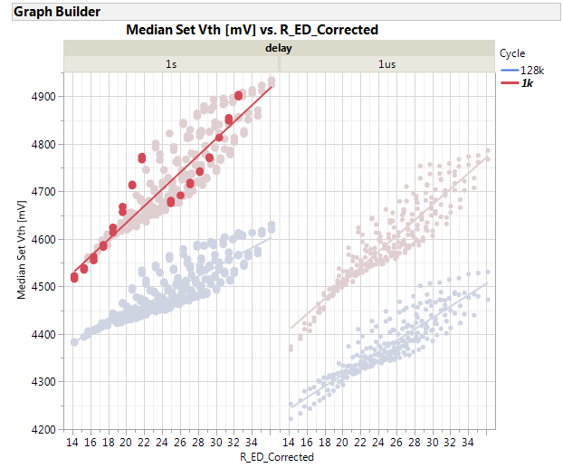
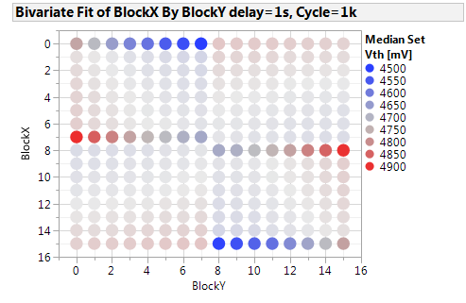
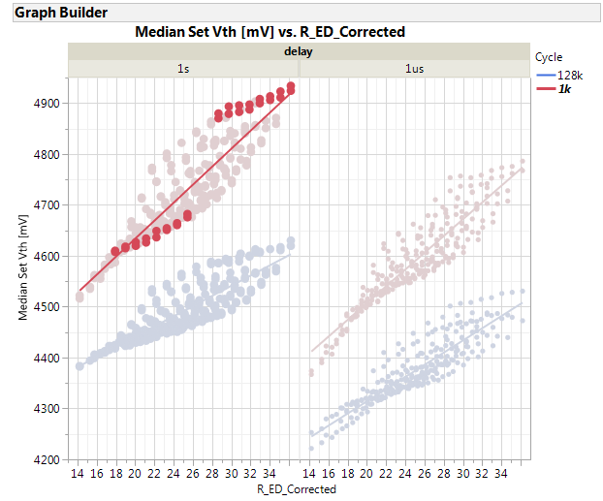
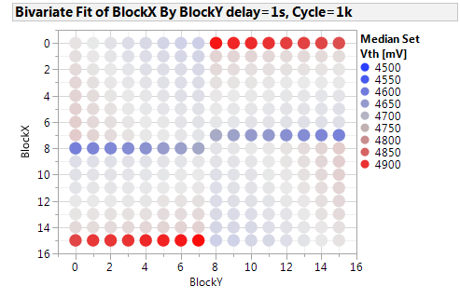
Moving along WL
simulated EDs
NEXT SLIDE
A
B
C
260mV total delta
(tile and WL decoder contribution add)
80mV total delta
(tile and WL decoder contribution subtracts)

Slide 12
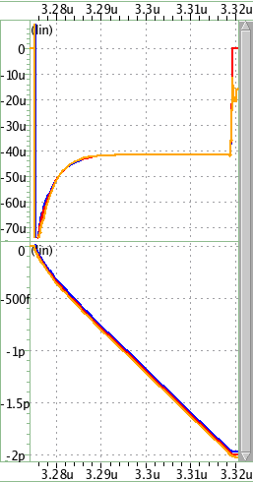
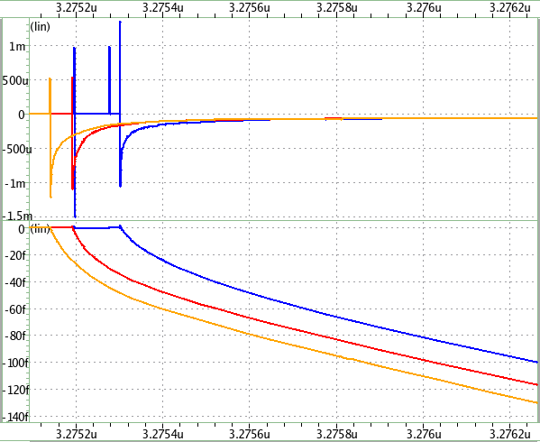
Moving along WL Cell current and charge during WRITE
Jeremy H.
Reverse WRITE
85C
V_{APPLY} = 7
V_{MID} = 3.5
Target Write current = ~42uA
Pre-write Vth = 5.4v
V_{HOLD} = 2.5v
1aF parallel with cell model
~1ns zoom in
44ns
ED of WL | Q (0s→1ns) | Q (0s→44ns)
A (full) | 103.6 fC | 1.98 pC
B (3/4) | 112.0 fC | 1.99 pC
C (1/2) | 121.1 fC | 2.01 pC
Current
1ns
Charge

Slide 13

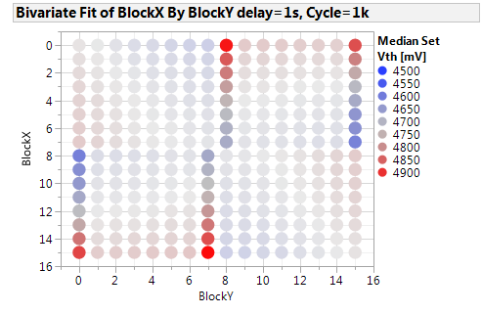
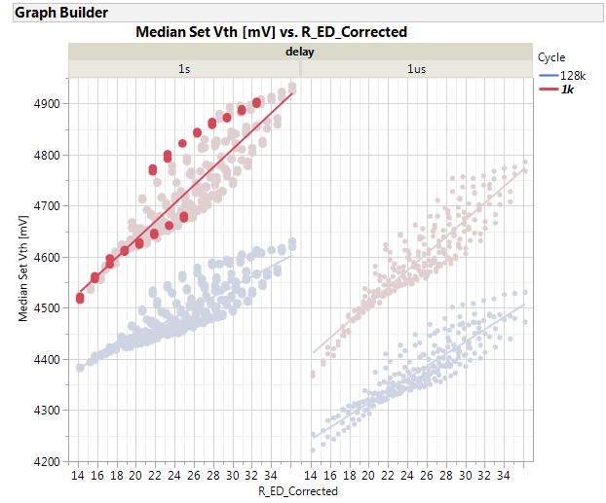
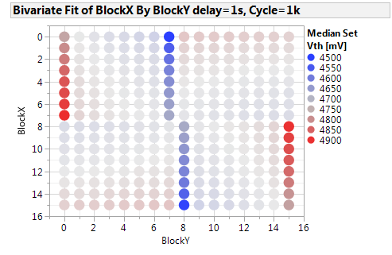
Moving along BL
280mV total delta
(tile and BL decoder contribution add)
150mV total delta
(tile and BL decoder contribution subtracts,
BL decoder cap seems to dominate)

Slide 14
Conclusions
Vth evolution mainly driven by total ED (distance from decoders)
Secondary effect (spread of correlation plot) is given by intra-tile capacitance that can add or subtract to decoder capacitance
The secondary effect generally is not visible on S15C or S26A because lines are driven from the middle, so decoder contributions (ED) generally is added always to intra-tile contribution
In any case spike mitigation on both selection polarities is strongly recommended for S24S vehicle (main variable to control spike aka Vth evolution during product operation)

Slide 15
Backup

Slide 16
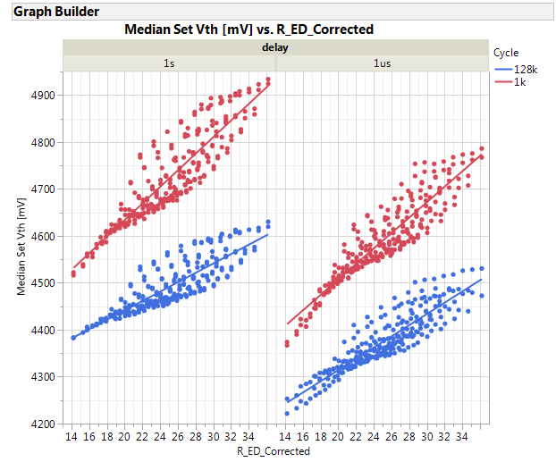
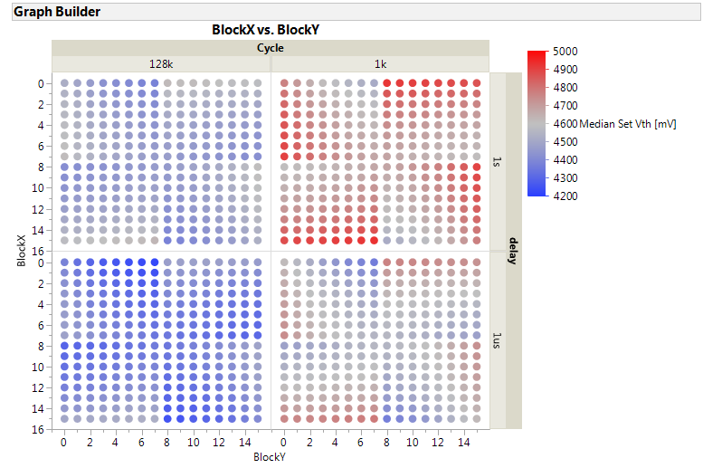

Slide 17
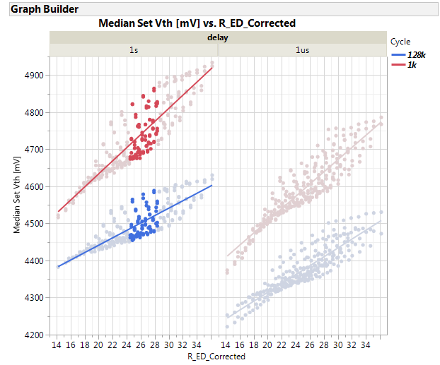
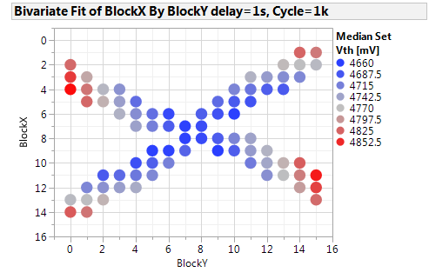
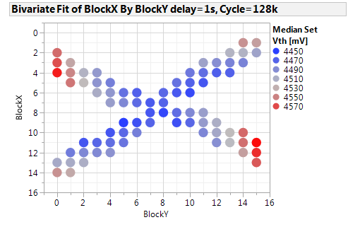
Cross shape in Vth topology ( same nominal ED )

Slide 18
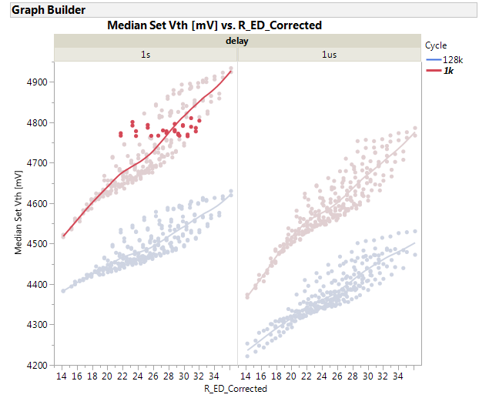
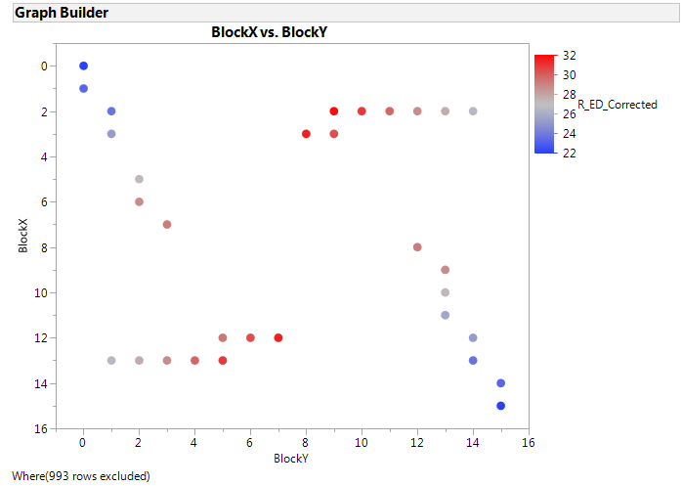
Cut along same Vth

Slide 19
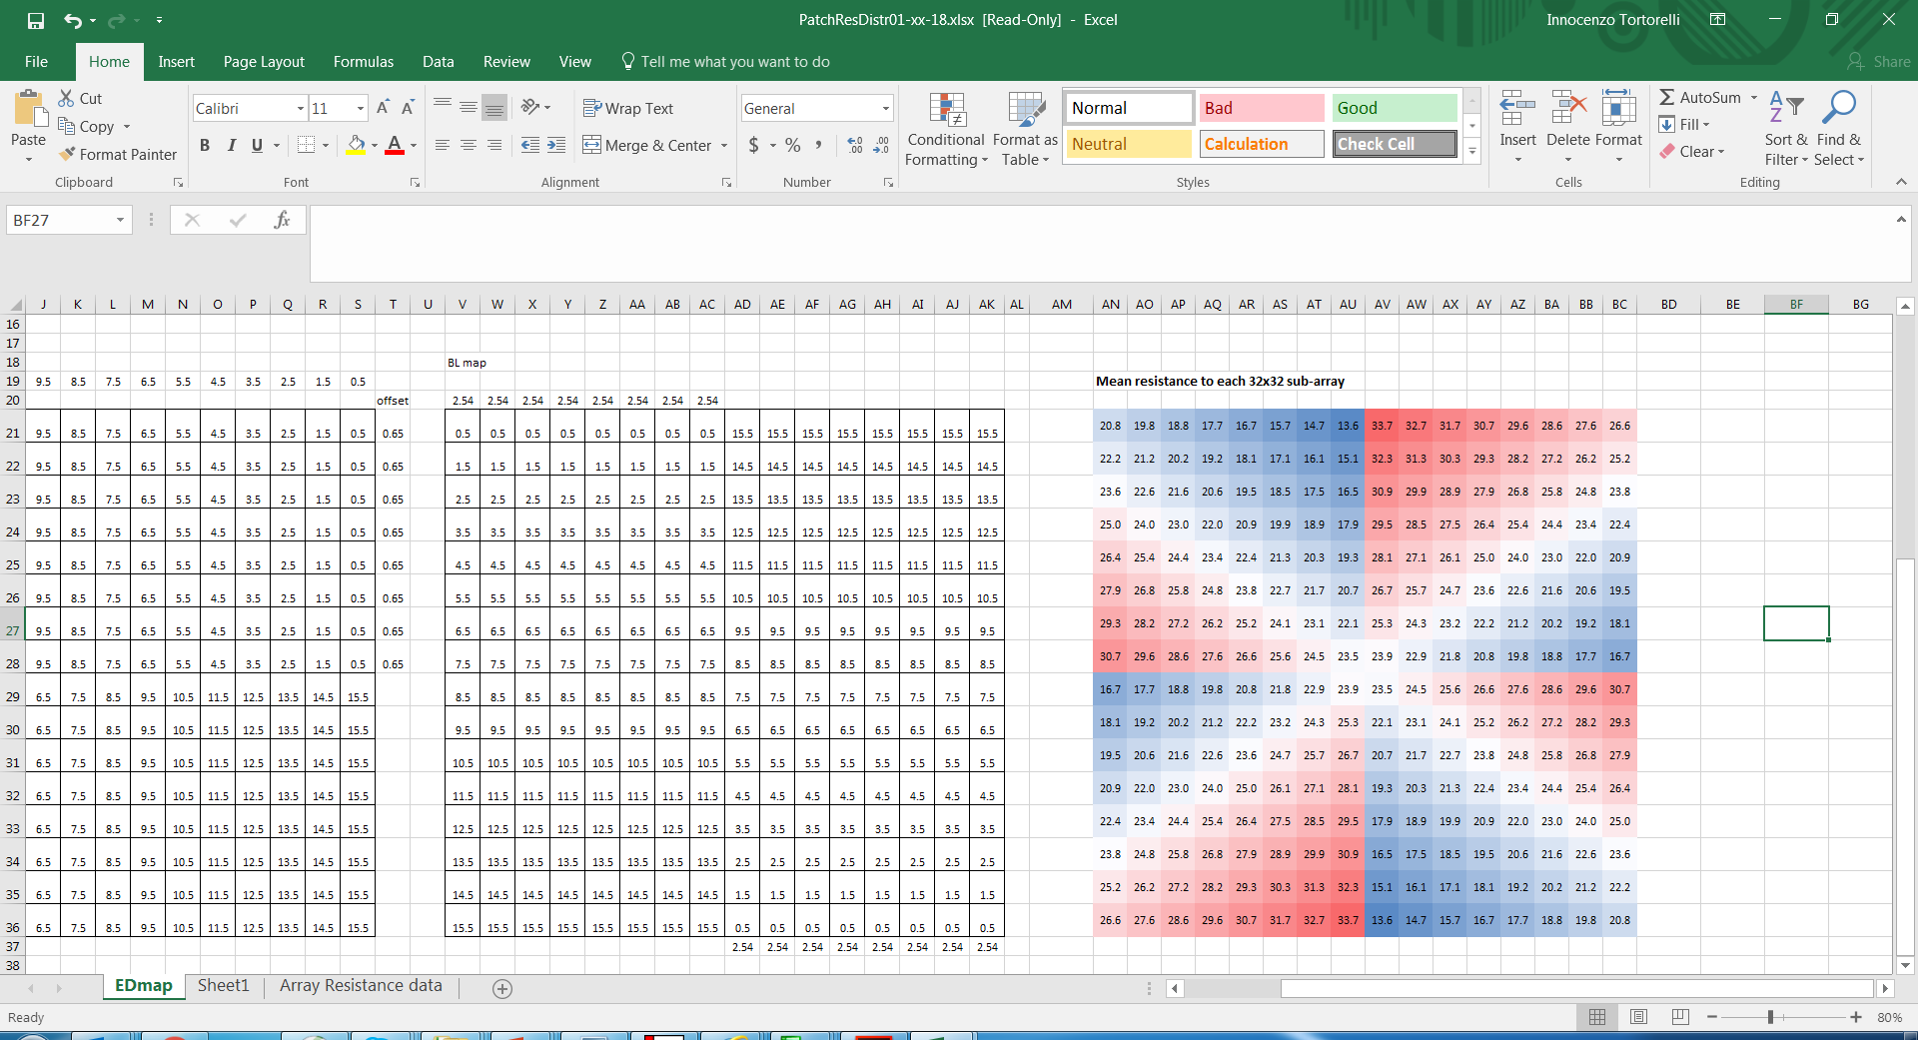
Tile map schematic, mean access resistance for each block [kOhm]
BL number
BL driver
Block 0-0 is the reference for probe
WL number
WL driver
WL driver
Block 15 – 11 show E2 / E4 tails related to 1 bit
(Low ED but not minimum)
BL driver

Slide 21
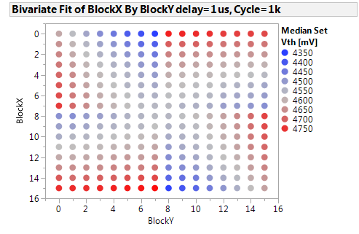
Full map @ 1kCycles (median set Vth by block, 1us delay)
Good match with access resistance map
BL number
BL driver
WL number
WL driver
WL driver
WL driver
BL driver
BL driver

Slide 22
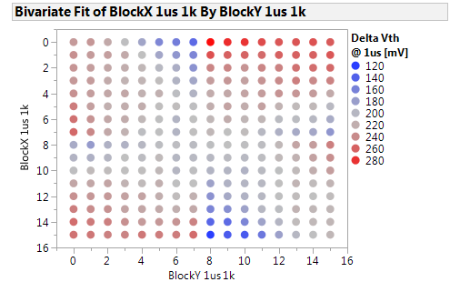
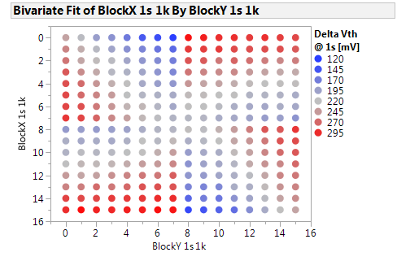
Median Set delta Vth evolution map (1k→128k Vth delta)
Some seasoning asymmetry visible at 1us, fully symmetrical at 1s delay following access resistance

Slide 23
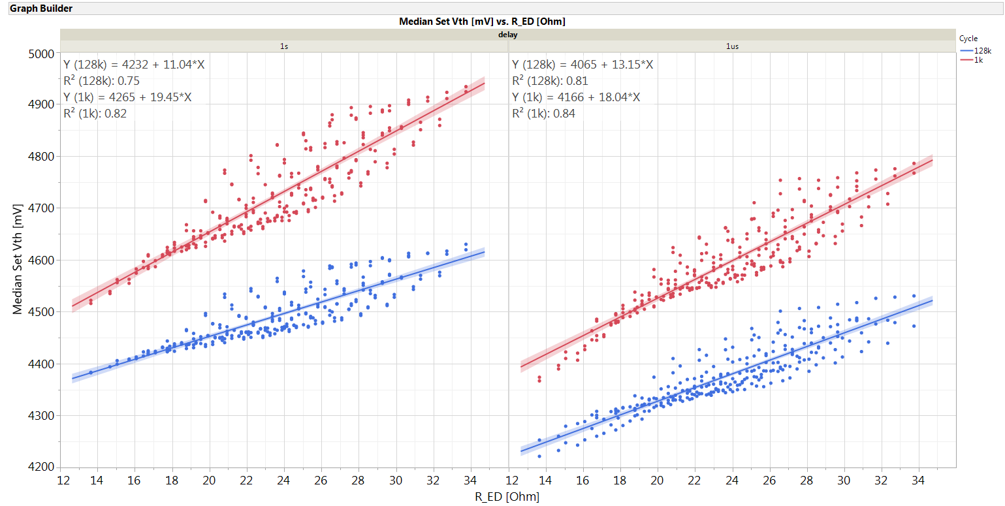
Median Set Vth by access resistance
Vth shift after cycling increase with ED

Slide 24
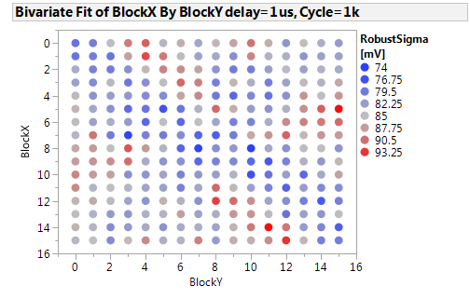
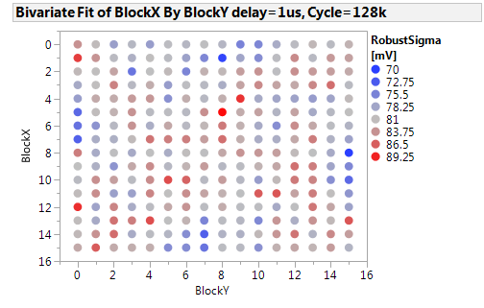
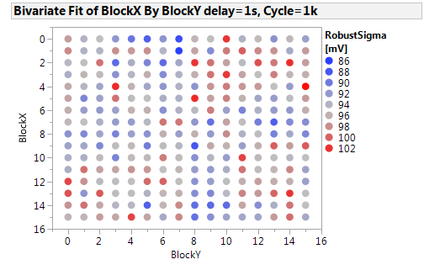
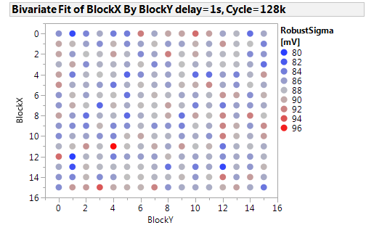
Set Robust sigma maps

Slide 25
Set Robust Sigma by access resistance [kOhm]
No big trend of robust sigma vs ED pre drift
[kOhm]

Slide 26
Set Vth vs BL and WL access resistance (high ED)
Higher sensitivity moving along BL for high total access resistance
BL number
BL driver
WL number
WL driver
WL driver
BL driver

Slide 27
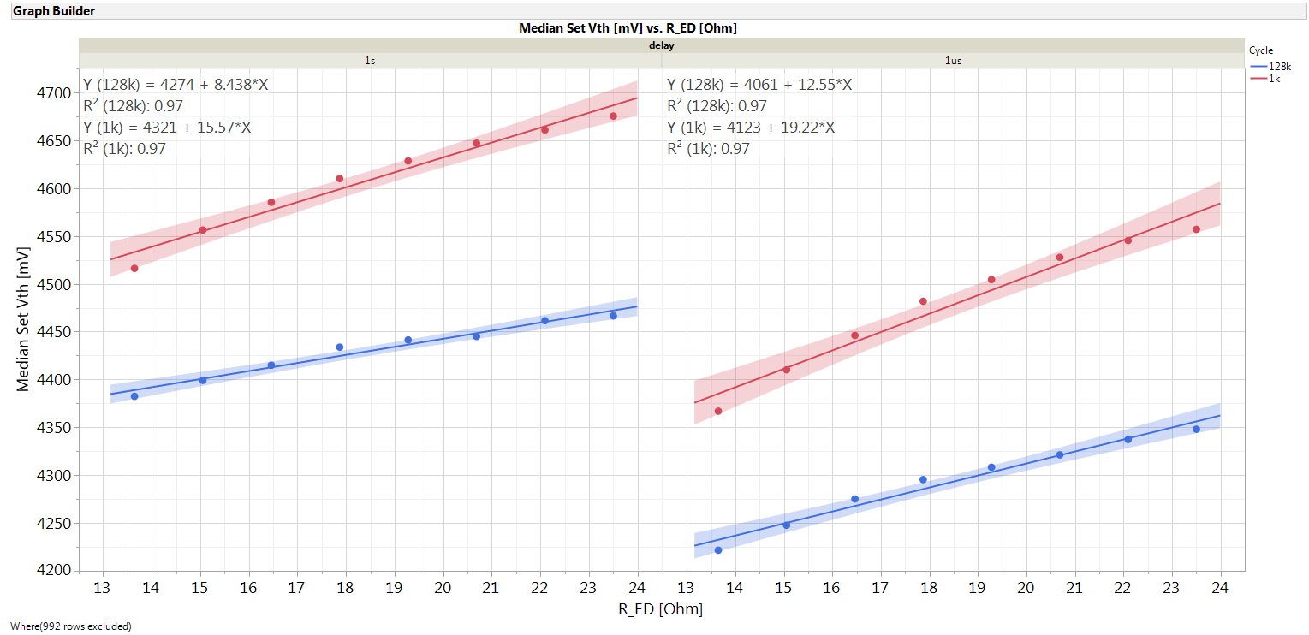
Set Vth vs BL and WL access resistance (low ED)
Higher sensitivity moving along WL for low total access resistance
BL number
BL driver
WL number
WL driver
WL driver
BL driver

Slide 28
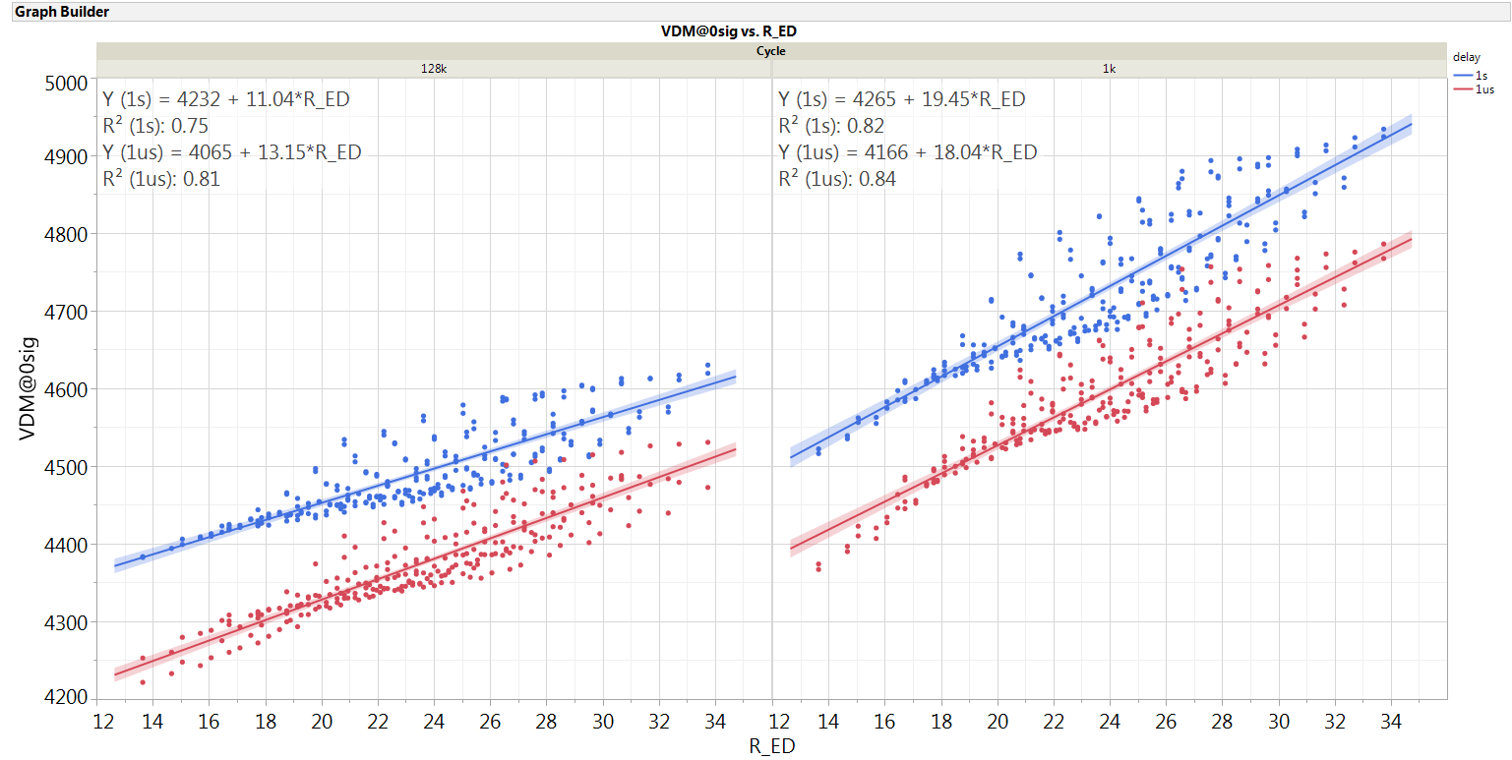
Median set Vth by ED: drift focus

Slide 29
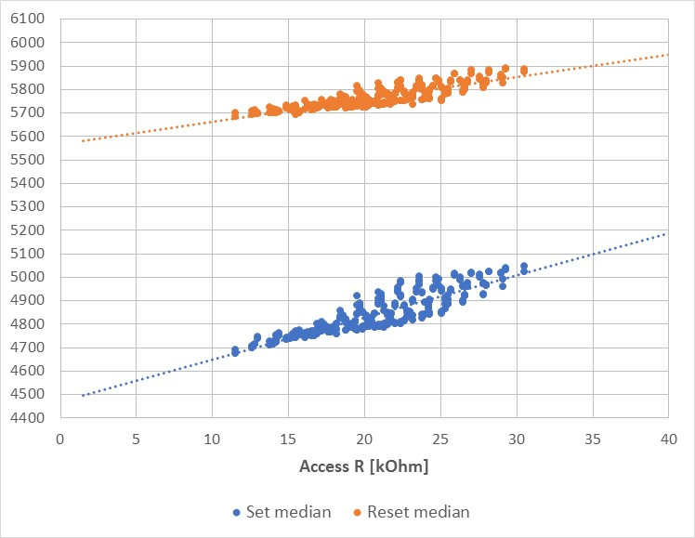
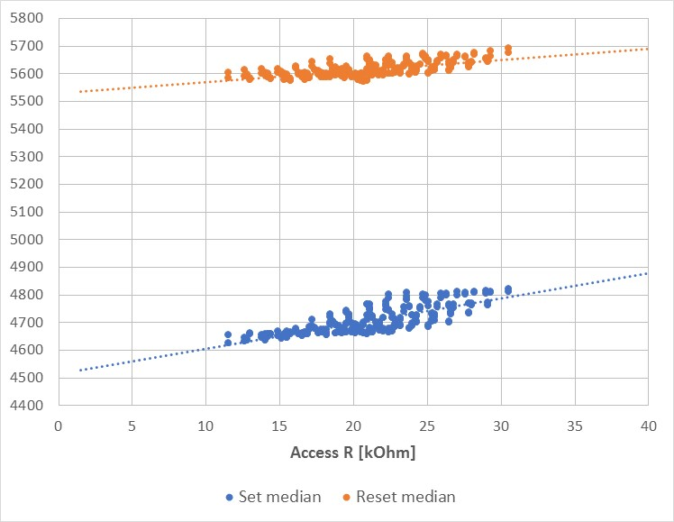
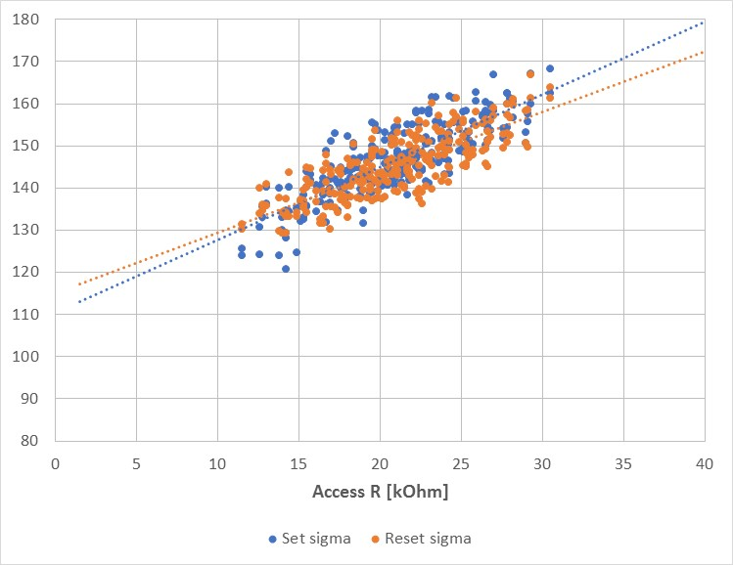
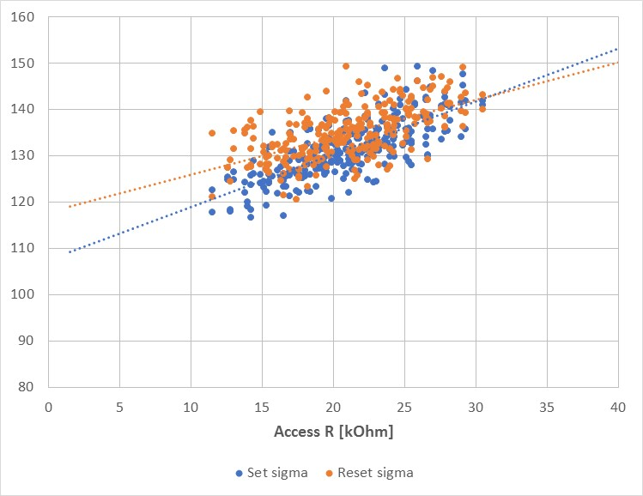
Cross tile components vs ED @ 85C (old POR): No spike inhibition
1k cycles
128k cycles
Vth trend by access resistance[mV]
Robust sigma trend by access resistance [mV]

