Slide 1
Rev0 SSM Read Window Budget and metrics tracking
Fuga, Agostino P., DerChang K.
ww12.5 v0
Presentation folder: SSM JDP Project Meeting
Link to excel file show in next slide

Slide 2
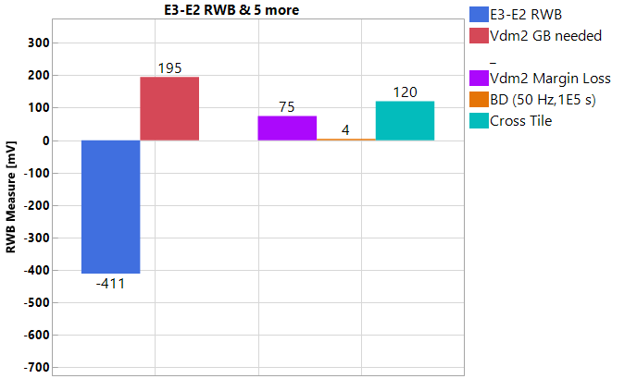
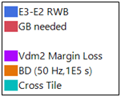
SSM RWB
ww12.2
RWB measurement (3.54σ RBER goal; 135 μs write ipd) | DTS0.3 [mV] | Definition | r5.3 status | Comments / Follow-ups
RWB (E3-E2) | >230 | E3(@3.54σ, 1us, 10k FW, 5k rds) - E2(@3.54σ ,10s) | -411 | To be > success criterion (sum of items below); Vdm distributions collected and extraction at RBER of interest
GB needed | <230 | Vdm2 Margin Loss + BD (50 Hz,1E5 s) + Cross Tile | 195 | Success criterion, w/ breakdown as below
Vdm2 Margin Loss | 200 | E2_drift(@0σ,10s-48h*,1 FW) - E3_drift(@0σ, 1us-3s*,10k FW) | 75 | * Projection from 3h (10s) for E2 (E3)
BD (50 Hz,1E5 s) | 0 |  | 0 | Test release to intercept PR4(?): Methodology dev. to be aligned to 3DxP
Cross Tile | 30 |  | 120 | Test release to intercept PR4(?)
Methodology: Rev0 RWB Measurement and Pareto released
Measured RWB to include worst-case E3/E2 @RBER goal (3.54σ), w/ E3 to include WE & RD GB @1μs t_{wait}, while E2 being @10s
Measured RWB success criterion set by GB needed, as determined by UD/BD Vdm2 margin loss, and cross-tile
Recommendation: Metrology and Analysis gap closure
PR3 (& PR4) release to include missing elements to drive RWB opt.
SWR analysis alignment to Rev0 methodology (line trend included)
RWB gap Pareto in r5.3 and rev5.3⁺ projections to drive roadmap
Success
criterion
r5.3
GAP
success criterion
(break-down)
RWB

Slide 3
SSM RWB breakdown (calc’s)
ww12.4
Link to excel
Objective: Establish RWB model & tracking, including POR/Pre-POR/Idea-phase overall methodology:
* If not noted, everything assumed @3.54σ and write/read ipd @135μs
** When sampling limits sigma visibility, data used @3.0σ and extrapolated @3.54σ w/ normal assumption; Use 10S E3 read, if no 3s read available
^ In grey elements for segmentation or w/ metrology to be developed

Slide 4
BACK-UP

Slide 5
SSM RWB analysis (Dual-Vdm)
Link to DTS0.3
Set@1us,85C
20kcycles
Set@1us,85C
fresh
Set@10s,85C
fresh
Reset@1us,85C
fresh
Reset@1us,85C
20kcycles
Reset@10s,85C
fresh
Normal Quantil [σ]
1.6V@1us,85C
fresh
105mV/σ
105mV/σ
0σ
Set Drift
1us-10s@85C
≤300mV
Max Vth evolution
fresh-20kcycles
30mV
Reset RD
5kreads
300mV
Reset Drift
1us-10s@85C
≤200mV
3.54σ
Vunselect
3.625 V
Vdm
5.31V
Vselect
7.25V
V_FF
9.3V
Voltage [V]
Die-to-Die variability, systematic supply variation, sense error and circuit variability is already included in the reported distributions
Worst case scenario: 1us-10s and fresh-20kcycles

