Slide 1
0177752 SR71B

Slide 2
Summary
CD-- straight profile @WL
Mono target (1C) vs cosputter Alloy #6
Trial | Cell stack | WL | AlOx lamina | Wf
1C | SD.k1 22nm | CD - - | No | 17,19,20,23
2E | Alloy #6 22nm | CD - - | No | 21,22,24,25

Slide 3
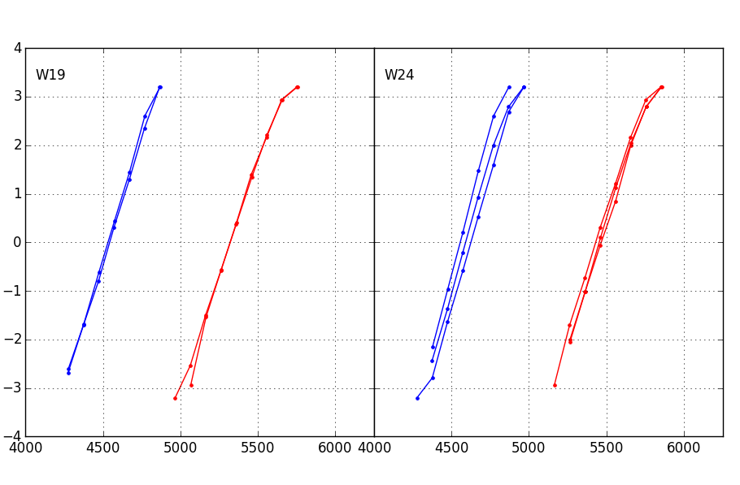
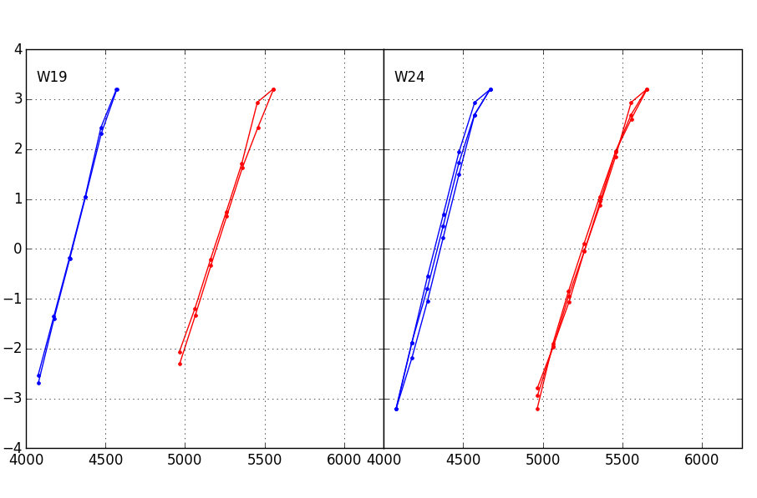
Distributions 1us
1k cycles
128k cycles
1C
SD.k1 22nm
2E
Alloy #6 22nm
1C
SD.k1 22nm
2E
Alloy #6 22nm

Slide 4
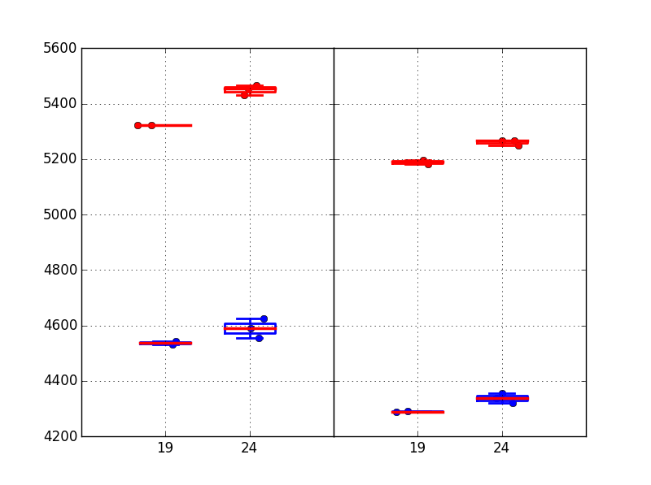
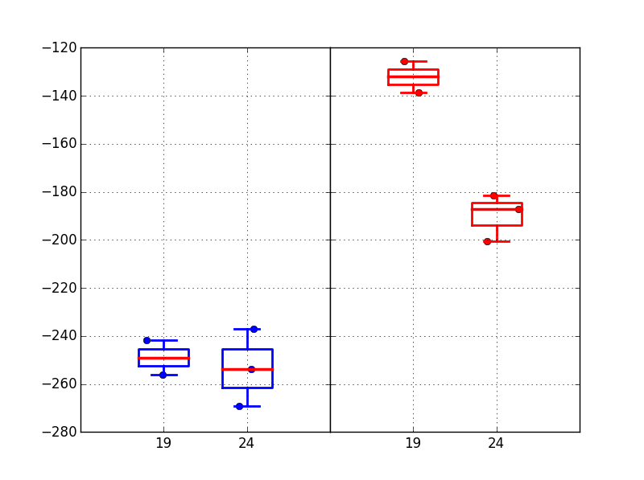
Vt Medians + Vt shift
Medians are slightly higher for cosputter
At early cycles, reset is significantly higher for cosputter
Reset Vt evolution 1k→128k is higher for cosputter
1k cycles
128k cycles
Median Vt
Trial | Cell stack | WL | AlOx lamina
1C | SD.k1 22nm | CD - - | No
2E | Alloy #6 22nm | CD - - | No
1C
2E
1C
2E
Vt shift 1k→128k cycles
SET
RESET
1C
2E
1C
2E

Slide 5
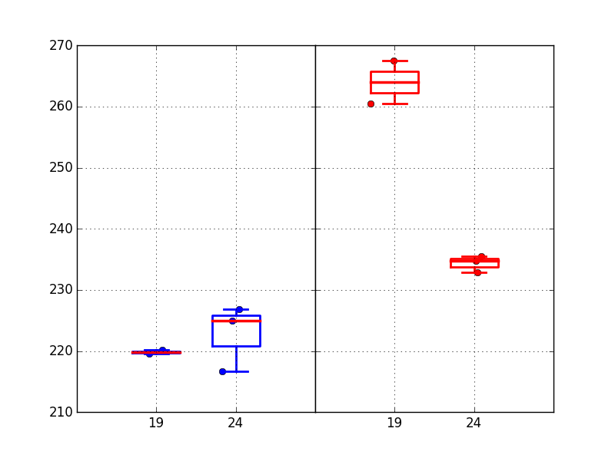
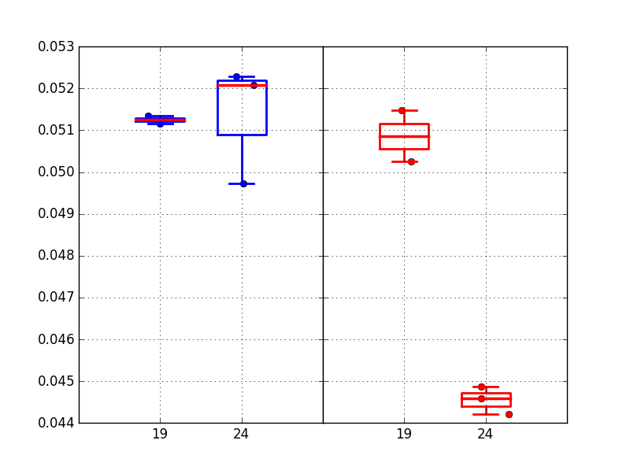
Median drift 1us-10s @85C (128k cycles)
Drift quite matched for set
Reset drift higher for mono target, cosputter in line with previous lots
Absolute drift mV
SET/RESET
Trial | Cell stack | WL | AlOx lamina
1C | SD.k1 22nm | CD - - | No
2E | Alloy #6 22nm | CD - - | No
1C
2E
1C
2E
Relative drift
SET/RESET
1C
2E
1C
2E

Slide 6
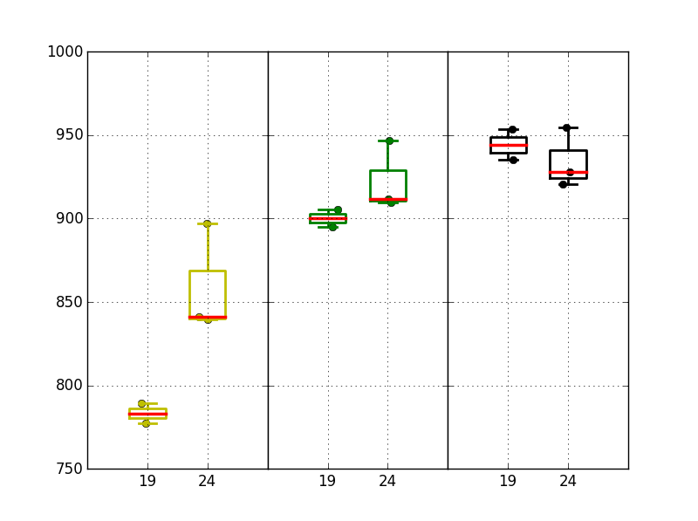
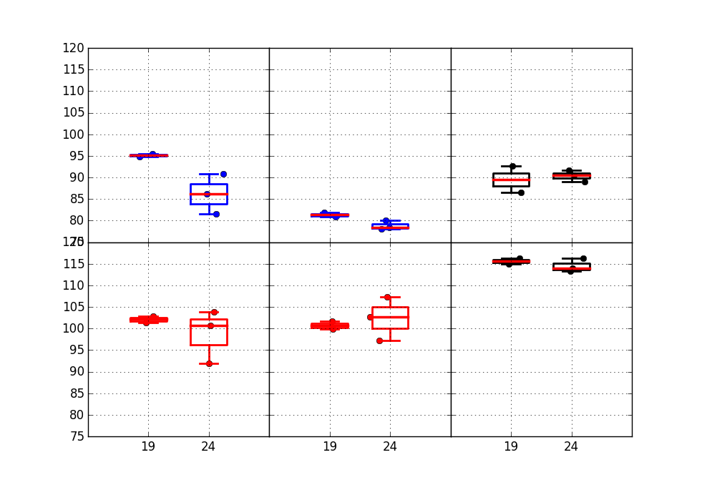
Window & sigma
Cosputter alloy #6 has larger median window, but differences with mono target even out after more cycling
Median
Window
Distribution sigmas are very similar, at early cycles slightly worse set sigma for mono target
Trial | Cell stack | WL | AlOx lamina
1C | SD.k1 22nm | CD - - | No
2E | Alloy #6 22nm | CD - - | No
1C
2E
1C
2E
1C
2E
1k cycles
128k cycles
128k cycles +10s drift
Robust
sigma
SET
RESET
1C
2E
1C
2E
1C
2E

Slide 7
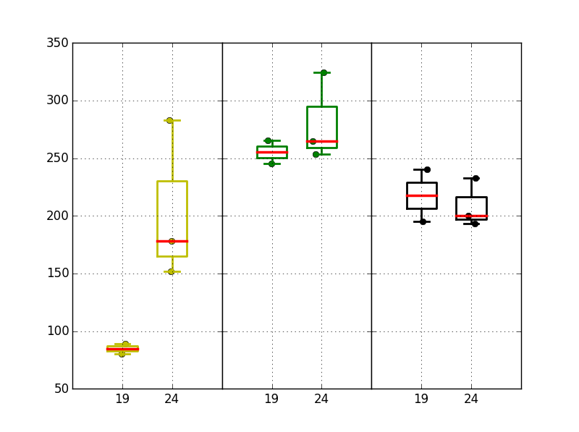
Projected window @3.54 sigma
Trial | Cell stack | WL | AlOx lamina
1C | SD.k1 22nm | CD - - | No
2E | Alloy #6 22nm | CD - - | No
Projected window is losing ~100mV for mono target, ONLY for 1k cycles
1k cycles 1us
128k cycles 1us
128k cycles +10s drift
1C
2E
1C
2E
1C
2E

Slide 8
Conclusions
Alloy #6 results from monolithic target vs cosputter are quite aligned except for:
Small offset for median Vt (higher for cosputter)
Reset Vt - until 1k cycles, cosputter has higher Vt (larger window). Due to more Vt evolution, there is a realignment for larger cycle counts. This point is not consistent with 2xCMOS results
Reset Drift – drift is higher for mono target
Set is aligned on most metrics, only initial set sigma is slightly better for cosputter

