Slide 1
SSM process development update
ww1811

Slide 2
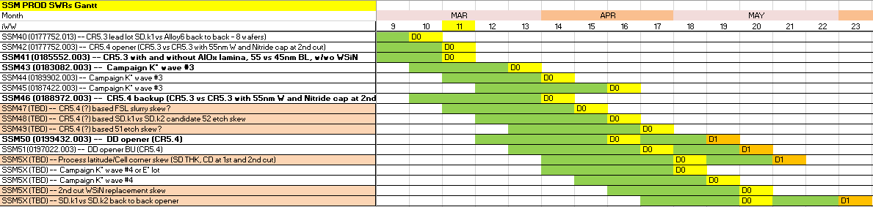
WIP status update
More emphasis on the structural health and DD in the next 4-5 week starts
Focus on CMP steps, 52 etch and D1 setup
First K* wave3 lot is projected to probe ww13

Slide 3
D1 SSM Deck Setup
Lead lot at 64L etch, Expected to reach F4 next week (WW12)
6-8 week cycle time projected for lead lot +1 week targeting
Probe WW18-WW20
Plan to include 1st cut polish centering SWR on remaining 13 wafers
Lead Lot Target plan
Lead DD Lots F2 Status
SSM SR71B reticle edits: 64/C1/65/66/C4
KRITTER

Slide 4
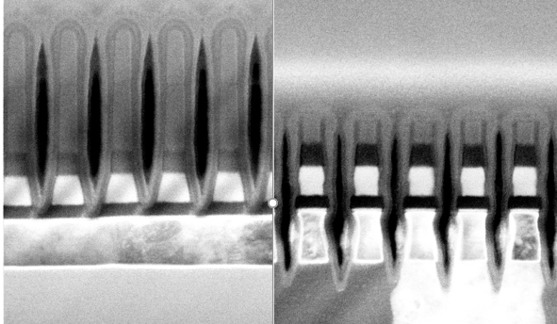
51 DE movie x-sections (CR5.3)
Tapered SD profile results in liner run out at LP etch
Liner protection remains on SD top (see the dashed line on the image), while SD bottom is narrowed by W etch
Pre-liner DEP SD profile optimization will be required
Post 51 LP etch
Post 51 FP etch + Liner dep

Slide 5
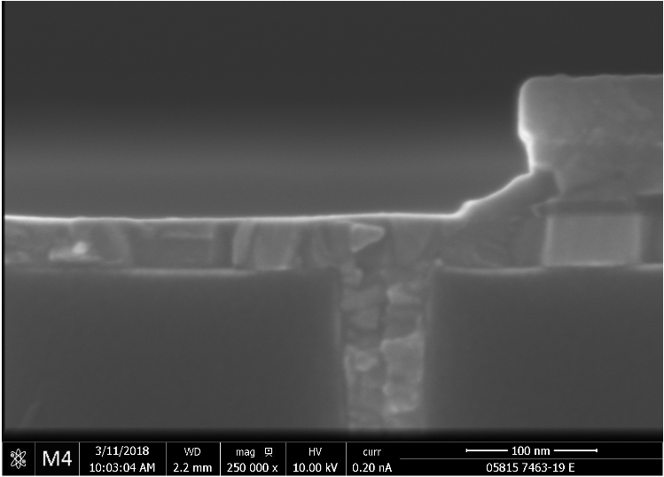
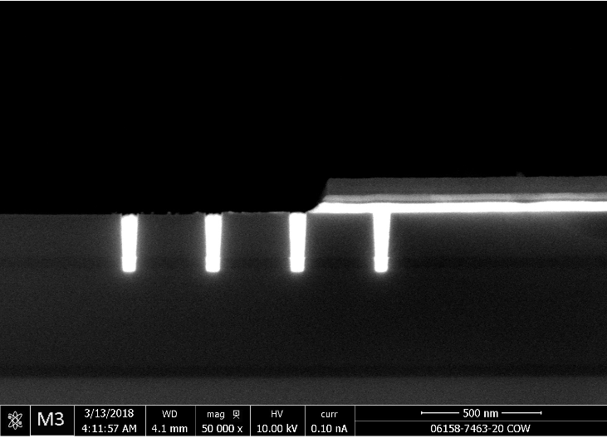
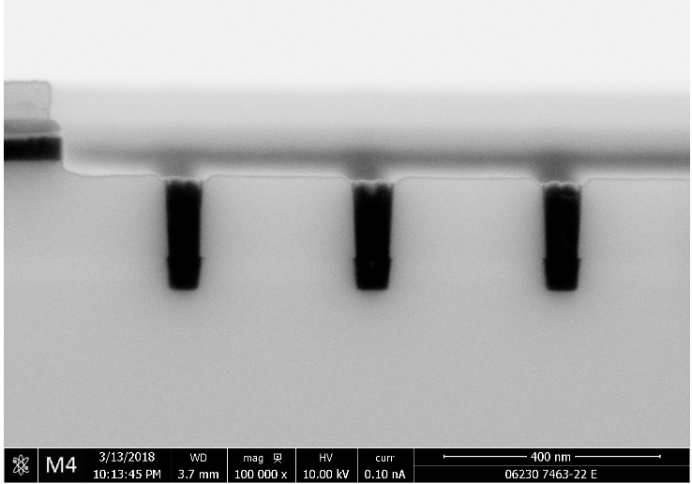
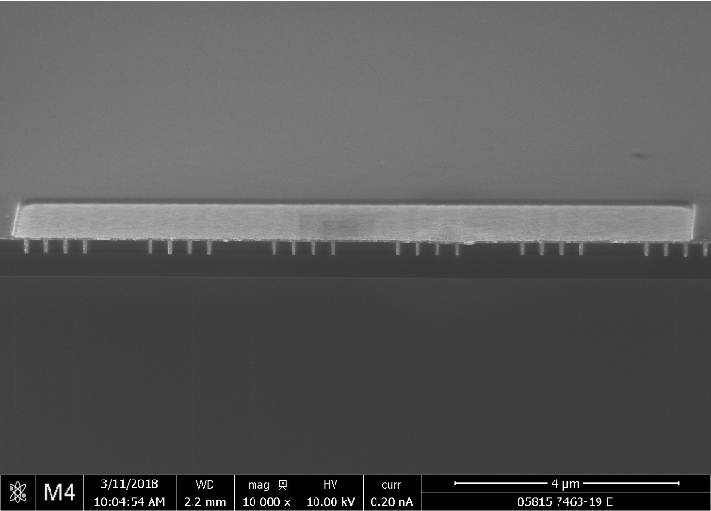
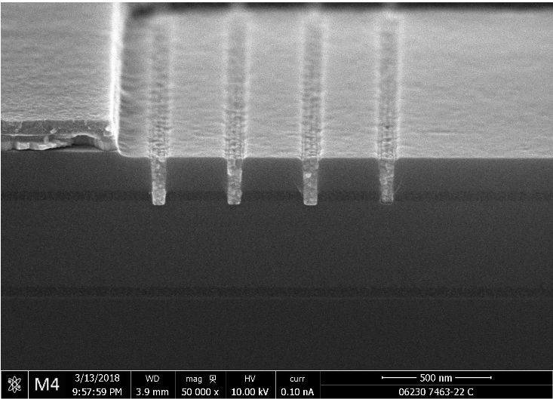
Campaign K* alloy14 (SD.k2 candidate) E1 etch
SSM POR E1 etch
SSM POR E1 etch +40% time
SSM POR E1 etch +60% time;
Higher Ar flow (+sputter)
In rich alloys had trouble to clear at E1 etch and significant etch time/conditions adjustment was required;
Need follow up on C1/C2 etch;
51-52 etch x-sections are expected from PROD K* lots

