Slide 1
SSM WSiN elimination lots 0180342.003 and 0178782.013
2018-Wk11
SSM team

Slide 2
SSM WSiN elimination - 0180342.003 and 0178782.013
Scope of the lots
To explore WSiN removal to increase the selection spike and to make faster the SMM cell seasoning
To evaluate the trade-off with the endurance and other electrical parameters
0180342.003
Originally planned with 55nm BL W thickness, but processed with std deposition and modified BL etch
Second lot to evaluate pro/con of eliminating WSiN at BL only
0178782.013
55nm BL W thickness vs 45nm POR thickness
Third lot to evaluate pro/con of eliminating WSiN at BL only

Slide 3
Lot trials
0180342.003
Trial | Cell stack | BL etch | WSiN @ BL | Wf
1C | 22nn ver12+2% In + T&B AlOx | POR | Yes | 14,17,20,21
2E | 22nn ver12+2% In + T&B AlOx | As 55nm | Yes | 16,22,23,25
3E | 22nn ver12+2% In + T&B AlOx | As 55nm | No | 15,18,19,24
0178782.013
Trial | Cell stack | BL W thickness | WSiN @ BL | Wf
1C | 22nn ver12+2% In + T&B AlOx | 45nm | Yes | 14,17,20,21
2E | 22nn ver12+2% In + T&B AlOx | 55nm | Yes | 16,22,23,25
3E | 22nn ver12+2% In + T&B AlOx | 55nm | No | 15,18,19,24

Slide 4
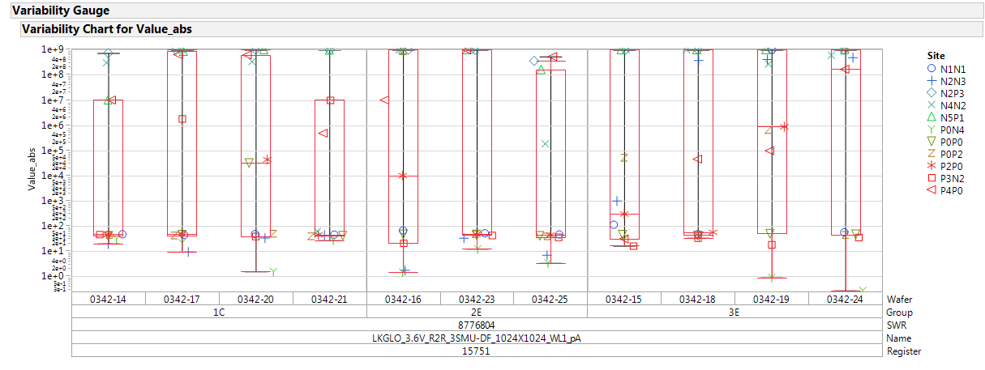
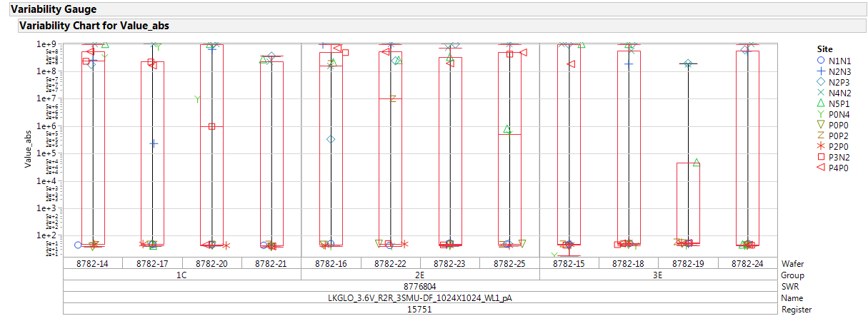
Param testing: R2R
0180342.003
R2R leakage is quite bad on all lot
0178782.013
R2R leakage is quite bad on all lot

Slide 5
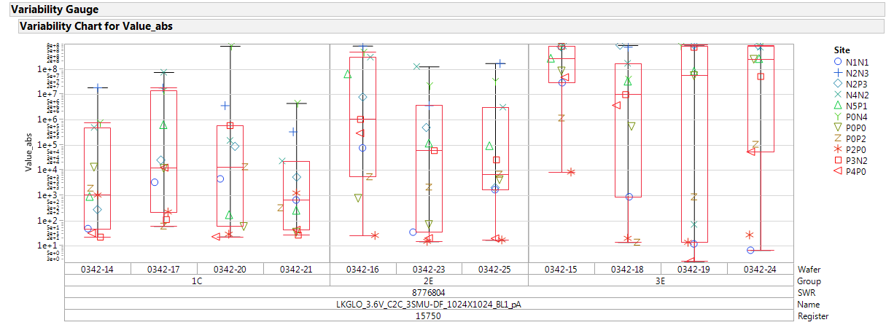
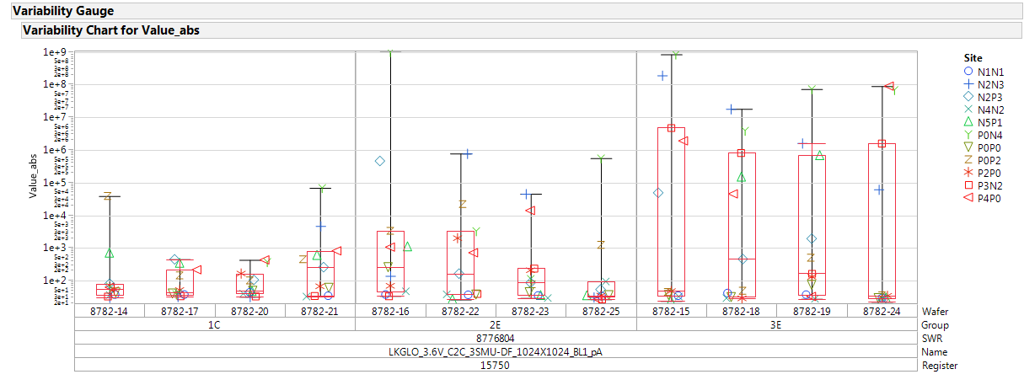
Param testing: C2C
0180342.003
C2C leakage is quite bad on all lot
C2C worsening for no-WSiN trial
0178782.013
C2C leakage is quite good on all lot
C2C worsening for no-WSiN trial

Slide 6
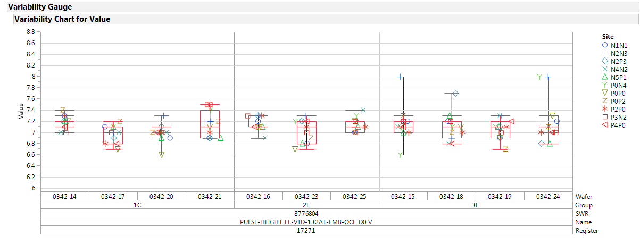
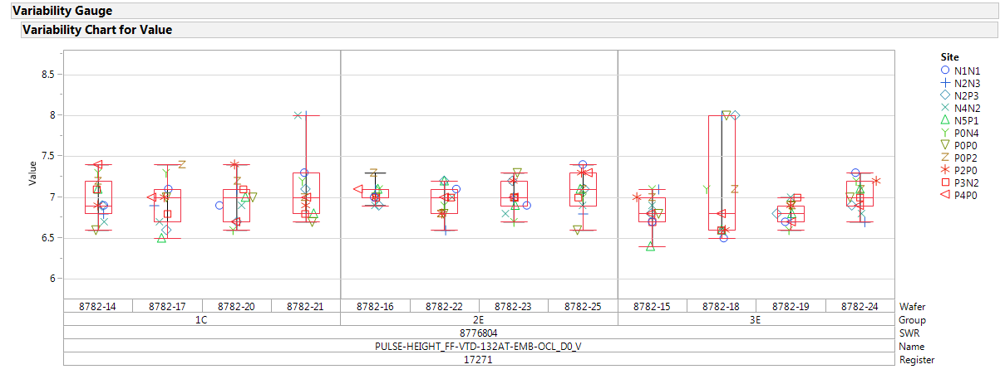
FF detection
0180342.003
0178782.013
FF are good
No toggle

Slide 7
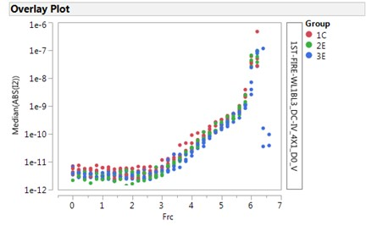
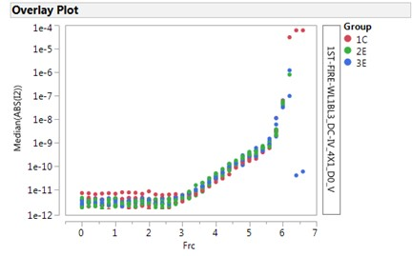
OCL I-V curves
0180342.003
0178782.013
OCL I-V are good
No toggle

Slide 8
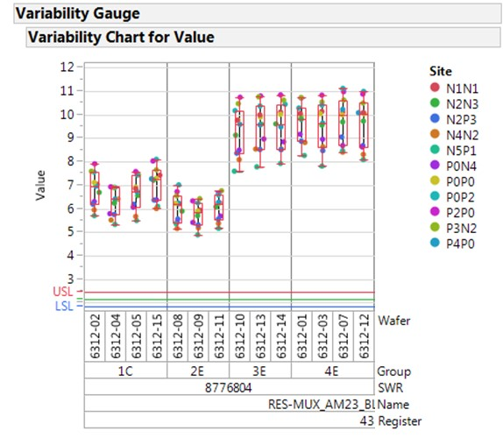
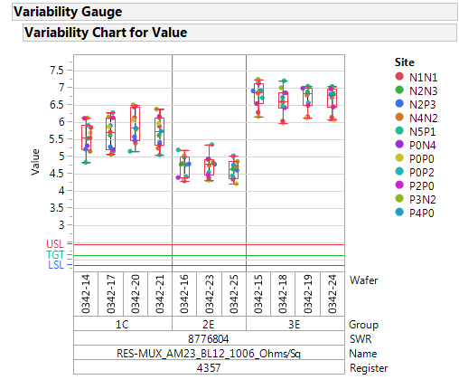
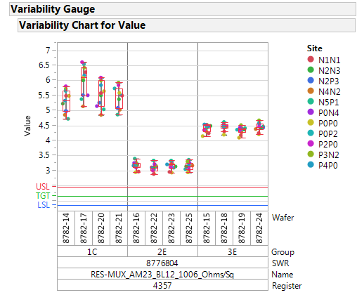
BL resistance
0176312.003
First no WSiN lot
0180342.003
0178782.013
WSiN elimination increases the BL resistance of about 40%
BL W thickness increasing from 45nm to 55nm reduces the BL resistance of 70% → is there any EOL thickness variation?

Slide 9
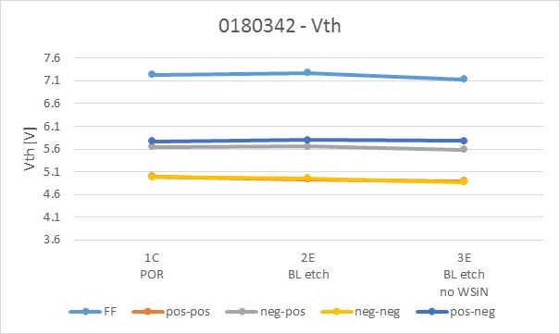
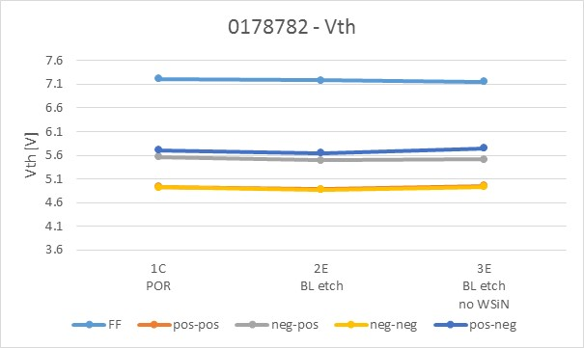
2xCMOS data: Median Vth
No significant modulation in FF and Vth

Slide 10
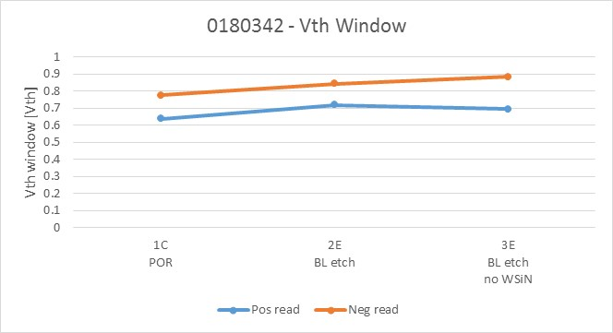
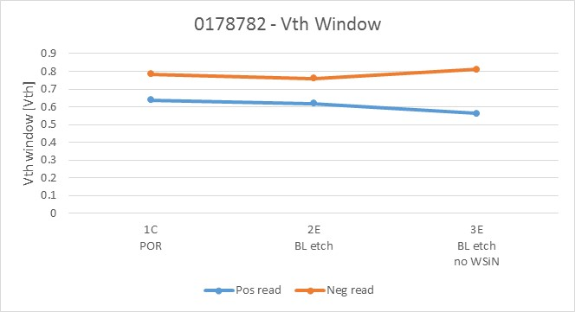
2xCMOS data: Vth window
No significant modulation Vth window from group 1C to 2E
Slight increasing of the positive and negative reading Vth window for no-WSiN group

Slide 11
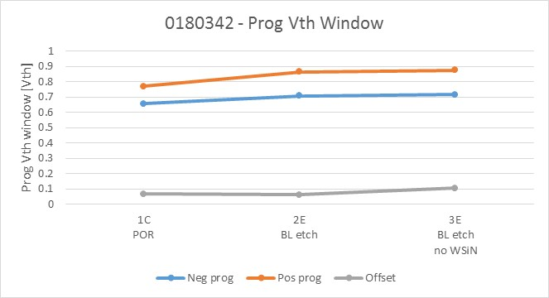
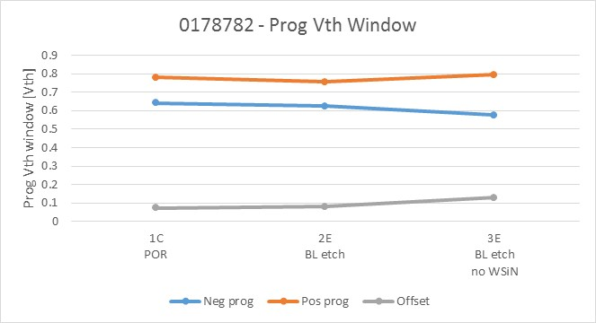
2xCMOS data: programming Vth window
Offset increasing for group 3E, consistent with the higher asymmetry

