Slide 1
SR71B – WSiN elimination
Lot 0180342.003
Lot 0178782.013

Slide 2
Split tables
0180342.003 → some misprocess @BL etch, data to be taken with caution
Trial | Cell stack | BL etch | WSiN @ BL | Wf
1C | 22nn ver12+2% In + T&B AlOx | POR | Yes | 14,17,20,21
2E | 22nn ver12+2% In + T&B AlOx | As 55nm | Yes | 16,22,23,25
3E | 22nn ver12+2% In + T&B AlOx | As 55nm | No | 15,18,19,24
0178782.013 → main focus for analysis
Trial | Cell stack | BL W thickness | WSiN @ BL | Wf
1C | 22nn ver12+2% In + T&B AlOx | 45nm | Yes | 14,17,20,21
2E | 22nn ver12+2% In + T&B AlOx | 55nm | Yes | 16,22,23,25
3E | 22nn ver12+2% In + T&B AlOx | 55nm | No | 15,18,19,24

Slide 3
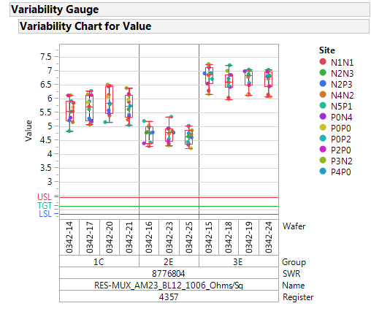
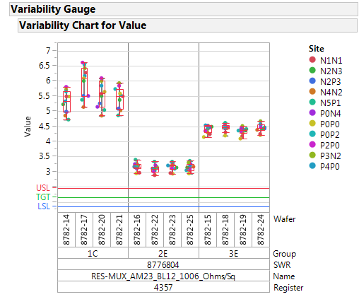
BL resistance from param
0180342.003
0178782.013

Slide 4
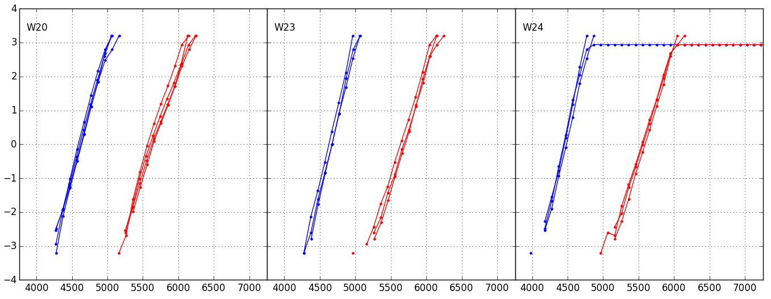
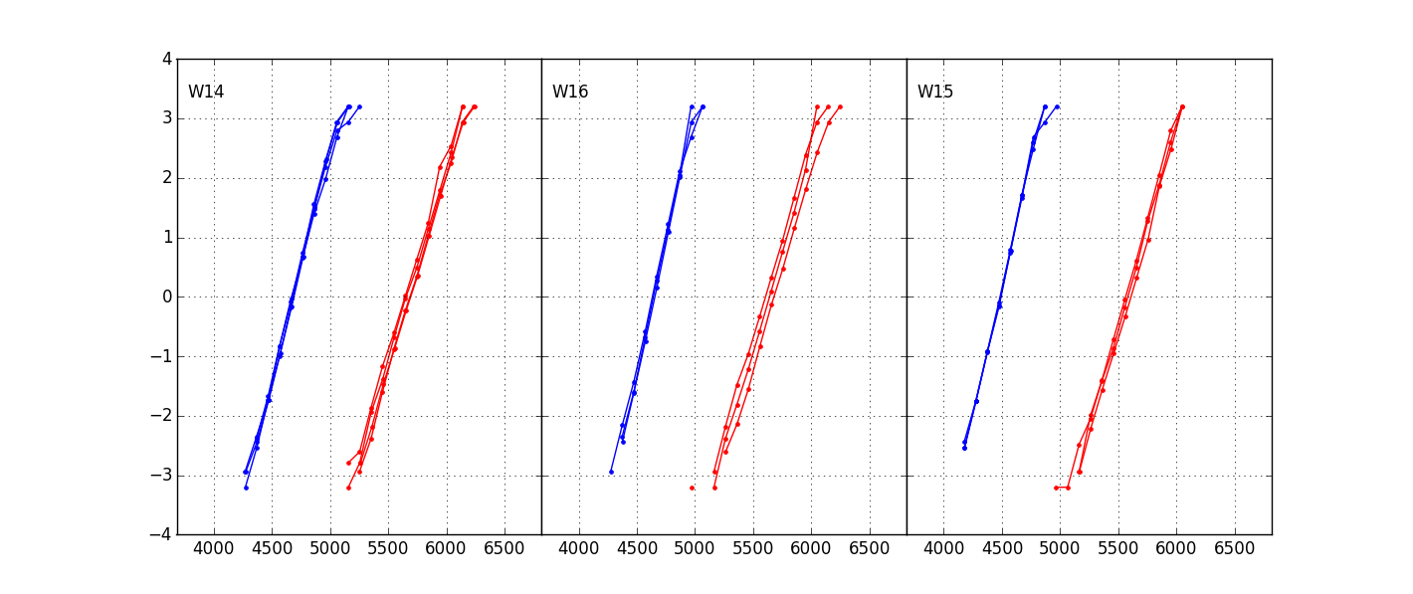
Distributions @1k cycles
1us
0180342.003
POR
BL 45nm
WSiN: Yes
BL 45nm
Wrong BL etch
WSiN: Yes
BL 45nm
Wrong BL etch
WSiN: No
0178782.013
POR
BL 45nm
WSiN: Yes
BL 55nm
WSiN: Yes
BL 55nm
WSiN: Yes
BL 55nm
WSiN: No

Slide 5
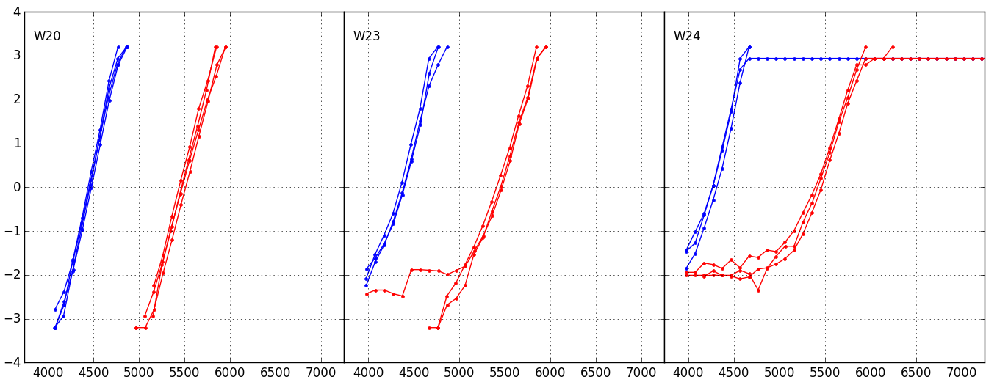
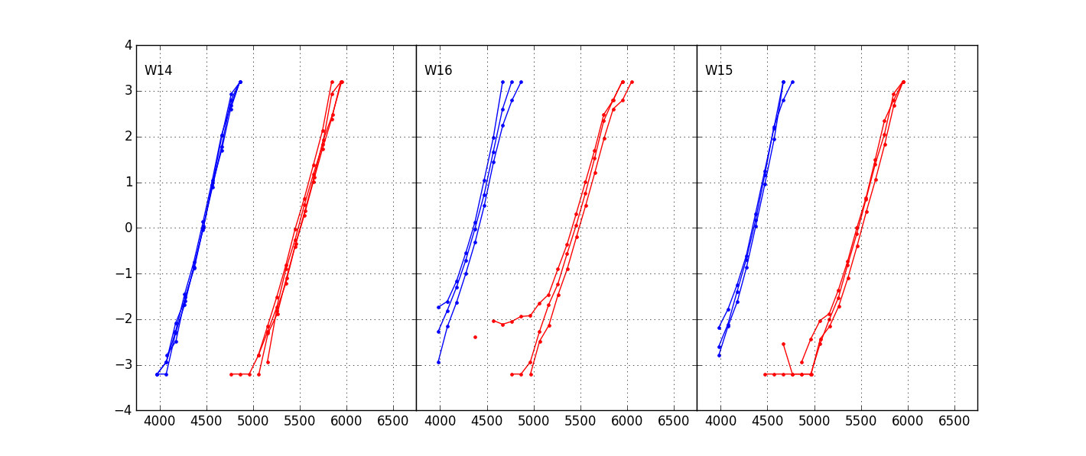
Distributions @128k cycles
1us
0180342.003
POR
BL 45nm
WSiN: Yes
BL 45nm
Wrong BL etch
WSiN: Yes
BL 45nm
Wrong BL etch
WSiN: No
0178782.013
Excluding groups that were processed with wrong BL etch, there is however some marginality after cycling with thicker BL, inducing low Vt tails.
Probably process related, maybe not complete SD etch @BL?
POR
BL 45nm
WSiN: Yes
BL 55nm
WSiN: Yes
BL 55nm
WSiN: No

Slide 6
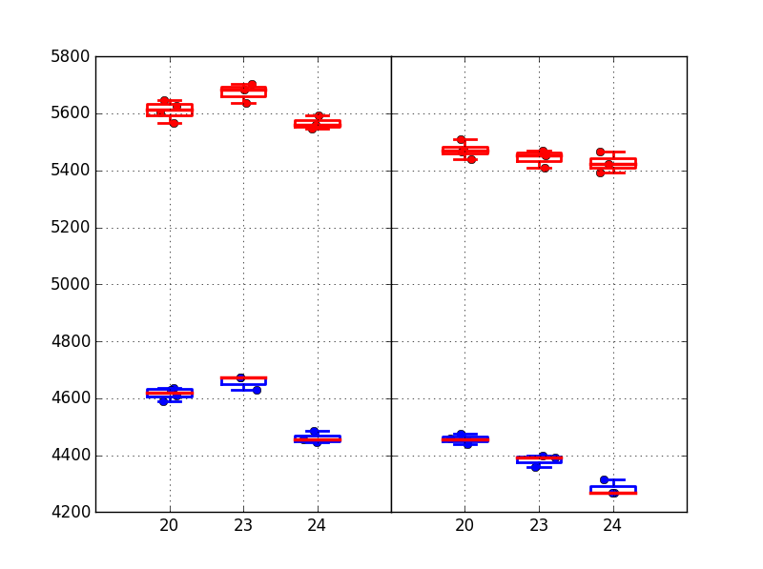
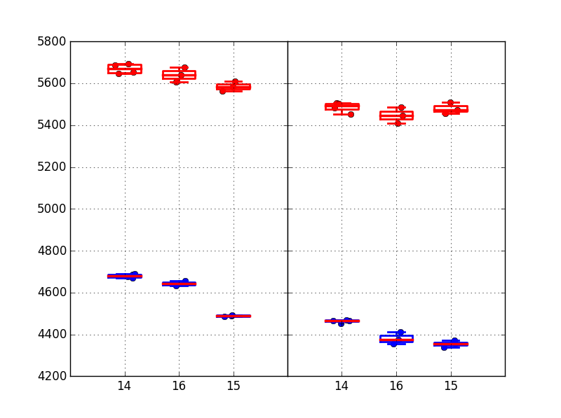
Median Vt 1us
No WSiN trials show lower Vt, especially at early cycling, in line with a more effective seasoning.
Toggle is more evident for Set
1kcyc
0180342.003
128kcyc
1kcyc
0178782.013
128kcyc
POR
BL 45nm*
WSiN: Yes
BL 45nm*
WSiN: No
POR
BL 45nm*
WSiN: Yes
BL 45nm*
WSiN: No
POR
BL 55nm
WSiN: Yes
BL 55nm
WSiN: No
POR
BL 55nm
WSiN: Yes
BL 55nm
WSiN: No

Slide 7
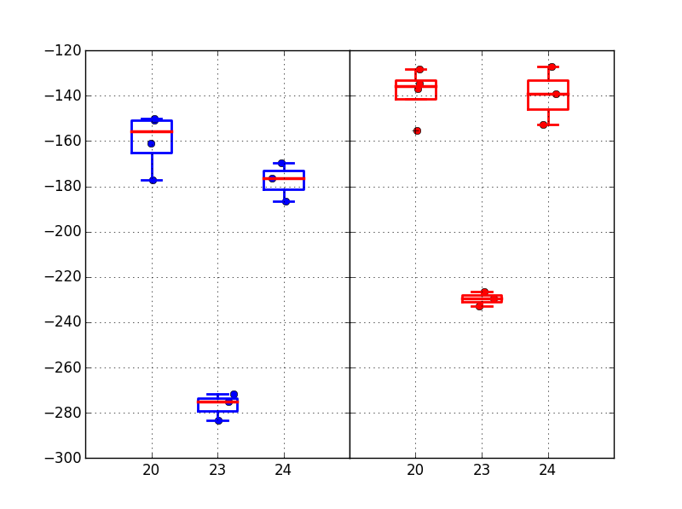
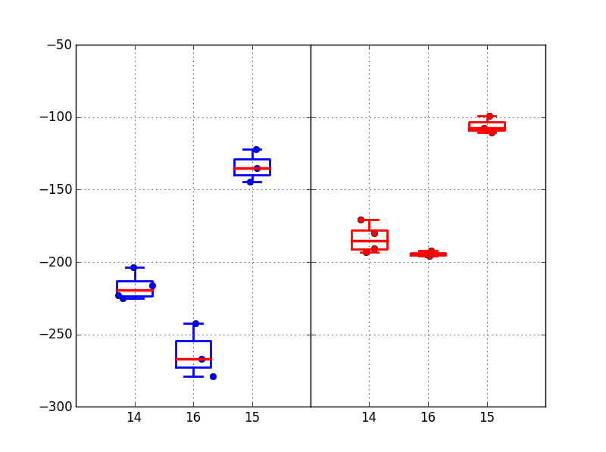
Vt shift 1k→128k cycles 1us
Vt evolution after 1k cycles slows down if WSiN is eliminated
SET
0180342.003
RESET
SET
0178782.013
RESET
POR
BL 45nm*
WSiN: Yes
BL 45nm*
WSiN: No
POR
BL 45nm*
WSiN: Yes
BL 45nm*
WSiN: No
POR
BL 55nm
WSiN: Yes
BL 55nm
WSiN: No
POR
BL 55nm
WSiN: Yes
BL 55nm
WSiN: No

Slide 8
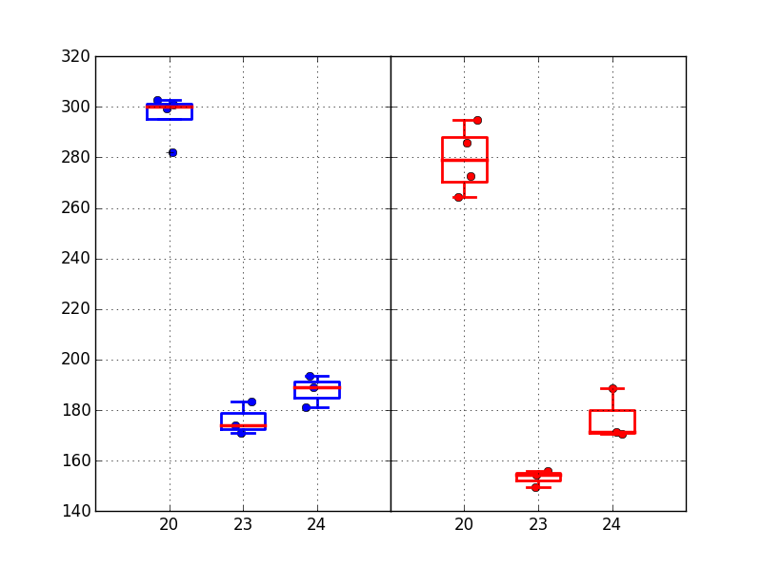
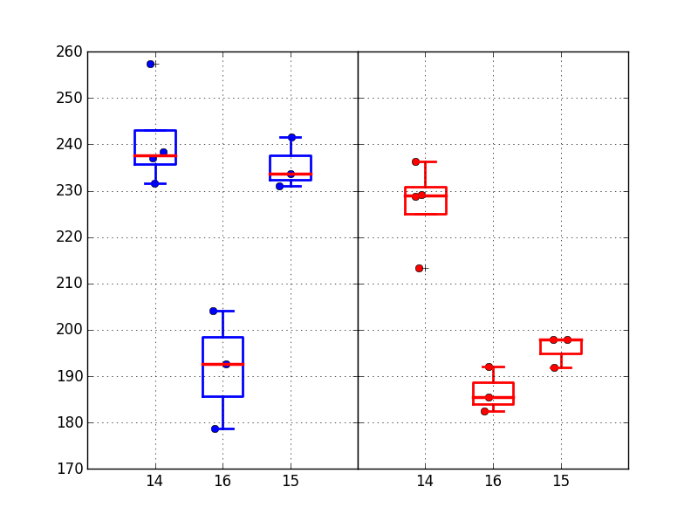
Drift 128k 1us→10s
Drift signal points to a larger (set) drift when eliminating WSiN
SET
0180342.003
RESET
SET
0178782.013
RESET
POR
BL 45nm*
WSiN: Yes
BL 45nm*
WSiN: No
POR
BL 45nm*
WSiN: Yes
BL 45nm*
WSiN: No
POR
BL 55nm
WSiN: Yes
BL 55nm
WSiN: No
POR
BL 55nm
WSiN: Yes
BL 55nm
WSiN: No

Slide 9
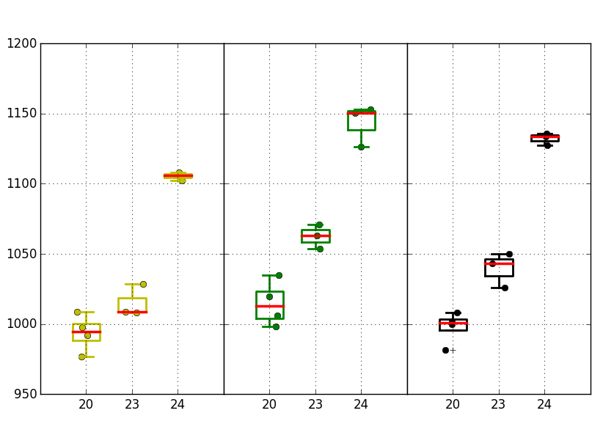
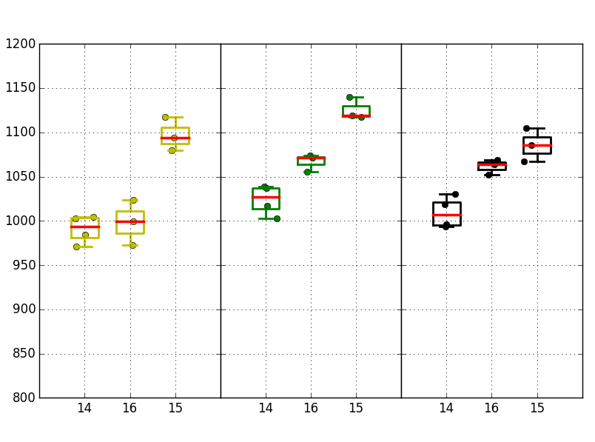
Median window
No WSiN @BL is beneficial for median window. A more moderate improvement is given by the thicker BL
0180342.003
0178782.013
1k 1us
128k 1us
128k 10s
1k 1us
128k 1us
128k 10s
POR
BL 45nm*
WSiN: Yes
BL 45nm*
WSiN: No
POR
BL 45nm*
WSiN: Yes
BL 45nm*
WSiN: No
POR
BL 45nm*
WSiN: Yes
BL 45nm*
WSiN: No
POR
BL 55nm
WSiN: Yes
BL 55nm
WSiN: No
POR
BL 55nm
WSiN: Yes
BL 55nm
WSiN: No
POR
BL 55nm
WSiN: Yes
BL 55nm
WSiN: No

Slide 10
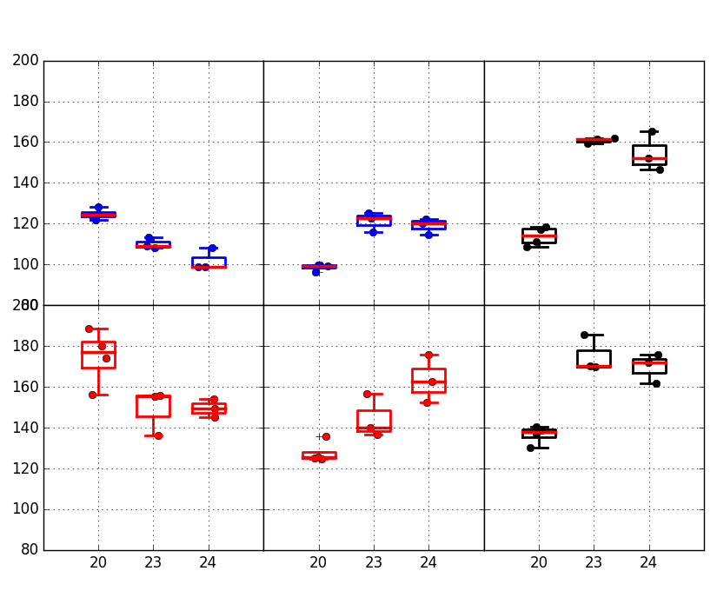
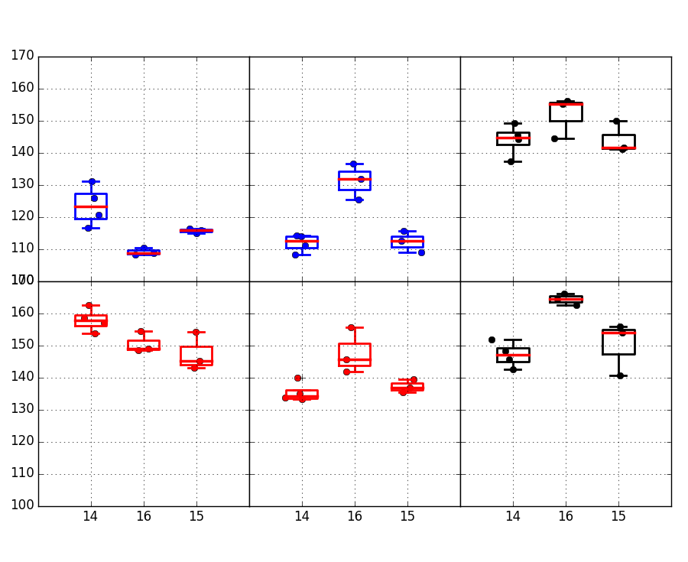
Robust sigma
Sigma for no WSiN trials is in line or better than POR, even if BL thickening is worsening the sigma after cycling (same process marginality of low Vt tails?)
0180342.003
0178782.013
1k 1us
128k 1us
128k 10s
1k 1us
128k 1us
128k 10s
SET
SET
RESET
RESET
POR
BL 45nm*
WSiN: Yes
BL 45nm*
WSiN: No
POR
BL 45nm*
WSiN: Yes
BL 45nm*
WSiN: No
POR
BL 45nm*
WSiN: Yes
BL 45nm*
WSiN: No
POR
BL 55nm
WSiN: Yes
BL 55nm
WSiN: No
POR
BL 55nm
WSiN: Yes
BL 55nm
WSiN: No
POR
BL 55nm
WSiN: Yes
BL 55nm
WSiN: No

Slide 11
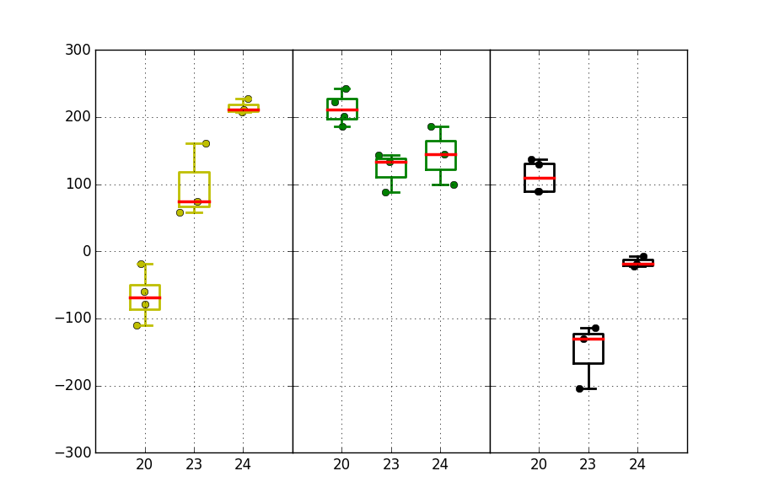
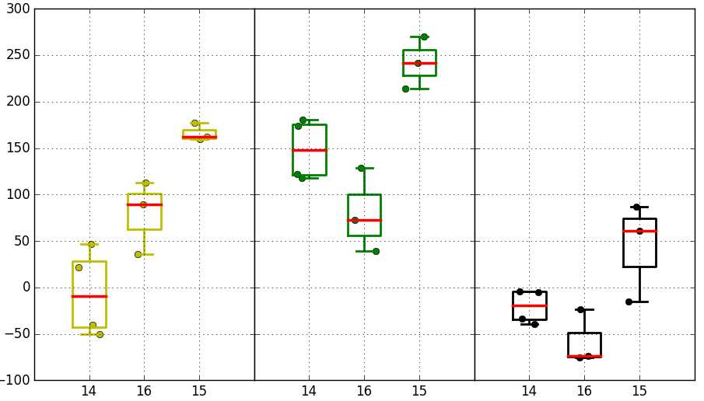
Projected window @3.54 sigma
No WSiN is best group for projected window
0180342.003
0178782.013
1k 1us
128k 1us
128k 10s
1k 1us
128k 1us
128k 10s
POR
BL 45nm*
WSiN: Yes
BL 45nm*
WSiN: No
POR
BL 45nm*
WSiN: Yes
BL 45nm*
WSiN: No
POR
BL 45nm*
WSiN: Yes
BL 45nm*
WSiN: No
POR
BL 55nm
WSiN: Yes
BL 55nm
WSiN: No
POR
BL 55nm
WSiN: Yes
BL 55nm
WSiN: No
POR
BL 55nm
WSiN: Yes
BL 55nm
WSiN: No

Slide 12
Conclusions
WSiN elimination shows (group 3E vs 2E):
  Lower Vt, especially in first range of cycling
  Smaller Vt evolution 1k→128k cycles
  Larger drift, especially for set
  Improvement in median window
  Above signals are in line with an increased selection spike, and with a spike-driven Vt evolution
Vt evolution and drift toggles of BL thickening (group 2E vs 1C) are not clear, and in general not consistent with a spike model (higher C and lower R)

