Slide 1
SSM process development update
ww1810

Slide 2
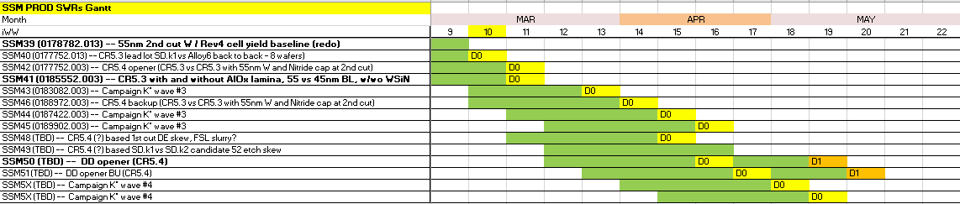
WIP status update
5 PROD SWRs are currently active in Fab4 line
Fab2 starts moved to 50wf/week as of ww08; Fab2 RPB inventory is 9 lots with another 5 in Fab4 buffer
DD startup is delayed 2 weeks due to late 64L mask arrival (now 3/12); D1 probe is pushed to mid-May

Slide 3
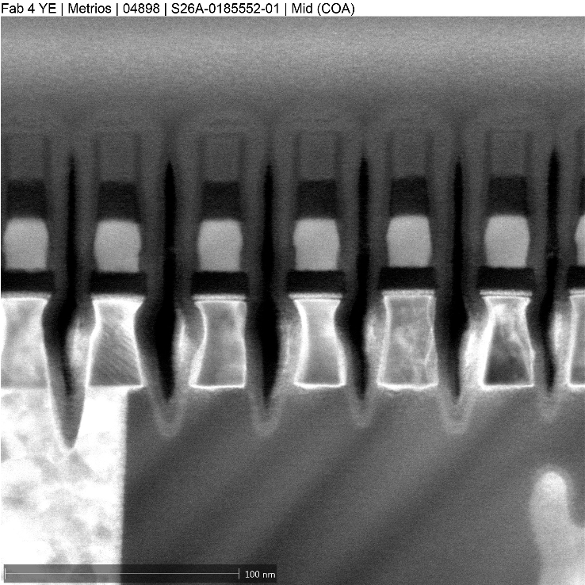
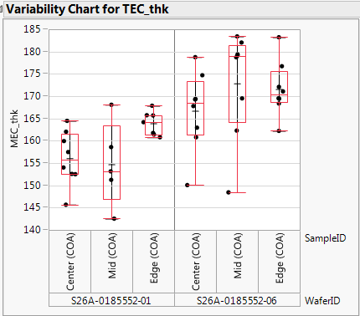
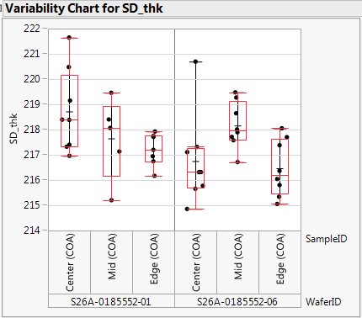
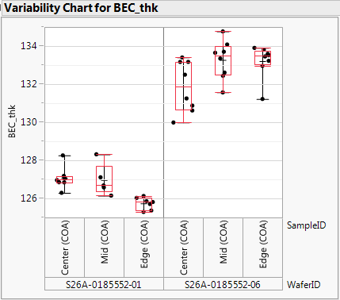
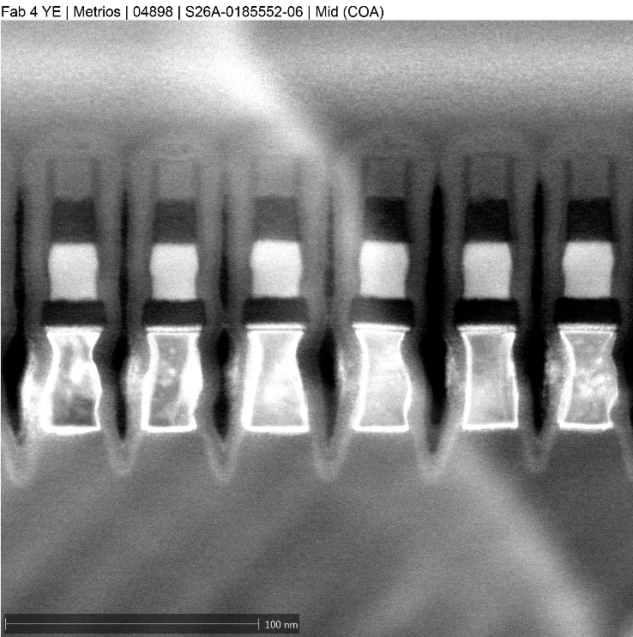
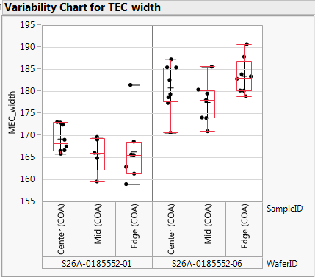
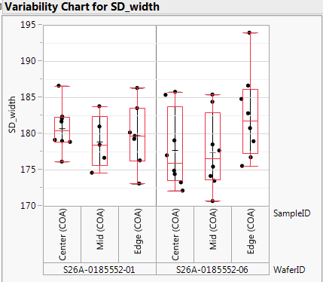
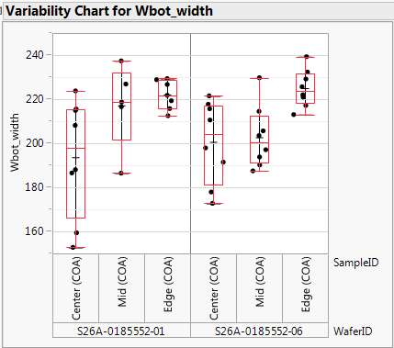
CR5.3 with and without AlOx lamina (1st cut)
Wf#1 SSM41 1E (CR5.3 POR)
Wf#6 SSM41 2E (CR5.3 + AlOx)
TEC and BEC thickness measurement absorbs AlOx lamina
Wider Top SD and TEC CDs with lamina, W CDs look comparable

Slide 4
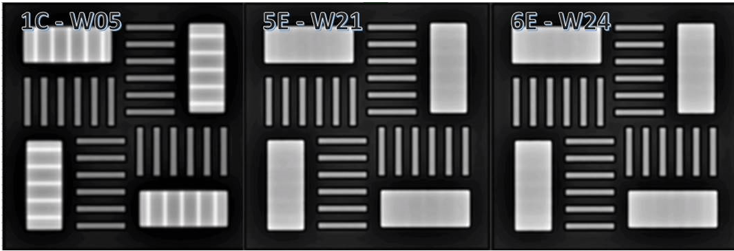
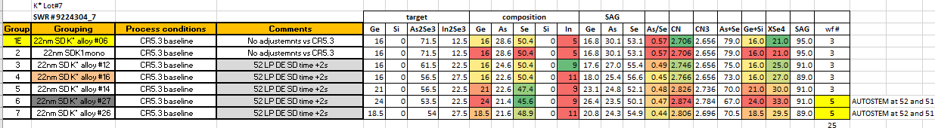
K* high In content – E1 under-etch
DEV work in progress to intercept following K* lots with fix at E1 etch;
Post WL etch AUTOSTEMs also dropped from K* lot#7 groups 6 and 7E

Slide 5
WW1810 – PI alignment on PROD experiments
Lots out:
SSM40 (SD.k1 vs Alloy6) – end of ww10
SSM42 (CR5.3 vs CR5.4) – end of ww11; Backup lot released ww10
SSM41 (CR5.3 w/wo AlOx, 45/55nm W at 52, w/wo WSiN at 52) – end of ww11
Analysis by ww13 gates conversion to CR5.4 and directions for AlOx and WSiN
K* (SSM43-45)
Lot7 (first lot of wave3) – 3-4 weeks to probe
Lot8, Lot9 – release ww11,12;
Intercept Lot8,9 with E1 targeting and maybe 52 targeting on DEV (3667463.013)
Structural PROD plan (3 lots)
1st cut and 2nd cut DE skews (~ww12 release)
SD thickness segmentation skew
Structural setup post R5.4 (65 CMP FSL slurry, BSOD?, CSOD+cure? 52 CDU)
DD
Lead – plan to start at Fab4 ww12 (2 weeks delay from original plan due to 64L)
BU Si SWR plan (at least partially share with Structural PROD plan)

Slide 6
WW1810 – PI alignment on DEV work
ww10-12 focus:
Shift from Nitride Cap to FSL slurry and BSOD/CSOD+cure evaluation to match SXP
Fix E1 etch issue on K* In-rich alloys prior to K* wave3 continuation
51, 52 etch structural pre-work
segment high pressure SD etch that lead to Vt window collapse
Separate SD etch alternatives from W etch alternatives at 51 WL etch
Understand partial liner run out evolution and ways to prevent runout
52 etch on In-rich alloys and CDU (edge of the wafer CDs)
ww12-14 DEV directions
DD setup (targeting);
Structural finger-print. TEM, XRF movie, MTS validation (on CR5.4?);
SD thickness skew (+/-3nm; -10nm?); CD (-1/-2/-4nm?) skew for scaling proxy.

Slide 7
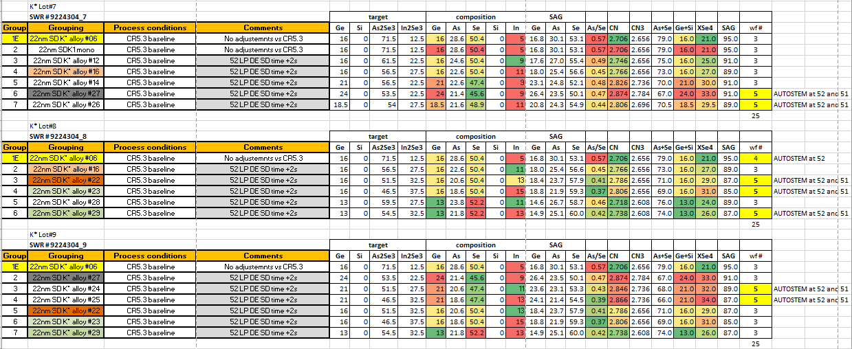
K* wave3

Slide 8
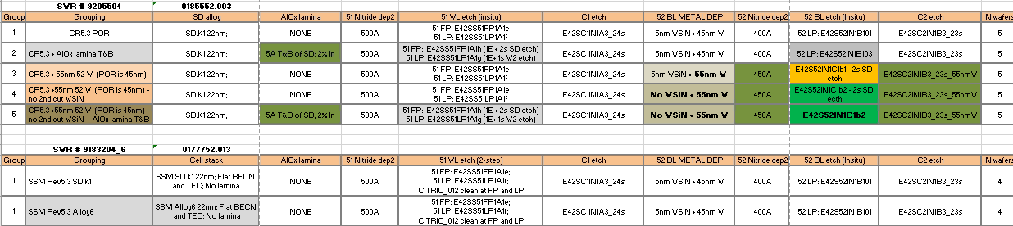
SWRs in line

