Slide 1
Vth evolution by ED
A1 reliability data
Enzo

Slide 2
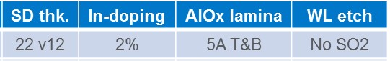
Summary
A1 lot 0173982
CD-- straight profile @WL
Reliability done on neg reading polarity
Trial | SD thk. | Ge% | As% | Se% | In% | Si% | 51 WL etch | Wf
1C | 22 ver12 | 13 | 30.4 | 48.6 | 2 | 6 | CD - - | 13,17,24
2E | 22 | 16 | 28.6 | 50.4 | 5 | 0 | CD - - | 18,20,23
3E | 22 | 16 | 26.6 | 50.4 | 7 | 0 | CD - - | 14,19,22
4E | 22 | 18.5 | 25.6 | 48.9 | 7 | 0 | CD - - | 15,16,21,25
Best
window
Old POR

Slide 3
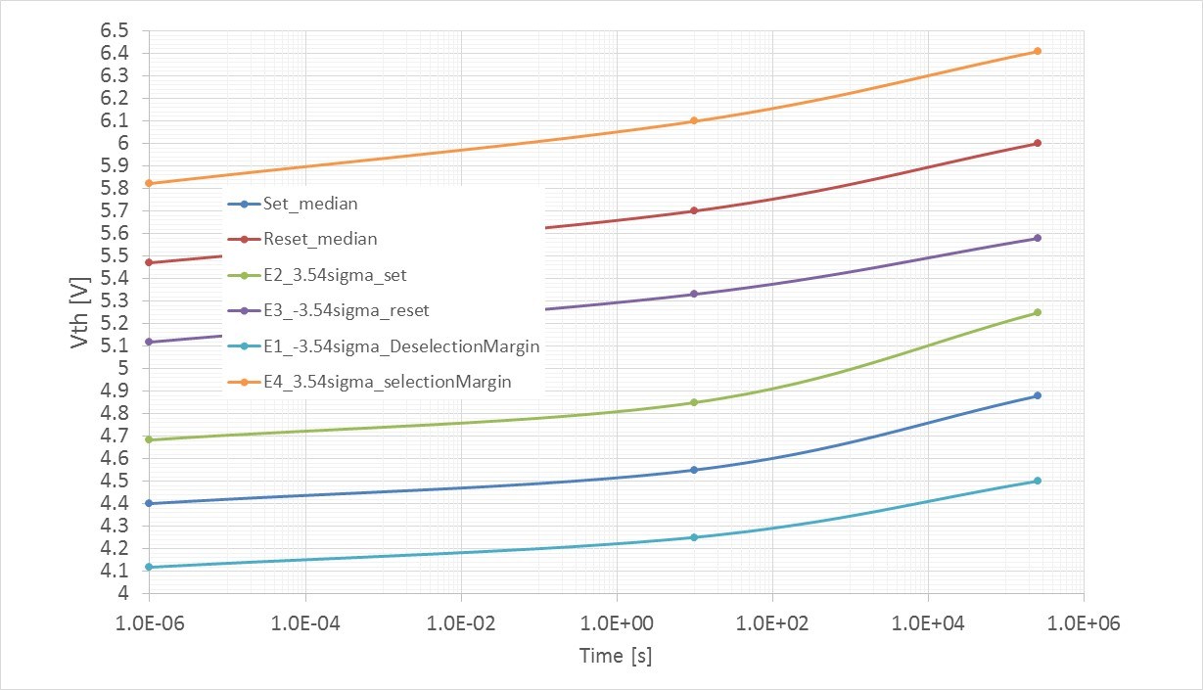
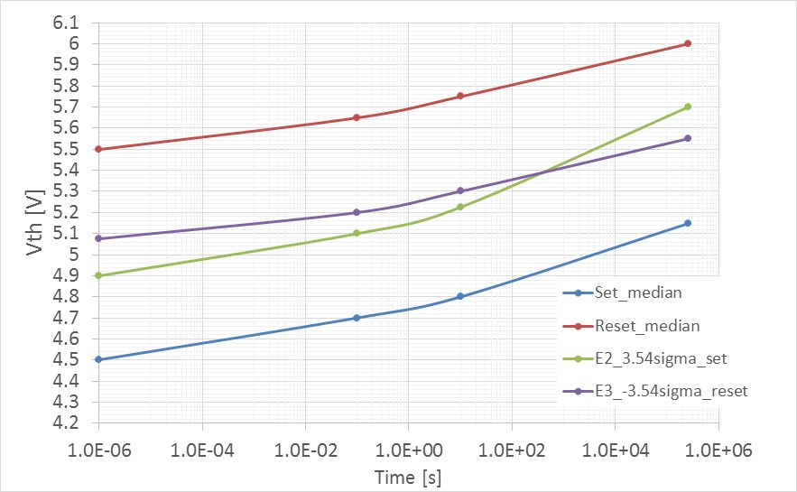
Best Window budget, ED4 only, 16k cycles: split 4E (85C time evolution)
150mV only gap to cover 1us→ 3days @85C with single Vdm with 3.54 sigma defectivity
No issue on E1/E4 but need to extend visibility up to 4 sigma
No reset read disturb budget in this calculation but single VDM will improve also reset read disturb
Split 4E, k*alloy
E4
E3
Vdm2
Vdm1
E2
Old POR with lamina
Window closure @ 100s
E1

Slide 4
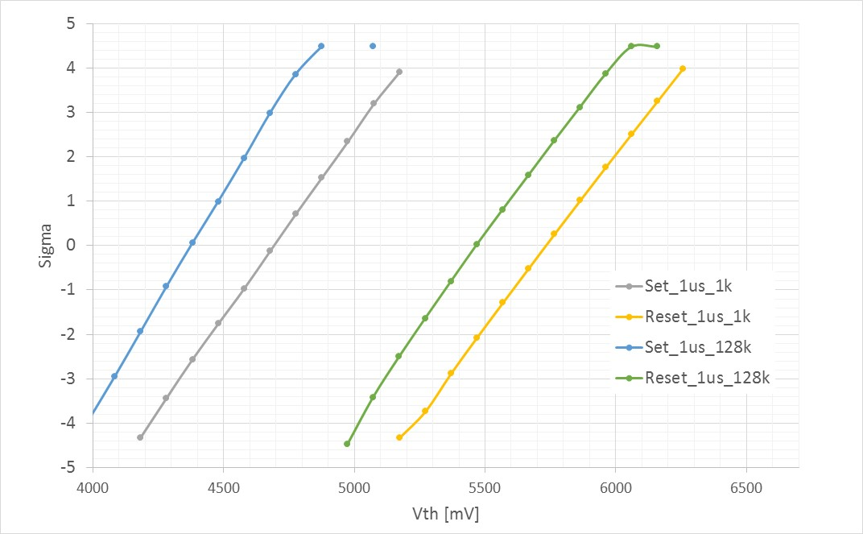
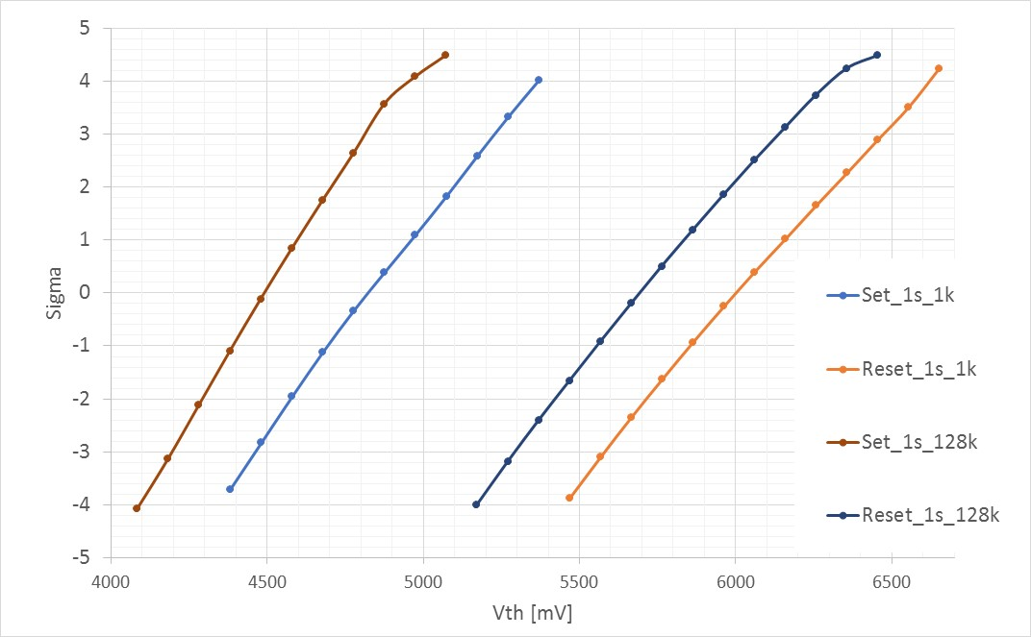
Full tile endurance (1k vs 128k, 135us IPD) : split 4E (260kb)
Pre drift distribution (1us delay)
Post drift distribution (1s delay)
400mV
Some high Vth tail appears (both E2 and E4) after 4 sigma statistic (one bit)
Huge Vth shift on upper part of set distribution non impacting RWB

Slide 5
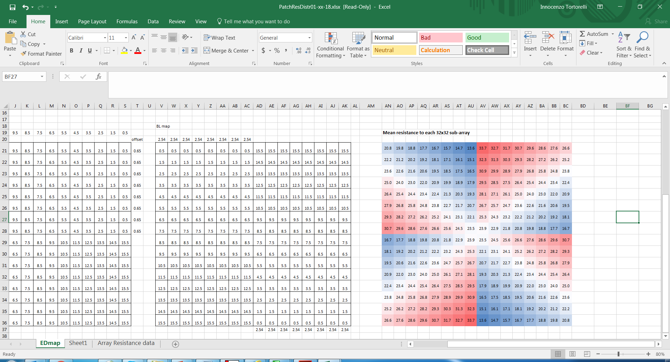
Tile map schematic, mean access resistance for each block [kOhm]
BL number
BL driver
Block 0-0 is the reference for probe
WL number
WL driver
WL driver
Block 15 – 11 show E2 / E4 tails related to 1 bit
(Low ED but not minimum)
BL driver

Slide 7
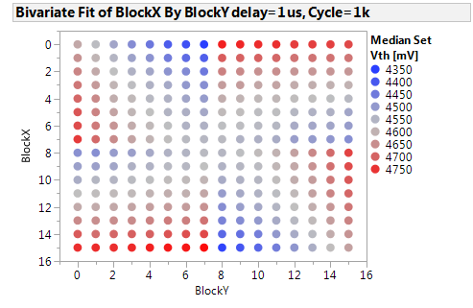
Full map @ 1kCycles (median set Vth by block, 1us delay)
Good match with access resistance map
BL number
BL driver
WL number
WL driver
WL driver
WL driver
BL driver
BL driver

Slide 8
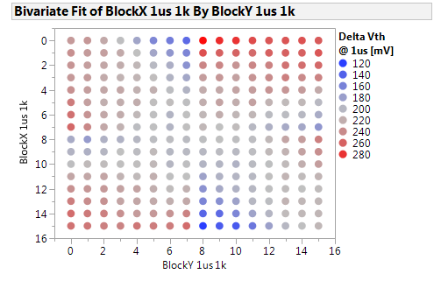
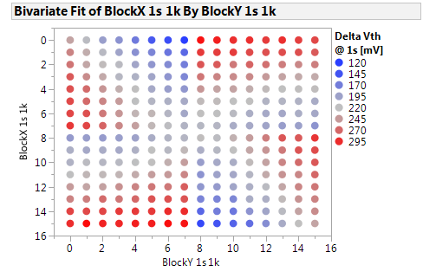
Median Set delta Vth evolution map (1k→128k Vth delta)
Some seasoning asymmetry visible at 1us, fully symmetrical at 1s delay following access resistance

Slide 9
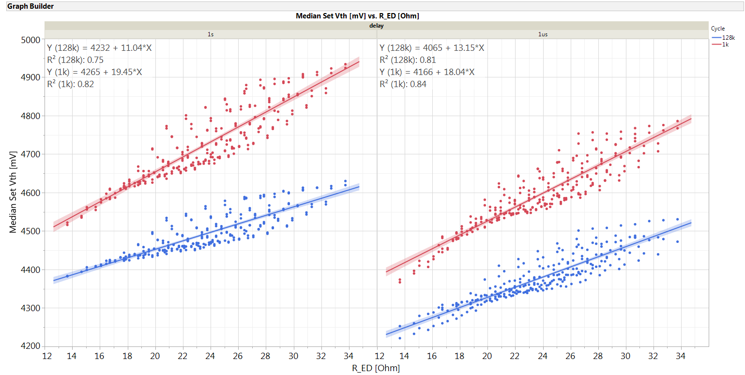
Median Set Vth by access resistance
Vth shift after cycling increase with ED

Slide 10
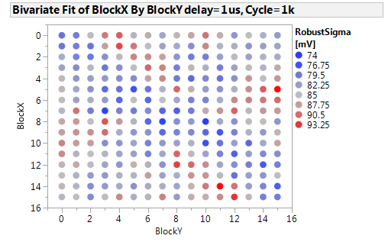
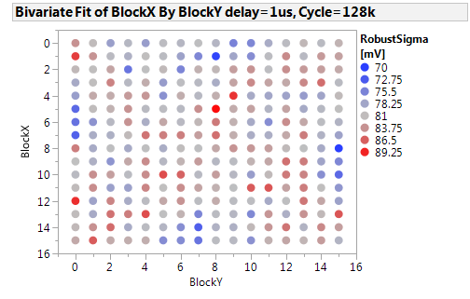
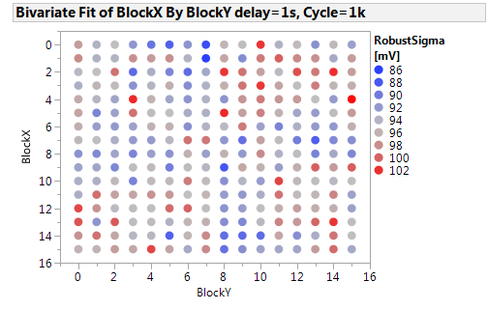
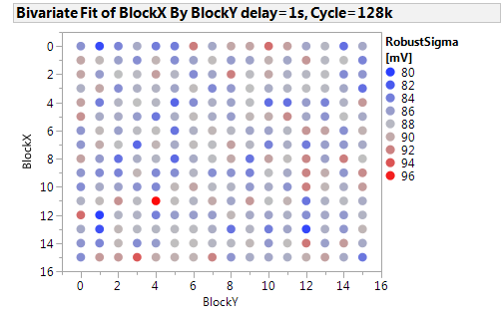
Set Robust sigma maps

Slide 11
Set Robust Sigma by access resistance [kOhm]
No big trend of robust sigma vs ED pre drift
[kOhm]

Slide 12
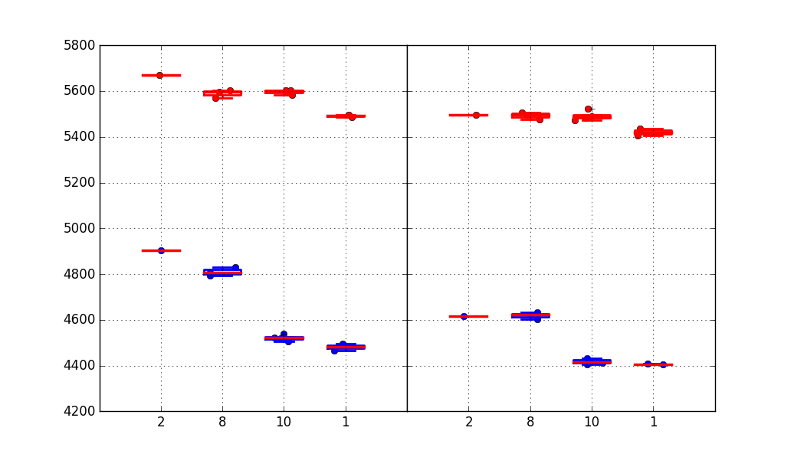
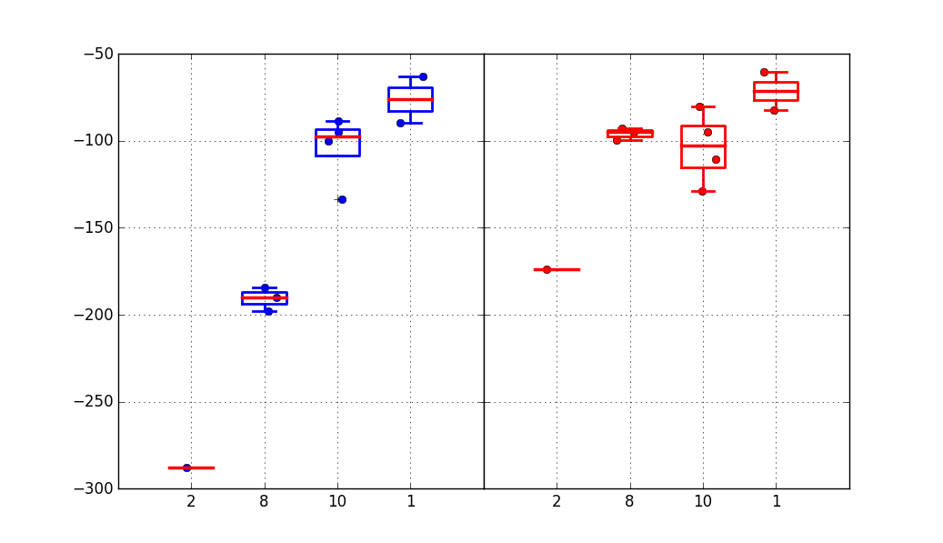
Accelerated seasoning trial: WSiN removal (0176312)
Mattia R. data
1k cycles
128k cycles
Median Vt
Without WSiN we get lower Vts (faster seasoning). Major toggle is with WSiN @BL
Vt shift 1k→128k cycles is much smaller for no WSiN @BL, consistent with a more effective 1k seasoning
1C
2E
3E
4E
1C
2E
3E
4E
Vt shift 1k→128k cycles
SET
RESET
Trial | Cell stack | WSiN @ WL | WSiN @ BL
1C | 22nn ver12+2% In + T&B AlOx | Yes | Yes
2E | 22nn ver12+2% In + T&B AlOx | No | Yes
3E | 22nn ver12+2% In + T&B AlOx | Yes | No
4E | 22nn ver12+2% In + T&B AlOx | No | No
1C
2E
3E
4E
1C
2E
3E
4E

Slide 13
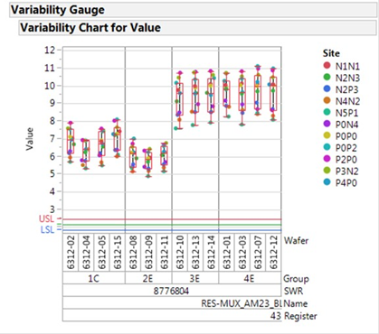
Extended endurance on selected blocks along BL direction (different EDs)
BL driver
Block 0,0
( BL near, WL far)
WL driver
Block 7,0
( BL mid, WL far)
+40% increase BL resistance
Block 8,0
( BL mid, WL near)
WL driver
Block 15,0
( BL far, WL near)
BL driver

Slide 14
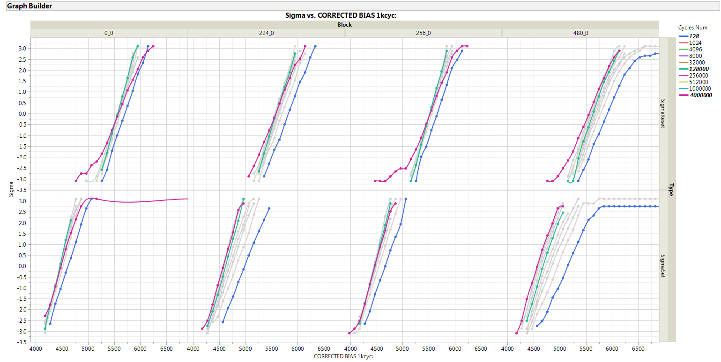
Extended endurance on split 3E (No WSiN @ BL)
Block 0,0
( BL near, WL far)
Block 7,0
( BL mid, WL far)
Block 8,0
( BL mid, WL near)
Block 15,0
( BL far, WL near)
21k R access
35k R access
21k R access
35k R access
No tails up to 4M cycles for cells not near to decoders

Slide 15
Median set and reset Vth and robust sigma evolution
Block 0,0
( BL near, WL far)
Block 7,0
( BL mid, WL far)
Block 8,0
( BL mid, WL near)
Block 15,0
( BL far, WL near)
21k R access
35k R access
21k R access
35k R access

Slide 16
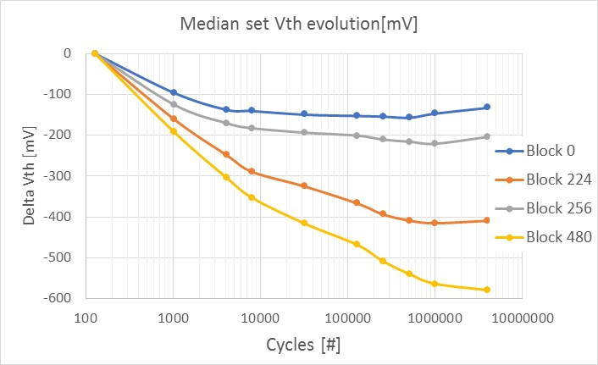
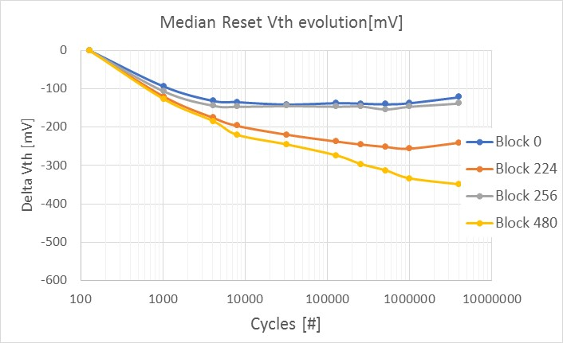
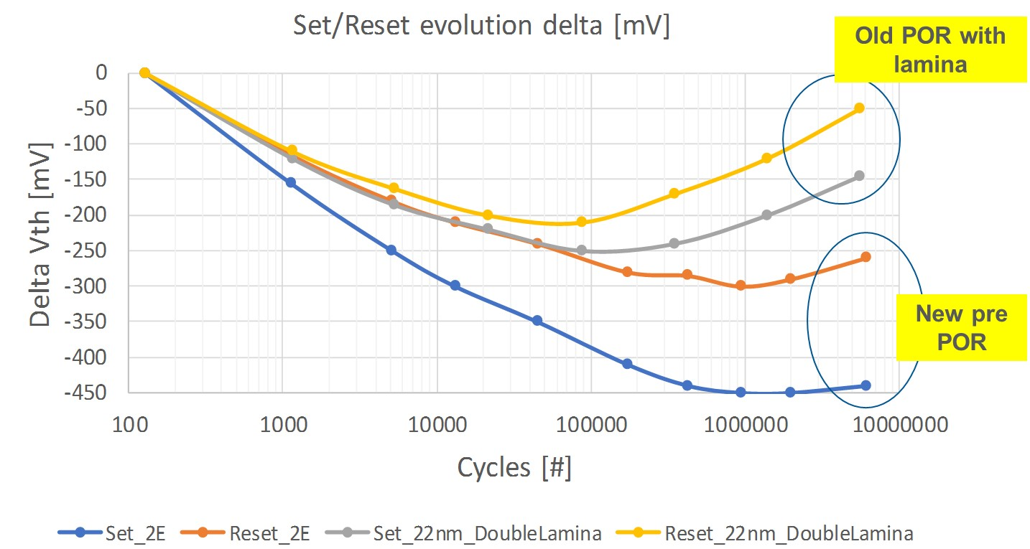
Median delta Vth shift: Reduced turnaround
21k R access
Block 0,0
( BL near, WL far)
Block 8,0
( BL mid, WL near)
Block 7,0
( BL mid, WL far)
Block 15,0
( BL far, WL near)
35k R access
Main trend with total access resistance, BL decoder distance show some asymmetry vs WL
Need to decrease line resistance
Block 0 old ref

Slide 17
Window evolution vs ED
Window evolution strongly dictated by set seasoning

Slide 18
Backup

Slide 19
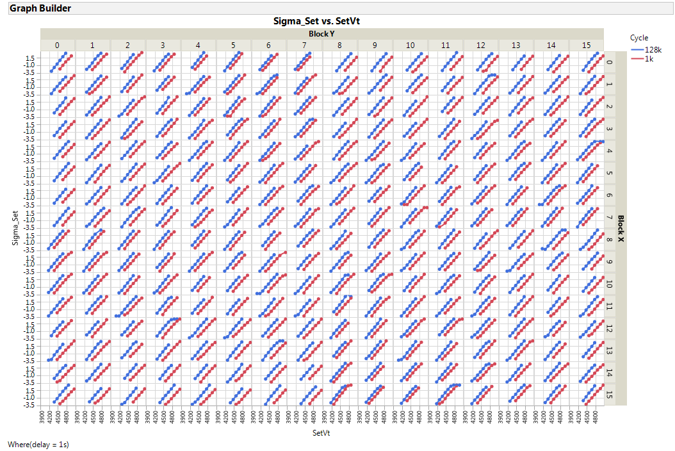

Slide 20
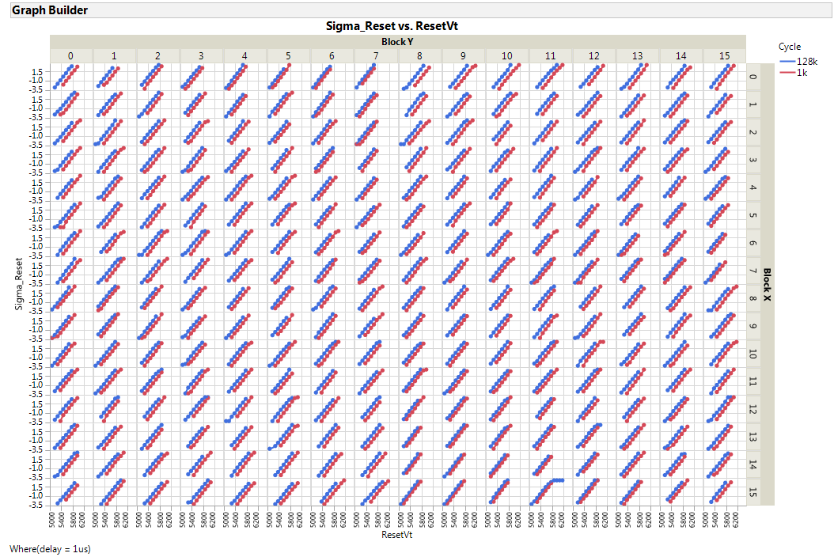

Slide 21
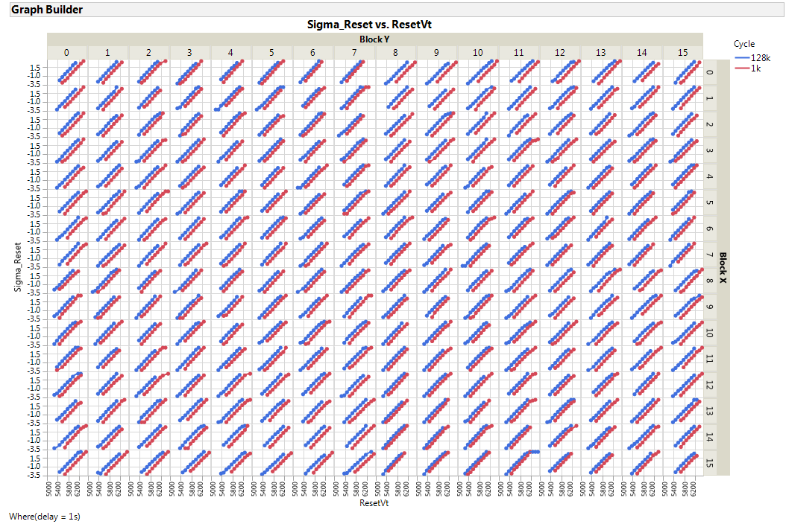

Slide 22
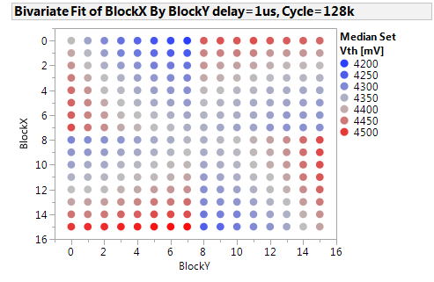
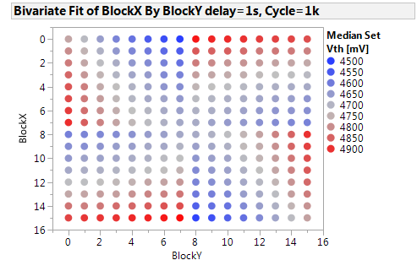
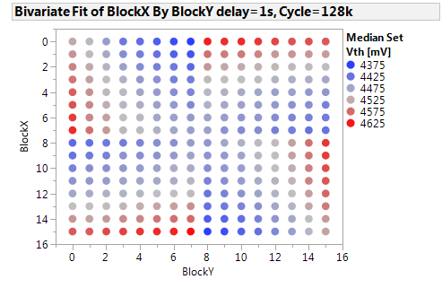
Median Vth [mV] set map

Slide 23
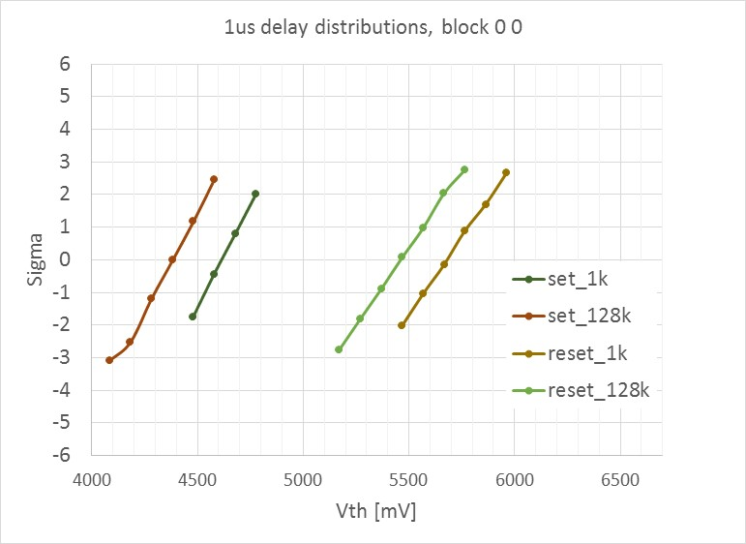
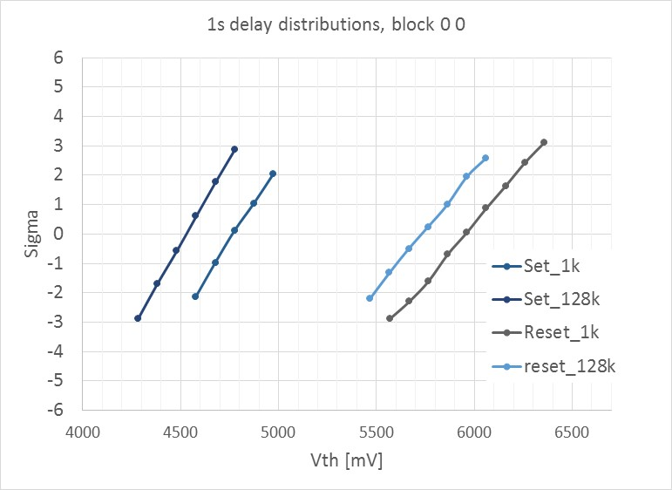
Vth shift on typical block 0,0
Typical shift of 200mV on std block used at probe (0,0)

Slide 24
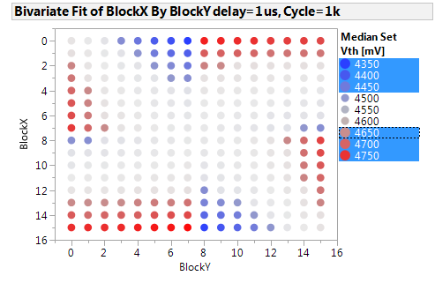
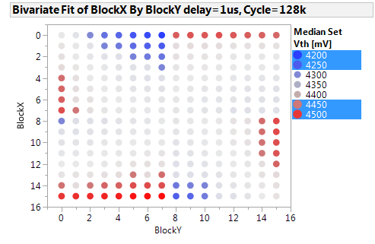
Edge block focus, 1us delay
Small and high EDs maintain +/-150mV delta with respect to median after 128k cycles

Slide 25
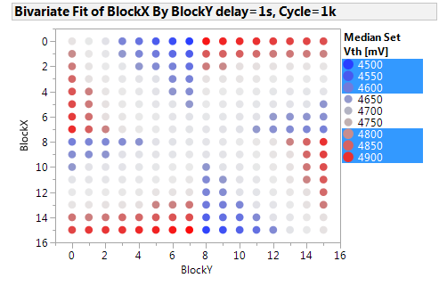
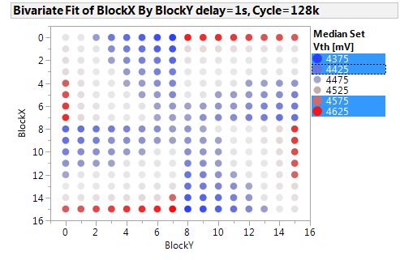
Edge block focus, 1s delay

Slide 26
Robust sigma maps

Slide 27
Set Vth vs BL and WL access resistance (high ED)
Higher sensitivity moving along BL for high total access resistance
BL number
BL driver
WL number
WL driver
WL driver
BL driver

Slide 28
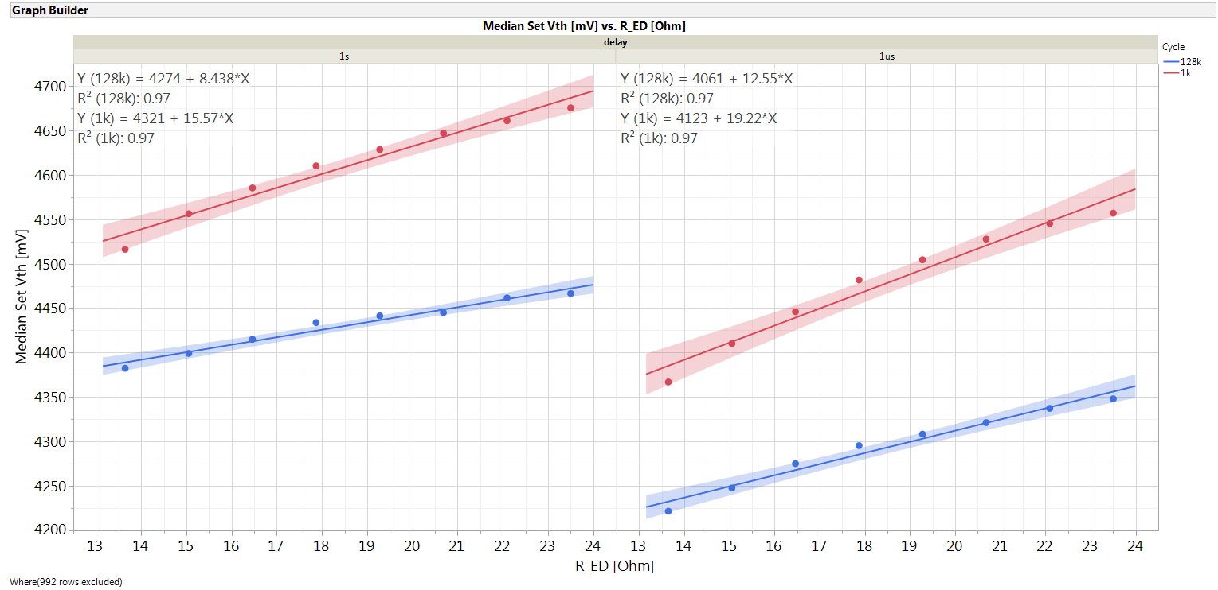
Set Vth vs BL and WL access resistance (low ED)
Higher sensitivity moving along WL for low total access resistance
BL number
BL driver
WL number
WL driver
WL driver
BL driver

Slide 29
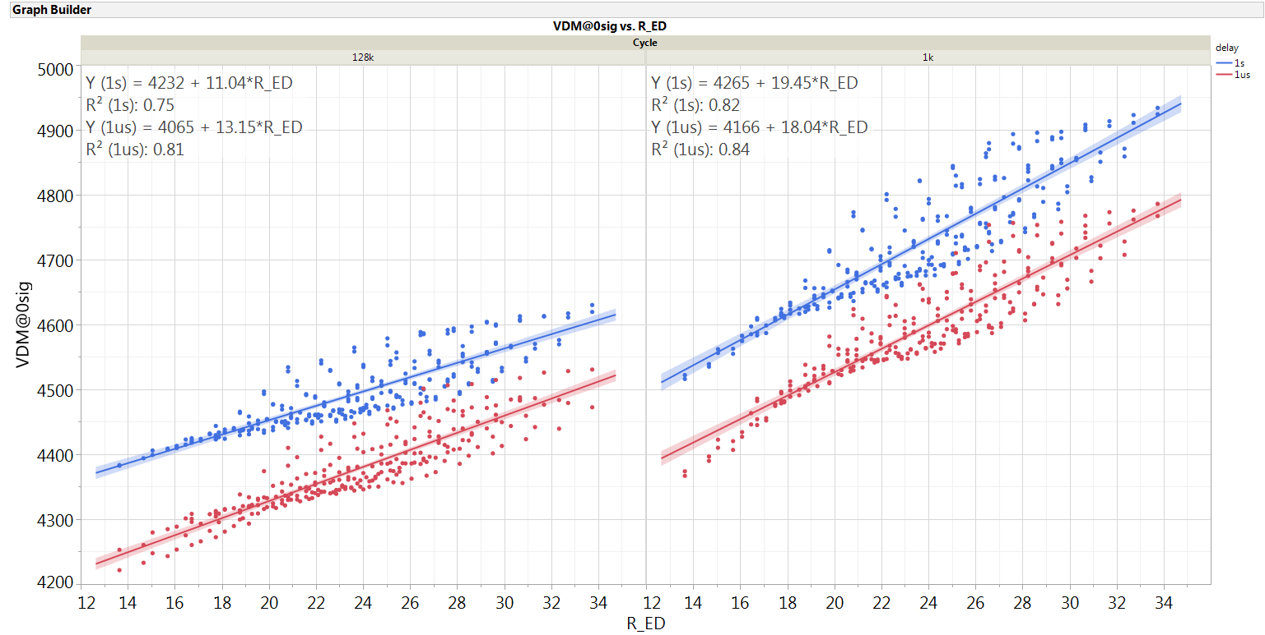
Median set Vth by ED: drift focus

Slide 30
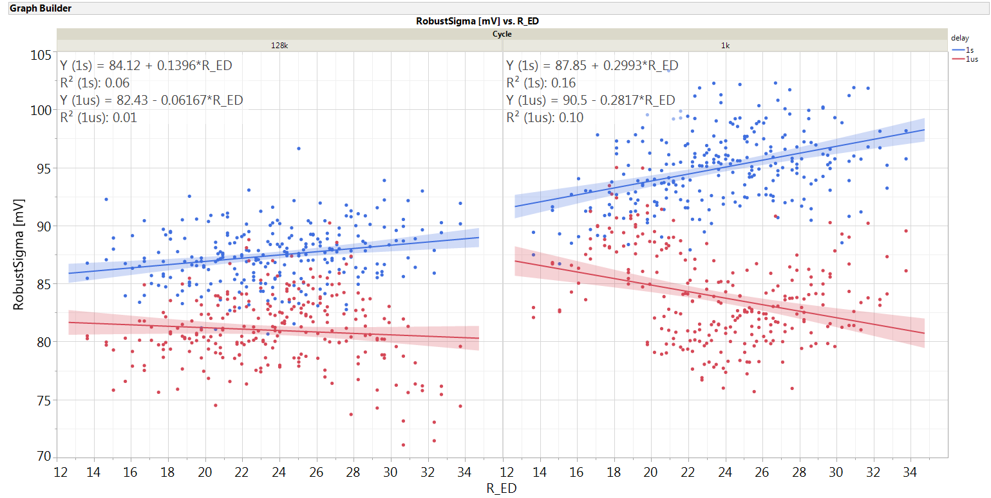
Set robust sigma vs ED: drift focus

Slide 31
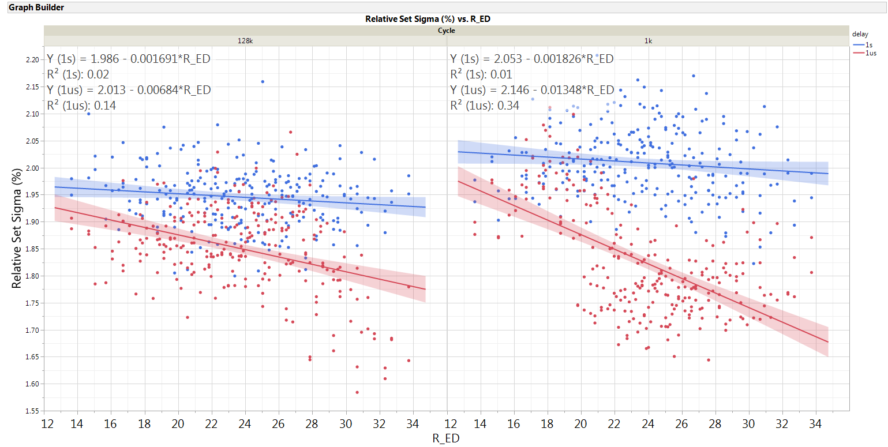
Set relative sigma by ED

Slide 32
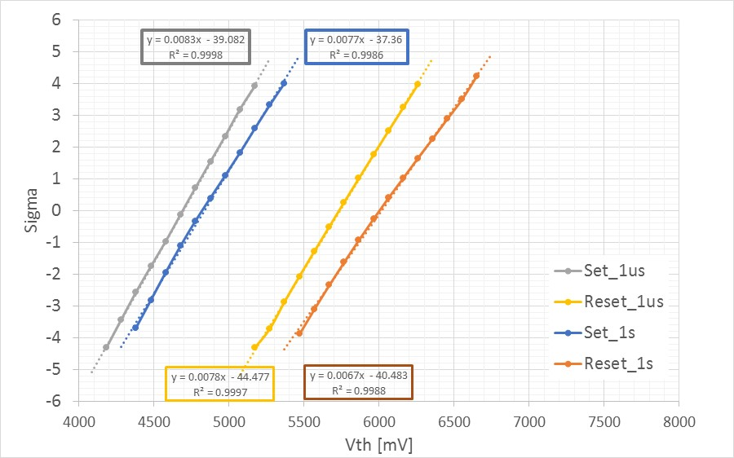
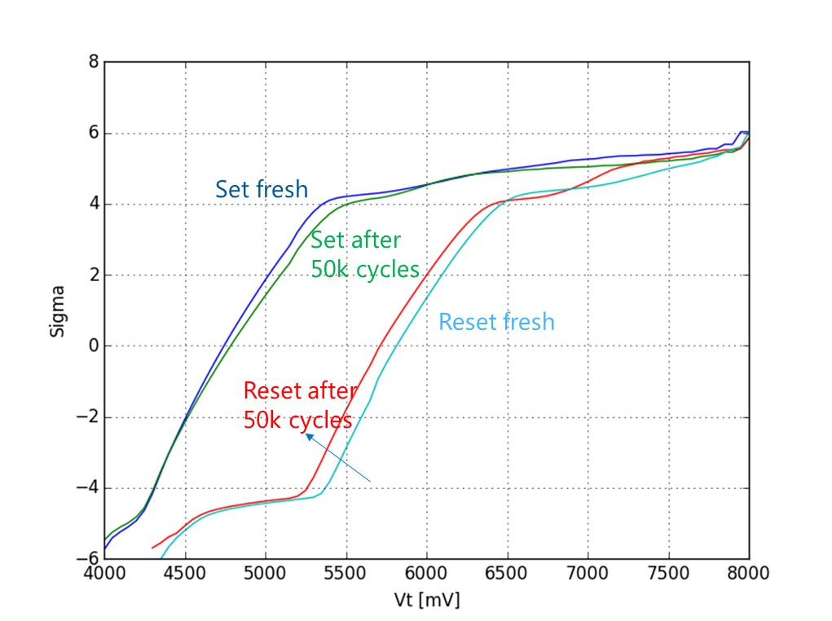
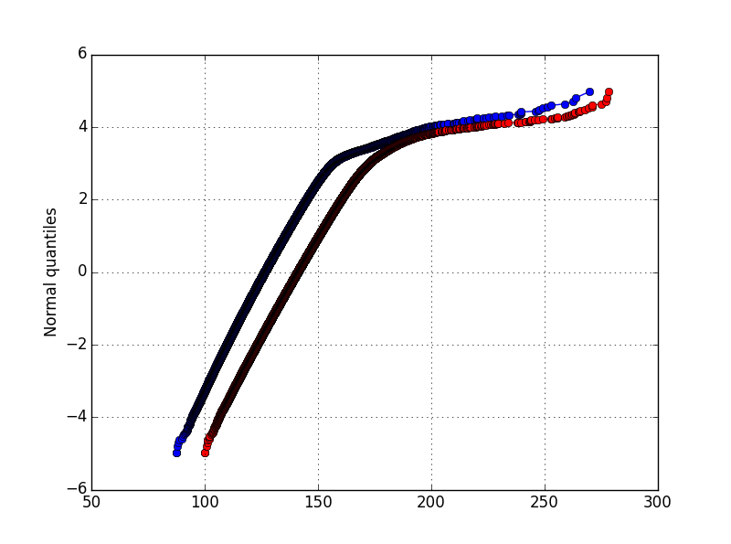
Full tile distributions (All EDs) : die screened from leakage test
SXP full stack, 1Gbit statistic, full tile distribution after seasoning and after cycling
SSM, 1k cycles, 4.5 sigma max statistic
S15C, cell rev 7.64. PG1T1 die
9889922, wf 25,
Split 4E, SD only
120mV/
sigma
128mV/sigma
1us interlaced histo, distortion from gaussian
Very good gaussian distribution for split 4E, no defectivity tails visible at single bit level. 128mV max sigma pre drift due to all ED convolved together (no dedicated differential seasoning)
125 mV best set sigma pre cycling on SXP

Slide 33
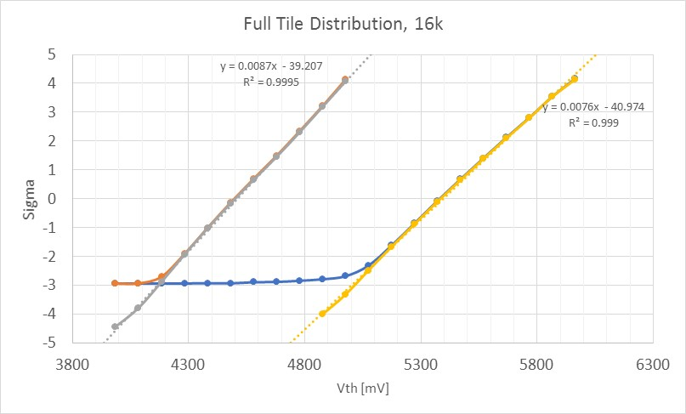
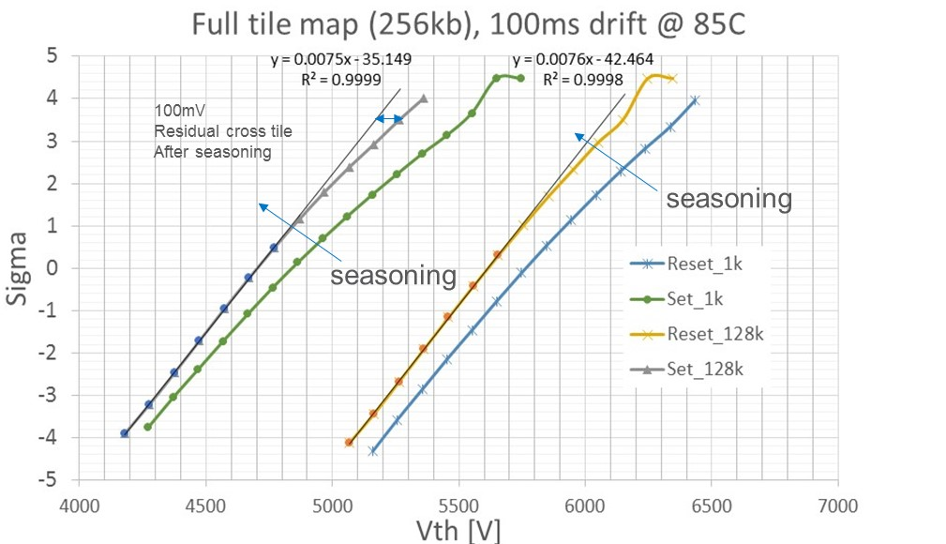
Full tile distributions (All EDs)
Split 2E
Old POR with lamina
115mV
/sigma
Shorts filtered
130mV
/sigma
Very good Gaussian shape for full tile map on new POR once shorts are filtered out. Sigma are increased with respect to ED4 block typical values:
115mV/sigma on set (it is 85mV on typical ED4 block)
130mV/sigma on reset (it is 100mV on typical ED4 block)

Slide 34
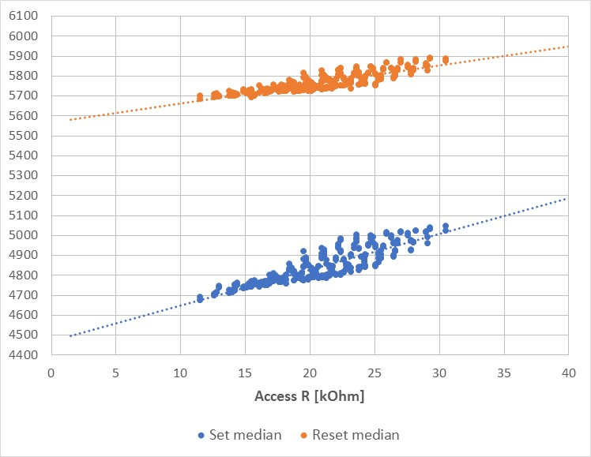
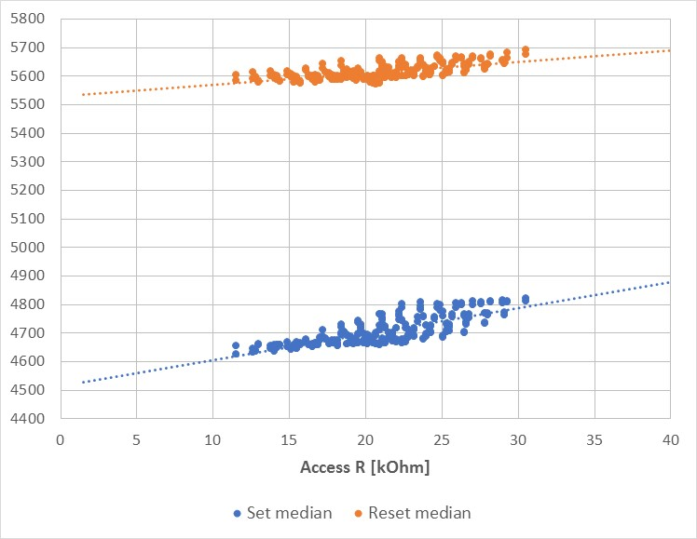
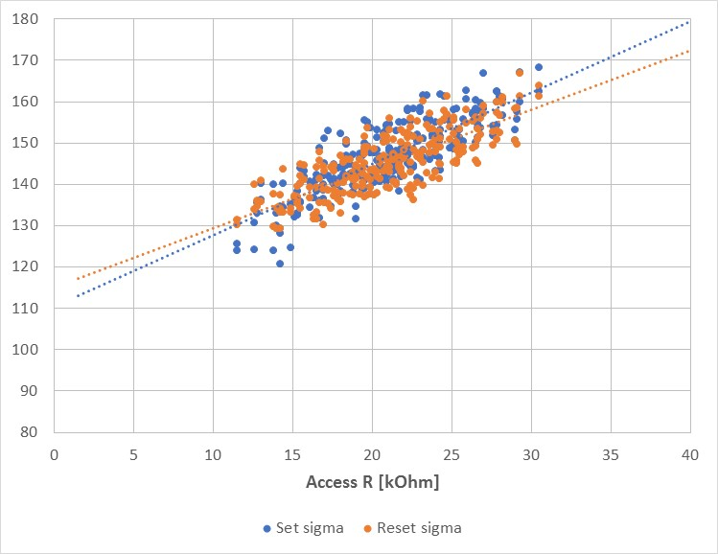
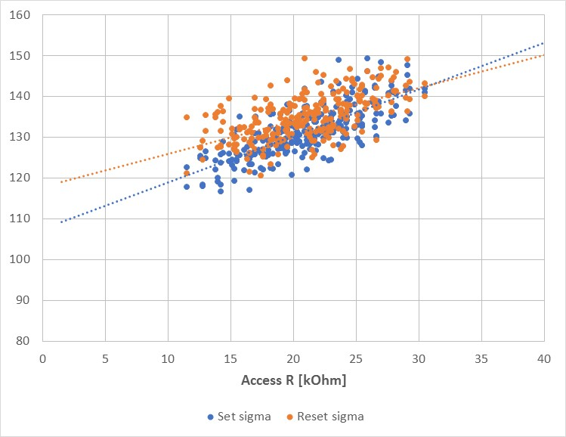
Cross tile components vs ED @ 85C (old POR): No spike inhibition
1k cycles
128k cycles
Vth trend by access resistance[mV]
Robust sigma trend by access resistance [mV]

Slide 35
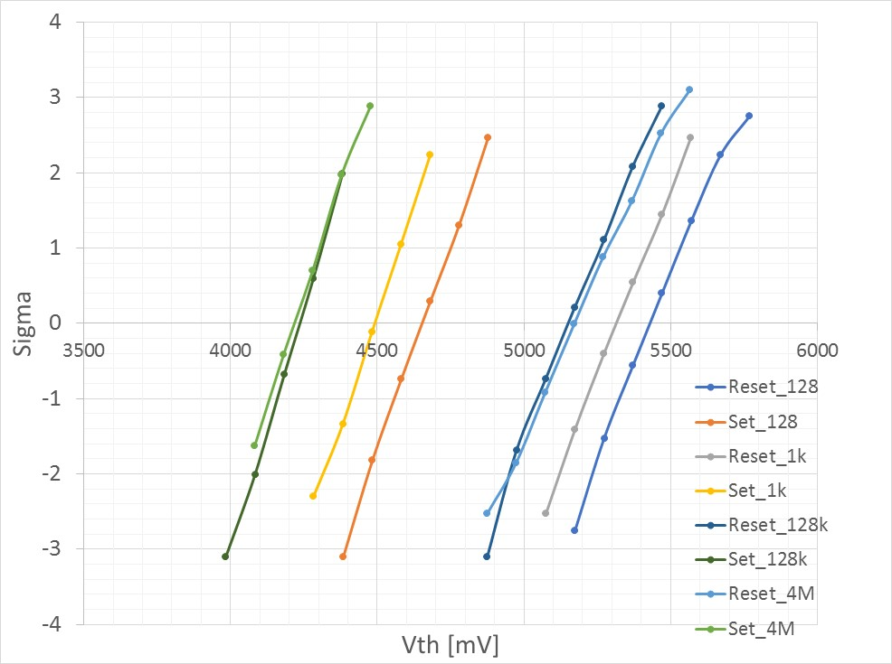
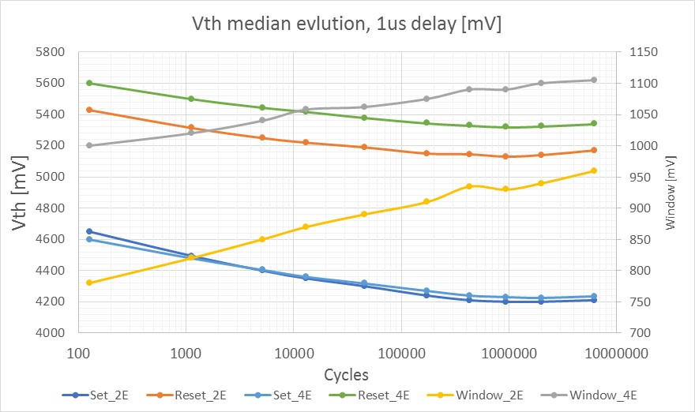
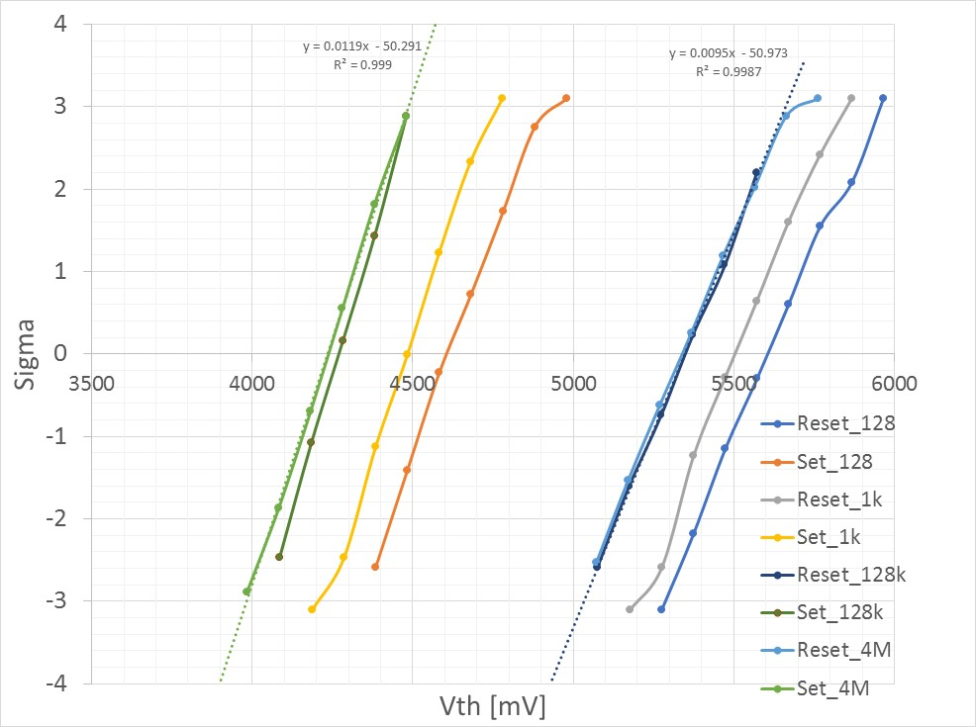
High window splits cycling evolution: 2E vs 4E (ED4)
Split 2E
Split 4E
No defectivity appears up to 6M cycles also for split 4E
Very good sigma stability after 6M cycles
84mV/sigma
EOL
105mV/sigma
EOL

Slide 36
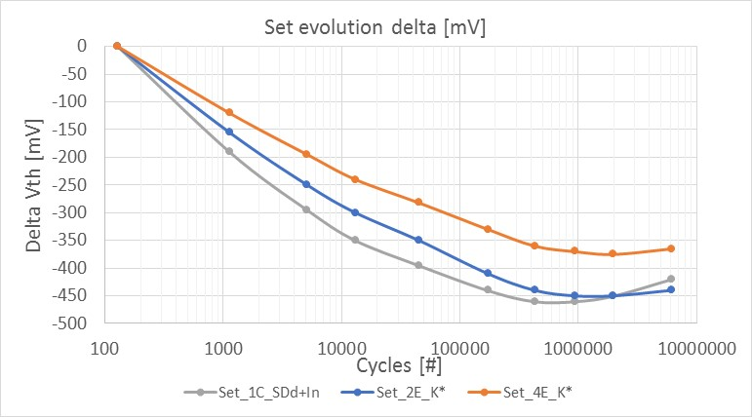

Set / Reset median delta Vth evolution (ED4)
200 mV
Best performances for split 4E in term of window and Vth evolution shift

