Slide 1
SSM FF asymmetry
2018-Wk10
SSM team

Slide 2
SSM FF asymmetry
Scope of the analysis
Recent SR71B array characterization on CR5.3 pointed out an asymmetry in FF depending ion the reading polarity → FF_negative_read>FF_positive_read
2xCMOS used to confirm this observation → confirmed
2xCMOS used to test the most relevant cell process change to investigate this effect
Lots used in the analysis
0104052 (A1 opener): CR4.0 (SDd+In+AlOx lamina with single step etch)
9971352 and 9962362 (Combo 1 and 2) to segment SDd, SDd+In, AlOx lamina, everything with the single step etch
0057102 and 0024692 (K* camp second wave): SDd+In and In-SAG with 2-step etch and liner

Slide 3
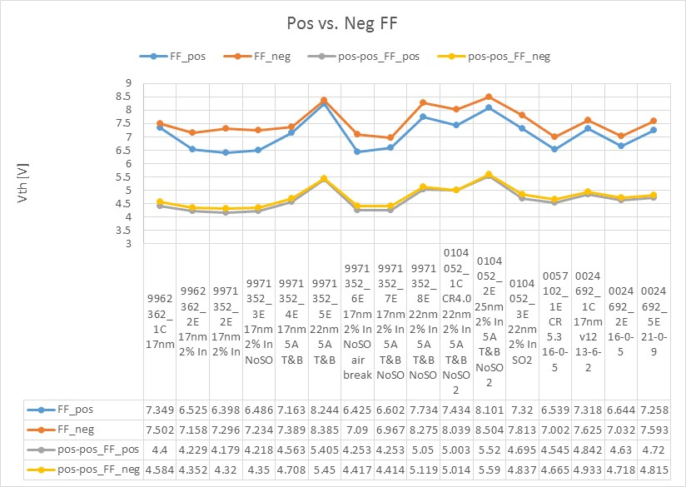
FF and Vth (pos-pos)
FF difference in SDd was around 150mV
FF difference in all alloys with In is 300-700mV
Vth pos-pos (after 20kcycles) keeps a small memory of the FF polarity → negative is higher

Slide 4
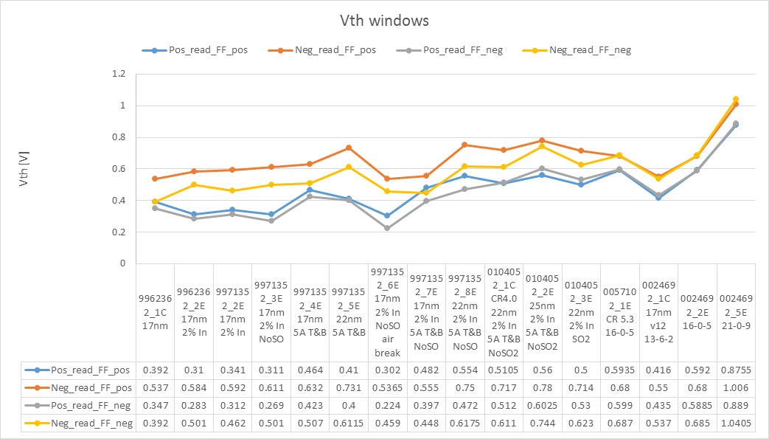
Vth window
Consistent difference in the Vth window, with negative reading after positive FF being the best
Vth windows are almost independent from the FF polarities for all the “liner” trials (CR5.3)

