Slide 1
AlOx lamina toggles

Slide 2
Summary
Comparison of In-doped SDdelta lamina / no lamina with straight cell profile process (100ms W2R data)
Testing was done at two different T! Trying to compare metrics that see little or none modulation with T
Lot 0024692 (test @85C)
Trial | SD thk. | Ge% | As% | Se% | In% | Si% | 51 WL etch | Wf
1C | 22 ver12 | 13 | 30.4 | 48.6 | 2 | 6 | CD - - | 5,14,20
Lot 0030002 (test @50C)
Trial | SD thk. | In-doping | AlOx lamina | 51 WL etch | Wf
3E | 22 ver12 | 2% | 5A T&B | 2-step CD - - | 2,7,9,21,24

Slide 3
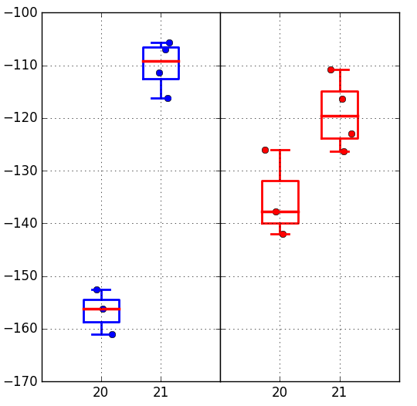
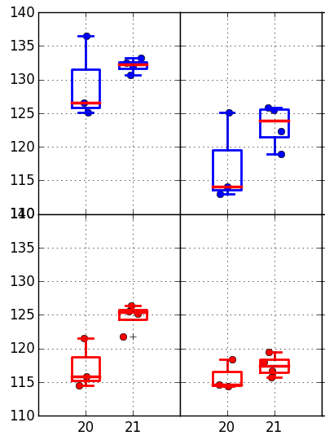
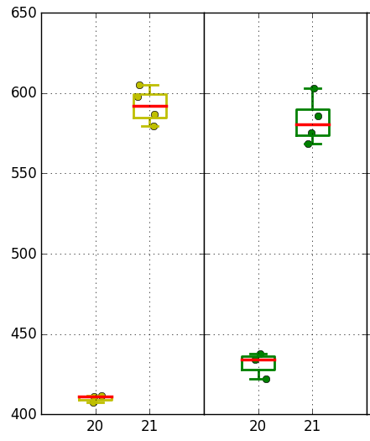
Boxplots
Vt shift 1k→128k cycles
Increasing window with lamina.
Spurious contributors:
Activation with different T
→ max 30mV
Memory effect (A0 silicon)
→ to be quantified
Set
Reset
Robust sigma is worse with lamina
Robust sigma
1kcyc
128kcyc
Median window
1kcyc
128kcyc
SET
AlOx: NO
@85C
AlOx: YES
@50C
AlOx: NO
@85C
AlOx: YES
@50C
RESET
Reduction of Vt shift 1k→128k cycles with lamina
AlOx: NO
@85C
AlOx: YES
@50C
AlOx: NO
@85C
AlOx: YES
@50C
AlOx: NO
@85C
AlOx: YES
@50C
AlOx: NO
@85C
AlOx: YES
@50C

