Slide 1
Synopsis on K* campaign from S26 data
Deeper insights, potential warnings and expectations
Lidia, Paolo

Slide 2
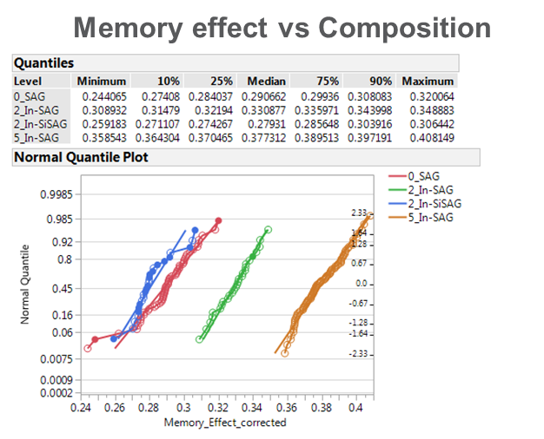
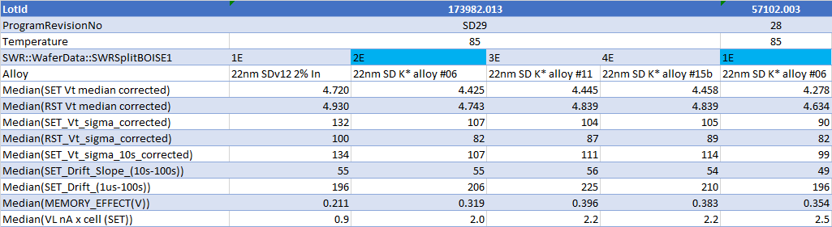
Memory effect upside
K* wave 2
5%
7%
5% In
K* wave1
Upside of memory effect is confirmed from K* wave 2
And increase further from 5% In to 7%
Absolute value shows L2L that need investigation
85C probe 0173982.013 + a repetition of Alloy 6 on 0057102.003
Zone A/B median after filtering from structure fail ED3
All the metrics have been corrected for the access transistor and refer to the voltage across the cell
Need to evaluate the impact on the array with proper access transistor contribution that differs between S15C and S26A
The lowest SET Vt can be over- estimated by the sweep range with current DAC. In general 10s SET Vt is properly extracted. Other metrics that uses 1us SET Vt can be also affected (memory effect is eventually under-estimated)

Slide 3
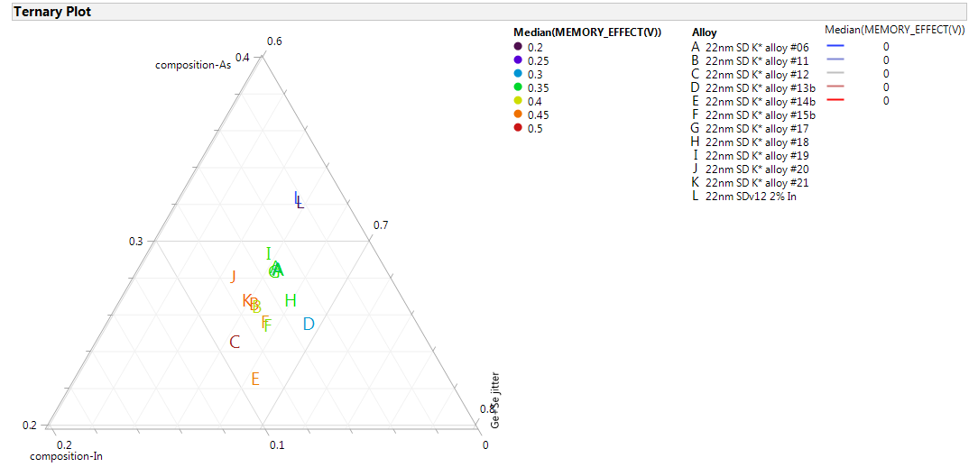
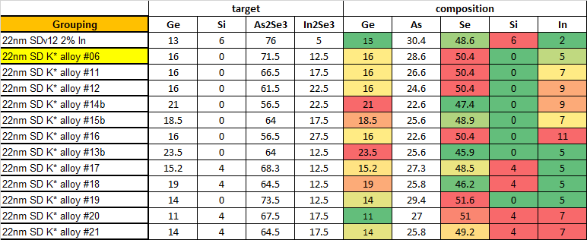
Memory effect
The big advantage of In-SAG wrt SiSAG consists in the higher Memory Effect:
~100-150mV upside with SDK#6 wrt SDv12+In
Higher Indium dose even more (but up to now at risk for WL shorts) → Assessment of the impact of seasoning on the marginality of high Indium alloys in progress
Check of Memory Effect thru cycling still under evaluation
SDK#6

Slide 4
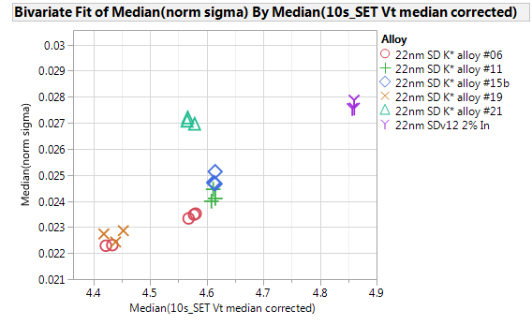
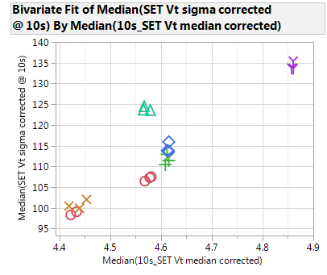
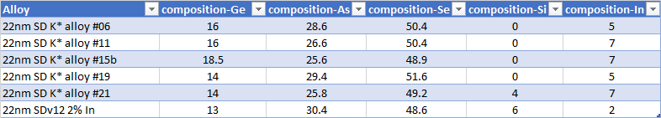
Vt sigma (10s)
Norm Vt sigma vs Vt 10s
Vt sigma vs Vt 10s
In-SAG: SET sigma improvement
no clear worsening from 5% to 7%
Carefully evaluate L2L
wave2 results better than wave1, that was structurally compromised
In Si-SAG
In SAG
Can be as low as 90mV at 1us
Alloy with much different composition have been intentionally excluded from this plot

Slide 5

Probe Drift
No Drift toggle up to 100 sec

Slide 6
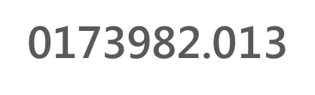
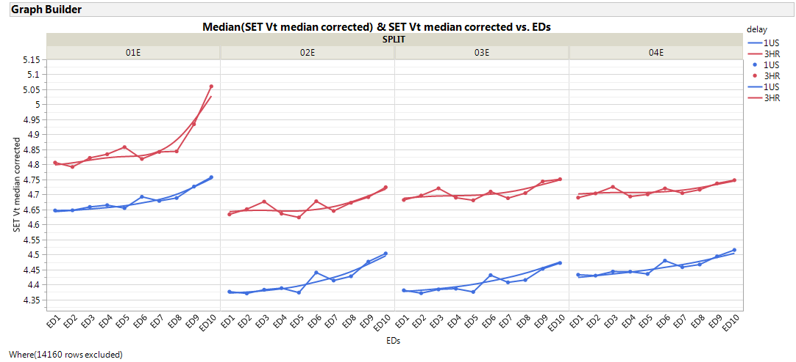
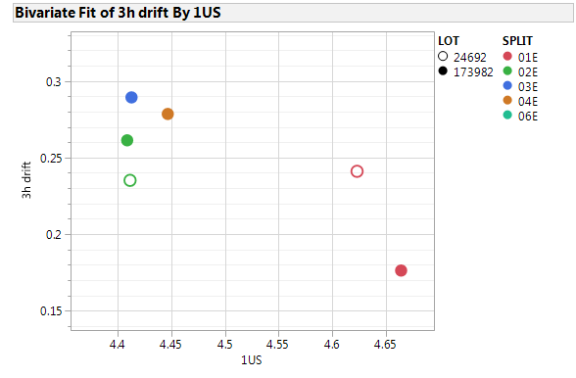
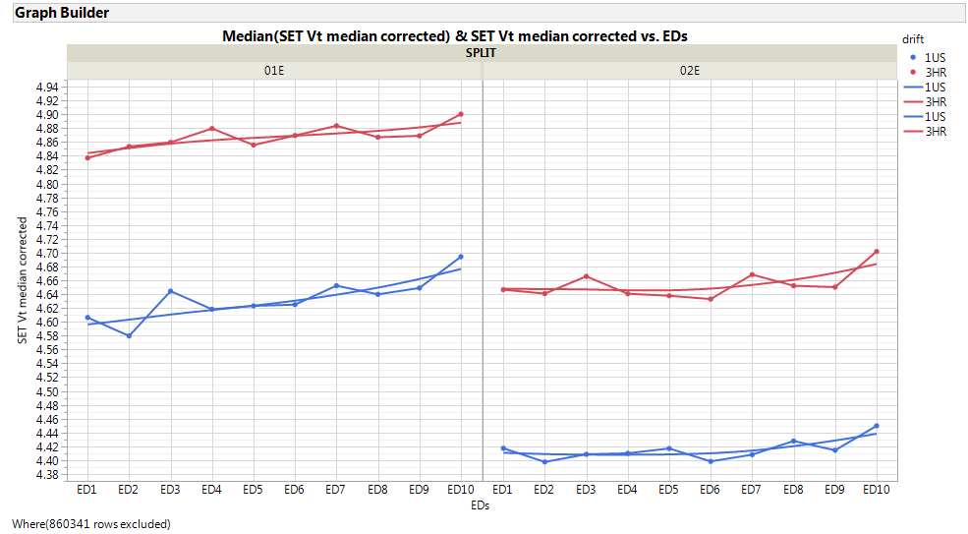
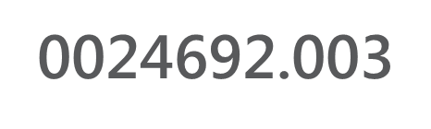
WLR drift 1us - 3hr 85C
3hr drift vs Vt
260mV
alloy11
alloy15b
180mV
alloy6
WR27A
Reticle A1
5% InSAG
POR
POR
ED9-10 excluded
Preliminary from WLR
1 lot is neutral
3982 shows an increase that can be from usual drift-Vt tradeoff
POR
240mV
alloy6
240mV
WR31A
Reticle A0

Slide 7
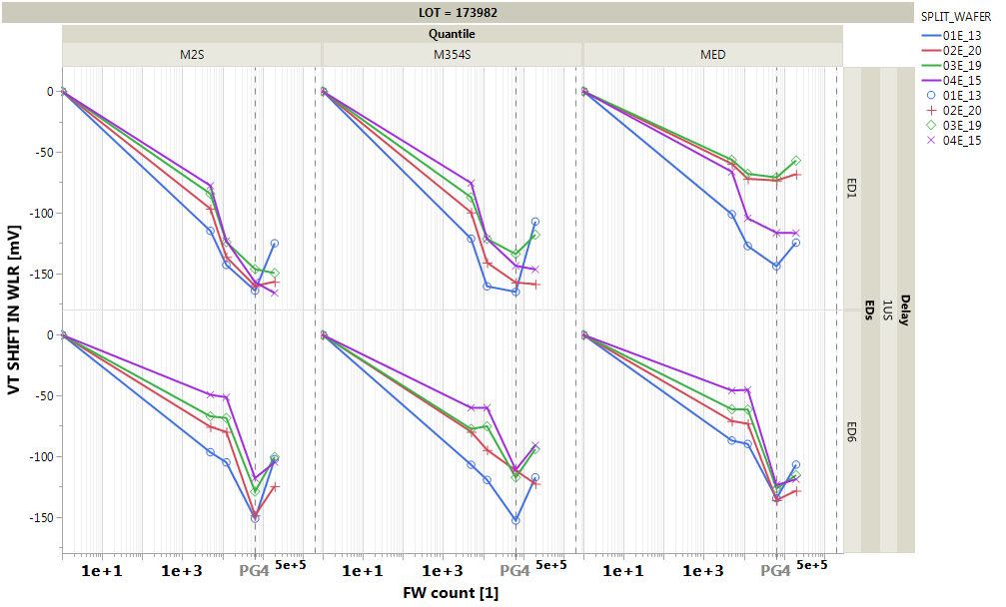
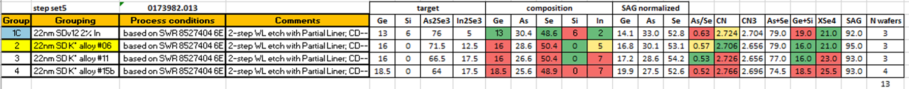
WLR data: Endurance
  Preliminary from WLR
  More exhaustive result from bench will be available
  SDK#6 presents some advantages wrt SDv12+In:
  Smaller degradation of V_{T} median with cycling
  Less pronounced turnaround
  Signal to be checked on the other lots

Slide 8
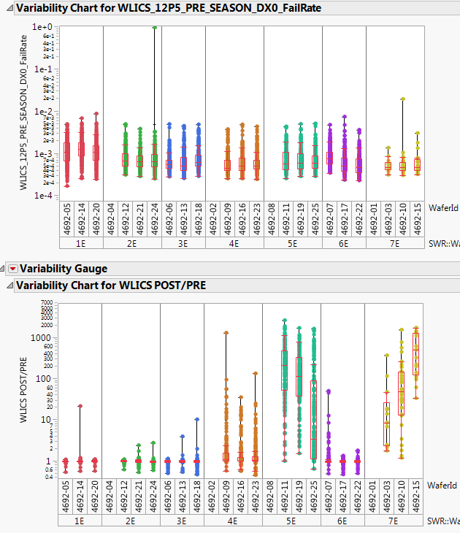
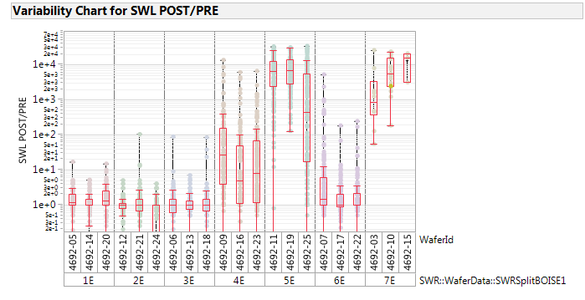
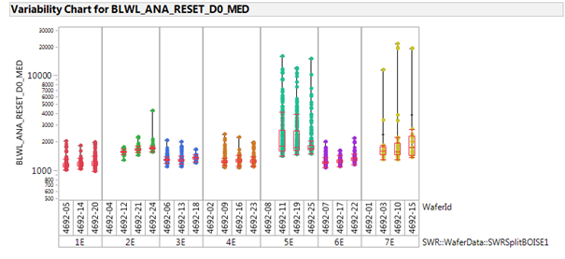
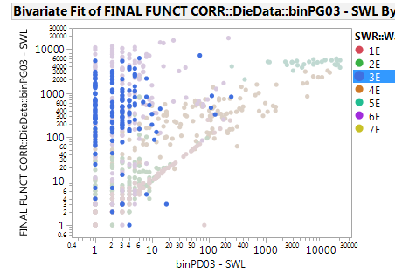
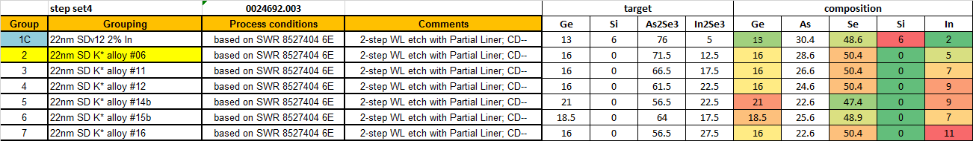
WLICS SWL increase with high In post Seasoning
WLICS huge increase after Seasoning for highest In composition, two worst grp 5E/7E have also tails of high VL, suspecting damage (IRST for seasoning at 120uA). Upon retest degradation continue and 3E is hit also
WLICS pre is clean
Lot 0024692 (probed at 50C) this is the reason why this alloy have not been evaluated for prev metrics
9%
9%
11%
In%
SWL at re-probe vs SWL after 1st seasoning

Slide 9
Summary
SDK#6 (In-SAG) upsides wrt SDv12+In:
  Sigma: more than 10mV sigma gain
  Memory effect: more than 100 mV larger
  Drift: equivalent up to VDM2, to be better segmented the VDM3
  Endurance: reduced E2 turnaround
  Note: all these parameters have been evaluated from SD only silicon probed with:
  The same seasoning as the one of the FS (that could not be optimum for SD-only)
  A 3E Set pulse with lower maximum current (~26 uA)
  PG4 t_{sense}
  Process with Liner-protected SD
  About points 1, 2 segmentation in progress (MattiaB.)

Slide 10
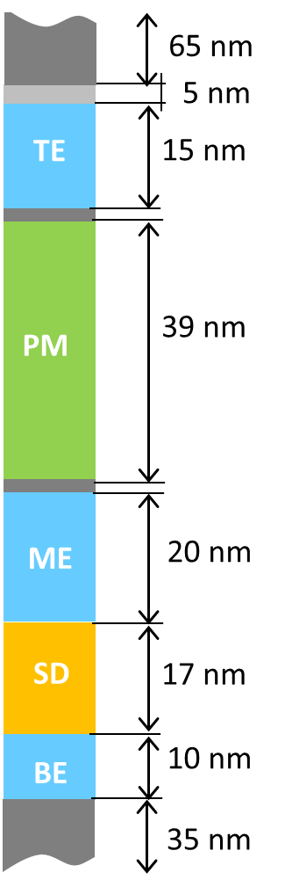
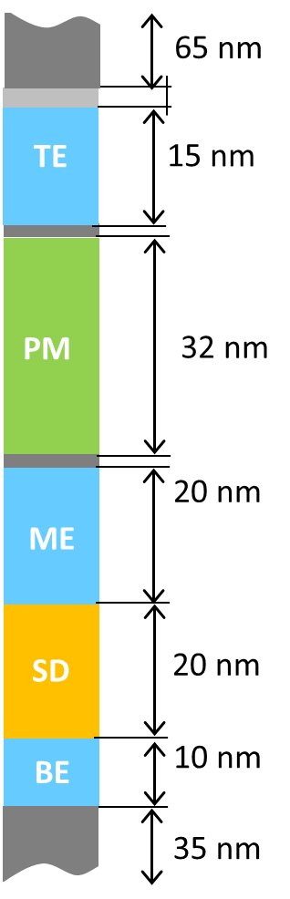
SiSAG vs In-SAG/In-SiSAG benchmarking for SxP
Considering valid the experimental picture reported in the previous slide:
  Sigma VT gain ~ 80 mV
  Memory effect gain ~ 120 mV
  Same Drift
we extrapolated the 200mV RWB gain thru the substitution of SiSAG with In-SAG
This gain can be transferred in -7nm PM thickness maintaining the same ΔV_{T} (considering 28mV/nm sensitivity)
Actual 30S
30S w/ In-SAG
In-SAG
$$\}$$
Si-SAG
$$\}$$
Recommendation:
SxP trial with In-SAG centered on 16%Ge and 5%In
To get the same POR V_{T} with In-SAG, we need to increase t_{SD} by ~ 3 nm, but 7 nm reduction on PM

Slide 11
Back-up

Slide 12
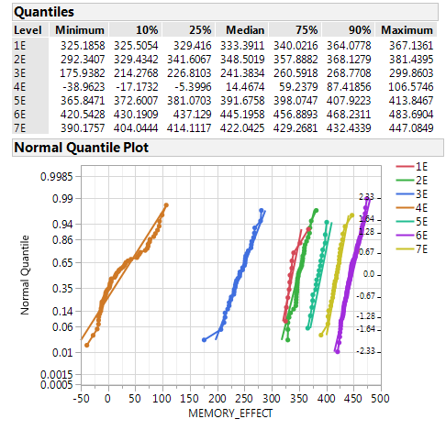
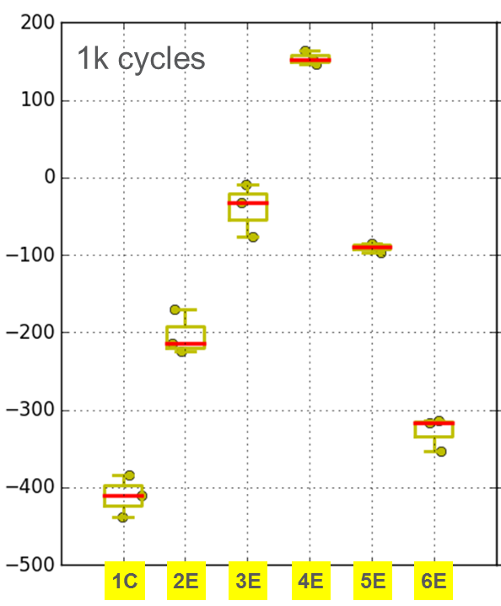
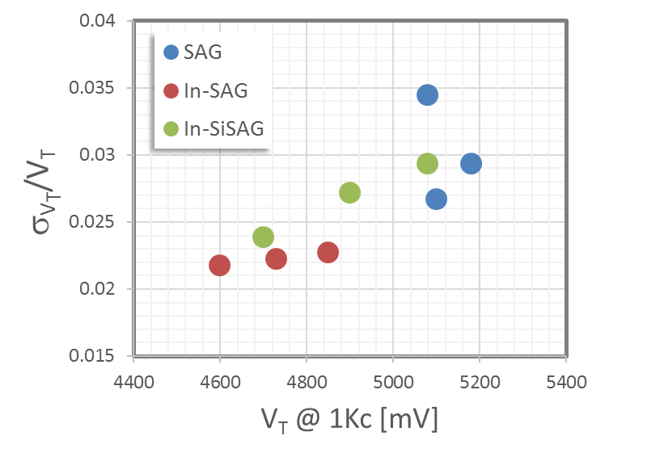
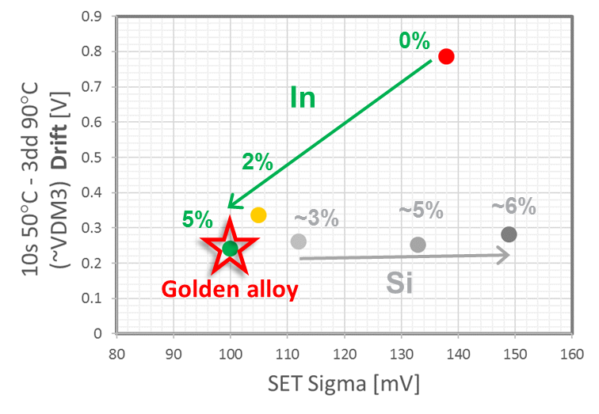
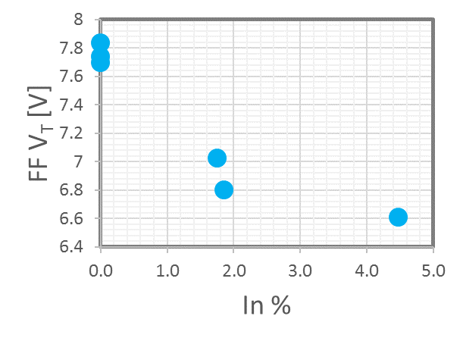
Upsides from S26
Memory effect vs Composition
Split | Ge | Si | In
1C | 13 | 6 | 2
2E | 16 | 0 | 0
3E | 21 | 0 | 0
4E | 25 | 0 | 0
5E | 16 | 0 | 2
6E | 16 | 0 | 5
7E | 19 | 0 | 2
2 Lots out of the K* camp (In-SAG and In-SiSAG)
Main upsides of the In-SAG matrix:
  FF reduction
  Lower sigma
  Good drift performances
  Higher Memory Effect
  Higher SSM window (just from SR71 and 2xCMOS)
Note: Memory Effect reliability to be verified
Golden alloy
SSM window
Normalized Sigma vs. V_{T}
Drift vs. Sigma
FF reduction
In-SAG alloys
In
Si
>1 Volt!
SSM window - 3.54s projected

Slide 13
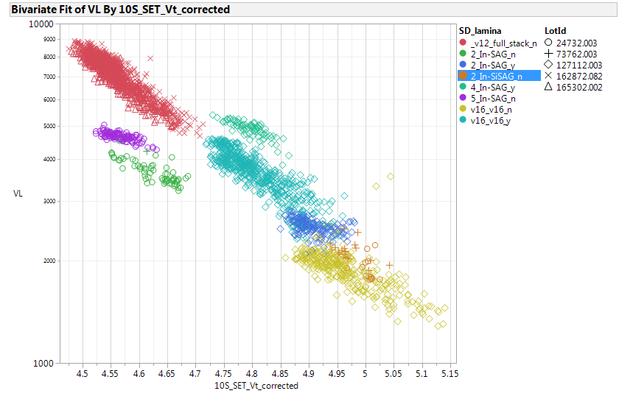
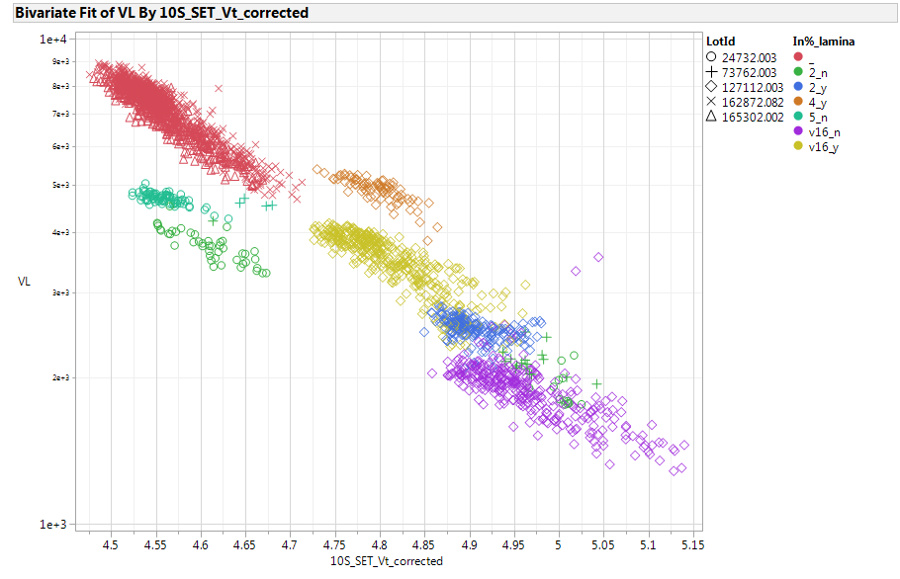
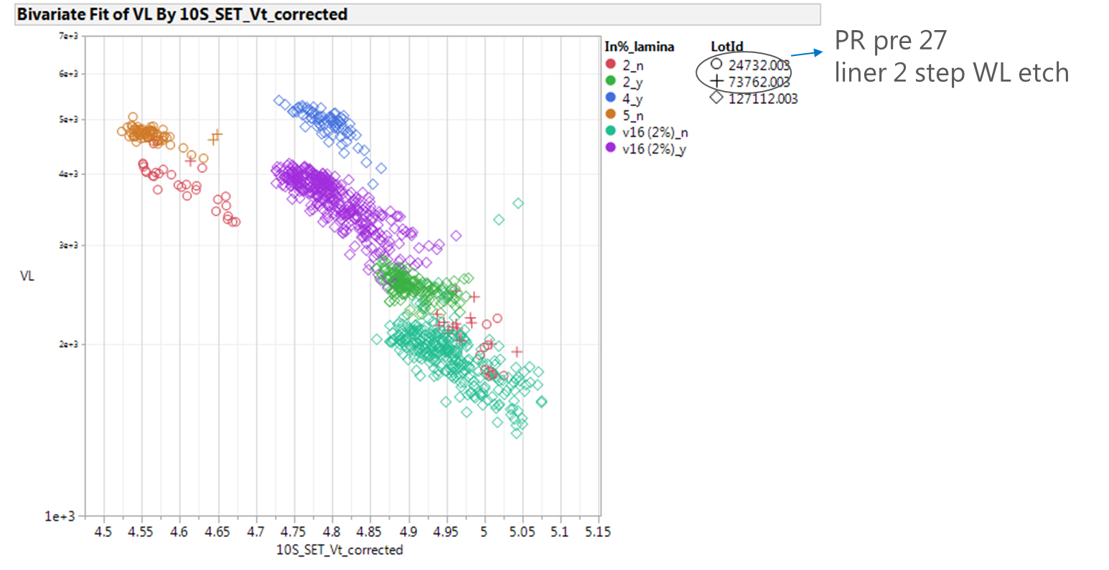
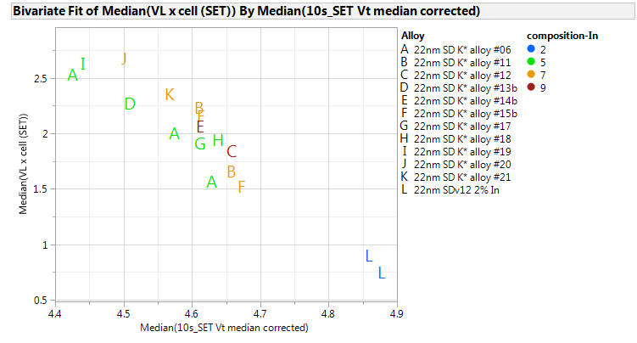
Potential warning of In-SAG: Leakage – S26 data
Full Stack
85°C
4% SD only w/ T&B lamina
5% SDonly
Inc In%
2% SDonly
VL at 3.6V nominal;
4K cells
50-50% SET/RST back pattern
SD at 22nm for SD only
+15-20% VL from 2% to 5% In
Adding lamina

Slide 14
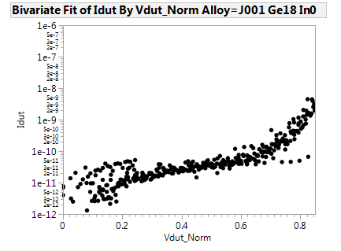
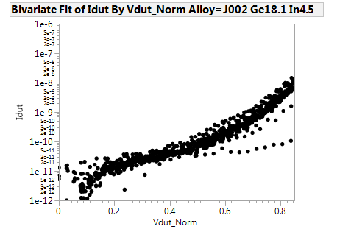
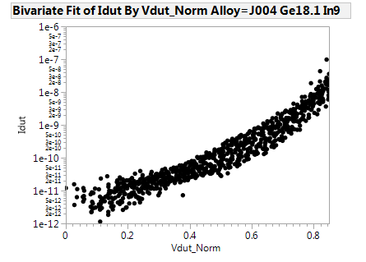
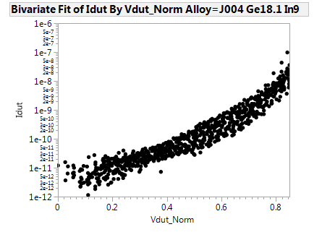

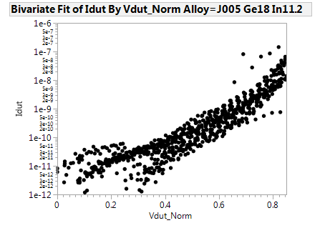
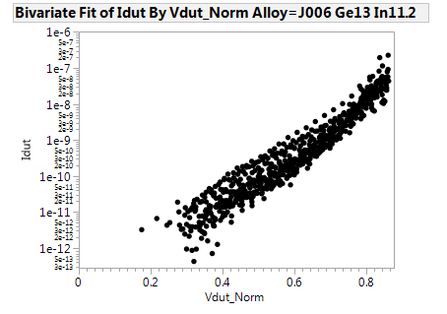
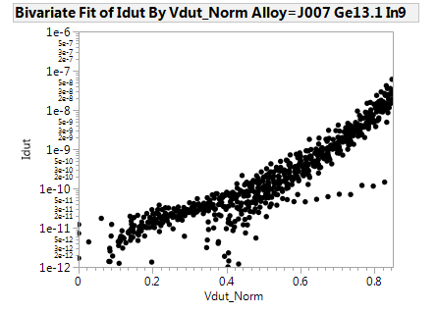
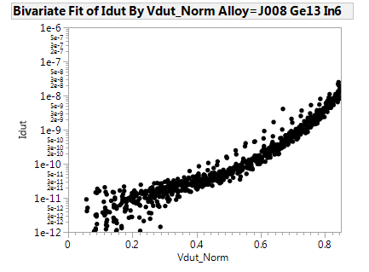
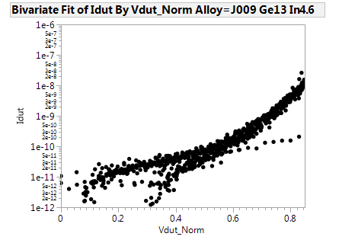
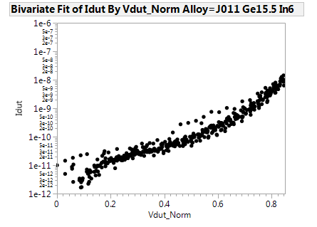
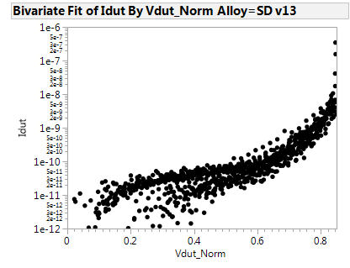

Camp J*: “Normalized” I-V curves (x-axis bias is from 0 to 85%V_{T})
The progressive In addition tends to increase the sub-V_{T} P-F conduction. See here the comparison with SDv13.
Leakage increase consistent with what observed on array
Ge 13%
Ge 13%
Ge 13%
In 11%
In 9%
In 6%
From the K camp
Ge 15%
$$\}$$
~4E alloy!
SDv13
In 5%
In addition

Slide 15
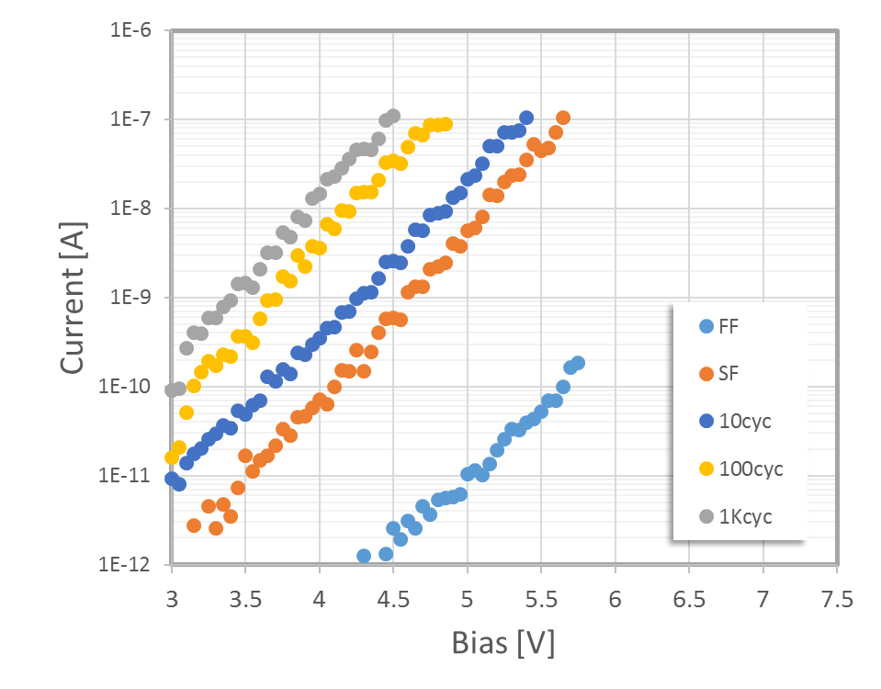
V_{T}
I_{LEAK}

Slide 16
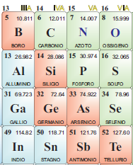
Recommendations:
2nd Lot confirmed the recommendation to purchase of In-SAG alloy with Ge16% and In 5% mono-tg as SSM pre-POR → ETA for tg arrival end-Jan
Preliminary analysis of K* pushes to consider In-SAG for 30S too → opportunity to run it on 3DXP when the 30S perspectives will be clarified
In-SAG results reinforce the roadmap for Ga-SAG
In line with the III-group exploration we can check if the the Electronegativity contrast wrt Se the important parameter for the SSM window?
    GaSe tg in house, more suitable for this campaign is the Ga₂Se₃ tg → just ordered (ETA ~ wk 8)
1.8
1.6
2.4
1.7

Slide 17
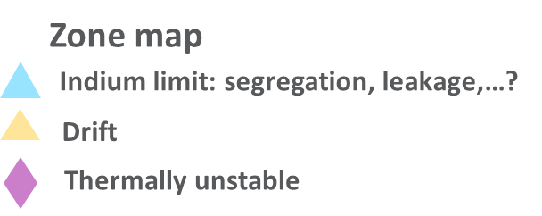
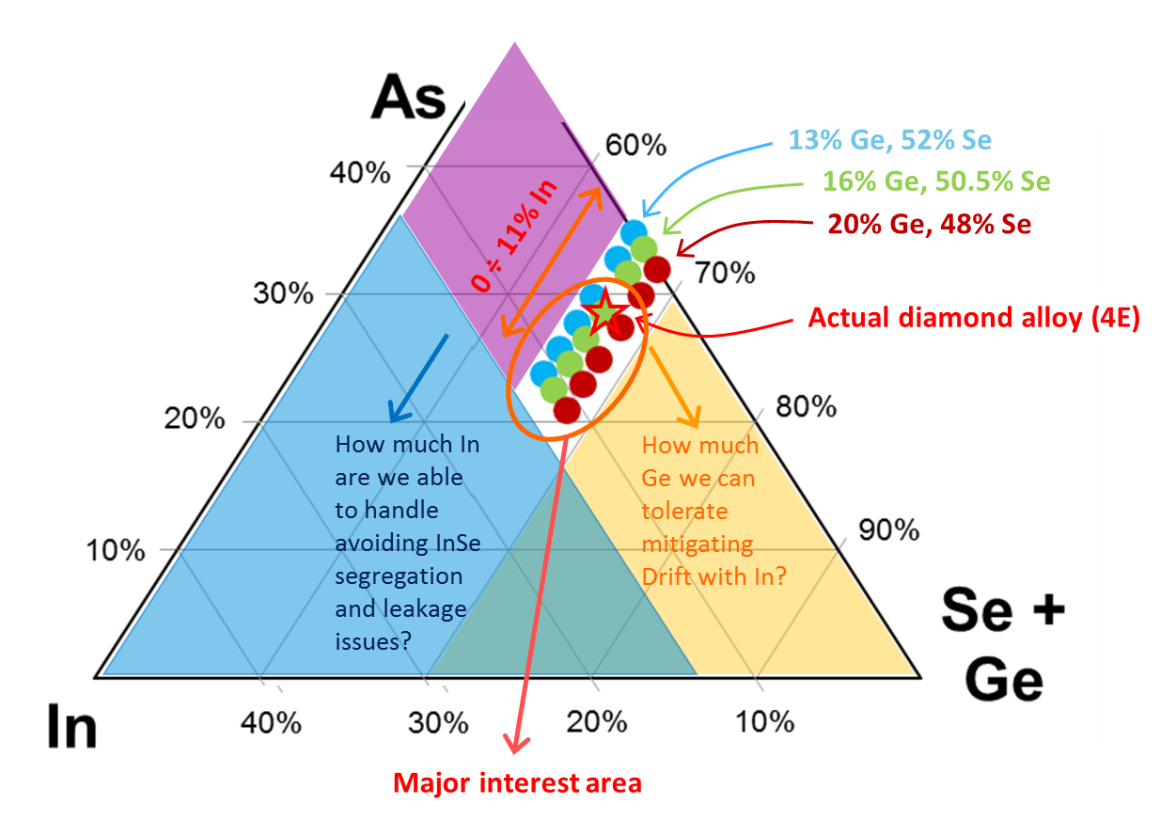
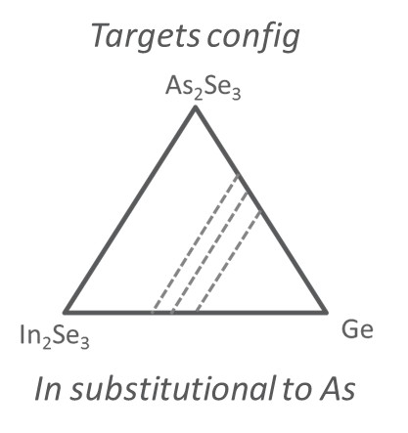
Towards a Treasure Map of the In-SAG based SD3
(including also In-SiSAG)
2 further A0 Lots planned to complete the treasure map exploration of the In-SAG (and In-SiSAG) system (split tables) + some selected alloys on A1 → Next read: wk 04
Main open question we need to answer: what is the maximum In% we can tolerate w/o segregation and leakage issues?

Slide 18
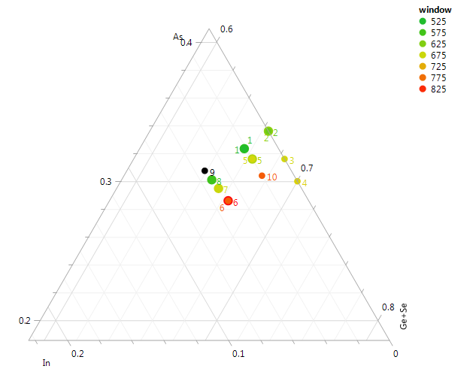
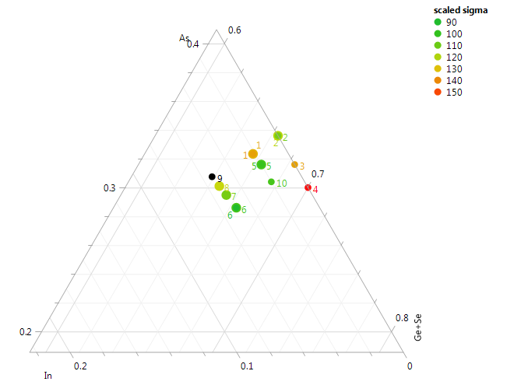
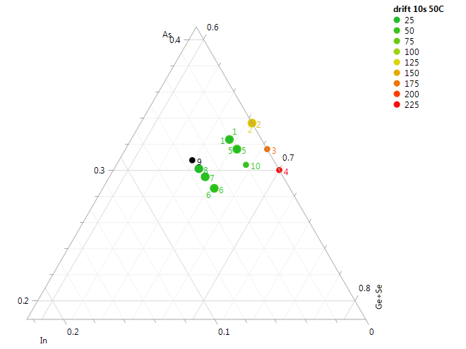
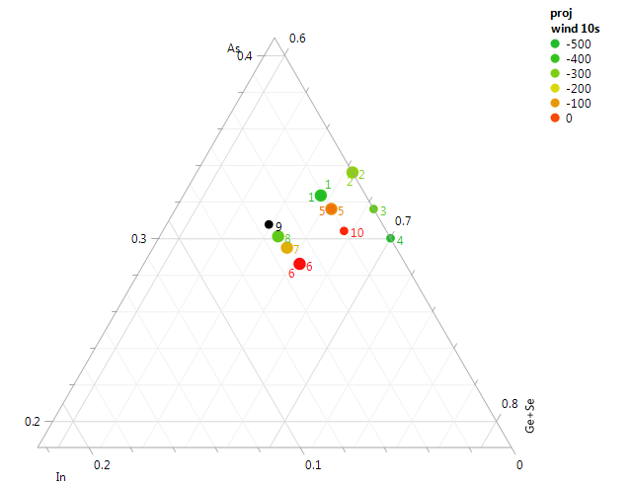

Area of further interest:
  +In, +Ge
  verify Si role

