Slide 1
SSM Update to JDP COMM
Apr/4/2018
Status and Plan:
Improving confidence on composition tuning
Monolithic target (SD.K1) match Alloy6 (POR) expectation (RWB gap to goal 430mV)
Lot SSM43 (K* campaign expansion) delivered 400~450mV median window improvement; SD.K2 definition confirmed, detailed RWB and reliability characterization to be followed.
Additional first cut module improvement in E1/C1 etch required for robust structure health.
Dual Deck lead lot on screamer in D0 array via/CMP module on track to begin D1 targeting for WW14. D0 probe WW15. DD probe WW18.
S24S bipolar decode and polarity logic completed. Initial layout fits under tile, routing in progress. Overall on track to rev2 in WW19 and DBR in WW39
Stepping-up Strategies and milestones defined to exit pathfinding
Solid fundamental of SSM switching mechanism using SR71
Statistical validation with S24S
Technology/Design/Collateral for Alpha product Development
Product/Technology scaling direction beyond Alpha product

Slide 2
K* SD Alloy / CR5.3 Learning
Baseline (CR5.3): SD.K1 monolithic target initial results close to expectations (within 20mV from POR Alloy6), despite composition offset (~2%)
Volume read data populated WW14-15 for lot-to-lot var. components
Cell Roadmap: K* SWR (SSM43) demoed median ΔVt close to DTS.
WLR to vet residual gap & pre-POR selection (WW14)
Structure Health: K* alloys require additional work at E1/C1 etch
C1 UE fix for structure yield is expected to be probed WW15
1st CR5.3 dual-deck read expected in WW18
To be
Revised
SR71 1D0 Cell RWB (Piecewise Built) S26A1 silicon (Neg Read) |  | Alloy6 CR5.3 85C [mV] | SD.K1 CR5.3 85C [mV] | Alloy14 CR5.3-based 85C [mV]
Vmd1 | ΔVt (1 μs) | 935 | 915 | 1340
 | SET σ (Vt) | 85 | 85 | 92
 | RST σ (Vt) | 101 | 100 | 120
 | SET drift (1 μs-10 s) | 220 | 220 | TBD
 | E3 GB WE | 95 | 95 | 95
 | E3 GB RD | 0.3 | 0.3 | TBD
Vmd2 | Rst drift (1 μs-3 s) | 245 | 245 | TBD
 | Set drift (10 s-48 h) | 320 | 320 | TBD
 | Gap to goal | -415 | -430 | > -95 (prj)
SD.K2
DTS goal
ΔVt (1 μs)
Alloy6
Normal Quantile [1]
SD.K1
CR5.3
Monolithic
Target
SD.K1
POR
Alloy6
VT [mV]

Slide 3
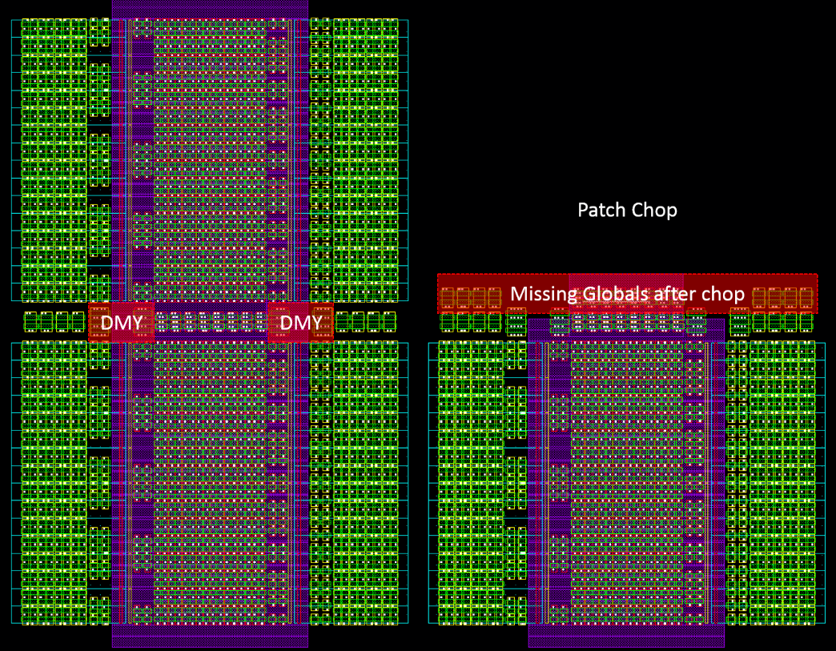
S24S Design Update
Design of bipolar decode and polarity logic complete / updates to ccell logic complete
Initial layout of new under tile circuitry fits under tile / routing updates in progress
Energy/performance impacts of new circuitry up next
On track to rev2 in WW19 and DBR in WW39
Bipolar
Decoder
Gp
To Be
Revised
main
Gn
PMOS
NMOS
PMOS
Partition
Edge
Milestone | Criteria
Rev 2 | Sheet level performance validation complete / circuits ready for layout
Rev 3 | Full chip functional and performance validation of features, specifications and test modes
DBR | Database Ready for Manufacturing

Slide 4
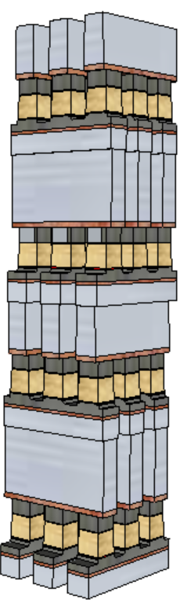
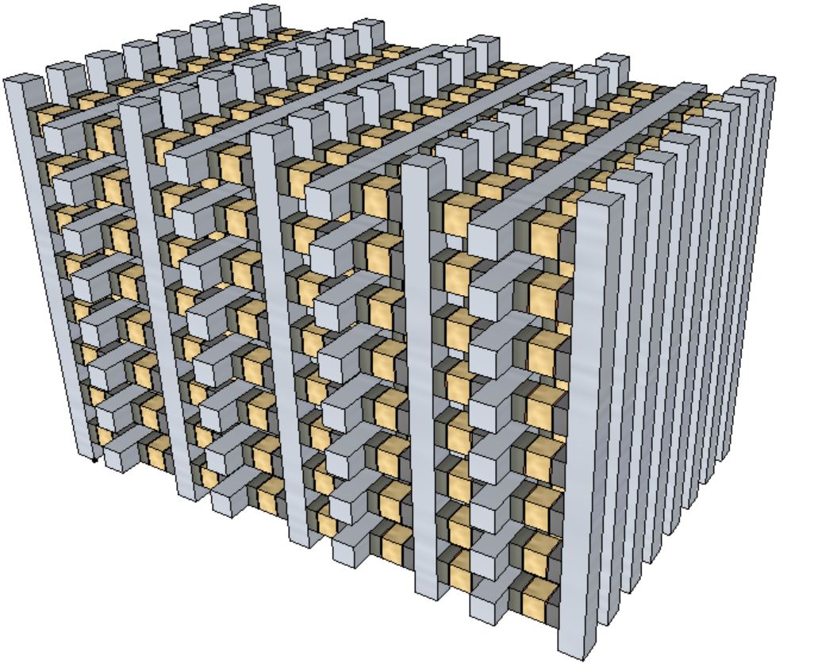
SSM Pathfinding Strategy and Milestones
The strategy for ‘fast fail or succeed’ is built on ‘stepping-up’ is
SR71 – SSM basics switching mechanism and its reliability, symmetry and scalability
S24S – Dual deck array feature development with high volume statistical validation.
Build alpha product – Design, process and collateral initial development in order to pick an array node for die size and performance matching or better than SXP counterpart.
Develop Scaling Roadmap –
Cost and performance: 2X density and ½ energy every generation.
Array Architecture: Stack (SXP-like) vs. Tier (3D NAND like)
3D-stack
Deliverables for “step up” or not
3D-tier

