Slide 1
SSM41 CR5.3 , lot 0185552.013 PRG rev 2.0
2018-Wk13
Enzo

Slide 2
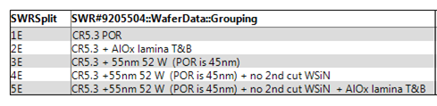
Lot trial
Main messages:
Allumina lamina increase Vth and sigmas with very small intrinsic window improvement (< 50mV). Some tails appears during cycling (not true for all dice)
55nm W pretty transparent on cell performances (cross tile to be checked) but more defectivity visible at time zero for split 3E (BL etch marginality)
No WSiN confirm accelerated Vth seasoning and strong sigma improvement through cycling
Coupling no-WSiN flow with lamina show a maximum projected window with minimum Vth shift through cycling. Need full tile testing for final assessment.

Slide 3
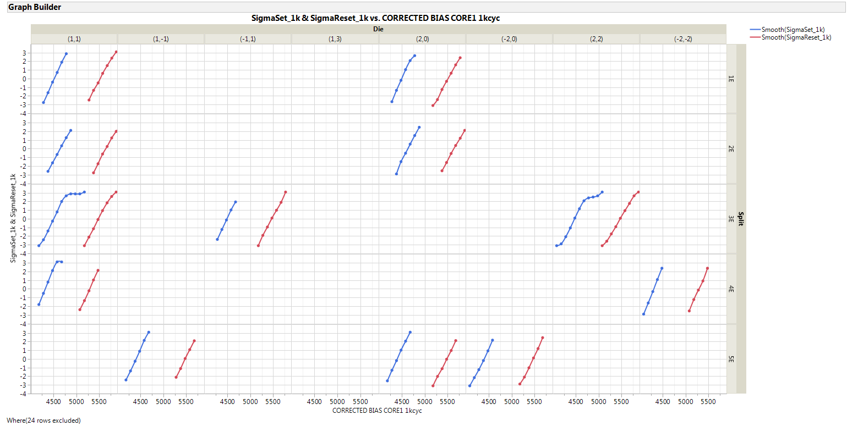
1k cycles distributions (1us)
Split 3E show some marginality at time zero also on same wf zone with respect to other split

Slide 4
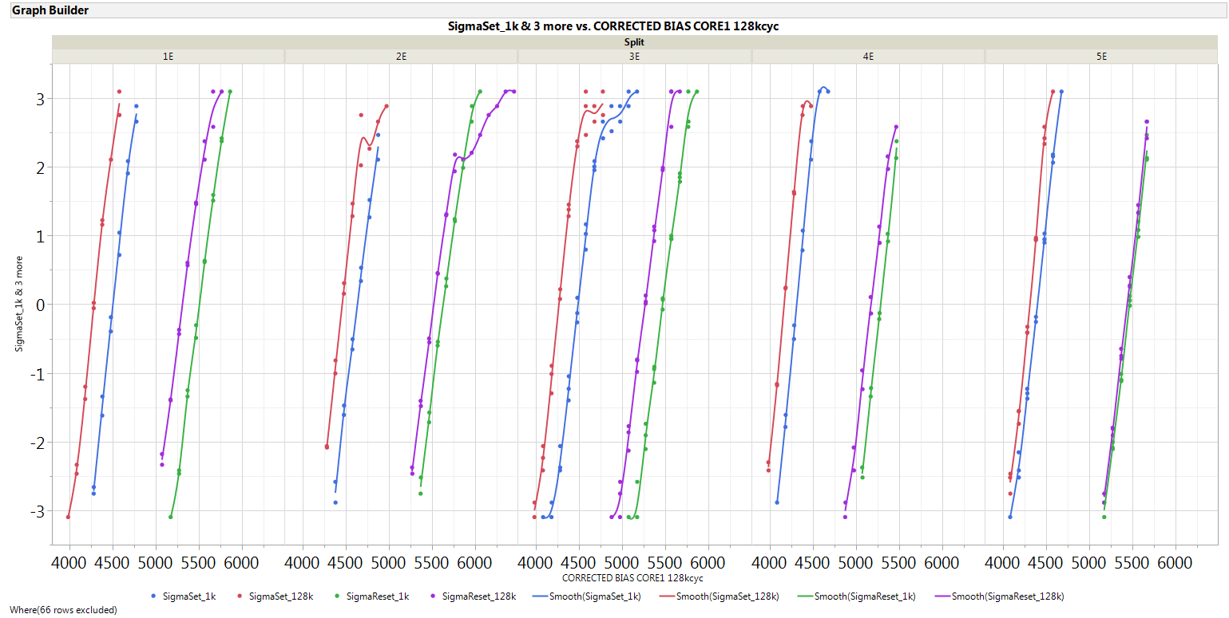
Distribution summary: 1k vs 128k cycles, 1us delay
Tails appears after cycling for split 2E on one die
Very strong Vth stabilization of Lamina + no WSiN split

Slide 5
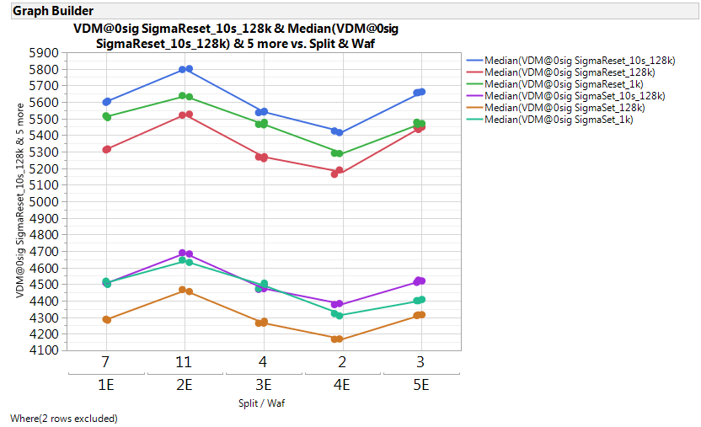
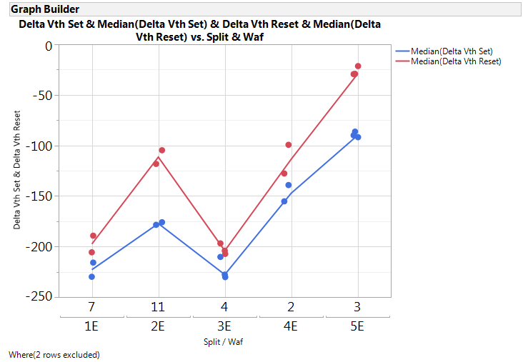
Median Vth trend and shift through cycling
Set / Reset median Vth [mV]
Median delta Vth shift through cycling (post 128k-pre 1k) [mV]
Lamina increase absolute Vth but reduce delta Vth shift through cycling
No WSiN confirmed to further reduce Vth shift through cycling (accelerated seasoning)

Slide 6
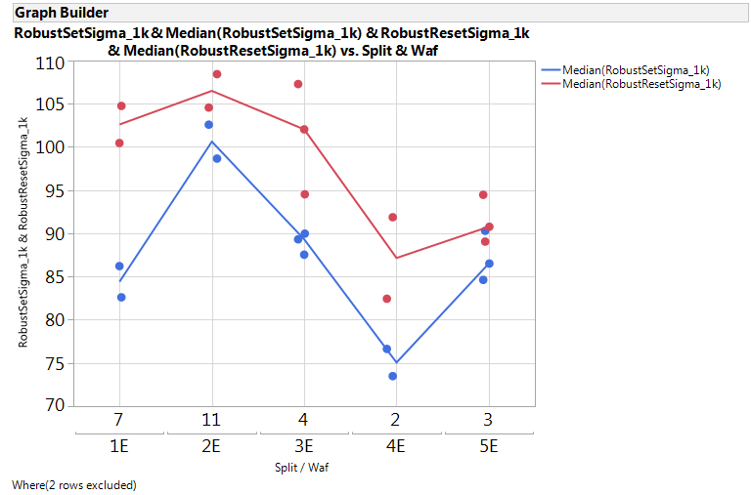
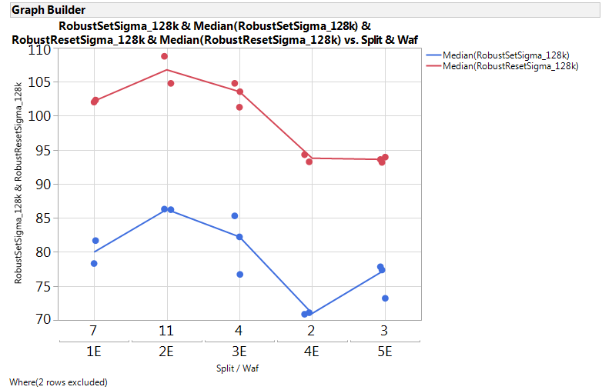
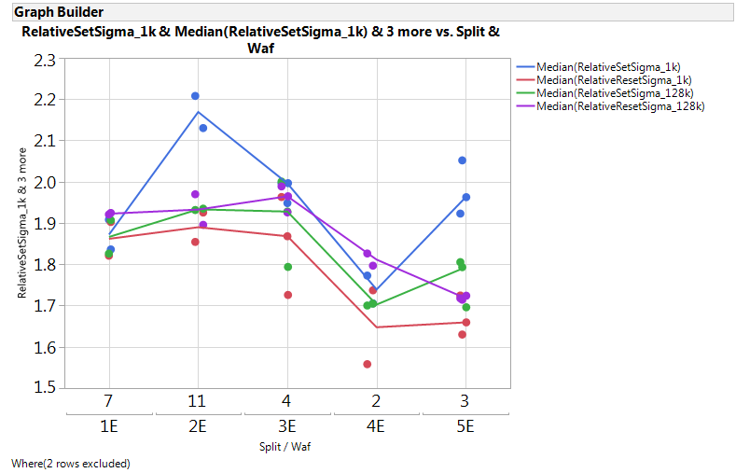
Robust Sigmas
Set/Reset sigma @ 1k [mV]
Set/Reset sigma @ 128k [mV]
Relative sigma %
Lamina increase absolute (and relative) set sigma while No-WSiN reduce it (accelerated seasoning)

Slide 7
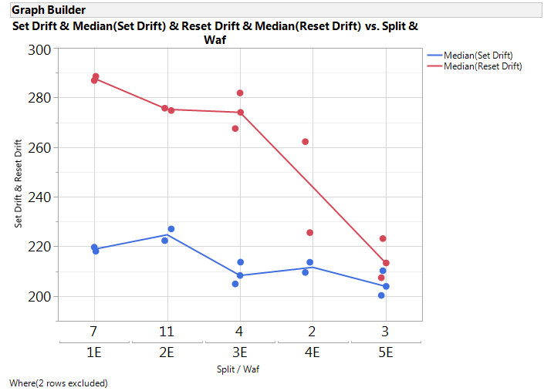
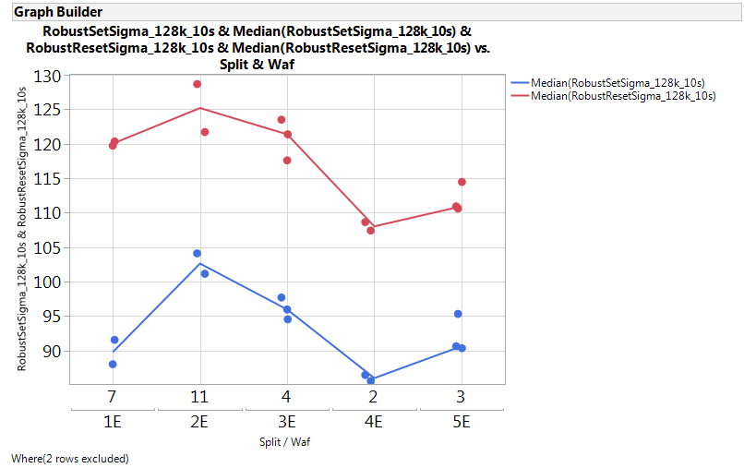
Drift 1us →10s @ 85C (after 128k cycles)
Median drift:Delta Vth [mV]
Set Sigma after drift [mV]
Split 5E has best balance between set and reset sigma (no window expansion through drift but better E4 margin)
Sigma trend between split after drift the same of pre drift

Slide 8
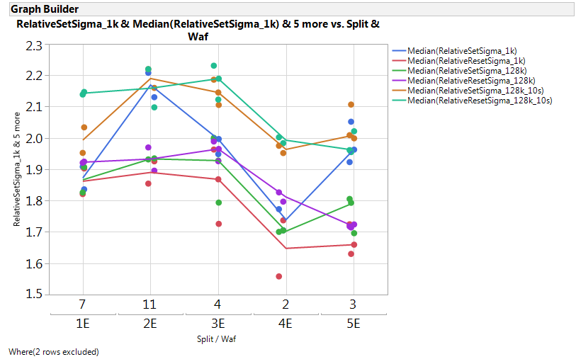
Relative sigma (all together) [%]
No WSiN is main knob to reduce relative sigma

Slide 9
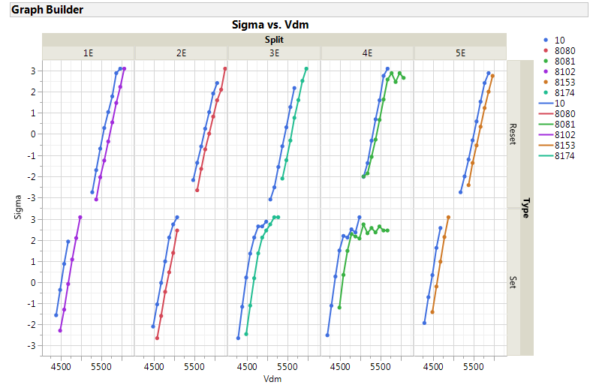
Long time drift after 32k cycles (10s→2h @85C)
Measured bake time [s] for each split
Split 4E has the minimum reset drift but no toggle on set, hence window is closing with drift time
No big split signals on set

Slide 10
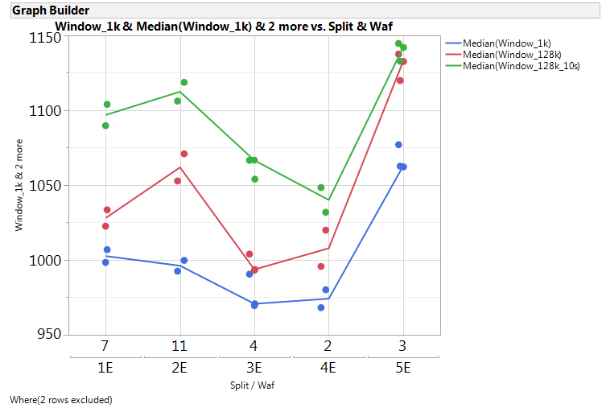
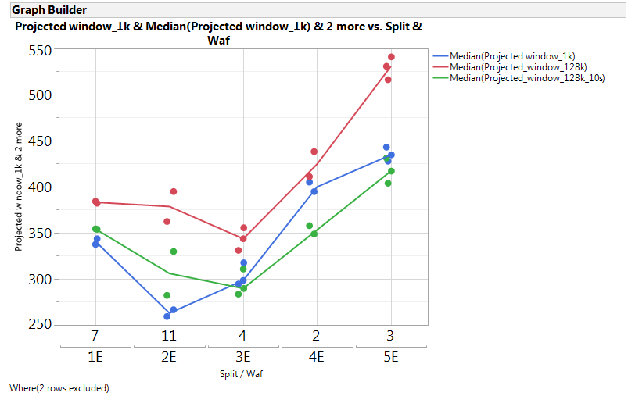
Median and Projected window @ 3.54 sigma
Median window [mV]
Projected window [mV] @ 3.54 sigma
Very interesting result for split 5E (55nm W +No-WSiN + lamina) interm of Vth stability and sigma
Worth to try a full map test on split 5E

Slide 11
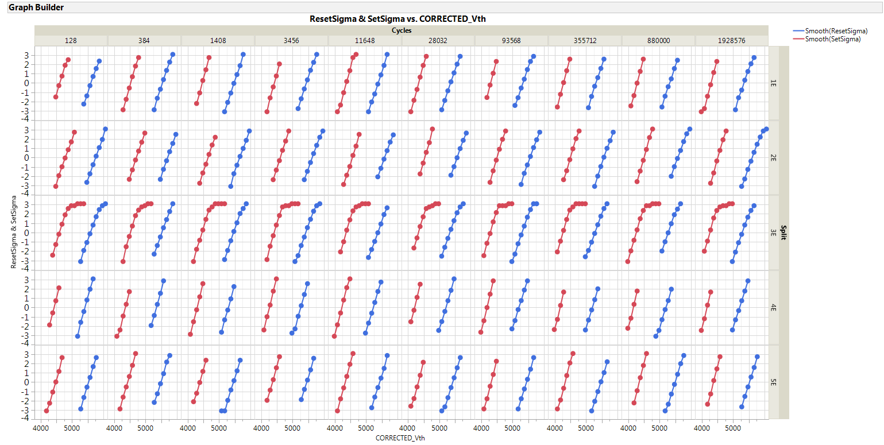
Extended endurance: all distributions by split/cycles

Slide 12
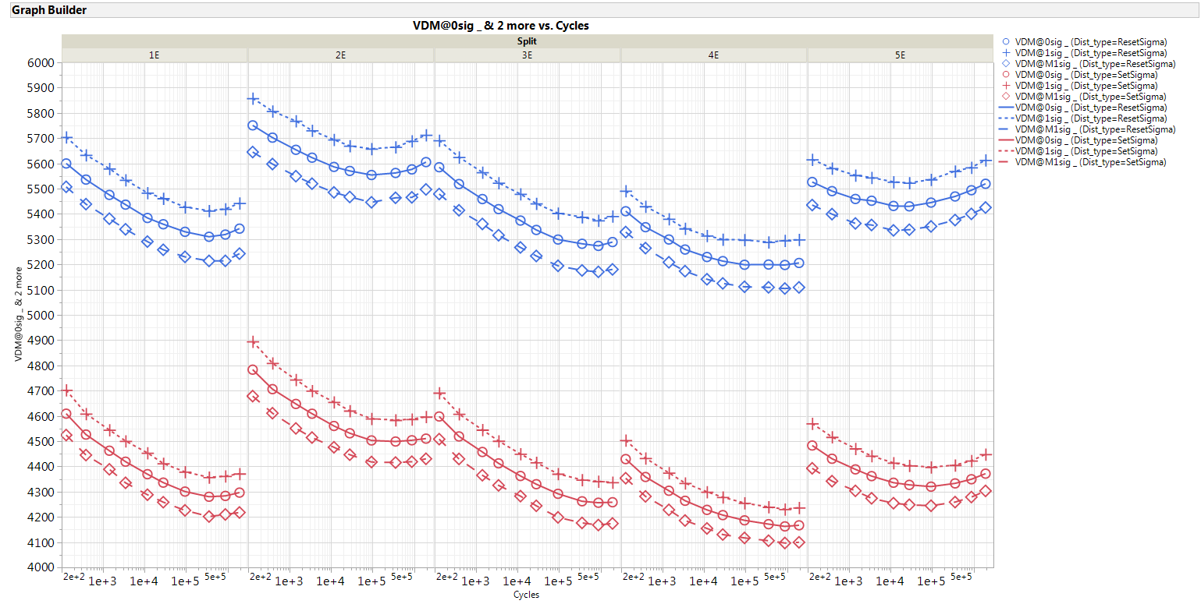
Extended endurance: Vth median and +/- 1 sigma evolution

Slide 13
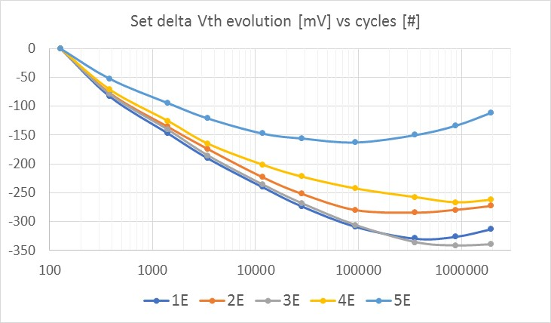
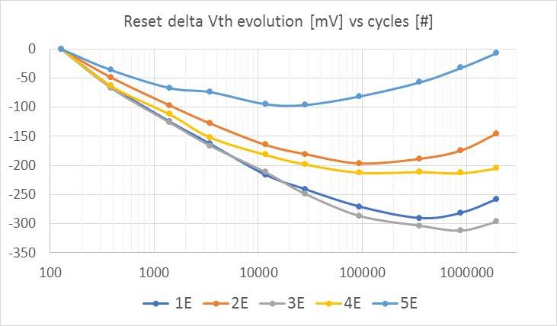
Delta Vth evolution through cycling by split
5E has the minimum evolution for all cycles

Slide 14
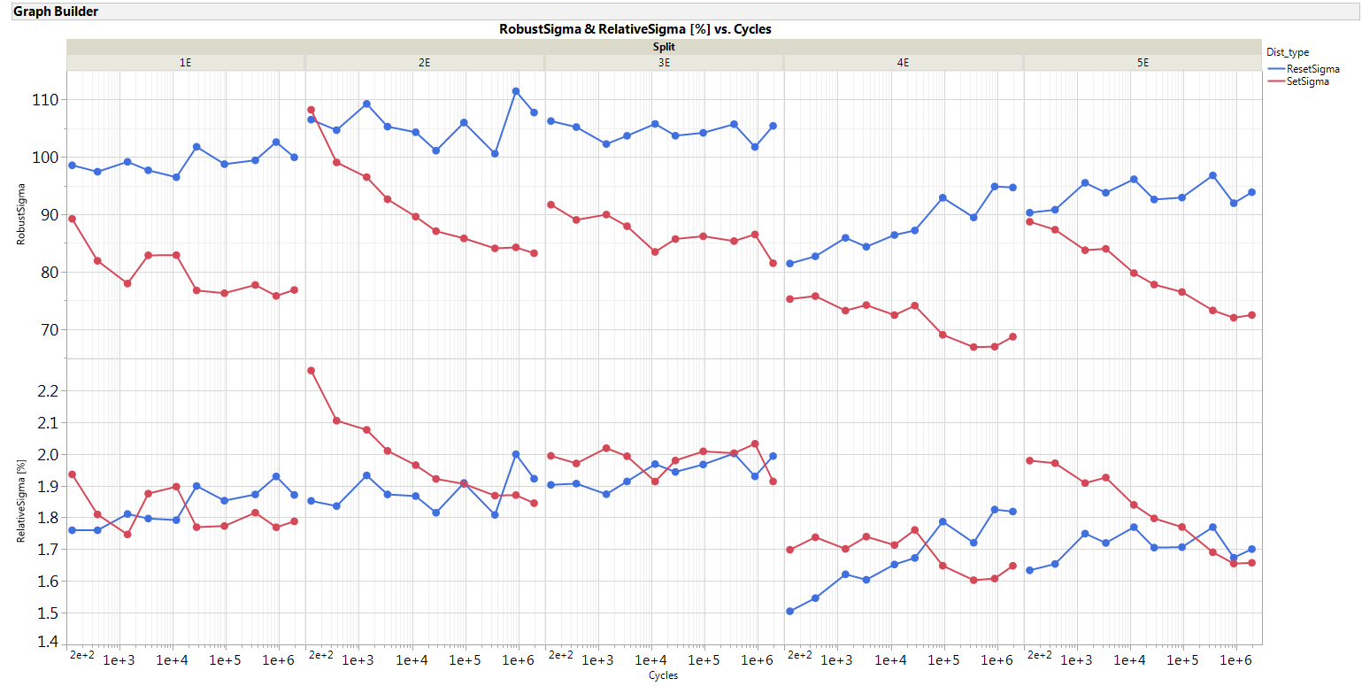
Absolute and relative robust sigma evolution by split
No WSiN split (4E/5E) have best sigma through all cycles

Slide 15
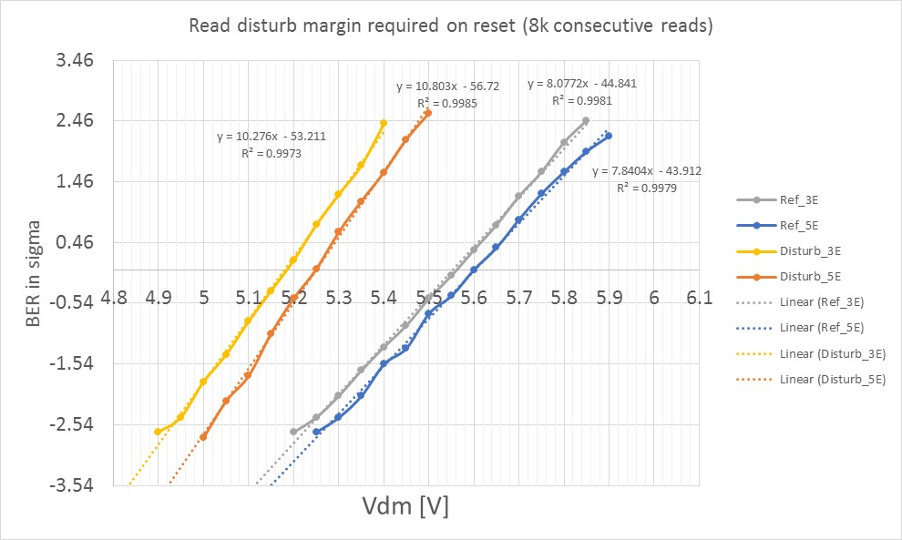
Read disturb (8k)
Margin required for 8k reads:
Split 3E=280mV
Split 5E=220mV
Need some more test to understand repeatability
Test worked correctly only for split 3E and 5E

Slide 17
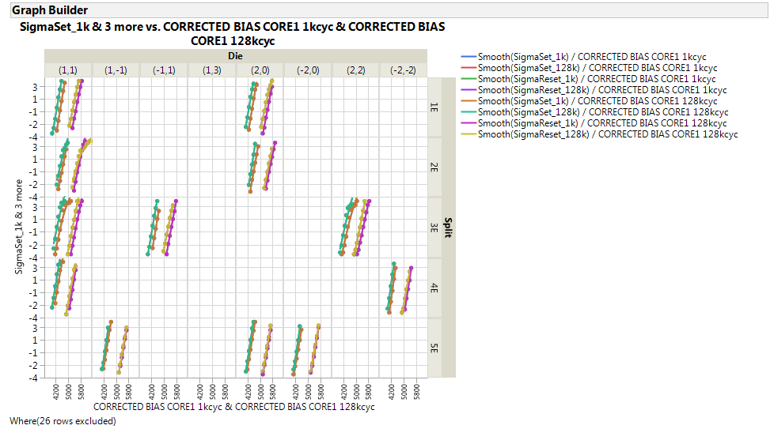
Data by split and by die

