Slide 1
Self-Select Memory IM JDP SOW
Version 2.0
February 23, 2018

Slide 2
Signature Page
This 3DXP Joint Development Program Statement of Work Rev 2.0 (“Self-Select Memory SOW”), having been approved by the JDP Committee is hereby approved by Intel and Micron respectively effective as of Feb 23, 2018, as signified by the signature of each company’s authorized representative below. It is understood and agreed that this JDP SOW may be amended in due course in accordance with the procedures set forth in the Joint Development Program Agreement.
MICRON TECHNOLOGY, INC |  |  | INTEL CORPORATION
By: |  |  | By:
Name: |  |  | Name:
Date: |  |  | Date:

Slide 3
Revision Page
Approval Date | REV | Pages Affected | Was | Is | Comments
Jan-20-2016 | 1.0 | ALL |  | Initial Self-Select Memory SOW
Feb-23-2018 | 2.0 | ALL |  | SSM technology and product SOW
Notes:
3

Slide 4
SOW Contacts
Name | Function | Company
Russ Meyer | JDP co-manager | Micron
Al Fazio | JDP co-manager | Intel
Mark Helm | Design | Micron
Matt Goldman | Design | Intel
Geetha Jayaraman | Product/Test Development | Intel
Kiran Pangal | Array Development | Intel
Fabio Pellizzer | Technology Development | Micron
DerChang Kau | Technology Development | Intel

Slide 5
SOW Contents
0.0 Purpose
1.0 Introduction
1.1 Background
1.2 Mission and Scope
2.0 Strategy
2.1 Strategy Overview
2.2 Bipolar Decoder Architecture
2.2 Scaling Strategy
3.0 Milestones
4.0 Cost analysis
5.0 Process Development
5.1 Risks
5.2 Cell Stack Definition
5.3 Process Architecture
6.0 Design SOW 6.1 Design Strategy 6.2 Key Specifications & Features 6.3 Design Milestones & Gates to Execution
7.0 Product/Test Development SOW
7.1 Array Development Strategy
7.2 Product Development Strategy
7.3 Wafer Test Strategy
7.4 Package Test Strategy
8.0 Budget

Slide 6
0.0 Purpose
The goal of the work is to validate Self-Select Memory, SSM, fundamentals for a Go/No-Go decision fast.
The intent and purpose of the document are –
To introduce SSM and alpha product for technology demonstration
To illustrate the strategy for “fast fail or succeed” with an alpha product
To establish milestones and incremental fail check based on the strategy
To define key activities and deliverables through the milestones
To define the resources and the budget to achieve the targeted deliverables

Slide 7
1.0 Introduction
Background, Mission and Scope

Slide 8
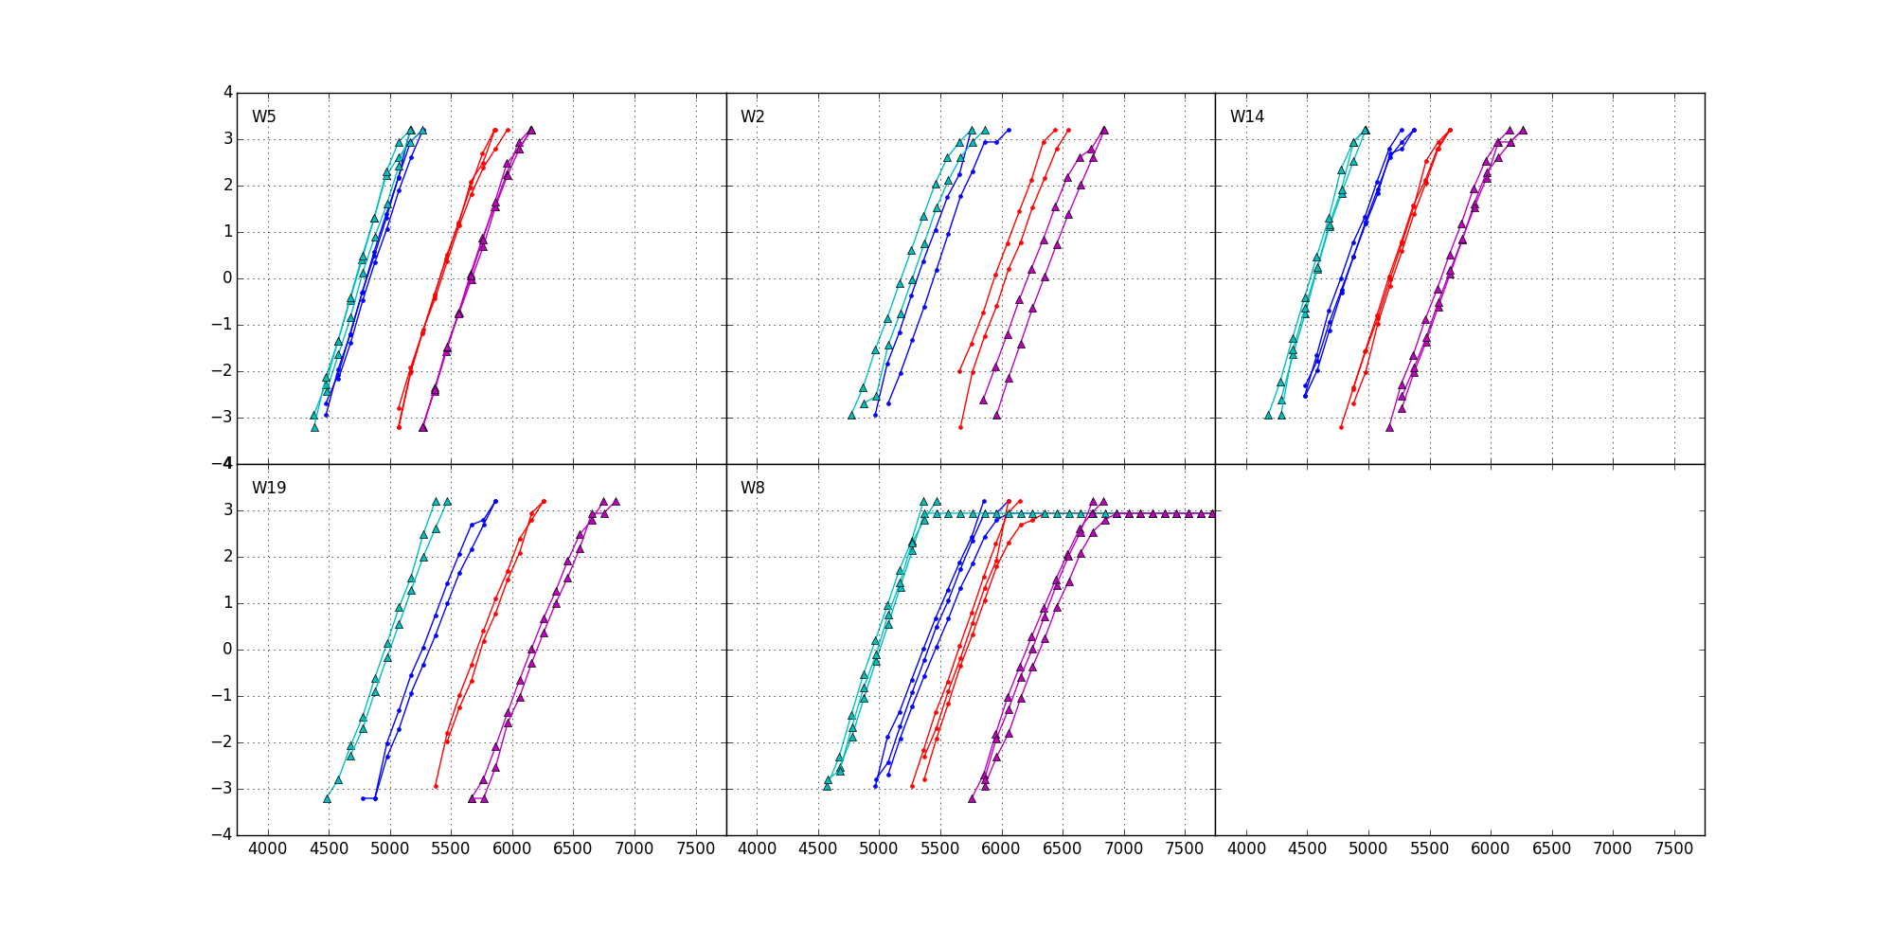
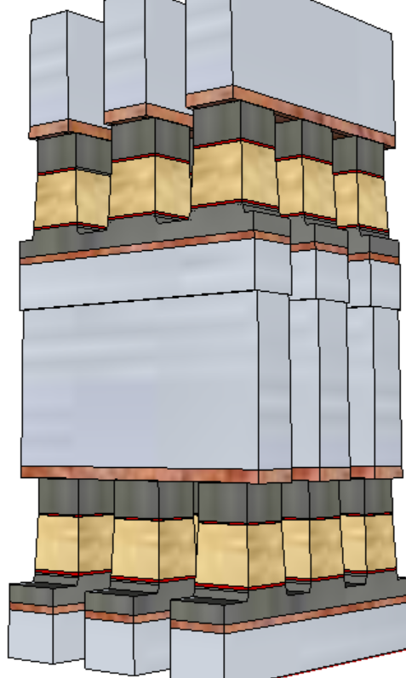
1.1 Background
+/+
−/+
S15B SD-only, lot 8792062, 18nm SDδ ver 4
Write/Read
Polarity
−/−
+/−
V_{T,High}
Positive
Write
σ of bit distribution
Pulse Polarity
Negative
read
TE
900mV
SD
V_{T,Low}
Negative
Write
Negative
read
BE
V_{TH} [mV]
Fundamentally, it is a 3DXP technology.
Physical construction of SSM array is BEOL 3D stackable X-Y cross point compatible with mainstream CMOS.
Read/write is to threshold a cell in a tile while the rest of cells are inhibited in subthreshold bias.
A V_{T} window (∆V_{T}) has been observed by applying programming pulses with opposite polarity. The best known ∆V_{T} physics is an electrochemical potential modulation by polarity.
Write – Band offset switching subject to mass transport (memory effects)
Read – Space Charge modulation resulting in voltage shift (memory window)

Slide 9
1.2 Mission & Scope
Mission
Scalability and Roadmap Development of 3D XPoint™ Technology
Scope
Seek for fundamental understandings of non-volatility of bipolar operation of SSM by demonstrating reliable Read Window Budget.
Validate bipolar decoder and power supply scheme with a multi-deck product by benchmarking density, energy and latency against the incumbent.
Develop world leading 3D XPoint product roadmap based on SSM physics, low cost process enablers and high efficiency decoding scheme.

Slide 10
2.0 Strategy
Overview & Scaling

Slide 11
2.1 Strategy Overview
“Fast fail or succeed” by building a 3DXP product for SSM
Test complete array in high volume and validate product worthiness by building prototypes
To minimize additional cell development beyond SSM pathfinding, the SSM process flow developed on S26A mask set will be exploited for alpha product demonstration.
Leverage 20’s infrastructure and synergy for high velocity development.
Bipolar Decoder Design
Fast implementation: based on S26A floor plan, inc. Pad
Low risk execution: S26A based CMOS technology & collateral @ minimum augmentation required
Algo development leverage by reusing S26 test infrastructure
Enable probe synergy with S26 PG1 specs at shorter write completion time
S26S Tapeout
Product vehicle: 256Gb in 197mm² @S26A Spec, plus
Power delivery for @ 240ns write completion testable
Fail or Succeed
20nm Startup Flow Defined
Structure and RWB demonstrated yield
DTS/MTS/RWB are consistent
Scaling Roadmap
Process architecture Stack (S26A like) vs. Tier (3DNAND-like)
SSM Switching Physics w/ 20nm Cell
Cell development (DTS/MTS) based on S26A scribe mini array and single cell structures (SR71, QTT, 2XCMOS)
Develop fundamental understanding of switching mechanism for tuning window and reducing distribution
20nm SSM Structure Yield
Establish S26A SSM-flow baseline and change control
Leverage with S26A yield improvement

Slide 12
2.2 Low Energy Bipolar Decoder Architecture
To meet energy spec of S26A, SSM requires Thick Gate nMOS Transistor (TGnMOST) development.
To fit TGnMOST bipolar decoders under tile, tighter DR will be needed.
Features | S26A | S24S (Design POR) | S26S
Density | 256Gb | 64Gb | 256Gb
Decoder | Unipolar | Bipolar with CMOS Pair | Bipolar with TGnMOST
Design Rule | S26A | S26A | To Be developed
Read/Write Throughput | 1600 / 800 MB/s | 930 / 527 MB/s | 1600 / 800 MB/s
Read / Write Energy | 52 / 118 pJ/b | 89 / 179 pJ/b | 52 / 118 pJ/b

Slide 13
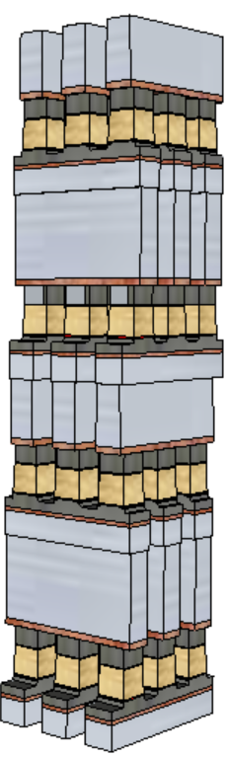
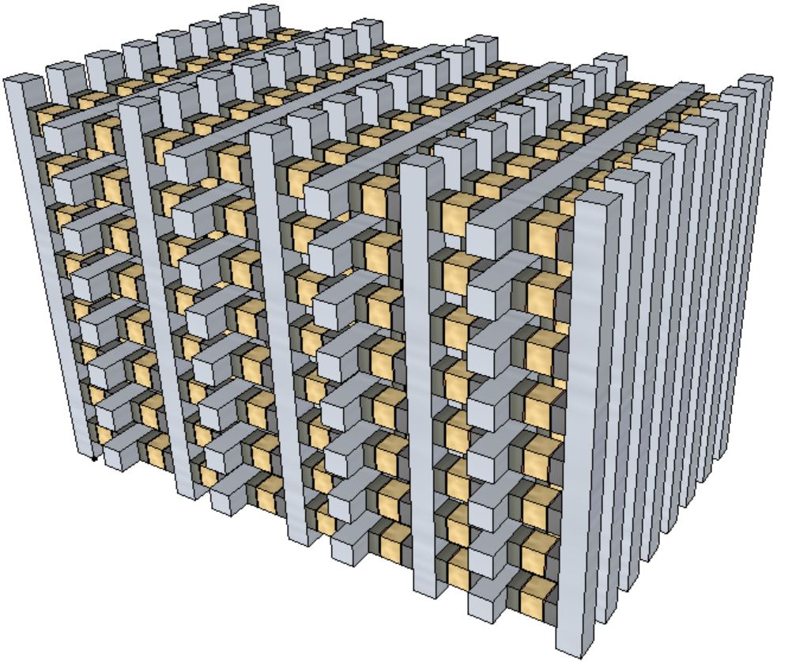
2.2 Scaling Strategy
Scaling Expectation
Density: doubling every generation
Latency: equal or reduce
Bandwidth/GB: Equal or improve
Expected Roadmap
Beyond Gen3
Reference architecture: SXP stack vs. 3D-NAND tier
Scalable architecture development starts when 1. Switching mechanism is manageable and 2. 20nm Product Vehicle is DBR’d
3D-stack
 | S26S | Gen2 | Gen3
Density/Die Size | 256Gb / 197mm² | 512Gb / 195mm² | 1Tb /<200mm²
half pitch | 20.5nm | 14nm | 10.25nm
Read/Write Latency | 95/240 ns | 80/240 ns | 80/80~120 ns
Read/Write Energy | 52/118 pJ/b | 26/59 pJ/b | 13/30 pJ/b
Read/Write Thruput | 1600/800 MB/s | 3200/1600 MB/s | 6400/3200 MB/s
I/O and Transfer Rate | DDR4 1600MT/s | DDR5 3200MT/s | DDR5 6400MT/s
3D-tier

Slide 14
3.0 Milestones
 |  | 2018 |  |  |  | 2019
 |  | Q1 | Q2 | Q3 | Q4 | Q1 | Q2 | Q3 | Q4
S24S | SSM RWB demonstrated on Dual Deck SR71
 | S24S DBR
 | PG4 RWB Demonstrated
 | PG1 RWB Demonstrated
S26S | SSM Collateral Release (TGnMOST, DR)
 | S26S DBR
 | Qual
Scaling Roadmap Pathfinding Starts
S26A PG1 PRQ

Slide 15
4.0 Cost Analysis
S26S Die size is the same as S26A
Bipolar decoders size should be equal or better than SXP counterpart.
Lower cost due to process simplification from partial etch architecture to single etch scheme.
Preliminary green-field analysis has been performed for cost-of-transition and cost-per-wafer
Based assumptions for the etch simplification of 20 series SXP technology
Higher yield expected due to SSM potentially overcoming several SXP issues, including
No cross-contamination between PM and SD
Lower cell aspect-ratio for etch and fill
Lower programming current ➔ Additional relaxation to metal (WL/BL) requirements for scaling
 | CoT ($M/1k) | Delta ($M/1k) | CPW | Delta
10s -> 20s MOR | 144.9 |  | $2,274.00
10s -> 4 Deck SSM | 114.8 | -30.1 | $2,040.00 | ($234.00)
10s -> 20s 2 Deck MOR | 26.1 |  | $1,559.29
10s -> 2 Deck SSM | 25 | -1.1 | $1,438.25 | ($121.04)

Slide 16
5.0 Process Development
Challenge, Cell definition and Process Architecture

Slide 17
5.1 Known Risks and Mitigation Strategy
Area | Issue | Mitigation Strategy
Memory Switching Mechanism | The best known mechanism is mass transport due to polarity. There are three risks associate with the mechanism What elements accountable for memory switching and process control/tuning of memory window Unable to quantify memory window subject to read polarity VT vs. PA/PW results not matching expectation (window expansion/saturation) | Composition skew and contamination control (including ambient). Cell morphology segmenation, including building two-deck SSM
Vt drift | Set drift is similar to SXP; however, reset drift is ½ of Set’s . No window expansion post drift. | Wider time-0 window to support single V_{DM} strategy True spec reset drift for alternative dual V_{DM} strategy
Reset Read Disturb | 300mV of Reset V_{T} reduction is observed after 20K Read cycles | Segment Reset V_{T} shift mechanism

Slide 18
5.2 Cell Definition
Initial cell development will be done on SR71B in S26A mask set, for both first and second deck.
The result will be S26S startup MTS
Write performance (write current and pulse width) and Read Window Budget must enable S26S qual
Product validation
S26S array experiment and characterization enables SSM optimization for S26A qual.
Item | Working Assumption / Status | Strategy / Key Enabling Factors
SD exploration | POR is SD2V16 | Explore composition skew on the class of SD1 and SD2 Deploy 3DXP material exploration BKM, including L0 thin film characterization L1 Cantilever process and characterization L1D on pitch process development and inline characterization L2 full loop process with physical and electrical assessment
Laminas | POR is 5Å Al₂O₃ sandwich SD | L1D and L2 for assessment
Electrodes | POR is the same as S26A’s TE and BE | Synergize with SXP counterpart Further optimization with L1D and L2 if needed
WL/BL metals | POR is the same as S26A’s | Synergize with SXP counterpart Further optimization with L1D and L2 if needed
Etch Profile | POR is same as S26A’s (≥89°) | L1D and L2 with etch experiment
Seal/fill | POR is same as S26A’s (no liner) | L1D and L2 including partial liner for profile engineering and transfer function tuning and contamination control

Slide 19
5.3 Process Architecture
CMOS and BEOL
High level of synergy to S26A
Adding Thick Gate nMOS Transistor for decoder, process and collateral development required.
Array Process
Structural yield on wafer will be evaluated and improved on S26A main array, 1-and 2-deck structural yield (now), may be extended to 4 decks before S26S TO (if needed)
 | S15C 41nm pitch / 2-deck 2Kx4K Tile | S26A 41nm pitch / 4-deck 4Kx4K Tile | S26S 41nm pitch / 4-deck 4Kx4K Tile
CMOS | 19 mask levels Dual gate CMOS (23A/110A) | No change from 10s HV CMOS width scaling | Copy from S26A Adding Thick gate nMOS Transistor for S26S
M1-M4 (Cu) | M1 single-damascene Cu M2-M4 dual-damascene Cu All 193-dry levels | M1, M4 single damascene Cu M2-M3 dual damascene Cu V3 and M4 goes 193i (+2) | Same as S26A
Array levels | 2 decks ➔ 4 PD levels 3 OPV levels 7 193i levels for array | 4 decks ➔ 8 PD levels 5 OPV levels 13 193i levels for array | Copy from S26A simplified cell stack and BL/WL patterning scheme
Top Metal / Passivation | Thick Al, SiO2+SiON Passivation, Polyimide | No Change | No Change

Slide 20
6.0 Design SOW

Slide 21
6.1 Design Strategy
Enable path to fast fail or success (S24S) by minimizing non-cell related design risks
Fork S26A3 database and disposition each post silicon issue’s impact on S24S ability to enable SSM learning
No changes to periphery or high speed IO circuits
No changes in die size, pad positions, or externally supplied voltage rails
Focused changes in address path and partition control logic to enable bidirectional operation
S24S (Design POR):
Inhibit 50% of the array drivers to provide area for new bipolar predrivers
Add tile level polarity control and update partition control logic to enable bipolar operation with SSM read/write algorithms

Slide 22
6.2 Key Specifications & Features
Features | S26A | S24S (Design POR)
Density | 256Gb | 64Gb
Die Size | 197mm² | 197mm²
I/O Performance (Interface) | 1600MT/s/pin (DDR4) | 1600MT/s/pin (DDR4)
Read Latency | 95ns | 95ns
Write Completion Time | 475ns | 240ns
Read/Write Throughput | 1600 / 800 MB/s | 930 / 527 MB/s
Read / Write Energy | 52 / 118 pJ/b | 89 / 179 pJ/b
Power Supplies | Vdd=Vddq=1.2V Vhh=3.3, Vpp=5.3, Vnn=-4.7V | Vdd=Vddq=1.2V Vhh=3.3, Vpp=5.3, Vnn=-4.7V
S24S density reduced by 75% to provide area to support bipolar decoders without any design rule changes
Write completion time reduction based on proposed SSM write functionality
Bipolar decoder functionality projected to increase read/write energy by 71%/51%
Read/write bandwidth aligned to match S26A equivalent power envelope

Slide 23
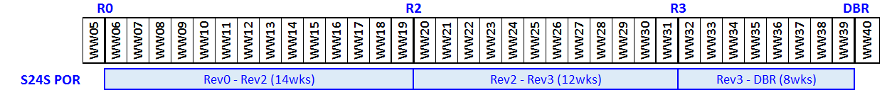
6.3 Design Milestones & Gates to Execution
Milestone | Criteria
Rev 2 | Sheet level performance validation complete / circuits ready for layout
Rev 3 | Full chip functional and performance validation of features, specifications and test modes
DBR | Database Ready for Manufacturing
Limited scope of change enables a direct path to Rev2 without requiring Rev1 alignment
Very little design overlap between S24S and S26S / replan required

Slide 24
7.0 Product/Test Development
Array, Product and Wafer/Package Tests development

Slide 25
7.1 Array Development Strategy
Array development through both SR71 and S26S including algorithms and trims for bipolar operation for technical risk assessment meeting product requirements and support the technology go or no go decision.
JDP Reliability teams will jointly support development of volume and bench level reliability data collection to enable technology and Product development.

Slide 26
7.2 Product Development Strategy
JDP PE teams will jointly support product design validation, characterization, and debug.
JDP PE teams will jointly support definition and implementation of all wafer and package test flows.
JDP PE teams will jointly develop all H/W and S/W capabilities needed to support:
µProbe / Wafer debug and EFA
Interface Validation/Characterization
Array Characterization
Package EFA
JDP PE teams will jointly support product and test flow optimization to enable technology development, product qualification, and HVM.
JDP Reliability teams will jointly develop wafer and package test reliability flows and development line sampling plans for both intrinsic and extrinsic CMOS and array reliability issues.

Slide 27
7.3 Wafer Test Strategy
JDP Probe teams will jointly develop all wafer test capability required to support the technology development and the full product specification. The required test flows are defined by the Product Engineering team. Flows may include:
Wafer Test Flow
Wafer Speed Binning Flow
WLR / ICF / ECF Flows
Wafer Level SR71 volume testing
JDP and IMFT Probe teams will jointly develop all H/W and S/W required to support the wafer test flows.

Slide 28
7.4 Package Test Strategy
JDP Test teams will jointly develop all package test capability required to support the technology development and the full product specification (S26S). Required test flows are defined by the Product Engineering team. Flows may include:
PGSRT
Hot Sort
Cold Final
Burn-in
JDP teams will jointly identify package test platforms which meet the technology development and product requirements.
JDP Test teams will jointly develop all H/W and S/W required to support the package test flows.

Slide 29
8.0 Budget
This SOW project scope and activities for 2018 are to be consistent with the 2018 SXP JDP budget.
Budgets for subsequent years of this SOW will be adopted on a yearly basis, as part of the overall SXP JDP budget.

Slide 30
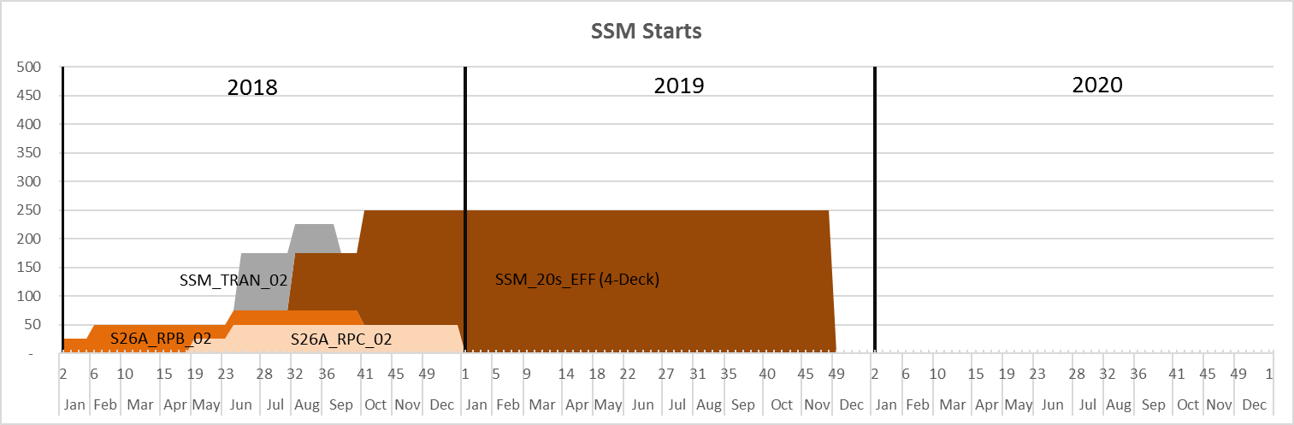
8.0 Budget
This SOW project scope and activities for 2018 are to be consistent with the 2018 SXP JDP budget.
Budgets for subsequent years of this SOW will be adopted on a yearly basis, as part of the overall SXP JDP budget.
20nm SSM Starts Plan

