Slide 1
Self-Select Memory IM JDP SOW
Version 2.0
January 31, 2018

Slide 2
Signature Page
This 3DXP Joint Development Program Statement of Work Rev 2.0 (“Self-Select Memory SOW”), having been approved by the JDP Committee is hereby approved by Intel and Micron respectively effective as of mmm dd, 2018, as signified by the signature of each company’s authorized representative below. It is understood and agreed that this JDP SOW may be amended in due course in accordance with the procedures set forth in the Joint Development Program Agreement.
MICRON TECHNOLOGY, INC |  |  | INTEL CORPORATION
By: |  |  | By:
Name: |  |  | Name:
Date: |  |  | Date:

Slide 3
Revision Page
Approval Date | REV | Pages Affected | Was | Is | Comments
Jan-20-2016 | 1.0 | ALL |  | Initial Self-Select Memory SOW
Jan-31-2018 | 2.0 | ALL |  | SSM technology and product SOW
Notes:
3

Slide 4
SOW Contacts
Name | Function | Company
Russ Meyer | JDP co-manager | Micron
Al Fazio | JDP co-manager | Intel
Mark Helm | Design | Micron
Matt Goldman | Design | Intel
Geetha Jayaraman | Product/Test Development | Intel
Kiran Pangal | Array Development | Intel
Fabio Pellizzer | Technology Development | Micron
DerChang Kau | Technology Development | Intel

Slide 5
SOW Contents
0.0 Purpose
1.0 Introduction
1.1 Background
1.2 Mission and Scope
3.0 Strategy
3.1 Overview
3.2 Development Vehicles
3.3 Alpha Product
3.4 Scaling Roadmap
4.0 Milestones & Check points
5.0 Cost analysis
6.0 Process Development
6.1 Risks
6.2 Cell Stack Definition
6.3 Process Architecture
7.0 Design SOW 7.1 Key Product Specs & Constraints 7.2 Design Strategy Overview 7.3 Design Strategy Details 7.4 Design Milestones & Gates to Execution
8.0 Product/Test Development SOW
8.1 Array Development Strategy
8.2 Product Development Strategy
8.3 Wafer Test Strategy
8.4 Package Test Strategy
9.0 Budget & Assumptions
Backup (success criterial, spec and other placeholder)

Slide 6
0.0 Purpose
The goal of the work is to validate Self-Select Memory, SSM, fundamentals for a Go/No-Go decision fast.
The intent and purpose of the document are –
To introduce SSM and alpha product for technology demonstration
To illustrate the strategy for “fast fail or succeed” with an alpha product
To establish milestones and incremental fail check based on the strategy
To define key activities and deliverables through the milestones
To define the resource and the budget to achieve the targeted deliverables

Slide 7
1.0 Introduction
Background, Mission and Scope

Slide 8
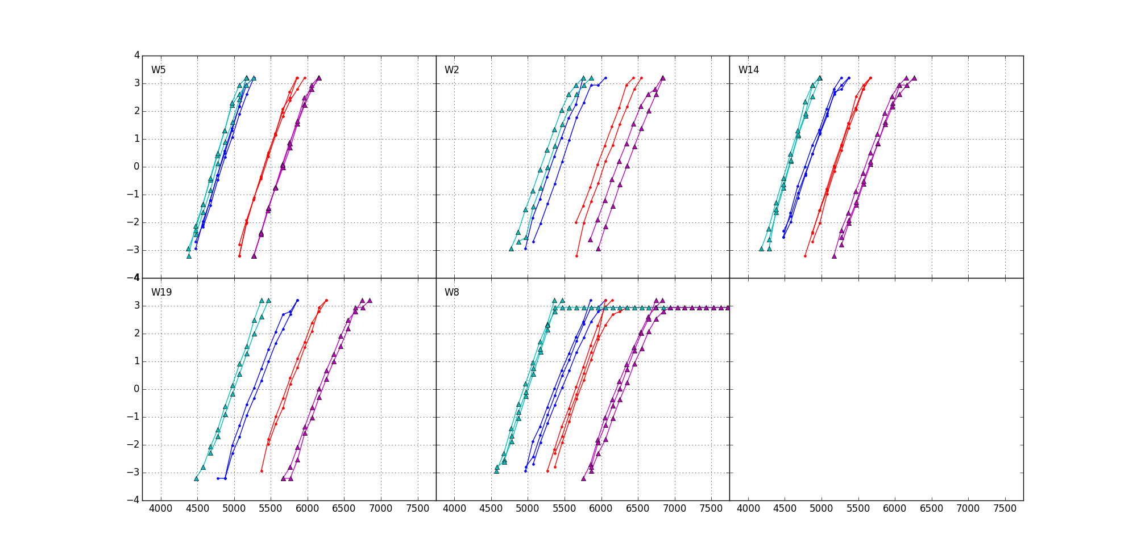
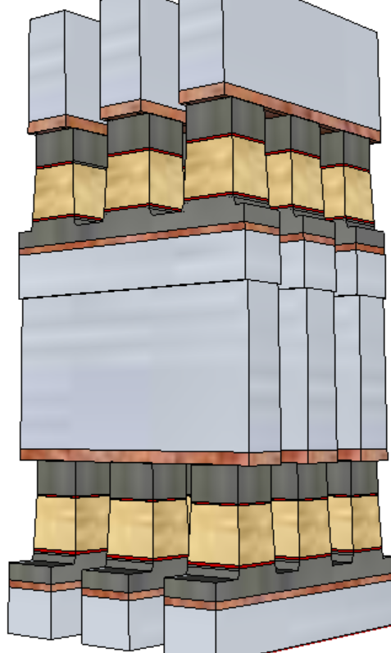
1.1 Bakground
+/+
−/+
S15B SD-only, lot 8792062, 18nm SDδ ver 4
Write/Read
Polarity
−/−
+/−
V_{T,High}
Positive
Write
σ of bit distribution
Pulse Polarity
Negative
read
TE
900mV
SD
V_{T,Low}
Negative
Write
Negative
read
BE
V_{TH} [mV]
Fundamentally, it is a 3DXP technology.
Physical construction of SSM array is BEOL 3D stackable X-Y cross point comptatible with mainstream CMOS.
Read/write is to threshold a cell in a tile while the rest of cells are inhibited in subthreshold bias.
A V_{T} window (∆V_{T}) has been observed by applying programming pulses with opposite polarity. The best known ∆V_{T} physics is an electrochemical potential modulation by polarity.
Write – Band offset switching subject to mass transport (memory effects)
Read – Space Charge modulation resulting in voltage shift (memory window)

Slide 9
1.2 Mission & Scope
Mission
Scalability and Roadmap Development of 3D XPoint™ Technology
Scope
Seek for fundamental understandings of non-volatility of bipolar operation of SSM by demonstrating reliable Read Window Budget.
Validate bipolar decoder and power supply scheme with a multi-deck product by benchmarking density, energy and latency against the incumbent.
Develop world leading 3D XPoint product roadmap based on SSM physics, low cost process enablers and high efficiency decoding scheme.

Slide 10
3.0 Strategy
Overview, Development Vehicles, Alpha Product and Scaling Roadmap

Slide 11
3.1 Strategy Overview
“Fast fail or succeed” by building a 3DXP product for SSM
Test complete array in high volume and validate product worthiness by building prototypes
To minimize additional cell development beyond SSM pathfinding, the SSM process flow developed on S26A mask set will be exploited for alpha product demonstration.
Leverage 20’s infrastructure and synergy for high velocity development.
Bipolar Decoder Design
Fast implementation: based on S26A floor plan, inc. Pad
Low risk execution: S26A based CMOS technology & collateral @ minimum augmentation required
Algo development leverage by reusing S26 test infrastructure
Enable probe synergy with S26 PG1 specs at shorter write completion time
S26S Tapeout
Product vehicle: 256Gb in 197mm² @S26A Spec, plus
Power delivery for @ 245ns write completion testable
Fail or Succeed
20nm Startup Flow Defined
Structure and RWB demonstrated yield
DTS/MTS/RWB are consistent
Scaling Roadmap
Process architecture Stack (S26A like) vs. Tier (3DNAND-like)
SSM Switching Physics w/ 20nm Cell
Cell development (DTS/MTS) based on S26A scribe mini array and single cell structures (SR71, QTT, 2XCMOS)
Develop fundamental understanding of switching mechanism for tuning window and reducing distribution
20nm SSM Structure Yield
Establish S26A SSM-flow baseline and change control
Leverage with S26A yield improvement

Slide 12
3.2 Development Vehicles
S26A – Live die and the scribe structures of S26A (20nm node) Plate-set
Dual deck process: product die structure yield learning for SSM baseline process flow
Single Cell: Basic bipolar characterization capability is established with the 2xCMOS test structure.
QTT (quarter-tile size mini array): A electrically bi-directional operable mini array test structure.
SR71 (one full tile array) – A bi-directional decoded, operable 512K addressable array:
S26S – A 20nm node bipolar 3DXP product in compliance with S26A spec
Features | S26A | S26S
Density | 256Gb | 256Gb
Die Size | 197mm² | 197mm²
Array Architecture | Quilt | Quilt
Number of Partitions | 32 | 32
I/O Performance (Interface) | 1600MT/s/pin (DDR4) | 1600MT/s/pin (DDR4)
Read Latency | 95ns | 95ns
Write Completion Time | 475ns | 240ns
Read/Write Throughput | 1600 / 800 MB/s | 1600 / 800 MB/s
Read / Write Energy | 52 / 118 pJ/b | 52 / 118 pJ/b
Power Supplies | Vdd=Vddq=1.2V Vhh=3.3, Vpp=5.3, Vnn=-4.7V | Vdd=Vddq=1.2V Vhh=3.3, Vpp=5.3, Vnn=-4.7V

Slide 13
3.3 Alpha Product
To build with S26S in compliance with S26A spec @ ½ set time.
Test complete array in high volume and validate product worthiness by building prototypes
High level of synergy and reuse with 20series in design, tests and collateral
Additional Thick Gate nMOS Transistor (TGnMOST) is required in order to meet S26A energy spec
S26S Design Start
100% S26A collateral
CMOS Bipolar Decoder for placeholder (no HV Stress)
20~50% high switching energy
Wafer level testable for SSM functionality @ ½ of set time
Power/thermal envelope prohibitive for full throttle component test (system level validation)
TGnMOST Collateral Development
Silicon meeting Vt, leakage and Idlin/Idsat
Favorable to
‘fast fail’
EoQ1 assessment for Q3 TO
First Stepping
w/o TGnMOST
Validation at lower BW
TGnMOST
Collateral Ready
Change CMOS decoder scheme to TGnMOST decoder scheme
Design to S26A full spec, compatible to S25A full spec
Spec-compliant S26S stepping
w/ TGnMOST

Slide 14
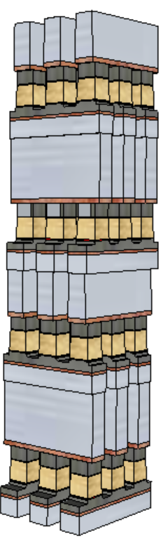
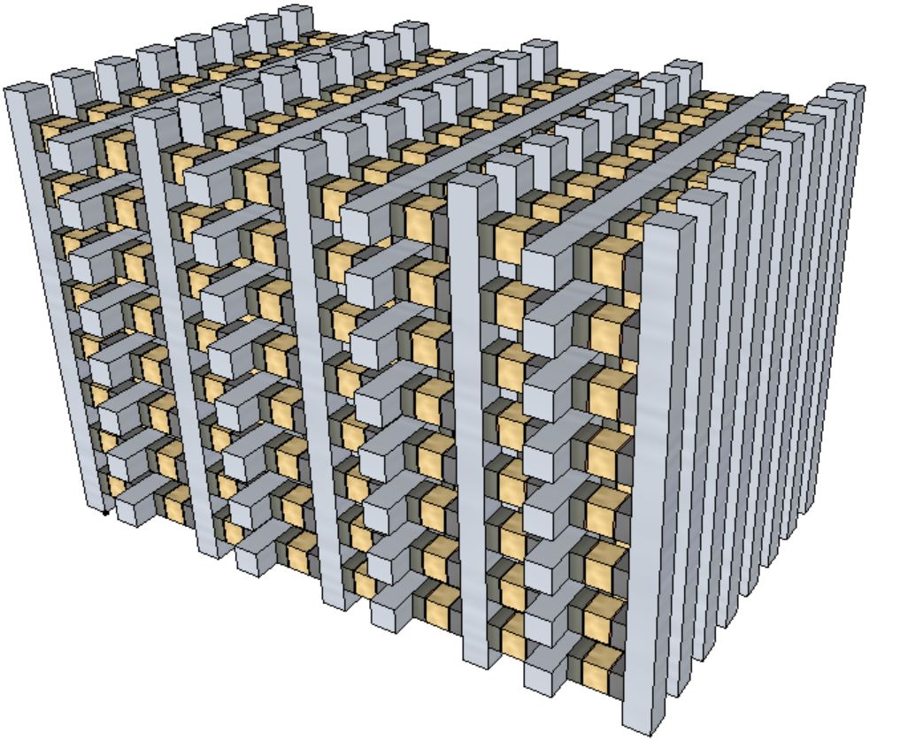
3.4 Scaling Roadmap
Architecture
SSM memory switching physics is the foundation
Scalable cell architecture will be established based on RWB tuning enablers.
Low cost process architecture will be developed in accordance to cell architecture.
Scalable memory core architecture will be developed based on cell architecture and scaling requirement for density and performance.
Scaling rule of thumb
Density: doubling every generation
Latency: equal or reduce
Bandwidth/GB: Equal or improve
Reference architecture: SXP stack vs. 3D-NAND tier
Scalable architecture development starts when switching mechanism is manageable and S26S DBR’d
3D-stack
3D-tier

Slide 15
4.0 Milestones & Fail Check
# | Objectives as measured by | ECD (Calendar year)
1 | SSM switch mechanism validated with Dual Deck silicon (SR71) S26S D0 vs. D1 Read/Write polarity defined; No RWB showstopper on paper | Q2/2018
2 | S26S DBR S26S matching S26A3 die size, spec @ ½ set speed S26S Startup flow defined | Q3/2018
3 | S26S Probe yielding @ PG1 spec Silicon demonstrated, no show stopper on bipolar ops. | Q2/2019
4 | S26S Memory Qual As measured by qual success criteria @ ½ set speed | Q4/2019

Slide 16
5.0 Cost Analysis
S26S Die size is the same as S26A
Bipolar decoders size should be equal or better than SXP counterpart.
Lower cost due to consolidate partial etch architecture to single etch scheme (and cell sealing).
Higher yield expected due to SSM potentially overcomes several SXP issues, including
No cross-contamination between PM and SD
Lower cell aspect-ratio for etch and fill
Lower programming current ➔ Additional relaxation to metal (WL/BL) requirements for scaling
Preliminary green-field analysis has been performed for cost-of-transition and cost-per-wafer
Based assumptions for the etch simplification of 20 series SXP technology
 | CoT ($M/1k) | Delta ($M/1k) | CPW | Delta
10s -> 20s MOR | 144.9 |  | $2,274.00
10s -> 4 Deck SSM | 114.8 | -30.1 | $2,040.00 | ($234.00)
10s -> 20s 2 Deck MOR | 26.1 |  | $1,559.29
10s -> 2 Deck SSM | 25 | -1.1 | $1,438.25 | ($121.04)

Slide 17
6.0 Process Development

Slide 18
6.1 Known Risks and Mitigation Strategy
Area | Issue | Mitigation Strategy
Memory Switching Mechanism | The best known mechanism is mass transport due to polarity. There are three risks associate with the mechanism What elements accountable for memory switching and process control/tuning of memory window Unable to quantify memory window subject to read polarity VT vs. PA/PW results not matching expectation (window expansion/saturation) | Composition skew and contamination control (including ambient). Cell morphology segmenation, including building two-deck SSM
Vt drift | Set drift is similar to SXP; however, reset drift is ½ of Set’s . No window expansion post drift. | Wider time-0 window to support single V_{DM} strategy True spec reset drift for alternative dual V_{DM} strategy
Reset Read Disturb | 300mV of Reset V_{T} reduction is observed after 20K Read cycles | Segment Reset V_{T} shift mechanism

Slide 19
6.2 Cell Definition
Initial cell development will be done on SR71B in S26A mask set, for both first and second deck.
The result will be S26S startup MTS
Write performance (write current and pulse width) and Read Window Budget must enable S26S qual
Product Validation
S26S array experiment and characterization enables SSM optimization for S26A qual.
Item | Working Assumption / Status | Strategy / Key Enabling Factors
SD exploration | POR is SD2V16 | Explore composition skew on the class of SD1 and SD2 Deploy 3DXP material exploration BKM, including L0 thin film characterization L1 Cantilever process and characterization L1D on pitch process development and inline characterization L2 full loop process with physical and electrical assessment
Laminas | POR is 5Å Al₂O₃ sandwich SD | L1D and L2 for assessment
Electrodes | POR is the same as S26A’s TE and BE | Synergize with SXP counterpart Further optimization with L1D and L2 if needed
WL/BL metals | POR is the same as S26A’s | Synergize with SXP counterpart Further optimization with L1D and L2 if needed
Etch Profile | POR is same as S26A’s (≥89°) | L1D and L2 with etch experiment
Seal/fill | POR is same as S26A’s (no liner) | L1D and L2 including partial liner for profile engineering and transfer function tuning and contamination control

Slide 20
6.3 Process Architecture
CMOS and BEOL
High level of synergy to S26A
Adding Thick Gate nMOS Transistor for decoder
Array Process
Structural yield on wafer will be evaluated and improved on S26A main array, 1-and 2-deck structural yield (now), may be extended to 4 decks before S26S TO (if needed)
 | S15C 41nm pitch / 2-deck 2Kx4K Tile | S26A 41nm pitch / 4-deck 4Kx4K Tile | S26S 41nm pitch / 4-deck S26S 4Kx4K Tile
CMOS | 19 mask levels Dual gate CMOS (23A/110A) | No change from 10s HV CMOS width scaling | Copy from S26A Adding Thick gate nMOS Transistor for S26S
M1-M4 (Cu) | M1 single-damascene Cu M2-M4 dual-damascene Cu All 193-dry levels | M1, M4 single damascene Cu M2-M3 dual damascene Cu V3 and M4 goes 193i (+2) | Same as S26A
Array levels | 2 decks ➔ 4 PD levels 3 OPV levels 7 193i levels for array | 4 decks ➔ 8 PD levels 5 OPV levels 13 193i levels for array | Copy from S26A simplified cell stack and BL/WL patterning scheme
Top Metal / Passivation | Thick Al, SiO2+SiON Passivation, Polyimide | No Change | No Change

Slide 21
7.0 Design SOW

Slide 22
7.1 Key Product Specs & Constraints
Key specs that will change or that will be a challenge to maintain vs S26A
Broad class of specs that will be unchanged vs S26A
Other spec or product constraints that design must meet
diesize / pad positions / available voltages

Slide 23
7.2 Design Strategy Overview
Decoders to be updated and fit in same space
Termination/drivers to be updated accordingly
Polarity control logic to be added
Read algo essentially unchanged from S26A
Write algo to be updated/simplified version of SET/RST from S26A
Validation focused on decode path and algo changes

Slide 24
7.3 Design Strategy Details
Item | Strategy | Details

Slide 25
7.4 Design Milestones & Gates to Execution
Milestone breakdown & associated key external risks/deliverables

Slide 26
8.0 Product/Test Development

Slide 27
8.1 Array Development Strategy
Array development through both SR71 and S26S including algorithms and trims for bipolar operation for technical risk assessment meeting product requirements and support the technology go or no go decision.
JDP Reliability teams will jointly support development of volume and bench level reliability data collection to enable technology and Product development.

Slide 28
8.2 Product Development Strategy
JDP PE teams will jointly support product design validation, characterization, and debug.
JDP PE teams will jointly support definition and implementation of all wafer and package test flows.
JDP PE teams will jointly develop all H/W and S/W capabilities needed to support:
µProbe / Wafer debug and EFA
Interface Validation/Characterization
Array Characterization
Package EFA
JDP PE teams will jointly support product and test flow optimization to enable technology development, product qualification, and HVM.
JDP Reliability teams will jointly develop wafer and package test reliability flows and development line sampling plans for both intrinsic and extrinsic CMOS and array reliability issues.

Slide 29
8.3 Wafer Test Strategy
JDP Probe teams will jointly develop all wafer test capability required to support the technology development and the full product specification. The required test flows are defined by the Product Engineering team. Flows may include:
Wafer Test Flow
Wafer Speed Binning Flow
WLR / ICF / ECF Flows
JDP and IMFT Probe teams will jointly develop all H/W and S/W required to support the wafer test flows.

Slide 30
8.4 Package Test Strategy
JDP Test teams will jointly develop all package test capability required to support the technology development and the full product specification. Required test flows are defined by the Product Engineering team. Flows may include:
PGSRT
Hot Sort
Cold Final
Burn-in
JDP teams will jointly identify package test platforms which meet the technology development and product requirements.
JDP Test teams will jointly develop all H/W and S/W required to support the package test flows.

Slide 31
9.0 Budget
This SOW project scope and activities for 2018 are to be consistent with the 2018 SXP JDP budget.
Budgets for subsequent years of this SOW will be adopted on a yearly basis, as part of the overall SXP JDP budget.

Slide 32
Backup
Including Placeholder for Device Target and Reliability Specitication

Slide 33
SSM DTS Rev 0
PG1/T1 | S26S | S26A
FF 100% bits [V] | 7.5~8.5 | 9.1
Set Vth [V] | 4.2~4.7 | 4.65
Set Vth sigma [mV] | 100~120 | 105
Reset Vth [V] | 5.2~6.0 | 5.95
Reset Vth sigma [mV] | 100~110 | 90
Vth window [V] | 1.4~1.6 | 1.3
True window @ 3.54σ [mV] | 150~400 | 610
Max Vth customer [V] | 6.5~7.0 | 7.7
Time 0 BER | 5e-5 | 5e-5
Set pulse total duration [ns] | 20~40 | 240
Set current [uA] | 25~50 | 3E-SET
Reset pulse total duration [ns] | 20~40 | 5-10
Reset current [uA] | 25~50 | <125
Min Prog-to-read delay [ns] | 1000 | 1000
Read method | SSR | SSR
Tsense [ns] | 30 | 30
PG1/T1 | SSM | S26A
Set read disturb | Negligible | 256k reads
Reset read disturb | 5k reads with 250mV of margin (256k reads with +100mV additional margin) | 256k reads
Write disturb | 512k cycles | 2048 NW
Write endurance | 10Mcycles | 4M NW
Vth shift @ max cycles [mV] | +200 | -150
Read endurance | 400Mreads | 400Mreads (with 1 FW every 5kreads)
Retention | 3day 0C-85C + 7yrs@40C | 2day 0C-85C + 7yrs@40C
Vth shift @ max retention [mV] | +600 | +650

