Slide 1
Self-Select Memory Research
IM JDP SOW
Version 2.0
January dd, 2018

Slide 2
Signature Page
This 3DXP Joint Development Program Statement of Work Rev 2.0 (“Self-Select Memory SOW”), having been approved by the JDP Committee is hereby approved by Intel and Micron respectively effective as of mmm dd, 2018, as signified by the signature of each company’s authorized representative below. It is understood and agreed that this JDP SOW may be amended in due course in accordance with the procedures set forth in the Joint Development Program Agreement.
MICRON TECHNOLOGY, INC |  |  | INTEL CORPORATION
By: |  |  | By:
Name: |  |  | Name:
Date: |  |  | Date:

Slide 3
Revision Page
Approval Date | REV | Pages Affected | Was | Is | Comments
Jan-20-2016 | 1.0 | ALL |  | Initial Self-Select Memory SOW
Jan-dd-2018 | 2.0 | ALL |  | Technology Feasibility Validation SOW
Notes:
3

Slide 4
SOW Contacts
Name | Function | Company
Hideki Gomi | JDP co-manager | Micron
Al Fazio | JDP co-manager | Intel
Mark Helm | Design | Micron
Dan Elmhurst | Design | Intel
Kiran Pangal | Array Development, including Product/Test | Intel
Fabio Pellizzer | Technology Development | Micron
DerChang Kau | Technology Development | Intel

Slide 5
SOW Contents
0.0 Purpose
1.0 Background
2.0 Scope
3.0 Strategy
4.0 Milestones
5.0 Design
6.0 Process
7.0 Test
8.0 Budget & Assumptions
Backup (success criterial placeholder)

Slide 6
0.0 Purpose

Slide 7
Purpose of SOW Rev 2.0
To Introduce self-select memory and value propostion
To define the pathfinding strategy for 3DXP technology
To define project deliverables through calendar year 2018
To define metrics and success criteria for progress tracking and decision making
To define the resource and the budget to achieve the targeted deliverables

Slide 8
1.0 Background
Introduction to self-select memory and value proposition

Slide 9
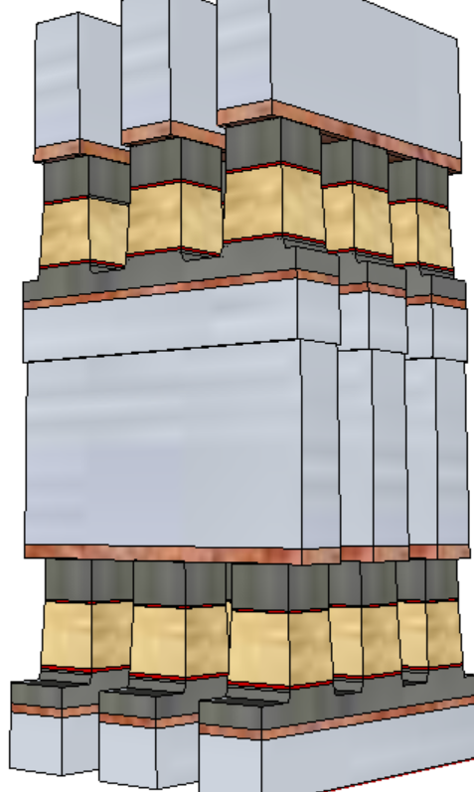
What is Self-Select Memory (SSM)
S15B SD-only, lot 8792062, 18nm SDδ ver 4
Pulse Polarity
V_{T,High}
Positive
Write
Negative
read
TE
SD
V_{T,Low}
Negative
Write
Negative
read
BE
Fundametally, it is a 3DXP technology.
  Physical construction of SSM array is BEOL 3D stackable X-Y cross point comptatible with mainstream CMOS.
  Read/write is to threshold select one cell while forward subthreshold to inhibit the rest of cells in a tile.
A V_{T} window (∆V_{T}) has been observed by applying programming pulses with opposite polarity. The best known ∆V_{T} physics is an electrochemical potential modulation effect subject to mass transport by polarity.
  Leakage characteristics of SD is unlikely to sustain a charge-trap nonvolatile memory model.
  Bipolar Read signature refutes filamentation.
  Bipolar Write supports mass transport between electrodes.

Slide 10
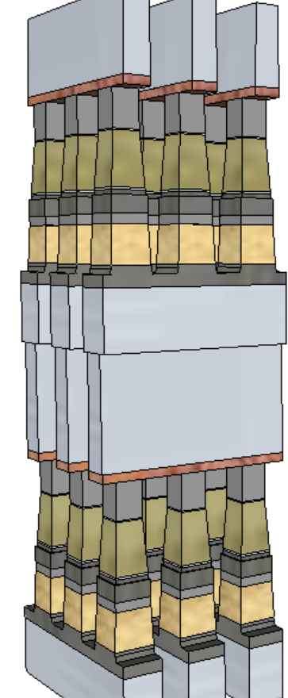
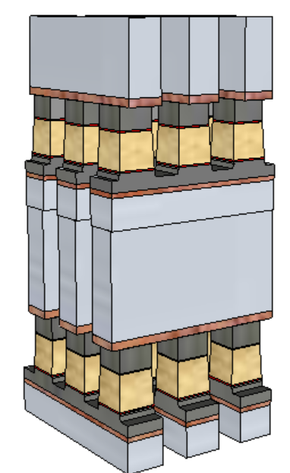
Potential Process Simplification (20nm Comparison)
SSM potentially overcomes several SXP issues
  No cross-contamination between PM and SD
  Lower cell aspect-ratio simplifies the cell sealing
  Lower programming current ➔ relaxes metal (WL/BL) requirements and associated array capacitance
 | 1st Cut |  | 2nd Cut
 | SXP | SSM | SXP | SSM
Stack height [nm] | 141 | 69 | 152 | 85
Stack Height, inc. HM [nm] | 296 | 142.6 | 297 | 191.7
Height/ Space for FP [nm] | 212.5/25.5 |  | 261/21.7
Height/ Space for LP [nm] | 246/19.6 | 142.6/19.6 | 182/18.4 | 191.7/18.4
Space Aspect Ratio for FP | 6.4 |  | 6.7
Space Aspect Ratio for LP | 8.4 | 4.8 | 9.1 | 5.4
SSM
SXP

Slide 11
Preliminary Analysis on Bipolar Array architecture
(20nm Comparison)
Potential for improving one of the key limiters of SXP:
High Write Latency (vs read)
Write latency may need to also consider spike mitigation and pulse termination, up to 50ns adder.
(Worst case latency limited BW: 3GB/s)
No MLC capability identified with demarcation read algorithm
Bipolar SXP window expansion capability is die size prohibited
 |  | Read |  | Write
 |  | SXP | SSM | SXP | SSM
Die Size | mm² | 197
Algo |  | Same |  | N.Write | F.Write
Latency | ns | 105 | 105 | 465 | 105~125
Energy | pJ/b | 52 | 52 | 118 | 118
Latency limited BW | MB/s | 4876 | 4876 | 1101 | 4096+
Power limited BW | MB/s | 1601 | 1601 | 800 | 800
SSM
SXP

Slide 12
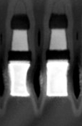
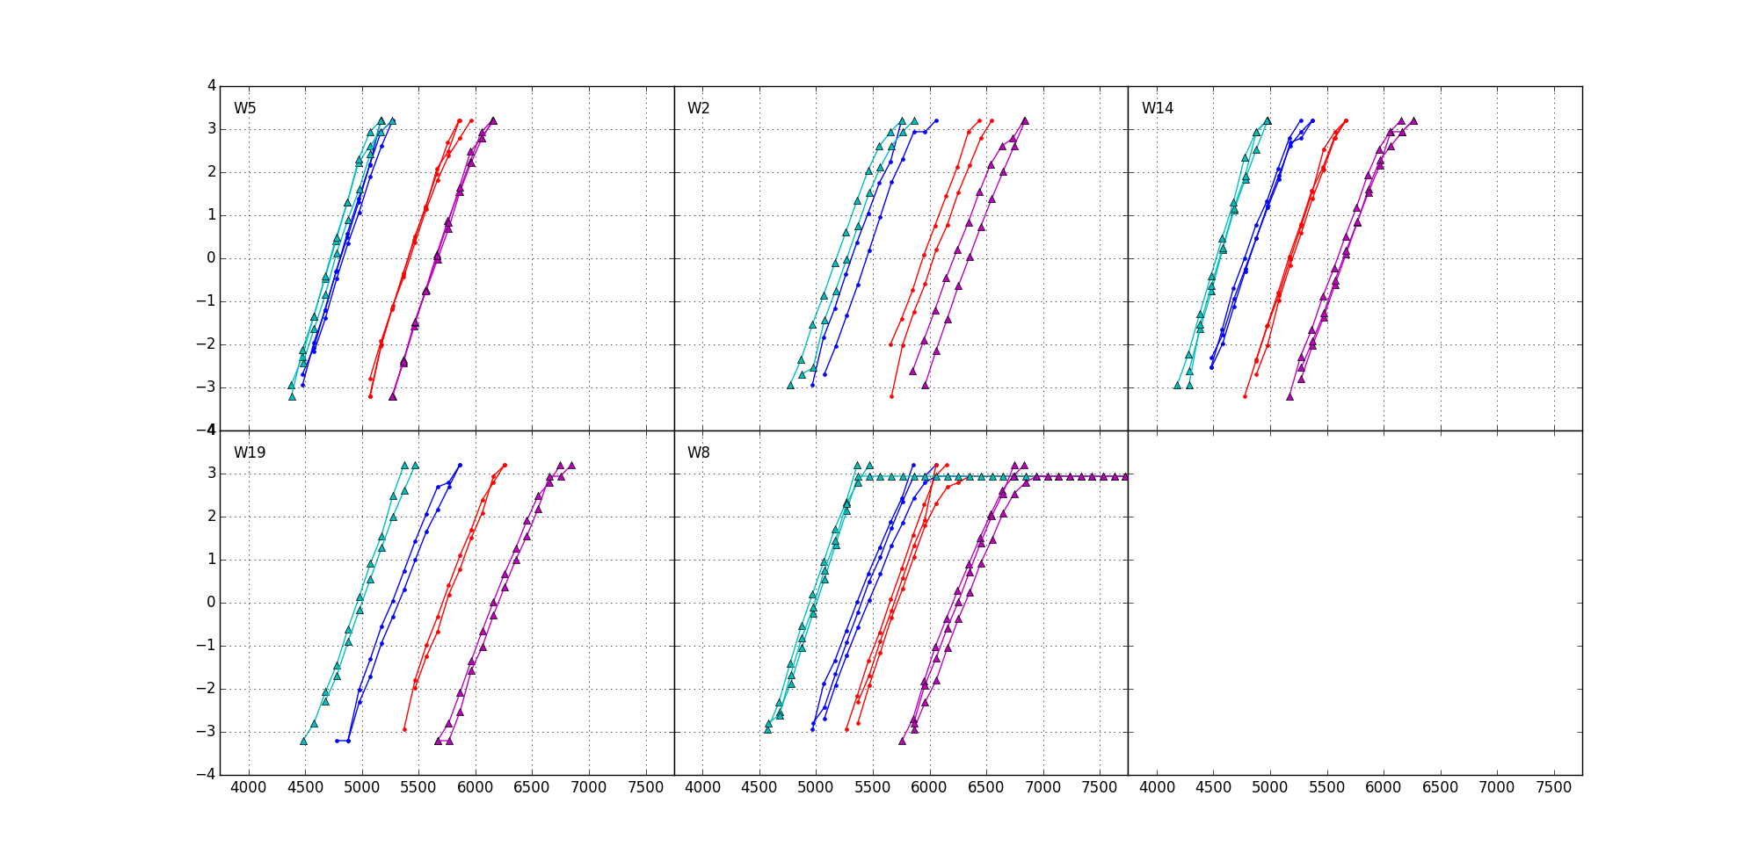
Current Status: SSM RWB
RWB Strategy: ∆V_{T} = 3.54∙(σ_{SET}+ σ_{RESET}) + E2 Drift + Cross Tile + E3 Shift + Reset RD GB
∆V_{T}=900mV, 1usec mean to mean shift
Sigma: dominant by “intrinsic” (repeatability)
  SET=115mV
  Reset=125mV
Drift: 550mV (Similar to SXP)
  Single V_{DM} – 1us~48Hr@ 85C
20K E3 shift: 150mV (similar to SXP)
Cross Tile: 50mV (Follow SXP BKM)
Reset Read Disturb: (SSM uniquely required)
  300mV
RWB: -1V; Recovery ideas:
Write/Read Polarity
45nm BL W (not shown)
+/+
−/+
SXP POR TE
−/−
5Å Al₂O₃ lamina
22nm doped V12
5Å Al₂O₃ lamina
SXP POR BE
900mV
+/−
37nm WL W
Vertical Profile engineering | 300~600mV
Composition optimization | 200~300mV
Electrode selection | 100mV
Algorithm development | 100~300mV

Slide 13
2.0 Scope

Slide 14
Scope
Cell Architecture
  Seek for fundamental understanding of non-volatility of bipolar operation.
  Build the cell stack with volume statistics to demonstrate reliable Read Window Budget meeting storage class memory attributes.
Bipolar Architecture
  Demonstrate read/write algorithm for 3DXP (dual deck minimum)
  Design a bipolar decode and power supply scheme with a product-like vehicle (density and die size) to investigate operating energy and read/write latency
  Volume validating the performance of product-like vehicle on par or better than SXP counterpart

Slide 15
3.0 Strategy

Slide 16
Mission & Strategy
Mission – Pathfinding for an alternative 3DXP technology for roadmap development and scalability extension
Self-Select Memory Switching Physics at 1st principle
  Electrical and Physical characterization to develop basic understanding of switching mechanism and window tuning method based
  Develop S26A SD-only process flow and physical and electric performance metrics
  Test and Characterize bi-direction Read/Write algorithm for NVM
Assess SSM for NVM limitation and trade-off
  Including program transfer mechanisms, distribution, disturb and retention
  Performance metrics subject to cell stack and architecture impact
Evaluate applicability of SSM basics for Comparable Technology Product such as
  Stand alone SSM using SD only stack
  SLC window expansion or MLC in S26A full stack

Slide 17
4.0 Milestones

Slide 18
Milestones & Check points
# | Objectives | ECD*
1 | Test structures design validated, including Opt-in metal jumper in IG88 and QTT | Feb/16
2 | SD-only flow portable to S26A | May/16
3 | Silicon validated, including bi-direction operation for read/write | June/16
4 | Validate SSM window & distribution for NVM retention and endurance | July/16
5 | SSM architecture and capability assessment. The output provides preliminary physics understanding of the mechanism underlying SSM effect in order to conduct next level of memory array research. | July/16
6 | Three subtopics of array emphasis: Each subtopic will be thoroughly characterized, yielding the necessary operational physical understanding and sufficient collateral data to have confidence in performance, reliability and scalability such that we are confident in proceeding further. The output defines 2017 research direction and success criteria which are tangible in MTS, DTS, Scalability and product architecture.
i | S26A SD only flow improvement for stand alone SSM | Q3/16
ii | Algorithm development and validation for S26A window expansion | Q4/16
iii | Algorithm development and validation for 3DXP full stack MLC | Q4/16
*: ECD aligned with S26A schedule

Slide 19
5.0 Design

Slide 20
Test structures on S26A
On S15C the reverse polarity measurement capability is established with the 2xCMOS test structure. 2xCMOS structure can provide intrinsic information, but no statistics (ramdom) and no info on ED variation (sysmatic) impact.
In addition to 2XCMOS strcture, reverse polarity capability with larger cell count will be added to S26A scribe in order to support both the investigation on single deck wafer of the second deck behavior, and the reverse polarity effects.
  IG88– Addressable single cell test structure: This is based on S26A-IG88. Half of IG88, 52 cells per placement, are designed for bi-direction. Opt-in metal jumper for metal mask optional TO to enable bidirectional operation schematics.
  QTT– A electrically bi-directional operable mini array test structure: This is based on S26A-QTT. A subset cells in QTT array are designed with opt-in metal jumper for bi-directional operable circuit scheme.
  SR71– A brand new bi-directional operable 512K array: Array characterization using Magnum tester is required.

Slide 21
6.0 Process

Slide 22
Masks and Process Flow
Enable Opt-in metal jumper for bidirectional operation in parallel with S26A POR tapeout
Process Flow #1: for SSM Integration:
  SD-only process flow based on S26A
Process Flow #2: for Window expansion and MLC
  Identical to S26A Full loop process flow

Slide 23
7.0 Test

Slide 24
Characterization and Algorithm
Key tasks include
  test structure design validation
  Device and Array Characterization
  Algorithm development
Test instruments include
Test Structures | Tester
2XCMOS | WLC platform
IG88 | WLC platform
QTT | WLC platform
SR71 | Magnum Tester

Slide 25
Array Test Scope
Magnum based development and characterization
Read/Write scheme development
  Histo based, engineering bench coverage
Basic reliability characterization
  Retention, Disturb and Endurance
Resources allocation
Expertise | Function | Heads | Duration | Hd∙Yr
PE | Test Development | 2~4 | 50% / Q2~Q4 | ¾~1½
TD | Array Characterization | 2~4 | 50% / Q2~Q4 | ¾~1½
DE | Si Validation | 2 | 33% / Q2~Q3 | ⅓

Slide 26
8.0 Budget

Slide 27
Budget and Assumptions
This SOW project scope activities for 2016 are consistent with the 2016 3DXP JDP budget.
  Resources and logistics are part of S26A development work
Budgets for subsequent years of this SOW will be adopted on a yearly basis, as part of the overall 3DXP JDP budget.

Slide 28
Backup Slides
Including Placeholder for Device Target and Reliability Specitication

Slide 29
Intrinsic Performance
Comparable leakage (same SD material).
More flexible Read algo (no spurious reset of Set bit).
Similar Set Vt, but much faster (~20ns demonstrated) and simple (no pulse shaping needed) and lower current Set operation.
Similar ΔVt, but much lower reset current (~1/3 of actual SxP current).
Negative polarity needed for reset operation (added decoder complexity/area).
A thicker SD is preferable (better Vth window, leakage and drift), so higher voltages may be needed.

Slide 30
Reliability
Comparable Drift for Set (same SD material) and better Drift for Reset (no additional Drift of reset PM).
No Read Disturb on Set
Read Disturb on Reset represents the only failure mode specifically related to the proposed approach → > 10⁴ reads feasible up to 125C
No Proximity Thermal Disturb (very low current and temperatures).
Similar Write and Read Endurance.
Good retention up to 125C, but activation energy still to be quantified (wip).
> 1E4 reads

