Slide 1
Self-Select Memory IM JDP SOW
Version 2.0
January 12, 2018

Slide 2
Signature Page
This 3DXP Joint Development Program Statement of Work Rev 2.0 (“Self-Select Memory SOW”), having been approved by the JDP Committee is hereby approved by Intel and Micron respectively effective as of mmm dd, 2018, as signified by the signature of each company’s authorized representative below. It is understood and agreed that this JDP SOW may be amended in due course in accordance with the procedures set forth in the Joint Development Program Agreement.
MICRON TECHNOLOGY, INC |  |  | INTEL CORPORATION
By: |  |  | By:
Name: |  |  | Name:
Date: |  |  | Date:

Slide 3
Revision Page
Approval Date | REV | Pages Affected | Was | Is | Comments
Jan-20-2016 | 1.0 | ALL |  | Initial Self-Select Memory SOW
Jan-dd-2018 | 2.0 | ALL |  | Technology Feasibility Validation SOW
Notes:
3

Slide 4
SOW Contacts
Name | Function | Company
Russ Meyer | JDP co-manager | Micron
Al Fazio | JDP co-manager | Intel
Mark Helm | Design | Micron
Dan Elmhurst | Design | Intel
Kiran Pangal | Array Development, including Product/Test | Intel
Fabio Pellizzer | Technology Development | Micron
DerChang Kau | Technology Development | Intel

Slide 5
SOW Contents
0.0 Purpose
1.0 Background
1.1 What is Self-Select Memory (SSM)
1.2 Potential Process Simplification
1.3 Potential Write Latency reduction
1.4 Current Status
2.0 Scope
3.0 Strategy Overview
3.1 Mission
3.2 Goal
3.3 Strategy
3.4 Three-Pronged Approach
4.0 Milestones & Check points
5.0 Design
6.0 Process
1.1 Cell Stack Definition
1.2 Structure Yield
7.0 Test
1.1 SR71
1.2 QTT
1.3 2XCMOS
1.4 S26S
8.0 Budget & Assumptions
Backup (success criterial placeholder)

Slide 6
0.0 Purpose
The goal of the work is to validate Self-Select Memory, SSM, fundamentals for a Go/No-Go decision fast.
The intent and purpose of the document are –
To introduce SSM and the value proposition for a low cost, higher performance 3D XPoint™
To illustrate the strategy for a high velocity pass/fail test using product vehicle
To establish interim milestones and critical path to achieve the goal based on the strategy
To define key activities and deliverables through the milestones
To define metrics and success criteria for progress tracking and decision making
To define the resource and the budget to achieve the targeted deliverables

Slide 7
1.0 Background
Introduction to self-select memory, value proposition and current status

Slide 8
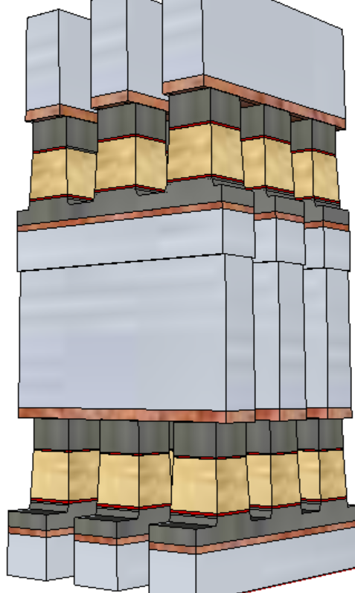
1.1 What is Self-Select Memory (SSM)
S15B SD-only, lot 8792062, 18nm SDδ ver 4
Pulse Polarity
V_{T,High}
Positive
Write
Negative
read
TE
SD
V_{T,Low}
Negative
Write
Negative
read
BE
Fundametally, it is a 3DXP technology.
Physical construction of SSM array is BEOL 3D stackable X-Y cross point comptatible with mainstream CMOS.
Read/write is to threshold select one cell while forward subthreshold to inhibit the rest of cells in a tile.
A V_{T} window (∆V_{T}) has been observed by applying programming pulses with opposite polarity. The best known ∆V_{T} physics is an electrochemical potential modulation effect subject to mass transport by polarity.
Leakage characteristics of SD is unlikely to sustain a charge-trap nonvolatile memory model.
Bipolar Read signature refutes filamentation.
Bipolar Write supports mass transport between electrodes.

Slide 9
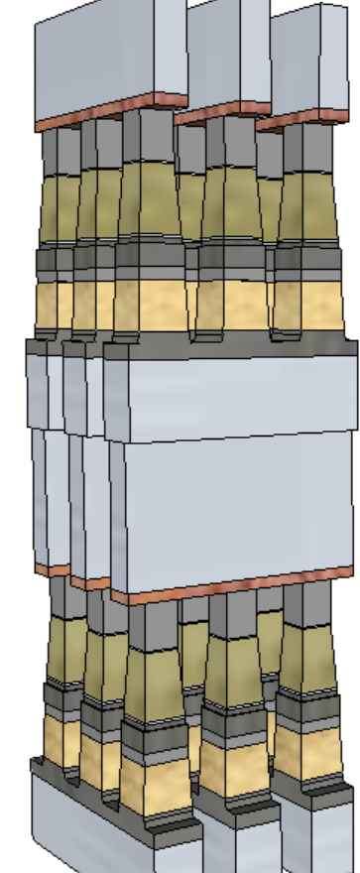
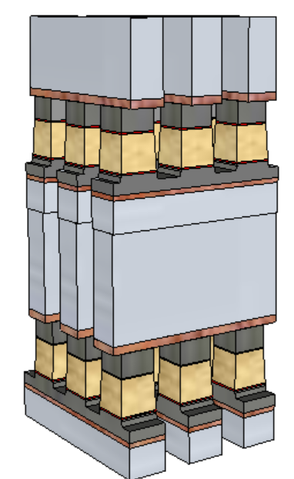
1.2 Potential Process Simplification (20nm Comparison)
SSM potentially overcomes several SXP issues
No cross-contamination between PM and SD
Lower cell aspect-ratio simplifies the cell sealing
Lower programming current ➔ relaxes metal (WL/BL) requirements and associated array capacitance
 | 1st Cut |  | 2nd Cut
 | SXP | SSM | SXP | SSM
Stack height [nm] | 141 | 69 | 152 | 85
Stack Height, inc. HM [nm] | 296 | 142.6 | 297 | 191.7
Height/ Space for FP [nm] | 212.5/25.5 |  | 261/21.7
Height/ Space for LP [nm] | 246/19.6 | 142.6/19.6 | 182/18.4 | 191.7/18.4
Space Aspect Ratio for FP | 6.4 |  | 6.7
Space Aspect Ratio for LP | 8.4 | 4.8 | 9.1 | 5.4
SSM
SXP

Slide 10
1.3 Preliminary Analysis on Bipolar Array architecture (20nm Comparison)
Potential for improving one of the key limiters of SXP: High Write Latency (vs read)
Write latency may need to also consider spike mitigation and pulse termination, up to 50ns adder. (Worst case latency limited BW: 3GB/s)
No MLC capability identified with demarcation read algorithm
Bipolar SXP window expansion capability is die size prohibited
 |  | Read |  | Write
 |  | SXP | SSM | SXP | SSM
Die Size | mm² | 197
Algo |  | Same |  | N.Write | F.Write
Latency | ns | 105 | 105 | 465 | 105~125
Energy | pJ/b | 52 | 52 | 118 | 118
Latency limited BW | MB/s | 4876 | 4876 | 1101 | 4096+
Power limited BW | MB/s | 1601 | 1601 | 800 | 800
SSM
SXP

Slide 11
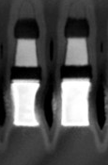
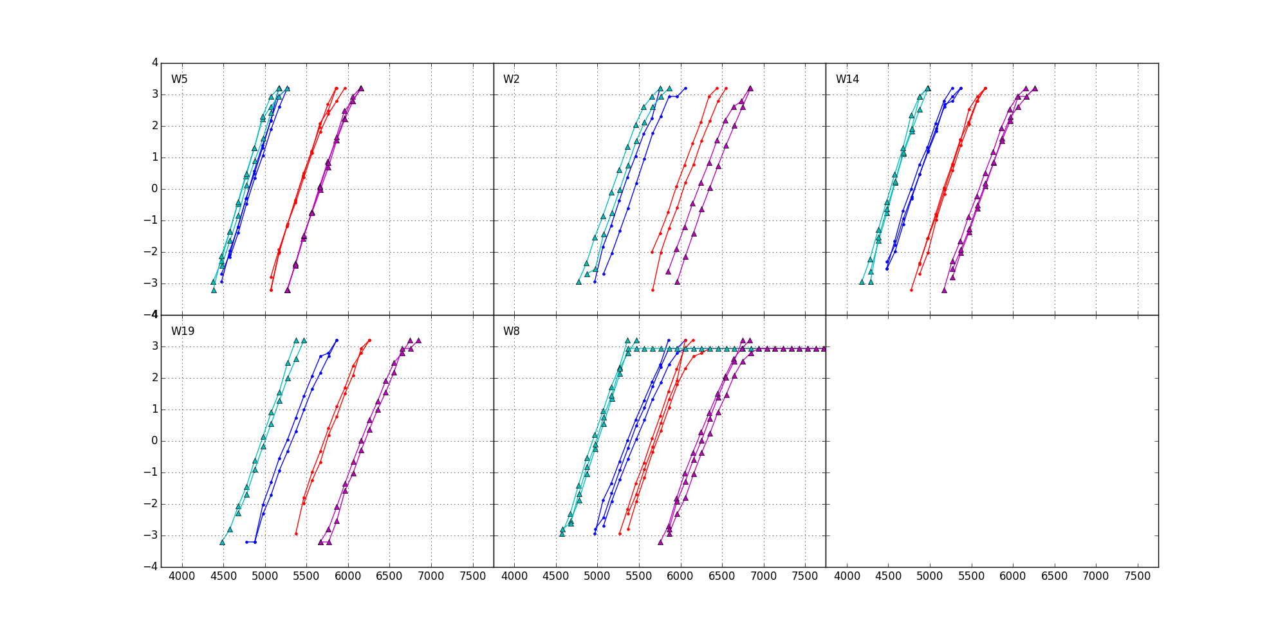
1.4 Current Status: 20nm SSM RWB RWB Strategy: ∆V_{T} = 3.54∙(σ_{SET}+ σ_{RESET}) + E2 Drift + Cross Tile + E3 Shift + Reset RD GB
∆V_{T}=900mV, 1usec mean to mean shift
Sigma: dominant by “intrinsic” (repeatability)
SET=115mV
Reset=125mV
Drift: 550mV (Similar to SXP)
Single V_{DM} – 1us~48Hr@ 85C
20K E3 shift: 150mV (similar to SXP)
Cross Tile: 50mV (Follow SXP BKM)
Reset Read Disturb: (SSM uniquely required)
300mV
RWB: -1V; Recovery ideas:
Write/Read Polarity
45nm BL W (not shown)
+/+
−/+
SXP POR TE
−/−
5Å lamina
22nm doped V12
5Å lamina
SXP POR BE
900mV
+/−
37nm WL W
Vertical Profile engineering | 300~600mV
Composition optimization | 200~300mV
Electrode selection | 100mV
Algorithm development | 100~300mV

Slide 12
2.0 Scope
Cell Architecture
Seek for fundamental understanding of non-volatility of bipolar operation.
Build the cell stack with volume statistics to demonstrate reliable Read Window Budget meeting storage class memory attributes.
Bipolar Architecture
Demonstrate read/write algorithm for 3DXP (dual deck minimum)
Design a bipolar decoder and power supply scheme with a product vehicle (density and die size) to investigate operating energy and read/write latency
Volume validating the performance of product vehicle on par or better than SXP counterpart

Slide 13
3.0 Strategy Overview

Slide 14
3.1 Mission
Pathfinding of an alternative 3DXP technology for roadmap and scalability development
3.2 Goal
High velocity validation SSM fundamentals for a Go/No-Go decision
3.3 Strategy
“Race to fail or succeed” by building a product worthy test vehicle for SSM
Test complete array in high volume and validate product worthiness by building prototypes
Leverage S26 infrastructure and synergy for faster development with three-pronged approach
Bipolar decoders design – based on S26 floor plan and pad placement for test synergy with S26 specs at shorter write completion time.
SSM Switching physics – cell development based on S26 scribe structures (SR71 array, QTT array and 2XCMOS cell) for electrical and physical characterization to develop fundamental understanding of switching mechanism and window tuning method.
Structure yield learning starts now – using S26 probe tape for SSM structure yield development; a co-development with switching physics and window tuning before test vehicle tapeout.

Slide 15
3.4 Three-Pronged Approach
Bipolar Decoder Design
Fast implementation: based on S26A floor plan, inc. Pad
Low risk execution: S26A based CMOS technology & collateral
Algo development leverage by reusing S26 test infrastructure
Enable probe synergy with S26 PG1 specs at shorter write completion time
S26S Tapeout
Product vehicle: 256Gb in 197mm² @S26A Spec, plus
Power delivery for @ 245ns write completion testable
Pass or Fail
Structure: PG4
RWB: PG1
Write Latency: 245ns or lower
SSM Switching Physics w/ 20nm Cell
Cell development (DTS/MTS) based on S26A scribe mini array and single cell structures (SR71, QTT, 2XCMOS)
Develop fundamental understanding of switching mechanism for tuning window and reducing distribution
20nm Startup Flow Defined
Structure and RWB demonstrated PG4 yield
DTS/MTS/RWB are consistent
20nm SSM Structure Yield
Establish S26A SSM-flow baseline and change control
Leverage with S26A yield improvement

Slide 16
4.0 Milestones

Slide 17
4.0 Milestones & Check points
# | Objectives | ECD
1 | PG1 RWB capable cell stack MTS defined with 1D0 | 3/31/2018
2 | SSM switch mechanism validated with Dual Deck silicon D0 vs. D1 Read/Write Polarity POR defined; No RWB showstopper for S26S | 6/30/2018
3 | S26 SSM flow dual-deck structure yield @ 50% in Zone A, B and C | 6/30/2018
4 | S26S silicon starts Dual-Deck RWB for PG1 & structure yield for PG4 demonstrated | 8/1/2018
5 | S26S Array S/U flow defined | Sep/1/2018
6 | S26S bipolar decoder design validated | Sep/30/2018
7 | S26S RWB @ PG4 demonstrated | Nov/15/2018
8 | S26S RWB @ PG1 demonstrated | Dec/15/2018

Slide 18
5.0 Design

Slide 19
6.0 Process
Key Activities and Deliverables

Slide 20
Cell Stack Definition
# | Milestone | ECD
1 | PG1 RWB capable cell stack MTS defined with 1D0 | 3/31/2018
2 | SSM switch mechanism validated with Dual Deck silicon D0 vs. D1 Read/Write Polarity POR defined; No RWB showstopper for S26S | 6/30/2018
3 | S26S RWB @ PG4 demonstrated | Nov/15/2018
4 | S26S RWB @ PG1 demonstrated | Dec/15/2018
Milestone

Slide 21
Structure yield

Slide 22
7.0 Test

Slide 23
8.0 Budget

Slide 24
Budget and Assumptions

Slide 25
Backup Slides
Including Placeholder for Device Target and Reliability Specitication

Slide 26
Intrinsic Performance
Comparable leakage (same SD material).
More flexible Read algo (no spurious reset of Set bit).
Similar Set Vt, but much faster (~20ns demonstrated) and simple (no pulse shaping needed) and lower current Set operation.
Similar ΔVt, but much lower reset current (~1/3 of actual SxP current).
Negative polarity needed for reset operation (added decoder complexity/area).
A thicker SD is preferable (better Vth window, leakage and drift), so higher voltages may be needed.

Slide 27
Reliability
Comparable Drift for Set (same SD material) and better Drift for Reset (no additional Drift of reset PM).
No Read Disturb on Set
Read Disturb on Reset represents the only failure mode specifically related to the proposed approach → > 10⁴ reads feasible up to 125C
No Proximity Thermal Disturb (very low current and temperatures).
Similar Write and Read Endurance.
Good retention up to 125C, but activation energy still to be quantified (wip).
> 1E4 reads

