Slide 1
SSM Update to JDP COMM
Jan/12/2018
Status, Risk and Mitigation
Rev 0 DTS released, based on single V_{DM}. RWB gap to goal is ~1V. Dual V_{DM} is prePOR, 200mV recovery expected.
  Additional ingredients under evaluation: composition tuning (200~300mV) and profile tapering (300~600mV).
  Dual-Deck (TO ECD WW03) is to evaluate electrical polarity vs. physical symmetry.
∆V_{T} leading model is electrochemical potential modulation subject to mass transport.
  Key risk is Reset Read Disturb. Segmentation is in progress.
SOW Plan:
The Goal is to fast succeed or fail. The strategy is taping out S26S, a S26A equivalent product @ ½ set time.
  Leveraging with S26A learning and infrastructure for cell development, structure yield and product validation.
  Finalizing bipolar decoder architecture, risks identified and mitigation plan in development.
Additional thick gate nMOS transistor is required in order to meet S26A spec for product validation
  Risk mitigation plan is under development for ‘fast succeed/fail’
Scaling Roadmap of 3D architecture will be developed based on ∆V_{T} fundamental

Slide 2
SSM Current Status: Risks and Mitigations
ΔVt increase and σVt control:
  ΔVt ~ 850mV with σVt ~ 105mV
  (SD alloy K* #6 w/ vertical profile)
  Target POR cell for Q2FY18
    SD alloy K* #6
    Single-step etch with SD tapered profile (w or w/o AlOx lamina)
    Standard W WL thickness
  Additional ingredients under evaluation
    BL tapering and absolute CD vs. relative tapering
    K* campaign prosecution
    G* campaign
Reset Read Disturb
  Margin required < 300mV for 5K read
  Separate intrinsic (soft program) vs extrinsic component to minimize window budget impact
Reset Drift
  Set drift is consistent with SXP data @ 85C
  Window loss for SSM in the range of 50mV from 1us to 10s

Slide 3
Plan for SOW: Strategy Overview
Bipolar Decoder Design
Fast implementation: based on S26A floor plan
Low risk execution: based on S26A design collateral + TGNMOS development
Algo development leverage by reusing S26 test
Enable probe synergy with S26 PG1 specs with shorter write completion time
S26S Tapeout meeting S26A spec
Product vehicle: 256Gb in 197mm²
½ write completion time
Dual Deck compatible with S25A spec
Success or Fail
20nm Startup Flow Defined
Structure and RWB demonstrated
DTS/MTS/RWB are consistent
Scaling Roadmap
Process architecture
Stack (S26A like) vs.
Tier (3DNAND-like)
SSM Switching Physics w/ 20nm Cell
Cell development (DTS/MTS) based on S26A scribe mini array and single cell structures (SR71, QTT, 2XCMOS)
Develop fundamental understanding of switching mechanism to tune window and reduce distribution
20nm SSM Structure Yield
Establish S26A SSM-flow baseline and change control
Leverage with S26A yield improvement

Slide 4
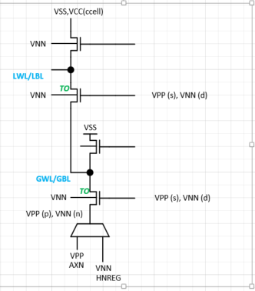
Bipolar Decode scheme and Risk
Scheme
Current is carried by N channel in both polarities
Max array voltage is lower than VPP by ~1v due to large N-channel Vt drop with back bias
Local and global select inverters see VPP+ to VNN oxide stress; require thick gate oxide (~ 200 A)
Junctions see VPP to VNN stress
Risks
Decoder fits in the S26 decoder foot print
Vt, leakage and Idlin/Idsat of the thick gate NMOS meet specs
Decoder meets reliability requirements

Slide 5
TGNMOS Development and S26S Intercept
TGNMOS Collateral Development
Silicon meeting Vt, leakage and Idlin/Idsat
S26S A0 Design Start
100% S26A collateral
CMOS Bipolar Decoder for placeholder (no HV Stress)
20~50% high switching energy
Wafer level testable for SSM functionality @ ½ of set time
Power/thermal envelope prohibitive for component test (system level validation)
EoQ1 assessment for Q3 TO
Not
acceptable
A0 TO
(two steppings)
Acceptable
S26S B-Stepping
Change CMOS decoder scheme to TGNMOS decoder scheme
Design to S26A full spec, compatible to S25A full spec
B0 TO

Slide 6
Backup Materials

Slide 7
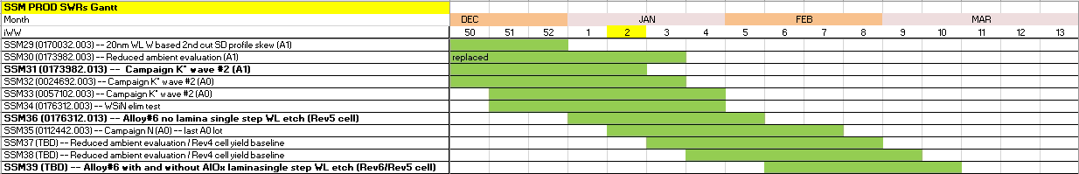
Silicon WIP status update
  Comments to the Gantt chart:
    Lots in bold will run with rotating Screamer priority
    G* is more distant, Q2 activity
    Dual deck setup is also Q2 activity, depending on the tape out schedule and first conversion layer.
  Quality issues:
    SSM29 lot had thick (55nm instead of 45nm) W deposited at 52 level. Can have issues related to BL-BL and periphery due to under-chop
    SSM31 also had misprocess at C2 OXIDE CMP, which has risk of BL-BL shorting.
    Both issues are related to 20s SXP line conversions affecting SSM setup, both fixed, but impacted PROD material.

Slide 8
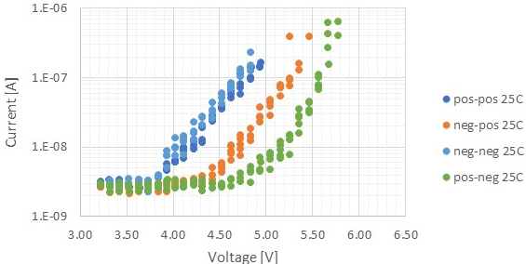
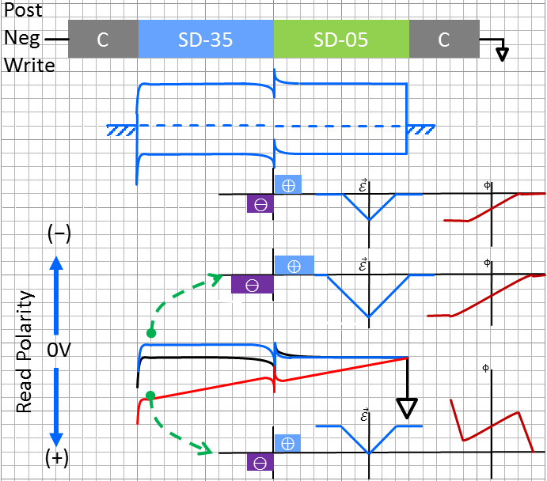
Electrical Equivalent Circuit and Possible Underline Physics
A V_{T} window (∆V_{T}) has been observed by applying programming pulses with opposite polarity. The best known ∆V_{T} physics is an electrochemical potential modulation effect subject to mass transport by polarity.
  Near parallel shift on SubVt I-V on polarity effects
  The equivalent circuit – a programmable battery connected
  to a Chal Glass Resistor serially
From empirical to physical
  Pursuing the validation of heterogeneous junction model
  Programmable battery is formed by the band offset
  Write –Band offset switching subject to mass transport.
  Read – Space Charge modulation results in voltage shift
SD Resistor

Slide 9
Basic Band Diagram of SD and Model assumptions
Electronic Structure of Amorphous Semiconductors, D. Adler and E. J. Yoffa, Phys. Rev. Lett. 36, 1197-1200 (1976)
Assumptions:
  EG:2eV
  Effective intrasite electronic correlation energy is negative therefore P-type is exhibited (pinned?)
3 Electronic models on with mass transport by polarity
  Composition “A” moves toward cathode (SD05→SD35)
  Homojunction – Correlation energy changed to positive therefore n-type (similar to tetrahedrally coordinated amorphous semiconductor)
  Heterojunction-I – Band offset due to coordination changes (Michaelson’s Electronegativity Scales & The work Function, IBM JRD 1978), higher Work Function
  Heterojunction-II – Band offset, but lower Work Function
  0.8eV Change is used to illustrate all 3 models
C
SD05
C
Vacuum
E_{c}
E_{f}
ϕ_{e}
E_{v}
SD35
Vacuum
(I)
(II)
(III)
∆E_{f}=+0.8eV
∆χ=−0.8eV
∆χ=+0.8eV

Slide 10


Model (III) – Heterojunction, lower 𝛘
(–) Bias Read, same polarity of write
  Space charge region maintained or no change. Potential drop evenly cross Chal glass.
(+) Bias Read, opposite polarity of Write
  Bias initially contributed to widen spacer charge region.
Lower 𝛘 heterogeneous junction model supports the observed polarity effect
Post
Neg
Write
C
SD-35
SD-05
C
⊕
$$\vec{ℰ}$$
ϕ
⊖
(−)
⊕
$$\vec{ℰ}$$
ϕ
⊖
0V
Read Polarity
ϕ
$$\vec{ℰ}$$
(+)
⊕
⊖

Slide 11
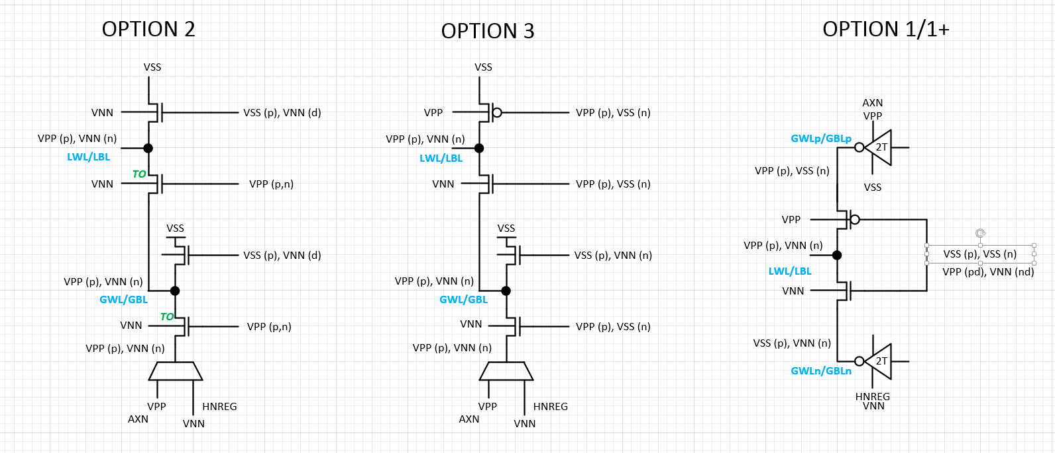
Bipolar Decoder Scheme
Write Energy [pJ/b] | 118 | 118 | 143 | 139~179
Read Energy [pJ/b] | 52 | 52 | 71 | 52
Write Completion [ns] | 475 | 240 | 240 | 240
Read Latency [ns] | 95 | 95 | 95 | 95
S26A Spec
Thick gate
nMOS x’tor

